Slide 1
Damping ring experimental program
CLIC Collaboration Working meeting
Yannis PAPAPHILIPPOUCERN
Special thanks to Hermann Schmickler
May 9th, 2012

Slide 2
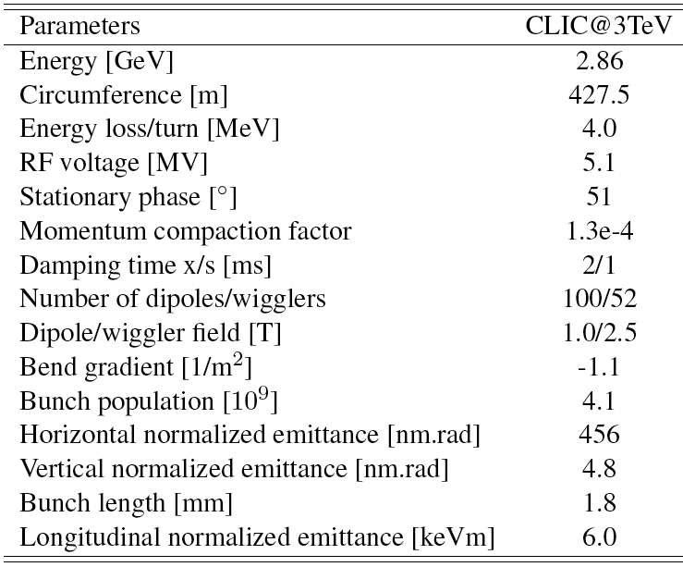
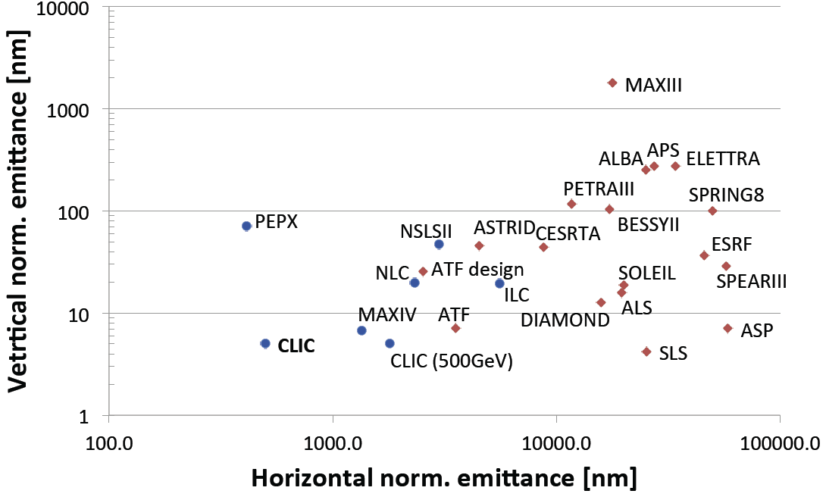
CLIC DR parameters
CLIC damping rings target ultra-low emittance in all 3 dimensions for relatively high bunch charge
Dominated by collective effects (IBS, space-charge, e-cloud, FII, CSR,…)
Challenging technology (SC wigglers, Extraction kickers, RF system, Vacuum, Instrumentation, Feedback)

Slide 3
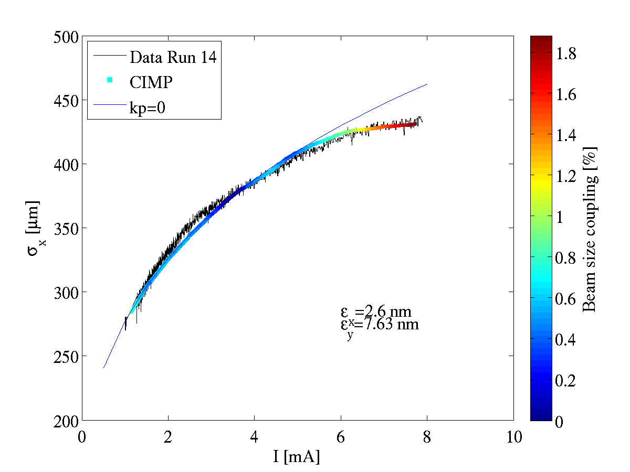
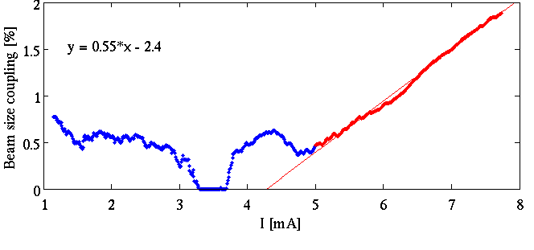
CLIC DR beam dynamics experiments
F. Antoniou
Low Emittance Tuning
  SLS, but also Australian Synchrotron
IBS
  CESRTA, SLS
E-cloud
  CESRTA
CSR
  ANKA, ATF
Optics, non-linear correction
  DIAMOND, SOLEIL
Fast Ion Instability
  SOLEIL
Instabilities
  SLS

Slide 4
DR technology and experimental program
Super-conducting wigglers
  Demanding magnet technology combined with cryogenics and high heat load from synchrotron radiation (absorption)
High frequency RF system
  1.5GHz RF system in combination with high power and transient beam loading
Coatings, chamber design and ultra-low vacuum
  Electron cloud mitigation, low-impedance, fast-ion instability
Kicker technology
  Extracted beam stability
Diagnostics for low emittance
  Profile monitors, feedback system
Prototype built in BINP, to be tested in ANKA (2013-2014)
Discussions with ALBA and SLAC (HELP NEEDED)
Measurements at SPS, ESRF, CERTA, discussions with MAXlab
Stripline designed by Spanish industry, to be tested in ALBA, pulser in collaboration with SLAC, Full system test in ATF
V-UV Profile Monitor (TIARA), initiated collaboration with ALBA

Slide 5
DR R&D
Area | Scope | Institutes | Period | Contract
Optics and non-linear dynamics | Methods and diagnostics for linear and non-linear correction | JAI | 2011-2013 | MOU
Vertical emittance minimization | Beam dynamics and technology (alignment, instrumentation) for reaching sub-pm vertical emittance | SLS, MAXlab, INFN/LNF | 2011-2013 | EU/TIARA
 |  | ACAS | 2010-2012 | MOU
 |  | JAI | 2011-2013 | MOU
Intrabeam Scattering | Experiments for theory/code benchmarking | CESR/TA, SLS | 2010-… | ILC/CLIC collaboration, LER network
E-cloud | Experiments for instability and mitigation
Fast Ion Instability | Experiments for theory/code benchmarking, feedback tests | SOLEIL, ATF | 2011-… | LER network
Super-conducting Wiggler | Prototype development and beam tests | KIT, BINP | 2011-2013 | MOU, K-contract
Fast kicker development | Conceptual design, prototyping and beam measurements (double kicker) | IFIC Valencia, ALBA, ATF | 2011-2013 | Spanish industry program
RF design | RF prototype and beam tests (including LLRF) | ALBA, SLAC | 2011-… | LER network
Vacuum technology | Desorption tests of coated chambers in a beam line | ESRF, MAXIV | 2011-…

Slide 6

WP6 - SVET
SVET: “SLS Vertical Emittance Tuning”
Objectives:
  Allow the Swiss Light Source (SLS) to be used as an R&D Infrastructure
  Demonstrate ultra-small vertical emittances as required for future Linear Collider Damping Rings (e.g. 5 nm normalized, <1 pm @ 2.86 GeV for CLIC)
  Enable to extend tests to lower energies (IBS dominated regime).

Slide 7
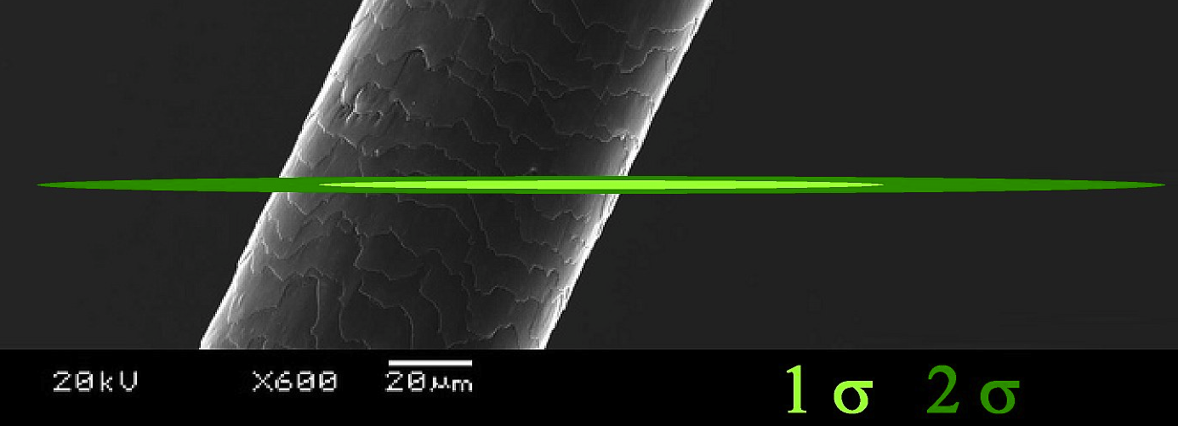
Vertical emittance
WORLD RECORD
M. Aiba, M. Boge, N. Milas, A. Streun
After re-alignment campaign of last autumn, series of MD shifts scheduled (end of 2011)
Beam of 400 mA stored in top up mode
Different methods of coupling suppression using 36 skew quadrupoles (combination of response matrix based correction and random walk optimisation)
Performance of existing emittance monitor had to be further stretched to get beam profile data at a size of around 3-4μm
Vertical emittance reduced to a minimum value of 0.9±0.4pm (CLIC damping rings target vertical emittance) which is a new world record
Work in progress for reproducibility of this result and understanding of systematic model errors

Slide 8
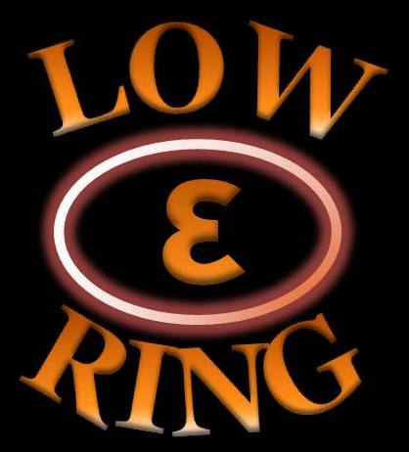
Low Emittance Rings’ network
  Bring together scientific communities of synchrotron light sources’ storage rings, damping rings and lepton colliders in order to communicate, identify and promote common work on topics affecting the design of low emittance lepton rings
  Initiated by a Low Emittance Ring workshop, 01/2010@CERN, see http://cern.ch/ler2010
  State of the art in design of accelerator systems especially in X-ray storage rings approaches the goals of damping rings for linear colliders and future B-factories’ upgrade projects
  Common tasks identified including beam dynamics but also technology
  Second workshop in 10/2011 @ Heraklion acts as a catalyzer, see http://cern.ch/lowering2011
  Collaboration network enable scientific interaction and coordination for common design work including measurements and tests in existing facilities for achieving ultra-low emittance, high intensity beams with remarkable stability

Slide 9
Low-ε-Ring
Coordination and Tasks
Coordinators: Y. Papaphilippou (CERN), S. Guiducci (INFN-LNF), R. Bartolini (STFC-JAI-DIAMOND)
Members: M. Biagini (INFN-LNF), M. Boege (PSI), R. Nagaoka (Soleil), H. Schmickler (CERN)
Additional non-EU members: M. Palmer (Cornell), J. Urakawa (KEK)
  Participants but not contractual partners
  Task 1: Low Emittance Ring Design (LERD)
    Coordinator: M. Boege (PSI)
  Task 2: Beam INstabilities, Impedances and Vacuum (BINIV)
    Coordinator: R. Nagaoka (SOLEIL)
  Task 3: Low Emittance Rings Technology (LERT)
    Coordinator: H. Schmickler (CERN)
  Interest expressed by the 28 following institutes: ANKA-KIT, ANL, Australian Synchrotron, BESSY/HZM, BINP, BNL-NSLSII,CELLS-ALBA, CERN, Cockroft Ins, CIEMAT, Cornell Un., DESY, Elettra, ESRF, FNAL, IFIC-Valencia, INFN-LNF, JASRI/SPring-8, JAI-DIAMOND, KEK, LBNL, MAXLAB, NTUA, PSI-SLS, SLAC, SOLEIL, Un. Of Creta, Un. Of Thessaloniki.

Slide 10
Dream Damping Ring Test Facility
Ring achieving lowest possible emittances in all three dimensions, in the range of few GeV
  Vertical and longitudinal easier than horizontal
Short bunch train structure similar to damping rings
  Bunch spacing of 0.67ns (1.5GHz RF system) should be a good compromise
Space for installing wigglers, kickers (and extraction line), vacuum test areas, RF, instrumentation
Beam conditions for studying IBS, space-charge, low emittance tuning, e-cloud (positrons), fast ion instability, CSR…
  High brightness single bunches/trains, small bunch length
Available beam time for experimental tests

Slide 11
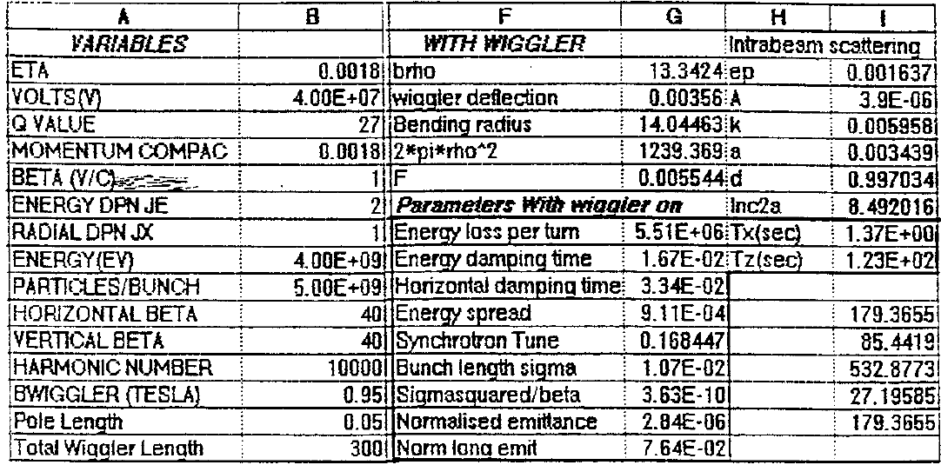
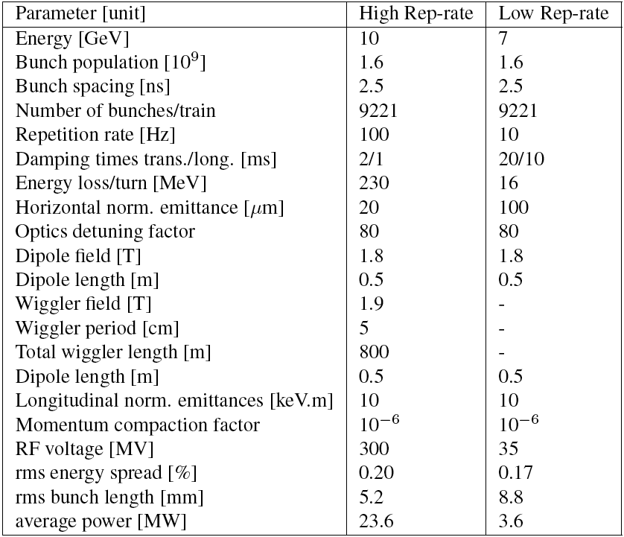
SPS
Evans and Schmidt, 1988
Already proposed as damping ring for CLIC and lately LHeC
Low energies (4-10 GeV) in coasting mode
Need wigglers (~300m) to get low horizontal emittance (3microns) and fast damping (a few tens of ms)
  May gain by lattice modification
Papaphilippou 2011
RF system upgrade
  Total voltage needed (Energy loss/turn of a few tens of MeV)
  Different RF frequency (the higher the better)
Need to revive lepton injector (now CTF) and transfer lines

Slide 12
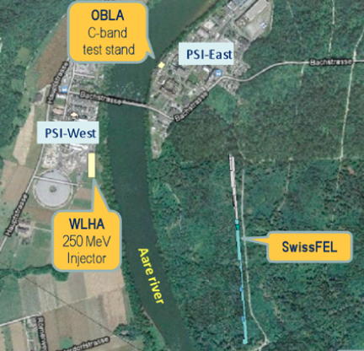
SLS
SLS Parameter | Value
Energy [GeV] | 2.411
Circumference [m] | 288
Energy loss/turn [MeV] | 0.54
RF voltage [MV] | 2.1
Mom. Comp. factor | 6.05e⁻⁴
Damping times h/v/l [ms] | 8.59/8.55/4.26
Hor. emittance [nm rad] | 5.6
Vert. emittance [pm rad] | 0.9
Bunch length [mm] | 3.8
Energy spread [%] | 0.086
SLS
Ultra-low emittances and ability to run at low energies
  Horizontal norm. emittance of 26microns (2.4GeV) down to 5microns (1.6GeV)
  Record vertical emittance of 0.9pm @ 2.4GeV (4.2nm normalized!!!). This is translated to 2.8nm normalized if established @ 1.6GeV
  Bunch length of ~4mm, energy spread of 0.09% (long. norm. emittance of 7.9keV.m @ 2.4GeV)
1.5GHz, 3rd Harmonic cavity
Proximity with Swiss FEL (can EAST meet WEST or 1 river to cross?)
Very close to the dream test facility
  BUT mainly a user facility

Slide 13
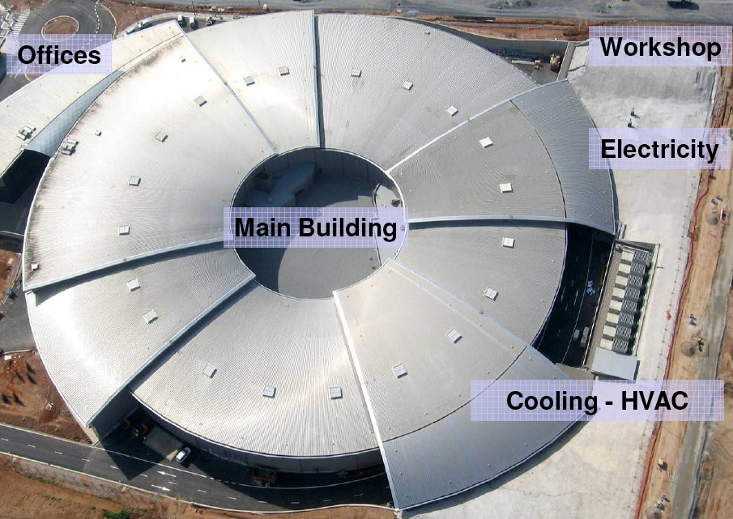
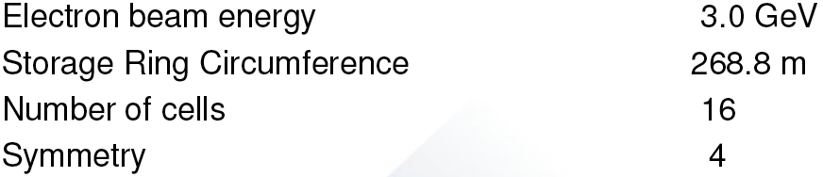
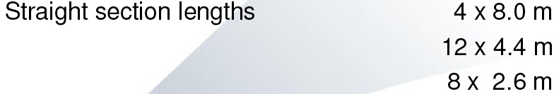
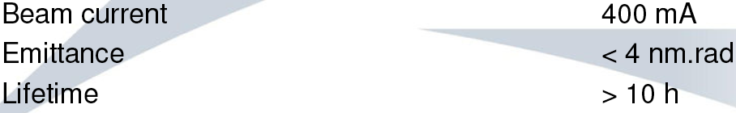
ALBA
Recently commissioned
Horizontal emittance of 4nm (23microns normalised, vertical not yet fully op
Ability to run at lower energies (not demonstrated)
RF system powered with IOTs
3rd harmonic cavity (1.5GHz)
Super-conducting wiggler from BINP
Some free straight sections for installing new equipment for tests
Not yet fully booked by users but it will come

Slide 14
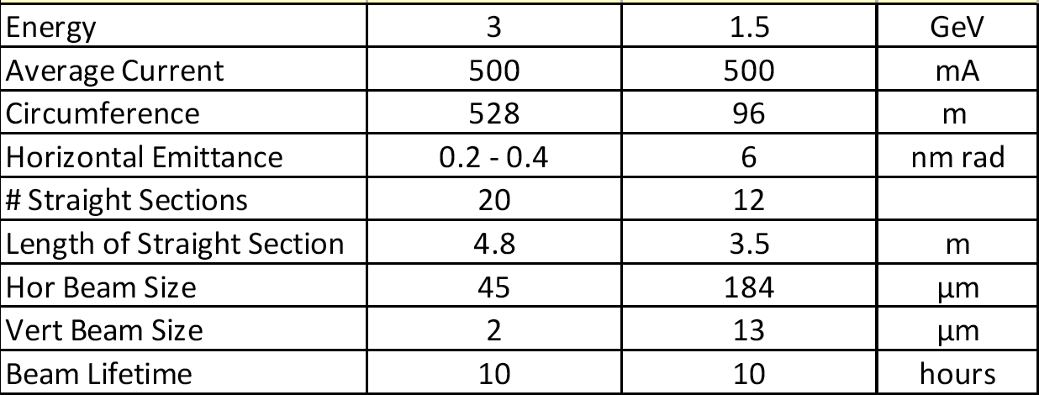
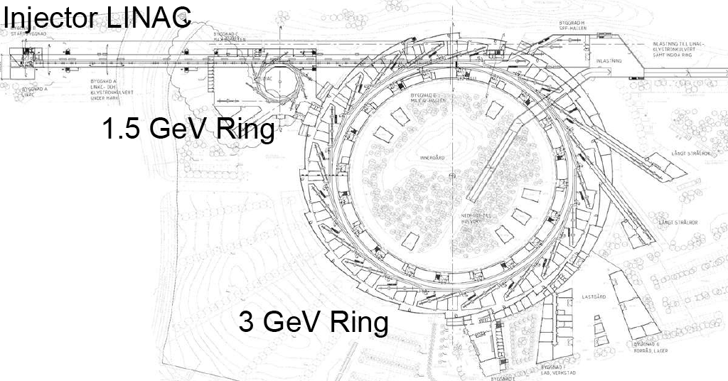
MAXIV
Ultra-low horizontal emittance for 3GeV ring
  0.2nm @ 3GeV including IBS effect (1micron normalized) using high field (2.2T) PM wigglers
A lot of fancy features
  Compact magnets, multipole kicker, high-field wigglers, instrumentation
100MHz RF system
  Long bunches of 50mm rms length using Landau cavity
Commissioning of ring starts in 2015

Slide 15
ATF
IP parameter | nominal | 04/2010 | 12/2010 | 02/2012
beam energy | 1.3 GeV | 1.3 GeV | 1.3 GeV | 1.3 GeV
ε_{x} | 2 nm | 1.7 nm | 1.8-2.7 nm | 1.84 nm
ε_{y} | 12 pm | <10 pm | 28-64 pm | 15.6 pm
β_{x}* | 4 mm | 40 mm | 10 mm | 10 mm
β_{y}* | 0.1 mm | 1.0 mm | 1.0 mm | 0.3 mm
σ_{x}* | 2.8 μm | 10 μm | 7.5 μm | 4.3 μm
σ_{y}* | 35 nm | 900 nm | 439 (247?) nm | 165 (100?) nm
Ideal for extraction kicker studies
  Double kicker system
Low vertical emittance <10pm
  A lot of beam size instrumentation
First IBS studies
Discussions for ATF3 damping ring experimental program combined with FF studies

Slide 16
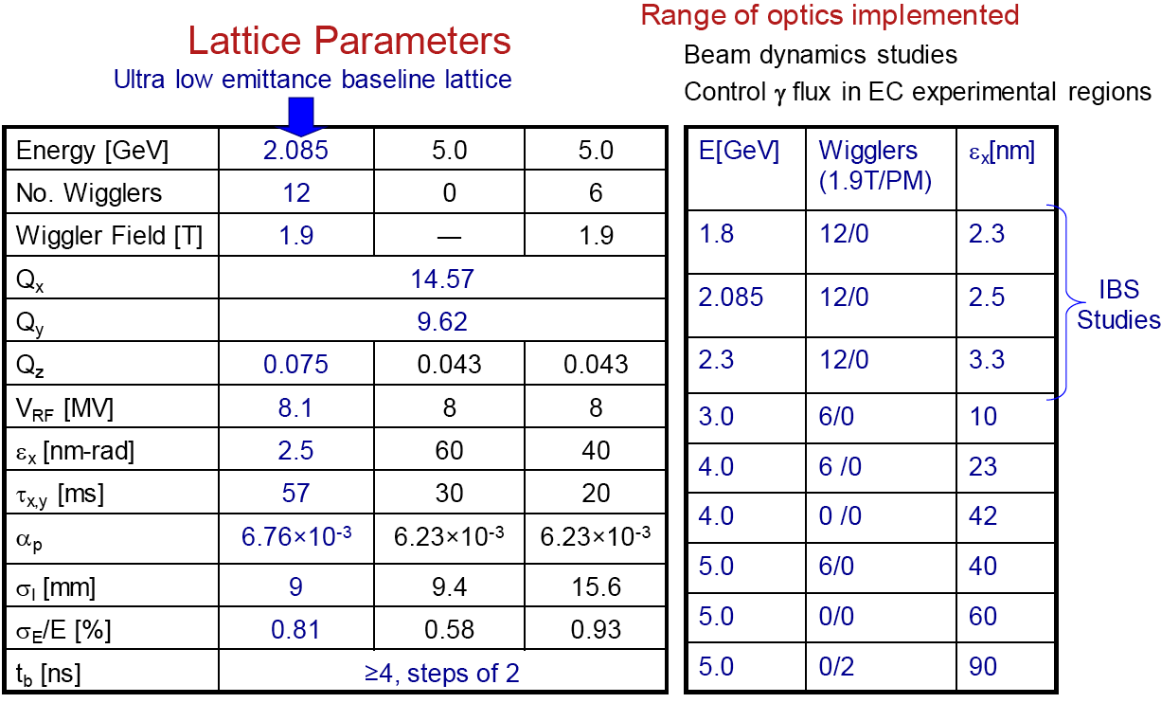
CESRTA
Huge effort for e-cloud evaluation and mitigation
  Positrons and electrons, vacuum chamber test areas
High-field wigglers
Variable energy, low horizontal emittance
Low Emittance Tuning
IBS measurements
Instrumentation for position, beam size, e-cloud
Future running?

Slide 17
Linear Collider Test Accelerator / PEPII
 | CesrTA | ILC | CLIC | LCTA/ PEP-II
Energy [GeV] | 2 - 5 | 5 | 2.86 | 2.86 - 5
Circumference [m] | 764 | 3200 | 493 | 2199
εx [nm-rad, 0 curr.] | 2.5 | 0.6 | 0.07 | 0.3
εy [pm-rad, 0 curr.] | 7 | 2 | 0.9 | 0.9
Beam Current [A] | 0.06 | 0.4 | 0.35 | 0.5
Number of bunches | 45 | 1300 | 312 | 1100
Bunch population | 2 x10¹⁰ | 2 x10¹⁰ | 4.1 x10⁹ | 2 x10¹⁰
spacing, bs [ns] | 4 | 6 | 0.5 | 6
σz [mm] | 9 | 6 | 1.4 | 9
α | 6.7 x10⁻³ | 3.3 x10⁻⁴ | 6 x10⁻⁵ | -

Slide 18
LCTA - Extraction Line
IP Nominal parameters and LCTA/PEP-II extraction line parameters.
 | ILC IP | CLIC IP | LCTA – EXT LINE
Energy, E0 [GeV] | 250 | 1500 | 2.86
Norm. Emittance, γεx [um] | 10 | 0.66 | 2
Norm. Emittance, γεy [um] | 0.04 | 0.02 | 0.005
β*y [mm] | 0.4 | 0.068 | 0.1
Vertical Beam Size [nm] | 5.7 | 1 | 9
Bunch length [um] | 300 | 44 | 9000
Factor 4 smaller than ATF2 goals

Slide 19
Conclusion
A number of existing or future low emittance rings are approaching design goals of CLIC damping rings
Some of them can be combined with a bunch compressor + linac for a general CLIC main beam test facility
Difficulty lies less on establishing an experimental program but more on the machine availability for running such experiments
May the dream come true

