Slide 1




RF session
X-band RF structure High Power Testing and Testing areas.
IFIC, Valencia
Test Infrastructure
CLIC Collaboration Working Meeting
9-11 May 2012
A. Faus-Golfe
IFIC, GAP (Group of Accelerator Physics)
http://gap.ific.uv.es
Valencia, Spain
Notes:
Work Package: X-band Technologies
In the areas of:
- X-band RF structure High Power Testing (TESTING)
- Creation and Operation of X-band High power Testing Facilities (TEST AREAS)
- Basic High-Gradient R&D (HIGH-GRADIENT)
Title: IFIC, Valencia - Test infrastructure

Slide 2
Experience
The European Space Agency (ESA) and the Val Space Consortium (VSC)
(Universitat de València Estudi General (UV) + Universidad Politécnica de Valencia (UPV) +
+ City Hall of Valencia + Valencian Regional Governement)
High Power RF Space Laboratory is a ESA Laboratory especialized in:
  - RF breakdown phenomena (Multipactor, Corona and power handling)
  - Passive Inter-Modulation (PIM).
The IFIC Group of Accelerator Physics (GAP) is participating in:
  development of medical accelerator structures
  (cyclinacs in S and C-bands, PARTNER project)
  measurement and data analysis of high-gradient structures at KEK and CTF3
  (in collaboration with CLIC RF group)
  Silvia Verdu Thesis work (IFIC-TERA)

Slide 3
Intentions
Strong willingness to join efforts of both communities,
Accelerators and Space Communications,
in the study and measurement of RF structures and associated phenomena.
RF breakdown & multipactor study, surface characterization (electronic microscopy, XPS-UPS, SEM), outgassing, nano-layer growing techniques, surface backing, etc.
  creation and operation of X-band high-power testing facility
  (high-gradient test stand in X-band (9.3 GHz))
  X-band RF structure high-power testing
Notes:
There is a strong willingness coming from …
Our interest in this WP is:

Slide 4
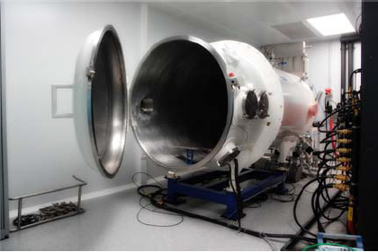
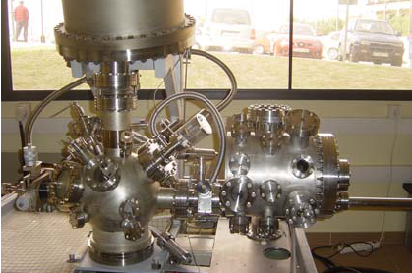
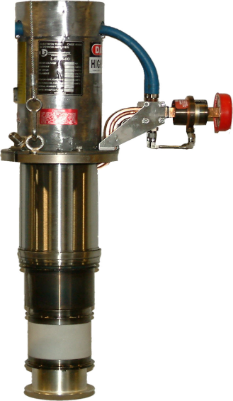
Equipment
EXISTING EQUIPMENT
5 high-vacuum chambers (min. press. 10-8 mbar),
Power amplifiers from 435 MHz to 30 GHz
Several spectrum analyzers, network analyzers, …
Waveguides, directional couplers, cables, attenuators, circulators, isolators, bolometers and others
Multichannel multipactor station , unique in the world
Electron sources: electron gun, 90Sr, Hg ultraviolet sources
XPS-UPS, SEM, electronic spectroscopy
Evaporation system for layer growing and outgassing studies
2 clean rooms class 10000 (equivalent to ISO 7)
+ mechanics & electronics workshop (2D and 3D metrology system)
TO BE FUNDED
9.3 GHz pulsed klystron: 6 MW peak, 6 kW average
Modulator
Vacuum chamber
XPS-UPS
9 GHz pulsed klystron
Notes:
So far, the High Power RF Space Laboratory
(X ray Photo emission Spectrography – Ultraviolet Photo Emission Spectrography)
Vacuum chambers: min. pressure 10-6, 10-7 and 10-8 mbar. Dimesions of vacuum chamber with lowest pressure: 1 meter long and 0.6 meter diameter.

Slide 5
Collaboration Info
Institute: | Valencia, IFIC
Main contacts: | Angeles Faus-Golfe
CERN responsible: | Walter Wuensch and Erk Jensen
Activity/work package/task: | X-band rf/high-gradient test areas/task 4 Related X-band test areas
Technical subject: | X-band technology development and high-power test area. Main activity is medical X-band linac development
Working arrangement: | Facility installed in VALspace consortium. Scientific program defined by IFIC
Funding status: | Applying for funding to Valencia region and someplace else. Decision expected June 2012.
Formal agreement: | Will be made for this activity after funding approved. CTF3 agreement with IFIC already exists.
Expected resources |  | 2012 | 2013 | 2014 | 2015 | 2016 | Comment
 | Material budget [keuro at current rate] | 40 | 40 | 40 | 40 | 40 | applying funding
 | Manpower at institute [FTEyears] | 2 | 2 | 2 | 2 | 2 | 1 technical, 0.5 professor, 0,5 engineer
 | Manpower at CERN [FTEyears] | 1 | 1 | 1 | 0 | 0 | 1 PhD student

