Slide 1
Staged CLIC Design
Daniel Schulte for
Ph. Lebrun, L. Linssen, S. Stapnes, J. Wells

Slide 2
CLIC Layout at 3 TeV
Drive Beam Generation Complex
Main Beam Generation Complex

Slide 3
Layout for 500 GeV
Only one DB complex
Shorter main linac
Shorter drive beam pulse
Drive Beam Generation Complex
800 klystrons
15 MW, 2x29µs=58µs
2.5 km
Drive beam
Main beam
Main Beam Generation Complex

Slide 4
Current CLIC Main Parameters

Slide 5
Strategy
To go to 3TeV directly does not seem not optimal
  There is likely physics at different energies below the maximum
  The 3TeV CLIC cannot easily be operated below 1TeV
    It seems overkill in any case
  The full resources are required for the construction and time for construction and political process may be substantial
  A lower energy first stage can be constructed faster and with less resources and provide physics earlier
  The construction of the full energy CLIC might need more time
    But the finalisation of the physics programme might not be delayed
    A staged approach may be required CLIC politically possible in the first place
Hence try to develop staged approach to CLIC
  With good physics case for each stage
  Not increasing the overall cost too much

Slide 6
CLIC Implementation – in Stages?
CLIC two-beam scheme compatible with energy staging to provide the optimal machine for a large energy range
Lower energy machine can run most of the time during the construction of the next stage.
Physics results will determine the energies of the stages
Linac 1
I.P.
Linac 2
0.5 TeV Stage
Injector
Complex
4 km
4 km
~14 km
Linac 1
I.P.
Linac 2
1-2 TeV Stage
Injector
Complex
7.0-14 km
7.0-14 km
~20-34 km
Linac 1
3 TeV Stage
I.P.
Linac 2
Injector
Complex
20.8 km
3 km
3 km
20.8 km
48.2 km

Slide 7
Strategy for a Staged Approach
Develop three stage project based on CDR designs, i.e. stick to basic parameters, e.g. structure design
  Possible in time for the third volume of the CDR
  The work in the first volume remains valid
  Need to define energies for the stages
Develop optimised staged project in the longer term
  May reduce the cost and power consumption

Slide 8
Choice of Energy Stages
We do currently not have the input from physics to make the choices
  Have to develop working baseline scenario
  Will adapt to improved knowledge
  As an illustration we assume one example physics scenario is realised in nature
Choices made
  Leave the final stage at 3TeV
  The first stage should be defined by physics
    Minimum energy for Higgs factory (125GeV Higgs) is about 250 GeV (Higgs + Z0 + 50 GeV)
    The top at threshold requires 350GeV (2 * top mass)
    Other physics is uncertain for now
    The physics team would like 500GeV
      Stick with requirements document
  The second stage is hard to define from physics
    Need to understand what we now about the example scenario from LHC and low energy results
    Chose around 1.5TeV, the highest energy with one drive beam generation complex

Slide 9
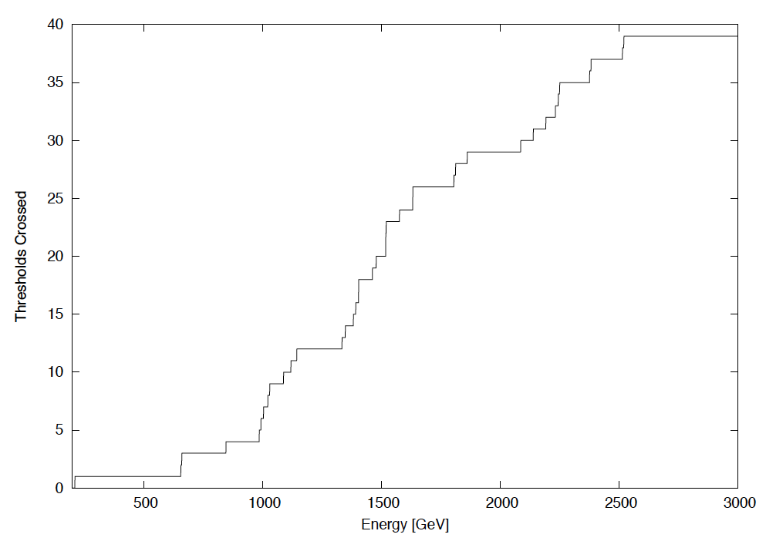
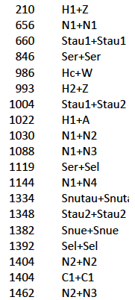
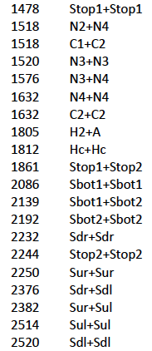
Thresholds Crossed as a function of Energy (GeV)

Slide 10
Current CLIC Energy Stages
Currently have two CLIC parameter sets
optimised and well studied 3TeV
not optimised 500GeV
main linac accelerating structure is not identical
  have a 3TeV-structure and a 500GeV-structure
  driven by more conservative emittance target at 500GeV
  and the required increase in average current
Considered upgrade from 500GeV to 3TeV
by using same structure lengths, RF pulse lengths, drive beam components, …
but have a slightly larger (16%) structure input power at 500GeV
  should be corrected in next iteration
could re-use 500GeV structure at 3TeV with 81MV/m gradient

Slide 11
Potential CLIC Parameters Based on 3TeV
B. Dalena, D.S.

Slide 12
Potential CLIC Parameters Based on 500GeV

Slide 13
Choices
Staging scenario A:
  Stage 1: use 500GeV from CDR vol. 1
  Stage 2: add 3TeV-structures to reach 1.4TeV
  Stage 3: add 3TeV-structures and replace 500GeV structures to reach 3TeV
Staging scenario B:
  Stage 1: use 3TeV-structures to reach 500GeV
  Stage 2: add 3TeV-structures to reach 1.5TeV
  Stage 3: add 3TeV-structures to reach 3TeV

Slide 14
Staged Scenario A
Power at 1.4TeV to be checked

Slide 15
Staged Scenario B
Power at 0.5 and 1.5TeV to be checked

Slide 16
Remark: Choices, Variations
Many variations are possible
  So will not mention them in any detail
  Just point to the general flexibility
Staging scenario A:
  Stage 1: use 500GeV from CDR vol. 1
  Stage 2: add 3TeV-structures to reach 1.4TeV
  Stage 3: add 3TeV-structures and replace 500GeV structures to reach 3TeV
Staging scenario A, variant 1:
  Stage 2: add 3TeV-structures and replace 500GeV structures to reach 1.5TeV
Staging scenario A, variant 2:
  Stage 3: add 3TeV-structures and replace 500GeV structures to reach 2.9TeV

Slide 17
Choices, Variations
An important variation exists for staged approach B
  The luminosity at 500GeV is only half of the luminosity for approach A
  But B is more consistent otherwise
  And first stage is cheaper
  Integrated project cost will also be lower
Staging scenario B:
  Stage 1: use 3TeV-structures to reach 500GeV
  Stage 2: add 3TeV-structures to reach 1.5TeV
  Stage 3: add 3TeV-structures to reach 3TeV
Staging scenario B, variant 1:
  Stage 1: use 3TeV-structures and use multi-pulsing to increase luminosity at 500GeV

Slide 18
Multi-Pulsing
In multi-pulsing the subsequent parts of the drive beam pulse are used to accelerate more than one main beam pulse
  We can accelerate up to 3 main beam pulses per drive beam pulse
A number of issues exist
  Enough space in the damping ring for nominal operation but not for low energy operation
  Average currents go up in the injector complex
    More RF needs to be installed
  Average current goes up in the damping ring
    Instabilities are more important
    More RF is needed
  Heat load in the main linac structures goes up
    Need to adjust design
    RF breakdown rate might be affected by short spacing between RF pulses

Slide 19
Low Energy Running
Baseline 500GeV
Reduced gradient
Early extraction, option 1
Early extraction, option 2

Slide 20
Performance below 500GeV
Staged design A
Energy changed by gradient scaling
Luminosity 2/3 of purpose designed machine at 250GeV
80% at 350
Comparison with early extraction at natural break points (decelerator ends) shows little gain at 250 and 350 GeV

Slide 21
Full Optimisation
Parameter optimisation
will be performed using experience
from CDR
Potential structures designs
Beam physics performance
RF limitations
Parameter set
Physics requirements
Cost model
Design choice

Slide 22
Conclusion
We have two new staged baseline designs for volume 3 and the European strategy
  Based on volume 1 designs
We will develop an optimised design afterwards
  Optimisation also for initial energy stage
  Include concept of staging in optimisation
  New cost model based on our costing experience
  Using improved understanding of technical system limitations
  Will be modified according to LHC findings

Slide 23
Reserve

Slide 24
Luminosity at Lower Energies II
Reduced structure number design
Energy changed by gradient scaling
Cases with less used sectors and scaling
Some gain at 250 and 350 GeV

Slide 25
Luminosity at Lower Energies
Baseline vs. reduced structure number design
Energy changed by gradient scaling
Baseline is slightly better at 250 and 350 GeV

Slide 26
Luminosity at Lower Energies
Baseline vs. reduced structure number design
Energy changed by early extraction and gradient scaling
Reduced number of structures is somewhat better at 250 and 350 GeV

Slide 27
Luminosity at Lower Energies
Baseline vs. reduced structure number design
Energy changed by gradient scaling and early extraction
Little gain at 250 and 350 GeV

Slide 28
Concept First Stage
Concept! Not to scale

Slide 29
Concept Second Stage

Slide 30
Concept Third Stage

Slide 31
Low Energy First Stage
Baseline 500GeV
Lower energy first stage, option 1
Lower energy first stage, option 2

Slide 32
Natural First Stages
Most convenient to use full decelerators
Current 500GeV structures require 16% more power than 3TeV structures, but we have 3% less structures
just live with it
reduce gradient and main beam current by 6.5%
reduce the number of PETS per decelerator and drive beam energy by 13% (check decelerator stability)
No of decelerators | baseline | 80/1.065 MV/m | Fewer structures
3 | 307 | 290 | 275
4 | 404 | 380 | 361
5 | 500 | 471 | 446
Note: using current 500GeV lattice design

