Slide 1
WP: CTC-006 - beam instrumentation task3
CLIC Electro-Optic Bunch Temporal Profile Monitor
Allan Gillespie¹ , David Walsh^{1,2}, Steve Jamison², Rui Pan^{1, 3}, Thibaut Lefevre³
¹ Carnegie Laboratory of Physics, University of Dundee, Dundee DD1 4HN, UK
² Accelerator Science & Technology Centre (ASTeC), STFC Daresbury Laboratory, Warrington WA4 4AD, UK
³ Beam Department, CERN, CH-1211 Geneva 23, Switzerland
Synopsis:
Activities at CLIC CALIFES
Activities at STFC Daresbury Laboratory
Activities at the University of Dundee
Planned group activities over next year

Slide 2
1. CALIFES Electro-Optic Bunch Profile Monitor
Development & commissioning of single-shot EO bunch profile monitor
̶ low time resolution system (~1ps)
Progress update (Rui Pan)
Planned EO monitor simulated and resolution calculated
Overall EO system for CTF3 designed
Laser system designed and purchased
Laser system and ancillary optics arrived
Control system design completed
All cables and optical fibres installed
Optical synchronization system designed
Transfer lines for laser and OTR photons designed
Laser laboratory under preparation
Camera and motors are being delivered
Two monitor vacuum chambers are being designed
Preliminary work completed for beam profile measurement

Slide 3

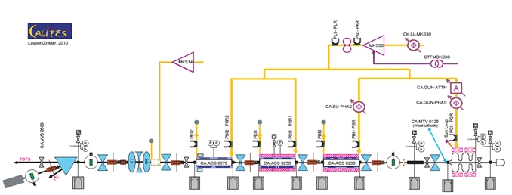
EO monitor
Standing-wave photo-injector
4
to Two Beam Test Stand (TBTS)
RF network
Complete set of diagnostics
3 travelling-wave structures (LIL)
Energy | 200 MeV
Energy spread | 1% (FWHM)
Pulse length | 0.6–150 ns
Bunch frequency | 1.5 GHz
Bunch length | 1.4 ps
Bunch charge | 0.085–0.6 nC
Intensity
- short pulse | 1 A
- long pulse | 0.13 A
Repetition rate | 0.833 – 5 Hz
Existing bunch profile monitors:
RF deflecting cavity
Bunch length measurement with 12 GHz high gradient acceleration structure (2 beam test stand)

Slide 4
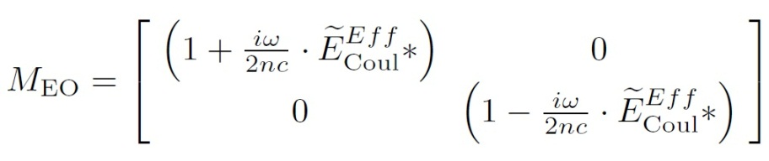
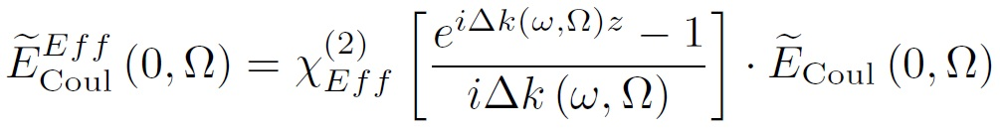
Electro-Optical Spectral Decoding
Simulations of bunch-induced polarisation change and non-linear interaction
Spectral Decoding (EOSD): The Coulomb field temporal profile of the e-bunch is encoded on to a time-wavelength correlated optical probe pulse. The profile is read-out through the spectrum of the probe pulse.
Where,
Where,

Slide 5

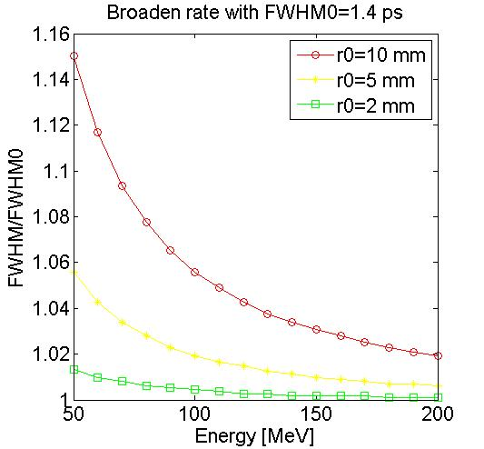
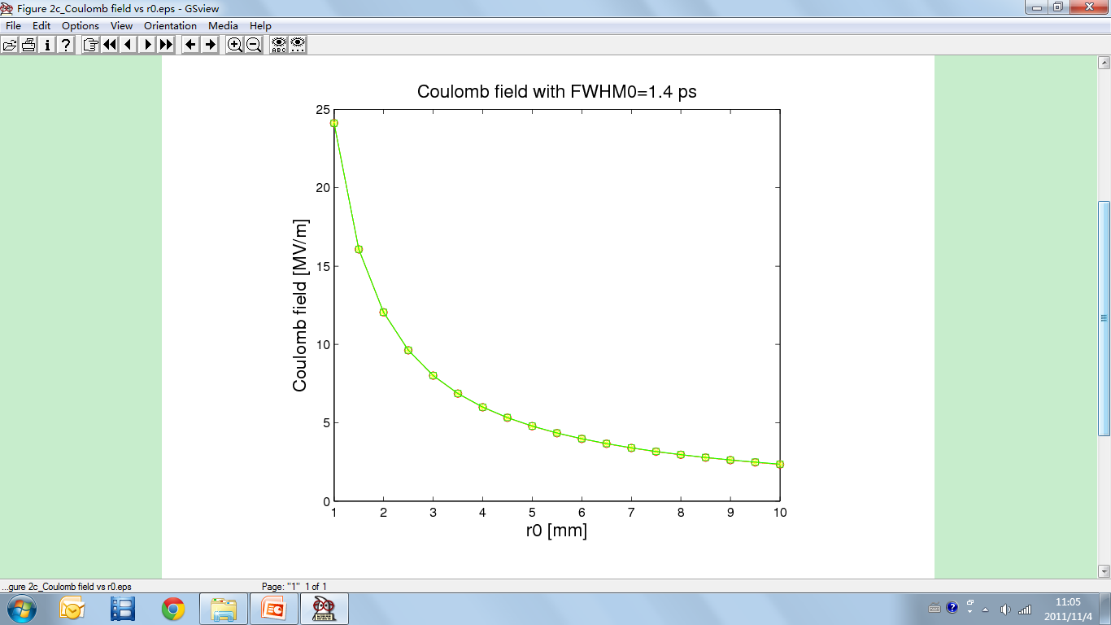

Simulation: Coulomb field of e-bunch and broadening
At high energies , the Coulomb field temporal profile is approximately the bunch temporal profile
Broadening of profile from transverse parameters:
β=0
β=0.9
β=0.9999
4%
For high energy beam (>150 MeV),
resolution broadening is < 4% @ 10 mm
r₀ = transverse separation from e-bunch
As r₀ increases, Coulomb field decreases

Slide 6
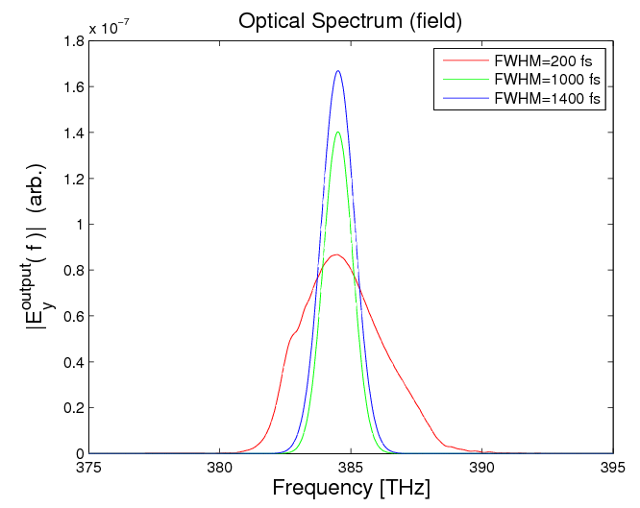
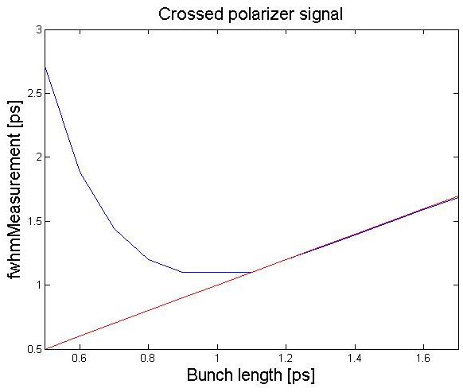
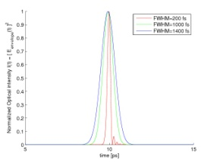
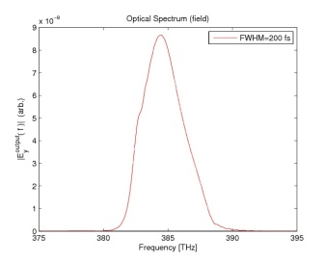
Simulation: limitations of EOSD
Interleaving bandwidth conflict for optical probe and bunch spectra
Without distortion
distortion
Other parameters:
Laser wavelength: 780nm
Laser pulse energy: 1.5nJ
Pulse duration: 150fs
Result is distortion for bunch lengths < 1 ps
Crystal thickness: 500μm
Crystal separation: 5mm
Reason:
Short bunch induces fast temporal modulation, which modifies spectral content and thus distorts t ↔ λ mapping

Slide 7
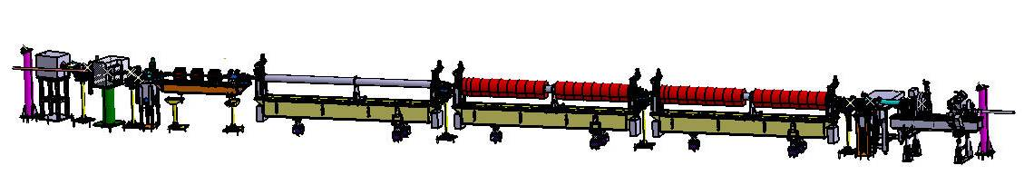

Implementation of the EO monitor at CALIFES
Diagnostic section
Accelerating structure
Photo-injector
Beam direction
Gated iCCD Camera
Intensifier size | 25 mm
Number of Pixels | 1280 x 1024
Pixel Size | 6.7 um x 6.7 um
Scan Area | 8.6mm x 6.9mm
Scaling Rates (magnification) | 1: 2.17
CCD Temperature (by air) | -12 ºC
Full Well Capacity (Image pixel well depth) | 25,000e⁻
Readout Noise | 7…8e⁻ @12.5MHz
A/D convertor | 12 bit
A/D conversion factor (Sensitivity) | 5 e⁻/count
Average Dark Charge (Equivalent Background Illuminance) | <0.1 e⁻/pixel sec
Readout Time (Full frame) | 8 fps
Min gating time | 3 ns
QE | ~25%
Grating
P: Polarizer H: Half wave plate
Q: Quarter wave plate
: Mirror with actuators
: Finger camera
Laser:
Wavelength: 780 nm Duration: 100 fs
Repetition: 37.4815 MHz Pulse energy: 2.7 nJ
Crystal: Thickness: 1mm Separation: 5-10 mm
In CLEX
In Lab
10 Actuators
3 Rotation motors
Finger cameras
7 Plane mirrors
2 Polarizers
2 Wave plates
1 Lens
1 Fibre head
1 Laser
1 ICCD Camera
1 Motor stage
10 Plane mirrors
3 Gratings
3 Lenses
1 Fibre head

Slide 8
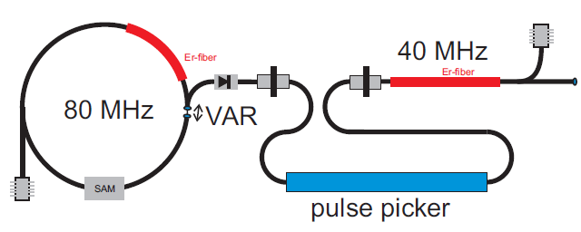
Laser ↔ e-bunch synchronization
Non-standard design,
providing higher pulse energy
Laser
37.5 MHz
74.9 MHz
Synchronization between laser pulse and e-bunch
Laser synchronised to accelerator RF (75MHz) at <200fs level.
OTR light transported to laser lab, providing beam arrival time monitor
Laser transported from same screen
Streak camera monitors few ps beam-laser synchronisation.
Optical delay for sub-ps to ns timing adjustments
Laser parameters
Wavelength: 780 nm & 1560 nm
Duration: <120 fs
Repetition: 74.9 MHz @ 1560 nm
37.5 MHz @ 780 nm
Pulse energy: 4.4 nJ @ 1560 nm
2.7 nJ @ 780 nm
(2) Spectral characterisation of the post-interaction laser pulse
A low jitter (<1ns) signal triggers the iCCD camera, gating a single laser pulse => can choose which electron bunch to characterise

Slide 9
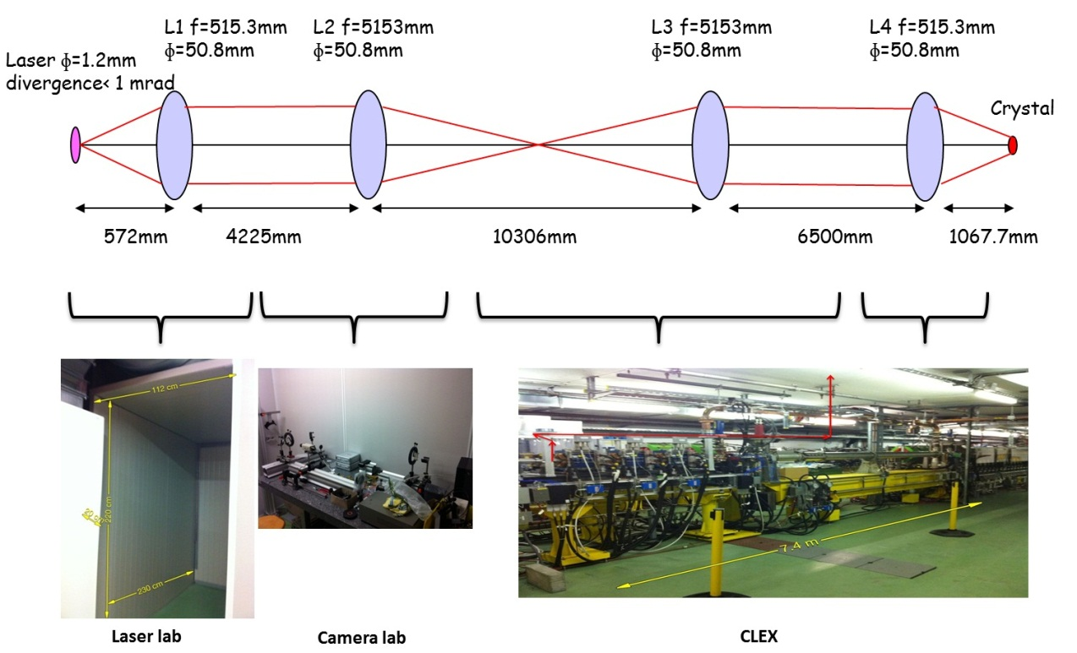
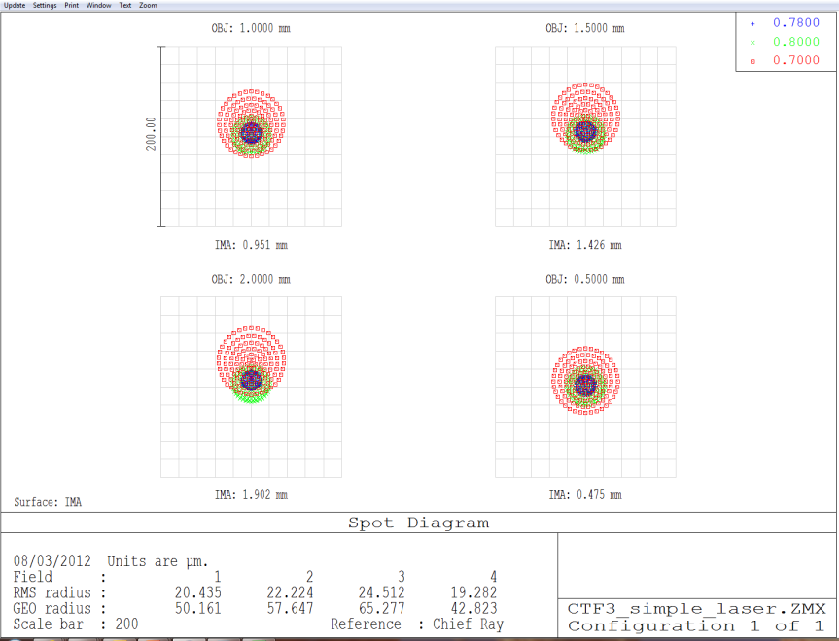
Optical Transfer Line
(1) Laser transfer line: from the laser lab to CLEX
Relay lenses stabilise optical transport
ZEMAX simulation
(purple dots are the centre wavelength)
Transfer the laser to the machine. The measured signal will be transferred back to the lab by optical fibre.
(2) OTR photons transfer line: from CLEX to the camera lab
Transfer OTR photons and laser photons to a streak camera for synchronization

Slide 10
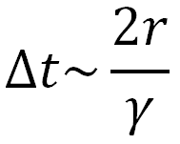
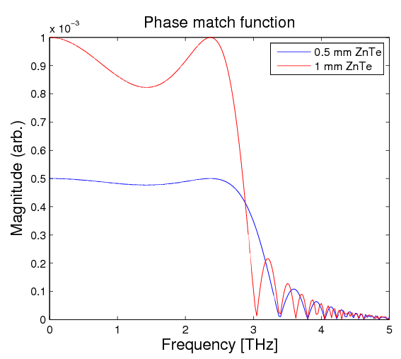
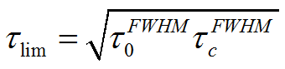
Contributions to System Time Resolution
1. Distance between crystal and e-beam
~10 fs at r=5 mm
2. The frequency response of crystal (material and thickness)
for 1 mm ZnTe: ~333 fs ~1/(3THz)
3. EOSD limitation (Laser pulse duration and chirped duration)
~550 fs ( for 100 fs pulse chirped to 3ps)
4. Resolution of spectrometer and iCCD ~3 fs
Grating
ICCD
Mirror

Slide 11
2. Activities at STFC Daresbury Laboratory
Testing optical requirements for ultimate time resolution monitor
Spectral Upconversion Techniques
Convert the far-IR – mid-IR spectrum to an optical spectrum
Offers potential for simple & robust bunch form factor measurements
  - Bandwidth reduction 1mm - 10μm → 800nm – 740nm
  - Simple CW lasers (?)
2011/12 experiments at Daresbury (Manchester University also collaborating)
Shooting for ultimate aim of CW laser probe:
- Simple 200mW diode laser, ALICE macrobunch CSR
wavelength drift believed to be obscuring the very small signal
2 Watt single mode (MHz linewidth) laser installed
(loan through University of Manchester collaboration)
Continuing absence of signal attributed to long bunch, low CSR energy,
& radiation transport losses.
Change of approach....
Use laser-generated THz for initial parameter setting experiments

Slide 12
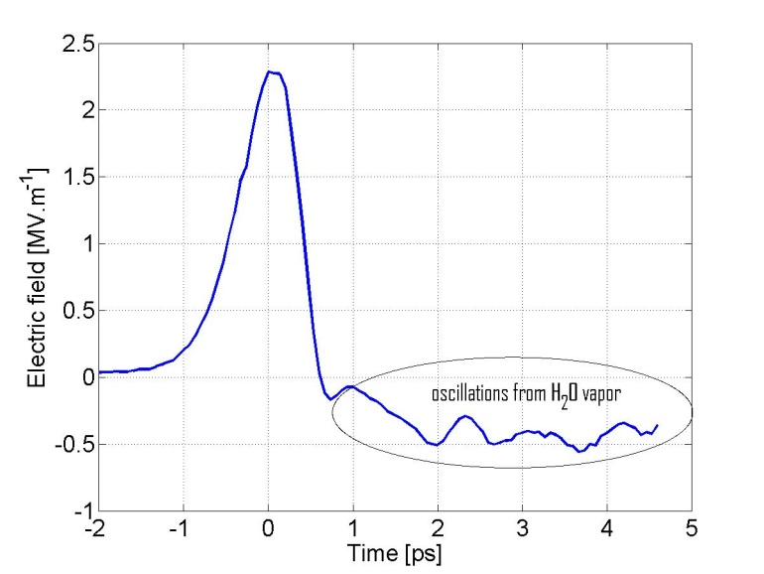
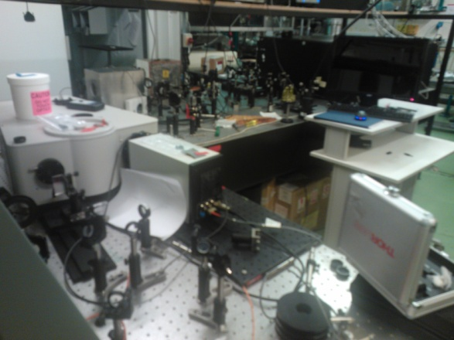
Laser-generated THz pulses as mimic of electron bunch
MV/m sub-ps source available with independent EO characterisation (separate project in high power THz generation for bunch manipulation)
→ Still failed to observe signal using single-mode laser
- believe currently just below signal-noise of detection systems
EO crystal efficiency, ITO dichroic losses,
shorter pulse/larger bandwidth => smaller Ι (λ) per nm
...returning to understanding of signal-noise levels with “quasi-CW” laser
- kW equivalent laser power trivially available
(~50ps 1064nm system to be used initially).
- small increase in complexity through synchronisation
Sub-picosecond pulse generation and detection in ASTeC laser lab
Upconversion of CTR on ALICE
Experiments for May 2012
delayed due to unscheduled
cathode replacement
(underway now)

Slide 13
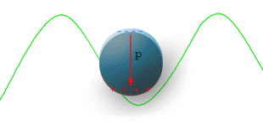
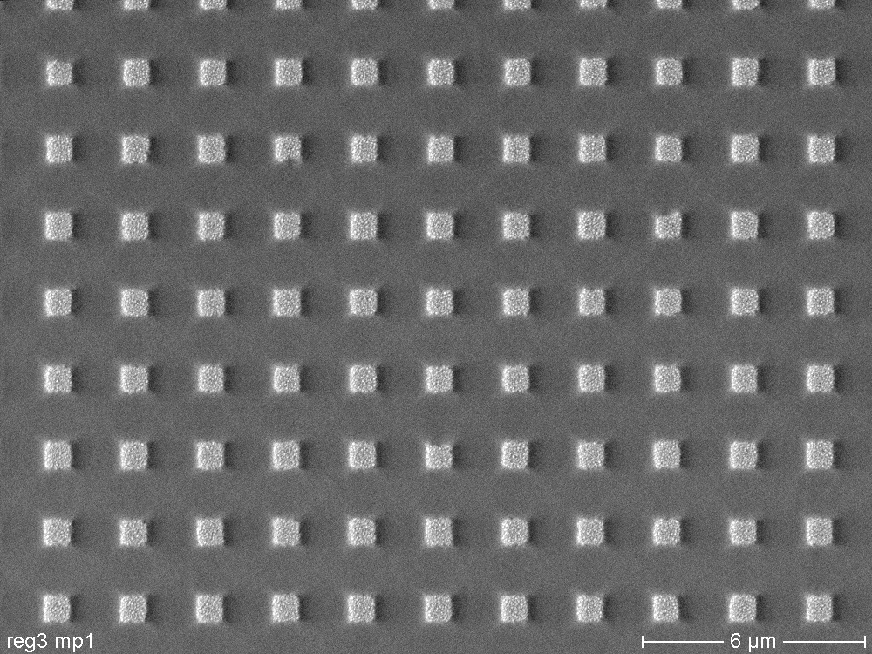
3. Activities at the University of Dundee
Development of alterative higher bandwidth non-linear materials
EO Detection solution in thin films & 2D structures
- to bypass propagation effects
Thin film polymers
Demonstrated broadband EO response
Sufficient EO efficiency
?? Accelerator environment, material stability ??
Nano-structured materials
Electro-optic effect from short-range structure.
... limited experimental demonstrations
Materials, Photonics & Smart Systems (MAPS) Group at Dundee
Fabrication & Applications of Nanocomposites
Dundee group expertise: DC electric field-assisted selective dissolution of nanoparticles in nanocomposites (patented technology)

Slide 14
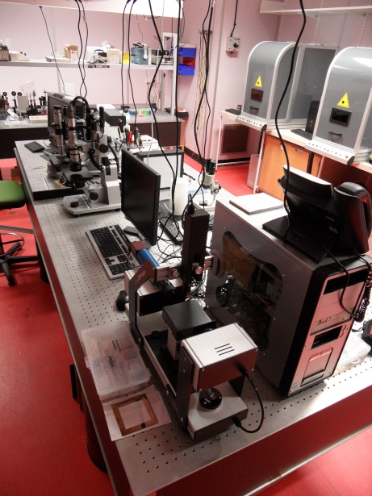
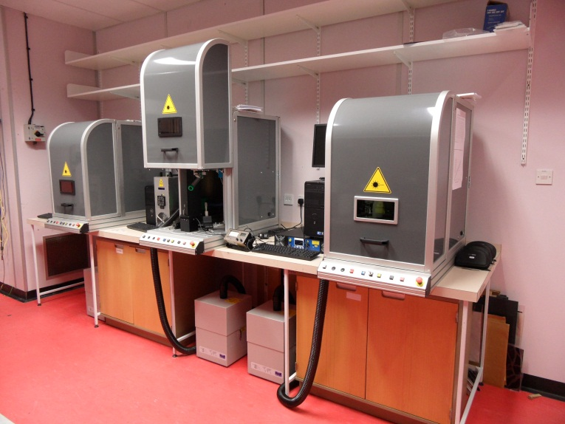
Overall R&D goals
Fabricate percolation films and metal-dielectric nanocomposite films at Dundee University → a type of “metamaterial” - utilising electric field & laser processing of materials
Test these films for the required E-O properties at Daresbury Laboratory
Incorporate materials into set-ups at PSI and CLIC
Progress
3 nanosecond laser systems (at wavelengths 355, 532 and 1064 nm) in place during 2011 for materials processing (£180,000 investment)
Picosecond (Coherent Talisker ULTRA 355-04) system being installed (May 2012)
Operates at same 3 wavelengths (£240,000 investment)
Talisker pulsewidth <15ps with an average power of up to 4W at 355nm, 8W at 532nm, and 16W at 1064nm.
First tests on new system planned for early June 2012

Slide 15
Summary
CALIFES preparations progressing well
Vacuum chambers to be installed during next shutdown (June 2012)
Laser laboratory under preparation, laser systems being installed May 2012
Daresbury experiments on spectral upconversion beginning to show results
Separate ASTeC project underway in high power THz generation for bunch manipulation
Dundee laser systems for processing alterative higher bandwidth non-linear materials are now in place, and will soon be available for regular use
Preparation and testing of silver & gold metal-dielectric nanocomposites (MDNs) are planned for near future

Slide 16
Planned activities for year 2 of project
Optical synchronization system implemented at CALIFES, and transfer lines installed for laser and OTR photons.
Laser and control systems completed and tested
First beam tests at CALIFES
“Conventional” E-O materials (organic crystals, thin film polymers, etc) tested and characterised at Daresbury
First MDN metamaterials produced at Dundee and evaluated at Daresbury
Arrangements put in place to test first high-resolution prototype system at PSI test facility

Slide 17
END

Slide 18
UK CLIC collaboration over three years (April 2011 to March 2014)
 |  |  |  |  |  | Collaboration Agreement
UK Laboratory | UK Laboratory representative | Task | UK responsible | CERN responsible | Reference | Amount GBP | CERN Payment Profile
 |  |  |  |  |  |  | 2011 | 2012 | 2013 | 2014 | Total
Dundee | A.Gillespie | Instrumentation: Electro-optic | A.Gillespie | T.Lefevre | KE1865 | 449,000 | 130 | 169 | 125 | 25 | 449
ASTEC | J.Clarke | Quadrupoles | J.Clarke | M.Modena |  |  | 127.5 | 169.2 | 169.2 | 42.5 | 508.3
 |  | Crab cavity | P.McIntosh A.Dexter | A.Grudiev | KE1866 | 563,000 | 13.3 | 18.3 | 18.3 | 5.0 | 55.0
Lancaster | A. Dexter |  |  |  | KE1867 | 130,000 | 39.3 | 40.3 | 46.5 | 4.0 | 130.0 | note: 90k£/FTE in Lancaster
Manchester | R.Jones |  |  |  |  |  |  |  |  |  | 0.0
 |  | Structures design | R.Jones | W.Wuensch | KE1868 | 422,000 | 3.0 | 148.0 | 149.0 | 122.3 | 422.3
Oxford | P.Burrows | Feedback & control | P.Burrows | D.Schulte |  |  | 25.5 | 95.0 | 95.0 | 17.5 | 233.0
 |  | Phase Feedforward | P.Burrows | D.Schulte |  |  | 45.5 | 155.0 | 200.0 | 39.5 | 440.0
 |  | Inst: Laserwire | G.Blair | T.Lefevre | KE1869 | 794,000 | 9.0 | 112.0 | 0.0 | 0.0 | 121.0
RHUL | G.Blair |  |  |  |  |  | 0.0 | 67.0 | 111.0 | 3.0 | 181.0
 |  | Instrum: Coherent bunch length | P.Karataev | T.Lefevre |  |  | 15.0 | 39.7 | 68.3 | 0.0 | 123.0
 |  | Instrum: BPM | Boogert | T.Lefevre | KE1870 | 642,000 | 9.0 | 87.0 | 80.0 | 0.0 | 176.0
 |  | RTML | S.Molloy | A.Latina |  |  | 0.0 | 2.0 | 2.0 | 2.0 | 6.0
 |  | BDS integration | A.Seryi | R.Tomas |  |  | 0.0 | 102.0 | 52.0 | 2.0 | 156.0
Total |  |  | P.Burrows | H.Schmickler |  | 3,000,000 | 417.1 | 1204.4 | 1116.3 | 262.8 | 3000.6 | k£
 |  |  | conversion using 1£ = 1.32 CHF (13.7.2011) |  |  |  | 550.55 | 1589.83 | 1473.516 | 346.94 | 3960.836 | kCHF

Slide 19
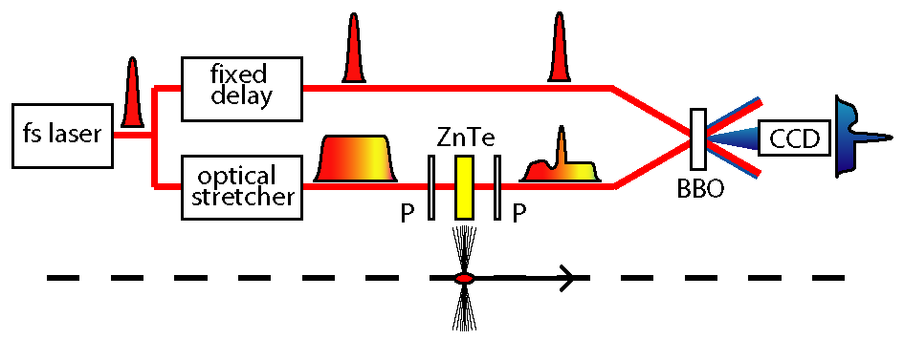
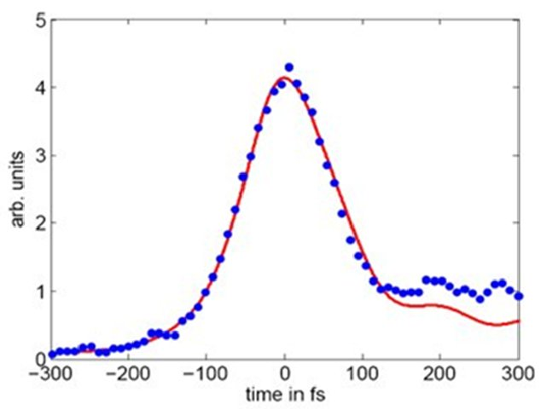
Plans for Longitudinal PM during the PPP
R&D on Electro-optical techniques on single shot temporal decoding techniques
Shortest measured electron bunch profile (at DESY FLASH) using 65um thick GaP crystal
The optimum fitted Gaussian curve sigma is 79.3 ± 7.5 fs
By S. Jamison and A. Gillespie
Notes:
Challenges CLIC Main Beam

Slide 20
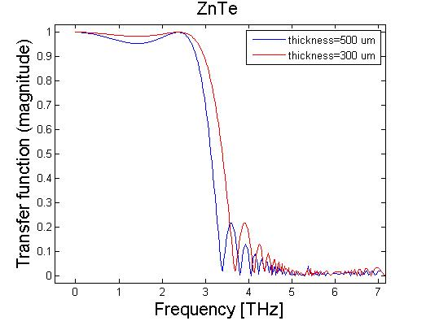

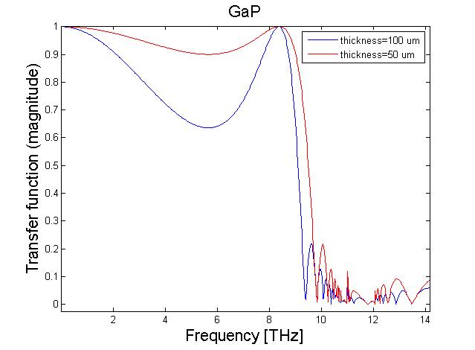
Plans for Longitudinal PM during the PPP
Improving the encoding process
  Investigation of new electro-optic
  materials for EO profile systems at CLIC
  Experimental characterisation of thin films
  and meta-materials as novel EO detectors.
  Demonstration of the concept of a multiple
  crystal detector spanning a wide optical bandwidth
Improving the decoding process
  Demonstration of single-shot X-FROG measurements on a laser-generated THz source.
  Demonstration of X-FROG detection on an electron beam source.
By S. Jamison and A. Gillespie
Notes:
Challenges CLIC Main Beam

