Slide 1
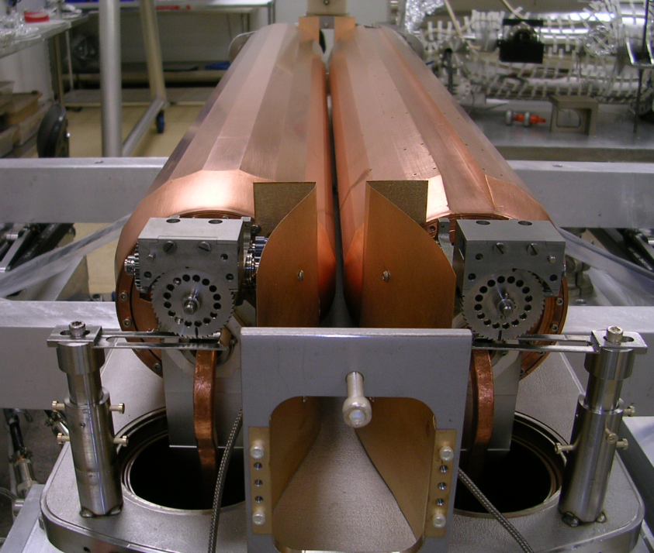
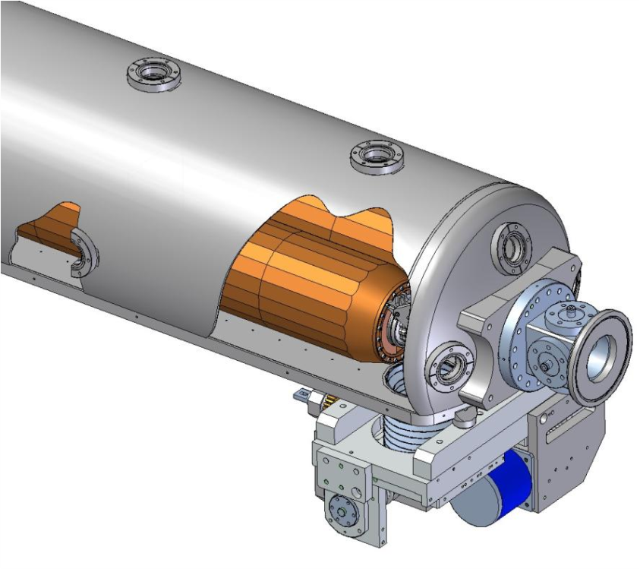
LARP Rotatable Collimator Prototype
Rotation Drives
BPM
Assembly completed and all mechanical tests successful:
    Cooling tubes now twist, under vacuum, as jaws turn, with R~1 mΩ & align well
Discovered after tank welded that the cooling tube of each of the two jaws had been damaged
First jaw, the thermal performance prototype, was wound with non-OFE Cu magnet conductor, 3/8” square with ¼” round cooling channel
Second jaw was wound with 10mm square, 1.5mm wall OFE Cu tubing

Slide 2
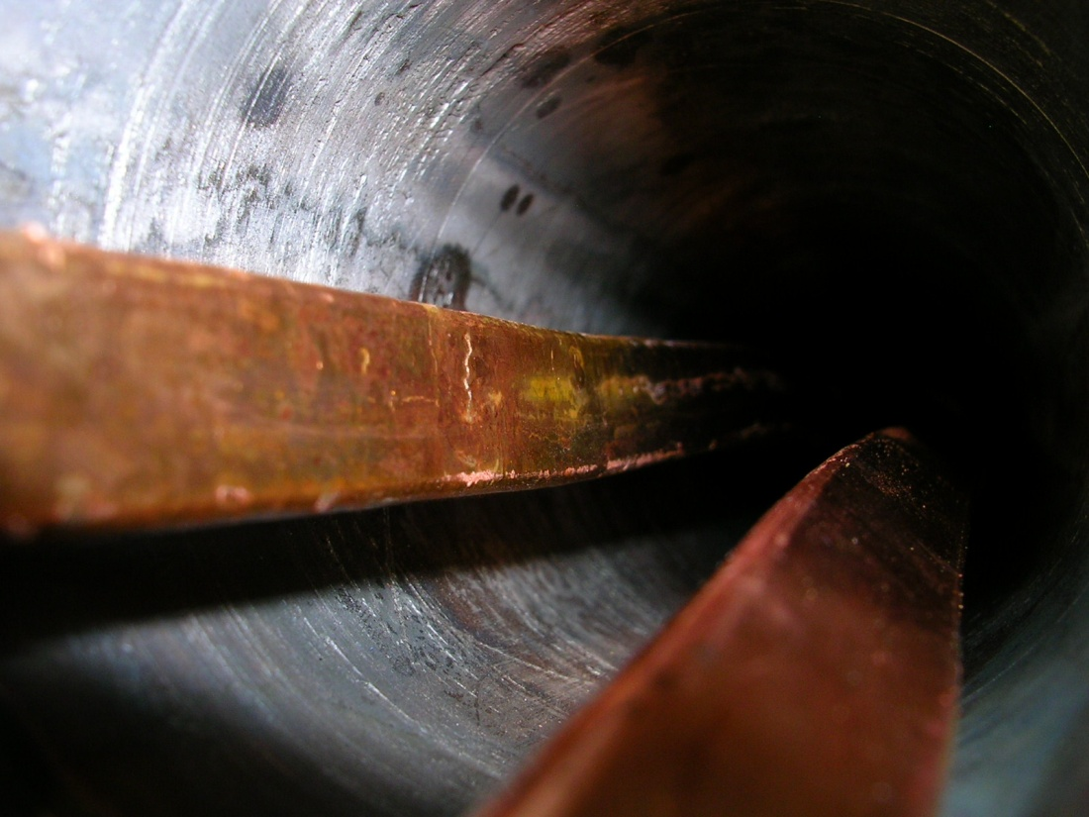
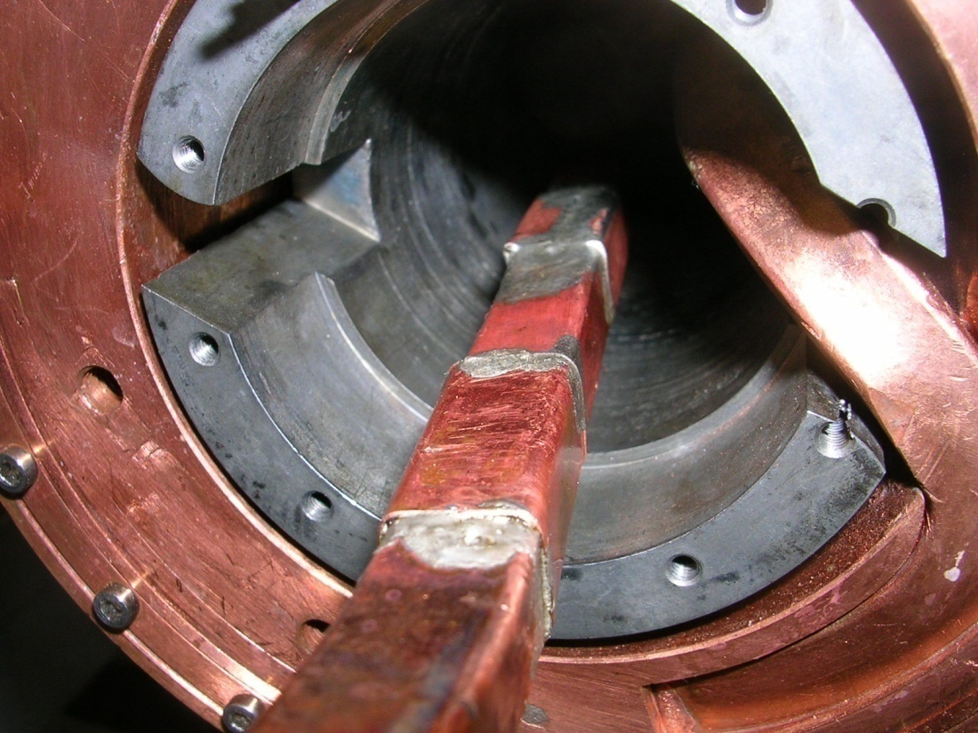
Crack in Copper Magnet Conductor Used for Winding First Prototype Jaw
Suspect weakening in non-OFE Cu tubing at crystal grain boundaries after last of many high temperature firings
Repaired with solder patch

Slide 3
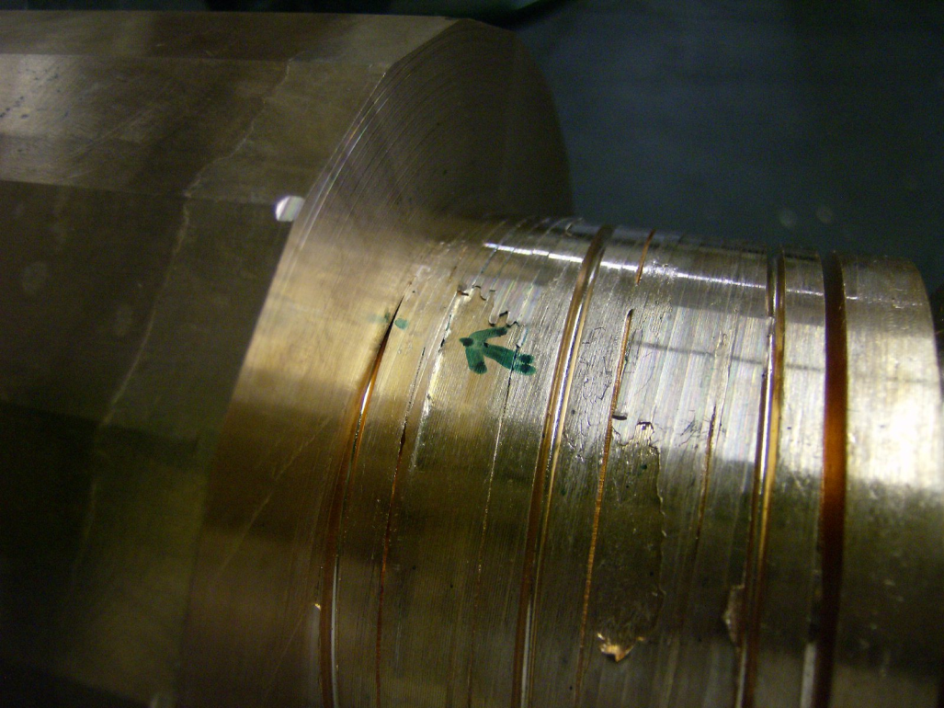
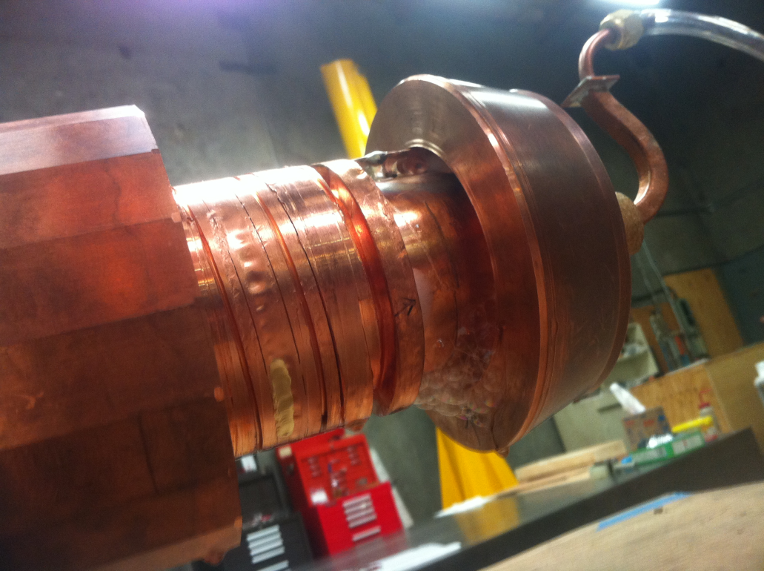
Leaks at Tack Welds and Perhaps at Thinned Points in Thinner Walled Tubing Used for Winding 2nd Prototype Jaw
Tube walls thinned to 0.030” in places when mandrel prepped for jaw braze
Repaired with “CuSil”
“SNOOP” bubbles at tack welds used to secure tubing: 5 leak points
Neither of these procedures are fundamental; assembly process will avoid these two procedures

Slide 4
Other Lessons Learned During Prototype Testing and Next Steps
After 5 weeks of bakeout tank & jaws (tubes sealed) reach P=4.4E-9 torr with clean RGA & rotation mechanism works after bakeout
“Less important” mechanical issues that need attention
  Replace problematic free floating RF bearings with race-constrained bearing
  Capture main bearing so cannot slide off during bakeout
  Replace W-S2 440 Stainless coated main bearing with ceramic bearing
    1 of 4 main bearings froze to race during bakeout (W-S2 316 SS bearings all fine)
  Replace 1 of 2 molybdenum rotation drives that cracked when spot welded
Non-fundamental issues that will not be changed
  Impedance dominated by tank size & simplified RF transitions
  Recent desire for BPMs that move with jaws will not be implemented
Plan is to replace both jaws & reinsert into existing base plate with existing vacuum bellows and motion system for beam and then destructive testing in HiRadMat facility
Modify assembly procedure to guarantee cooling tube integrity
Delivery to CERN Summer 2012
Activity supported by SLAC and carry-forward funds

Slide 5
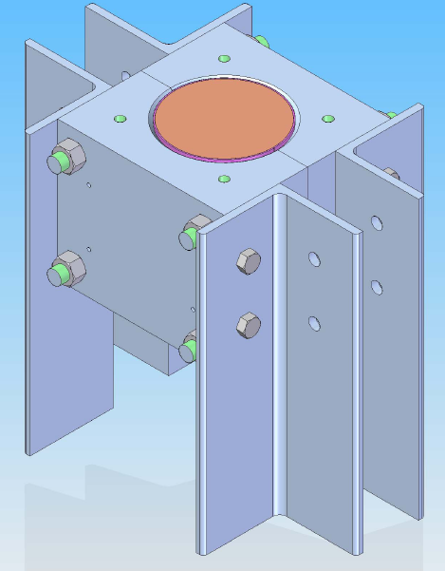
Work in Progress
New Procedure:
  Wrap a 2mm thick OFE copper sheet around the mandrel with its wound cooling tube
    Braze material between sheet and OD of mandrel
  Braze in 316 SS Compression Fixture to lock down tubes without spot welds
  Tubes not touched during machining to true OD for jaw braze
Tests in progress
  20cm proof-of-principle (10.02.12)
  Destructive hydraulic test of 1.5mm wall 10x10 tuning (17.02.12)
Two new shafts were scheduled to be brazed 06.02.12
Next steps
  Full length compression fixture
  Wind exitsing mandrels with existing tubing braze

