Slide 1
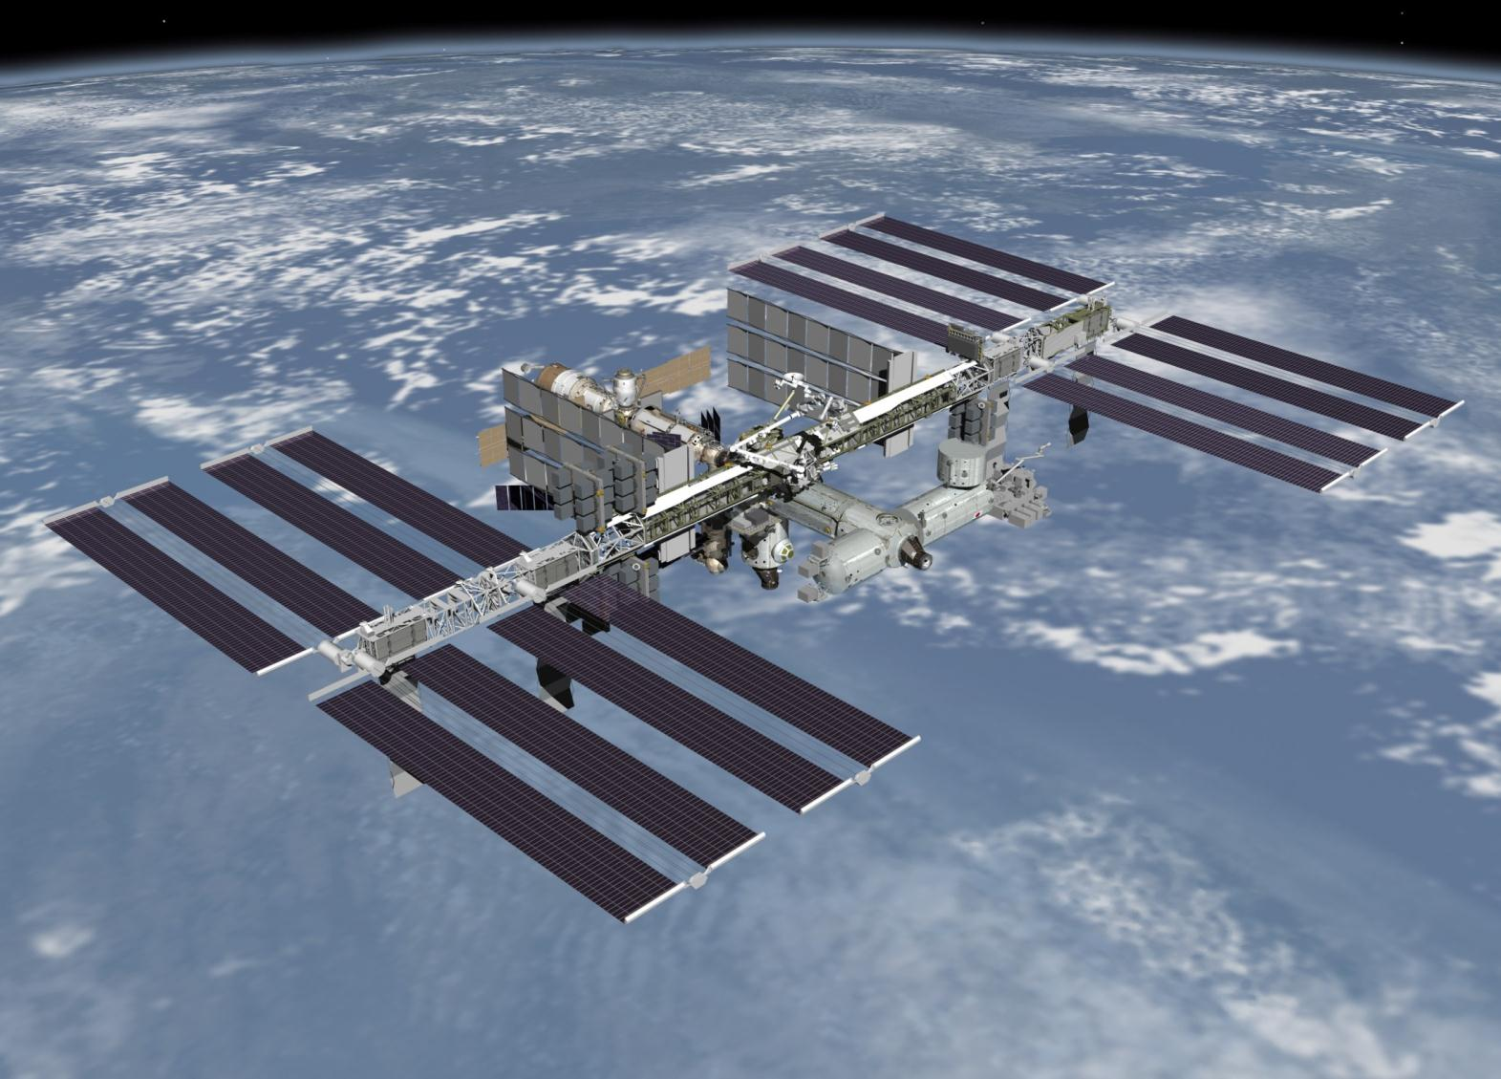

Overview of CERN 2011 Test
Overview of CERN 2011 Test
神奈川大工，早大理工^{A}，横国大工^{B}，
Univ. of Siena^{C}，INFN Florence^{D}，INFN Rome Tor Vergata^{E}，NASA GSFC^{F}
田村忠久，鳥居祥二^{A}，片寄祐作^{B}，小澤俊介^{A}，赤池陽水^{A}，
植山良貴^{A}，伊藤大二郎^{A}，苅部樹彦^{A}，近藤慧之輔^{A}，仁井田多絵^{A}，
Pier Marrocchesi^{C}，Paolo Maestro^{C}，Gabriele Bigongiari^{C}，Simone Bonechi^{C}，
Gianmaria Collazuol^{C}，Oscar Adriani^{D}，Nicola Mori^{D}，Alessandro Gherardi^{D}，
Francesco Palma^{E}，Cristian De Santis^{E}，Roberta Sparvoli^{E}，John William Mitchell^{F}

Slide 2
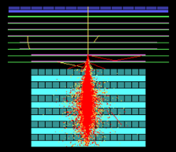
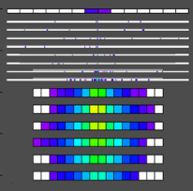
Components of CAL
・ CHD （CHarge Detector）
・ IMC （IMaging Calorimeter）
・ TASC （Total AｂSorption Calorimeter）
CHD
・Plastic Scintillator
32×450×10 ㎜³
×14 bars×2 layers
・PMT readout
CAL
IMC
・SciFi belts (1㎜Sq. SciFi 448)
・XY directions 2belts in one layer
・W boards between 8 layers
（0.2 r.l. ×5 + 1 r.l. ×2）
・SciFi 7168 read out with
112 64ch MaPMT
・MaPMT read out with
VA32HDR14.3（GM-IDEAS）
TASC
・PWO logsof 19×20×326 ㎜³
・16 logs ×12 layers（27 r.l.）
・Readout
1st layer: PMT
2～12 layers: APD/PD
electron 1 TeV
（Simulation）
Image data

Slide 3
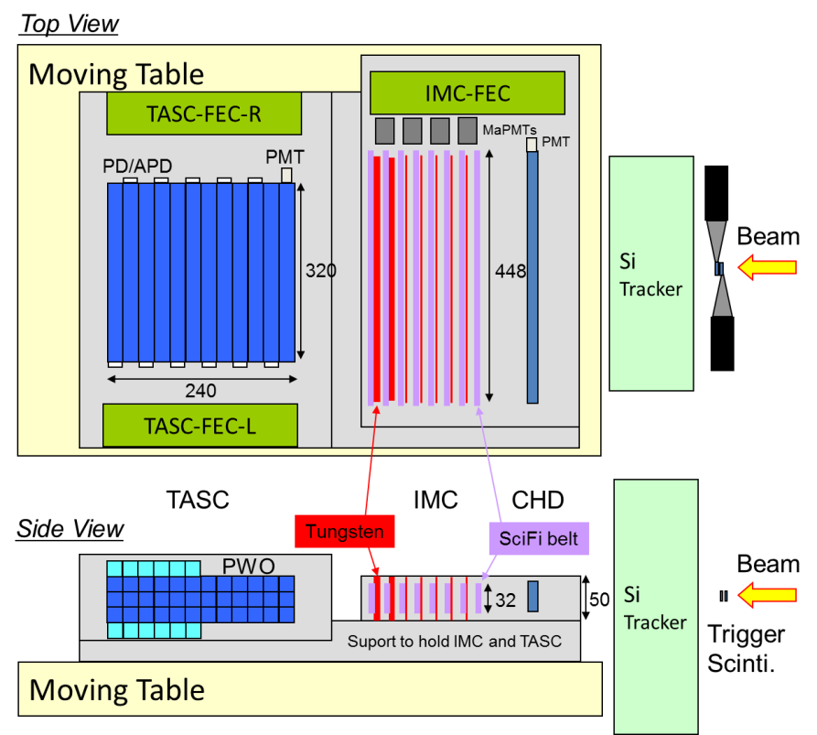
Set up of detectors for CERN2011
Proto-type of CALET(one directional)
・trigger scintillators
・Si strip detector
4 layers
・CHD
4 SciBar
・IMC
SciFi belts 8 layers
・TASC
PWO 3×12 layers
・Moving table

Slide 4
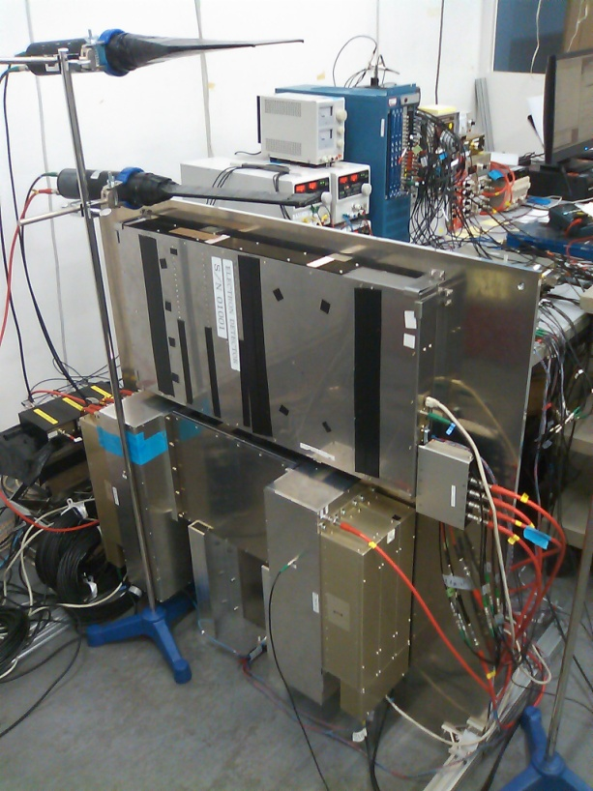
Test to take cosmic-ray muon data
with the detectors standing in waseda
IMC
TASC
TASC
FEC

Slide 6
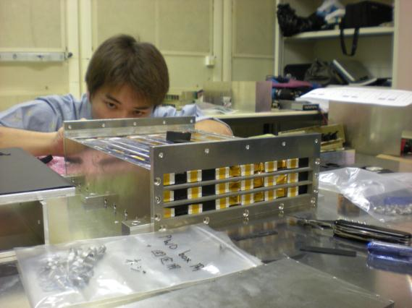
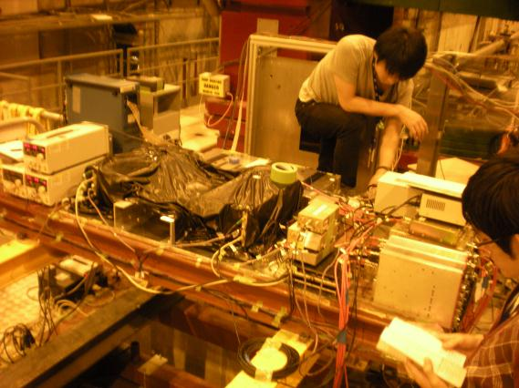
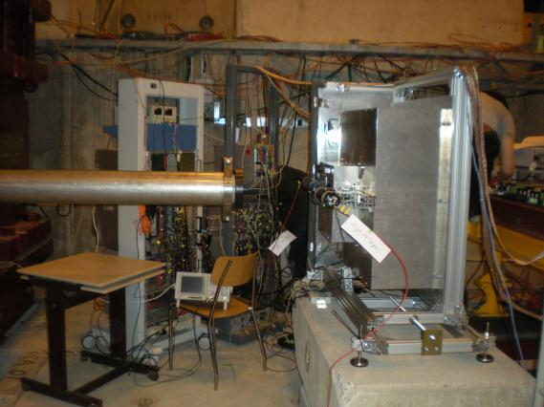
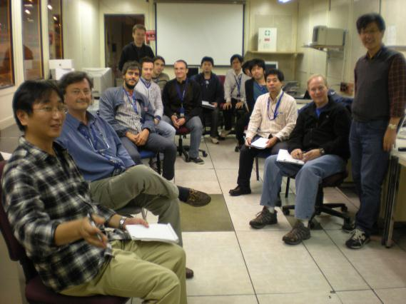
・Japan（10）: Waseda U. 8、Kanagawa U. 1、YNU 1
・Italy（10）: Siena U. 4、Firenze U. 2、Rome U. 3、 Padoba U. 1
・USA（1）: GSFC 1
21 shifters

Slide 7
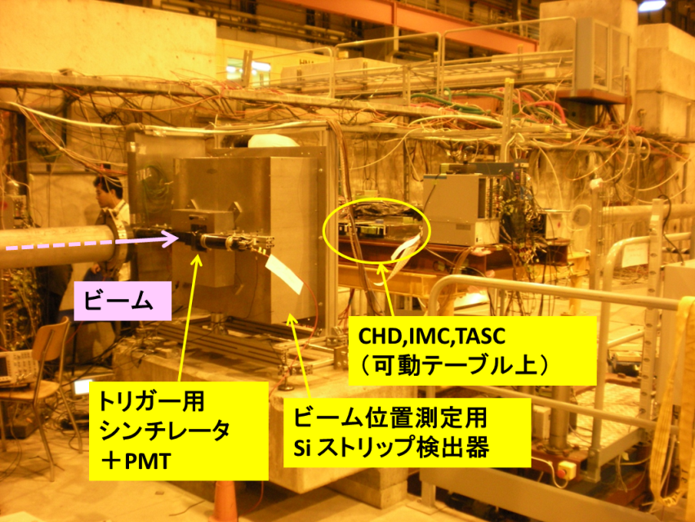
Beam test at CERN-SPS
・2011/9/19～28
・Beam line: T2-H4
・electron/positron（10～290 GeV/c）
・proton（30～350 GeV/c）
・moun（150 GeV/c）
Beam
CHD, IMC, TASC
on the moving table
Trigger
scintillator
+ PMT
Si strip detector
to determine beam position

Slide 8
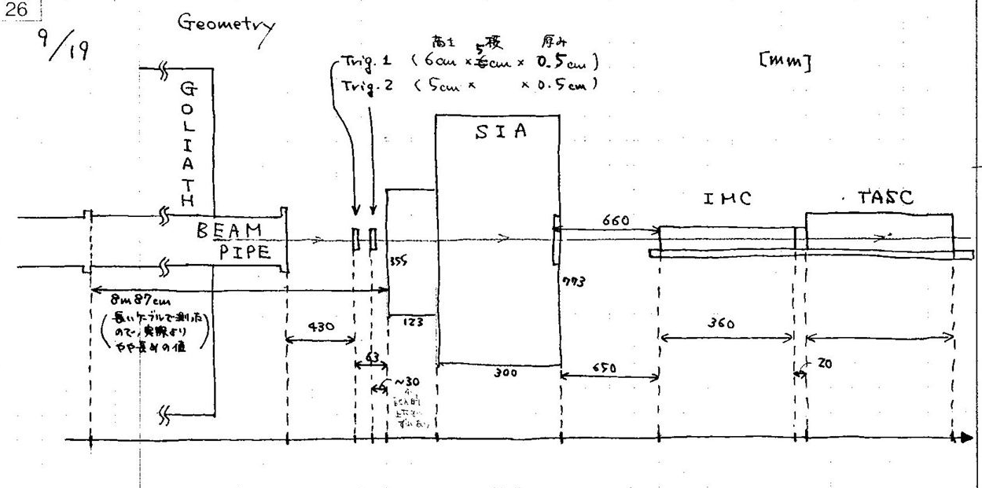
Configuration of detectors setup

Slide 9
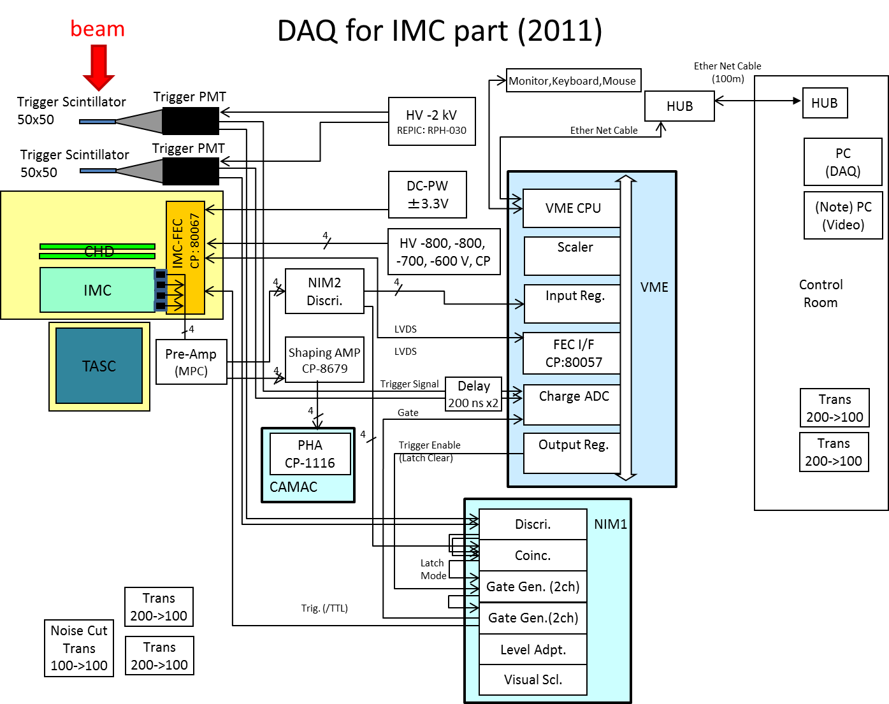

Slide 10
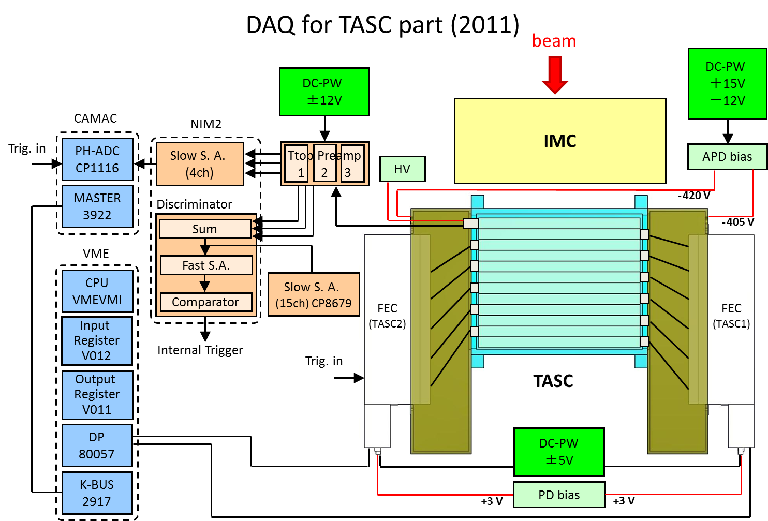

Slide 11
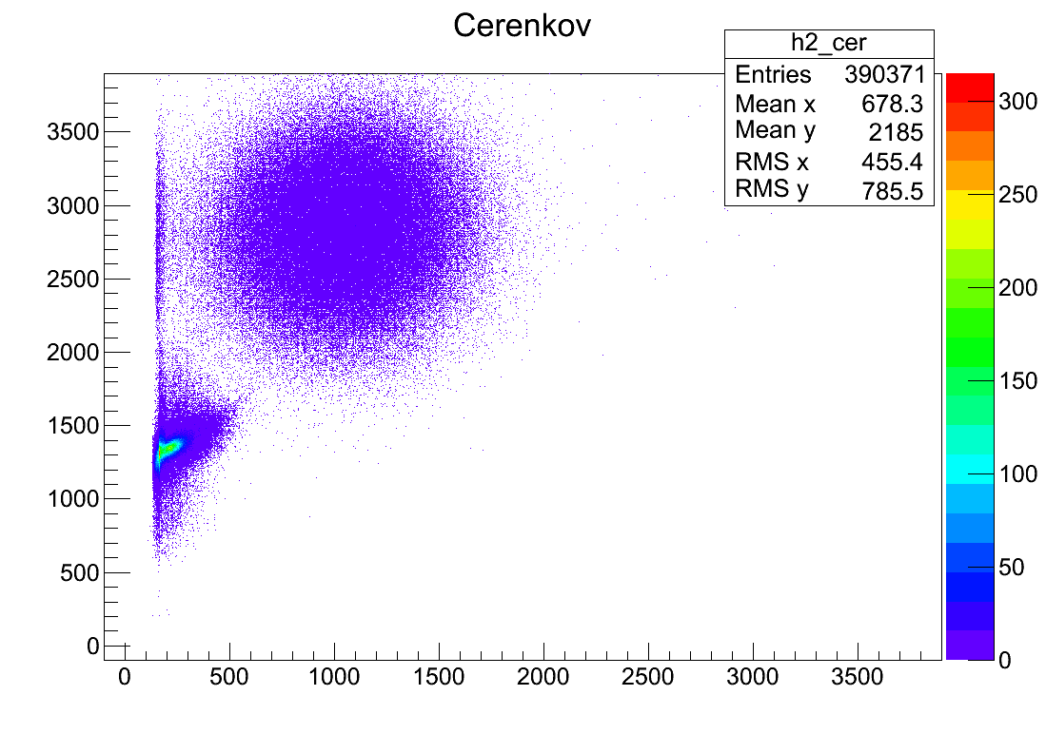
Cherenkov Detctor
(proton 30 GeV/c)
Cerenkov counter2 [ADC counts]
Cerenkov counter1 [ADC counts]

Slide 12
HV setting values
MaPMT
  Layers e/p muon
  1,2 : -800 V -800 V
  3,4 : -800 V -800 V
  5,6: -700 V -800 V
  7,8: -600 V -800 V
TASC-PMT
  Top -478 V, Middle: -490 V, Bottom: -470 V
APD
  TASC-FEC1 (Jura): 405 V, TASC-FEC2 (Saleve): 420 V

Slide 13
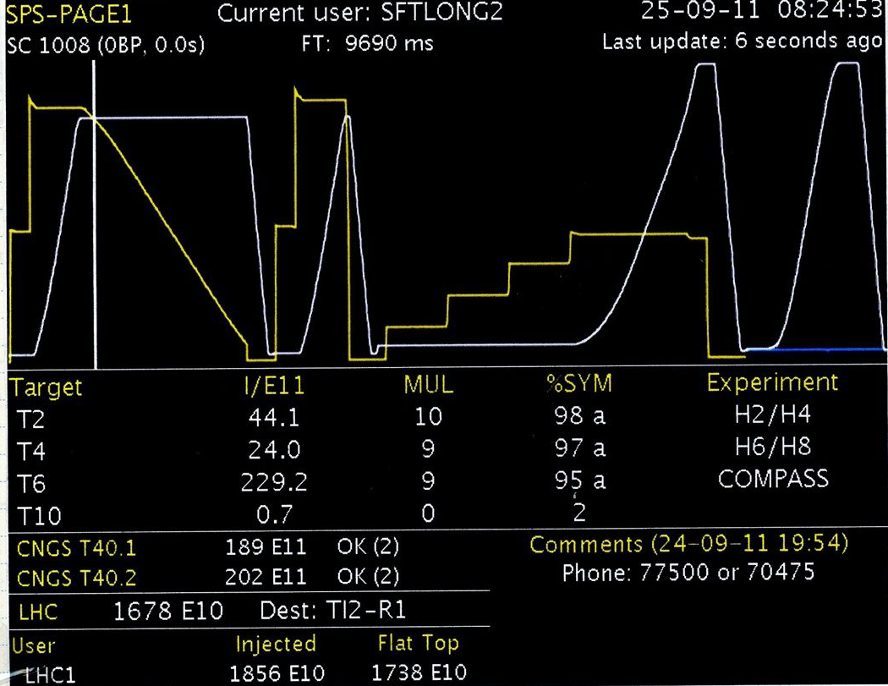

Slide 14
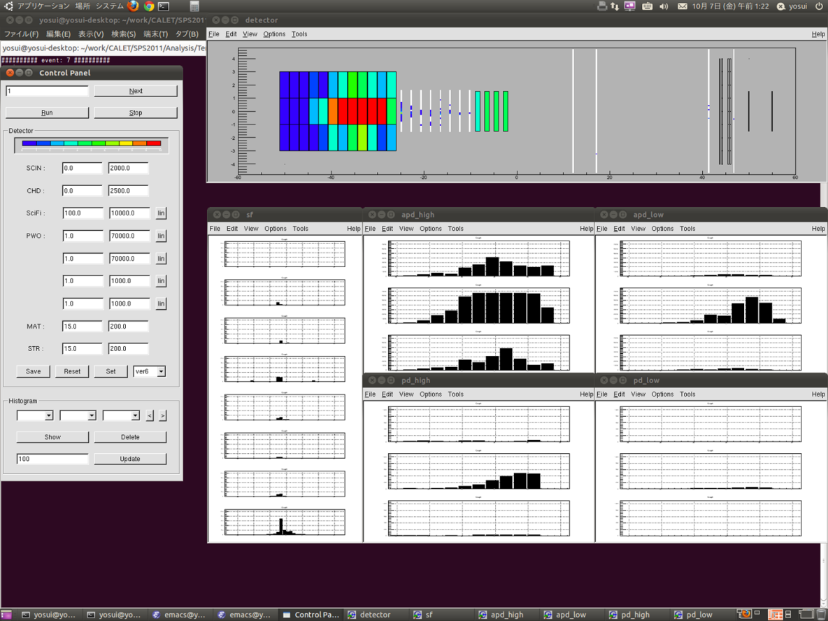
Example of event monitor
TASC
IMC
Beam
SciFi
APD(H)
APD(L)
positron 290 GeV/c
PD(H)
PD(L)

Slide 15
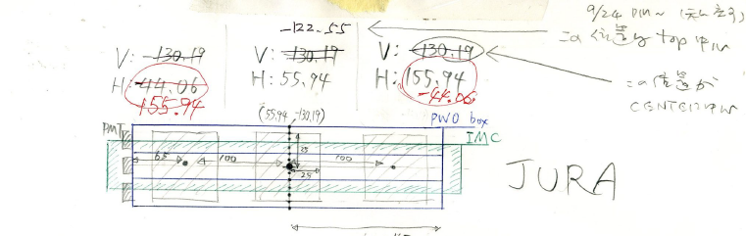
Beam position
BEAM
Center (H:55.94, V:-122.55)
Horizontal: center ± 100 mm (3 points)
Vertical: center + 20 mm (2 points)

Slide 16
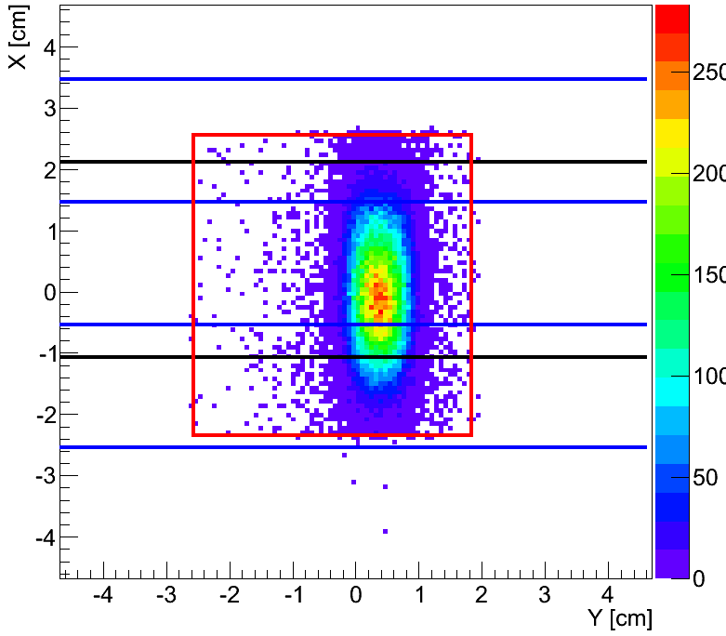
An example of beam profile
(Si tracker)
Proton 30GeV （RunNo.288）

Slide 17
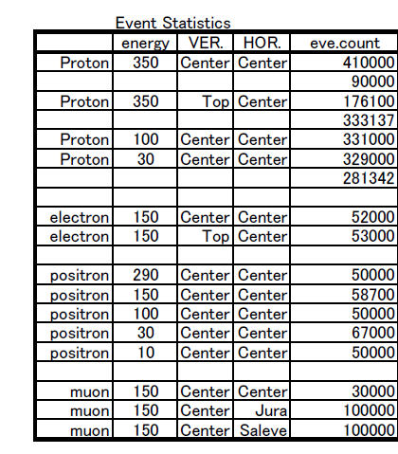
Event Statistics
・Beam position
3 points in horizontal
（center, ±10㎝）
2 points in vertical
（center, +2㎝）
・electron/position
381 k events
・proton
1,950 k events
・muon
230 k events

Slide 18
Temperature monitor for SPS2011
Data logger (HIOKI Memory HiLogger 8430)
Thermocouple
IMC-3
Environment
Position |  | Logger ch
IMC-1 | SciFi Belt | Ch 10
IMC-2 | SciFi Belt | Ch 9
IMC-3 | FEC surface | Ch 8
Environment |  | Ch 6
TASC-1 | PWO 1st | Ch 3
TASC-2 | PWO 6th | Ch 2
TASC-3 | PWO 7th | Ch 1
IMC-2
TASC-1
TASC-2
TASC-3
IMC-1

Slide 19
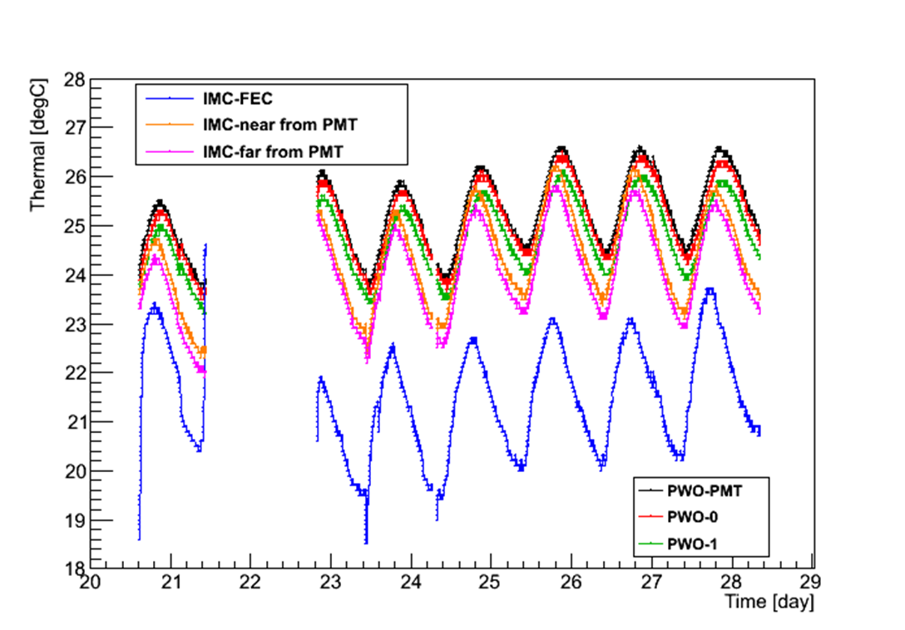
History of temperature during beam test
IMC-3
IMC-2
IMC-1
TASC-3
TASC-2
TASC-1

Slide 20
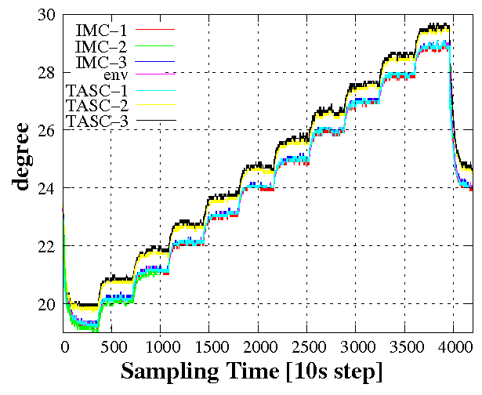
Calibration of temperature sensors
Temperature and humidity Chamber
The measurement range 20-30℃, 1℃ step
There is a systematic differential depend on thermocouple type (K and T)
→ Wrong setting of Logger(?)

Slide 22
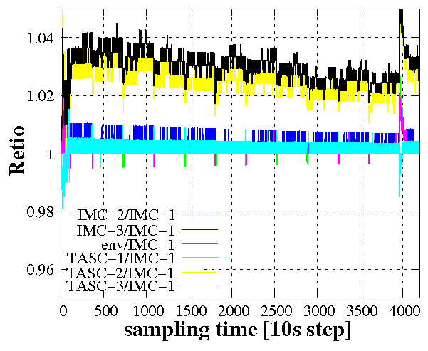
Temperature monitor for SPS2011
Normalized by IMC-1
The distribution of measurement less than 2% relatively

