Slide 1
CALET Beam Test 9/11
John Mitchell

Slide 2
CERN Accelerator
Complex

Slide 3
CERN Accelerator Complex

Slide 4
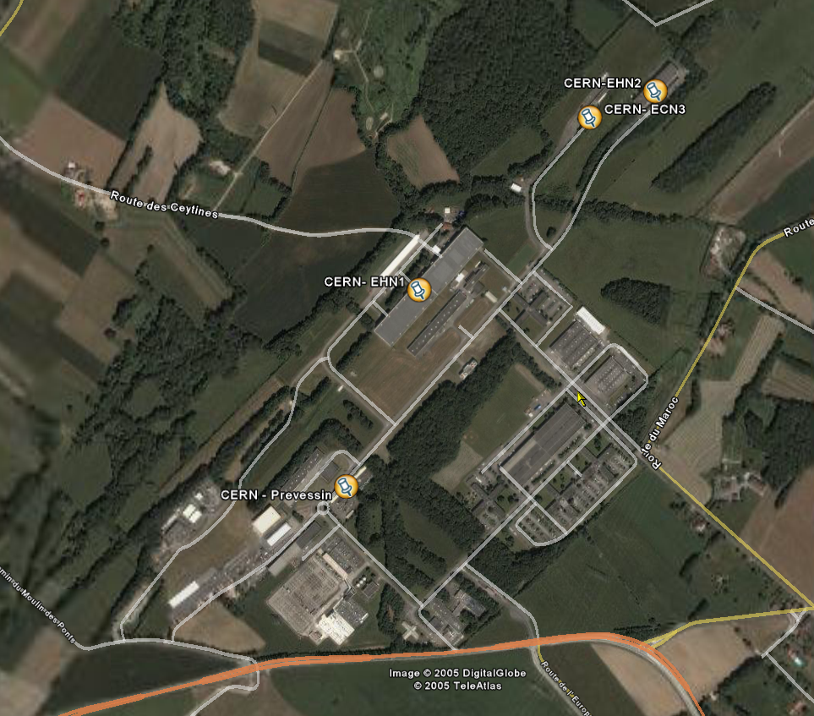
The SPS North Area
EHN1
EHN2
(COMPASS)
ECN3
(NA48)
BA80
(ps building)
BA81
(ps building)
TCC2 access
TCC2 targets
(underground)
CCC

Slide 5
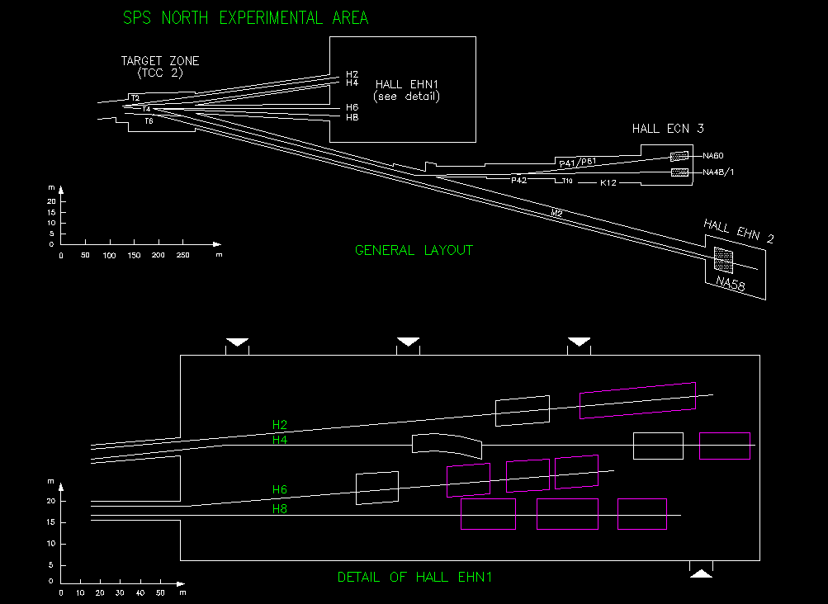
Experimental Areas
6.5 Km of beam lines
About 1000 equipment installed
The SPS North Area
CALICE/ILC
NA49
GLAST, DREAM, AMS,…
CMS
ALICE
CERF/SC-RP
CRYSTALS/LHC Coll.
LHCb
ATLAS
TOTEM

Slide 6
H4 Beam Optics

Slide 7
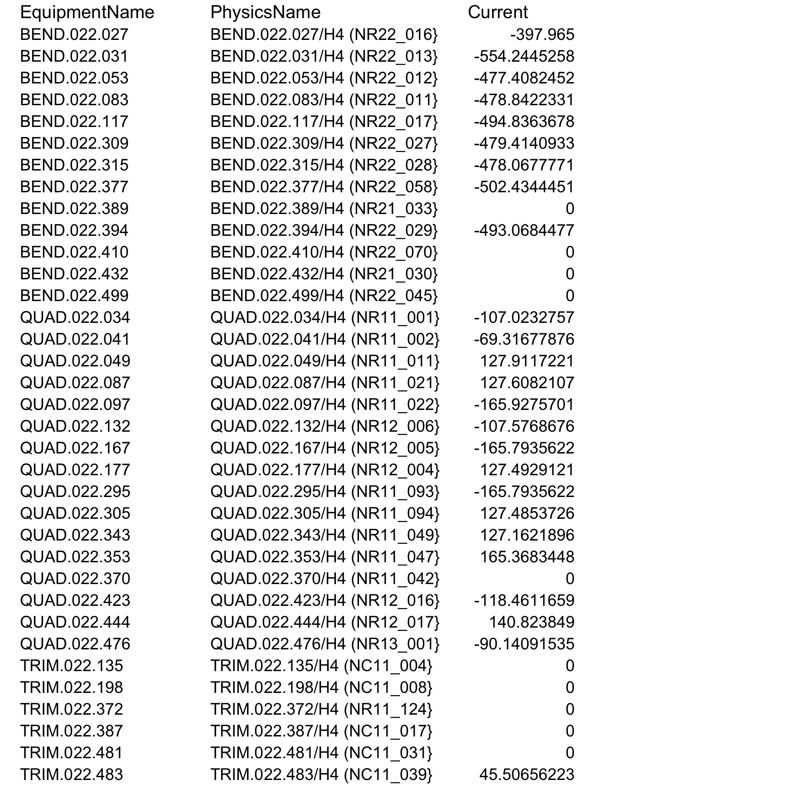
H4 Magnet Settings Example

Slide 8
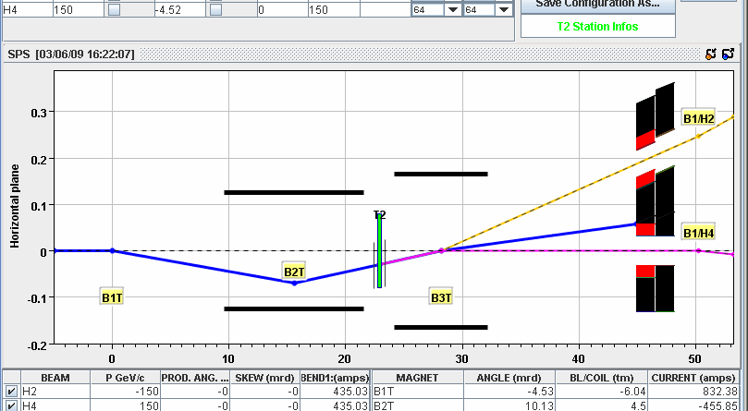
T2 Target Configuration Hadrons
“Democratic Wobbling”

Slide 9
CALET Beam Files
H4A beam files for CALET 2011
Wobbling T2.001 (democratic)
  H4A.171 (-150 secondary hadrons) - used for muons
  H4A.411 (+150 secondary hadrons)
  H4A.472 (+150 positrons)

Slide 10
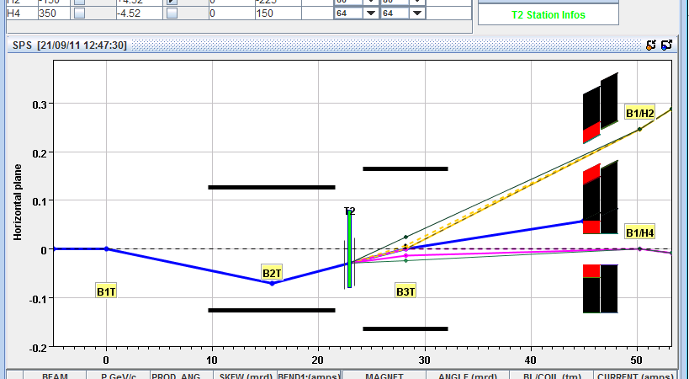
T2 Target Configuration Hadrons
2.55 mr to H4

Slide 11
CALET Beam Files
Wobbling T2.030 (+350 secondary protons at 2.55 mr to H4)
  H4A.411 (+150 secondary hadrons)
  H4A.951 (+350 secondary hadrons)
  H4A.053 (-150 electrons)

Slide 12
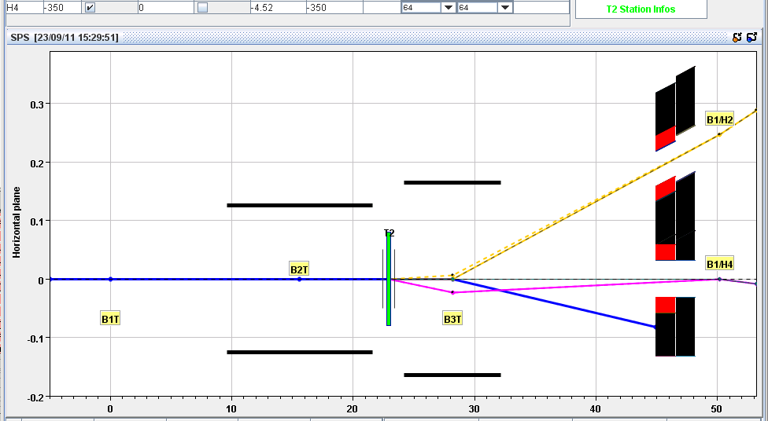
T2 Target Configuration Electrons/Tertiary Hadrons 0 mr to H4

Slide 13
CALET Beam Files
Wobbling T2.031 (0 mr to H4 for neutrals - used for electrons/positrons, and hadrons from lambda/kaon decay)
  H4A.253 (-150 electrons)
  H4A.267 (+10 positrons)
  H4A.269 (+30 positrons)
  H4A.271 (+100 positrons)
  H4A.273 (+150 positrons)
  H4A.276 (+290 positrons)
  H4A.282 (+30 hadrons from lambda/kaon decay - about 50% pions/50% protons)
  H4A.283 (+100 hadrons from lambda/kaon decay - mostly protons)
  H4A.285 (+150 hadrons from lambda/kaon decay - mostly protons) H4A.286 (-150 hadrons from lambda/kaon decay - all pions)

Slide 14
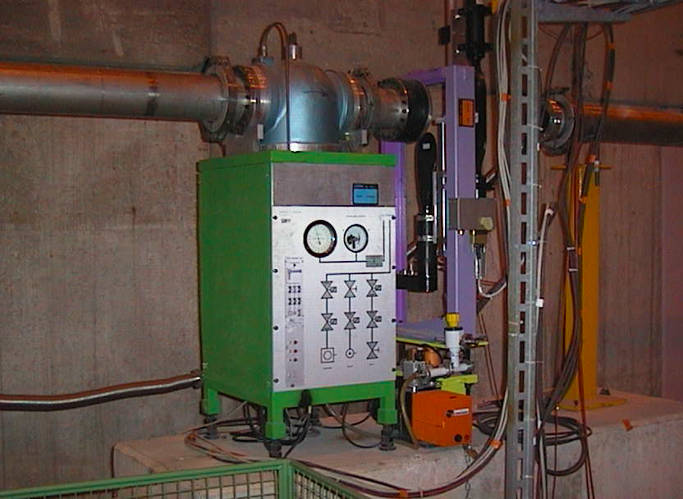
XCET Cherenkovs – He, N2, CO2

