Slide 1
Test pulse calibration in Laboratory
Kenji YOSHIDA

Slide 2
Calibration for electronics with test charge input
Y. Ueyama, S. Ozawa

Slide 3
Test charge calibration
Test charge input
Calibration of ..
  Linearity
  Pedestal for PH-ADC(TASC 1st layer & CHD_{jp} & IMC Dynode)
Charge injector
9.283pF
Pulsar
Attenuator
Charge
51Ω

Slide 4
TASC-TOP readout SPS2011
P.A.
CSA(calet)
CAMAC
Layer 1
Slow S.A. H.G.
PH-ADC
P.A.
OP-AMP(calet)
VME
PWO
PMT
P.A.
S.A.
Clear pulse
Slow S.A. L.G.
PH-ADC
Layer 1
Slow S.A. H.G.
PH-ADC
S.A.
calet
PWO
PMT
P.A.
Slow S.A. L.G.
PH-ADC
F.S. + Discri.
Input Reg.
Layer 1
Slow S.A. H.G.
PH-ADC
PWO
PMT
P.A.
Slow S.A. H.G.
PH-ADC
Slow S.A. L.G.
PH-ADC
Slow S.A. L.G.
PH-ADC
Layer 2-12
SUM-AMP
PWO
APD/PD
TASC-FEC
IMC Anode readout SPS2011
FEC For bCALET-2
S/N 073195
SciFi
PMT
SciFi
PMT
SciFi
PMT
SciFi
PMT

Slide 5
IMC Dynode and CHD readout for SPS2011
F.S. + Discri.
Input Reg.
P.A.
CSA(as calet)
CHD(JPN)
PMT
P.A.
Slow S.A.
PH-ADC
P.A.
OP-AMP(as calet)
F.S. + Discri.
Input Reg.
CHD(JPN)
PMT
P.A.
Slow S.A.
PH-ADC
S.A.
Clear pulse
F.S. + Discri.
Input Reg.
CAMAC
SciFi
PMT
dynode
P.A.
Slow S.A.
PH-ADC
VME
64
anode
F.S. + Discri.
Input Reg.
SciFi
PMT
P.A.
Slow S.A.
PH-ADC
64
F.S. + Discri.
Input Reg.
SciFi
PMT
P.A.
Slow S.A.
PH-ADC
64
F.S. + Discri.
Input Reg.
SciFi
PMT
P.A.
Slow S.A.
PH-ADC
64
IMC-FEC

Slide 6
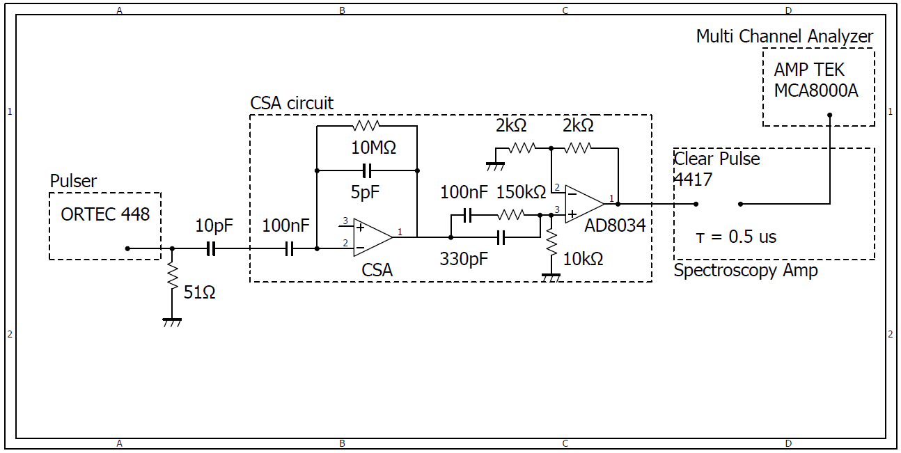
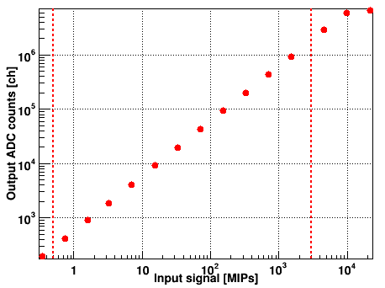
Checking the Linearity of CSA
Cf = 5 pF＋1pF(internal)
In this graph,
MIPs was defined with
APD 1mip charge.
Feedback capacitor was 6 pF.
Qin = V ×10pF
Cf = 6 pF
Linearity ~ 3 ×10³ MIPs
(1MIP 2.1 [fC]@APD G=50)
Linearity ~ 60MIPs
(1MIP 200 [fC]@PMT500[V])
Linearity ~ 1200 MIPs
(1MIP 100 [fC]@PMT450[V])
CHD
Cf = 120 pF
TTOP
Qin: 2.1fC～1MIP
Cf = 120 pF

Slide 7
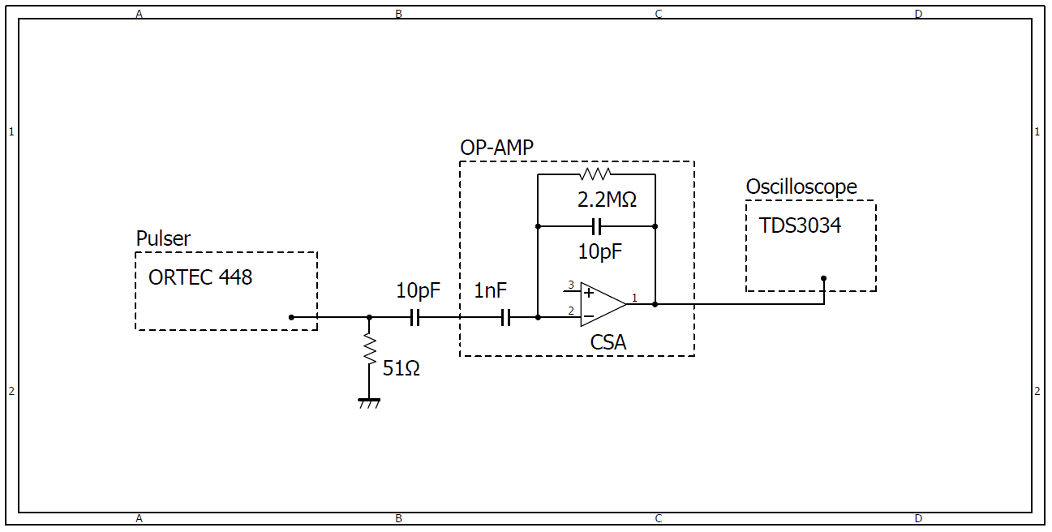
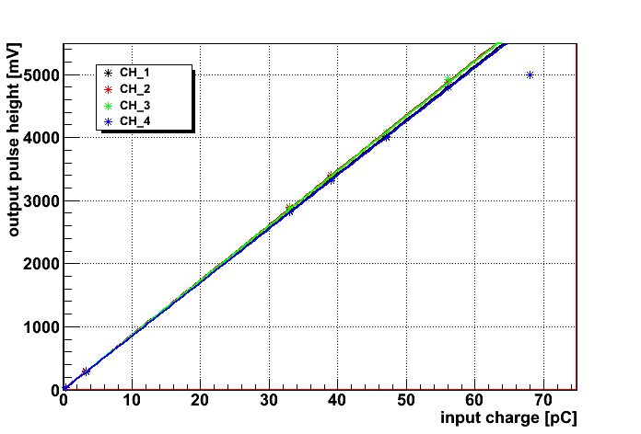
Linearity of Pre AMP for IMC Dynode
Qin = V ×10pF
Dy 1,2
Linearity ~ 33 MIPs
(1MIP 160 [fC]@PMT 800 [V])
Linearity ~ 85 MIPs
(1MIP 64 [fC]@PMT 700 [V])
Linearity ~ 245 MIPs
(1MIP 22 [fC]@PMT 600 [V])
Dy 3
Dy 4
1 MIP(dynode)

Slide 8
The calibration of PH-ADC

Slide 9
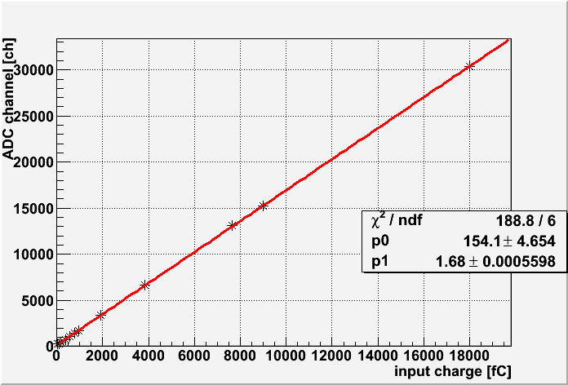
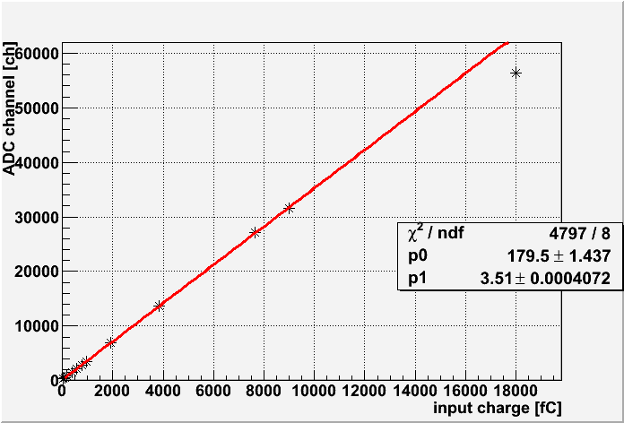
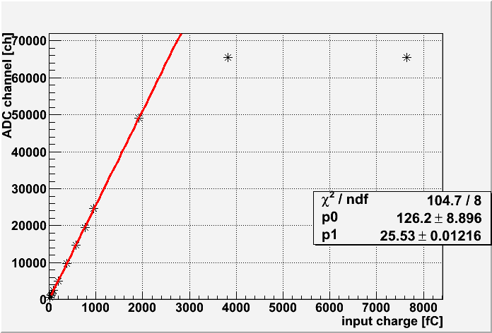
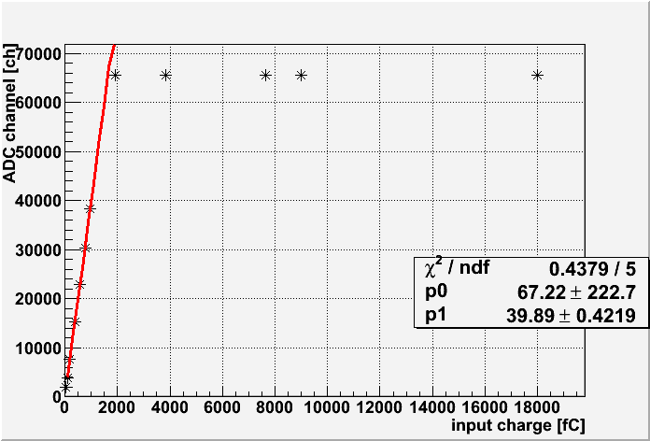
PH-ADC pedestal and linearity calibration
CHD 1
Dynode 1
Dynode 4
TASC-TOP SUM HighGain

Slide 10
PH-ADC slope and pedestal calibration (preliminary)
PHADC channel | target | (slope) | pedestal [ch]
1 | CHD #1 | 1.68035 | 154.094
2 | CHD #2 | 0.574692 | 197.157
3 | Dynode #1 | 3.54453 | 146.255
4 | Dynode #2 | 3.44006 | 40.6197
5 | Dynode #3 | 4.39587 | 138.69
6 | Dynode #4 | 25.4713 | 133.277
7 | TASC TOP SUM High | 39.8917 | 67.2193
8 | TASC TOP SUM Low | 1.0813 | 37.4566
9 | TASC TOP #1 High | 3.93418 | 155.461
10 | TASC TOP #1 Low | 0.124272 | 209.485
11 | TASC TOP #2 High | 3.84957 | 121.782
12 | TASC TOP #2 Low | 0.117459 | 191.29
13 | TASC TOP #3 High | 3.73582 | 159.043
14 | TASC TOP #3 Low | 0.120923 | 24.533
15 | --- no use --- | --- | ---
16 | --- no use --- | --- | ---
ADC [ch] = input charge [fC] × (slope) + pedestal

Slide 11
Issues on the PH-ADC calibration
The PH-ADC slopes and pedestals in the table is used in the present data analysis.
As shown in the PH-ADC calibration figures, some PH-ADC calibration data points are not enough.
The present PH-ADC calibration table is a preliminary version, and later we will upgrade and distribute the table with enough calibration data points.

Slide 12
The calibration of IMC FEC

Slide 13
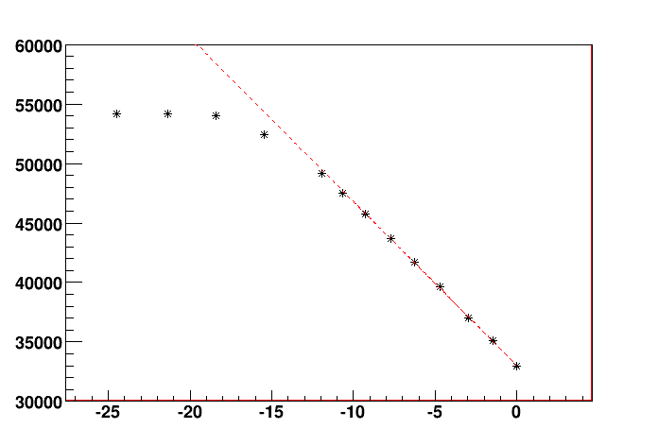
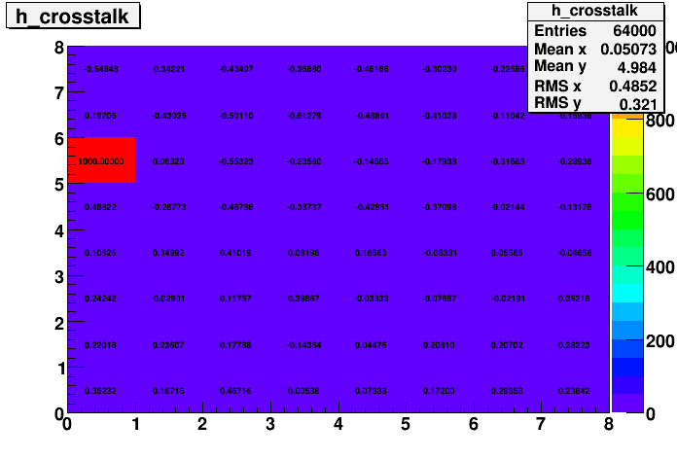
IMC FEC calibration
Ex. CH461
(ADC) = - 1379.1 (Input [pC]) + 33011.9
→ 8.78 [fC/count]
ADC [count]
Cross talk (input -24.956pC)
Input charge [pC]

Slide 14
Backup

Slide 15
Readout equipment for SPS2011
For IMC MaPMT Anode
  CP 80067 S/N 073195 (for bCALET-2)
    Va32HDR14.3
    PCB is same as bCALET-2
For TASC-TOP PMT
  Charge sensitive amp
    Similar as CALET read out
  Shaping AMP
    Similar as CALET (Made by D. Ito)
    Dual range
  CP 1116 Peak hold ADC module
    16bit
    Gate width = 6μs
For TASC-TOP Sum and CHD and IMC MaPMT Dynode
  Almost same as TASC-TOP PMT
  Pre AMP of IMC Dynode are OP-AMP(same as CALET)
  Shaping amp is CP 8679/M(Unipolar, gain adjustable )

Slide 16
The gain of amplifiers
 | 1MIP ADC [ch] | 1MIP Charge out[fC] | Pre amp | Shaping Amp gain
TASC-TOP High-gain | 400 | 100@-480 | 120pF | (600)
TASC-TOP Low Gain | - | - |  | (20)
CHD | 1000 | 200@-600V | 120pF
IMC(Dynode 1st,2nd) | 1000 | 200@-800V
IMC(Dynode 3rd) | 1000 | 200@-700V
IMC(Dynode 4th) | 1000 | 200@-600V
TASC TOP SUM | 1000 | 200@-450V | 120pF
Pre AMP gain = Q/Cf

Slide 17
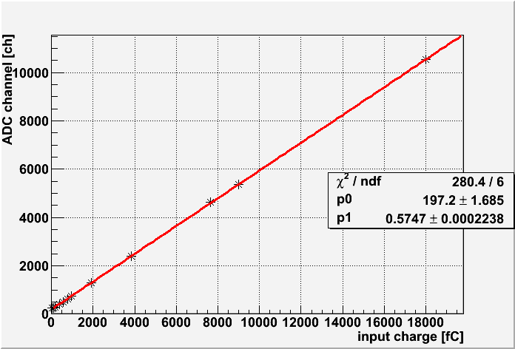
PH-ADC pedestal and linearity calibration backup
CHD 1
CHD 2

Slide 18
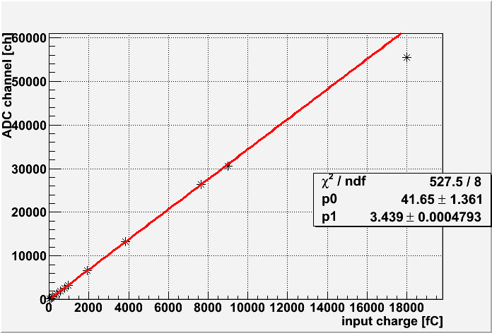
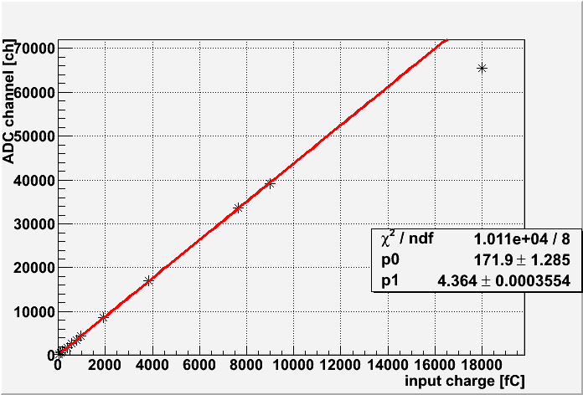
PH-ADC pedestal and linearity calibration backup
Dynode 1
Dynode 2
Dynode 3
Dynode 4

Slide 19
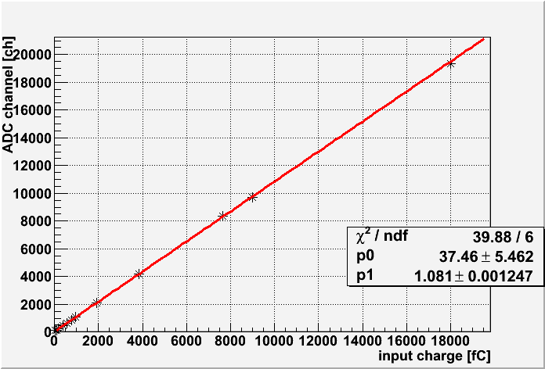
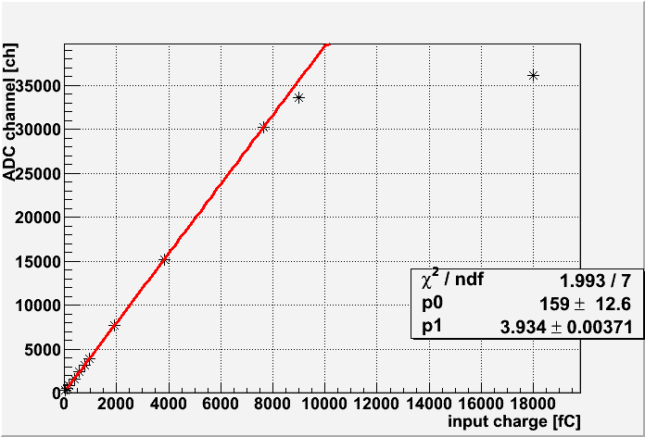
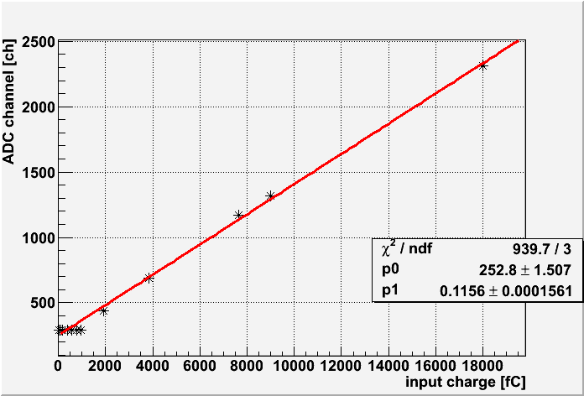
PH-ADC pedestal and linearity calibration backup
TASC TOP SUM HighGain
TASC TOP SUM LowGain
TASC TOP #1 HighGain
TASC TOP #1 LowGain

Slide 20
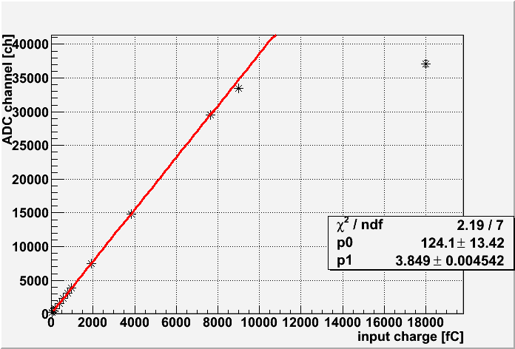
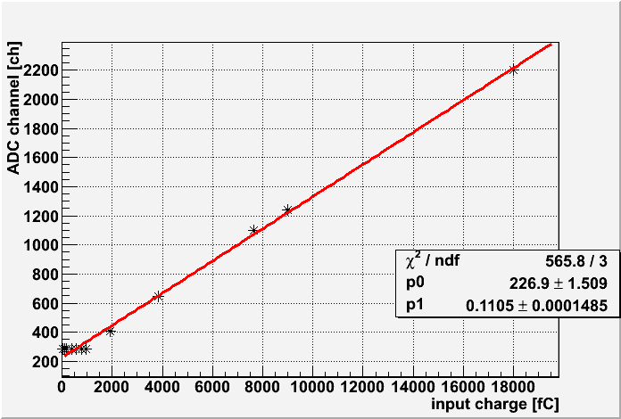
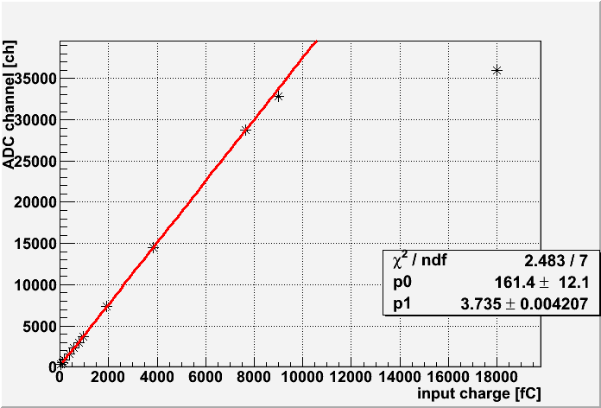
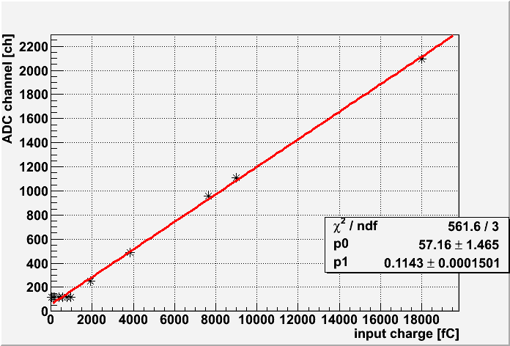
PH-ADC pedestal and linearity calibration backup
TASC TOP #2 HighGain
TASC TOP #2 LowGain
TASC TOP #3 HighGain
TASC TOP #3 LowGain

Slide 21
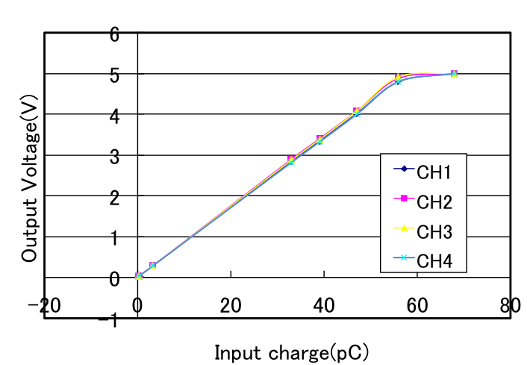
Linearity of Pre AMP for IMC Dynode

Slide 22
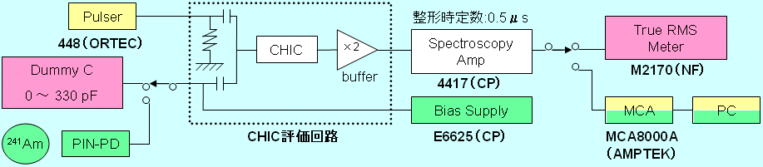
Checking the Linearity of CSA
Qin = V ×10pF
9.283pF
51Ω
400ch
～2.1fC
Dynamic Range
Required
（0.5～3×103 MIPs）
Qin: 2.1fC = 1MIP

