Slide 1
TASC Basic Analysis
Kenji YOSHIDA

Slide 2
Pedestal in TASC

Slide 3
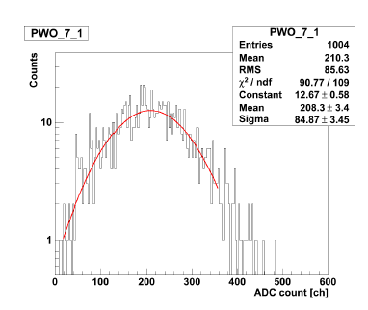
Pedestal measurements in TASC 2nd – 12th layer PWOs
An example pedestal measurement (TASC 8th layer, lower PWO with APD H.G.)

Slide 4
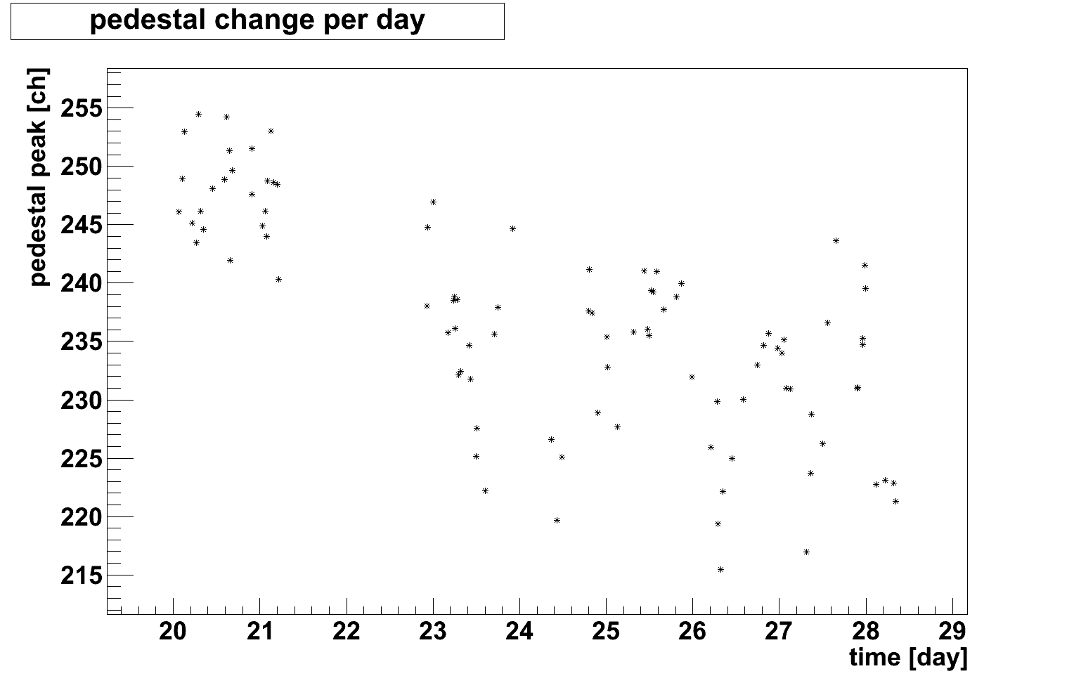
Time Variation of Pedestal Peaks
TASC 3rd layer, middle PWO with APD H.G.

Slide 5
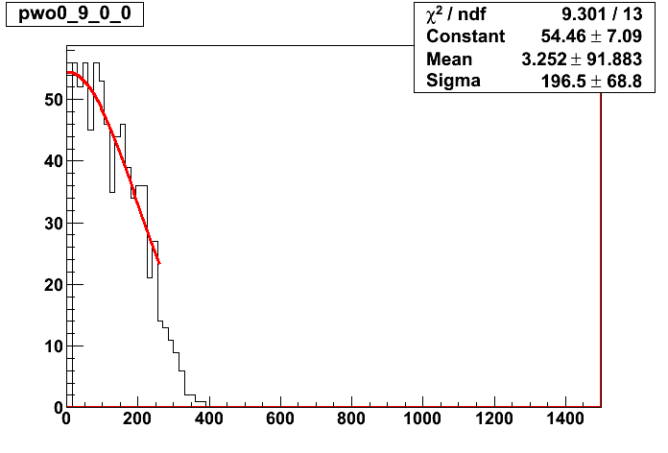
Rejected pedestal data
As a general rule, muon, e, and p run data are corrected by using the last pedestal run data.
(*)Pedestal data separated > 3 sigma are rejected.
*
*
*
*
*
Error×3
*
*
*
*
*
*
*
*
*
*
*
Fitting Line
*
*
*
*
*
*
*
*
*
*
*
*
*
*
counts
*
*
*
*
*
Rejected
*
Error×3
ADC count [ch]
An example of rejected pedestal

Slide 6
Muon calibration

Slide 7
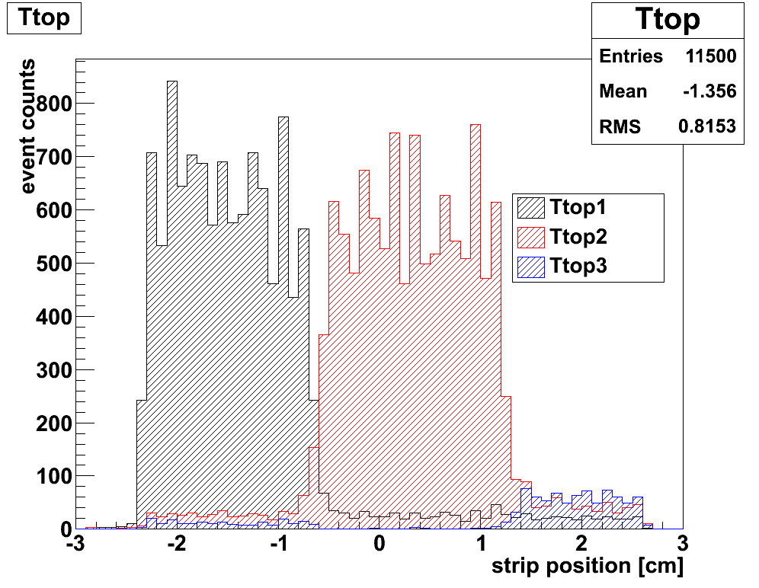
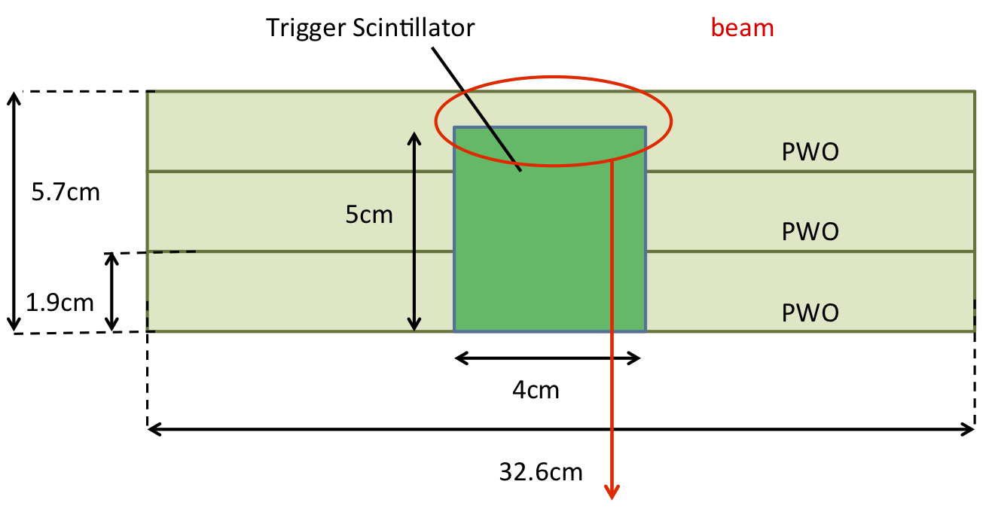
1MIP determination with muon beams
Si Strip
＊IMC is omitted in this figure
Electrode gap for Si strip：0.183mm
Read out by collecting 4 electrodes
-> Si strip interval: 0.732mm
-> Track determination with0.7mm
TASC
beam
Ttop3
Ttop2
Ttop1
12 layers
Si
Event Selection
The upper PWO has lower events than the lower and middle PWOs.
PWO | Ttop 1 | Ttop2 | Ttop3
Distance from Si Strip center [cm] | -2.2~-1.2 | -0.5~0.5 | 1.3~2.0

Slide 8
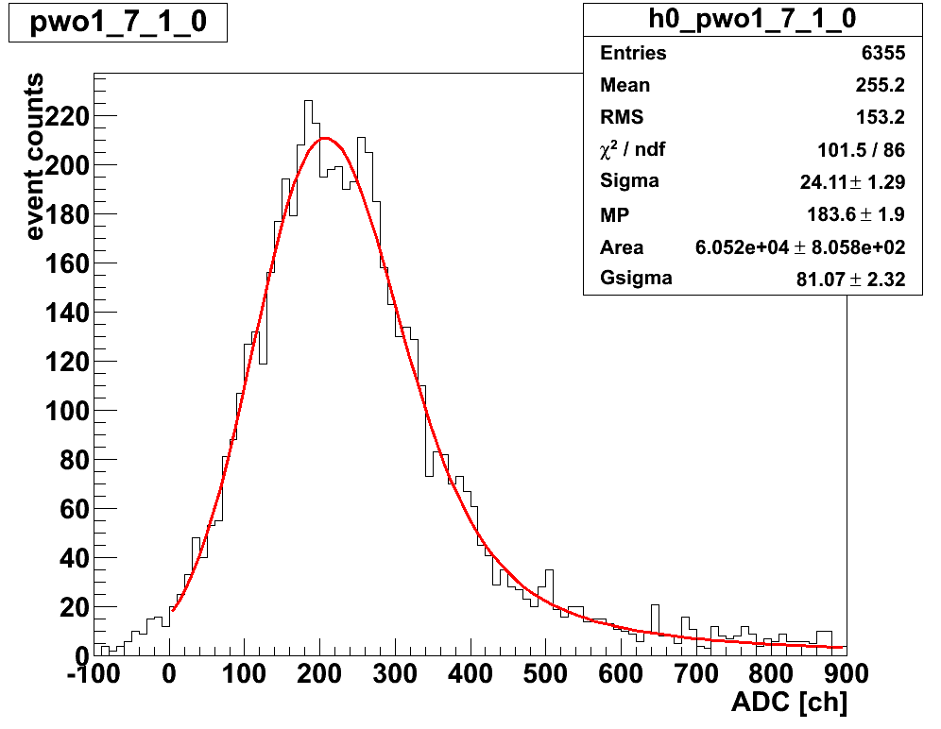
1MIP determination by using muon beams
Convolved function of Gauss to Landau distribution
Pedestal data are subtracted
1MIP = the Most Provable value of the Landau component

Slide 9
Temperature effect for 1MIP determination

Slide 10
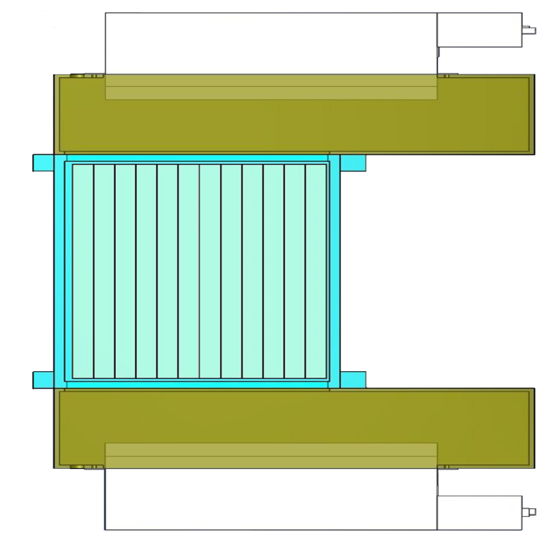
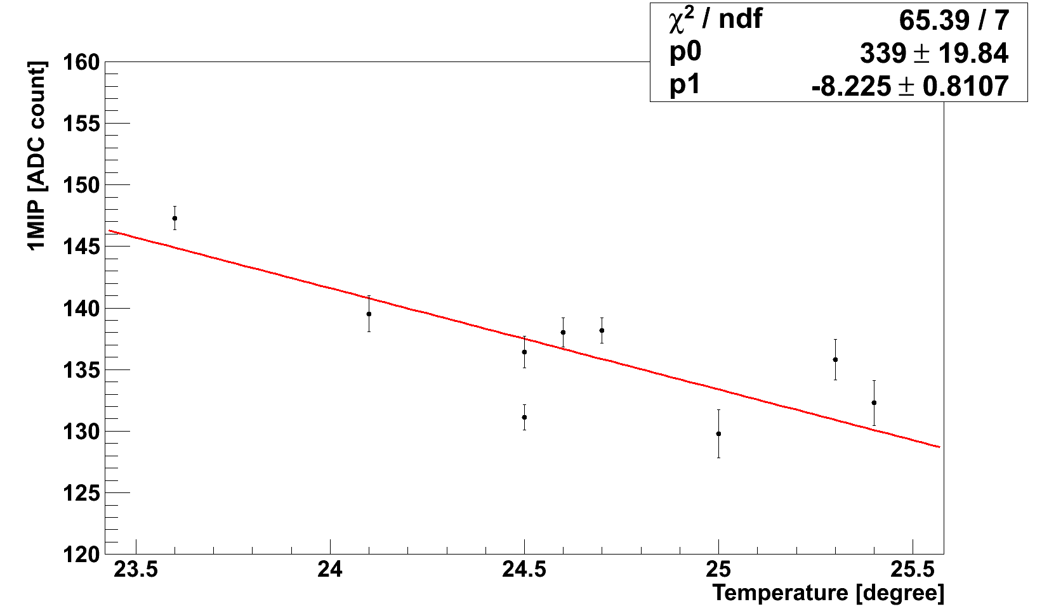
Temp. Correction
318
130
120
PWO : Temperature dependent amount of Luminescence
APD : Temperature dependent properties
460
PWO
350
Temp. measurements with thermocouples
beam
6Layer
100
Temperature correction for 1MIP
[mm]
TASC BOX
An example of temperature variation for PWO APD H.G. signals (TASC 11th layer, Lower PWO)
1MIP = p0 + p1*T(℃)
=> 1MIP Temperature Correction for each PWO APD H.G. signal

Slide 11
High/Low Gain

Slide 12
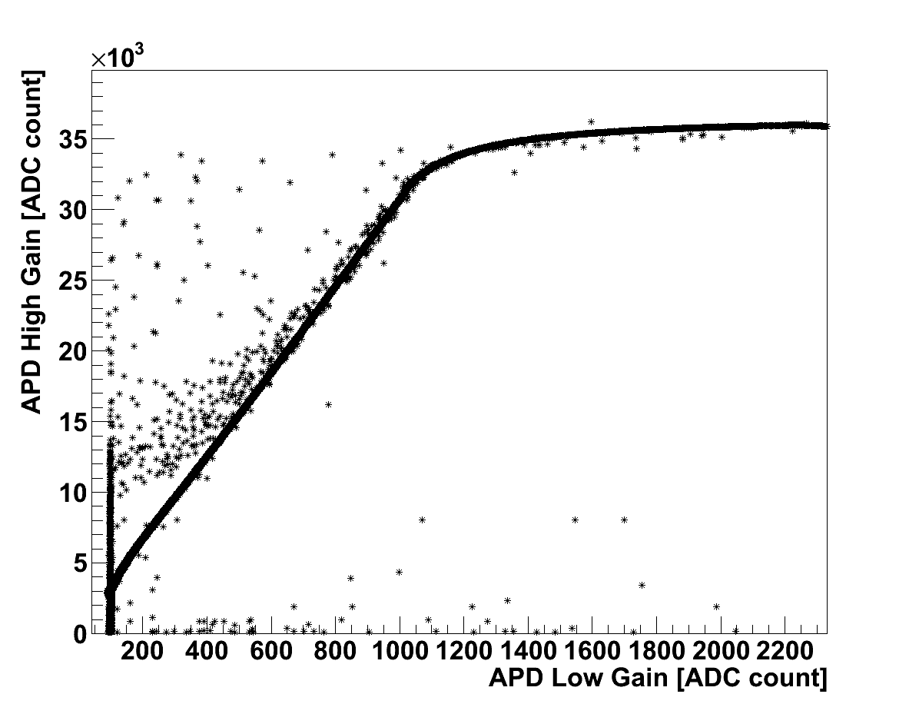
Correlation between High Gain and Low Gain for the TASC First layer PWO
p 350GeV
In fitting with a linear function, these signals are removed.
High gain VS low gain in TASC (first layer)

Slide 13
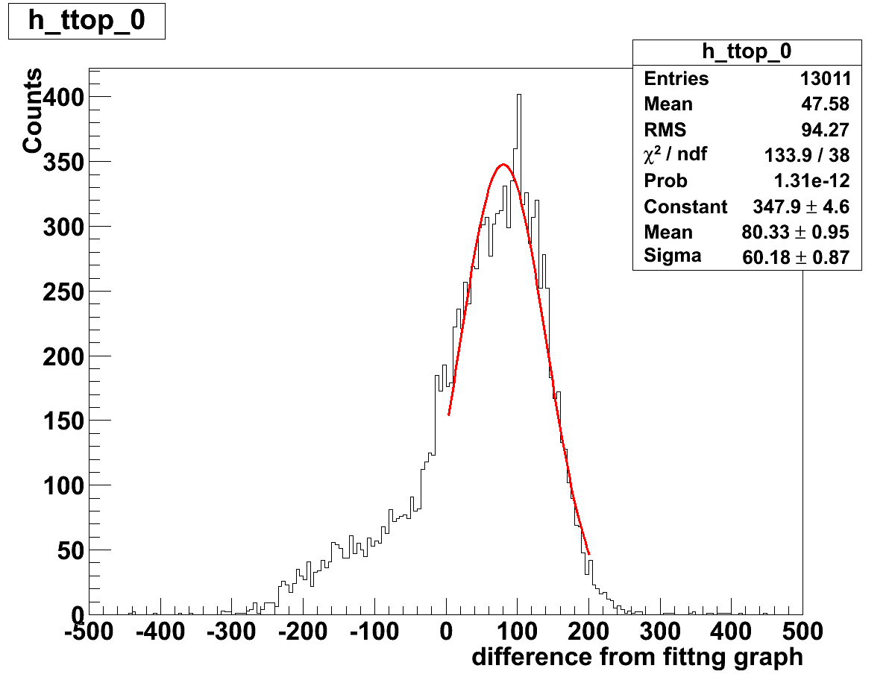
Event Selection to derive the correlation between H.G. and L.G.
difference from fitting graph
High gain [ADC count]
make histogram
removed
3σ
3σ
removed
Low gain [ADC count]
High gain VS low gain in TASC first layer
The distribution of differences from fitting graph
(red curve: Gaussian curve)
Event data within 3 sigma are selected.

Slide 14
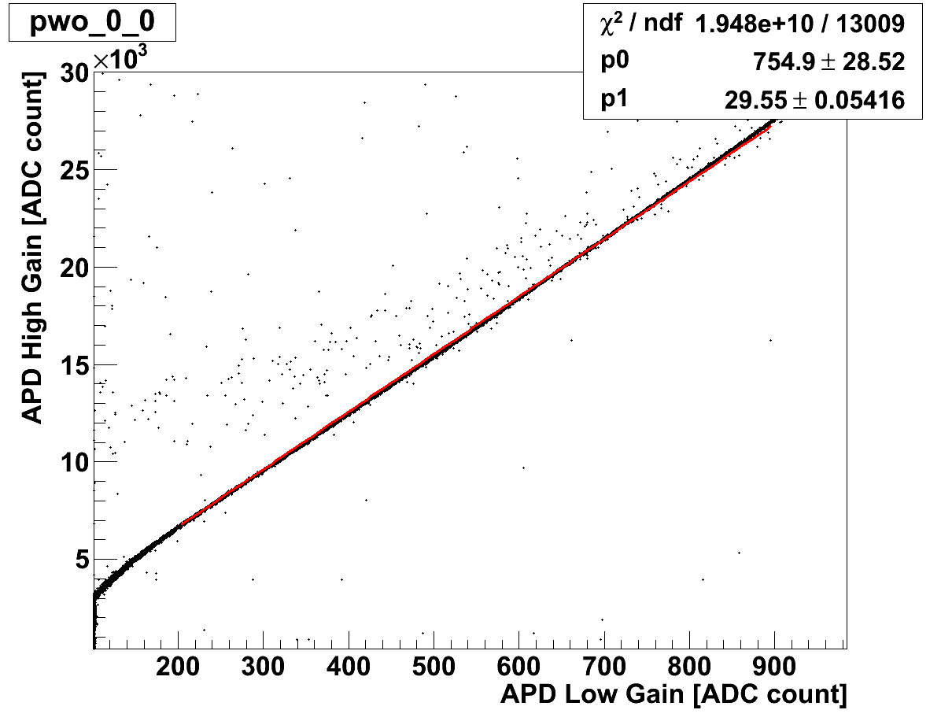
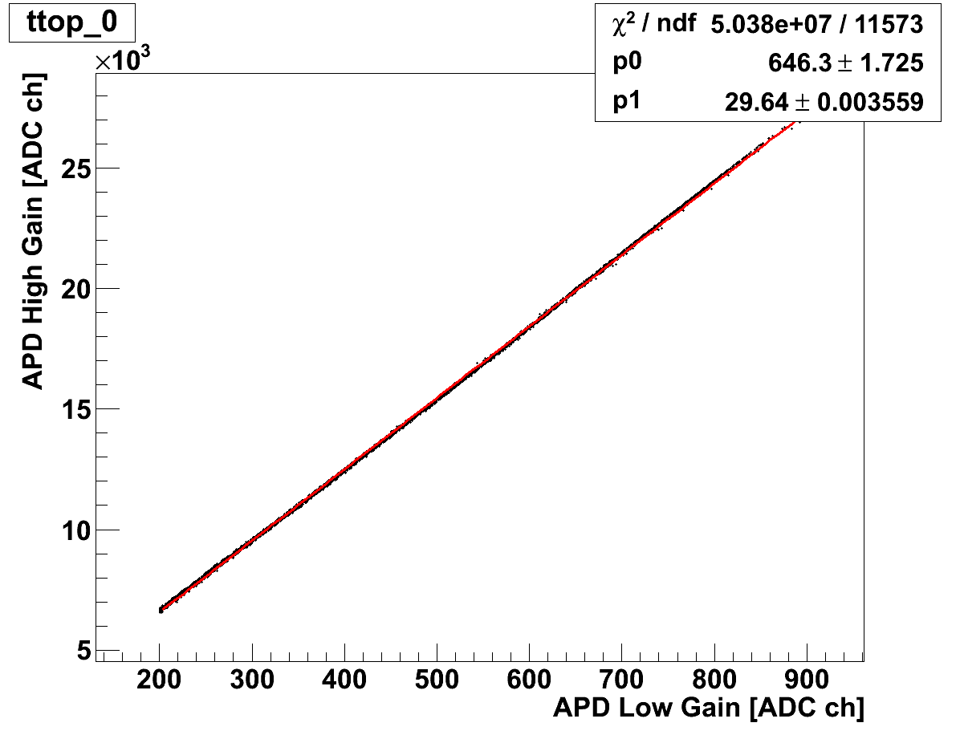
PMT High Gain (ADC count)
PMT High Gain (ADC count)
PMT Low Gain (ADC count)
PMT Low Gain (ADC count)
High gain VS low gain in the TASC first layer PWO (before event selection)
High gain VS low gain in the TASC first layer PWO (after event selection)
PMT-H.G. = p0 + p1*PMT-L.G.

Slide 15
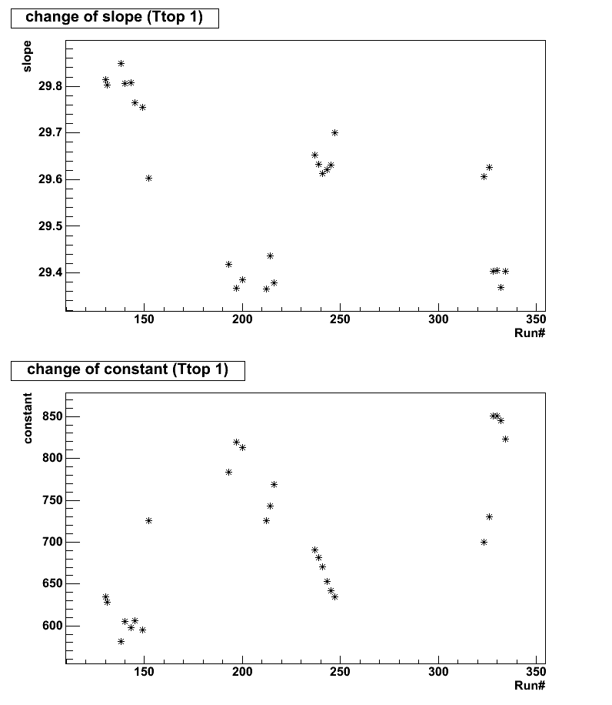
Variation of the correlation between High gain and Low gain in the TASC first layer PWOs
P1
PMT-H.G. = p0 + p1*PMT-L.G.
P0

Slide 16
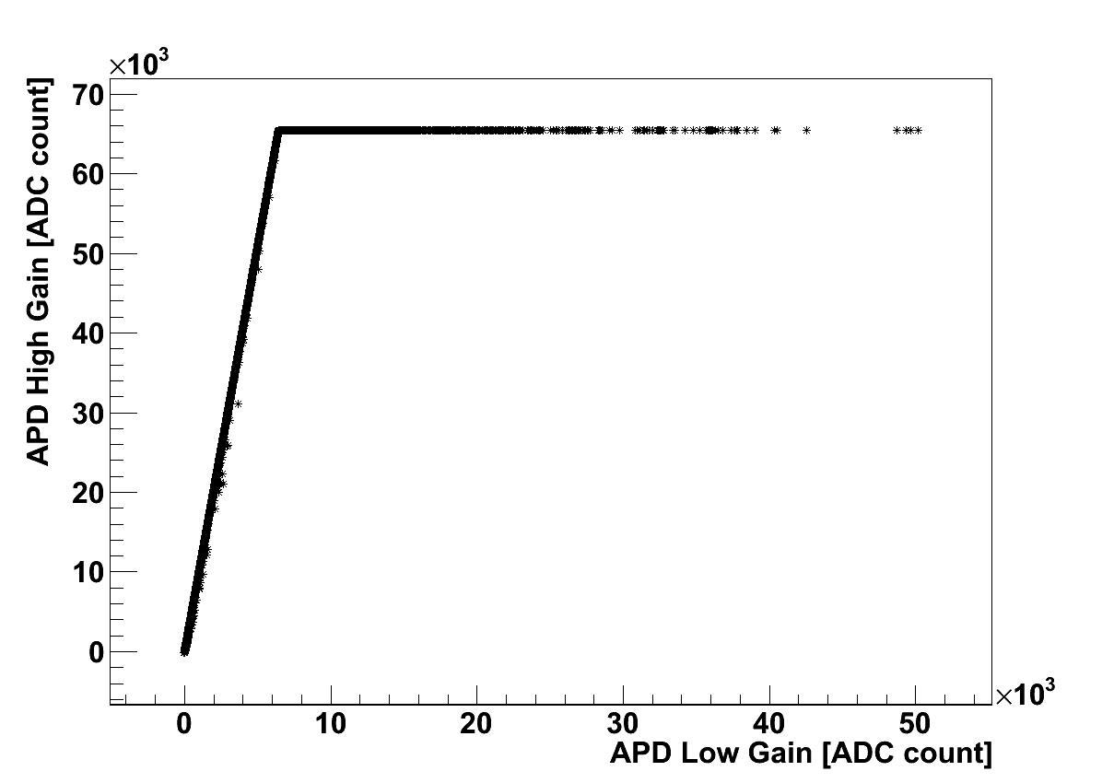
Correlation between APD High Gain and APD Low Gain in TASC (2nd – 12th layer)
p 350GeV
Fitting with a linear function
(APD-H.G.) = p1*(APD-L.G.)
1000
6000
APD high gain VS APD low gain of a PWO in TASC (2nd ~12th layer)

Slide 17
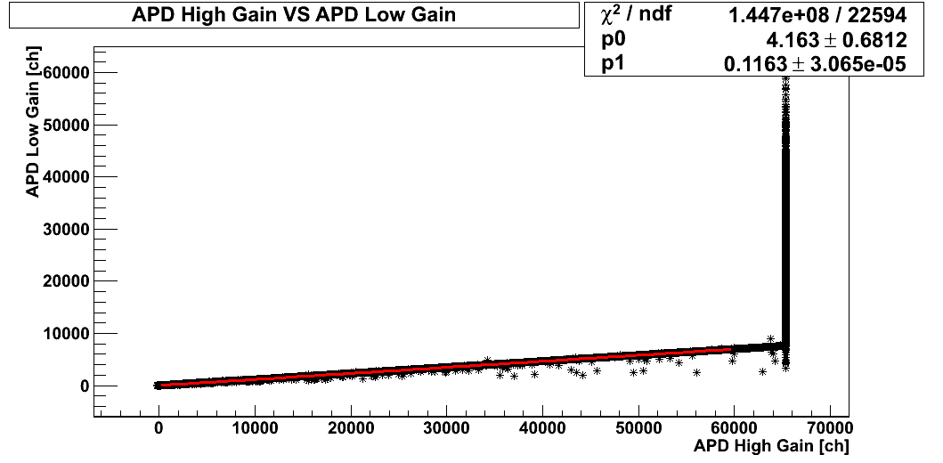
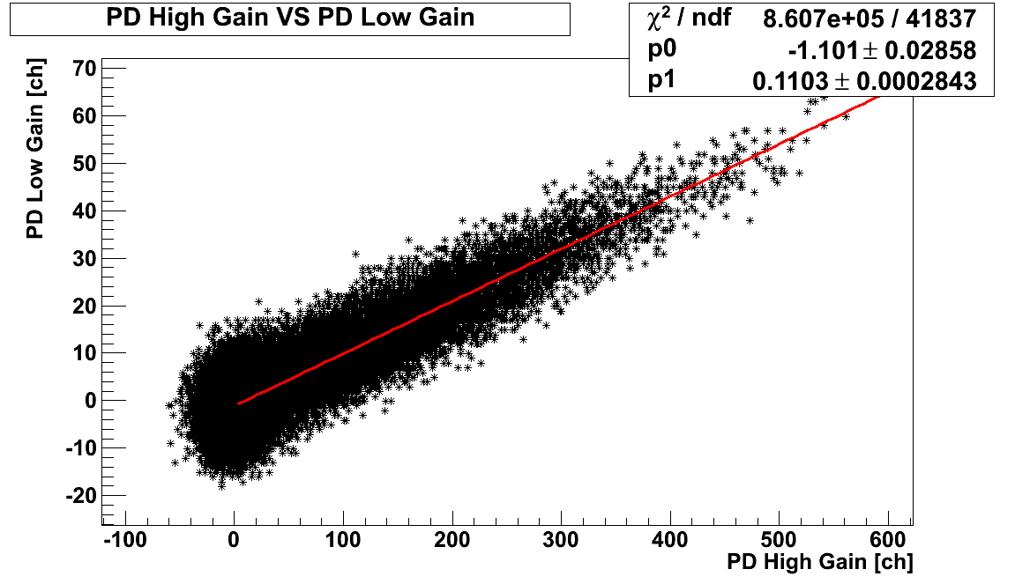
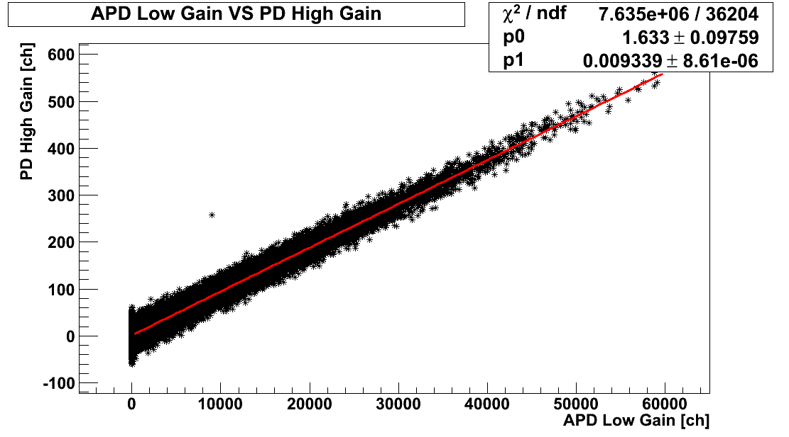
Examples of correlation among APD-H.G., APD-L.G., PD-H.G., and PD-L.G.
Overflow
Correlation between APD High Gain and APD Low Gain
Correlation between PD High Gain and PD Low Gain
By using Proton 350GeV data
(*) Red line: preliminary fitting results.
Unused in this analysis.
(*) In this comparison with M.C., PD H.G. and PD L.G. are not used.
Correlation between APD Low Gain and PD High Gain

Slide 18
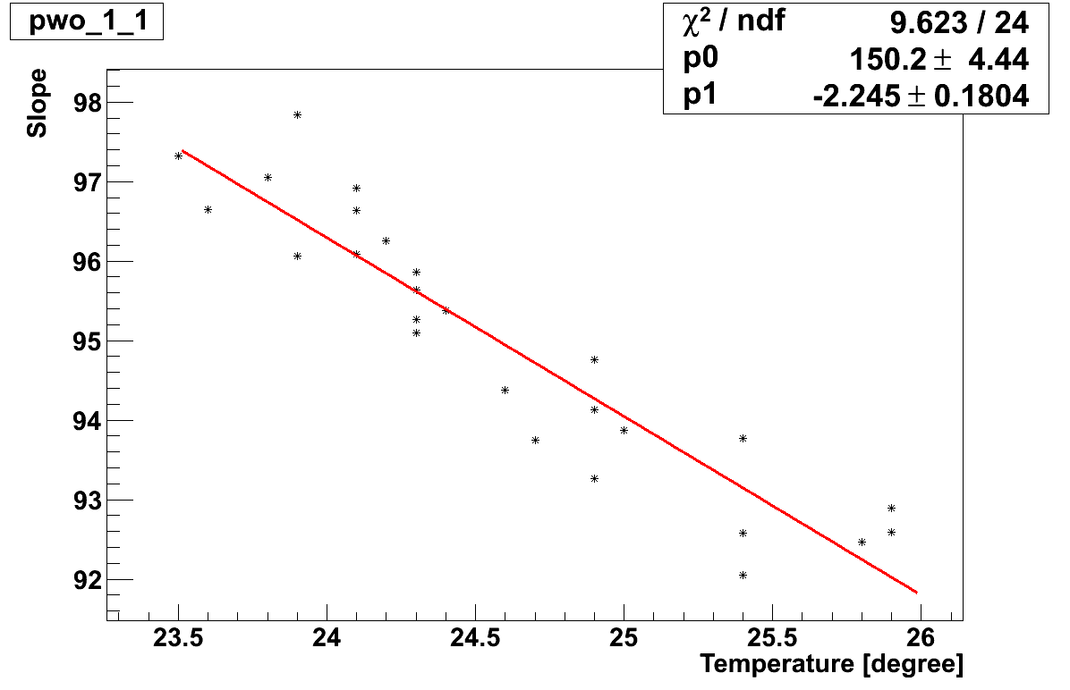
Temperature dependence on
APD Low Gain/PD High Gain
(*)TASC 2nd layer, bottom PWO

Slide 19
Energy Deposit distribution for each TASC layer

Slide 20
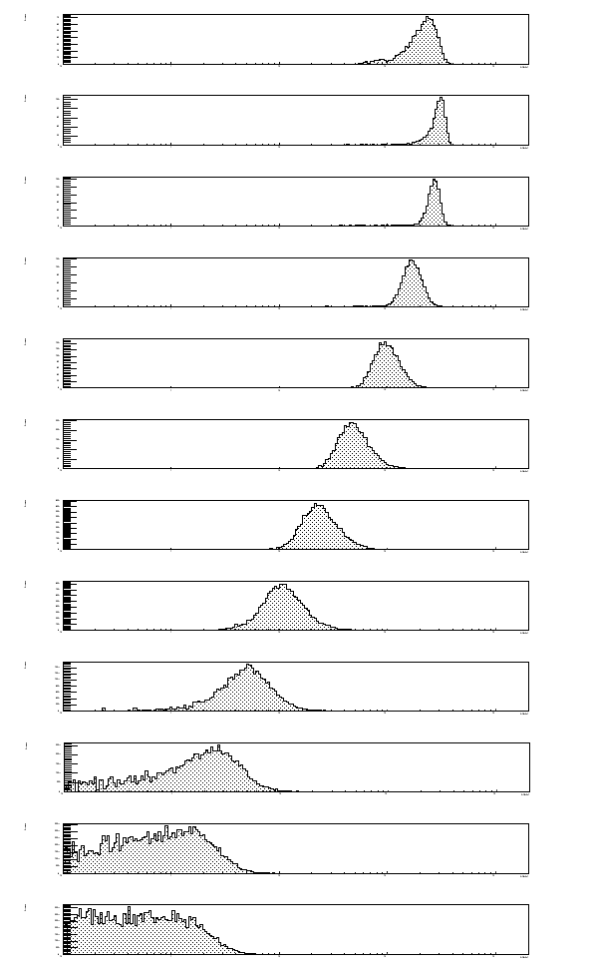
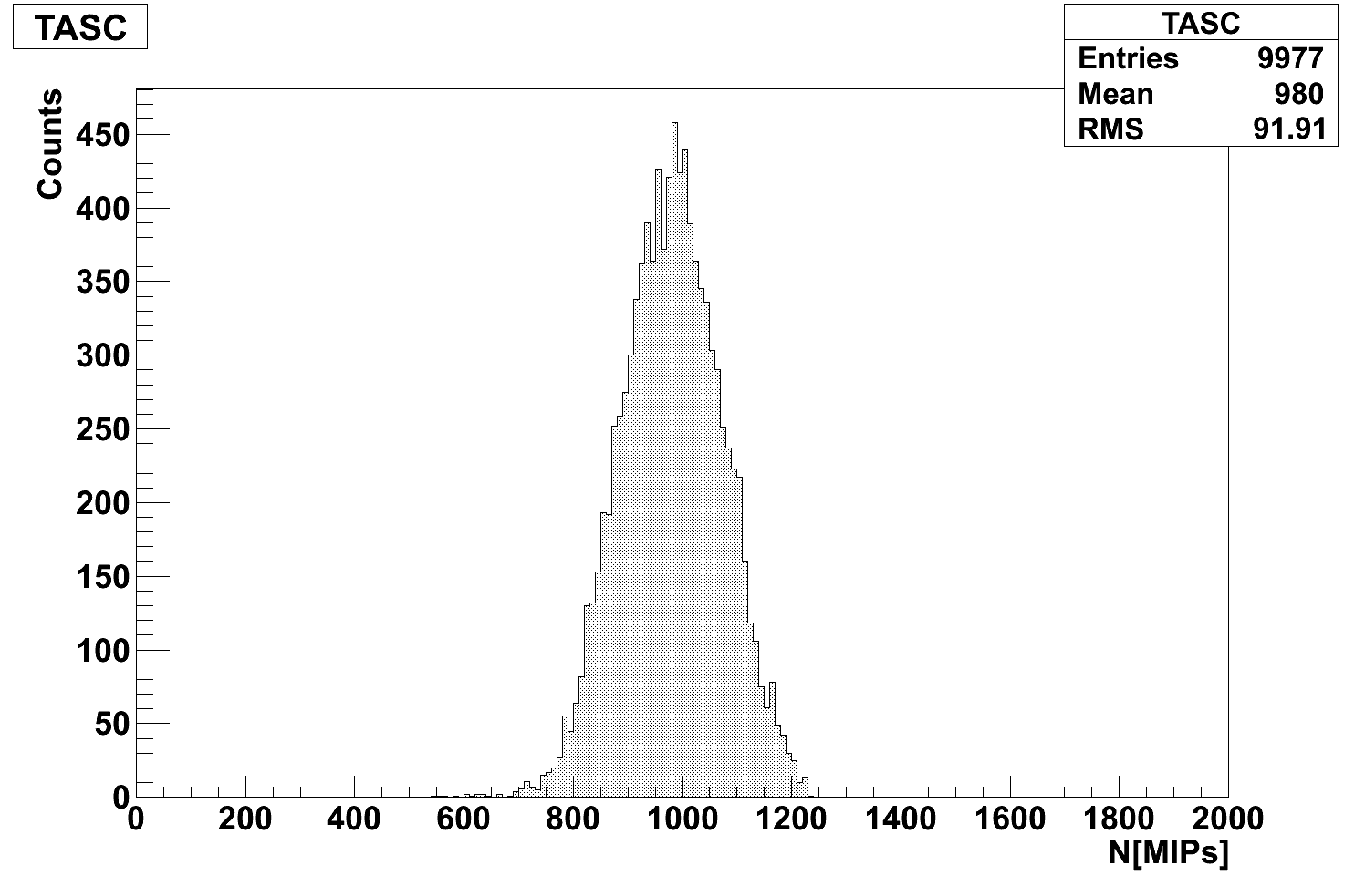
Energy Deposits. In each TASC layer
1layer
10⁰
10
10²
10³
Positron 30 GeV
Total Energy Deposit for TASC
Comparison with M.C. Simulation
12layer
Vertical axis: Counts in linear scale
Horizontal axis: MIPs in log scale

Slide 21
Back up

Slide 22
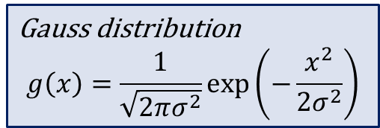
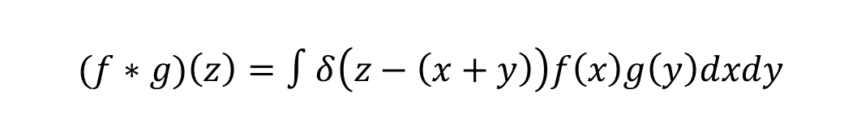





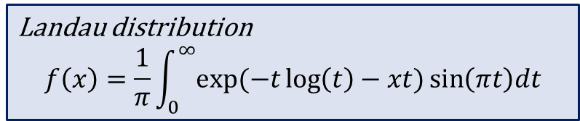
Convolved function of Gaussian to Landau distribution
Gauss function <= Pedestal distribution
Convolution
Gauss Function
$$σ$$
$$y=g(x)$$
・・・
$$x$$
Most Probable Value (MP)
Landau function
Gauss distribution
$$g\left(x\right)=\frac{1}{\sqrt{2πσ^{2}}}\exp\left(−\frac{x^{2}}{2σ^{2}}\right)$$
$$y=f(x)$$
・・・
$$x$$
Landau distribution
$$f\left(x\right)=\frac{1}{π}\int_{0}^{∞}{exp⁡(−t\log\left(t\right)−xt)}\sin\left(πt\right)dt$$
$$(f∗g)\left(z\right)=∫δ\left(z−\left(x+y\right)\right)f\left(x\right)g\left(y\right)dxdy$$

Slide 23
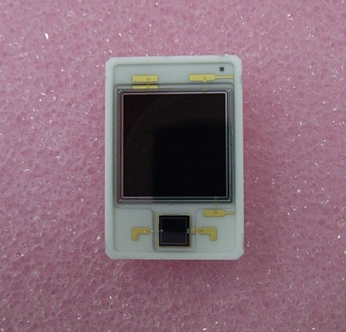
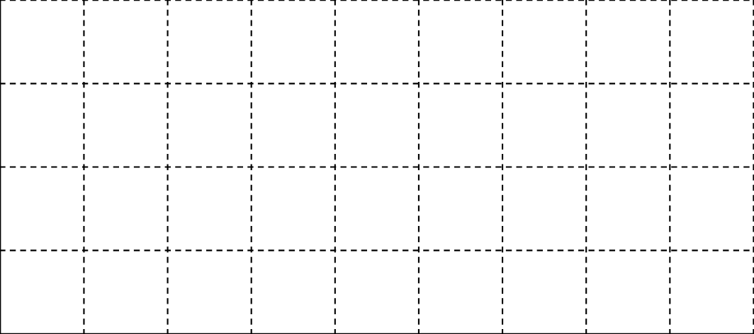
Signal Readout of TASC
Comparison of each Gain to PD+Low Gain (=1)
13.4mm
ch | APD/PD gain | Acceptance surface | Amp. Gain ratio | Total Gain ratio
①APD+High Gain Shaper | 50 | 18 | 30 | 2.7×10⁴
②APD+Low Gain Shaper | 50 | 18 | 1 | 9.0×10²
③PD+High Gain Shaper | 1 | 1 | 30 | 30
④PD+Low Gain Shaper | 1 | 1 | 1 | 1
×
×
=
APD
10×10mm²
×
×
=
19.7mm
PD
2.4×2.4mm²
×
×
=
S10937-9351
(Hamamatsu Co.)
×
×
=
① APD + High Gain Amp.
② APD + Low Gain Amp.
③ PD + High Gain Amp.
④ PD + Low Gain Amp.
APD
PD
4000
②
③
④
①
400
Effective ADC [ch]
40
APD,PD: multi-gain amp.
=> Dynamic range: >10^6
4
10⁻¹
10⁰
10¹
10²
10³
10⁴
10⁵
10⁶
[MIP]

Slide 24
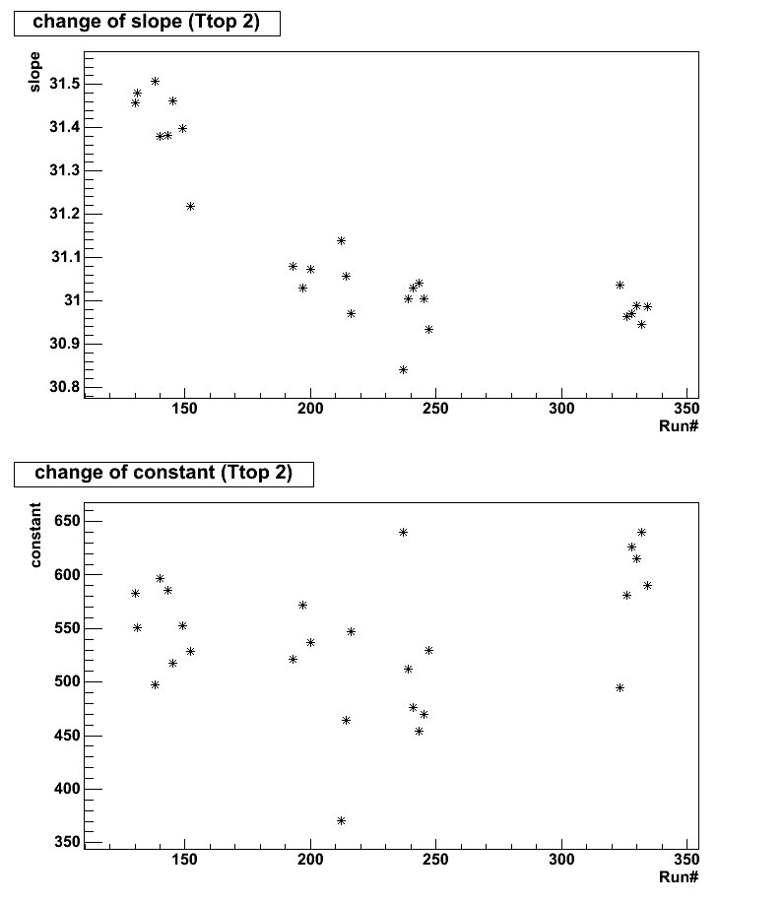
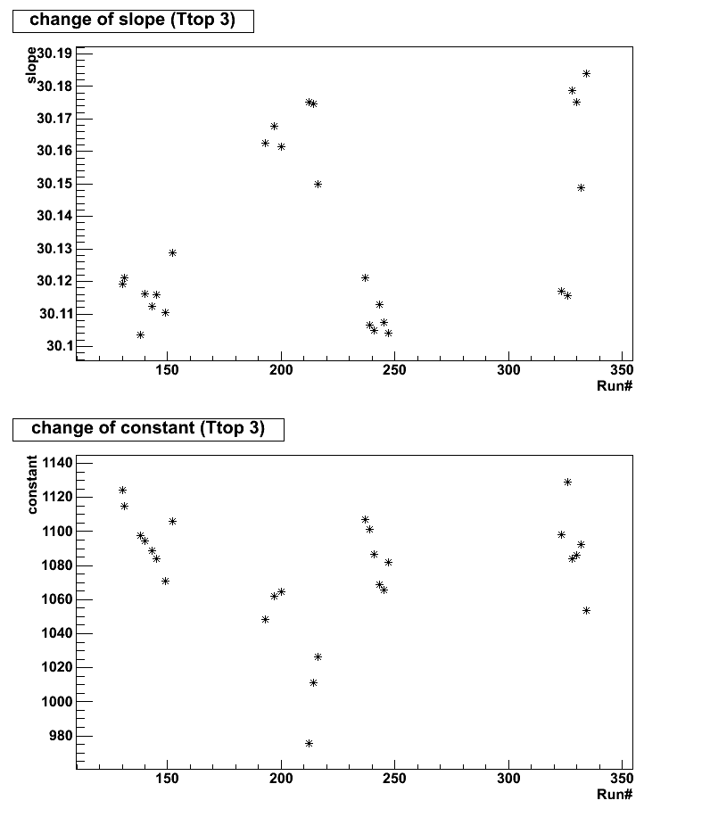
Variation of the correlation between H.G. and L.G. in the TASC First layer PWOs

