Slide 1
Position Calibration
2012.3.16
Y. Akaike

Slide 2
Detector Configuration
SIA
TASC box
Strip
IMC box
PWO
Trig
CHD
SciFi
Beam
32.8cm
Movable plate
X
side view
Z
IMC box
TASC box
SIA
CHD
SciFi
PWO
Trig
Strip
Beam
Z
Movable plate
Y
Top view

Slide 3
Analysis method
Correction for Si-Strip alignment
Track reconstruction
Correction for Trig. Scin position
Derivation of beam profile
Correction for SciFi position
Define track position on Strip layers as beam incident position
Correction for PWO position
Correction for CHD position
Get accurate position of each detector relative to Si-Strip from reconstructed track

Slide 4
Correction for Si-Strip alignment
Luminous strip
correction
Si-Strip
⇒ Correct misalignment between Si-Strip layers using most
luminous fiber of each layer

Slide 5
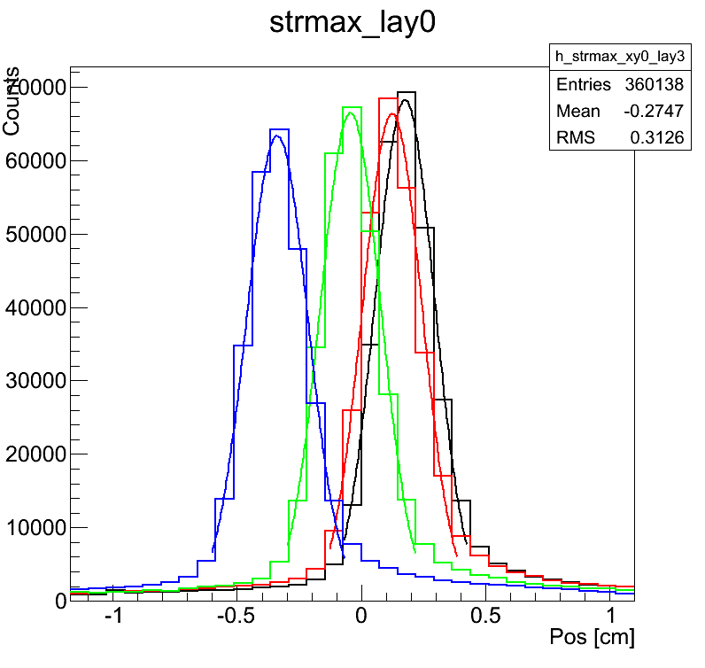
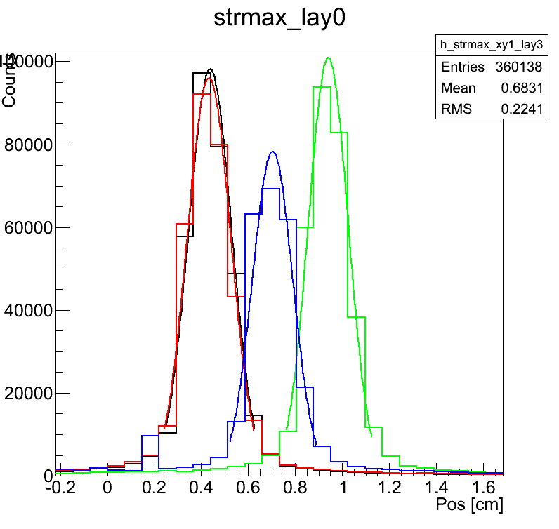
Correction for Si-Strip alignment
Position distribution of most luminous fiber of each Si-Strip
（horizontal ：position [cm], vertical : counts）
※ used data
Proton 350GeV
（H4A.951）
Layer １：black
Layer ２：red
Layer ３：green
Layer ４：blue
Adjust position of Layer 2-4 with reference to Layer 1
X-layer
Y-layer
Peak value of fitting function (Gaussian)
 | X-layer |  | Y-layer
 | Peak value [cm] | Difference from Layer 1 [cm] | Peak value [cm] | Difference from Layer 1 [cm]
Layer １ | 0.174 | 0 | 0.437 | 0
Layer ２ | 0.123 | 0.051 | 0.432 | 0.005
Layer ３ | -0.045 | 0.219 | 0.940 | -0.503
Layer ４ | -0.339 | 0.513 | 0.703 | -0.266

Slide 6
Track reconstruction using Si-Strip
Select most luminous fiber from each layer
as a track pass point candidate
No
Drop out
ΔE > 0.3MIP in at least 3 layers
Yes
Choose second luminous fiber instead of most luminous one
Exclude the fiber from candidates
Fit by straight line
Yes
R.M.S of residuals < half width of fiber
No
worst candidate = most luminous fiber
No
Yes
Reconstruction complete

Slide 7
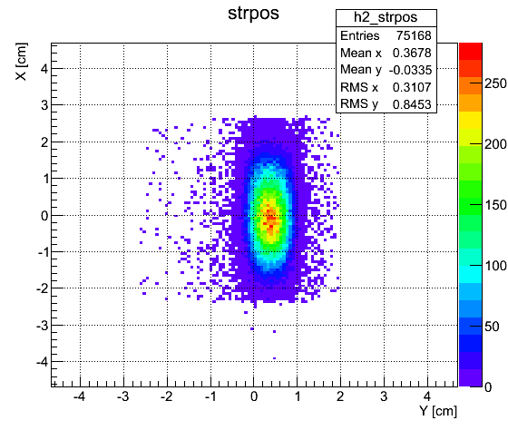
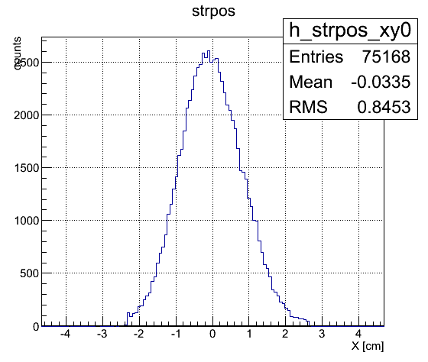
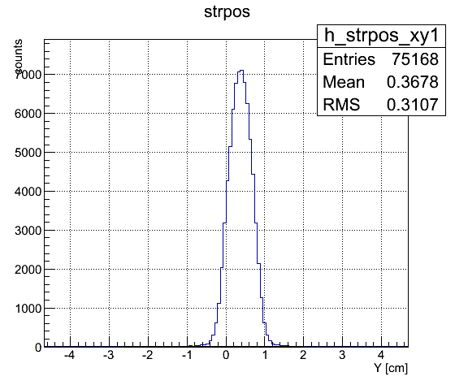
Estimation of beam profile
Define reconstructed track position on Si-Strip layers as beam incident position
ex：beam profile of proton 30GeV （RunNo.288）
projection
projection
※use the adjusted position with
reference to Layer 1

Slide 8
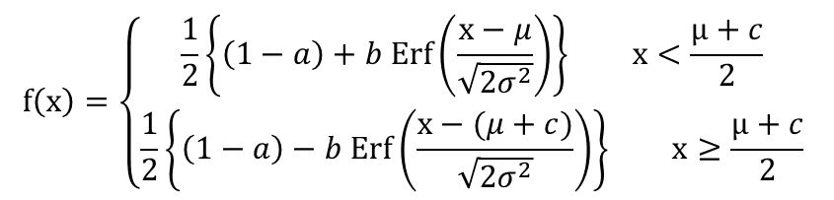
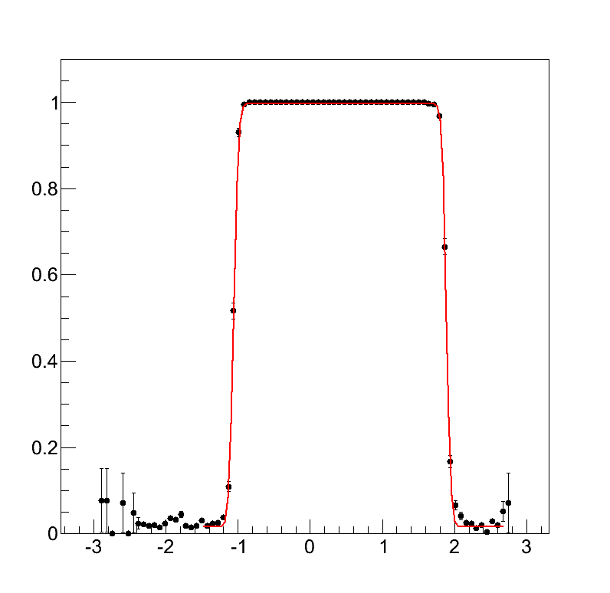

Correction of CHD position
Get accurate position of CHD from the distribution of track position on Si-Strip
※use muon data, height of movable plate = 131.56mm
Detection efficiency of CHD0
(ΔE in CHD > 0.5MIP )
※ set a, b, c,μ,σ as free parameter
Detection Efficiency
 | Center pos. [cm] | Size [cm]
CHD0 | 0.412 | 2.95
CHD1 | 0.438 | 2.96
CHD2 | 0.760 | 3.13
CHD3 | 0.760 | 3.13
c
μ
Track Position [cm]

Slide 9
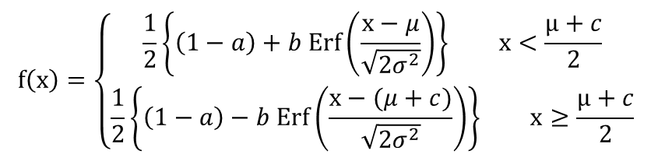
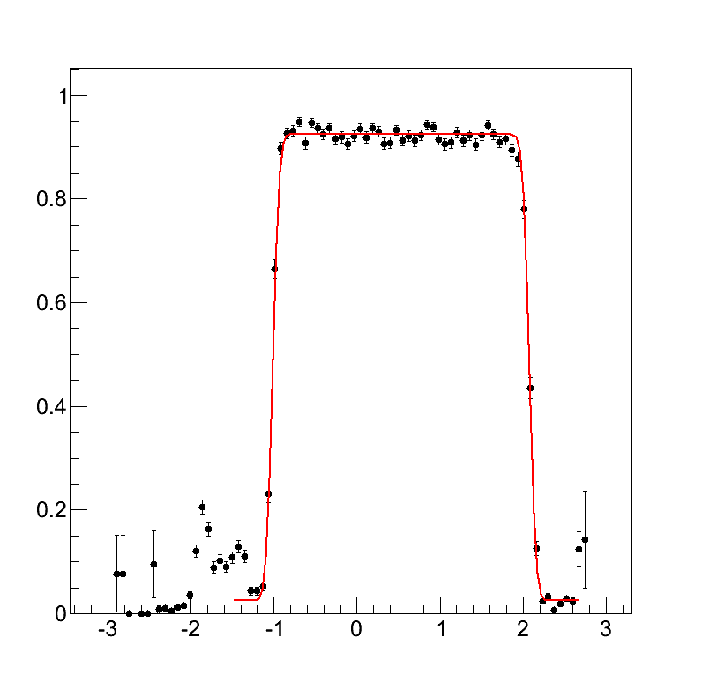

Correction for SciFi position
Get accurate position of SciFi layers from the distribution of track position on Si-Strip
※use muon data, height of movable plate = 131.56mm
Detection efficiency of SciFi layer1
(sum of dE in SciFi layer > 0.5MIP)
※ set a, b, c,μ,σ as free parameter
 | Center pos. [cm] | Size [cm]
Layer1 | 0.529 | 3.10
Layer2 | 0.580 | 3.13
Layer3 | 0.524 | 3.08
Layer4 | 0.562 | 3.13
Layer5 | 0.567 | 3.13
Layer6 | 0.569 | 3.12
Layer7 | 0.574 | 3.12
Layer8 | 0.505 | 3.11
Detection Efficiency
c
μ
Track Position [cm]

Slide 10
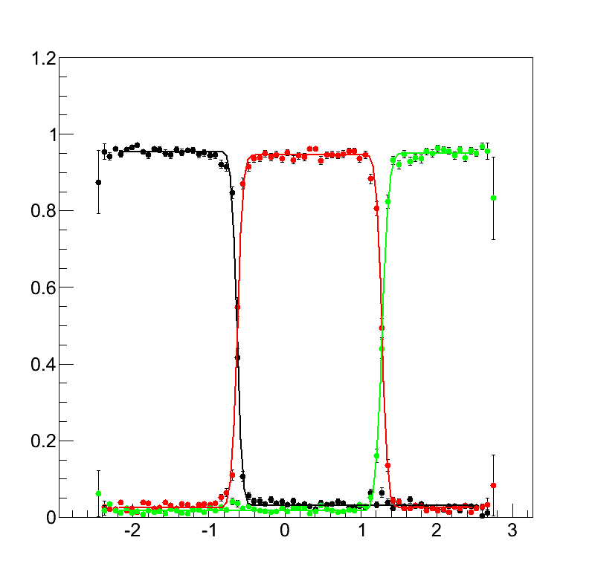
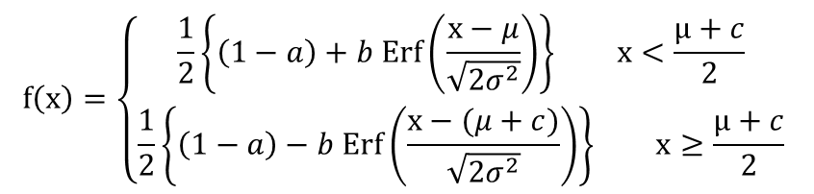

Correction for PWO position
Get accurate position of PWO from the distribution of track position on Si-Strip
※use muon data, height of movable plate = 131.56mm
Detection efficiency of PWO in Layer1
(dE in PWO > 0.5MIP)
 | Center pos. [cm] | Size [cm]
Layer1 | 0.326 | 1.91
Layer2 | 0.292 | 1.88
Layer3 | 0.294 | 1.85
Layer4 | 0.286 | 1.87
Layer5 | 0.291 | 1.87
Layer6 | 0.320 | 1.88
Layer7 | 0.306 | 1.88
Layer8 | 0.312 | 1.85
Layer9 | 0.310 | 1.85
Layer10 | 0.315 | 1.87
Layer11 | 0.329 | 1.85
Layer12 | 0.388 | 1.98
Detection Efficiency
c
μ
Track Position [cm]
※ set a, b, c,μ,σ as free parameter

Slide 11
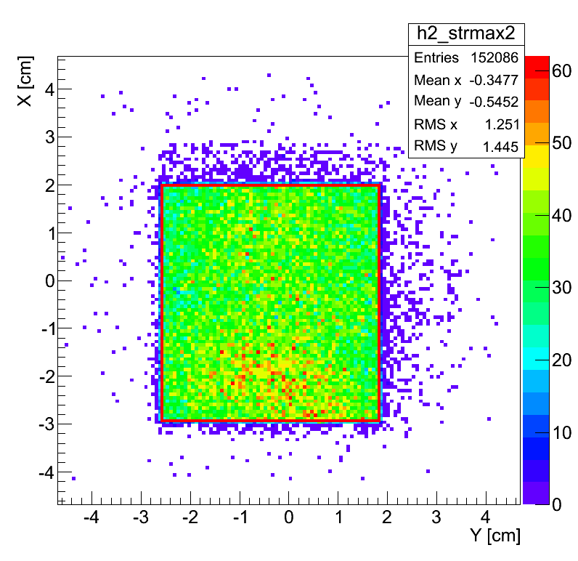
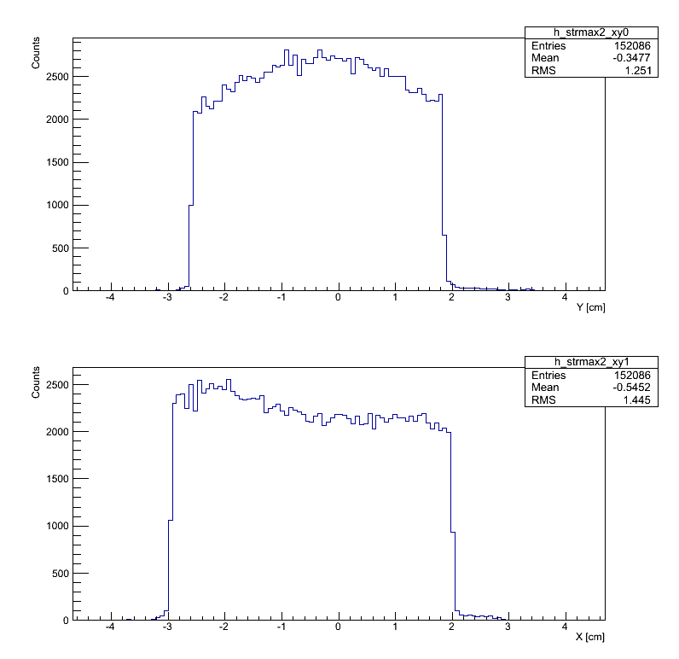
Correction for trigger scintillator position
Draw a map of track position on trigger scintillator
Estimate center position difference between trigger Scintillator and Si-Strip layer1,
and size of the scintillator
※ use muon150GeV
Y-position
4.392cm
-0.366cm
Position [cm]
X-position
4.9044cm
Position of trig. scin.
-0.4758cm
Position [cm]
Projection X, Y (horizontal : position, vertical : counts)

Slide 12
Size of each detector
CHD
TASC
 | Standard [cm] | estimated [cm]
CHD0 | 3.0 | 2.95
CHD1 | 3.0 | 2.96
CHD2 | 3.2 | 3.13
CHD3 | 3.2 | 3.13
 | Standard [cm] | estimated [cm]
Layer1 | 1.9 | 1.91
Layer2 | 1.9 | 1.88
Layer3 | 1.9 | 1.85
Layer4 | 1.9 | 1.87
Layer5 | 1.9 | 1.87
Layer6 | 1.9 | 1.88
Layer7 | 1.9 | 1.88
Layer8 | 1.9 | 1.85
Layer9 | 1.9 | 1.85
Layer10 | 1.9 | 1.87
Layer11 | 1.9 | 1.85
Layer12 | 2.0 | 1.98
IMC
 | Measured [cm] | estimated [cm]
Layer1 | 3.20 | 3.10
Layer2 | 3.20 | 3.13
Layer3 | 3.19 | 3.08
Layer4 | 3.18 | 3.13
Layer5 | 3.10 | 3.13
Layer6 | 3.21 | 3.12
Layer7 | 3.19 | 3.12
Layer8 | 3.20 | 3.11
Analytical size estimated from Si-Strip data is ~2 % smaller than actual measured value

Slide 13
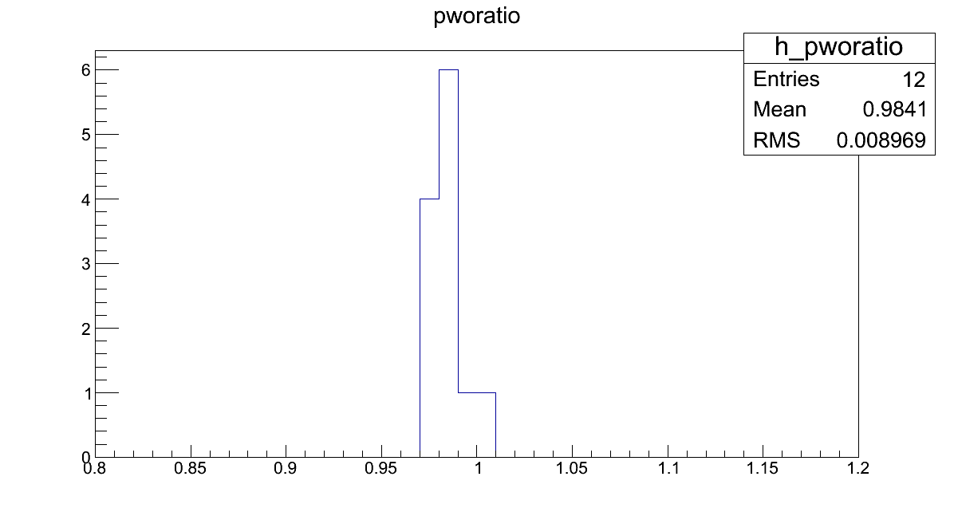
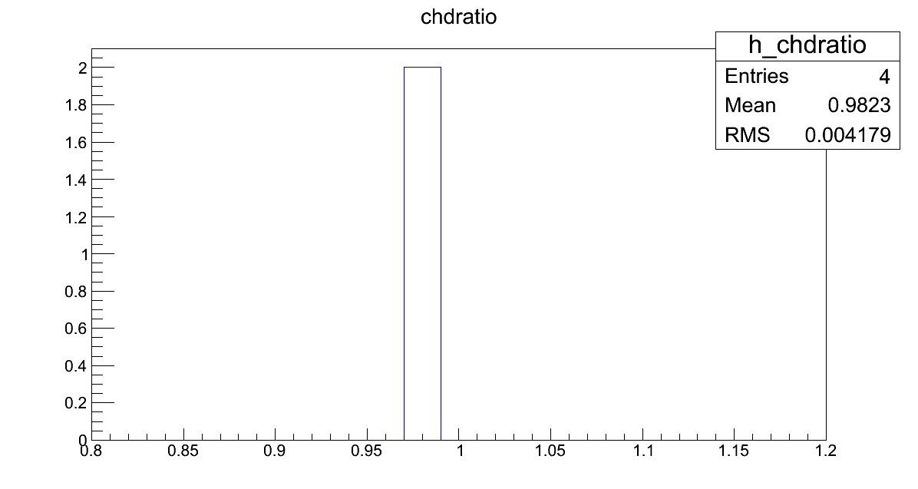
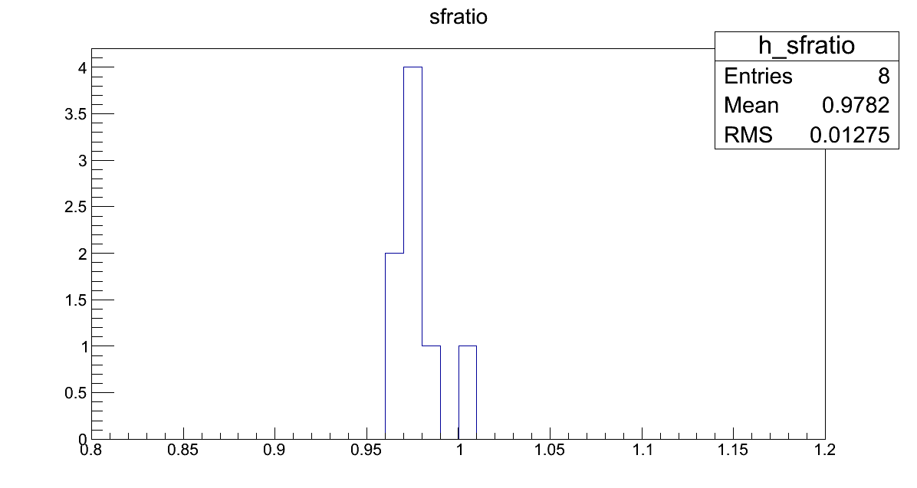
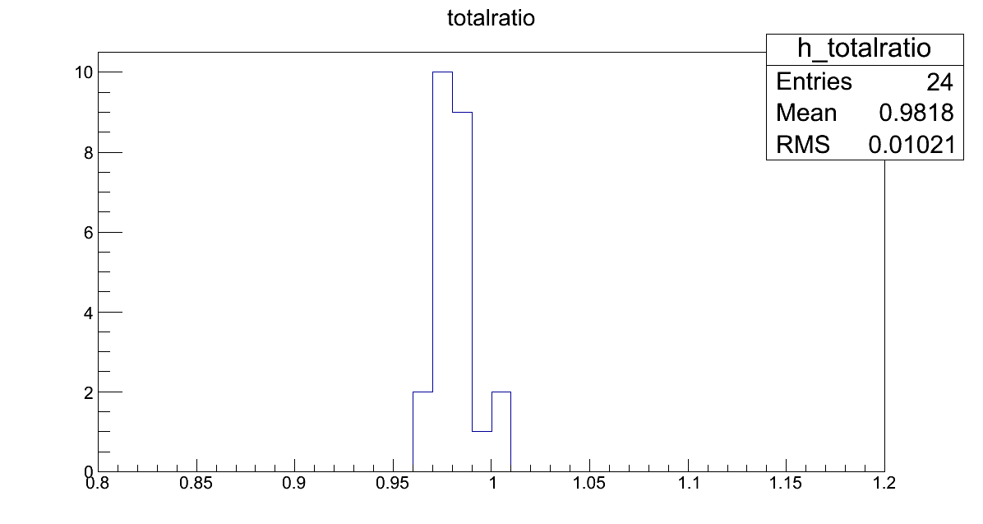
CHD：0.982
PWO：0.984
Estimated / measured
Estimated / measured
SciFi：0.978
Total：0.978
Estimated / measured
Estimated / measured

Slide 14
Assuming the detector incline,
  L’ / L = cos θ ≒ 0.98
  θ = 11.5 degree
  ← too big?
  Strip-pitch is exactly 732 um?
  The beam direction is spread?
  An assumption that the beam direction is exactly vertical is bad?
θ
L
L’

Slide 15
END

