Slide 1
Particle tracking with the beam tracker
Paolo Maestro
University of Siena
Beam Test F2F Meeting
CERN March 15-17, 2012

Slide 2
Outline
Detector configuration
Beam profiles
Track reconstruction with Si-strips
Si-strip sensors “internal” alignment
Alignment of the Beam Tracker and IMC/TASC
Measurement of the attenuation length of the IMC fibers using the Beam Tracker
Charge ID with Si array

Slide 3
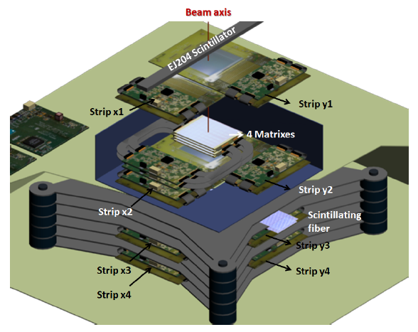
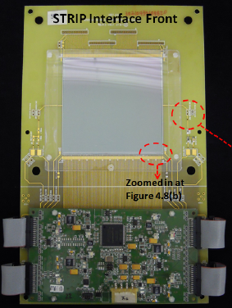
Tracker configuration
Top Tracker
2 Pairs of X-Y Strip sensors
9.4cm x 9.4cm
strip pitch 183 μm
128 channels. Readout pitch 732μm
(Ganging of 4 strips)
4 Matrices (8 x 8 Pixel Array)
9.0 cm x 9.0 cm
1.125 cm x 1.125 cm pixel area
Interpixel distance 80 μm
Bottom Tracker
2 Pairs of X-Y Strip sensors

Slide 4
Beam test layout
x₄
y₄
x₃
y₃
x₂
y₂
x₁
y₁
9.4 cm
Beam
y
7.5 cm
35.3 cm
6.1 cm
x
z
Si-strip
Trigger
Scintillators
Si-strip
Si-strip
Si-strip
Si-strip
Si-strip
Si-strip
Si-strip
Si-matrix

Slide 5
Protons @ 350 GeV run 328-334 BEAM PROFILES
YZ view
XZ view

Slide 6
e+ 30 GeV run 280-284 BEAM PROFILES
YZ view
XZ view

Slide 7
Average beam particle trajectory
Strip# | Δ (mm) p | Δ (mm) e+
0Y | -0.40 | -0.44
1X | 1.35 | 1.27
2X | -0.28 | -0.35
3Y | -0.69 | -0.71
4Y | 1.62 | 1.68
5X | 1.10 | 1.14
6Y | -0.53 | -0.54
7X | -2.18 | -2.06
θ_{x} ~16 mrad
p @ 350 GeV run 328-334
θ_{y} ~12 mrad
XZ view
YZ view
Need to correct for:
Si strips misalignment
Beam tracker tilt angle
e+ 30 GeV run 280-284

Slide 8
Si strips tracking algorithm
Clusters of adjacent Si-strips with energy deposit > 12 ADC (hits) are identified in each layer.
Each cluster defines a candidate track point, with X(Y) coordinate equals to the COG (center of gravity) of the cluster and Z coordinate equals to the position of the sensor.
Candidate tracks are built by scanning all the possible combinations of candidate track points in each view (XZ and YZ).
Ensemble of candidate tracks with at least 3 points (per view).
The parameters of each track in the ensemble are calculated by a χ² fit.
The track with minimum χ² is selected as the beam particle trajectory.
Pulse height distribution
of the hits associated to the
reconstructed trajectories

Slide 9
XZ VIEW
YZ VIEW
Scintillator
Top Tracker
x1
y1
Matrix
x2
y2
Bottom Tracker
y3
x3
y4
x4

Slide 10
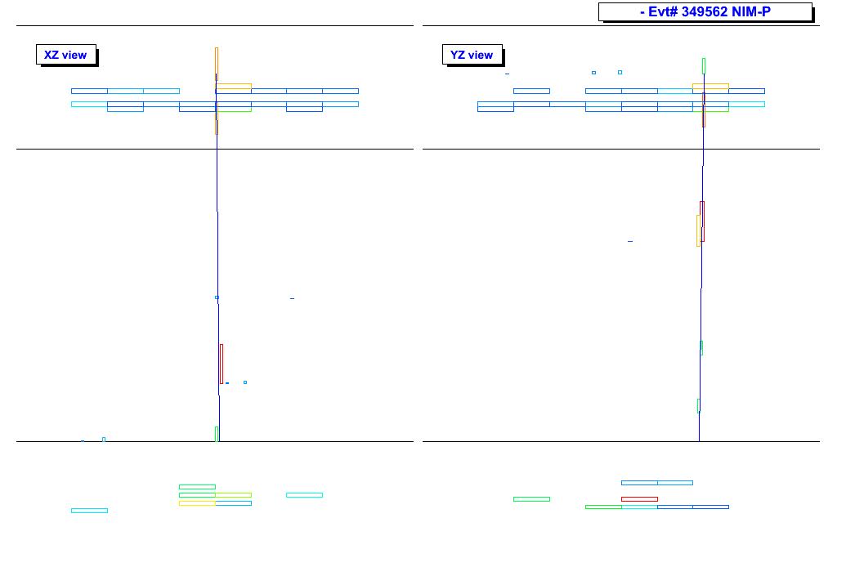

Si strip alignment
Find the offset S_{j} (j=1,…,N_{layer}) to be applied to the nominal strip coordinate (x_{strip}^{j}) to get the best alignment of the sensors
Iterative procedure in each view (XZ/YZ) based on a χ² minimization
Free parameters : 4 S_{j} shifts, one per layer in that view
x_{track}^{j} is the intercept of the fitted track with the layer j
SCIFI2
SCIFI3
STR5
STR7
S₅
zoom
S₇

Slide 11
YZ view: distribution of the residuals y_{strip} - y_{track} before alignment

Slide 12
YZ view: distribution of the residuals y_{strip} - y_{track} AFTER alignment
Resolution on impact
point ~50-60 μm

Slide 13
Si strip layer 0
Si strip layer 3
y_{strip} – y_{track} < 0
y_{strip} – y_{track} > 0
y_{strip} – y_{track} > 0
y_{strip} – y_{track} < 0
Si strip layer 6
Si strip layer 6

Slide 14
XZ view: distribution of the residuals x_{strip} - x_{track} before alignment

Slide 15
XZ view: distribution of the residuals x_{strip} - x_{track} AFTER alignment
Resolution on impact
point ~50-60 μm

Slide 16
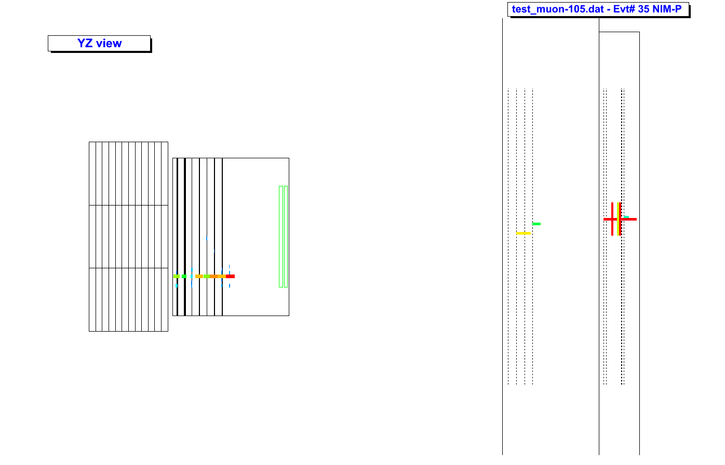
TASC
IMC
6 cm
9.4 cm
18.5 cm
65 cm
Beam Tracker

Slide 17

TASC
IMC
6 cm
θ_{y} ~12 mrad
9.4 cm
18.5 cm
65 cm
Beam Tracker
Beam Tracker

Slide 18
Si strip-IMC alignment
Find the tilt angle of the BT w.r.t. IMC/TASC
Iterative procedure based on a χ² minimization
y_{IMC} is the intercept of the IMC reconstructed trajectory with the first IMC layer, i.e. the beam particle impact point on IMC
y_{BT} is the impact point on IMC of the BT reconstructed trajectory, rotated in the IMC reference frame according to equation
θ , O_{y} , O_{z} are the free parameters in the fit.
y’z’ are the coordinate in the BT reference frame

Slide 19
BEFORE alignment
YZ view: distribution of the residuals y_{BT} - y_{IMC}
AFTER alignment
RMS of impact
point on IMC ~ 1 mm
BT too far from IMC !

Slide 20
Measurement of the attenuation length of IMC fibers
λ = 324 ± 36
λ = 299 ± 25
λ = 273 ± 27
Layer 3
Layer 0
muon run 189
Layer 5
muon run 154-184
muon run 186
Measurement of the fiber signal as a function of the x-coordinate of the impact point reconstructed with the beam tracker.
Fit the attenuation curve with
Attenuation lenght from the fit ~ 300 cm

Slide 21
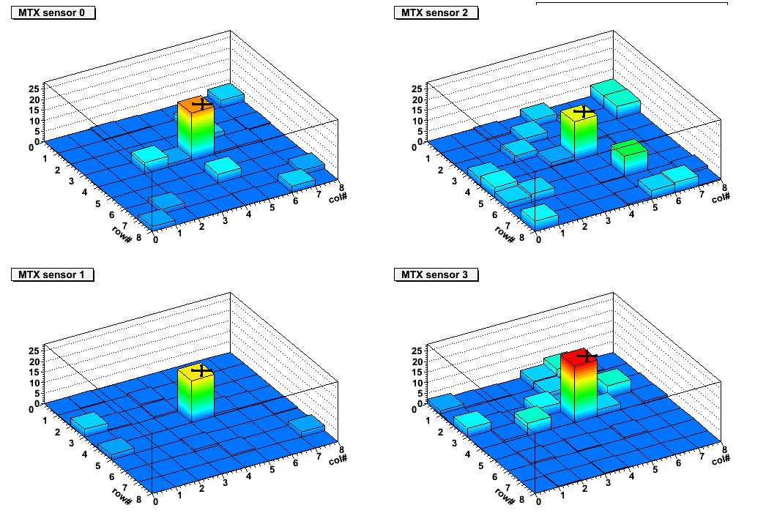
CHARGE ID with the Si array
The intersection of the reconstructed trajectory with the Matrix sensors is used to identify the
pixel hit by the beam particle.
Four independent samples of dE/dx of the primary particle ➔ Charge ID

Slide 22
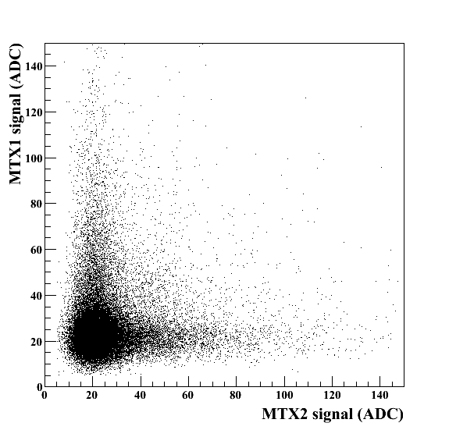
Muons pulse height distribution
in Si-array
Heavy ion spectra at GSI

Slide 23
Conclusions
Tracking algorithm is fast and efficient and allows to reach a spatial resolution of the impact point ~50 μm
Beam tracker alignment in two steps: 1. internal alignment among the Si strip sensors;
2. alignment with IMC/TASC.
Procedure based on χ² minimizations work fine. They have been applied to different runs and produce stable results (in terms of correction factors).
Critical issue: BT and IMC at the beam test were placed too far ~ 1 m.
That amplifies the effect of small rotations <1° between the two systems, degrading the fine
spatial resolution of the reconstructed impact point achievable with BT.
Nevertheless we use the BT to measure the x-coordinate (not readable by the IMC
prototype) and study the response of fiber and crystals as a function of the impinging point
of the particles.
Lesson learnt for the next beam test:
- BT should be placed as close as possible to IMC to provide a fine tracking.
- Si array can be used to determine the particle charge with a fragmented ion beam.
FUTURE PLAN FOR THIS ANALYSIS
Write the BT reconstructed particle track parameters in the ntuples, in TParticleIncident class of the CALET MC unified format (equivalent to LEVEL-2 data)

