Slide 1
Siemens Openlab
Major Review
September 2012

Slide 2
Contents
Organization
Data Analytics
PLCs Security
WinCC Open Architecture
  Database Archiver
  Deployment Tool

Slide 3
Organization
Management
Siemens - Thomas Hahn
ETM - Guenther Zoffmann
CERN - Manuel Gonzalez
Database
Archiver
Marcin Bogusz
Deployment Tool
Pavel Fiala
Rainer Glocknitzer
Security
Filippo Tilaro
Brice Copy
Piotr Golonka
Ewald Sperrer
Fernando Varela
Hans-Walter Hirsch
Jan Kaestner
TBD
Data Analytics
TBD
TBD
openlab
Researcher
CERN
Supervisor
Siemens/ETM
Supervisor

Slide 4


Typical Control System Architecture
Configuration DB,
Commercial
Custom
SECURITY
Archives,
Storage
Log files, etc.
FSM
WAN
Supervision
SCADA
WinCC OA
LAN
OPC
DIM
PLC
LAN
Process
Management
Communication Protocols
VME
PC
PLC/UNICOS
Field Bus
VME
Node
Node
Field
Field Buses & Nodes
Management
Experimental Equipment
Sensors/Devices
Openlab Major Review Report September 2012

Slide 5
Data Analytics
New activity in Phase IV
  Focus on data gathered/produced in Controls
  Currently being defined
Prepared initial list of Use Cases
  Infrastructure (e.g. electrical network)
  Control System “health”
  Analysis of alarms
Joint Workshop Siemens-Oracle
  Identify possible synergies
  Aim to have it in November

Slide 6
Siemens Openlab
Major Review
September 2012
PLCs Security
Author: Filippo Tilaro
Supervised by: Brice Copy

Slide 7
PLC Security project phases
Phase III
2009 ->2012
ISA-99 as reference standard
Security standards analysis:
Phase IV
2012->
Test-bench modules integration
PLC monitoring improvements
ISCI-CRT certification 2nd part
New Testing techniques
Fulfilling the ISCI-CRT certification requirements:
Release to Siemens a complete test definition set and implementation to be reproduced in Siemens Labs
Design and implementation of the Test-bench for robustness of Industrial Equipments(TRoIE)
tools evaluation & development
Openlab Major Review Report September 2012

Slide 8


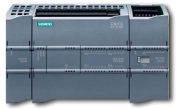
Achievements I
Integration of the test-bench modules:
Through the use of Enterprise Service Bus (ESB)
  Orchestrate application modules
  Message routing and transformation
  Wide range of connectors: REST, SOAP, LDAP, JDBC, JMS, HTTP/S, FTP/s, Email/SMTP, Facebook, Twitter…
Stop /TCP
Stop /UDP
Inbound
Router
Service
Inbound
Router
App1
App2
PLC Monitoring
Channel
Endpoint
Endpoint
Channel
Testing
Framework
Transformer
Transformer
Testing traffic load
Monitoring traffic load
Target
Openlab Major Review Report September 2012

Slide 9
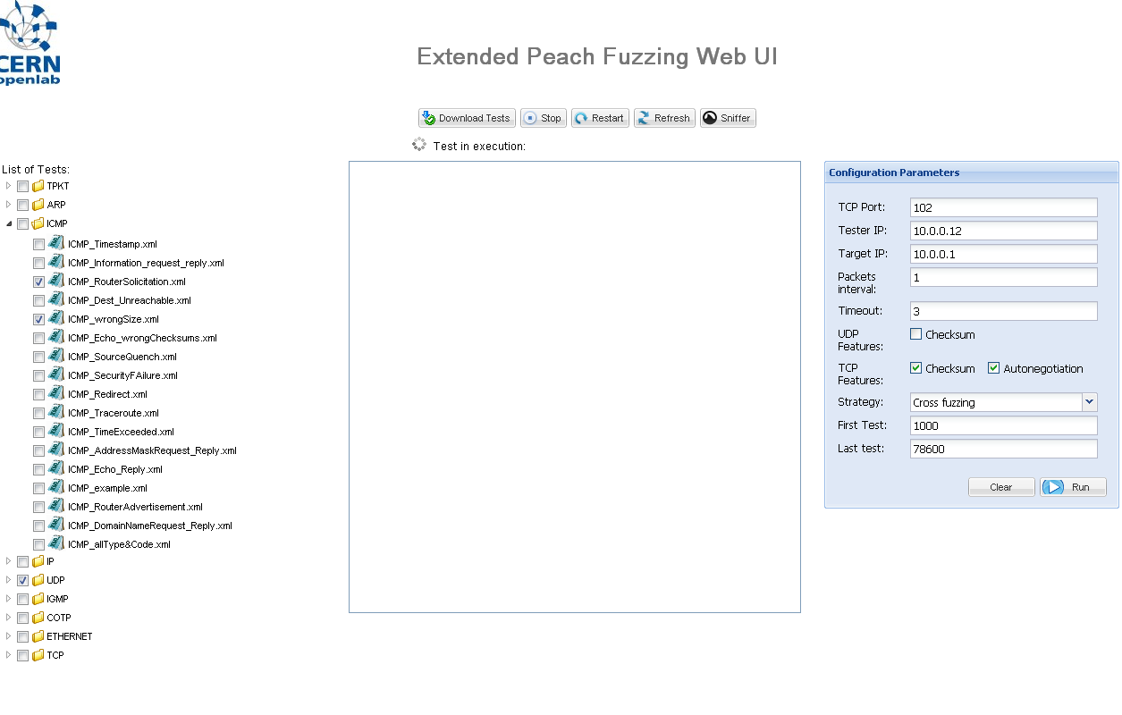
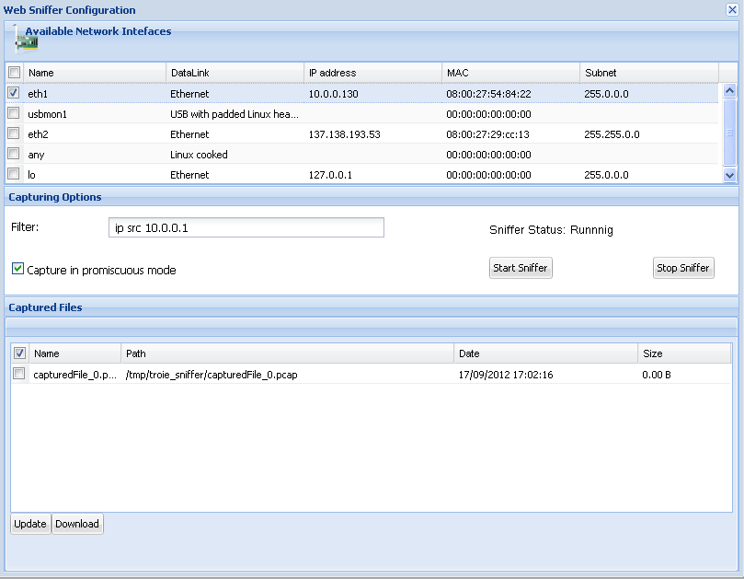
Achievements II
Communication Monitoring System
  Development of a web driven sniffer
  Internal module of the TRoIE test-bench and communicating with other internal modules
Openlab Major Review Report September 2012

Slide 10
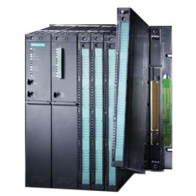
Undergoing activities
PLC Status monitoring:
Previous existing CERN system:
  PLC DIAMON with ‘libnodave’ (open-source library)
Siemens Softnet library
  Development of a server-side monitoring system able to question the Siemens PLCs
  Integration with the GWT client application within the TRoIE test-bench
Publishers: DIP/DIM, CMW, WinCC OA, WebService
PLC Agent
DLL based on Softnet
Communication
Softnet Server
Openlab Major Review Report September 2012

Slide 11


ISCI CRT certification Phase 2
Extension of the CRT for not covered protocols:
  S7, Profinet, OPC, DNS, HTTP, FTP, IPv6,Modbus / TCP, SNMP
  List of tests:
    Storms and Maximum Load Tests
    Single Field Injection
    Combinatorial Fields Injection
    Cross State Fuzzing (for stateful protocols)
Openlab Major Review Report September 2012

Slide 12
Conclusions and Next Steps
Current and finished activities:
  PLC communication monitoring
  Improve the PLC internal status monitoring
Design of new testing techniques:
  Multi-Protocols (Man-in-the-middle) layer testing
    Able to test any kind of communication protocols
    Scalable and user-friendly to define new grammars
    Overcome the current testing framework limitations
      Traffic generation, multi-layer fuzzing
Extending to the supervision level: SCADA system like WinCC OA, OPC OA ...
Openlab Major Review Report September 2012

Slide 13
Siemens openlab
Projects
September 2012
WinCC OA
Marcin Bogusz
Pavel Fiala

Slide 14
WinCC OA
RDB archiving
  WinCC OA version 4 archiving
    Future SCADA system
    Work on a storage plug-in for Oracle RDBMS
  WinCC OA 3.11 archiving
    New Features Validation
    Large Scale Performance tests
Centralized Deployment Tool
    New Fellow Pavel Fiala
    Started with the ASCII Manager

Slide 15
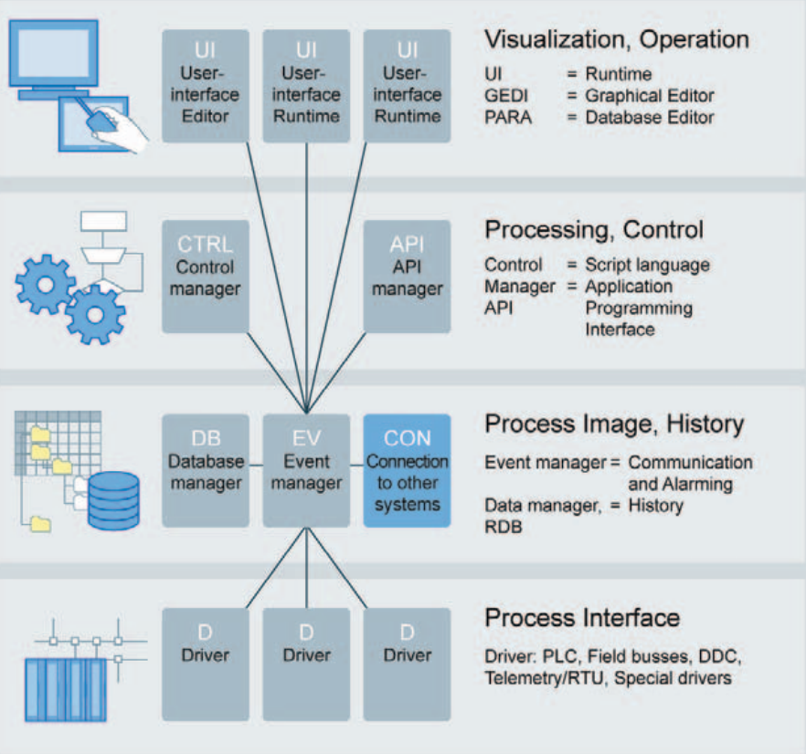
RDB Archiving

Slide 16
WinCC OA Version 4
Upcoming SCADA system to be released in the next years
New storage and component architecture
  Storage architecture designed not only for WinCC OA but other Siemens products which require archiving
CERN is developing an Oracle archiving module (Oracle plug-in).
Other relational database plug-ins developed by ETM (SQLite, MS SQL Server)
Modules are based on the framework provided by ETM, developed jointly by ETM and Siemens

Slide 17
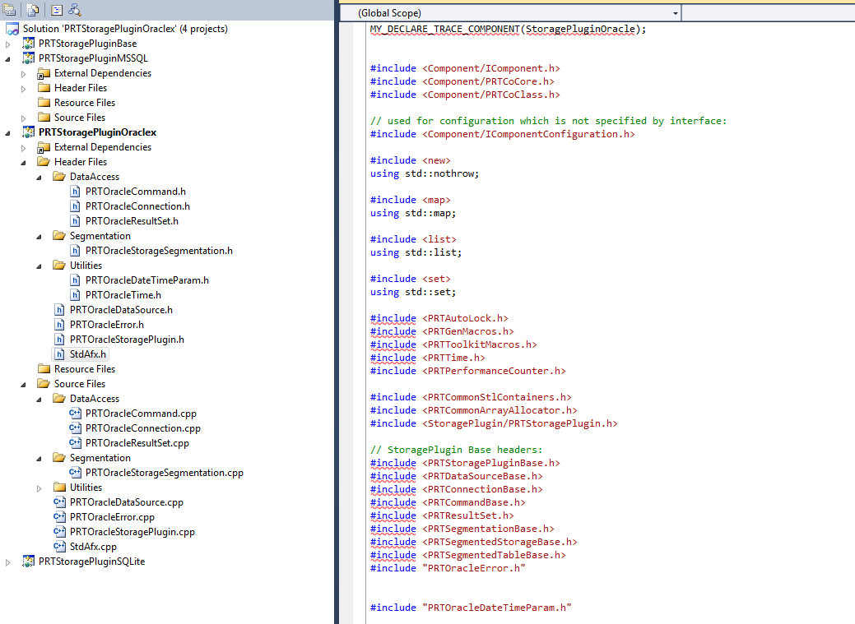
WinCC OA 4
Oracle plug-in development has been resumed
  Storage framework (part of IOWA) has changed
  Plug-in code has been re-written to adjust for these changes
  Formalized design and test documentation according to ETM standards
  OCCI challenges resolved (Threading, 64-bit integer support...)
  Adjusted test infrastructure
Work re-organized in “waves” (iterations)
  Two visits to ETM in Linz
  Workshop and work coordination
    New workspace, tests
  WinCC OA 4 – IOWA integration

Slide 18
WinCC OA 4
Achievements
  Milestone : Wave 1 completed
    Plugin code passes all the ETM unit tests
Next Steps (Wave 2)
  Planning phase started
  Missing Functionality – storage segmentation
  Changed interface adjustments
  Database schema (re)design
    Survey of other products (at CERN, open source)

Slide 19
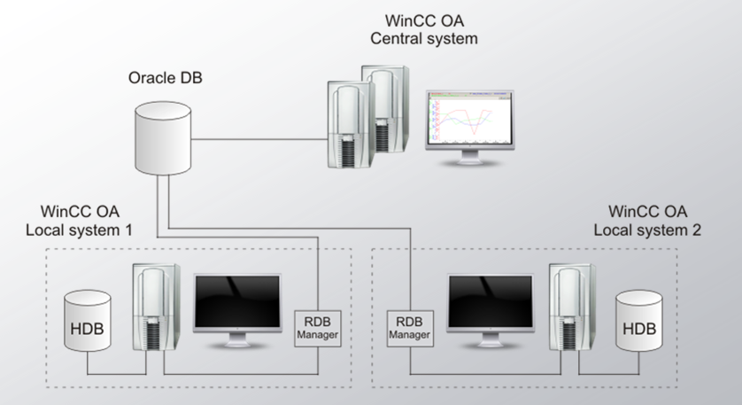
WinCC OA 3.11
WinCC OA 3.11 is being validated at CERN
  Successor to 3.8 SP2 for the long shutdown 1
New Features Validation
  Parallel archiving feature tested
    Local file archiver (HDB) & Oracle DB
  RDB Compression mechanism
    Follow-up of 3.10 validation

Slide 20
WinCC OA 3.11
Scalability performance tests
  Update of previous round of tests (~7 years ago)
    New hardware and software versions
    Scalability reassessment
      New up-to-date performance figures
  Test machines have been set up
    50 WinCC OA servers (up to 200 projects)
    Oracle server – 2 node RAC
  Collaborating with IT-DB experts
    Setup
    Optimization
      Use of IOT
      Index compression...

Slide 21
Deployment tool

Slide 22
ASCII Manager
Key component of the Centralized Deployment Tool
  Will allow pushing new versions of WinCC OA-based components onto sets of remote projects
Imports/exports the run-time database of a project from/to files
Initial tasks
  Benchmark the current performance
  Introduce XML format for files
  Extend the functionality of the manager by:
    Pre-validating the file contents prior to imports
    Deletion of database entries
    Coherent exports to ensure the completeness of parameterization
  Performance optimization
  GUI usability improvement

Slide 23

Any Questions
Thank you for attending!
Openlab Major Review Report September 2012

