Slide 1
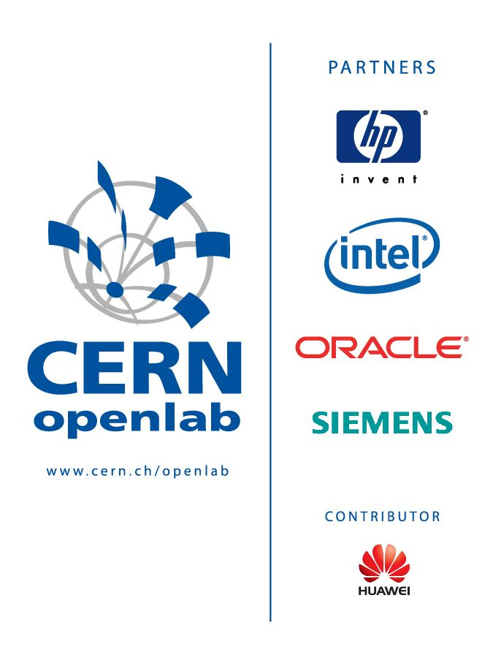
CERN openlab Major Review Meeting 2012
Summer student excursions
Sverre Jarp
27 September 2012

Slide 2
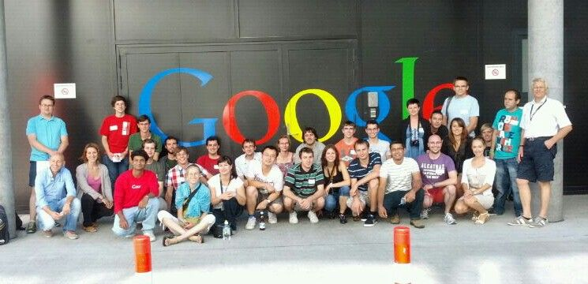
Zurich 2012
Successful two-day excursion (August 2012)
  Open Systems (1/2 day)
  Google (1 day)
  ETHZ (further studies tutorial)
  Some sightseeing
Openlab students + IT technical students

Slide 3
What about 2013 ?
Are our partners interested in hosting such visits ?
  In a European city (within easy reach)
  During one or two (days/half-days)
  Mixing serious briefings with interesting social activities

