Slide 1




HIGHLY-IONIZING PARTICLES @ THE LHC
Non-SUSY Scenarios
NICK E. MAVROMATOS
KING’S COLLEGE LONDON & CERN-PH-TH
London Centre
for Terauniverse
Studies (LCTS)
AdV 267352

Slide 2
OUTLINE
MOTIVATION: Several theories BSM predict extra highly-ionising matter…
Focus on Non-SUSY scenarios & some unconventional SUSY ones
DOUBLY-CHARGED HIGGS MODELS
QUIRKS
Q-BALLS
D-matter
CHAMPS
Charged TeV Black Hole remnants…
RELEVANCE TO MoEDAL
IF: MASSIVE, LONG-LIVED &
HIGHLY IONISING

Slide 3


Slide 4
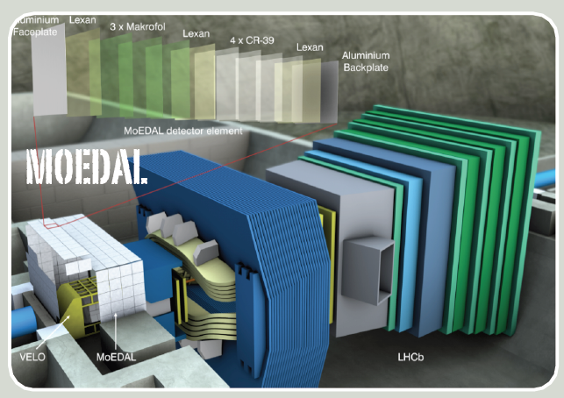
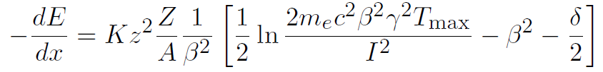
The Pirnciples of MoEDAL Searches
Particle must be massive, long-lived & highly ionizing to be detected at MoEDAL
To get high ionization we need:
    Magnetic charge or multiple electric charge (Monopoles, Dyons, SMPs…)
    Very low velocity & electric charge (Stable Massive Particles - SMPs)
    Any combination of the above
MoEDAL has a threshold of Z/β ~ 5 5
VELOCITY: β =V/C

Slide 5
The Pirnciples of MoEDAL Searches
Particle must be massive, long-lived & highly ionizing to be detected at MoEDAL
To get high ionization we need:
    Magnetic charge or multiple electric charge (Monopoles, Dyons, SMPs…)
    Very low velocity & electric charge (Stable Massive Particles - SMPs)
    Any combination of the above
MoEDAL has a threshold of Z/β ~ 5 5
VELOCITY: β =V/C

Slide 6
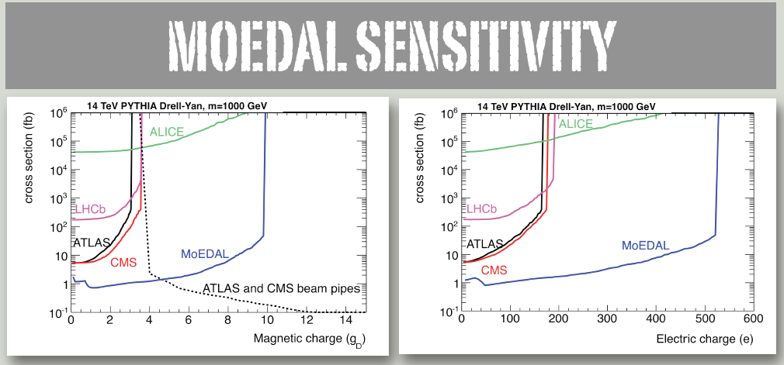
@ 20 fb⁻¹ (assumed)
ArXive:1112.2999v2

Slide 7
DOUBLY CHARGED
HIGGS

Slide 8
DOUBLY-CHARGED HIGGS
Extended Higgs sector in BSM models: SU_{L}(2) x SU_{R}(2) X U_{B-L}(1) P-violating model
Higgs triplet model with massive left-handed neutrinos but not right-handed ones
COMMON FEATURE: doubly charged Higgs bosons H±± as parts of a Higgs triplet
H_{L}±± : couple to Higgs, EW gauge bosons & left-handed charged leptons
H_{R}±± : couple to Higgs EW gauge bosons & right-handed charged leptons

Slide 9



Higgs Triplet Model (HTM) - details
Yukawa couplings
Higgs triplet
Realistic neutrino masses &
for
Triplet in 2 x 2 rep:

Slide 10
COLLIDER PRODUCTION OF H_{L,R}±±
Comparable
Cross sections
if m(H±±) ≈ m (H±)

Slide 11
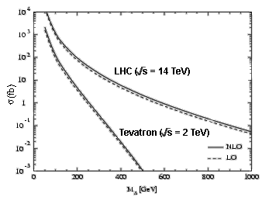
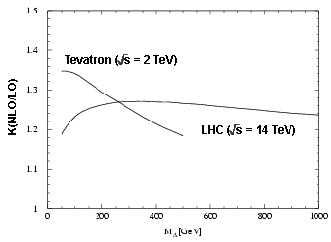
Collider Production of H± ±
Pair Production :
W-W Fusion :
_
_
q′
_
q′
H⁺⁺
H⁺⁺
q′
W
H
++
W
--
-
q
γ * /Ζ∗
H⁻⁻
q
W
+
W
q
Dominant Production mode
Small probability
Cross section independent of
Fermionic coupling
|ρ_{EW} - 1| Is small, experimentally observed
Doubly-charged Higgs
production cross section is enhanced substantially (~35%) due to NLO corrections.
R-handed H++ cross section is smaller by a factor of ~2 due to different value of coupling of these particles to Z bosons.
M. Spira & M. Mühlleitner, hep-ph/0305288

Slide 12
DECAYS OF H_{L,R}±±
DECAYS TO WW
LEPTONIC DECAY MODES :
DOMINANT FOR MASS RANGE:
LEPTON-FLAVOUR-VIOLATING DECAY MODES ALLOWED
-may be particular large, e.g. BR(H⁻⁻ ⁻⁻ → μ τ) ≈ 1/3

Slide 13
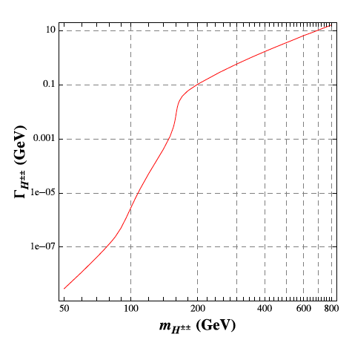



Life-Time of H±±
Depends on many
parameters : Yukawa h_{ij,}
mass of H±±, , v_{Δ} ,
QCD effects....
Chiang, Nomura, Tsumura, arXive 1202.2014

Slide 14


Life-Time of H±±
Depends on many
parameters : Yukawa h_{ij,}
mass of H±±, , v_{Δ} ,
QCD effects....
Essentially there are
no constraints on its
life time …
it can be
long (e.g. for h_{ij} < 10⁻⁸)
→ RELEVANT
FOR MoEDAL
Chiang, Nomura, Tsumura, arXive 1202.2014

Slide 15

Decaying H±± SEARCHES @ LHC
@ LHC:
Several Studies @ LHC in decay channel
(increased sensitivity of LHC vs Tevatron)
e.g. study of production
followed by a decay
Εxpected LHC exclusion limits assuming BR(H±± → μ± μ± ) = 100 %

Slide 16
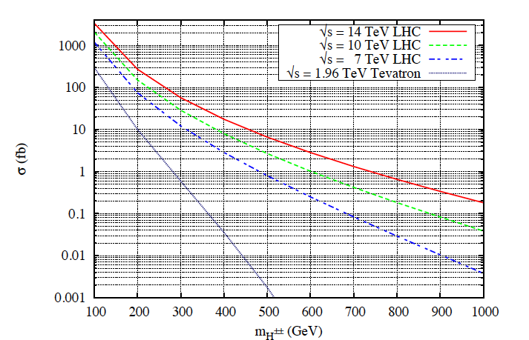
Akeroyd, Chiang, Gaur, arXive:10092780

Slide 17
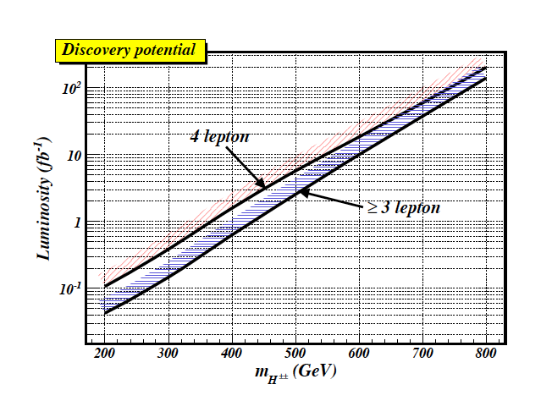
H±± SEARCHES @ LHC - Higgs Triplet Model
Three-Lepton decay signatures may offer significantly greater discovery potential
of H±± in Higgs triplet model vs four-lepton signatures
In such a case, production mechanism contributes to
the signal and has superior
sensitivity in the region of
m(H±±) > 200 GeV
(i.e. high invariant mass of charged
lepton pairs) for which
SM background is small

Slide 18


H±± SEARCHES @ LHC –HTM
Akeroyd, Sugiyama, arXive:1105.2209
Large branching ratios of in sizable regions of parameter space
From
→
pair production of H±± with cross section
comparable to standard H±± pair production
via
→ enhanced detection process in four lepton channel @ LHC
Additional decays from production of
neutral triplet scalars, lead to additional production of H± with additional production
(via H± decays) to H±±.

Slide 19
Connection with MoEDAL
H±± must be long-lived & highly ionizing in order to be detected at MoEDAL
To get high ionization we need:
    Magnetic charge or multiple electric charge (Monopoles, Dyons, SMPs…)
    Very low velocity & electric charge (Stable Massive Particles - SMPs)
    Any combination of the above
MoEDAL has a threshold of Z/β ~ 5 5
VELOCITY: β =V/C

Slide 20
Long Lived Doubly Charged Higgs
No constraint on the lifetime of H±± , can be long
Search for particles with cτ > 3 m, no decay within the detector
They will behave like heavy stable particles, (muons but more ionising)
Main process of energy loss is ionization
, dE/dx ∝ (charge)²
Measurement of ionization – dE/dx measurement along the charged
particle track in tracker and calorimeter.
Background – Advantage is lack of Standard Model decays.
Events expected from highly ionizing particles.
Muons – data from cosmic rays (pure muon sample)
CDF strategy:
S Banerjee ICHEP2004
Electrons – W
e υ Monte Carlo sample
Hadronic decays for taus from Monte Carlo sample
QCD contribution calculated from experimental data

Slide 21
Long Lived Doubly Charged Higgs
No constraint on the lifetime of H±± , can be long, e.g. Yukawa h_{ij} < 10⁻⁸
Search for particles with cτ > 3 m, no decay within the detector
They will behave like heavy stable particles, (muons but more ionising)
Main process of energy loss is ionization
, dE/dx ∝ (charge)²
Measurement of ionization – dE/dx measurement along the charged
particle track in tracker and calorimeter.
Background – Advantage is lack of Standard Model decays.
Events expected from highly ionizing particles.
Muons – data from cosmic rays (pure muon sample)
CDF strategy:
S Banerjee ICHEP2004
Electrons – W
e υ Monte Carlo sample
Hadronic decays for taus from Monte Carlo sample
QCD contribution calculated from experimental data

Slide 22
Long Lived Doubly Charged Higgs
No constraint on the lifetime of H±± , can be long, e.g. Yukawa h_{ij} < 10⁻⁸
Search for particles with cτ > 3 m, no decay within the detector
They will behave like heavy stable particles, (muons but more ionising)
Main process of energy loss is ionization
, dE/dx ∝ (charge)²
Measurement of ionization – dE/dx measurement along the charged
particle track in tracker and calorimeter.
Background – Advantage is lack of Standard Model decays.
Events expected from highly ionizing particles.
Muons – data from cosmic rays (pure muon sample)
CDF strategy:
S Banerjee ICHEP2004
Electrons – W
e υ Monte Carlo sample
Hadronic decays for taus from Monte Carlo sample
QCD contribution calculated from experimental data

Slide 23
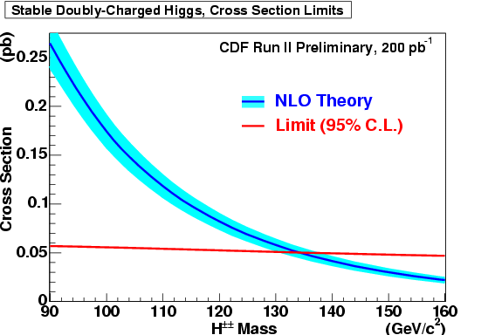
Mass Limit for Long Lived H±±
CDF strategy:
S Banerjee ICHEP2004
Bayesian upper limit on H±± crosssection
σ H±±
=
Upper Limit on No. of Signal Events at 95% C.L. for 0 Observed Events
Total H±± Acceptance x Integrated Luminosity
For a H±± mass of 130 GeV H±± cross section is 0.057 ± 0.0066 ± 0.0030
Mass Limit for Quasi-Stable Doubly charged Higgs is 134 GeV

Slide 24
Long Lived Doubly Charged Higgs & MoEDAL
For very small Yukawa couplings h_{ij} < 10⁻⁸ the doubly charged Higgs boson could be quasi-stable.
In this case very slow pseudo-stable Higgs could be detected in the MoEDAL NTDs. For example with CR39, one could detect doubly charged Higgs particles with a Z/β > 5 (15), where β ≤ 0.4 (0.13).
If such slow heavy particles are produced then one could have difficulty measuring them in ATLAS and CMS as their journey through the detector to the muon system would span more than one beam crossing.

Slide 25

Long Lived Doubly Charged Higgs & MoEDAL
For very small Yukawa couplings h_{ij} < 10⁻⁸ the doubly charged Higgs boson could be quasi-stable.
In this case very slow pseudo-stable Higgs could be detected in the MoEDAL NTDs. For example with CR39, one could detect doubly charged Higgs particles with a Z/β > 5 (15), where β ≤ 0.4 (0.13).
If such slow heavy particles are produced then one could have difficulty measuring them in ATLAS and CMS as their journey through the detector to the muon system would span more than one beam crossing.

Slide 26
QUIRKS

Slide 27

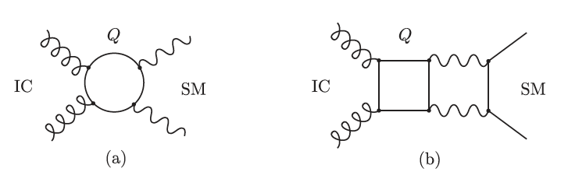
EXTENSION OF THE SM WITH NEW HEAVY FERMIONS (QUIRKS) CHARGED
UNDER BOTH A NEW UNBROKEN GAUGE GROUP & THE SM GUAGE GROUP
Kang, Lutty arXive: 0805.4642
NEW GAUGE GROUP (``INFRACOLOUR’’ (IC)) SU(N) WITH FERMIONS
(QUIRKS) IN FUNDAMENTAL REPRESENTATION BECOMES STRONG AT A SCALE
Λ << m , WHERE m IS THE QUIRK MASS ASSUMED TO BE IN THE
PHENOMENOLOGIVCALLY INTERESTING RANGE 100 GeV < m < TeV
COUPLING OF FM TO INFRACOLOUR SECTOR

Slide 28


EFFECTIVE OPERATOR MEDIATES INFRACOLOUR
GLUEBALL DECAY WITH RATE OF ORDER
INFRACOLOUR GLUEBALLS CSAN DECAY INSIDE PARTICLE DETECTOR
FOR Λ > 50 GeV
FOR Λ < 50 MeV LIFE TIME BECOMES LONGER THAN AGE OF UNIVERSE
(METASTABLE STATE) → RELEVANCE FOR MoEDAL AS
QUIRKS CAN BE HIGHLY IONIZING

Slide 29

IN PARTICULAR:
BREAKING OF INFRACOLOUR STRING IS
EXPONENTIALLY SUPPRESSED FOR Λ << m
Life time :
(cf. Schwinger mechanism
for pair creation of charged
ptcles by weak Electric field )
Longer than Age of Universe for m > 100 GeV, Λ = 50 MeV

Slide 30
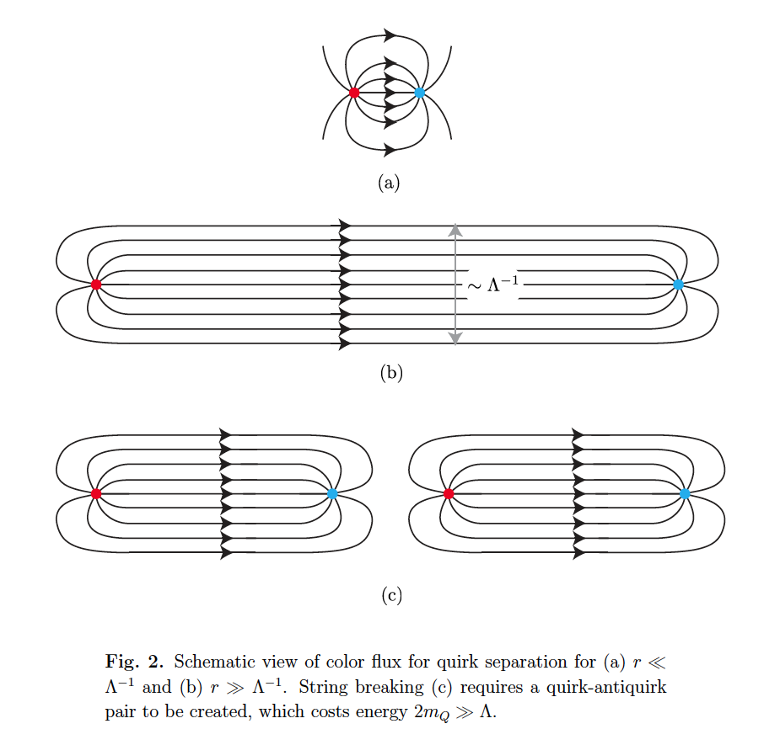
Kang, Lutty arXive: 0805.4642

Slide 31

IN PARTICULAR:
BREAKING OF INFRACOLOUR STRING IS
EXPONENTIALLY SUPPRESSED FOR Λ << m
QUIRK-ANTIQUIRK PAIR STAYS CONNECTED BY THE INFRACOLOUR STRING
LIKE A ``RUBBER BAND’’ THAT CAN STRETCH UP TO MACROSCOPIC LENGTHS
ASSUMING QUIRKS TO HAVE CHARGE e , no strong colour charge →
quirk-antiquirk pair is reconstructed in the detector as a highly-ionizing track
SIGNATURE: large ionization-energy loss rate dE/dx , a jet, from initial state
radiation, and missing transverse energy E_{T} aligned with the track
D0 Coll. arXive:1008.3547

Slide 32
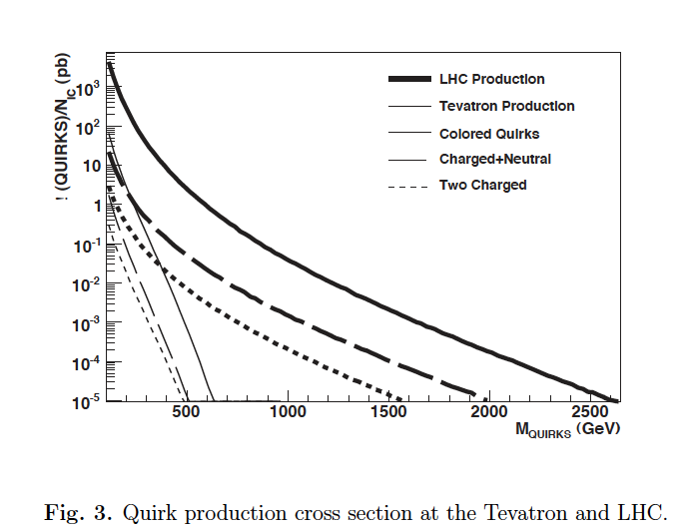
QUIRK PRODUCTION
Kang, Lutty arXive: 0805.4642

Slide 33
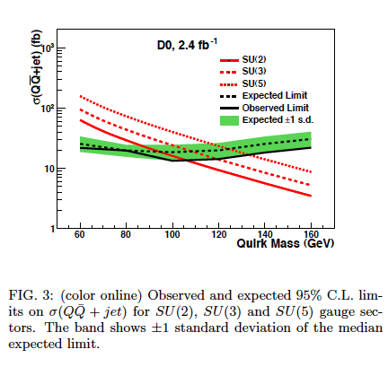
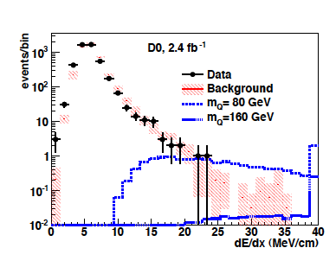
D0 Coll. arXive:1008.3547
QUIRK SIGNAL

Slide 34
QUIRK IN MoEDAL…
QUIRK-ANTIQUIRK PAIR STAYS CONNECTED BY THE INFRACOLOUR STRING
LIKE A ``RUBBER BAND’’ THAT CAN STRETCH UP TO MACROSCOPIC LENGTHS
STRONG IONIZATION EFFECTS – MOST RELEVANT for MoEDAL detector for Λ < 10 keV
Two scenarios for quirk-antiquirk pair:
Move away from the LHCb detector towards
the plastic film as a slowly moving pair (decelerated by flux tube)
if produced close to threshold: One end moves towards LHCb detector & gets stuck, the other towards the plastic film
Quirks May be undetected if moving slowly although stuck in the detector.
LHCb much less dense medium for quirk motion → good candidates for MoeDAL

Slide 35
Q-BALLS

Slide 36



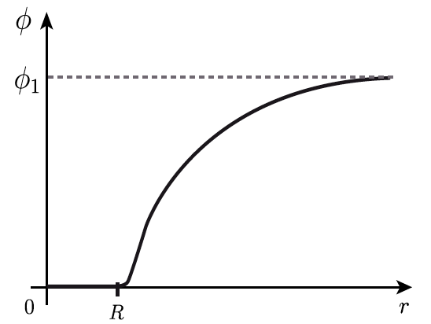


Q-balls
Non-topological soliton field configurations with a global charge Q
Coleman
Friedberg-Lee-Sirlin (multiple scalars)
Global U(1) (phase) symmetry
Spherical
Q-ball
φ = 0
(Potential Minimization)
Size R → Minimize:
φ = φ₁ ≠ 0

Slide 37




Single scalar field Q-balls of size R
φ rotates around the internal symmetry space SO(2) with frequency ω
Conserved charge:
Energy is minimised @ radius R, with energy
per unit charge at minimum
Stable Q-ball if
Many SUSY models have logarithmic one-loop corrections which allow such a condition
to be satisfied, but in most models Q-ball masses are much higher than
electroweak scale … so unlikely to be produced at LHV energies….
Q-balls may be important for Cosmology: can be produced abundantly
in early Universe & play a role in Baryon asymmetry and Dark Matter
Kusenko, Shaposhnikov, Tinyakov

Slide 38
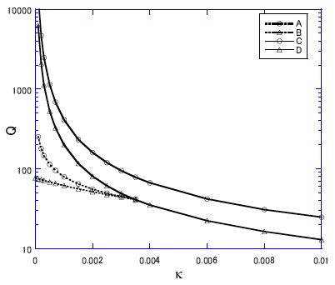


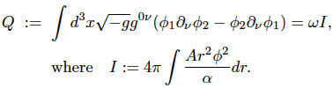
…BUT ABOVE RESULTS FOR FLAT SPACE TIMES ---
Gravity affects Q-ball stability
Tamaki, Sakai arXive:1108.3902
Stable Q-balls with arbitrarily small charge exist in non-flat space-times in
contrast to Minkowski space-time cases for Affleck-Dine potentials …
…no matter how weak gravity is

Slide 39

Q-balls in MoEDAL
HENCE ….
Self-gravitating stable charged Q-balls
with relatively low masses may EXIST →
relevant for LHC energies,
can be highly ionizing
(mass is not relevant for ionization)
so relevant for MoEDAL

Slide 40
CHAMPS
Charged
massive
Particles

Slide 41
de Rujula, Glashow, Sarid (1990)
Dimopoulos, Eichler, Esmailzadeh, Starkman (1990)
Starkman, Gould, Esmailzadeh, Dimopoulos (1990)
WHAT ARE SIMPS?
(I) Charged Massive Particles (CHAMP) : if the whole of DM, as originally assumed
→ cosmological compatibilities require them to be heavy ( 20 teV < M_{Ch} < 1000 TeV)
if charge + 1: Superheavy remnants of H isotopes in the Universe,
particle-antiparticle symmetric → anti-CHAMP may bind with ⁴He nuclei after BBN
but mostly bind to protons to behave like superheavy stable neutrons
But, may be CHAMPS are a (small) part of DM: if neutral DM decays
(at late eras) to CHAMPs stringent bounds may be re-evaluated,
e.g. fraction of CHAMP in galactic halo
< 0.4 – 1.4 x 10⁻² (Sanchez-Salcedo et al. 1002.3145)
Also Galactic magnetic fields || disc, prevent CHAMPS from entering the disc
(non detection on Earth) if their charge q_{X} & mass are in the range:
Chuzhoy & Kolb 0809.0436

Slide 42
CHAMPS - REVISITED
Chuzhoy & Kolb 0809.0436
Also Galactic magnetic fields || disc, prevent CHAMPS from entering the disc
(non detection on Earth) if their charge q_{X} & mass are in the range:
DM density profiles:
these CHAMPS interact with ordinary matter via magnetic field mediation →
affect visible Universe → their density profiles depend on the Galaxy
→ : moderate effects in large elliptical galaxies and Milky way,
expulsion of CHAMPS with moderate charge (Coulomb Interactions
not important) from spherical Dwarf Galaxies → agreement with observations ?
DM Annihilation different from Cold Dark Matter (CDM) model:
attractive Coulomb potential between X⁺ , X⁻
increased annihilation cross section (relative to CDM models)
by a factor c/v (Sommerfield-Sakharov effect)
after CHAMP becomes non relativistic the annihilation rate
falls off slower than in CDM → kinetic energies scale as (1 + z) with redshift
present annihilation rate depends on fraction of X⁻ bound to baryons

Slide 43
CHAMPS - REVISITED
Langacker, Steigman
arXive:11073131
(II) Fractionally Charged Massive Particles (FCHAMP): Leptons with electroweak
interactions (charge U_{Y}(1)) but no strong interactions of mass m_{L} and charge Q_{L} e that
could be fractional.
Constraints from primordial nucleosynthesis & Cosmic Microwave Background
& invisible width of Z boson → Q_{L}-m_{L} relation:
Surviving FCHAMP abundance on Earth several orders of magnitude higher than
limits from terrestrial searches for fractionally charged particles → close window
for FCHAMP Q_{L} ≥ 0.01.
BUT… as Q approaches an integer |Q_{L} – n| ≤ 0.25 these searches are increasingly
insensitive → ``unconstrained islands ‘’ in Q_{L}-m_{L} planes to be explored by
searching for FCHAMPS in Cosmic Rays
& in MoEDAL detector via tracks in the plastics…
…If we can produce FCHAMPS @ LHC….

Slide 44
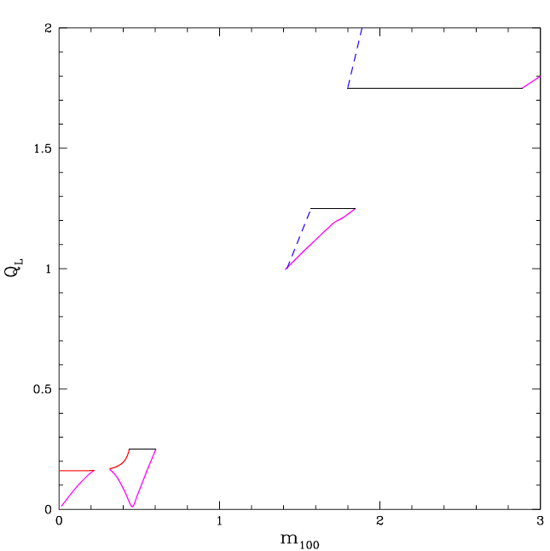

FCHAMPS ``ISLANDS’’
Langacker, Steigman
arXive:11073131

Slide 45
de Rujula, Glashow, Sarid (1990)
Dimopoulos, Eichler, Esmailzadeh, Starkman (1990)
Starkman, Gould, Esmailzadeh, Dimopoulos (1990)
WHAT ARE SIMPS?
(III) SIMP could be neutral (fermion)
Wandelt et al., astro-ph/0006344
Bai, Rajaraman, 1109.6009
e.g. behave like a neutron
so most of astrophysical & terrestrial
constraints can be avoided, especially
if light ….

Slide 46
CONSTRAINTS ON SIMPS/CHAMPS
Bai, Rajaraman, 1109.6009
(i) Direct Detection Searches:
ground exps (CDMS, XENON) → stringent bounds on low cross sections
High Cross sections : SIMP stopped in the atmosphere do not reach ground or
underground detectors -→ high-altitude expts (Baloon, satellite… X-ray Quantum
Calorimeters (XQC)) reach interactions above the atmosphere &
eliminate large portion of SIMP parameter space
(ii) Earth Heating:
SIMP captured gravitationally by Earth, accumulate at core,
→ self-annihilate into SM ptcles → thermalize/modify Earth’s heat flow,
(iii) Neutron Star core collection of scalar SIMP → collapse to black hole
(iv) Cosmic Rays:
protons-SIMP scattering → π⁰ → γγ (assume SIMP near Galaxy Center, uncertain)
(v) CMB, Large Scale Structure modified by strong SIMP - baryon interactions
(vi) Bound States SIMP-Nucleons: if formed -→ constraints exclude models →
avoid such bound states → repulsive forces between SIMPS and nucleons

Slide 47
CONSTRAINTS ON CHAMPS FROM PLASTIC COSMIC RAY DETECTOPS
Scattering of SIMPs off molecules in plastic causes sufficient damage by molecular
bond breaking provided energy deposition is such that:
This corresponds to cross sections
Minimum length of tracks required for tracks to be seen (e.g. 2.5 mm)

Slide 48


Wandelt et al., astro-ph/0006344
Bound States SIMP-Nucleons:
Avoid such bound states → repulsive forces between SIMPS and nucleons → fermion SIMP and scalar φ attractive mediator (for charge neutrality of the Universe), scalar force < two pion exchange
→ nucleon bound states do not form due to φ :
Bai, Rajaraman, 1109.6009
Toy (Instructive) Models
Extend SM by one massive particle m_{x}
Important information: nucleon-X
cross section σ_{xp}
Not modification of Galactic halo shape (e.g. Bullet Cluster) →

Slide 49
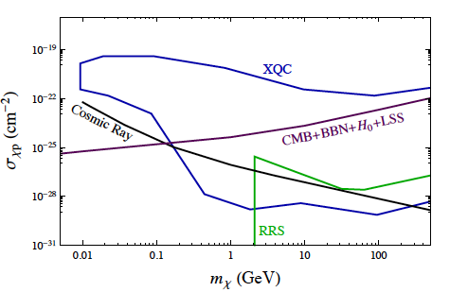
CONSTRAINTS ON SIMPS/CHAMPS
Bai, Rajaraman, 1109.6009
m_{X} < 1 GeV , σ_{xp} < 10⁻²⁵ cm⁻² ALLOWED !!

Slide 50
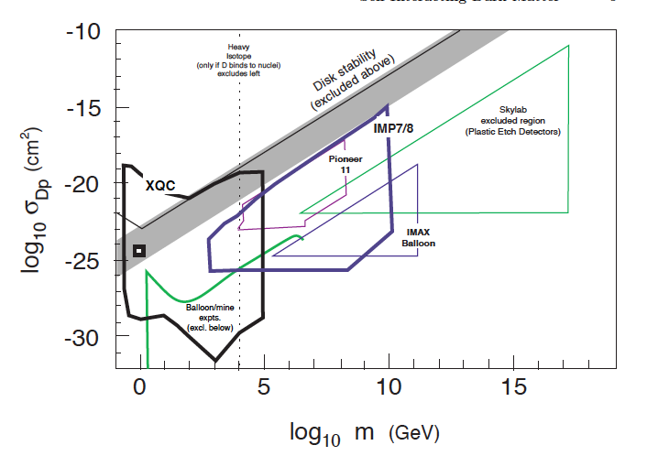
Wandelt et al., astro-ph/0006344

Slide 51
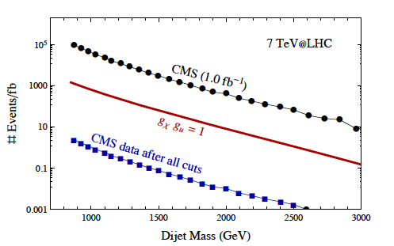

DARK MATTER di-JETS FROM ALLOWED Neutral SIMPs
Bai, Rajaraman, 1109.6009
scattering Length
can be smaller than
calorimeter size →
deposit energy in
the form of Jets →
if DM neutral, no track
→ difference from QCD jets
Such phenomena for m_{χ} < 1 GeV are interesting but not relevant to MoEDAL…

Slide 52
Relevant to MoEDAL possibly if …
sufficient damage in plastics
requires
Cosmology constraints
So we need unnatural large factors if relevance to MoEDAL is attained
e.g. for m_{χ} = 1 TeV
must have
Rather unlikely , taking into account other constraints –
see above … BUT not quite impossible

Slide 53
D-MATTER

Slide 54
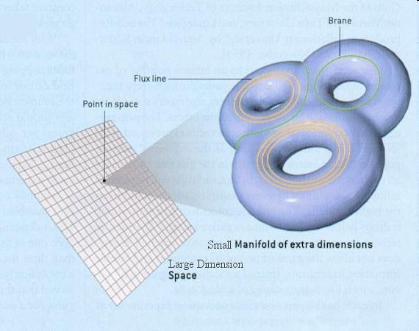
What is String Theory?
Fundamental Excitations
are not point-like but
one-dimensional (strings)
Open
Closed
ONE VERSION :
Strings live in Large
Four space-time dimensions but have extra dimensions
``Curled-up’’ in small-size but of complicated
Geometry spaces

Slide 55
What is String Theory?
Fundamental Excitations
are not point-like but
one-dimensional (strings)
Open
Closed
ONE VERSION :
Strings live in Large
Four space-time dimensions but have extra dimensions
``Curled-up’’ in small-size but of complicated
Geometry spaces
Gravitons
(carrier of Gravitational
Interactions)

Slide 56

What is String Theory?
Fundamental Excitations
are not point-like but
one-dimensional (strings)
Open
Closed
ONE VERSION :
Strings live in Large
Four space-time dimensions but have extra dimensions
``Curled-up’’ in small-size but of complicated
Geometry spaces
Gravitons
(carrier of Gravitational
Interactions)
Gravity Unified
with rest of Interactions

Slide 57
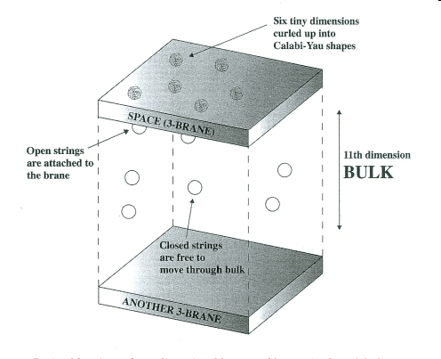
SECOND VERSION OF STRING THEORY (BRANE-THEORY):
Our Universe
Lorentz Invariant

Slide 58
SECOND VERSION OF STRING THEORY (BRANE-THEORY):
Our Universe
Lorentz Invariant
(Standard Model particles)

Slide 59
SECOND VERSION OF STRING THEORY (BRANE-THEORY):
Our Universe
Lorentz Invariant
(Standard Model particles)
(Gravitons)
Gravity Unified
with rest of Interactions

Slide 60
STRING/D-BRANE BASICS
p-branes:
have p longitudinal
dimensions
over which strings
have their ends
attached
String theory
p-brane types allowed
Heterotic Strings admit no p-branes

Slide 61
STRING/D-BRANE BASICS
String theory
p-brane types allowed
Phenomenologically
relevant
Heterotic Strings admit no p-branes

Slide 62
STRING/D-BRANE BASICS
String theory
p-brane types allowed
Wrap
3-branes
around
3 cycles
Effective
``point-like’’
localised on
higher
dimensional
brane worlds
Heterotic Strings admit no p-branes

Slide 63
STRING/D-BRANE BASICS
String theory
p-brane types allowed
Wrap
3-branes
around
3 cycles
Effective
``point-like’’
localised on
higher
dimensional
brane worlds
e.g. 5,7-branes
Heterotic Strings admit no p-branes

Slide 64
ANTOHER VERSION of BRANE WORLDS with D-PARTICLE
(POINT-LIKE BRANE) DEFECTS :
(Standard Model particles)
(Gravitons)
D-particle defect
J Ellis, NEM, M Westmuckett

Slide 65
ANTOHER VERSION of BRANE WORLDS with D-PARTICLE
(POINT-LIKE BRANE) DEFECTS :
(Standard Model particles)
(Gravitons)
D-particle defect
(effectively point-like,
wrapped up 3-brane
around 3 cycle)
J Ellis, NEM, M Westmuckett

Slide 66
ANTOHER VERSION of BRANE WORLDS with D-PARTICLE
(POINT-LIKE BRANE) DEFECTS :
Our Universe
NO LONGER
Lorentz Invariant
Recoil of defect
(Standard Model particles)
(Gravitons)
D-particle defect
J Ellis, NEM, M Westmuckett

Slide 67
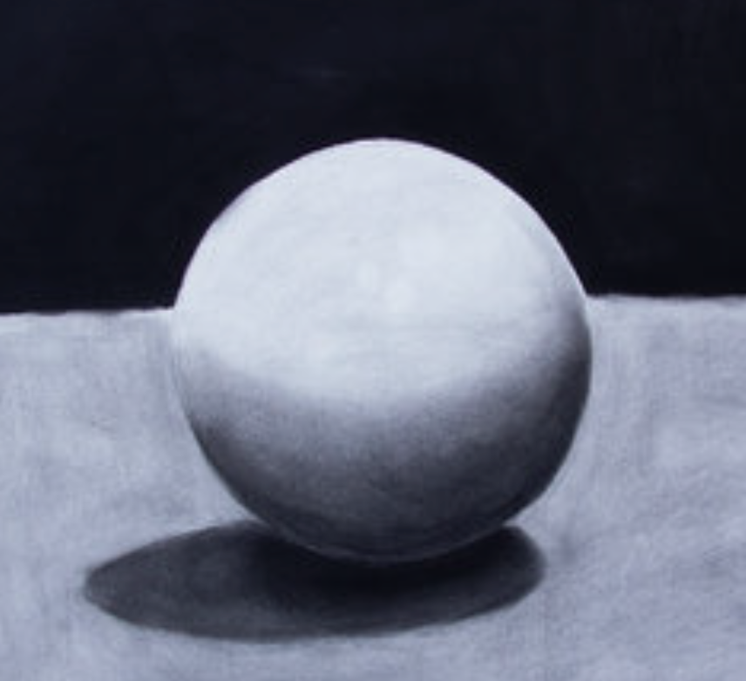
D-matter
Such wrapped up p-branes branes
around p-cycles appear as localised objects
when embedded in higher-dimensional
p’ brane worlds (p’ > p)
Have small (string scale) compactification radii
Can be considered as effectively point-like ``localised’’
excitations from string vacuum
TERMED D-PARTICLES → form of D(efect)-matter
They have masses M_{D} = M_{s}/g_{s}
M_{S} = STRING MASS SCALE (≥ TeV phenomenologically)
g_{s} < 1 = (WEAK) STRING COUPLING
wrapped
up p-brane
p’ brane
G Shiu L-T Wang 2003
J Ellis, NEM, Wesmuckett 2004
Can play the role of a kind of
Dark matter/dark energy fluid

Slide 68
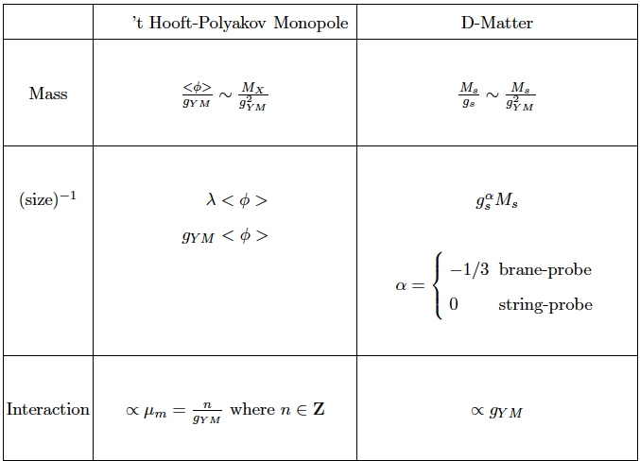
D-matter vs Monopoles

Slide 69
D-matter vs Monopoles
Symmetry Breaking scale

Slide 70
D-matter vs Monopoles
Symmetry Breaking scale
NON-PERTURBATIVE
PERTURBATIVE

Slide 71
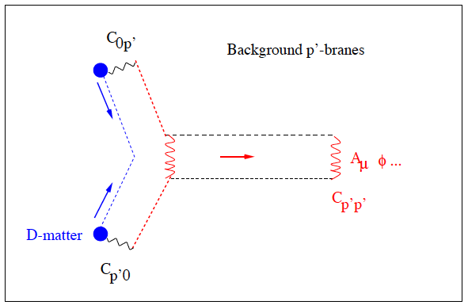

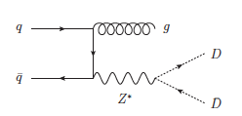
D-matter/SM matter interactions
Via exchange of open strings
stretched between D-particle
and p’ (D-brane) world
D-matter Mass spectrum
Can be produced @ LHC
if M_{s} = O(10 TeV)
Lightest D-matter
(stable, play role of DM)
e.g.

Slide 72
D-matter/SM matter interactions
Via exchange of open strings
stretched between D-particle
and p’ (D-brane) world
D-matter Mass spectrum
Can be produced @ LHC
if M_{s} = O(10 TeV)
Lightest D-matter
(stable, play role of DM)
e.g.
Excited states can be electrically
(or magnetically) charged → can be
highly ionizing → relevant to MoEDAL

Slide 73
Black-Hole
Remnants in Large extra dimensions

Slide 74
Large Extra dimension models motivated by string theory
Arkani-Hamed
Dimopoulos, Dvali
(string models)
Randall Sundrum
(brane models)
Both relevant
for providing
resolution of
the hierarchy
problem
in field theory
Stringy effects @ low
scales (TeV ) possible

Slide 75
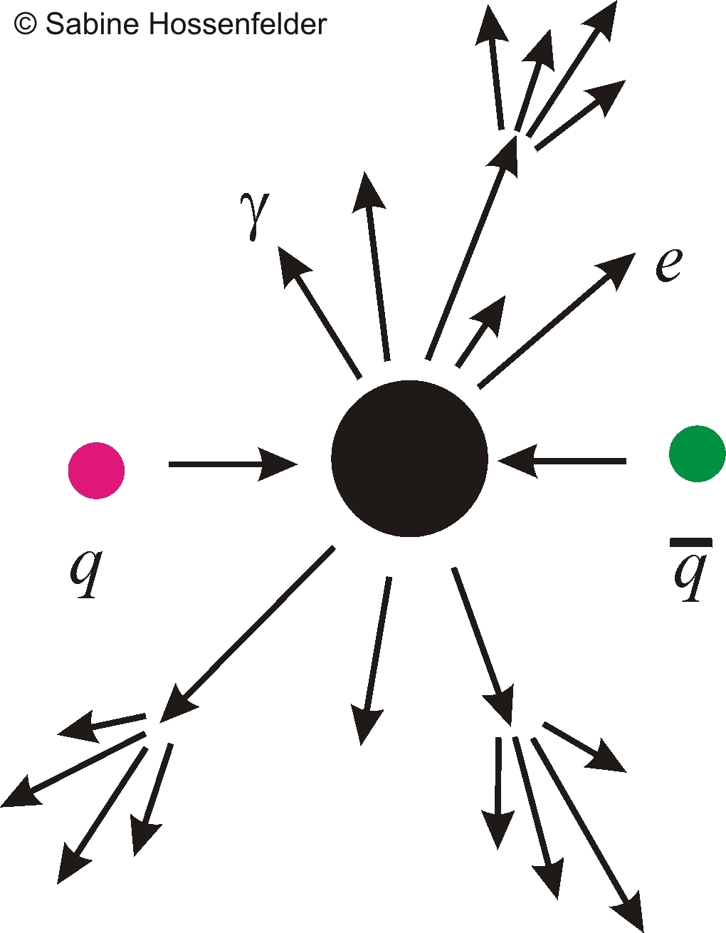
Large Extra dimension models motivated by string theory
Arkani-Hamed
Dimopoulos, Dvali
(string models)
Randall Sundrum
(brane models)
Both relevant
for providing
resolution of
the hierarchy
problem
in field theory
Stringy effects @ low
scales (TeV ) possible
Dimopoulos, Landsberg
Formation of TeV Black Holes (BH) by high energy SM particle Collisions

Slide 76
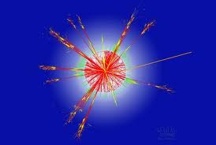
Large Extra dimension models motivated by string theory
Arkani-Hamed
Dimopoulos, Dvali
(string models)
Randall Sundrum
(brane models)
Both relevant
for providing
resolution of
the hierarchy
problem
in field theory
Stringy effects @ low
scales (TeV ) possible
Dimopoulos, Landsberg
Formation of TeV Black Holes (BH) by high energy SM particle Collisions
BH produced in proton-proton collisions can carry electric charge
Charged BH Hawking evaporate but not completely → certain fraction of final
BH remnants carry charge (BH±)

Slide 77
BH formed from proton-proton collisions are formed from interactions of
valence quarks (carry largest available momenta of partonic system) →
BH average charge 4/3 → after evaporation to stable remnants, some
accumulated net charge
Most of BH remnants carry charge zero or one (in units of electron charge)
smaller but non negligible fraction carry multiple charges → highly ionizing,
relevant to MoEDAL
Estimated number of BH remnants vs charge using PYTHIA event generator
& CHARIBDIS program for BH decay

Slide 78
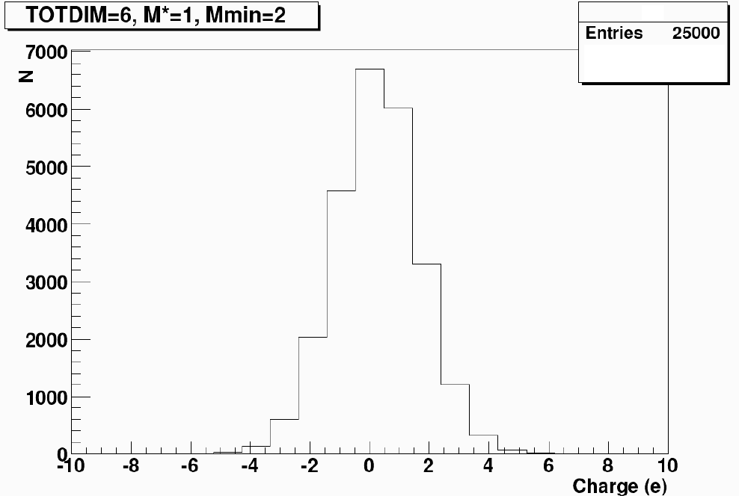
TeV
remnant

Slide 79
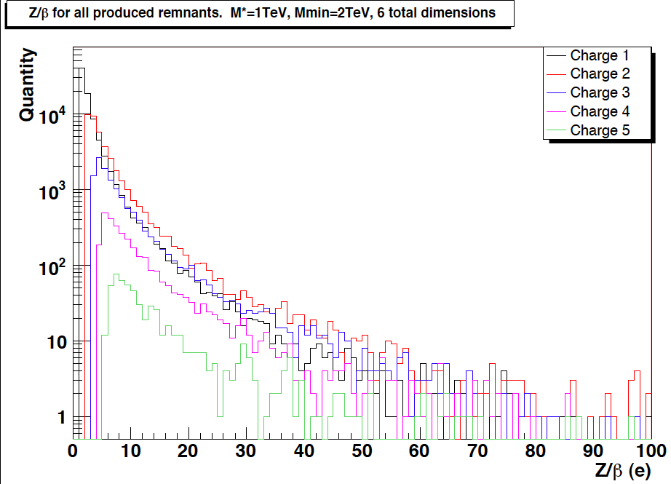

Slide 80
Conclusions - Outlook
Topic of talk: Several Instances where highly ionizing massive particles can appear @ the LHC energy range in non supersymmetric scenarios
Such charged massive particles vary from Q-balls to extra-dimensional TeV mass Black Hole remnants and D-matter
Can be relevant for MoEDAL Physics if long lived & slowly moving, highly ionizing → may be undetectable in ATLAS & CMS, good targets for MoEDAL?

Slide 81
Conclusions - Outlook
PROSPECTS LOOK GREAT FOR LHC Expts
FUTURE LOOKS BRIGHT FOR MoEDAL - MAY DETECT NOT ONLY MONOPOLES BUT OTHER EXOTICS AS WELL & probably exclusively …
MAY BE SURPRISES ARE AROUND THE CORNER EVEN FOR THEORISTS
…Carry on Searching …

Slide 82
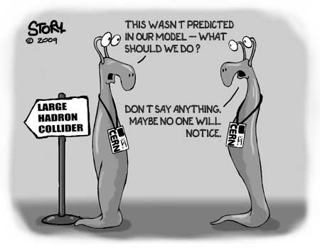
Conclusions - Outlook

Slide 83


Conclusions - Outlook
I do not
think so! I’m
checking on you theorists!

