Slide 1

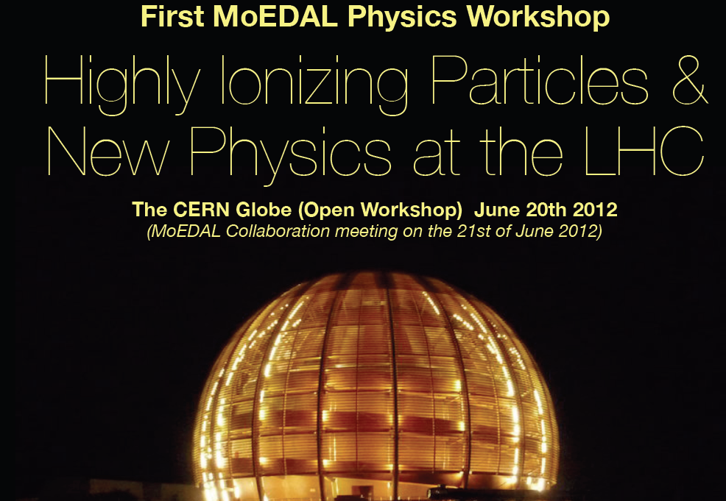
Search for Heavy Stable
Particles in CMS
Albert De Roeck
CERN, Geneva, Switzerland
Antwerp University Belgium
Davis University USA
June 20 2012

Slide 2
Contents
The CMS experiment and the LHC
Searching for heavy stopped particles
Searching for heavy ionizing particles
Searching for displaced vertices
Outlook for monopole searches
Summary

Slide 3
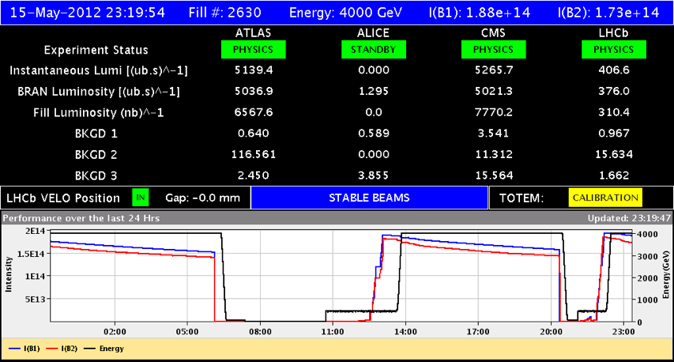
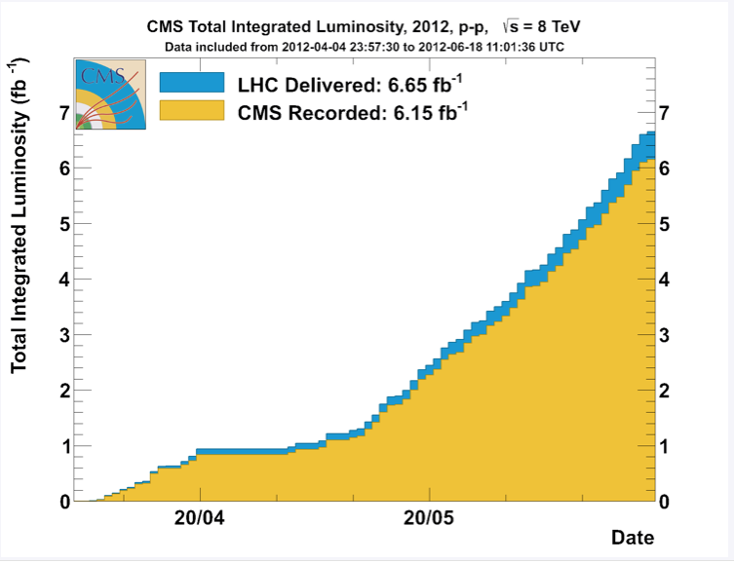
LHC is performing well …
2012: Proton – Proton collisions
at 8 TeV
The experiments have collected
~6.6 fb⁻¹ recorded luminosity, before
the 2012 summer conferences.
We doubled the 2011 data sample
…and in total expect more than 20 fb⁻¹
of data 2011-2012 combined
->Exciting times for searches
->Exciting time for the Higgs for
ATLAS and CMS

Slide 4
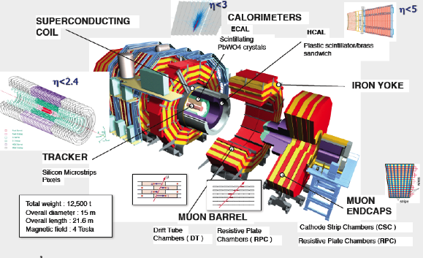
The CMS Experiment
Acceptance: Calorimetry |η| <5.0 Tracking |η|<2.4
Length = 22 m Width = 15 m Height = 15 m but spatial precision ~ 100 μm

Slide 5
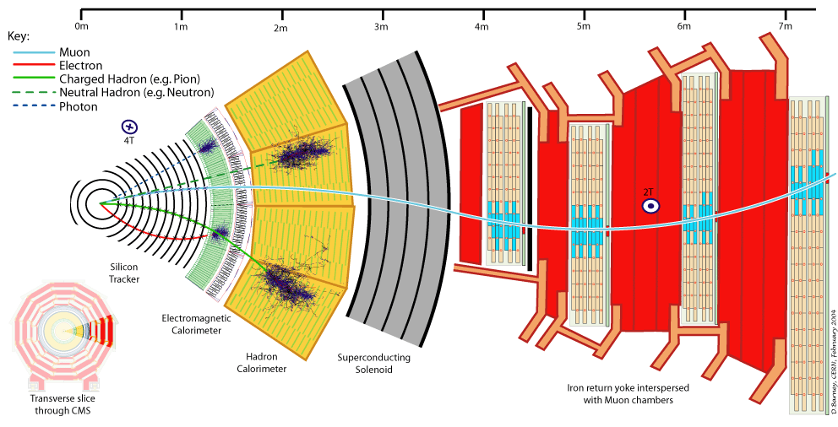
Particle Detection in CMS
Electromagnetic Calorimeter
Muon Spectrometer
Hadron Calorimeter
Inner Tracker
Magnet
Return flux
4
Notes:
4

Slide 6
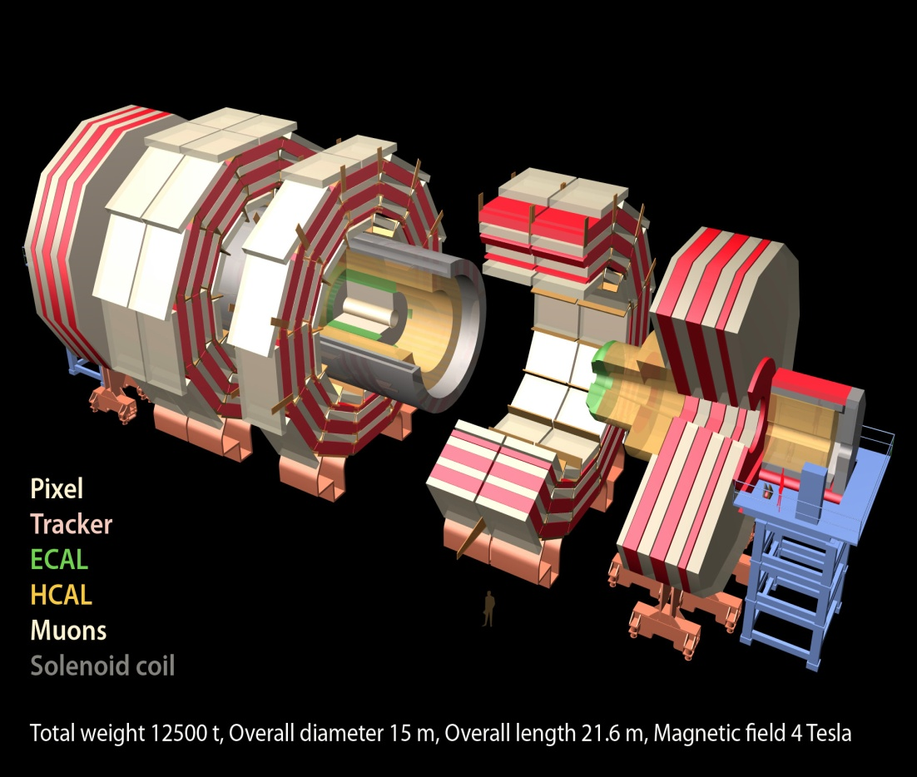
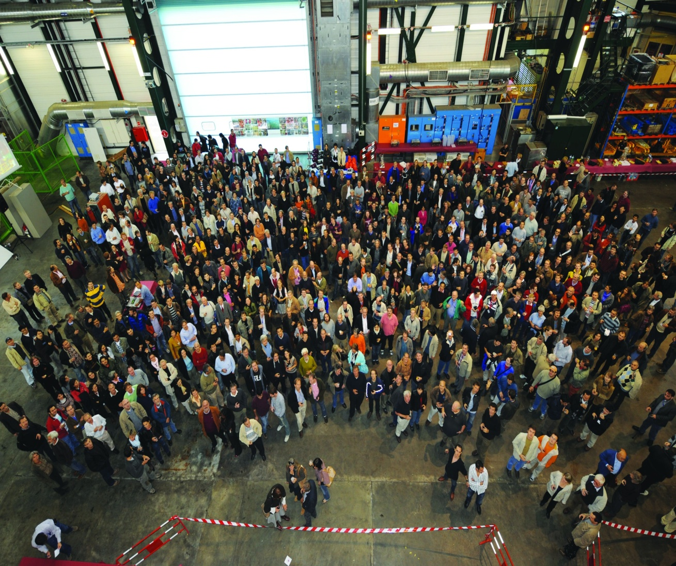
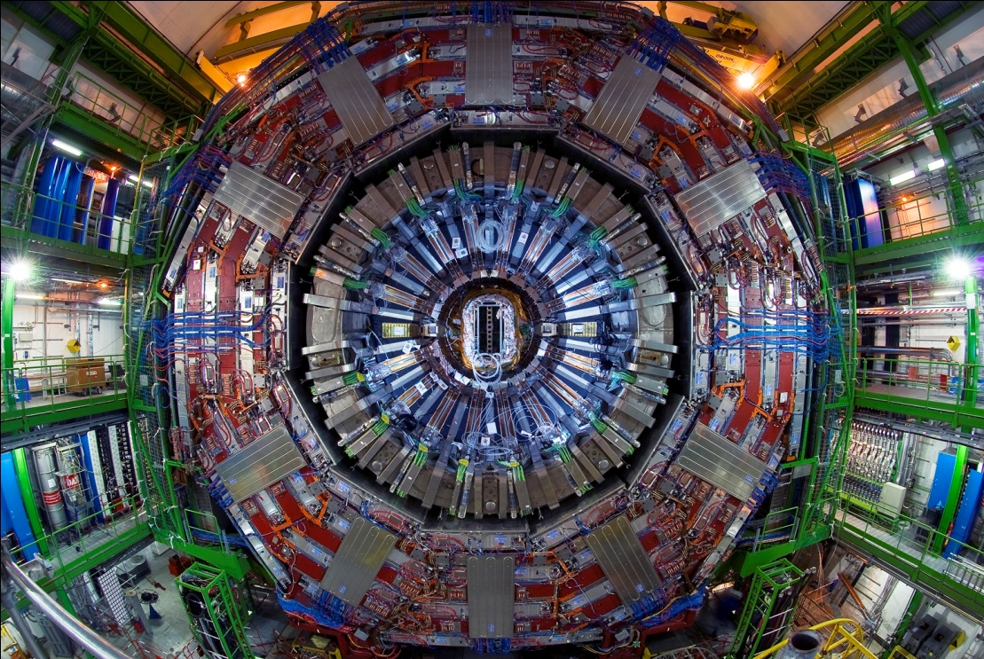
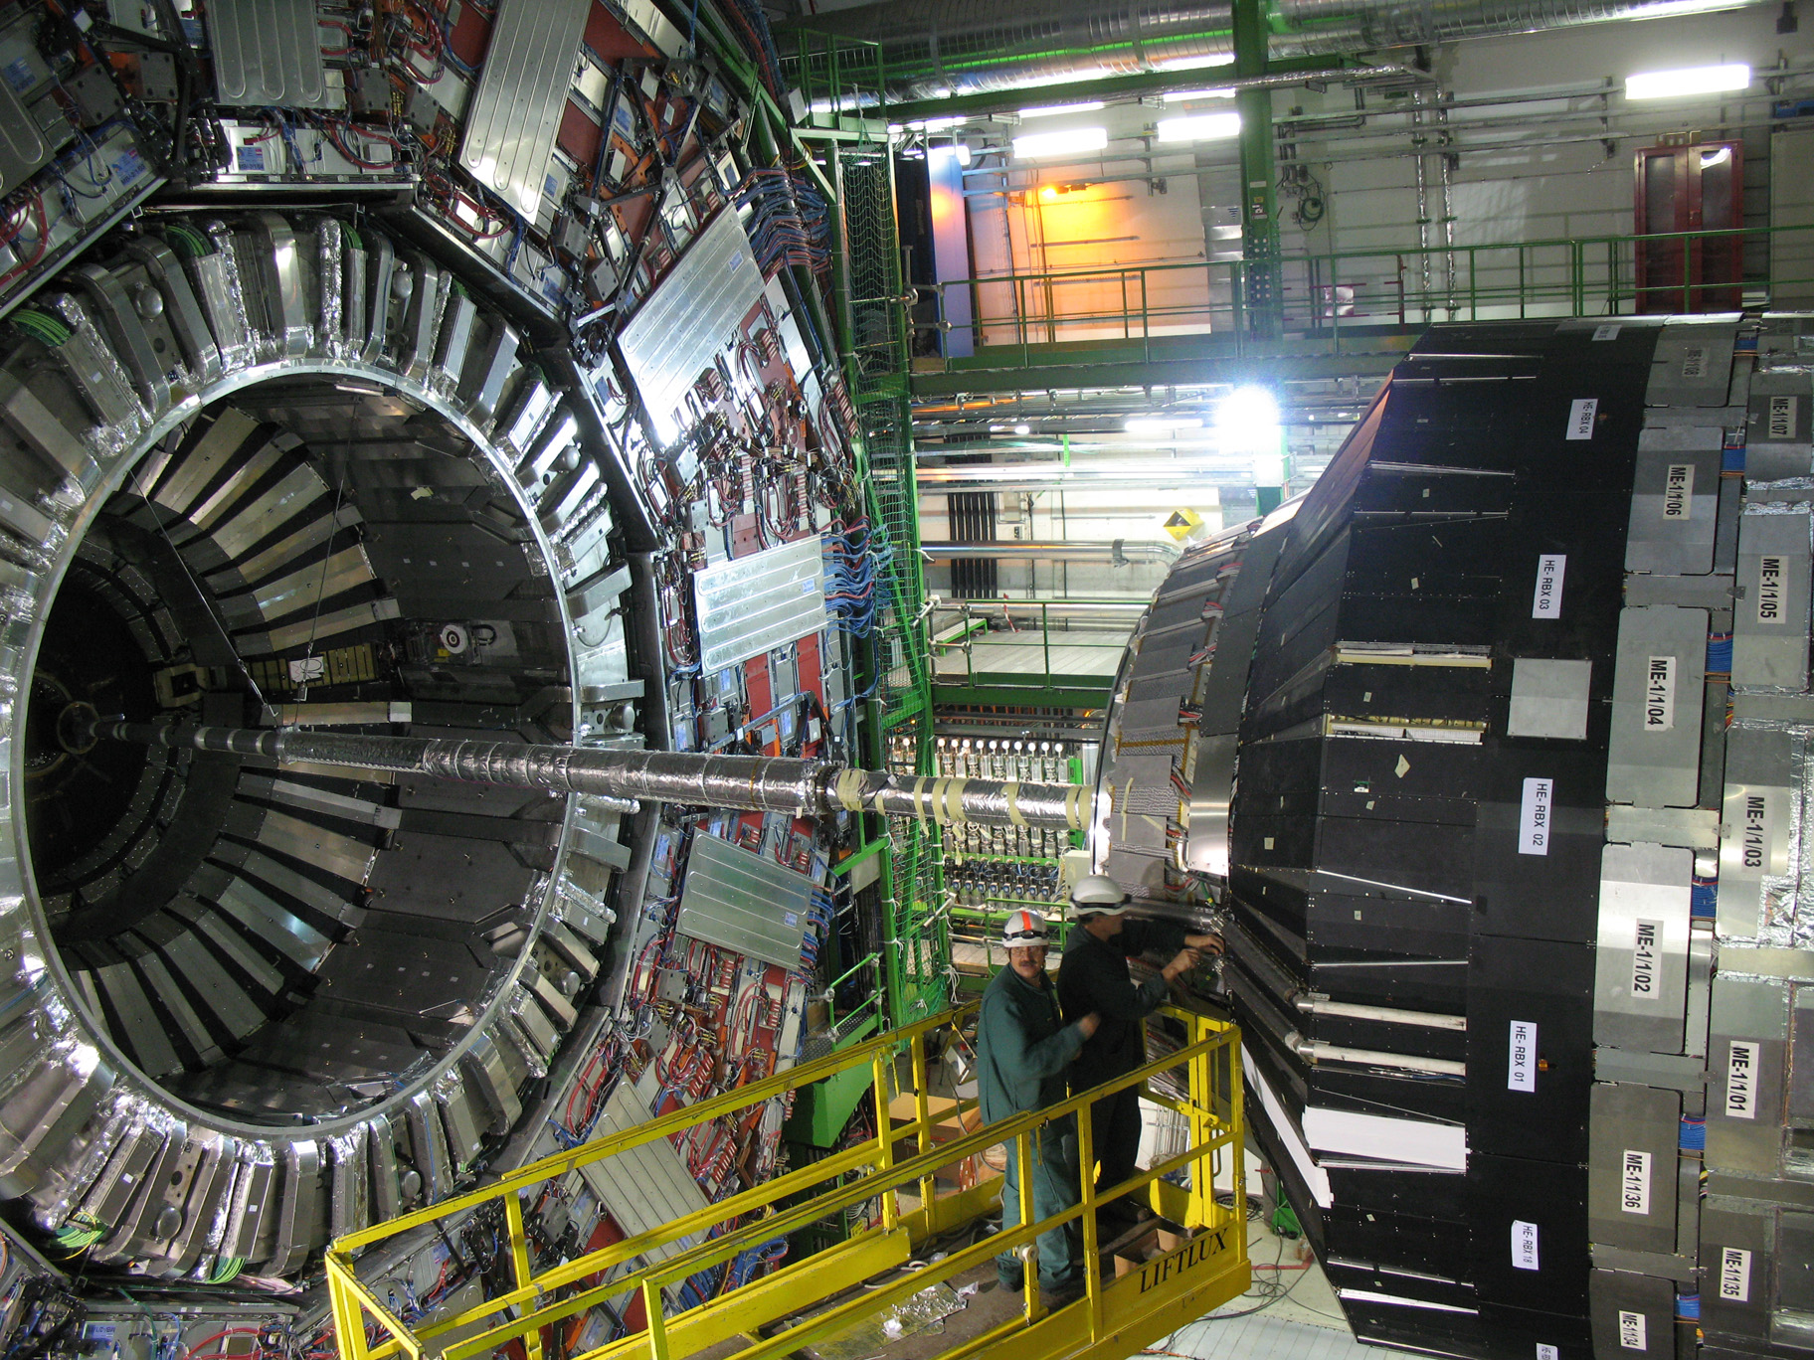
The CMS Collaboration: >3200 scientists and engineers,
>800 students from 185 Institutions in 39 countries .
~ 1/4 of the people who made CMS possible

Slide 7
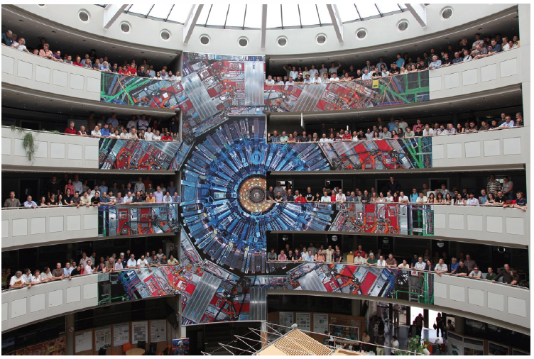
The CMS Experiment (B40)

Slide 8
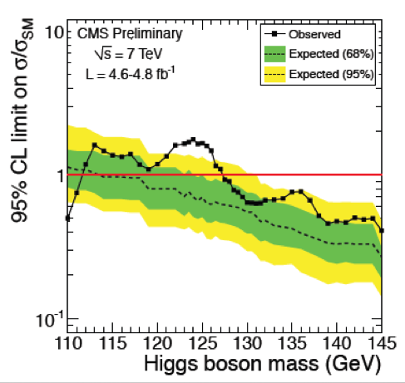
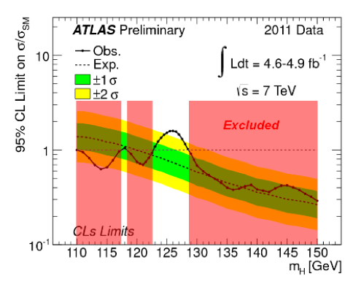
The Higgs Search on 2011 Data
Results from the 2011 data
The mass region where Higgs particles can possibly live has been reduced to very small mass range of 115-130 GeV (95% CL)
We see an excess of events in that region over expectation from pure background. Cool!
Is this the first sign of the ‘growing Higgs signal?
Is it a statistical fluctuation in the background? We can’t say for sure.
→ In about 2 weeks time we look at the 2012 data!!!

Slide 9
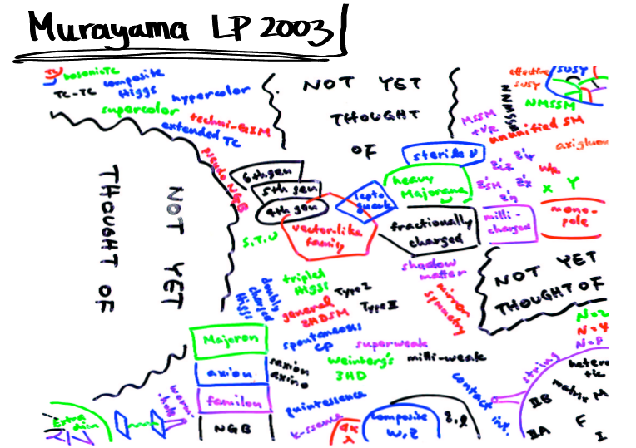
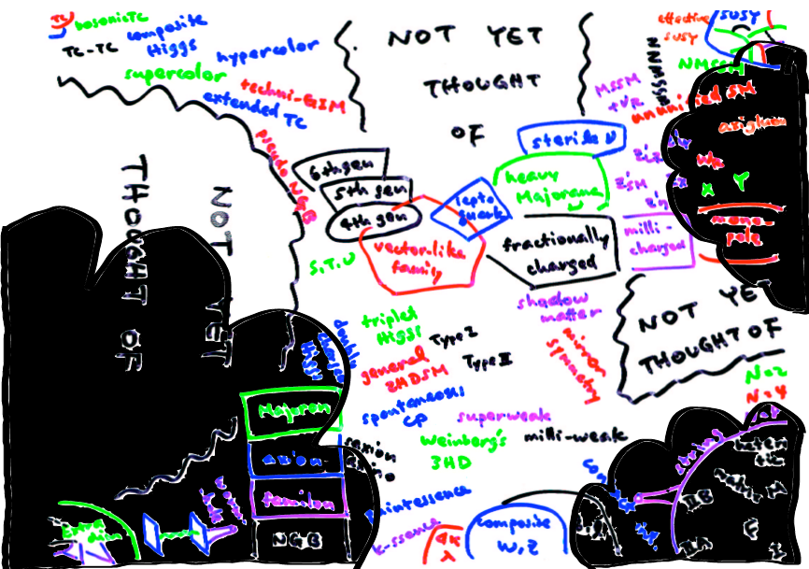
New Physics: Theory Space
2011: LHC Impact
M. Schmaltz
Note that during the 3-4 years before first collisions we
-LHC experimentalists-
got more models to deal with
than we needed…
Some theorists found it a
challenge to invent a model
with signatures difficult for
the experiments:
heavy stable charged particles,
hidden valley models, Quirks…
NOW WE STRIKE BACK!!
A number of analyses search
for “unusual” particles in CMS

Slide 10
Searches for Unusual Particles
Heavy stable charged particles with unit charge traversing the detector
Heavy stable charged particles with multiple charge traversing the detectors
Heavy stable charge particles with fractional charge traversing the detector
Heavy new particles decaying in the detector
Heavy new particles stuck in the material in or before the detector

Slide 11
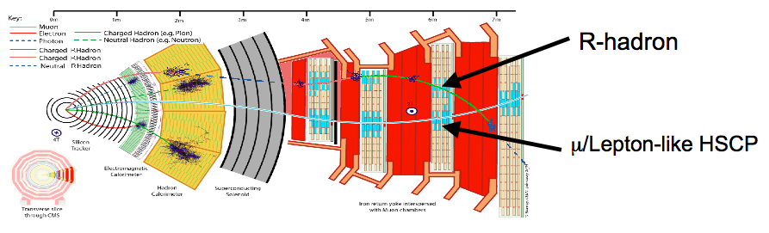
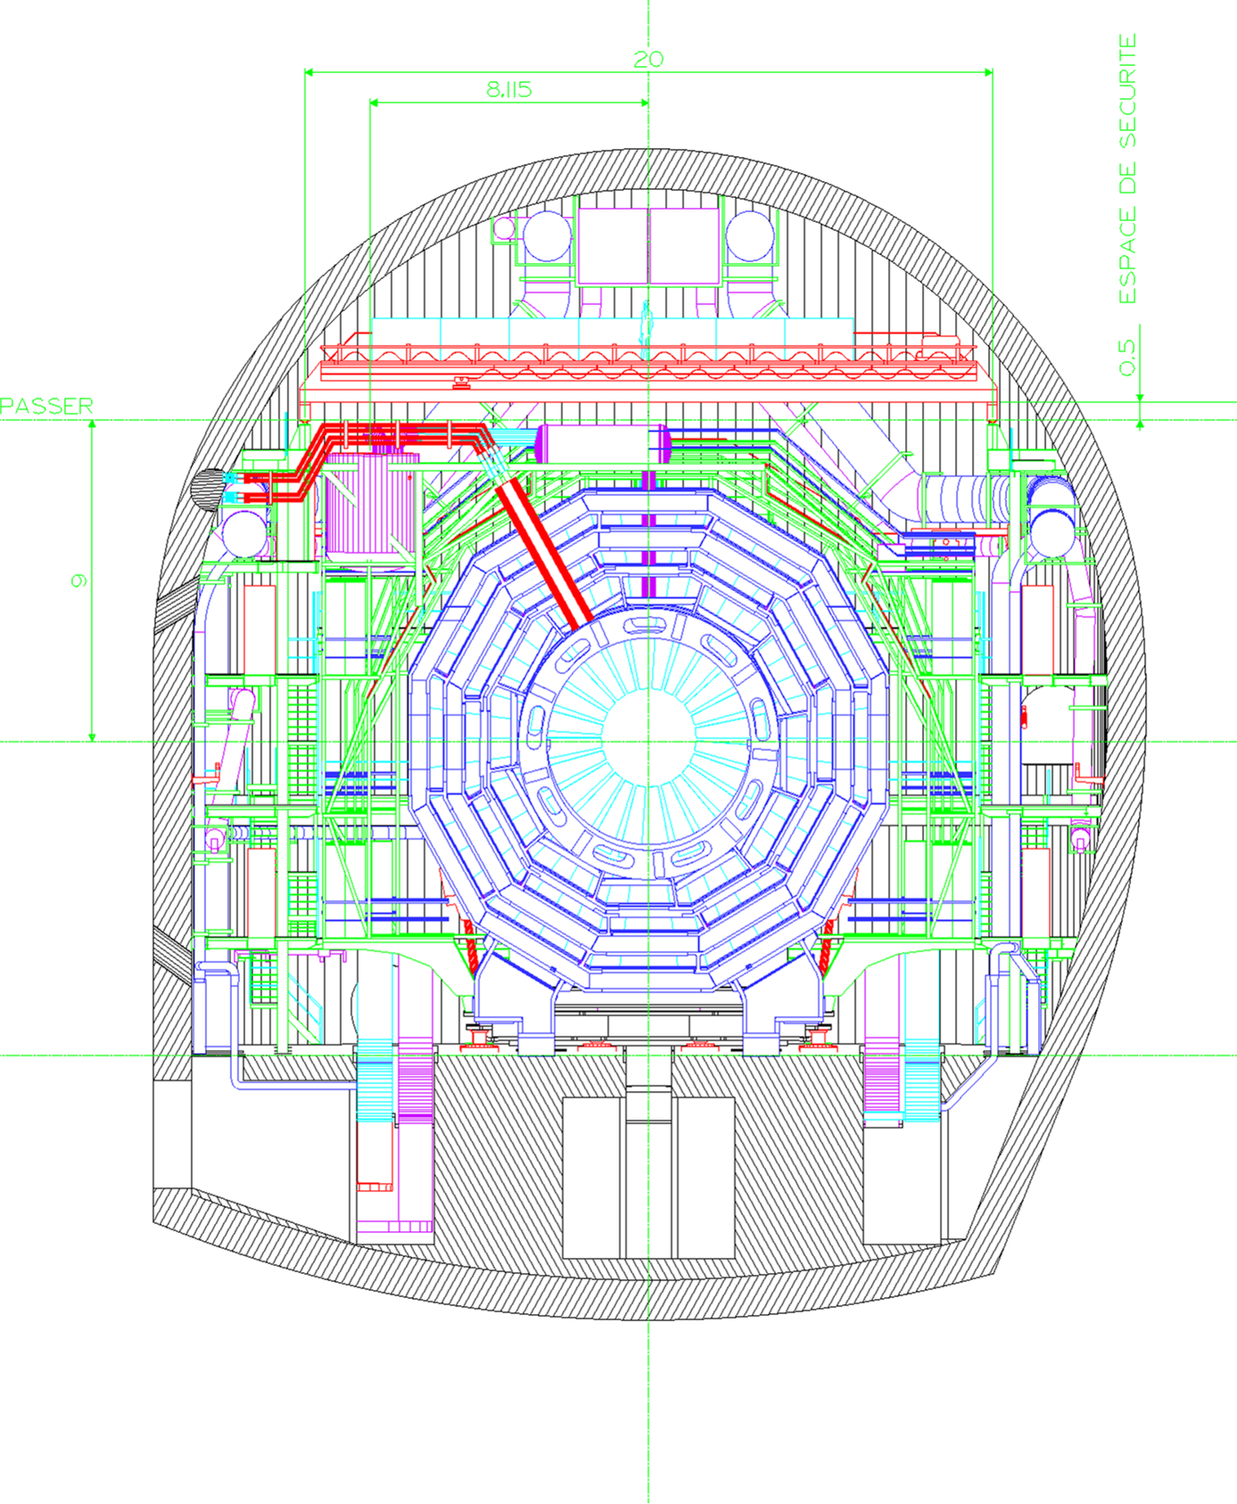
Long Lived Particles
Split Supersymmetry
The only light particles are the Higgs and the gauginos
- Gluino can live long: sec, min, years!
- R-hadron formation (eg: gluino+ gluon): slow, heavy particles
Gravitino Dark Matter and GMSB
In some models/phase space the gravitino is the LSP
⇒ NLSP (neutralino, stau lepton) can live ‘long’
⇒ non-pointing photons
Hidden Valley modes!…
Plethora of possibilities for long lived neutrals
EG: K. Hamaguchi,M Nojiri,ADR hep-ph/0612060
ADR, J. Ellis et al. hep-ph/0508198
Sparticles stopped in the detector,walls
of the cavern, or dense ‘stopper’ detector.
They decay after hours---months…
⇒Challenges to the experiments!

Slide 12
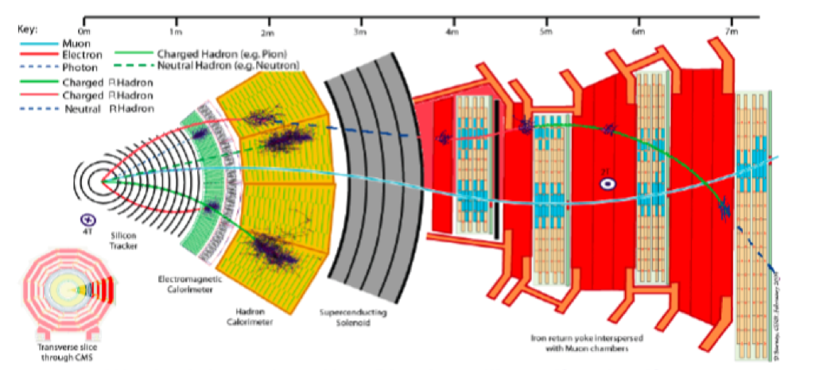
R-Hadrons Passing Through the Detector
• They ‘sail’ through the detector like a ‘heavy muon’
• In certain (hadronization) models they may change charge on the way
• They also loose a lot of energy when passing the detector (dE/dx)
Weird
signature!!

Slide 13
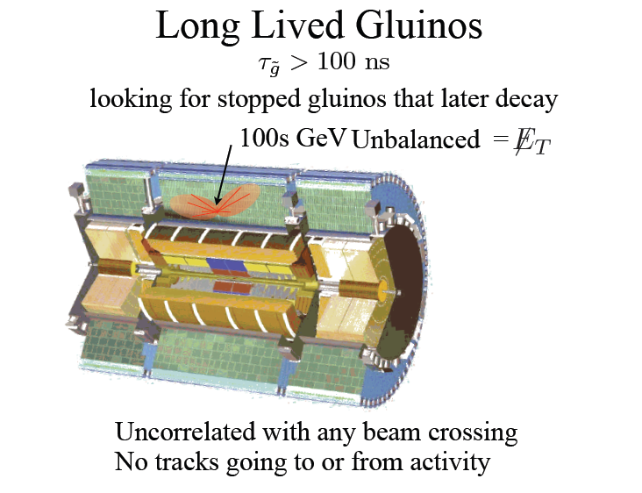
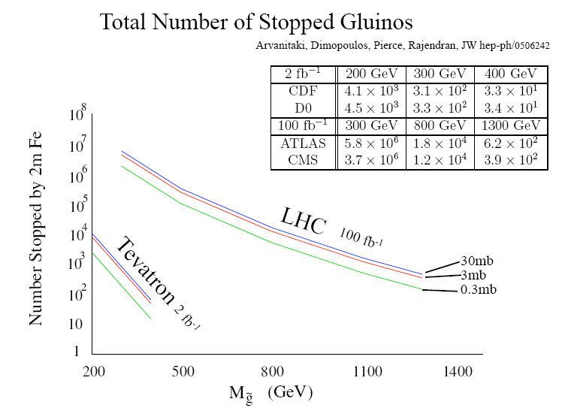
Stopped R-hadrons or Gluinos!
The R-hadrons may loose
so much energy that they
simply stop in the detector
⇒ Special triggers needed, asynchronous with the bunch crossing

Slide 14
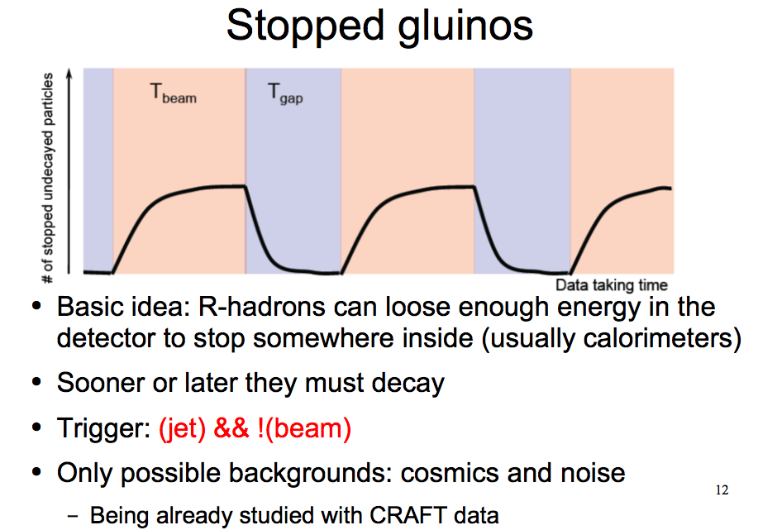
Eg when there is no beam!
Can be studied in the experiments with cosmic data before data taking

Slide 15
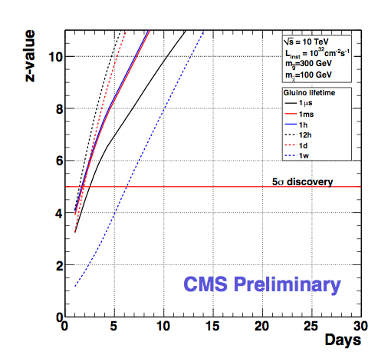
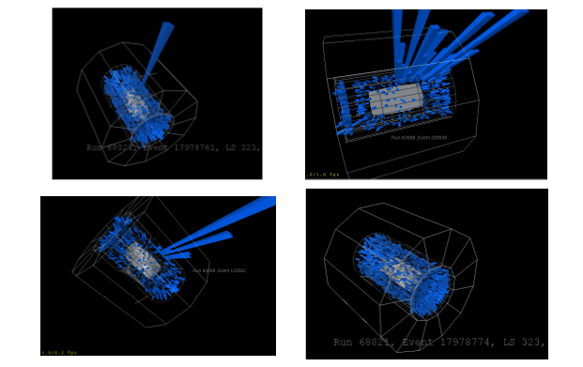
Stopped Gluinos
Studies in CMS with the 2008/2009 cosmic data:
All events we found then are background and we learn how to cut on them!
Sensitivity for a luminosity of 10³² cm⁻²s⁻¹
Find energy
splashes with
certain
topology
Discovery with only
a few weeks running??

Slide 16
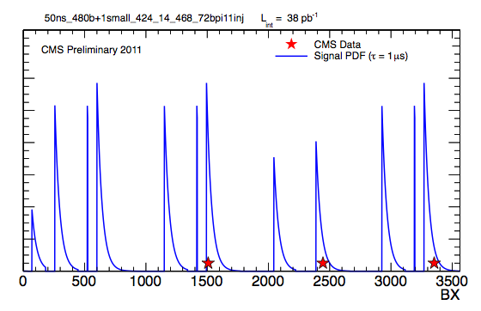
Search for Stopped Gluinos
In-orbit positions of observed events in a subset of the data
with the decay profile for a 1µs lifetime hypothesis overlaid

Slide 17
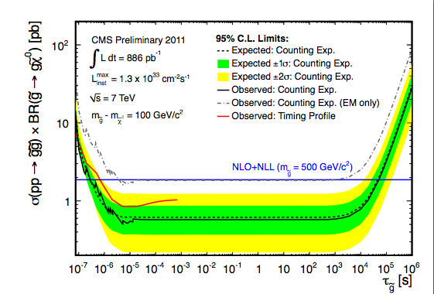
Search for Stopped Gluinos
95%C.L. limits on gluino pair production cross section times branching fraction

Slide 18
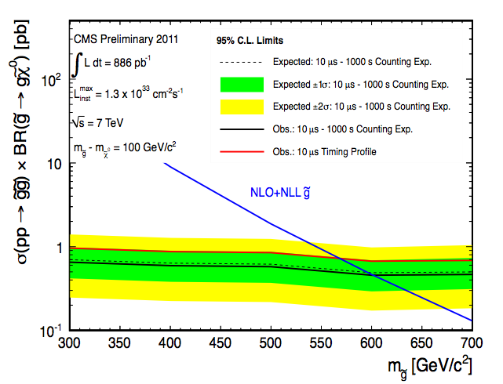
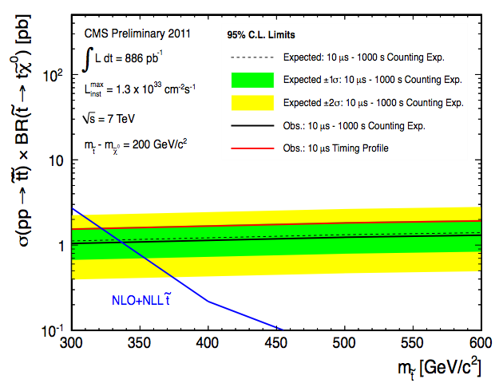
Search for Stopped Gluinos
Search for Heavy Stable Charged Particles that stop in the detectors
and decay a long time afterwards (nsec, sec, hrs…)
Special data taking after the beams are dumped and during beam
abort gap
CMS-EXO-11-020
95% CL Limits: Stopped Gluinos > 600 GeV, Stopped Stop quarks> 337 GeV

Slide 19


Heavy Charged Particles
Detection techniques used for heavy (multiple/fractional ) stable charge particles in CMS
• Abnormal energy loss (de/dx) for given momentum
• Slower than speed of light (lowβ) via time of flight measurements
with the CMS muon system (CSC/DT/RPC)
• A few special measurements
Time of flight

Slide 20
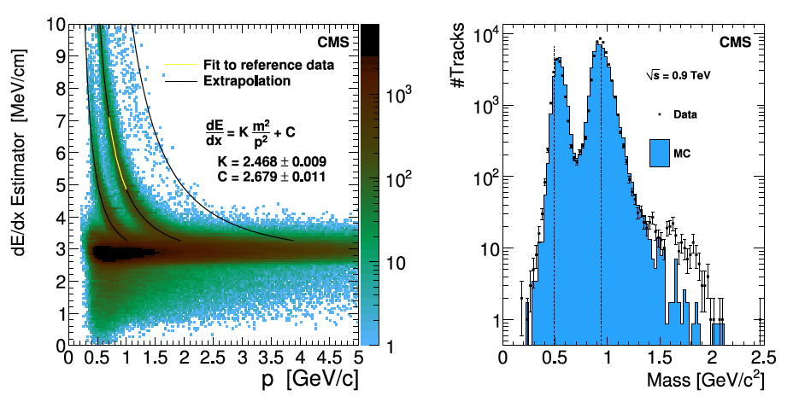
Energy Loss in the Tracker
Using the energy loss de/dx in the silicon tracker
Clear tracks from kaons and protons observed

Slide 21
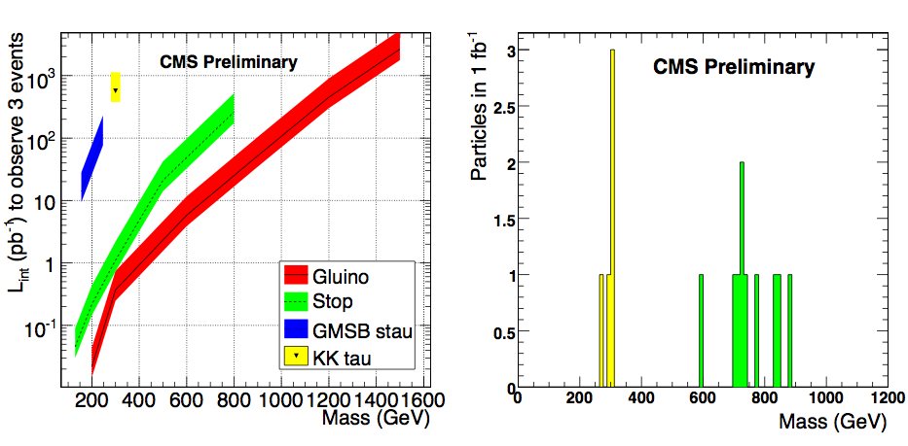
Heavy Stable Charged Particles
Sensitivity for different models:
⇒ Gluinos, stop, stau and KK_tau production
CMS Physics TDR 2006
Luminosity needed for
a discovery
Mass reconstruction for a 200 GeV KK_tau
and a 800 GeV stop particle

Slide 22
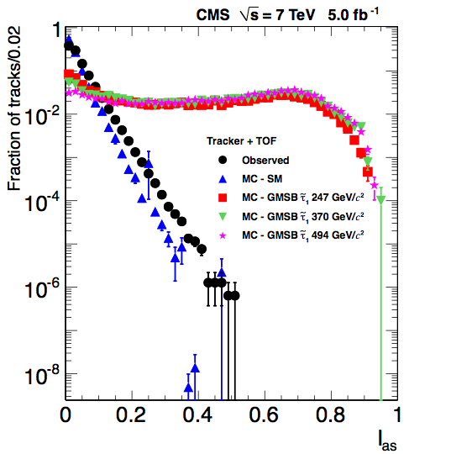
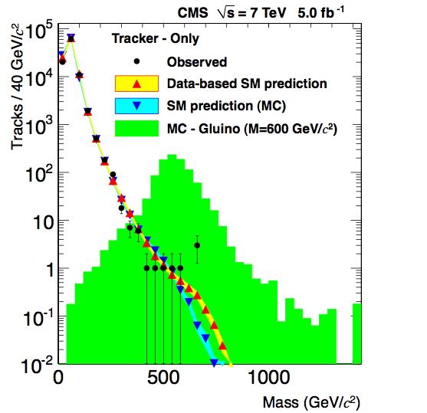
Heavy Stable Charged Particles
dE/dx related variable

Slide 23
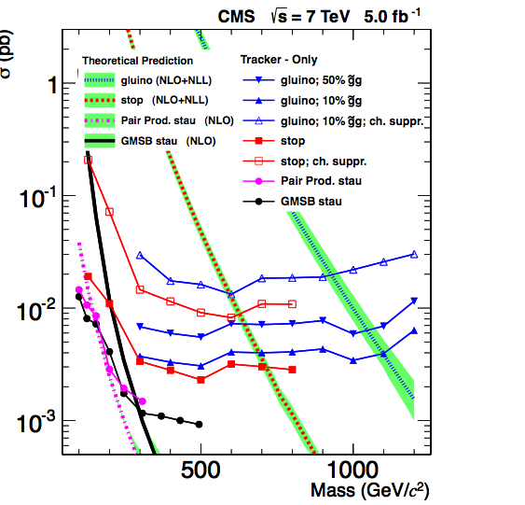
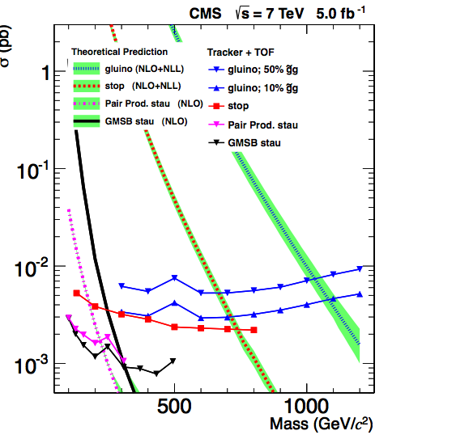
Heavy Stable Charged Particles
CMS-EXO-11-022
Stable particles that
traverse the detector,
and move slowly
Eg heavy stable
gluino or stop/stau
Search limits using
tracker de/dx and
Muon TOF information
Result for 5 fb⁻¹:
#Events consistent with
estimated background
No gluinos (stop) found for masses up to
about 1200 (800) GeV

Slide 24
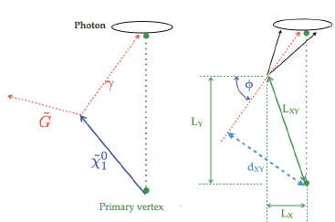
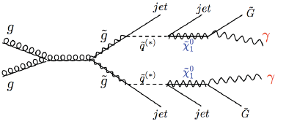

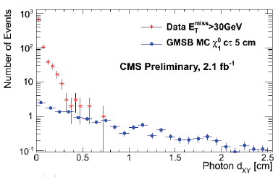
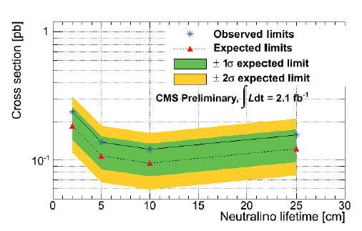
Displaced Photons
EG: GMSB models, Hidden Valleys
•Use photon conversions in CMS tracker
•Probe ~0.1-1.0 nsec lifetimes
(2-25 cm displaced vertices)
•Select events with 2 jets, 2 photons and MET
CMS-EXO-11-067
Cross section upper limit
Transverse displacement

Slide 25
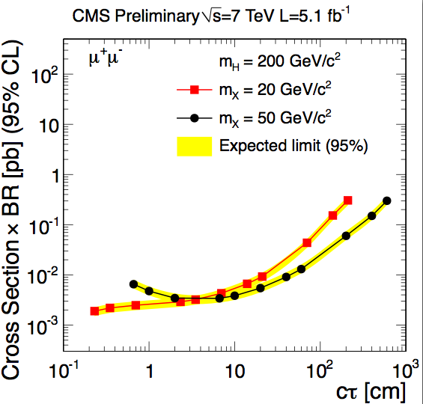
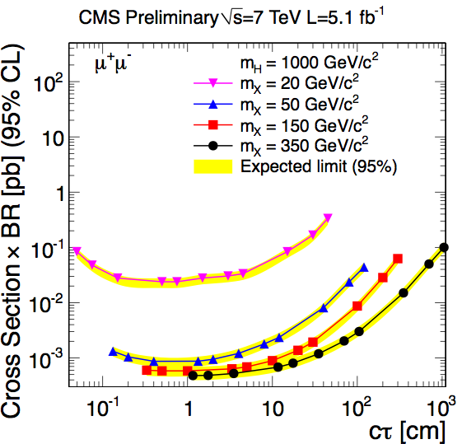
Long Lived Stable Particles
Long lived neutral particles like in Hidden Valley models
•Simple Example: Higgs→ X, where X decays into leptons
Search for electrons from displaced vertices in the inner tracker
Part of CMS tracking to find displaced vertices, for up to 50 cm displacement
CMS-EXO-11-101
m_{H}=200 GeV
m_{H}=1000 GeV
Upper limits on cross sections ~ 0.7-10 fb (if decay in detector)

Slide 26

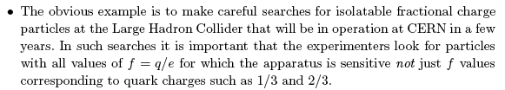
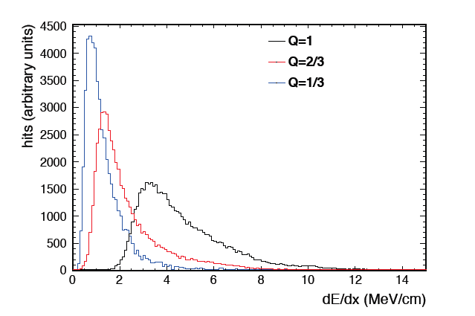
Fractional Charged Particles
M. Perl et al., 2004
Search possible in CMS
Both for q=1/3e and q=2/3e
Tracks with a high number of low-ionizing hits in the tracker
Results soon on 2011 data
Sensitivity to masses in the 200-300 GeV range.

Slide 27
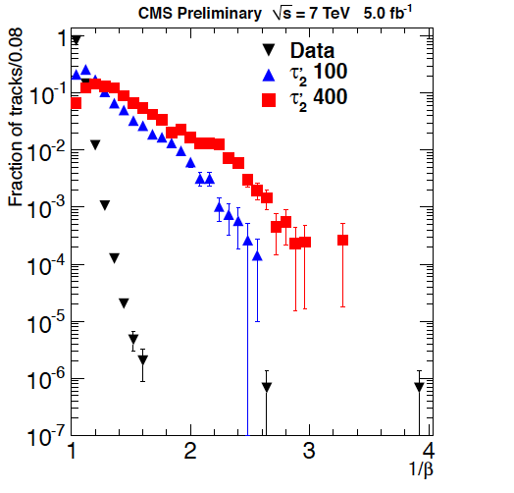
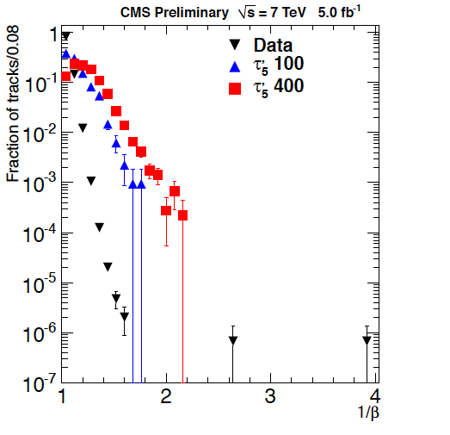
Multiple Charged Particles
Time of flight
q =2e
Time of flight
q =5e
Results to be released soon (for q= 1e – 5e)
Sensitivity on the mass in the range 400-500 GeV

Slide 28
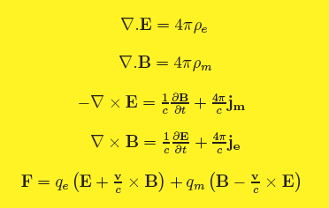

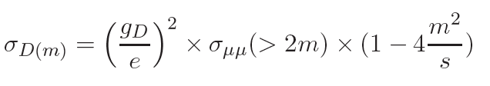
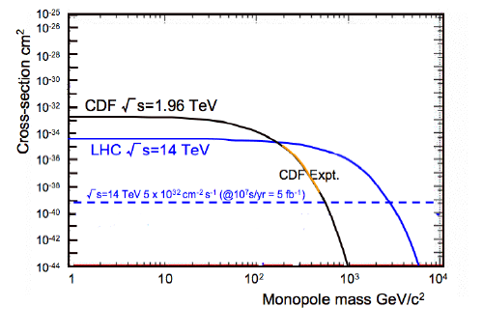
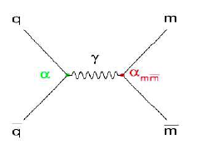
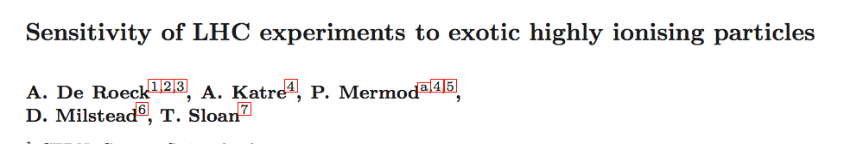
Monopoles
Magnetic Monopoles to explain the quantization of electric charge (Dirac ‘31)
= n 68.5e
Symmetrizes maxwell equations
Searched for at all colliders
Tevatron limits ~ 400-800 GeV
arXiv: 1112.2999

Slide 29
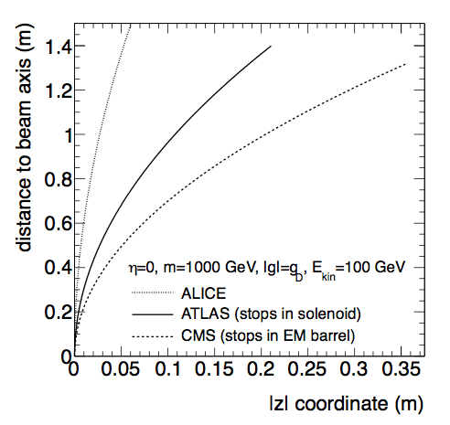
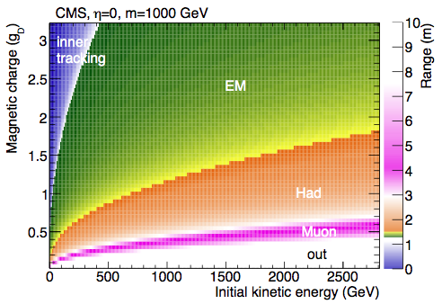
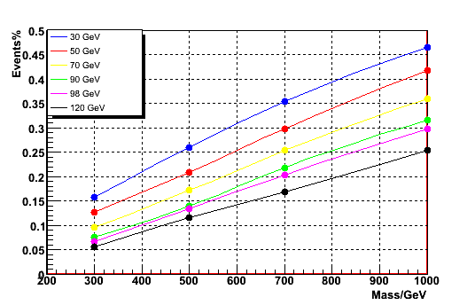

Potential for Monopole Searches in CMS
Monopoles will loose a lot of energy, and stop in the detector
Bending in the RZ plane in solenoid field (needs revised reconstruction)
Monopole range
Bending in RZ
PhD Study:
Stop in ECAL
(Y. Assran)
Simulation Studies
Kinematic acceptance in ECAL

Slide 30

Beampipe Monopole Search
H1 experiment at the ep collider HERA, Hamburg
trapped in the beampipe material?
Also searched for
at the Tevatron
Possible at the LHC!!

Slide 31


Monopoles Stopped in the Beampipe
Test performed with pieces of material from the LHC from 18 m away from
the interaction region
Faulty connecting “fingers” were removed
and scanned in a SQUID in Zurich
See talk by D. Milstead

Slide 32


Monopoles Stopped in the Beampipe
Energy below which a monopoles
stops in the beampipe vs g_{D} and
η=-ln tanθ/2
Acceptance of monopoles in
the CMS (ATLAS) beampipe

Slide 33


Monopoles 14 TeV
5% acceptance contours
10 events /2 years running
Complementary reach for MoEDAL and the central detectors
Beampipe analyses can be important to cover larger phase space

Slide 34
SUMMARY
CMS has a good coverage for the exotica landscape, particularly the ‘bread and butter’ one (Extra Dimensions, Z’, supersymmetry, technicolor, Leptoquarks, …)
CMS is not especially designed for the detection of particles with unusual properties, but the detector has sufficient flexibility. Time of flight and de/dx are the key components, as well as displaced vertices, and more…There will be challenge our triggers & software, and detector constraints with time (luminosity)
Studies are carried out on heavy stable charged particles, with fractional charge or multiple charge, stopping particles (eg monopoles), displaced vertices…
Beampipe analyses may play an important role
Complementary reach with resp. to MoEDAL sensitivity
Interesting times ahead!

Slide 35
Backup

Slide 36

Multiple Charged Particles

