Slide 1

The Quest for Cosmic Monopoles

Slide 2
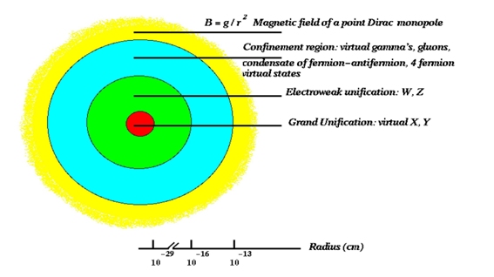
GUT MMs
Gauge theories of unified electroweak and strong interactions predict MMs
SU(5)
10¹⁵ GeV
SU(3)_{C} x [SU(2)_{L} x U(1)_{y}]
10² GeV
SU(3)_{C} x U(1)_{EM}
10⁻³⁵ s
10⁻⁹ s
r > few fm B≈ g/r²
Size: extended object
Mass m_{M} ≥ m_{X}/G > 10¹⁶ GeV ~ 0.02 μg → 10¹⁷ GeV
( Kaluza –Klein poles → > 10¹⁹ GeV , SUSY → > 10¹⁷ GeV
Produced at t∼10⁻³⁵ s after the Big Bang
May be present today in the Cosmic Radiation as “relic” particles

Slide 3
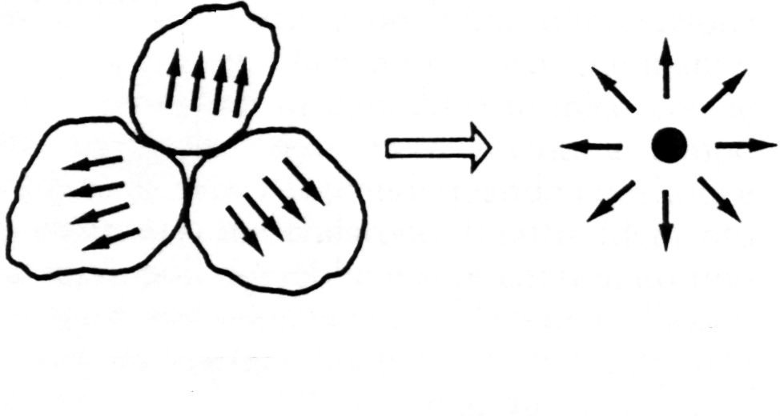
GUT MM properties
Magnetic charge g = n g_{D} several models predict n>1 (2,3)
Production: In the Early Universe at G.U.T. phase transition
- as topological defects G→U (1) x … (t~ 10⁻³⁵ s )
- in high energy collisions (t~ 10⁻³⁴ s )
monopole
Frozen domains
e⁺ e⁻ → M M
q q → M M
MMs follow “history” of the Universe  slowed down  formation of galaxies  magnetic fields  poles accelerated

Slide 4
MM Energy Loss
β > 10⁻² Ionization (à la Bethe-Bloch) (Ze_{eq})²= (gβ)² (a)
for β = 1 : (dE/dx)_{MM} = 4700 (dE/dx)_{m.i.p.}
10⁻⁴<β<10⁻² Excitation Medium as Fermi gas (b)
10⁻⁴<β<10⁻³ Drell effect M + He → M + He*
+ Penning effect He*+ CH₄ → He + CH₄ + e⁻
β < 10⁻⁴ Elastic collisions (c)
liquid H₂
(a)
(c)
(b)

Slide 5
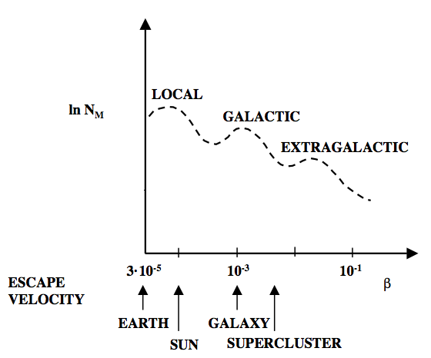
Searches in Cosmic Rays
Expected MM velocities are related to the escape velocity of the system in which they are confined
- No predictions from Cosmology on MM flux
- Upper limits on MM fluxes put constraints on some cosmological models

Slide 6
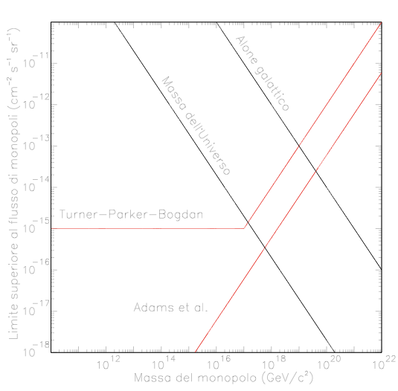
Astrophysical limits on Magnetic Monopole flux
- Survival of galactic magnetic fields
“Parker Bound” (TPB)
Φ_{TPB} < 10⁻¹⁵ cm⁻² s⁻¹ sr⁻¹ for β <3 10⁻³
Φ_{TPB} < 10⁻⁹ β² m₁₇ cm⁻² s⁻¹ sr⁻¹ for β >3 10⁻³
Survival of early seed of
galactical magnetic field
“Extended Parker Bound” (EPB)
Φ_{EPB} < m₁₇ 10⁻¹⁶ cm⁻² s⁻¹ sr⁻¹
m₁₇ = m_{M}/10¹⁷ GeV/c²
Limits from Universe mass density
“uniform” or “clumped”
MM flux Upper Limits (cm² s⁻¹ sr⁻²)
Clumped
Uniform
Parker
EPB
Monopole Mass (GeV/c²)

Slide 7
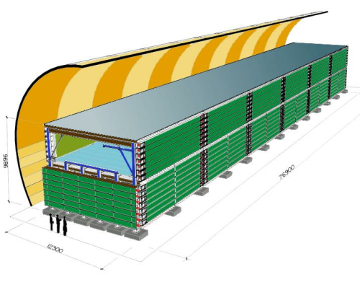
The MACRO experiment
@ Gran Sasso underground Lab (Italy) (3700 m w.e.)
Data taking from 1989 to 2000
9 m
76 m
3 Subdetectors:
- Scintillators
- Limited Streamer Tubes
- Nuclear Track Detectors
12 m
SΩ ∼10,000 m²sr
Notes:
dovresti dire da qualche parte che citi un esperimento gia’ concluso da 12 anni... ma cil cui upper limit rimane il migliorie fino a beta=0.6

Slide 8
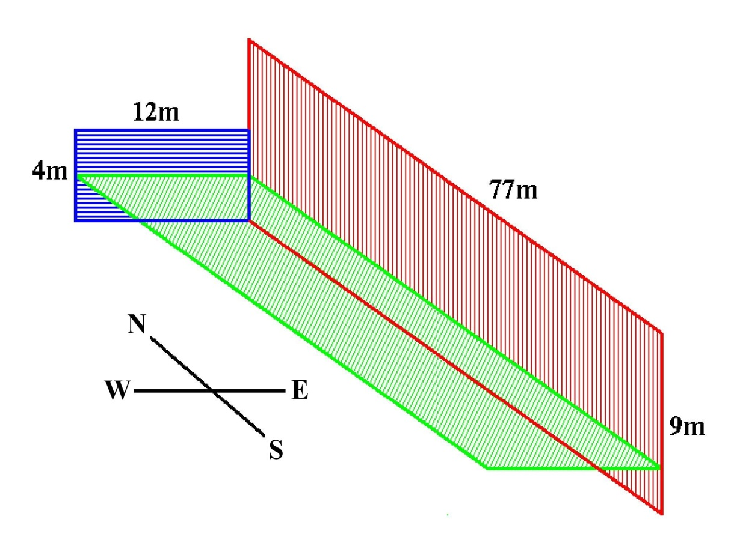

The MACRO track-etch subdetector
Total surface : ∼ 1263 m²
SΩ _{fast MM} ∼ 7100 m² sr
T_exposure ∼ 10 years
Fast
MM
Nuclear fragment
Slow
MM
M.I.P.
CR39
Used in triggered and stand-alone mode
Lexan
Aluminium
modules 24.5 x 24.5 cm²

Slide 9
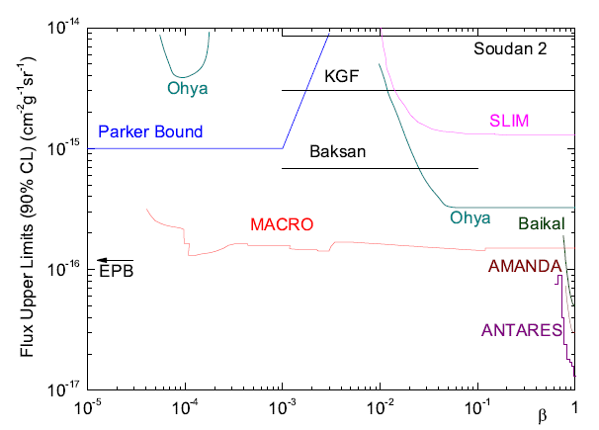
Present world limits for GUT MMs

Slide 10
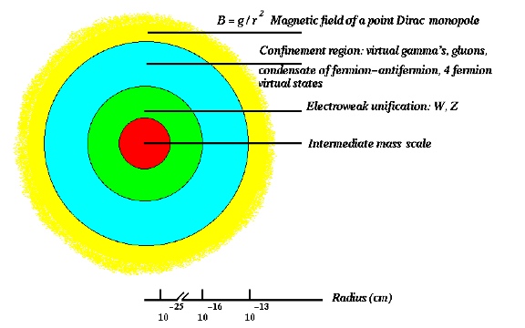
Intermediate mass MMs (10⁵ - 10¹² GeV)
Produced in the Early Universe in later phase transitions
Ex. M ∼ 10¹⁰ GeV, g = 2 g_{D ,}
IMMs can be accelerated in the galactic B field to relativistic velocities
W = g_{D} B L ∼ 6 x 10 ¹⁹ eV (B/3x10⁻⁶ G) (L/300pc)
Galaxy W ∼ 6x10¹⁹ eV
Neutron stars W ∼ 10²⁰ - 10²⁴ eV
AGN W ∼ 10²³ - 10²⁴ eV

Slide 11
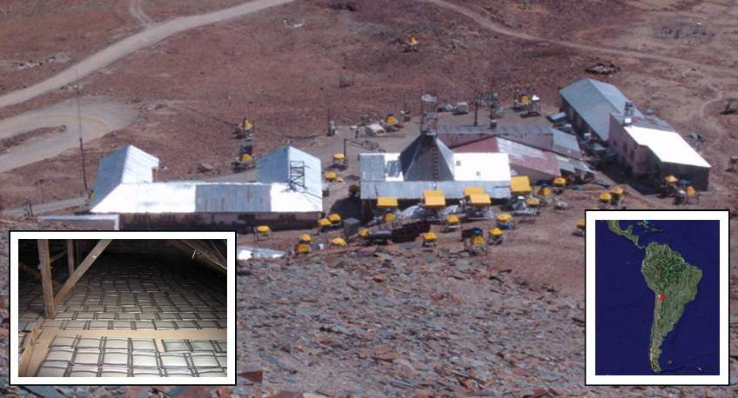
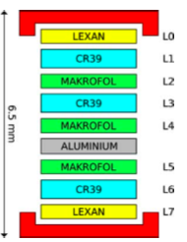
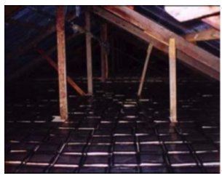
The SLIM experiment
430 m² of NTDs @ Chacaltaya, Bolivia, 5230 m asl
Detector surface 430 m² (7420 stacks)
Atm depth 540 g/cm²
Rigidity ~ 12.5 GV
Average exposure time t = 4.2 years
Atm Pressure ~ 0.5 atm
Mean Temperature = 12 °C
Rd concentr. ~ 40-50 Bq/m³
Neutron flux = 1.8x10⁻² cm²
Exposure : 2000-2005
Notes:
Anche qui devi dire che SLIM e’ stato concluso nel 2007 e speigare che e’ l’esperimento che ha esteso la ricerca a bassi valori delle masse

Slide 12
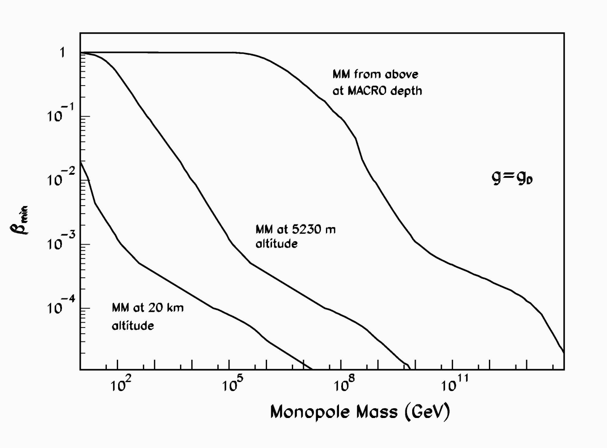
Accessible regions in the plane (mass, β) for MMs from above

Slide 13
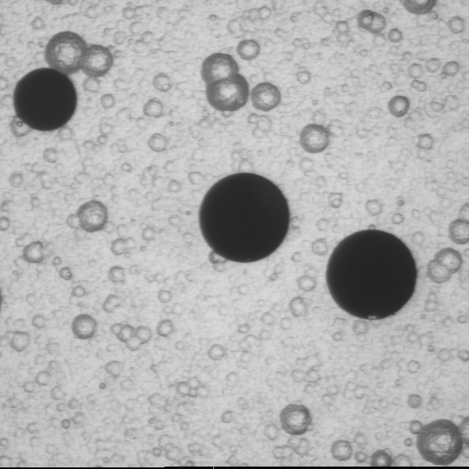
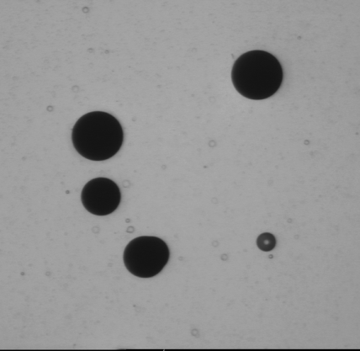
SLIM Nuclear Track Detectors
CR39®
ρ = 1.32 g /cm³
(C₁₂H₁₈O₇)_{n}
A/Z = 1.877
CR39® 0.1%
dioctyl phthalate DOP
ρ = 1.32 g /cm³
(C₁₂H₁₈O₇)_{n}
MAKROFOL ®
ρ = 1.29 g /cm³
(C₁₆H₁₄O₃)_{n}
A/Z = 1.896
Chemical etching modes
 | detector type | solution
 | CR39 | 8N KOH + 1.5% ethyl alcohol 70° C 30h
Strong | CR39 DOP | 8N KOH + 1.5% ethyl alcohol 75° C 30h
 | Makrofol | 6N KOH + 20% ethyl alcohol 75° C 30h
Soft | CR39 | 6N NaOH + 1% ethyl alcohol 70° C 40h
 | CR39 DOP | 6N NaOH 70° C 40h
150X150 μm²
150X150 μm²
158 A GeV ⁸²⁺Pb + fragments in CR39
6N NaOH
+ 1% ethyl alcohol
6N NaOH

Slide 14
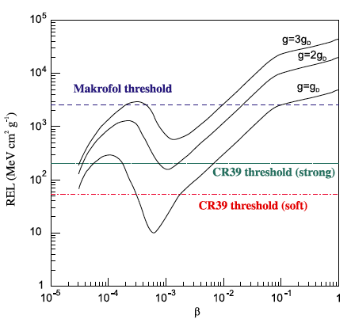
Restricted Energy Loss vs β for MMs in CR39

Slide 15
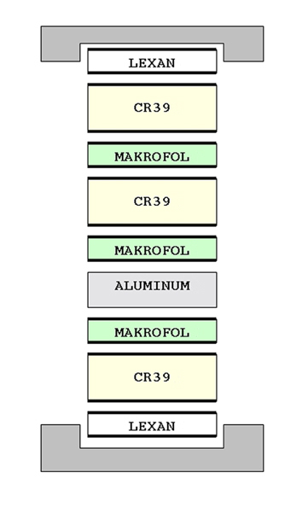
The search technique
Strong etching (large, easy to detect tracks)
General scan of the surface
If a signal is found
in the first sheet...
Soft etching
Scan in the predicted position measurement of REL and direction of incident particle.
The signal: collinear etch pits + constant energy loss thru the stack foils

Slide 16
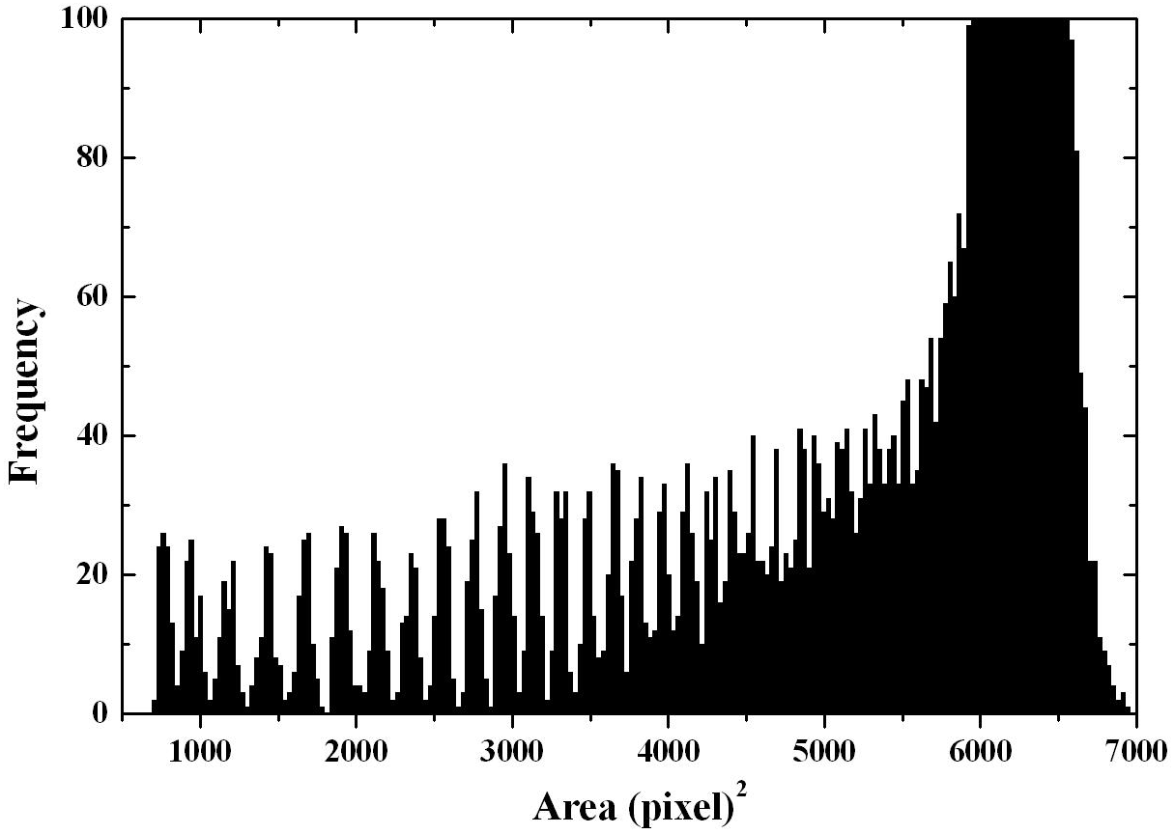
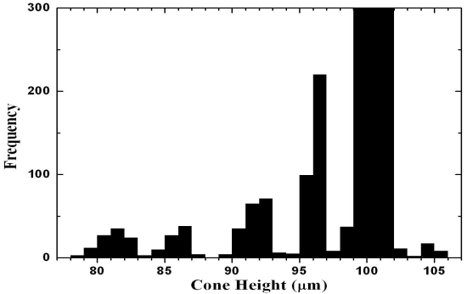

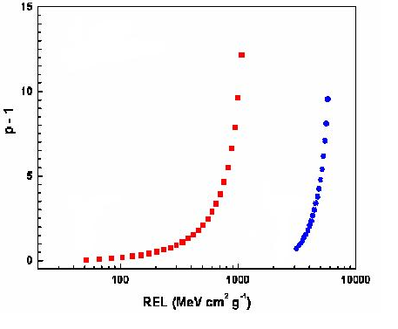
(a)
(b)
MAKROFOL
Z/β = 82
158 A GeV Pb⁸²⁺ + fragments
Z/β = 78
83
78
6N KOH + ethyl alcohol 20%, 50 ºC
v_{B}=3.5 ± 0.1mm/h
60
70
Z/β = 51
Thresholds:
CR39 Z/β ~ 7
Makrofol Z/β ~ 50
CR39
Makrofol
23rd ICNTS
44

Slide 17
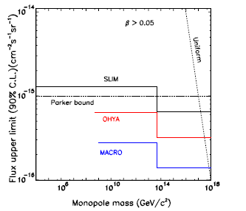
IMMs: world flux upper limits
Notes:
per quali masse si applica? Antares ?

Slide 18
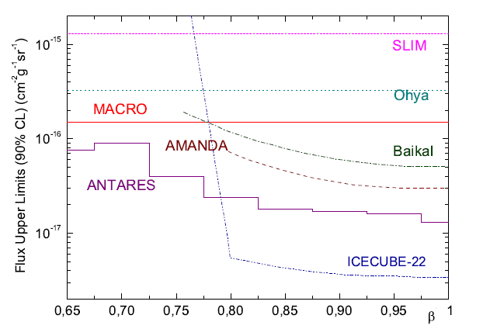
Flux upper limits at relativistic velocities
Notes:
a Neutrino 2012 Anatres ha presenatto il suo upper limit.
ATTENZIONE: loro assumono che il MM viene dal basso (so M>??) ma che sia anche relativistico: e’ questionable.

Slide 19
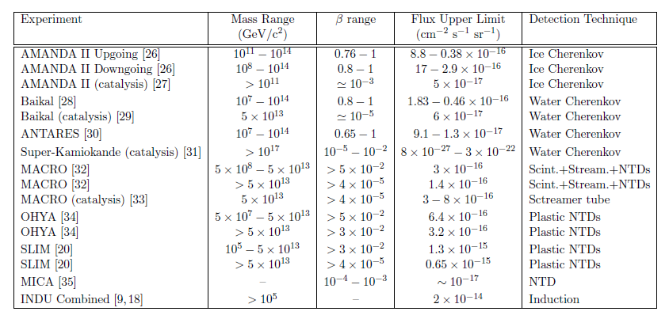
Summary Table
Notes:
Direct searches for MMs induced nucleon decay were made with large neutrino
telescopes [15, 16] and by the MACRO experiment [17]. An indirect
search for GUT monopoles was also performed by the Super-Kamiokande
collaboration [18]. Looking for a neutrino signal coming from proton decay
catalised by GUT MMs captured in the Sun, they were able to set a flux
upper limit at F < 10^-23 cm^-2 s^-1 sr^-1 for a monopole mass < 10^17 GeV/c2
and velocity β = 10^-3 assuming a catalysis cross section σ ∼ 1 mb

Slide 20
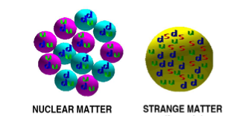
Strange Quark Matter
E. Witten, Phys. Rev. D30 (1984) 272A. De Rujula, S. L. Glashow, Nature 312 (1984) 734
Aggregates of u, d, s quarks + electrons
Ground state of QCD
Stable for ∼ 300 < A < 10⁵⁷
ρ_{SQM} ~ 3.5 x 10¹⁴ g cm⁻³
ρ_{nuclei} ~ 10¹⁴ g cm⁻³
Produced in Early Universe and/or in Neutron Star collisions

Slide 21
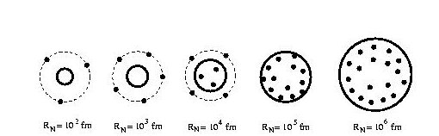
SQM : alias Nuclearites, Strangelets
Nuclearite : large neutral Thomson-like atom constituted by an SQM bag core + electrons
Strangelet : small, Bohr-like atom constituted by an SQM bag core surrounded by electrons
R (fm) 10² 10³ 10⁴ 10⁵ 10⁶
M (GeV) 10⁶ 10⁹ 10¹² 10¹⁵ 10¹⁸

Slide 22
Charge vs mass relation: Z /A « 1
Ordinary Nuclei
0.5A
₁₀³
0.3A^{2/3}
8A^{1/3}
₁₀²
Z
~0.1A
₁₀
₁₀³
₁₀⁴
₁₀⁵
₁₀⁶
A
M. Kasuya et al. Phys.Rev.D47(1993)2153 H.Heiselberg, Phys. Rev.D48(1993)1418
J. Madsen Phys. Rev.Lett.87(2001)172003

Slide 23
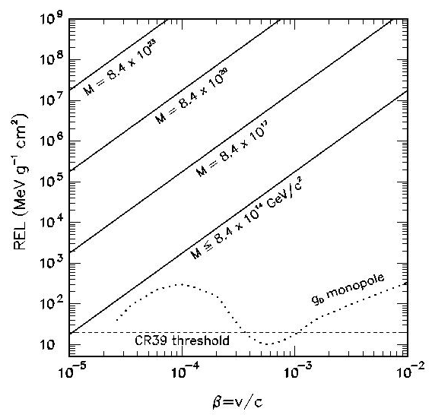
Energy Loss
Nuclearites, ß~10⁻³
Main energy loss mechanism by elastic and quasi elastic collisions with atoms and molecules
dE/dx= - σ ρ_{medium} v²_{N}
∼ π 10⁻¹⁶ cm² R_{N} < 1Å
σ ∼ π x R²_{N} R_{N} > 1Å
Energy Loss in CR39
Notes:
Molto piu’ grande dei mm, sempre sopra soglia

Slide 24
Energy Loss
strangelets,
  Behave like ordinary nuclei
  Same acceleration processes and Energy Loss
Restricted energy loss in CR39 nuclear track detector
Notes:
Above threshold for almost all velocities

Slide 25
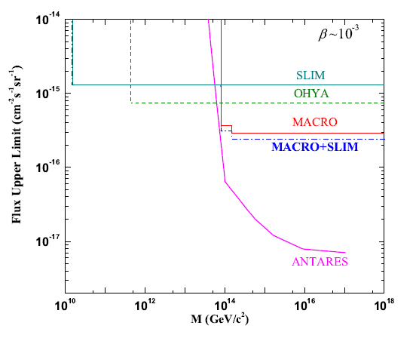
Nuclearites : World Flux upper limits
SLIM :5300 m a.s.l Mt. Norikura: 2000 m a.s.l.
Ohya : 100 hg/cm² underground
MACRO : 3700 hg/cm² underground
Notes:
Most are NTDs searches

Slide 26
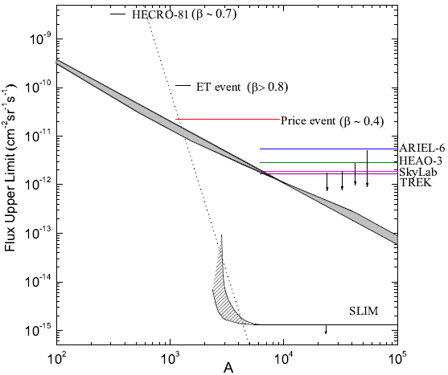
Strangelets : World Flux upper limits
and search status
Flux Upper Limits at 90% C.L. for downgoing Strange Quark Matter
Results put some constrain in existing strangelets propagation models.
More with the future AMS2 experiment
Notes:
Propagation Models :
The same limit applies for downgoing strangelets with ve- locities at the detector level β<0.6, as can be seen from Fig. 6. Other limits derived from experiments onboard balloons and in space are also shown for comparison (Fowler et al., 1987, ARIEL-6; Binn et al., 1989, HEAO-3
Lines are ﬂux pre- dictions from diﬀerent models (Madsen, 2005; Rybczynski et al., 2001, 2006). The ﬂuxes of some cosmic ray unexpecte
According to themodel of decreasing strangelet when propagating through the atmosphere (Wilket al., 1996, Rybczynski et al., 2001, 2006) the SLIM experiment with its 427m2 area and 4.22years exposure should have detected about 5to10 events, takinginto account the detector angular acceptance. In the case of the propagation model assuming strangelet sgrowing in mass and charge (Banerjeeet al., 1999, 2000a, 2000b) the number of events that should have been recorde dby SLIM is about 80 events. The null observation could thu sexclude thi smodel whilet he model of marginallyexcluded.
Banerjee et al. May be excluded.
Wilk et al. Only marginaly excluded.

Slide 28
Back slides

Slide 29
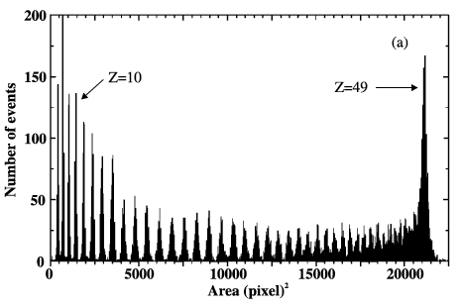
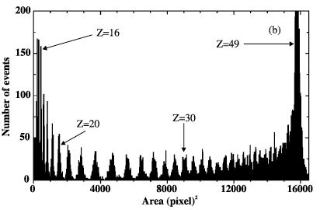
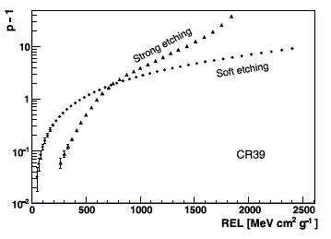
Calibrations
160 A GeV In ⁴⁹⁺ fragments
Soft etching
Strong etching
Notes:
We have calibrated the detector, as described before, with fast ion beams in the 2 etching condition we use for strong ecthing and soft etching
You can see how the threshold changes with the etching condition

Slide 30
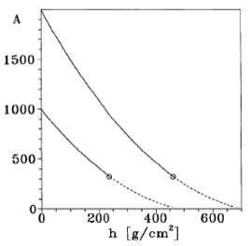
Strangelets Propagation in Atmosphere
Strangelets losing mass when colliding with air nuclei:
- Wilk,G. et al. J. Phys. G 22 (1996) L105.
Small strangelets accreting neutrons and protons increasing their mass and charge.
- Banerjee S., et al., J. Phys. G 25 (1999) L15.

Slide 31
Strangelets Flux Predictions
Two models:
→ Strange star binary collision + propagation in the galaxy: F ∝ A^{-0.467} Z^{-1.2} max[R_{SM}, R_{GC}]^{-1.2}.
→ Candidate events + relative abundance of elements in the Universe: F ∝ A^{-7.5}.
J. Madsen, Phys. Rev. D71 (2005) 014026
Chacaltaya Laboratory 540 g/cm² (1sr):
Madsen: ~ 300 events/100 m² / year.
Wilk*: ~ 6 events/100 m² / year.
Banerjee*: ~5-10 events/100 m² / year.

