Slide 1
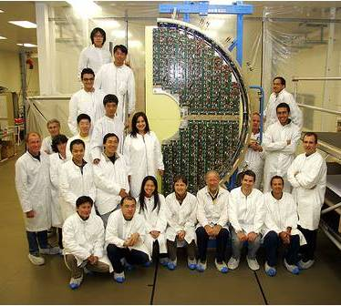
Measurement of the leakage current of Si sensors of the CMS Preshower after an integrated luminosity of 5.86 fb⁻¹
D. Barney, M. Guthoff, A. Honma, S-W. Li, A. Peisert,
Y-M. (Jacky) Tzeng, G. Qin
Description of the Preshower
Current measurement
Calculation of annealing effects
Summary and conclusions

Slide 2
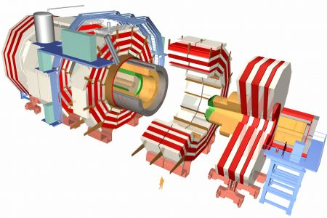
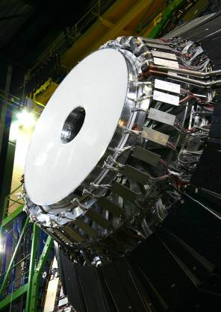
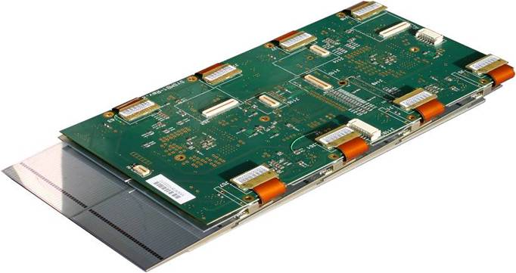
The CMS Preshower: part of the end cap el. calorimeter
Preshower + ECAL
Z = ± 304, 309 cm
45 cm < R <121 cm
2 layers of lead absorbers
each followed by Si sensors
and digital electronics
assembled into “ladders”
of 6 to 10 modules
ladder
digital electronics
Si sensors, 63x63 mm²
4288 total, 1072/absorber

Slide 3
Silicon sensors
Produced by ELMA (Russia) 1529
BEL (India) 1162
Hamamatsu 989
ERSO (Taiwan) 481
MTS (Taiwan) 100
IMEL (Greece) 27
About 50 sensors produced primarily by Greece and Taiwan showed large anomalous leakage currents.
Very likely surface currents caused by radiation from the collisions in LHC.
The root cause and the underlying mechanism not understood (note in preparation).
Only Hamamatsu sensors were used for comparing the calculations of the annealing
with the measurements.

Slide 4
The CMS Preshower: powering and I measurement
Sensors are biased by pairs, with some exceptions at the innermost and outermost perimeters that are biased individually.
There are 2216 bias lines between the detector and the patch panel in
the service cavern which groups them into 192 CAEN channels.
Each channel powers between 6 and 35 sensors.
All CAEN channel voltages and currents are stored in the CMS database..
Manual measurements of the current of each pair/singlet were performed
Several times in different conditions:
cooling on, power on
cooling on, power off
cooling off, power off, temperature of the sensors = T_{cavern}
from the analysis of these measurements we concluded that the temperature of the sensors is 2ºC higher than the T of the coolant

Slide 5
The CMS Preshower: cooling
Very efficient cooling of absorbers
(no constraints of material budget)
T_{coolant_in} = 9 ºC
ΔT_{coolant} = 0.5 ºC
Temperatures measured on hybrids
T_{average} = 12.4 ± 0.5 ºC
Uniform temperature over all sensors
-Z
+Z

Slide 6
Current: measurement and simulation
Current density measured on December 14, 2012 at the initial full depletion voltage and at 18.9ºC (power and cooling switched off)
scaled to 0ºC
Fluka simulation:
1000 collisions at 3.5 TeV
the geometry Φ symmetric
the flux of particles is scaled to the flux of 1 MeV equivalent neutrons
statistical error ~ 4%
gives ~20% higher fluence than simulated at the time of Engineering Design Report
Absolute scale
13% difference
center of the sensor or of the pair
I ~ exp(-0.031R)

Slide 7
Annealing effects
Calculated using the Hamburg model for a single sensor placed in a spot with the highest particle fluence.
Temperature and delivered luminosity retrieved daily.
Single sensor current scaled for comparison with the measured current on CAEN supplies.
Channels supplying only
Hamamatsu sensors chosen
for this comparison:
channel 1 – 20 sensors
channel 2 – 7 sensors
Good agreement shows that
the annealing effects are well
described by the model and the parameters chosen are correct.

Slide 8
Summary and conclusions
The CMS Preshower is composed of 4 layers of absorber followed by silicon sensors
  1072 sensors per plane, 4288 total, 17 m²
Measurements of the leakage current of sensors pairs and singlets were performed several times in different conditions
  Last on December 14, 2011, after an integrated luminosity of 5.86 fb⁻¹, at 18.9ºC
The dependence of the current on the distance from the beam is in good agreement with the Fluka simulation
  The absolute value is 13% lower than simulated
  Exponential dependence – ~e^{-0.031R}
The Fluka simulation at 7 TeV gives about 20% higher fluence than what was calculated for 14 TeV at the time of Engineering Design Report
  Might have consequences on the lifetime of the detector
The Hamburg model describes well the annealing of the current
The measurement of the full depletion voltage is in progress and will be reported later

