Slide 1
Micromegas for the ATLAS upgrade (MAMMA)
Status report
Jörg Wotschack (CERN)
for the
MAMMA Collaboration
Work in close collaboration with CERN PCB workshop (R. de Oliveira)

Slide 2
Topics covered
Status of NSW project in ATLAS
1 x 1 m² prototype MM chamber, first experience
1 x 2 m² chamber construction issues & plans
Construction simplifications in view of production
Test of mechanical precision of large micromegas (MM) boards
Next steps

Slide 3
Status of the New Small Wheel project
The ATLAS upgrade programme foresees to replace in the LHC shutdown 2018 the first station of forward muon chambers (Small Wheel) to cope with the anticipated higher rates
Early May 2012 the ATLAS Muon Collaboration chose to equip the New Small Wheels with two detector technologies, each covering the full detector area: thin-gap MWPCs (TGCs) and micromegas
The decision was subject to a number of milestones to be fulfilled by end of 2012
Initial Design Review took place 29/30 August 2012
Kick-off meeting on 31 August(for institutes to express their interest to participate in the NSW)
ATLAS Executive Board (EB) endorsed the project
ATLAS Collaboration Board (CB) approval is expected this week

Slide 4
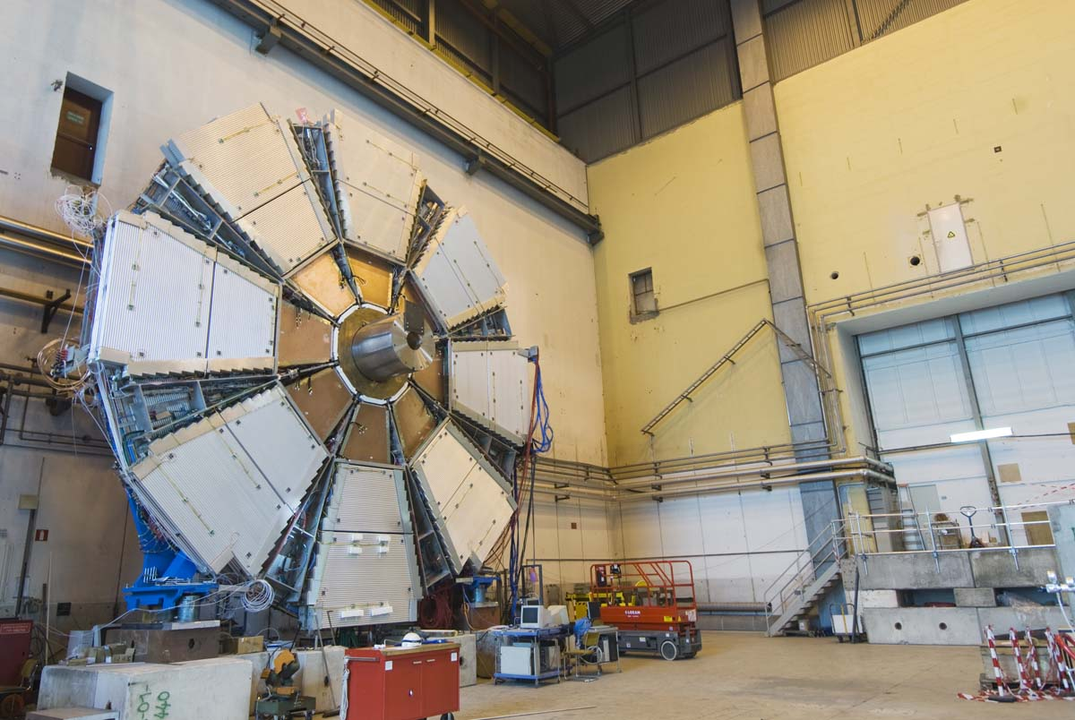
ATLAS Small Wheel upgrade project
Today:
MDT chambers (drift tubes) +
TGCs for 2nd coordinate (not visible)
Equip the New Small Wheels with sTGCs and micromegas detectors
Detector dimensions: 0.5–2.5 m²
Combine precision and 2nd coord. measurement as well as trigger functionality in a single device
Each detector technology comprises eight active layers, arranged in two multilayers
Each MM layer comprises two coordinates with 0.5 and 1.5 mm strip pitch
  2M readout channels
  a total of about 1200 m² of detection layers
2.4 m
CSC chambers

Slide 5
Milestones for MMs
Demonstration that MMs of 2 x 1 m² can be built with the required precision
Demonstration of resolution for inclined tracks (µTPC scheme) – has been addressed and shown in H6 test beam during summer (see talk by T. Alexopoulos in WG2 on Thursday)
Demonstration that sparks do not create long-term damage to the chambers – has been addressed at CEA Saclay by studying alpha decays in MMs (see talk by F. Jeanneau in WG2 on Thursday)
  Demonstration that MMs can operate in magnetic field and the required spatial resolution can be achieved (H2 test in June)
In addition reporting items include:
  Demonstration of MM trigger concept (H6 test in Aug.–Oct. using new VMM1 chip from BNL)
  MM industrialization (see talks by F. Jeanneau and M. Hoffmann in WG7)

Slide 6
Towards large-area MMs
First step was to build a 1 x 1 m² chamber and to test it during summer in the H6 beam
  The goal was to establish a construction concept that could be used for the larger chambers
Given that the machines to go to larger dimensions were not yet installed in the CERN PCB workshop we were obliged to go with standard-size PCBs.
The next question was the mesh, bulk or no bulk?
  We had experienced problems in large chambers with currents; any dust caught under the mesh is hard to remove
  We opted for a non-bulk technique that uses also pillars to keep the mesh at a defined distance from the board, however, the mesh is not fixed but integrated with the drift-electrode panel and placed on the pillars when the chamber is closed.

Slide 7
1 x 1 m² sketch (not to scale)
Stiffening panel
Drift electrode
Pillars (128 µm)
PCB1
PCB2
Aluminium support plate
Rohacell

Slide 8
1 x 1 m² sketch (closed)
Stiffening panel
5.00
PCB1
PCB2
Aluminium support plate
Rohacell

Slide 9
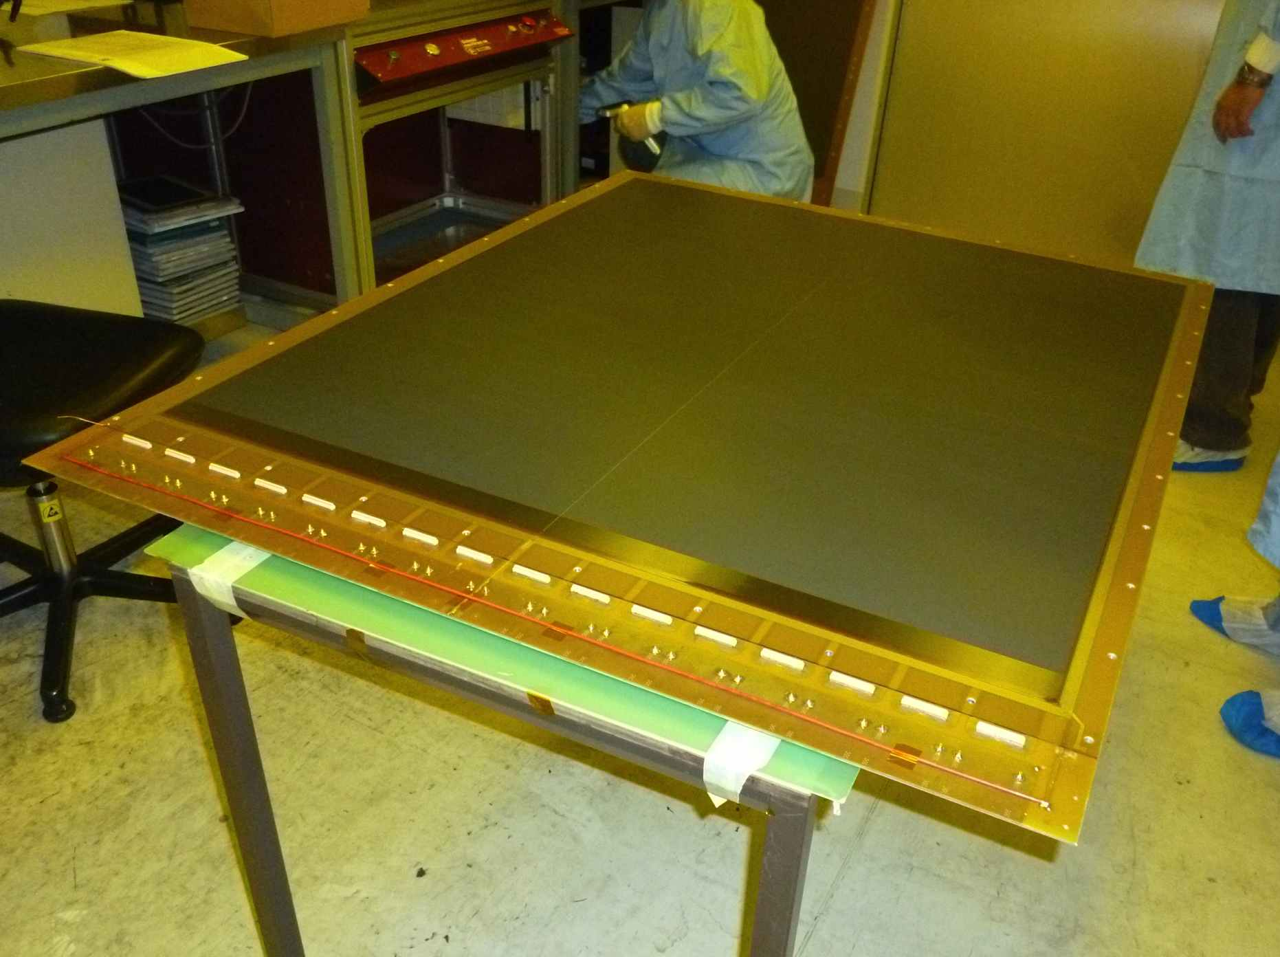
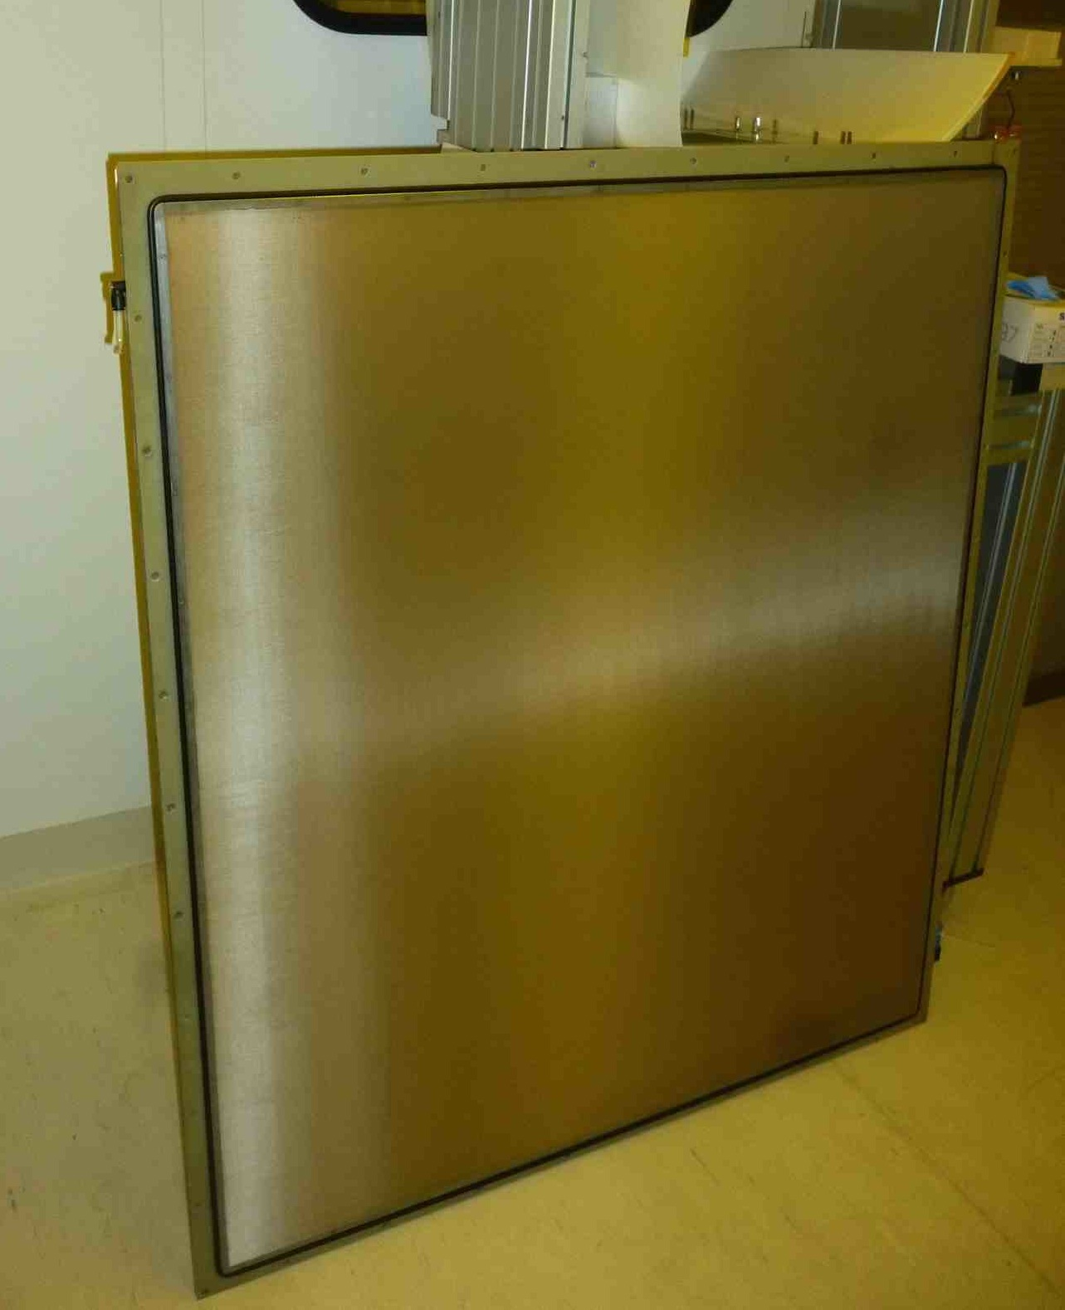
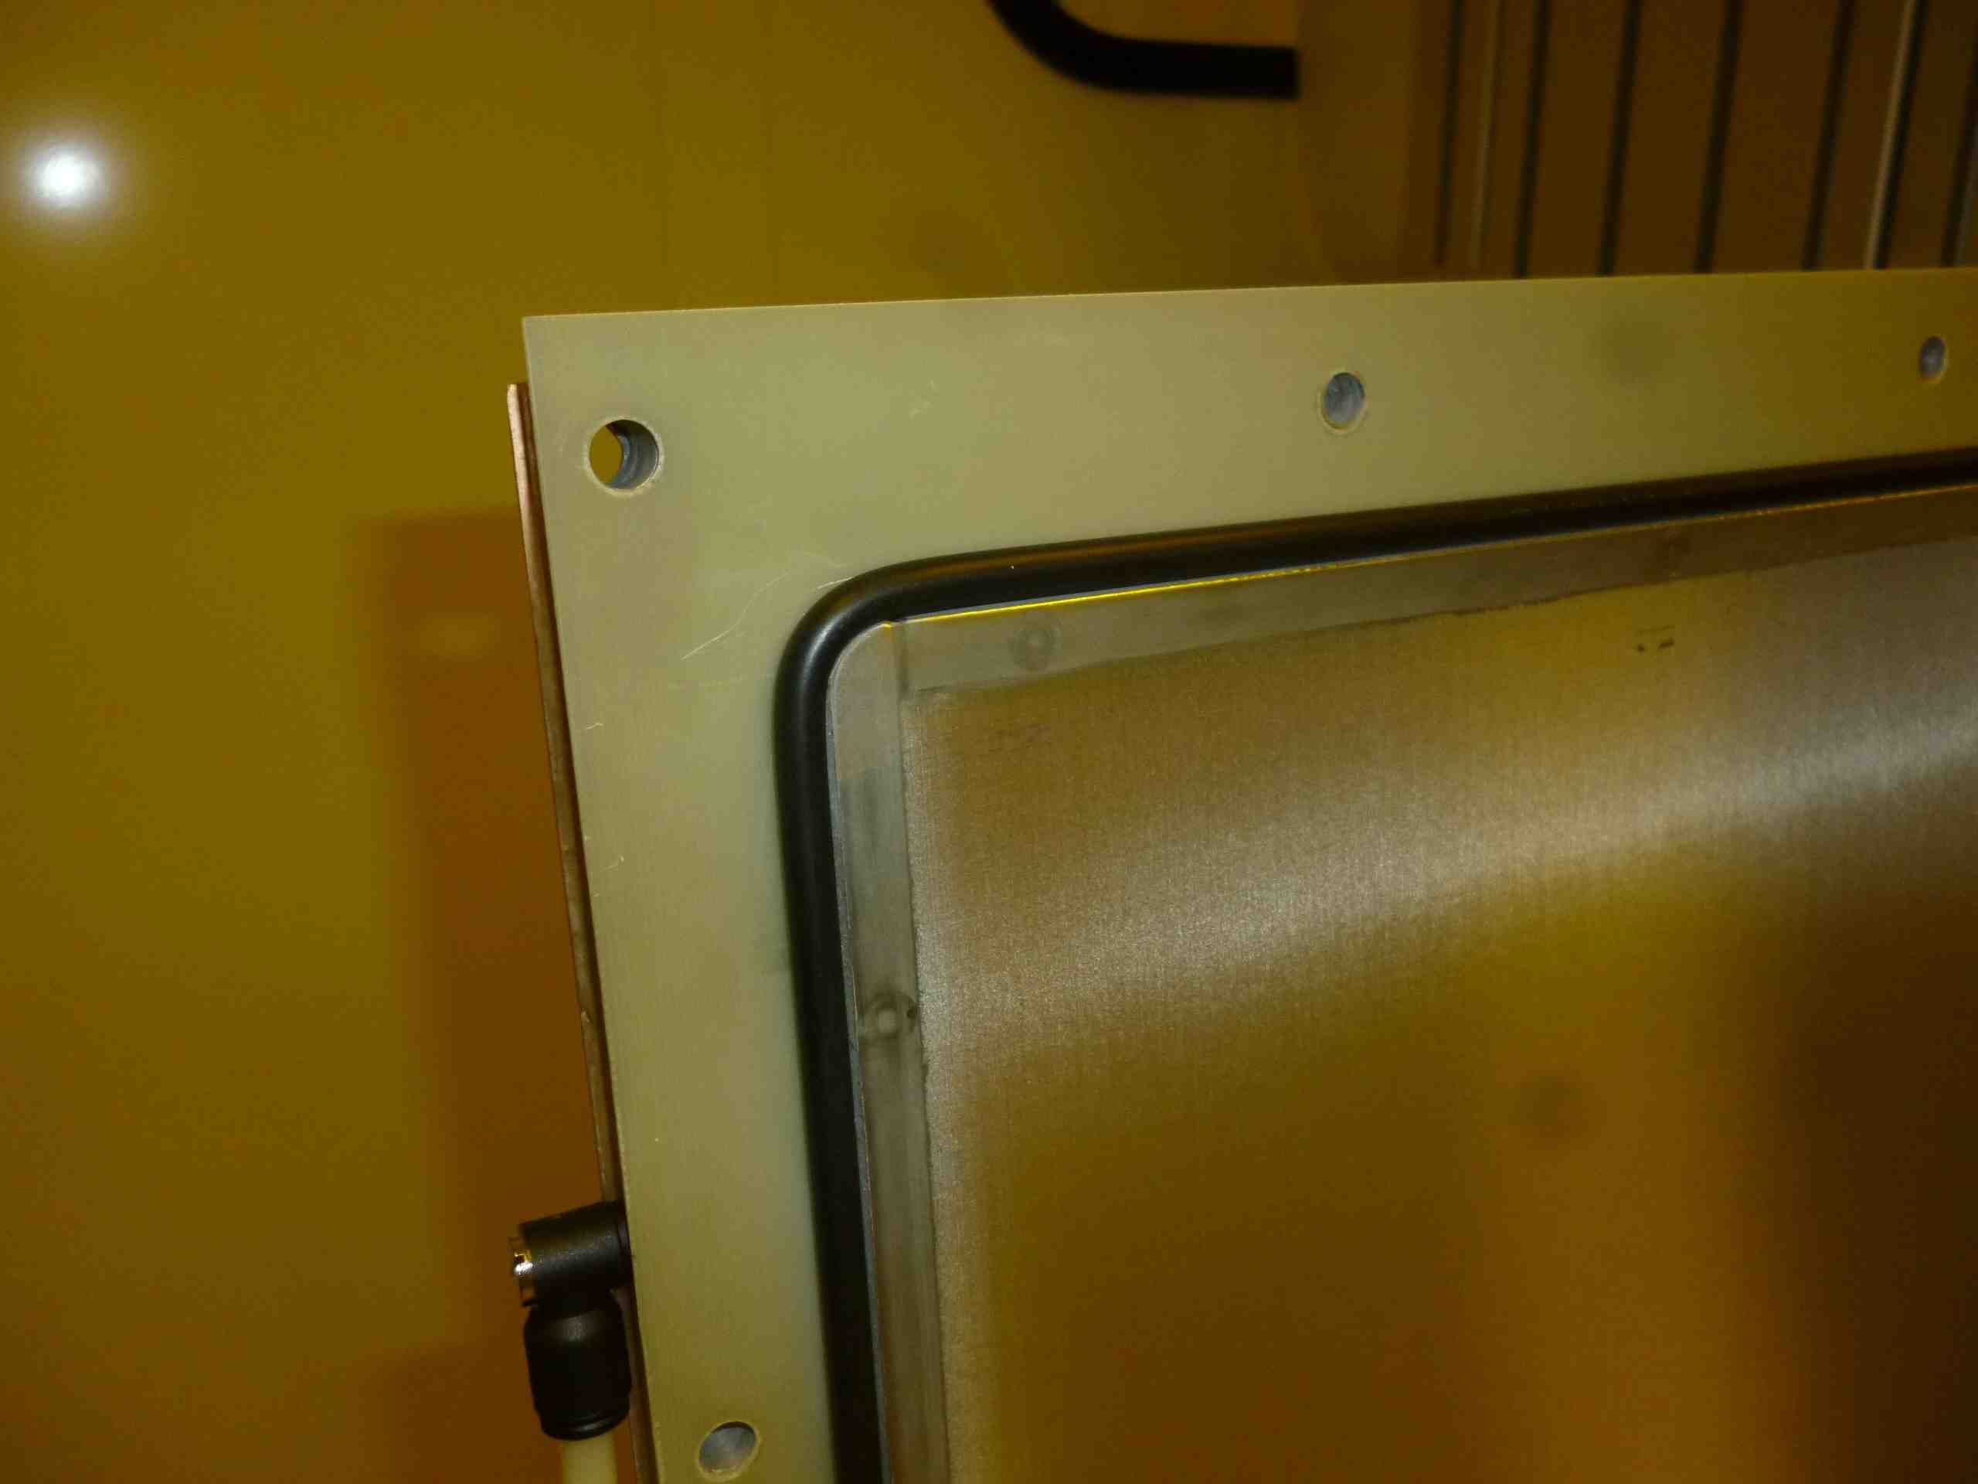
1 x 1 m² micromegas
1 x 1 m² readout board composed of 2 boards of 0.5 x 1 m²
2048 strips of 1.06 m length with a pitch of 0.45 mm
Drift electrode and mesh panel (top) and detail showing the O-ring as gas seal

Slide 10
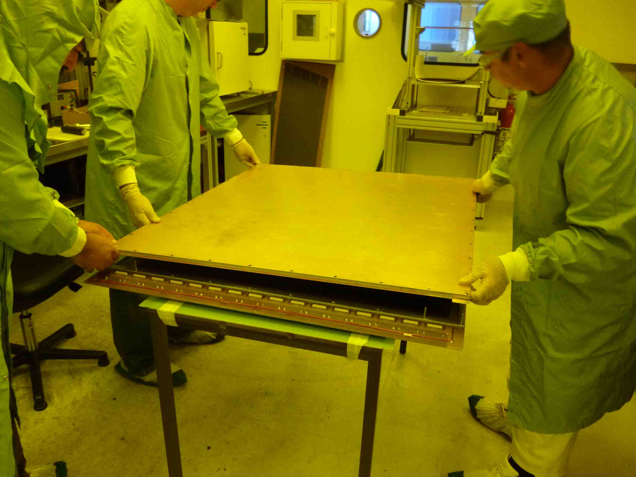
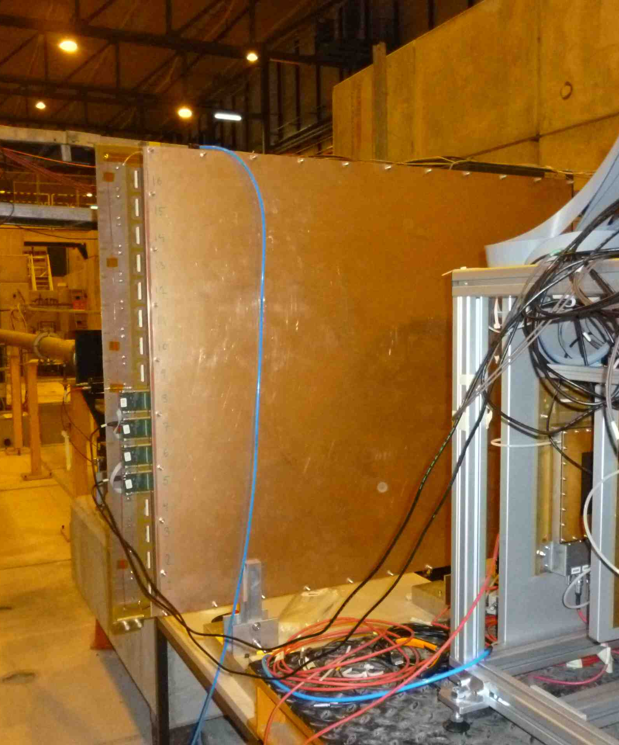
1 x 1 m² micromegas
1 x 1 m² MM being closed in Rui’s ‘clean room
1 x 1 m² MM in H6 test beam

Slide 11
First experience with 1 x 1 m² chamber
Chamber construction and assembly was straight-forward
  Separation of readout panel and drift/mesh panel is attractive
  Chamber can be opened and cleaned, if required; easy assembly
The chamber works as expected
  Initial currents (few 100 nA to µA) traced back to gas pipe material (Rilsan) leading to high water content in the gas, cured by using Cu pipes (after that very low currents)
  Cosmics showed nice signals and good homogeneity over full chamber area; low noise despite 1.06 m long strips
  Good performance confirmed by test beam results

Slide 12
Performance of 1 x 1m² MM
Test beam results (120 GeV pions)
Single hit clusters not included
Typical distributions for H6 run

Slide 13
Performance of 1 x 1m² MM
Test beam results (120 GeV pions)
Spatial resolution
σ ≈ 80 µm
Charge response along strip
Resolution along strips

Slide 14
Inefficiencies for 1 x 1m² MM
Inefficiencies across strips
Inefficiency ≈ 1%
(compatible with the area covered by the pillars (d= 4 mm))
Inefficiencies along strips

Slide 15
Preliminary conclusions on 1 x 1 m² MMs
The chambers work nicely
  Response is as expected and homogeneous (at least to our requirements)over the full area
  With strips of 1.06 m length and 0.45 mm the pedestal fluctations are about a factor 2 larger than for the 10 x 10 cm² MMs
  Beware of plastic (Rilsan) pipes
The floating mesh concept works
  The chamber needs an about 10% higher HV compared to a bulk chamber, suggesting that the amplification gap is about 10–15 µm larger

Slide 16
Towards 2 x 1 m² MMs
Requirements:
  Chamber dimensions 1 x 2.4 m² (overall)
  2 x 2048 readout + resistive strips (0.45 mm pitch), separated in the middle
  Flatness of readout plane to better than 60 µm over full area
  Alignment of layers with respect to each other to 40 µm
Construction ideas
  Follow the scheme used for 1 x 1 m² chamber
  Four 0.5 x 1.2 m2 PCBs glued to stiffening panel
  Floating mesh, integrated into drift-electrode panel

Slide 17
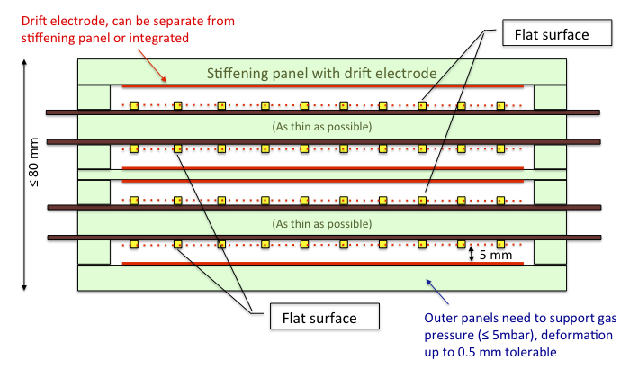
Multilayers
The basic detector unit is an assembly of four layers that form a stiff multilayer.
The individual (flat) layers should be arranged in two doublets in which the micromegas are mounted back-to-back
The flat surfaces of all layers should be parallel to within 40–60 µm and the strips in all layers must be parallel with the same precision.
The overall size of the ML (3 or 4 units or full sector) is still subject to discussion and depends on the overall NSW layout
Strip position references should be visible for the alignment system
Sketch of a multilayer arrangement (not to scale).
The overall thickness should not exceed 80 mm.
Several assembly schemes are under study

Slide 18
Board construction improvements under study
Board weight
  PCB thickness of 0.5 mm or less seems feasible
Printing of resistive strips and 2nd coordinate strips instead of etching
  First tests with printing the resistive strips were done in Kobe (Japan) and at CERN with promising results (see Rui’s talk)
  Expect considerable reduction of production time and cost
Connectivity
  For 2 M channels, connectors are an important cost factor. We are studying a connector-less system using elastomer Zebra interconnects that does not require any soldering.
  All three features are incorporated in the design of the next (small) prototype (under construction)

Slide 19
PCB strip precision measurements
Largest boards to be produced are 1 x 2.4 m²
In order to understand which strip precision can be obtained in a standard PCB, we ordered 6 boards with dimensions of 1 x 0.6 m² and five boards of 2 x 0.6 m² from Eltos, Arezzo, Italy, and Triangle Lab, Carson City, Nevada, USA
The art work (1250 strips of 300 µm width and 400 µm pitch) was done at CERN, no special precision was asked to the companies
Board quality was in general good, but not perfect
Strip pitch of 400±1 µm was achieved, however, a max. deviation of distance between 1st and last strip (0.5 m) of up to 100 µm was observed in boards of both producers
Reason for this needs to be understood, probably the film masks are the culprits

Slide 20
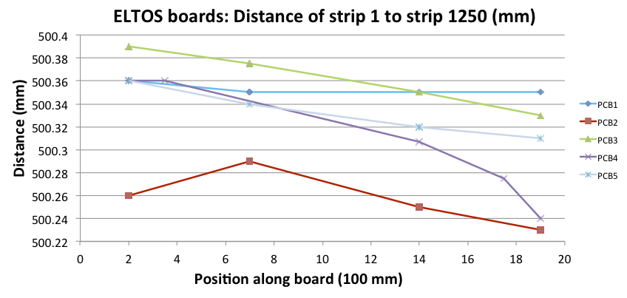
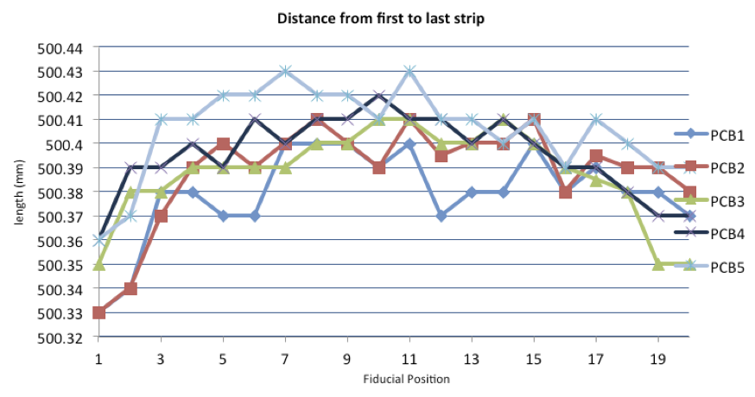
Measurements of 2m boards
Measurements with laser interferometer and traveling microscope
Different boards from same producer follow same trends, but different for Triangle and Eltos
Similar results for 1 m boards
Results are almost OK; can probably be improved without adding (too much) cost
100 µm
100 µm
Position along board (100 mm)

Slide 21
Next steps
Construction and test of a few small chambers to test the ideas outline above
  Test beam in 2nd half of October
Construction of 2 x 1 m² MM chambers for end of 2012 (milestone)
  Construction follows the scheme used for the 1 x 1 m²; 4 boards and floating mesh
  In parallel, follow bulk scheme

Slide 22
Time line for MM production
Demonstration of 2 x 1 m² MM construction by end of 2012 (milestone)
NSW Technical Design Report (TDR) by 31 May 2013
By mid 2013 a baseline detector design should be available, followed by a full-size prototype in fall 2013, involving industry
Module_0 in 2014, in parallel with setup of production and assembly sites and procedures
Production in 2015/16
Installation as of 2016 possible, if NSW structure available
Installation in ATLAS during LHC shutdown 2018

