Slide 1
e¯e⁺-> Z, γ, Z’* ->μ¯μ
Study the sensitivity to Z’ and the couplings determination using
Sequential Standard Model (SSM) described in James Wells note,
and implemented in whizard2, by Jurgen Reuter (ISR included)
Summary of previous meeting results, and follow-up, compare
e¯:80,e⁺30, with e¯:90,e⁺:none , (Gudi’s suggestion)
Model dependent couplings determination,
model dependent and independent bounds given in paper
9607306v2 (A.Leike and S.Rieman)
Systematic error assumptions at 3 TeV:
μ± reconstruction efficiency an ID : Δσ/σ = 1%
μ± charge confusion : ΔAFB/AFB=1%
Luminosity : Δσ/σ = 0.5 %
Polarization : Δσ/σ = 1%

Slide 2
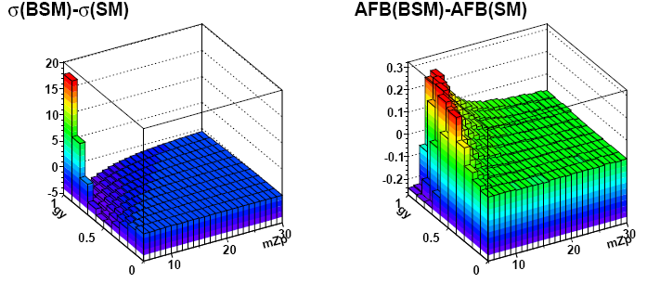
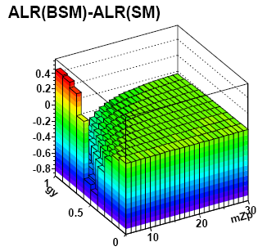
e¯e⁺-> Z, γ, Z’* ->μ¯μ, 3 TeV
Observables
1) whizard2 used to calculate:
σ(BSM), AFB(BSM), ALX(BSM), BSM=SSM
for 6<mZ’<30 TeV and 0.05<gY < 0.95, gBL=0
2) BSM values compared with SM values.
σ(SM)=10.8 fb, AFB(SM)=0.46, ALX(SM)=0.074
AFB=(σFW-σBW)/(σFW+σBW)
ALX=(σLX – σRX)/(σLX + σRX)

Slide 3
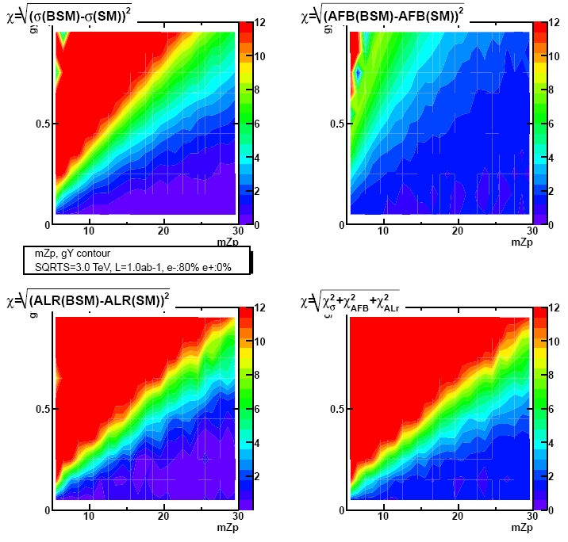
e¯e⁺-> Z, γ, Z’* ->μ¯μ 3 TeV mZ’, gY Contour e-80%,e+:0
Sensitivity to Z’ given by:
Χ²₁=(σ(SM)- σ(BSM) )² /(Δσ(BSM)²)
Contour Plot (mZ’, gY, √ Χ²)
Χ²₂=(AFB(SM)-AFB(BSM) )²/(ΔAFB²)
Χ²₃=(ALX(SM)-ALX(BSM) )²/(ΔALX²)
χ²= Χ²₁ + Χ²₂+ Χ²₃
when √Χ²>12 , √Χ² set to 12
Errors computed assuming:
For σ and AFB , L=1 fb¯¹
Pol: e-80:e+0 , L = 2x 500 fb¯¹,
σ -> sensitivity up to 15 Tev
(gBL=0, gY>0.25)
Best sensitivity from ALX

Slide 4
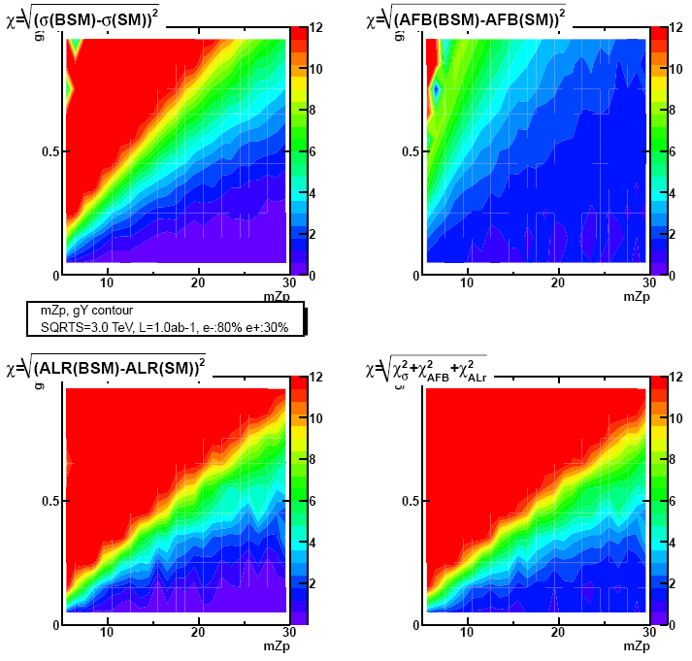
e¯e⁺-> Z, γ, Z’* ->μ¯μ 3 TeV
Sensitivity, e-80%,e+30%

Slide 5
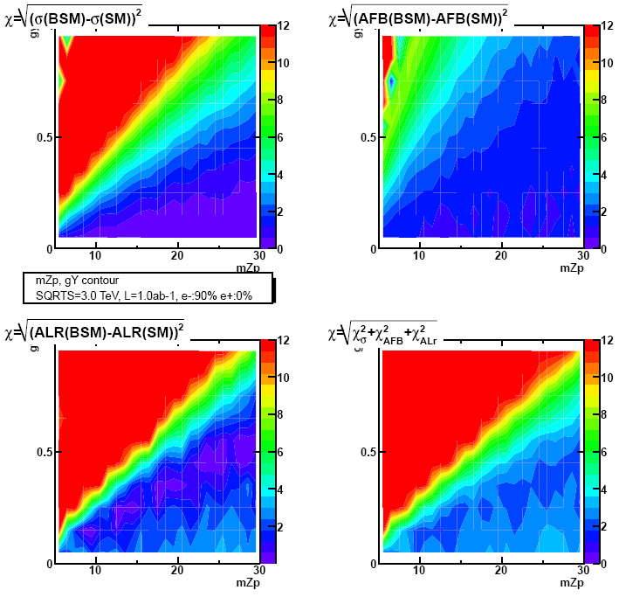
e¯e⁺-> Z, γ, Z’* ->μ¯μ 3 TeV
Sensitivity, e-90%,e+0%

Slide 6
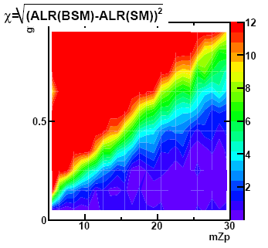
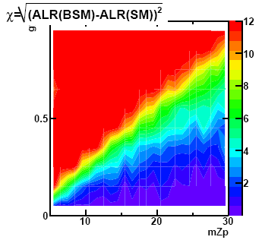
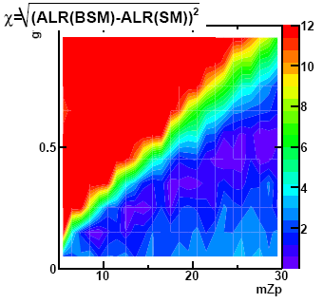
e¯e⁺-> Z, γ, Z’* ->μ¯μ 3 TeV
Contour .. ..
Sensitivity from ALX:
Χ²=(ALX(SM)-ALX(BSM) )²/(ΔALX(BSM)²)
Contour plots H2(mZ’, gY, √ Χ²)
Upper Left plot : e¯80:e⁺0 , L 2x500
Upper Right plot: e¯80:e⁺30, L 2x500
Lower Right plot : e¯90:e⁺0 ,L 2x500
e⁺:30% polarization ↗ sensitivity
e¯:90% is not ~ to 30% e+ polarization

Slide 7
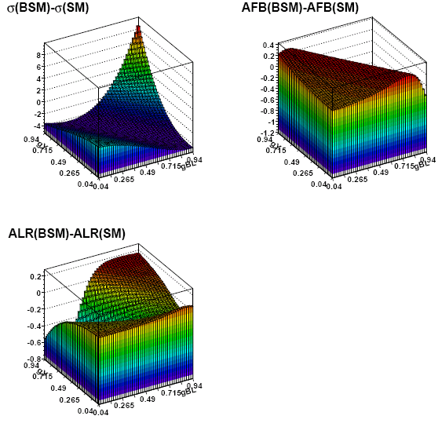
gBL, gY determination
Observables
As for the previous study:
1) Calculate σ(BSM), AFB(BSM), ALR(BSM),
for mZ’= 7, 9, 10 and 12 TeV,
0.05< gBL<0.95 , step 0.02
0.05<gY<0.95
2) Compare them with SM values.

Slide 8
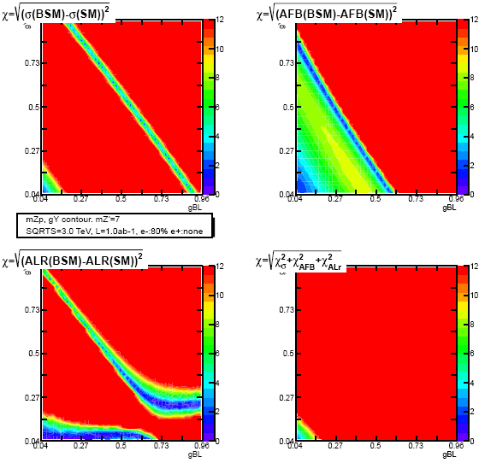
gBL, gY contour mZ’=7 TeV
For each observable compute χ² in each bin
Compute χ² = Σ χ²i
For mZ’=7 Tev,
χ² > 9. in all bins
gBL, gY plane can be covered without ALX

Slide 9
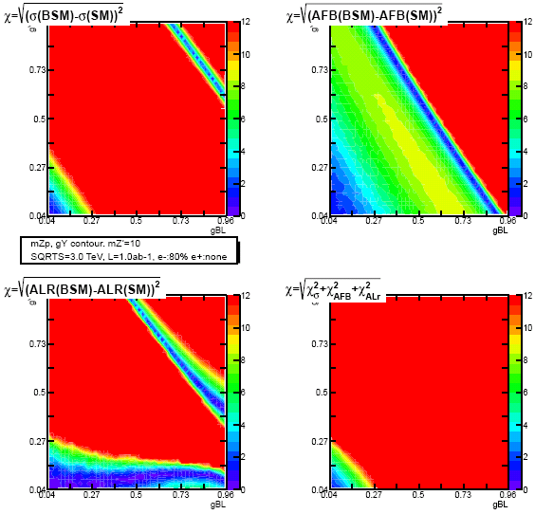
gBL, gY sensitivty mZ’=10 TeV
Compute

Slide 10
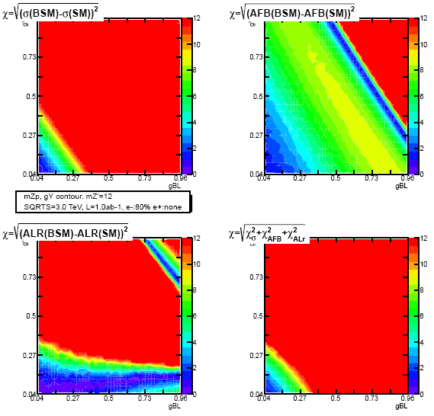
gBL, gY sensitivty mZ’=12 TeV
For mZ’=12 TeV
χ² < 9. for gBL and gY<0.1
Compute

Slide 11
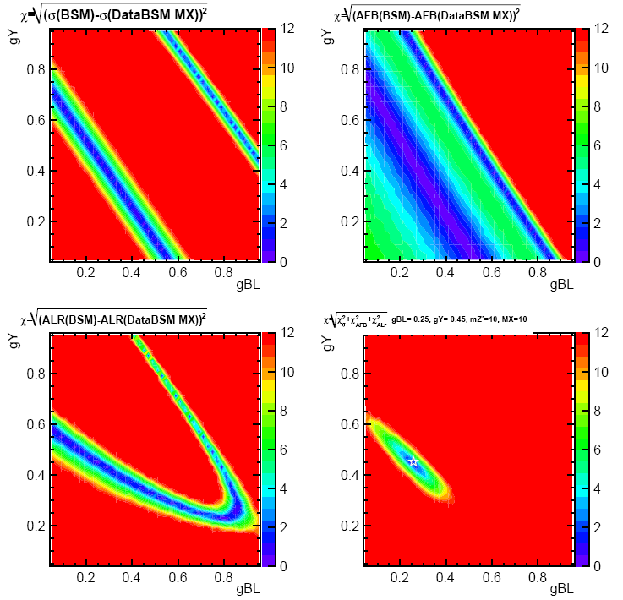
gBL, gY determination mZ’=10 TeV
Assume that at CLIC we observe a difference with the SM
Nature -> Data D
mZ’=10 TeV
gBL=0.25 and gY=0.45
Compare Data with model (SSM)
For each observable, compute :
Χ²₁=(σ(SSM)- σ(D) )² /(Δσ(D)²)
Χ²₂=(AFB(SSM)-AFB(D) )²/(ΔAFB²)
Χ²₃=(ALX(SSM)-ALX(D) )²/(ΔALX²)
χ²= Χ²₁ + Χ²₂+ Χ²₃
Errors from Data point
χ² contour-> minimum
close to:
gBL=0.25 and gY=0.45
(white star)
gBL, gY plane can’t be covered without ALX
Compute

Slide 12
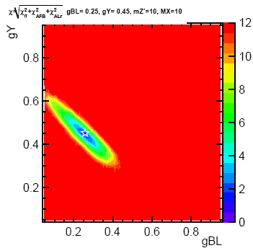
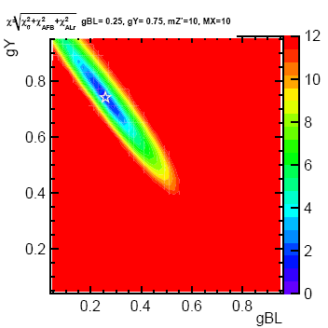
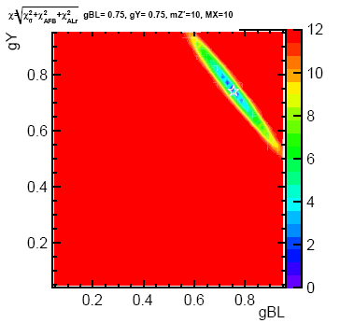
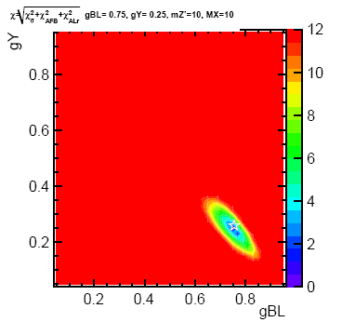
gBL, gY determination mZ’=10 TeV
Repeat the exercise for different points in
The gBl, gY plane
Contour larger depending on the position in the plane.
Minimum always found close to the expected value.
Checked using
Minuit fit
mZ’ unknown for real data

Slide 13
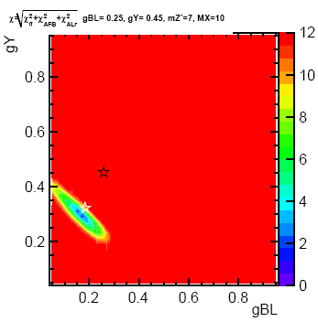
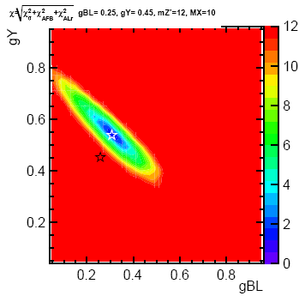
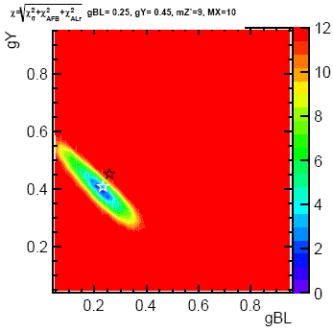
gBL, gY determination mZ’ mass dependence
mZ’ mass unknown => Compute χ² of data and SSM observables for different Z’ masses, here 7 , 12 and 9 TeV; minimum found away from the expected value (black star ),
Below for mZ’= 7 TeV, gBL~0.17, gY~0.3; gY/gBL = gYd/gBLd =0.55
and mZ’= 9 TeV, gBL~0.22, gY~0.4;
Above for mZ’=12 TeV, gBL~0.3 , gY~0.55;
Rescaling values, gBL=gBL.10/7=0.24 and gY=gY.10/7=0.43 (or X/10)-> white star =>
The minimum moves along a line, changing Z’ mass assumption -> gY/gBL.

Slide 14
Summary
At 3 TeV, with 1 ab-1, the cross section measurement gives a
sensitivity to a Z’ up to 15 Tev (gBL=0, gY>0.25)
gBL, gY determination requires the measurement of several
observables, e.g, σ, AFB, ALX
Polarization, e¯:80%,e⁺:none, is essential for the determination of
the couplings.
e¯80%,e⁺:30% polarization improves the sensitivity
e¯:90%,e⁺:none is not ~ to e¯80%,e⁺:30%
gBL and gY can be determined up to ~ 12 TeV.
-> gY/gBL independent of Z’ mass
consistent with conclusions of paper 9607306v2
(a very comprehensive study)
Results will be checked with beamstrahlung when whizard2 ready

