Slide 1
INDICO
Event Management and Archival
Thomas Baron
CERN-UNOG Meeting 28th February 2012
Notes:
1

Slide 2
Outline
What is Indico ?
Features
Managing conferences
Managing meetings
Finding information
Collaboration Hub
Indico Outside CERN
Why choose Indico?

Slide 3
What Is Indico?
Web-based event organisation platform
From the simplest lecture to the most complex conference
Archive of events metadata and related documents (minutes, slides etc.)
An open collaboration hub at the heart of the Organisation’s collaboration strategy

Slide 4

What Is Indico?
Started as a European Project (2002-2004)
In production at CERN: http://indico.cern.ch
And in > 90 institutions around the world:
http://indico-software.org/wiki/IndicoWorldWide
Dedicated Indico servers installed at GSI, DESY, Fermilab, MIT, iHEP (China), EU-projects…
Free and Open Source

Slide 5

Features

Slide 6
Features: Managing Conferences
Manages the whole conference lifecycle
> Web Site Management
> Conference Program Definition
> Call for Abstract
> Abstract Selection, refereeing
Contributions
> Timetable Setup
> Slides and paper Submission
Sessions
> Attendant Registration, payment, badges
Conferences
> Paper Reviewing
> Evaluation form
> Long term archive and proceedings

Slide 7
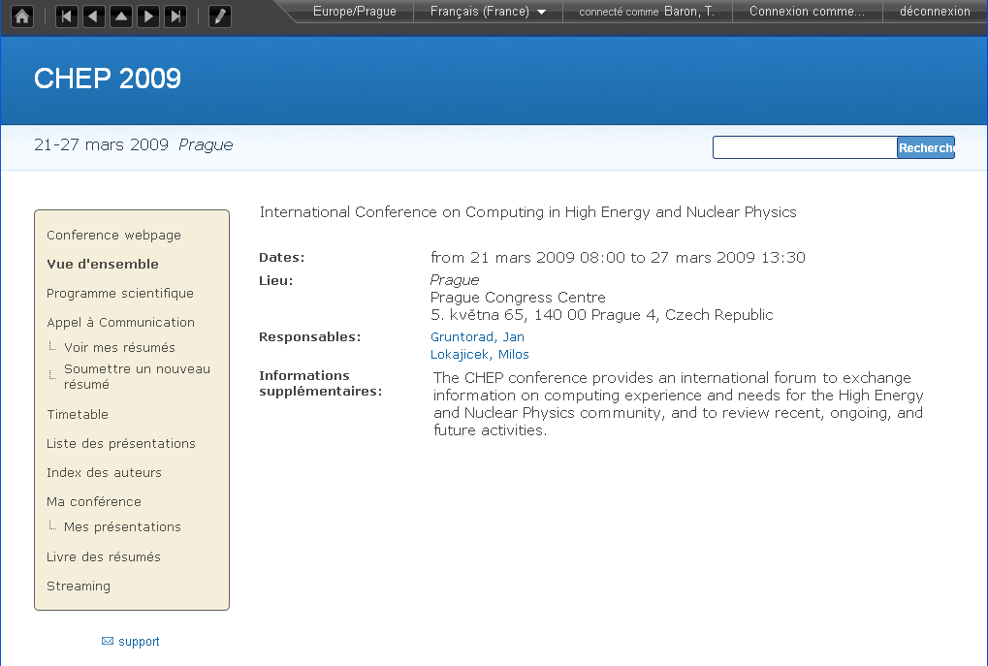
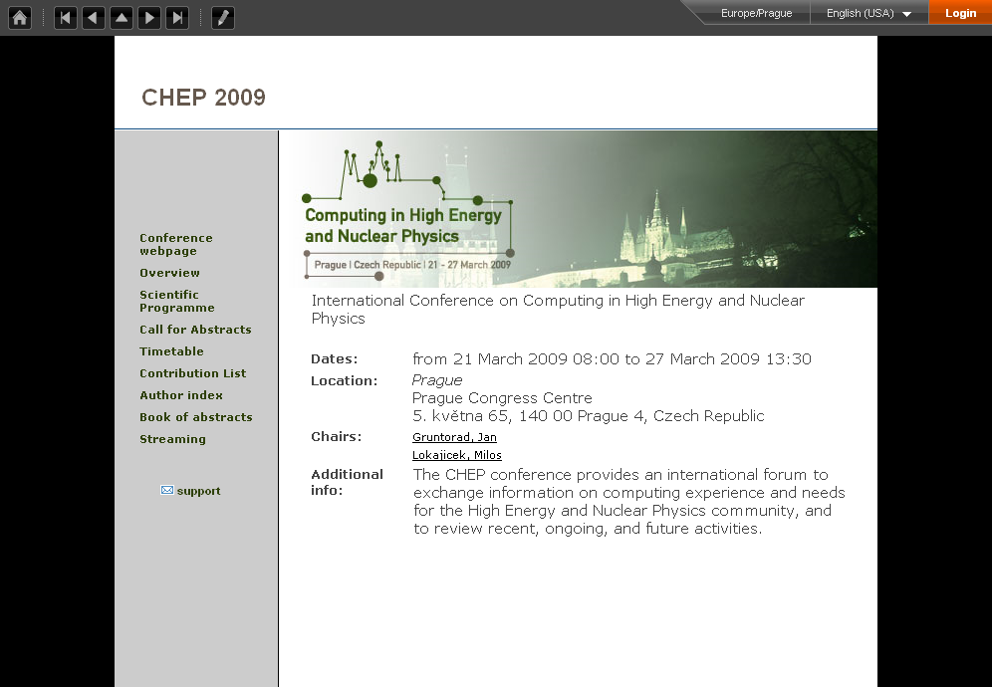
Features: Managing Conferences
> Web Site Management
> Conference Program Definition
> Call for Abstract
> Abstract Selection, refereeing
Contributions
> Timetable Setup
> Slides and paper Submission
Sessions
> Attendant Registration, payment, badges
Conferences
> Paper Reviewing
> Evaluation form
> Long term archive and proceedings

Slide 8
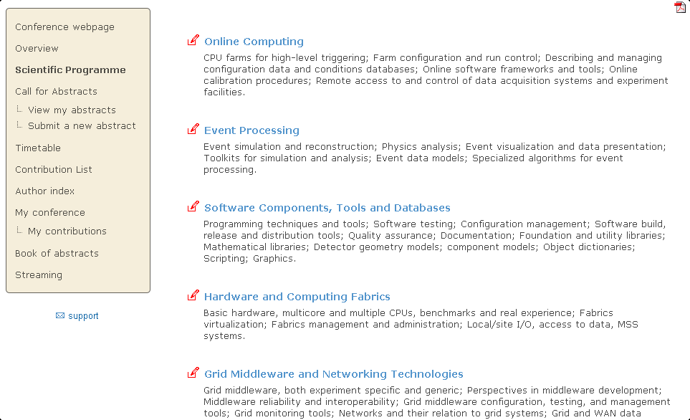
Features: Managing Conferences
> Web Site Management
> Conference Program Definition
> Call for Abstract
> Abstract Selection, refereeing
Contributions
> Timetable Setup
> Slides and paper Submission
Sessions
> Attendant Registration, payment, badges
Conferences
> Paper Reviewing
> Evaluation form
> Long term archive and proceedings

Slide 9
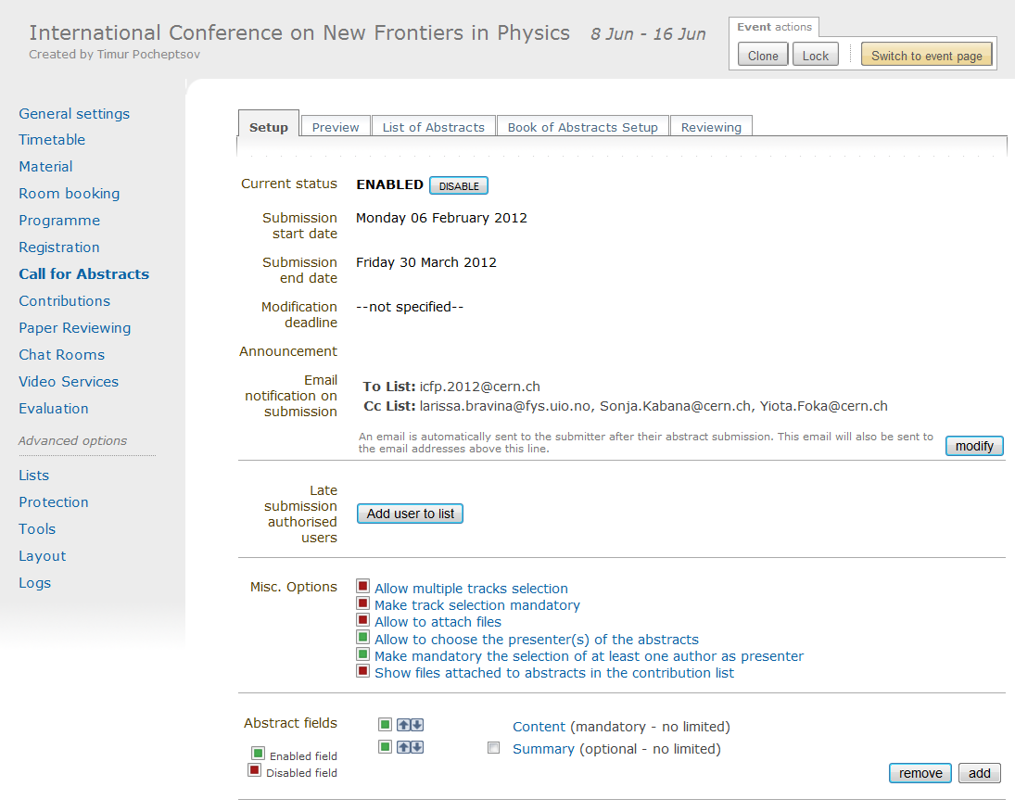
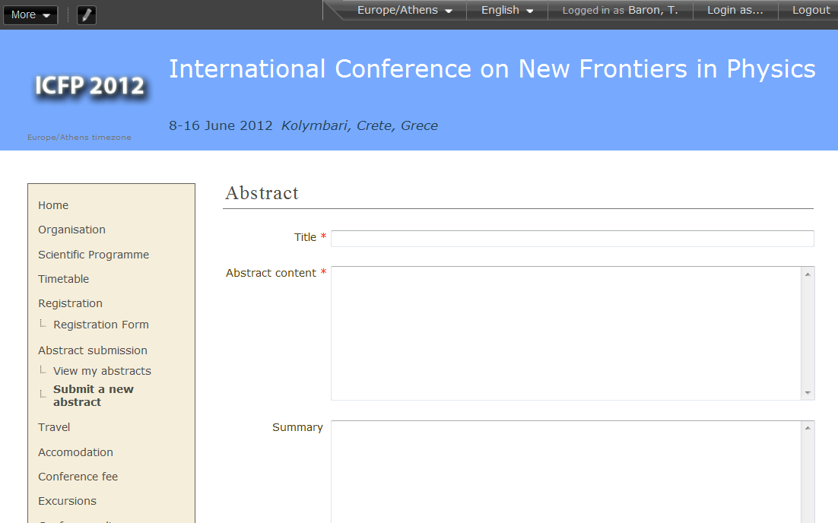
Features: Managing Conferences
> Web Site Management
> Conference Program Definition
> Call for Abstract
> Abstract Selection, refereeing
Contributions
> Timetable Setup
> Slides and paper Submission
Sessions
> Attendant Registration, payment, badges
Conferences
> Paper Reviewing
> Evaluation form
> Long term archive and proceedings

Slide 10
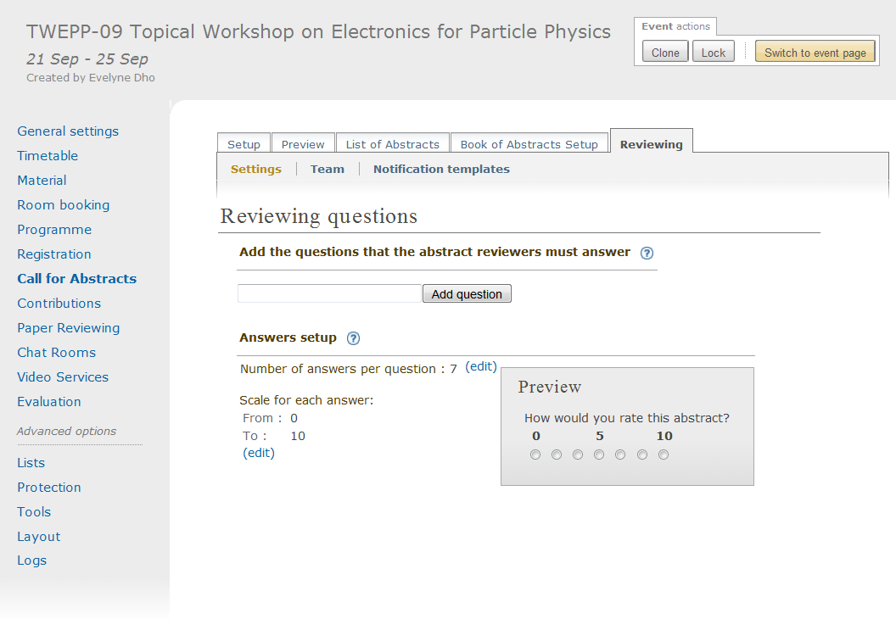
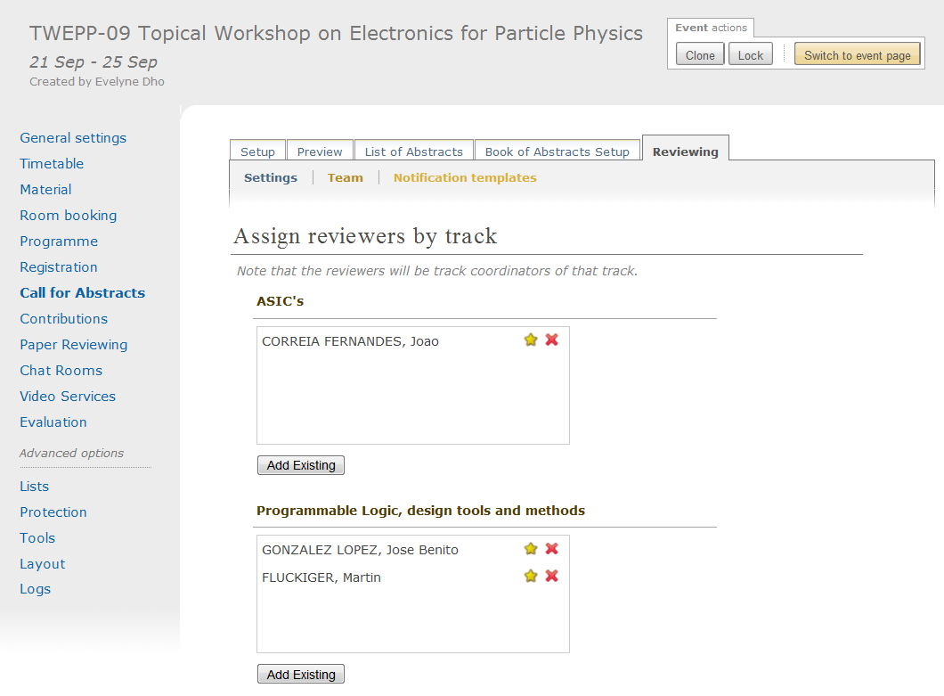
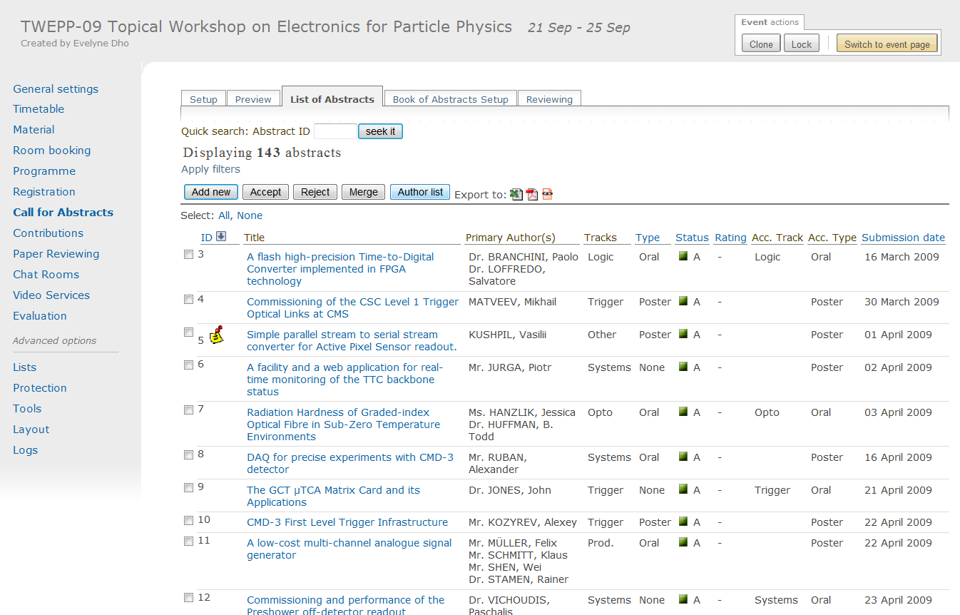
Features: Managing Conferences
> Web Site Management
> Conference Program Definition
> Call for Abstract
> Abstract Selection, refereeing
Contributions
> Timetable Setup
> Slides and paper Submission
Sessions
> Attendant Registration, payment, badges
Conferences
> Paper Reviewing
> Evaluation form
> Long term archive and proceedings

Slide 11
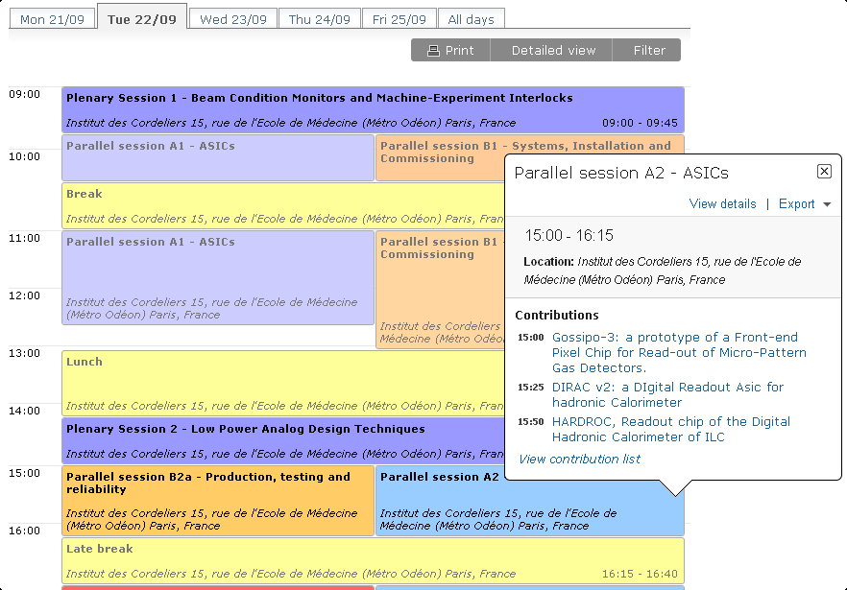
Features: Managing Conferences
> Web Site Management
> Conference Program Definition
> Call for Abstract
> Abstract Selection, refereeing
Contributions
> Timetable Setup
> Slides and paper Submission
Sessions
> Attendant Registration, payment, badges
Conferences
> Paper Reviewing
> Evaluation form
> Long term archive and proceedings

Slide 12
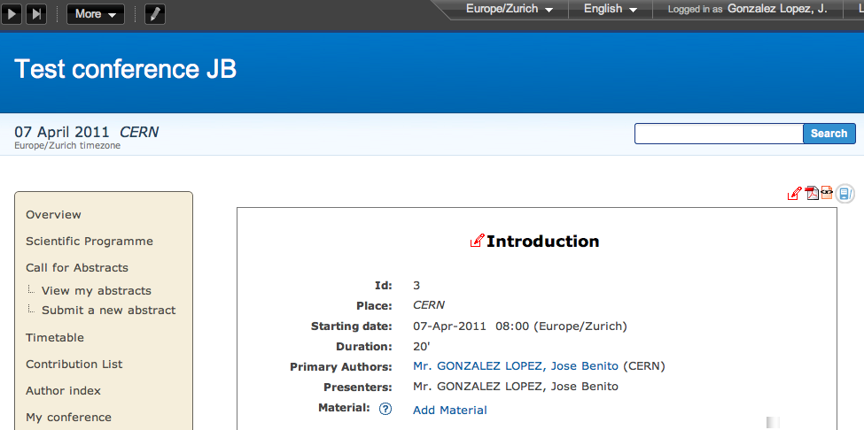
Features: Managing Conferences
> Web Site Management
> Conference Program Definition
> Call for Abstract
> Abstract Selection, refereeing
Contributions
> Timetable Setup
> Slides and paper Submission
Sessions
> Attendant Registration, payment, badges
Conferences
> Paper Reviewing
> Evaluation form
> Long term archive and proceedings

Slide 13
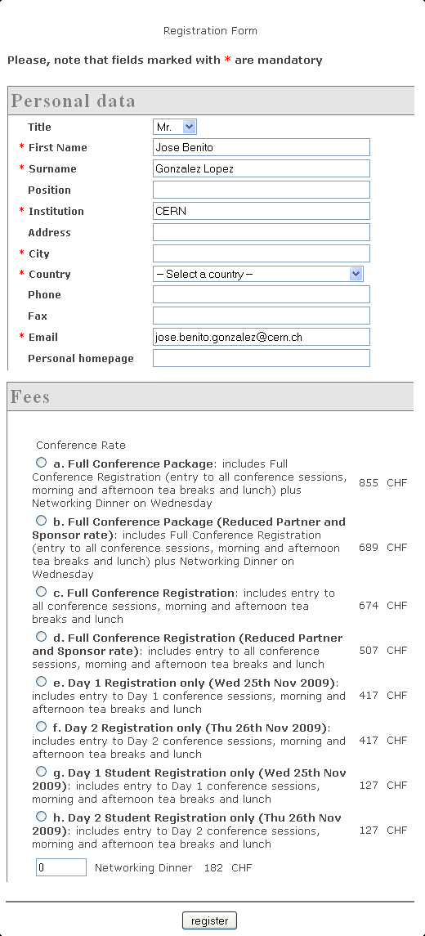
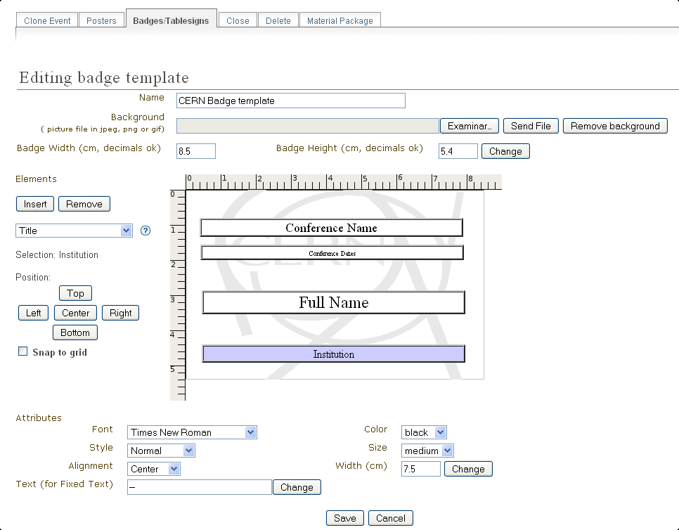
Features: Managing Conferences
> Web Site Management
> Conference Program Definition
> Call for Abstract
> Abstract Selection, refereeing
Contributions
> Timetable Setup
> Slides and paper Submission
Sessions
> Attendant Registration, payment, badges
Conferences
> Paper Reviewing
> Evaluation form
> Long term archive and proceedings

Slide 14
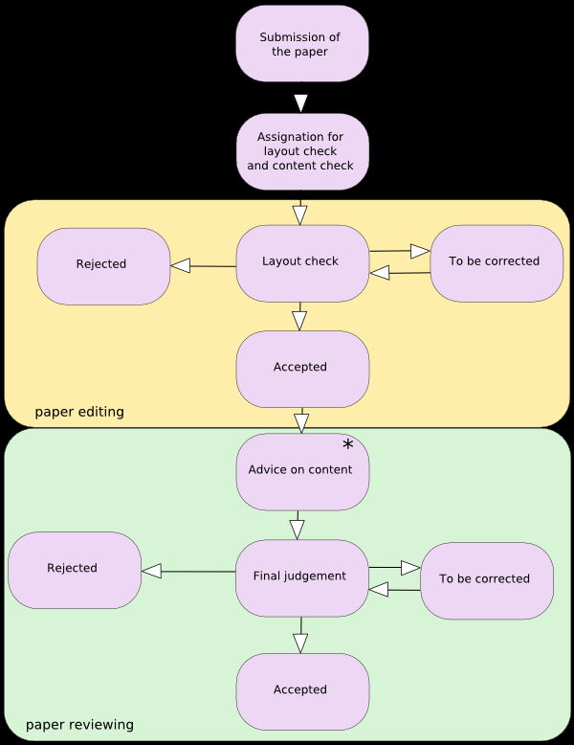
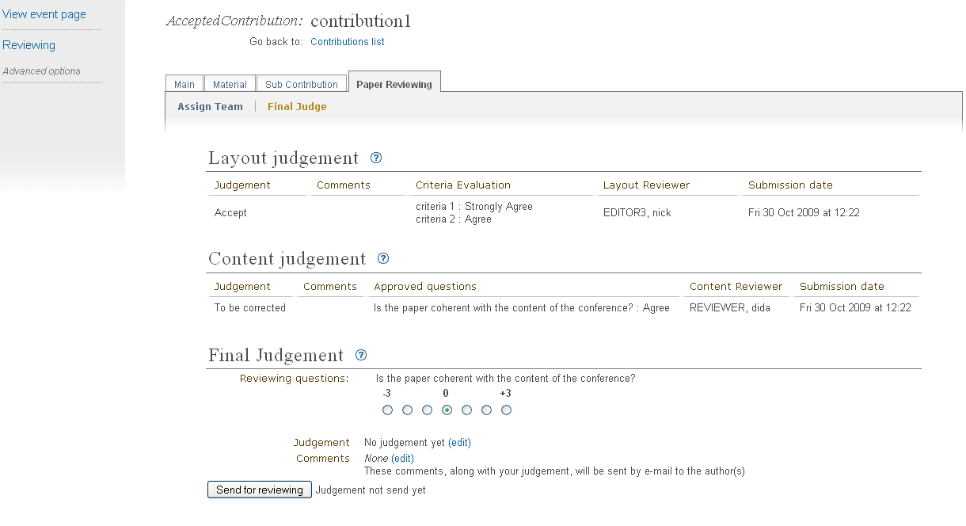
Features: Managing Conferences
> Web Site Management
> Conference Program Definition
> Call for Abstract
> Abstract Selection, refereeing
Contributions
> Timetable Setup
> Slides and paper Submission
Sessions
> Attendant Registration, payment, badges
Conferences
> Paper Reviewing
> Evaluation form
> Long term archive and proceedings

Slide 15
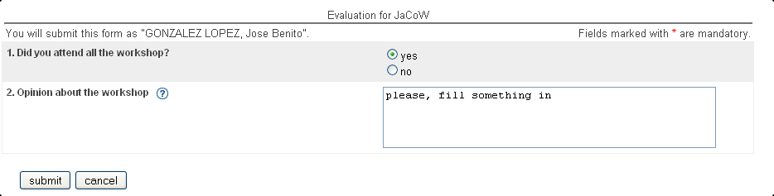
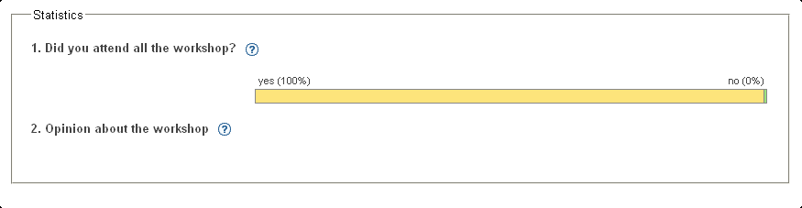
Features: Managing Conferences
> Web Site Management
> Conference Program Definition
> Call for Abstract
> Abstract Selection, refereeing
Contributions
> Timetable Setup
> Slides and paper Submission
Sessions
> Attendant Registration, payment, badges
Conferences
> Paper Reviewing
> Evaluation form
> Long term archive and proceedings

Slide 16
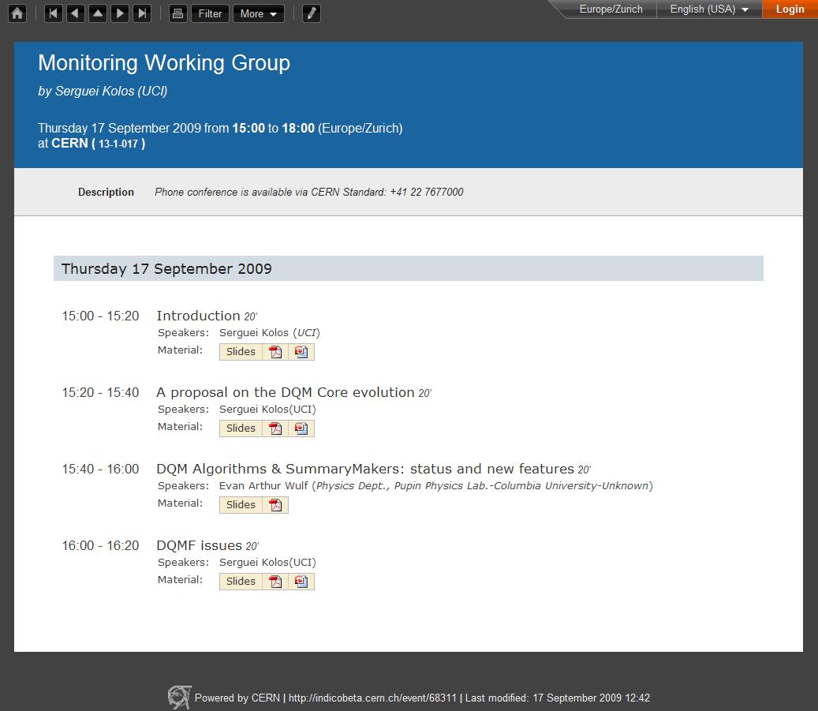
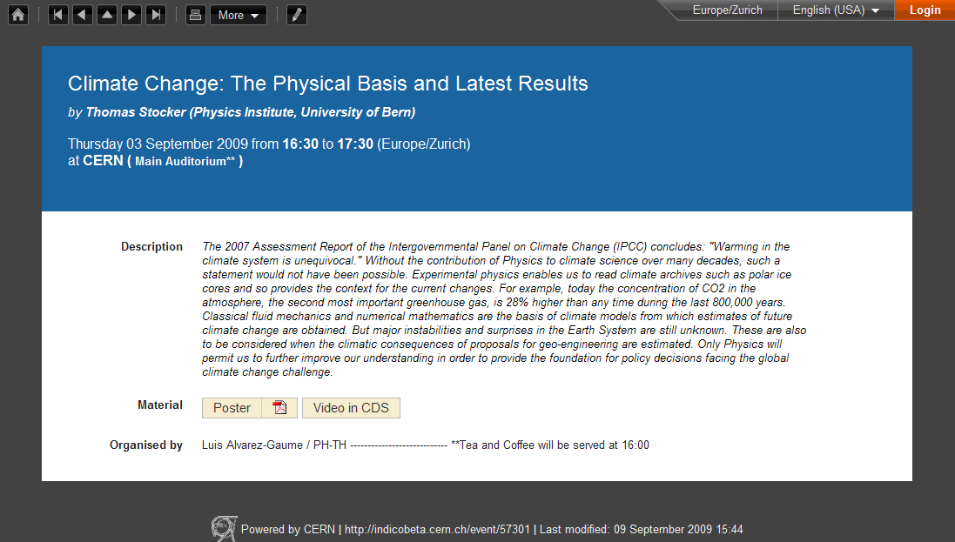
Features: Managing Meetings

Slide 17
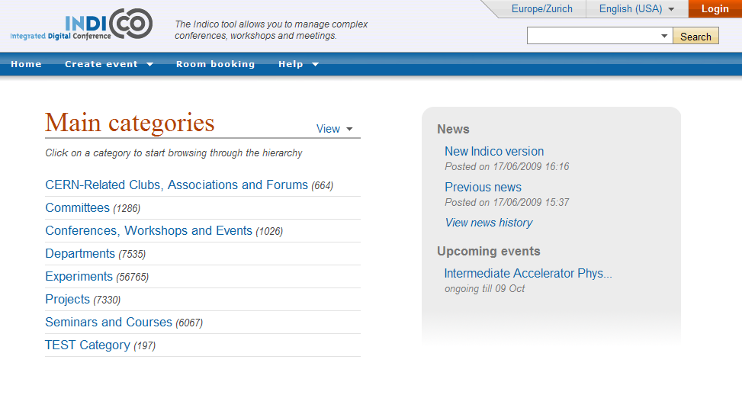
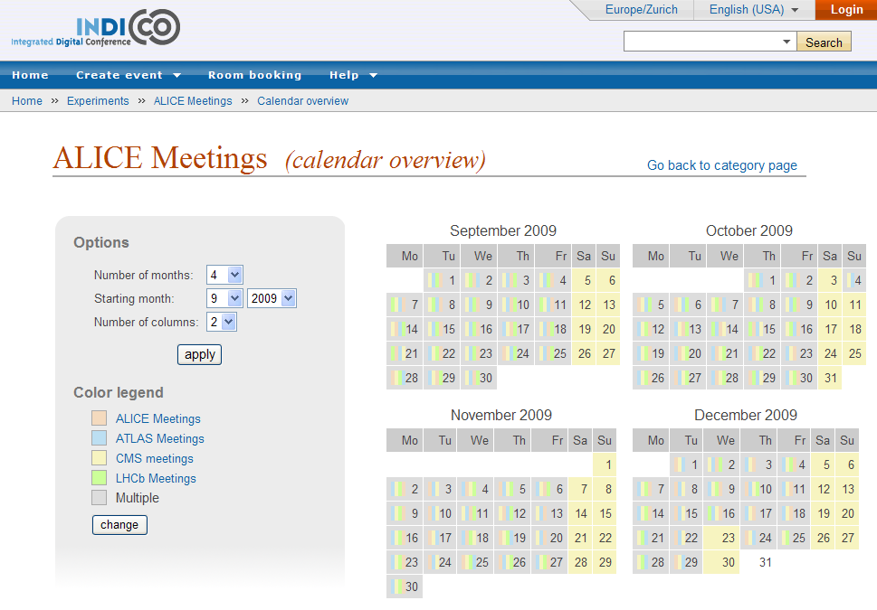
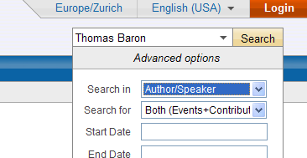
Features: Finding Information

Slide 18
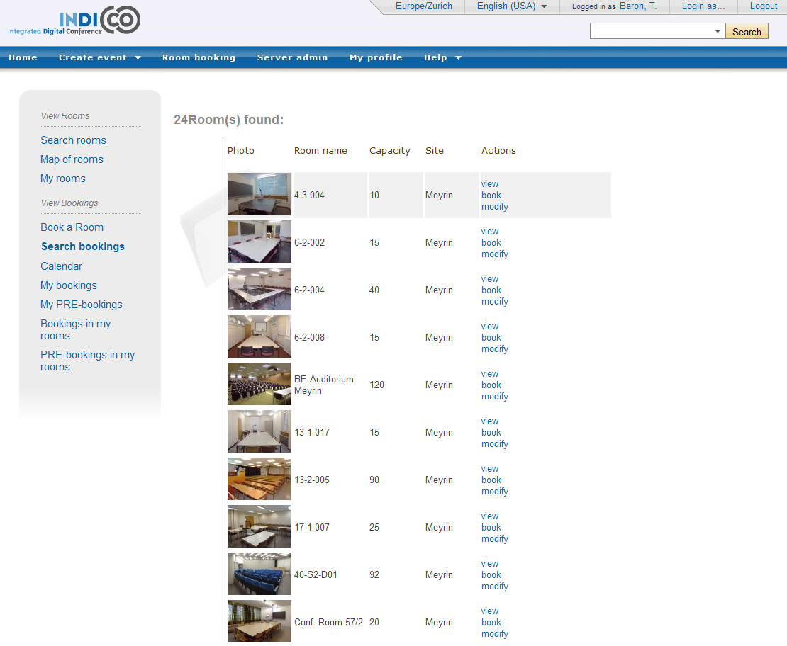
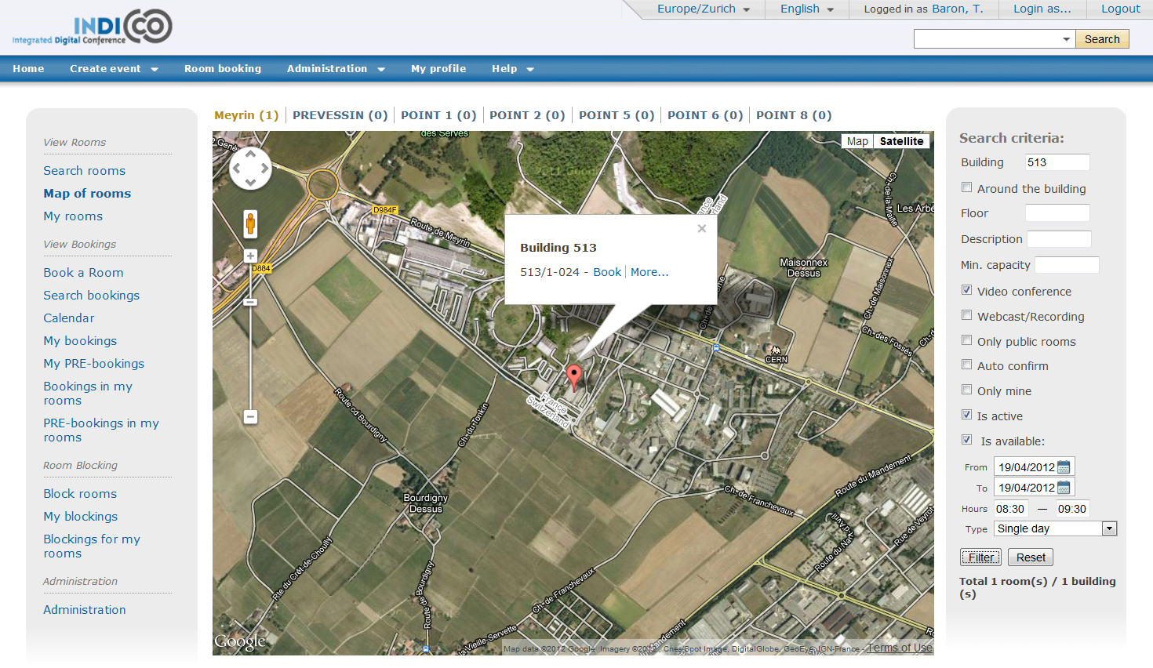
Features: Collaboration Hub
Room
booking

Slide 19
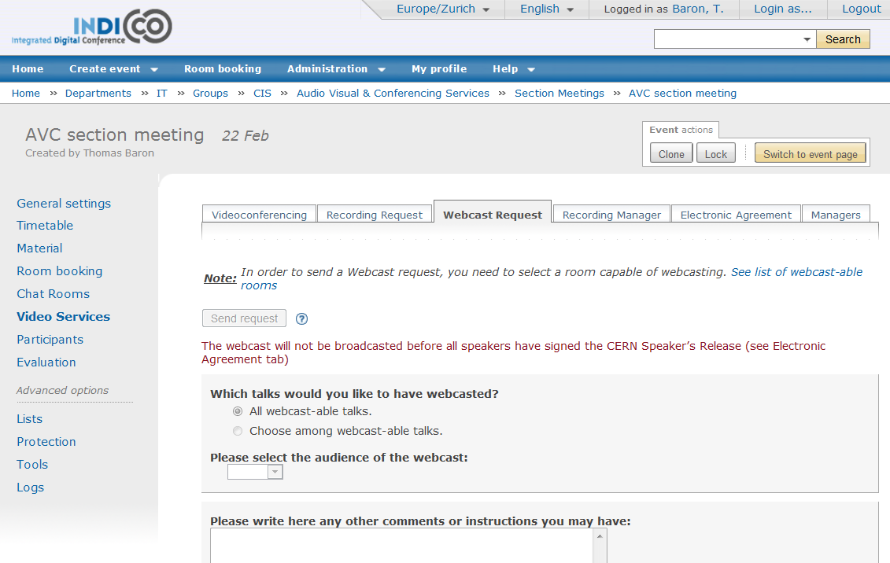
Features: Collaboration Hub
Booking collaboration services: videoconference, webcast, recording, chat

Slide 20
Indico Outside CERN
Open-source Software
Released under the GNU GPLv3
Distributed on a dedicated site: http://indico-software.org/
Easily installed
Good packaging
On one single server or on a cluster (like at CERN: currently 4 servers)
Ongoing work on Indico virtualisation and cloud-based services

Slide 21
Indico Outside CERN
Supported
Community site http://indico-software.org/wiki/Community
Active and archived mailing lists for administrators of Indico servers
Some companies are selling various commercial services around Indico

Slide 22
Why Choose Indico ?
Easily integrated to your Organisation
Modular architecture; Open plugin model
To your local authentication system
Existing module for LDAP
Full layout customization
Easy and secure data export mechanisms
In various formats: XML, HTML, ICS, JSON
Easy link with Exchange, Outlook, Google Calendar
Using public/private keys and signed requests
Controlled data export to search engines (through the LiveSync module)

Slide 23
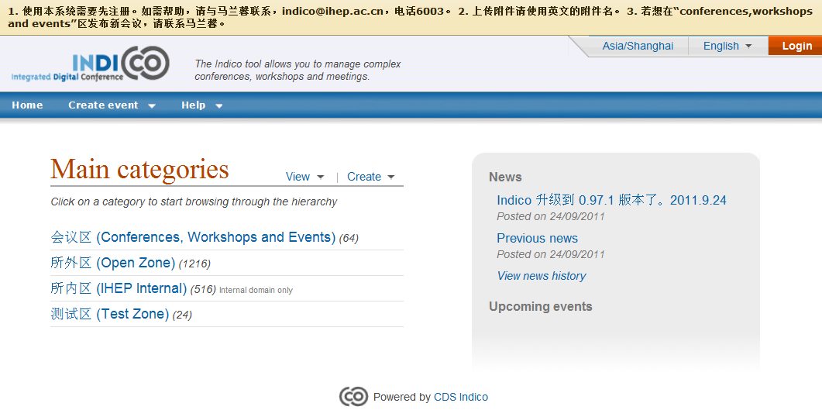
Why Choose Indico ?
Secure
Protection model
Fine-grained
User or group based
Solid development process
Coding standards
Code reviews
Tests cycle
Internationalised
3 languages currently available (EN, FR, SP)
Easy to add new translations (2 text files); even in non-latin character sets (UTF8)
Timezone-aware

Slide 24
Why Choose Indico ?
Extensible and reliable
At CERN
170.000 events
720.000 talks
920.000 files – several TB of data
Useful!
At CERN
15.000 unique visitors (~1M hits) on average per day

Slide 25
Thank you for your attention
Any questions ?
Thomas.baron@cern.ch
http://indico.cern.ch
http://indico-software.org

