Slide 1
Status of Vacuum System and near future plan
Junichiro KAMIYA
J-PARC/Japan Atomic Energy Agency

Slide 2
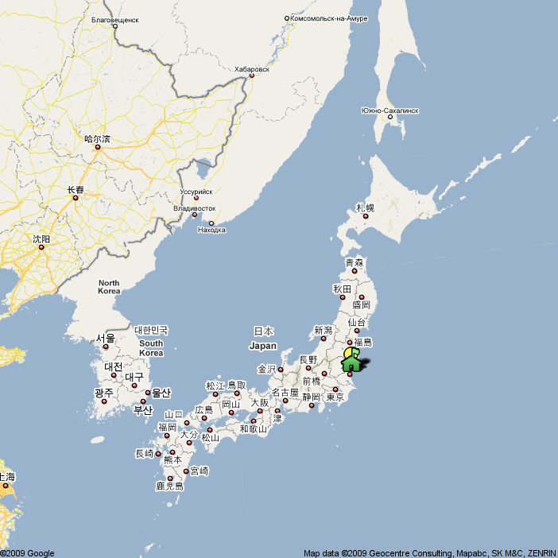
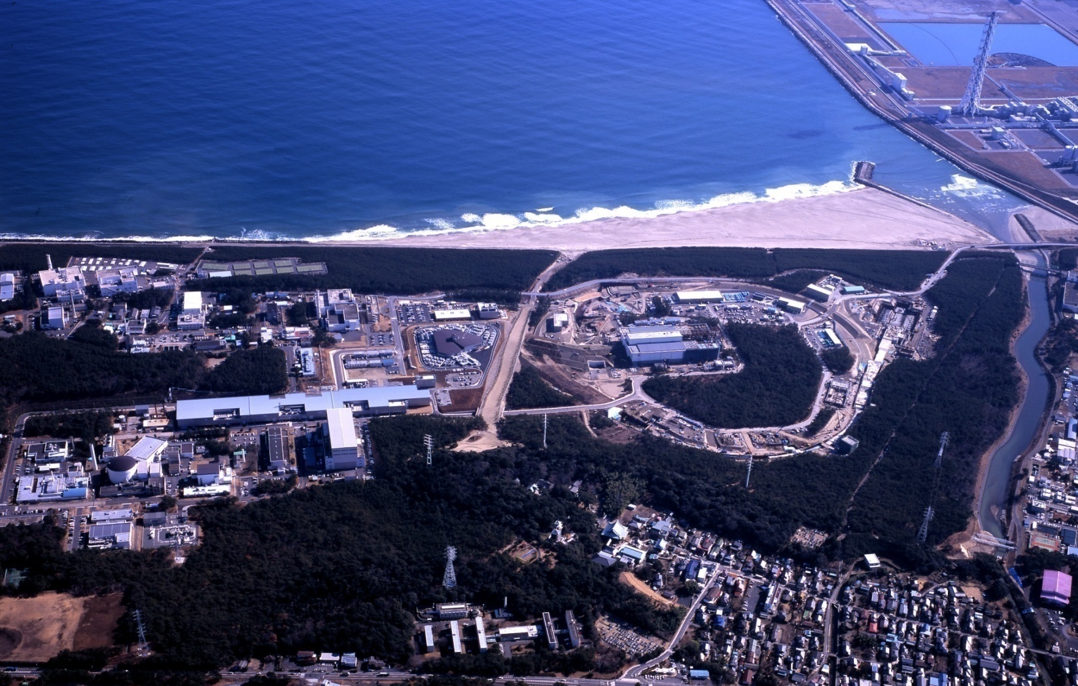
Japan Proton Accelerator Research Complex (J-PARC)
J-PARC,
Tokai-mura, Ibaraki-ken
Tokyo
Japan
3GeV RCS
Hadron
Linac
MLF
50-GeV MR

Slide 3
J-PARC RCS(rapid cycling synchrotron) design:
Beam power 1MW= 3GeV, 8.3x10¹³ protons, 25Hz
Challenge to vacuum components
Small residual radio activity: Titanium ducts & bellows
N.Ogiwara, Vacuum 84(2010)
Resistance to radiation: TMP with high radioactive resistance
Suppression of eddy current
& low impedance
: Ceramic ducts with RF shield
M. Kinsho, Vacuum 81(2007)
Components with low outgassing
: Ferrite cores of kicker magnet
J. Kamiya, J. Vac. Soc. Jpn(2007)
: Cu block of beam collimator
K. Yamamoto, Phys. Rev. ST-AB 11(2008)

Slide 4
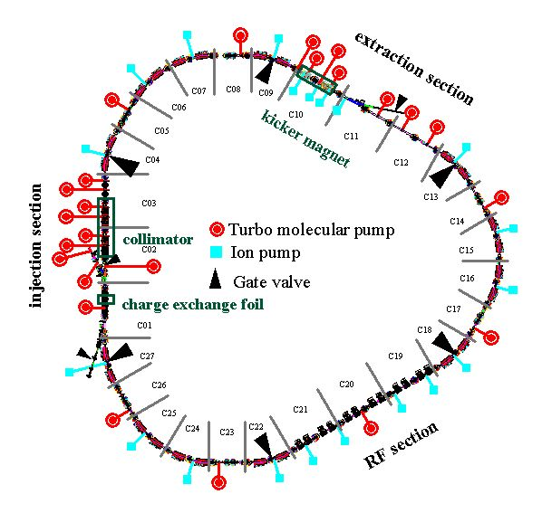
RCS Vacuum System
1st arc
3GeV
To neutron source (Hg target)
& 30GeV Synchrotoron
Vacuum system
Vacuum chambers
108 Ceramic ducts
186 Ti ducts & bellows
Pumps
24 Turbo molecular pumps
(20 Spattering ion pumps)
Gauges
44 Cold cathode gages
17 BA gages
44 Pirani gauges (beam line and back line of TMP)
2nd arc
181MeV
3rd arc
From Linac
Circumference 348.3m
Other vacuum components
Collimators
Kicker magnet
Charge exchange foil …..

Slide 5
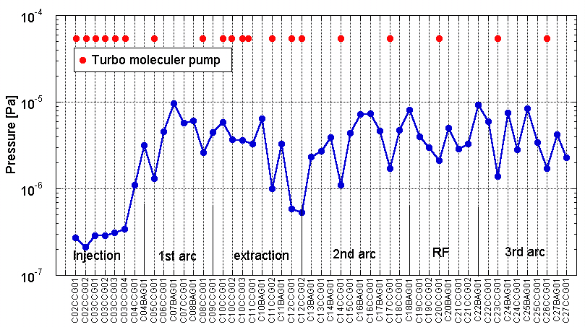
Vacuum Performance ~static pressure distribution
Beam off, All magnet are excited.
Pressure of less than 10⁻⁵ Pa is stably maintained.

Slide 6
Source of Dynamical pressure change in high intensity accelerator
~Mechanism is similar to plasma-surface interactions in nuclear fusion machines.
G. M. McRACKEN, P.E. SCOTT, Nuclear Fusion, Vol.19, No.7(1979)
1) Thermal desorption of gas adsorbed on the vacuum walls
2) Desorption due to bombardment by ions, electrons, and photons
3) Chemical reactions which release gaseous contaminants such as H₂O and CH₄.
We are seeing the combination of those interactions.

Slide 7
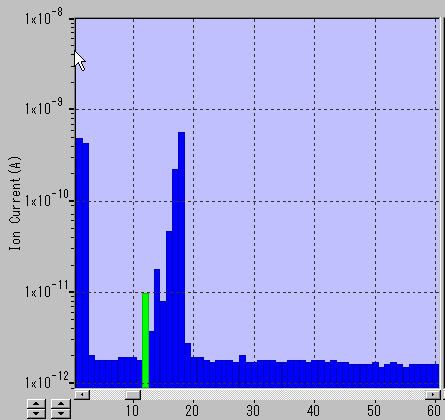
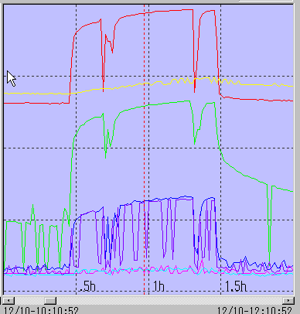

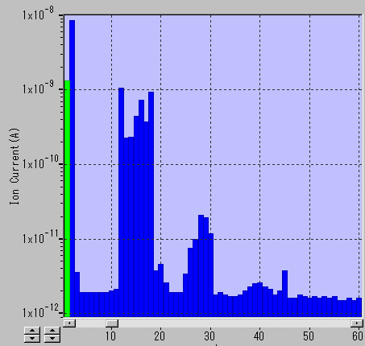
Dynamic Pressure in RCS (2) ~ gas analysis
gaseous molecule
proton beam
+
ion
Beam off
+
desorption
Ion bombardment ~one of the process of dynamic pressure change
300kW beam
H2
H2O
Beam on
CH4
CO
C2H4 etc.
Especially in the beam operation just after a maintenance, we see the large pressure increase.

Slide 8
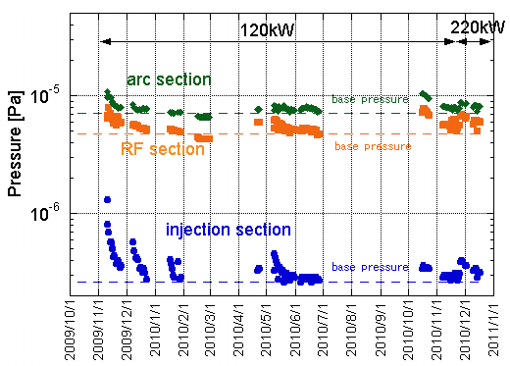
Dynamic Pressure in RCS (2)~ conditioning effect
maintenance
maintenance
Pressure distribution
after long beam operation.
Pressure history (on beam)
There is a conditioning effect by the beam during a continuous beam operation.
There is no pressure increase after long term beam operation.
-> After molecules on the surface are desorbed by the particle hit, a clean surface is obtained.
For higher power beam?
No one knows. We will see.

Slide 9
Development of the vacuum component
Vacuum chamber and bellows of
magnetic material with high permeability
2. In-situ bake out for kicker magnets

Slide 10
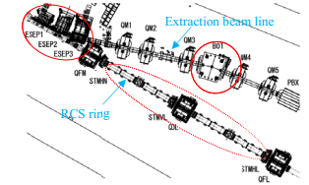
1. Magnetic field shielding by vacuum chambers of magnetic material
Leakage field from a magnet in the extraction line distort the beam orbit in RCS.
Most effective way to shield such field is to cover the beam by the magnetic materials at the nearest space.
=Vacuum wall
These components are made of magnetic alloys.
Beam ducts
Bellows
Turbo molecular pumps
Request from beam commissioning group
Magnetic field in the area (~10gauss) must be 1/10 at beam position.
Beam ducts, bellows, turbo molecular pumps of magnetic materials.

Slide 11
Selection of magnetic alloy
SUS430(ferritic stainless steel):
○Ready availability: easy
△magnetic permeability (μ): 500~1000
Enough field shielding characteristic with a thickness of more than 10mm
-> Enable for flanges(t30mm) and outer case of TMP (t10~20mm)
Permalloy (Ni base alloy with very high permeability)
○ magnetic permeability (μ): >10000
△ Ready availability: difficult especially for thick alloy
-> Enable for bellows (t0.2mm) and ducts (t3mm)
Permalloy
Permalloy
SUS430
SUS316L
SUS430
bellow
Beam duct

Slide 12
Conditions for magnetic annealing
Mechanical stress = Decrease of magnetic permeability
→ Magnetic annealing(=heat treatment) is necessary after cutting, bending, pressing etc..
Dependence of magnetic shielding characteristic on annealing temperature
External field (Bout)
Gauss meter
(Measure of Bin)
Bellow of permalloy
Good shielding characteristic for the annealing temperature with more than 850 degC(10H).

Slide 13
Magnetic field shielding
x
z
+500
0
-500
-750
External field Bx_out=20gauss
Ducts
Bellows
B_in/B_out<1/10 is achieved.

Slide 14
Vacuum fire
If we work annealing in good vacuum, it can combine with vacuum fire.
850degC 10H
Temperature [degC]
TDS spectrum(H2O)
Outgassing rate of permalloy
Before vacuum fire: 1.e-8 Pam/s
After vacuum fire: 3.e-9Pam/s

Slide 15
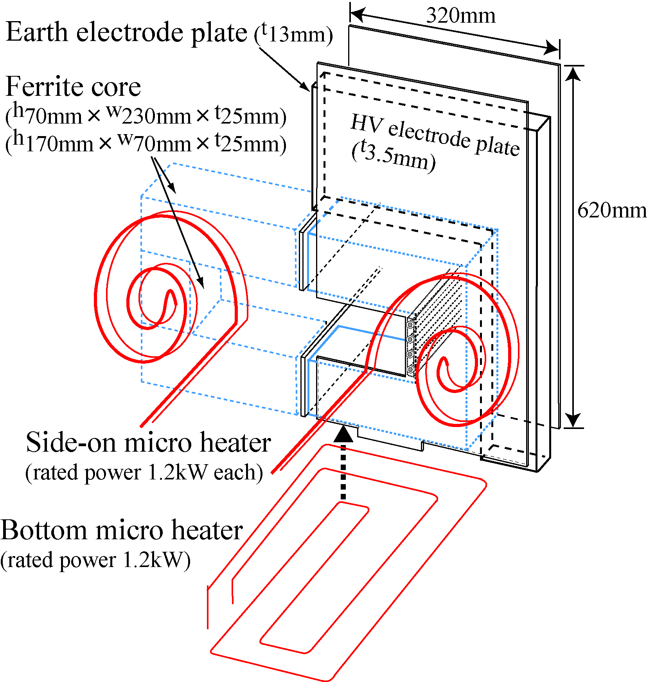
2. In-situ bake out for kicker magnets
Kicker : Outgassing from ferrite cores
= Water is a main component due to the porosity of ferrites.
The usual way= bake-out the whole vacuum chamber
x huge heater capacity
x heat expansion of the chamber (Critical to the accelerator, which have many components in small area.)
Raise the temperature of the structure inside without heating the vacuum chamber.
Concept of setup.
Relative position of kicker and heaters.

Slide 16
Temperature of ferrite cores due to the in-situ method
Required heater power to reach
a kicker temperature up to 100 ºC.
Temperature of ferrite cores and vacuum chamber.
Heater power at this measurement 1.6kW << Former heater power 10kW
(heaters are put onto the outer surface.)
Install heaters directly into vacuum＋Heat shield panels to direct the radiated heat to kicker
=
Effective and “eco” way for outgassing reduction!

Slide 17
Summery
Status of vacuum system
Dynamical pressure change due to high power beam has been observed.
After molecules on the surface are desorbed by several mechanisms, pressure is stable even during high power beam operation up to 200kW.
What will happen in higher beam power?
Development of vacuum components
We are developing vacuum components such as
Vacuum chambers and bellows of magnetic alloy with high permeability
In-situ outgassing reduction method for kicker magnets
We desire the continuous collaboration about information exchange, development of vacuum components, and scientific research about accelerator vacuum.

