Slide 1
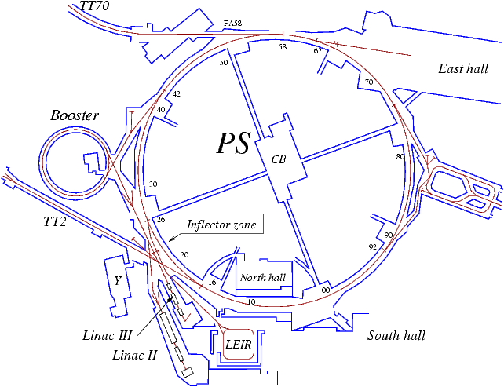
Review of vacuum activities.
PS Complex - Shutdown 2011 – 2012
Paul Demarest – TE-VSC-IVM

Slide 2
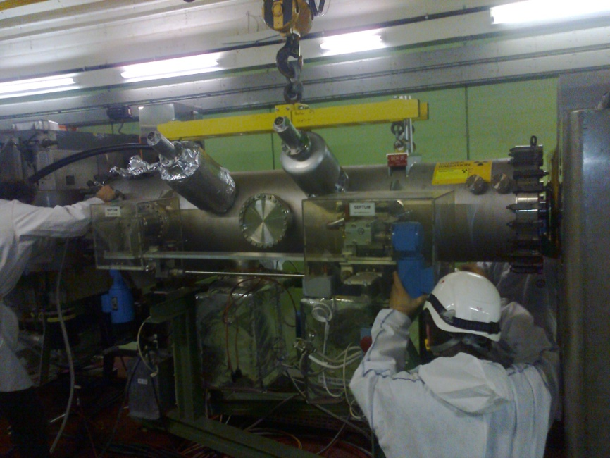
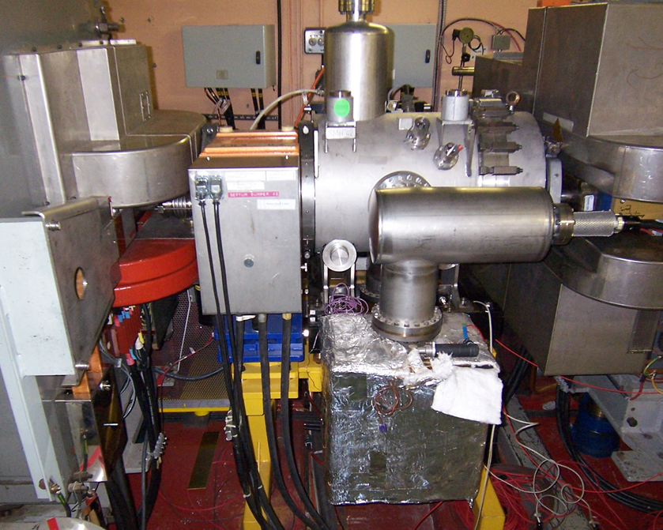
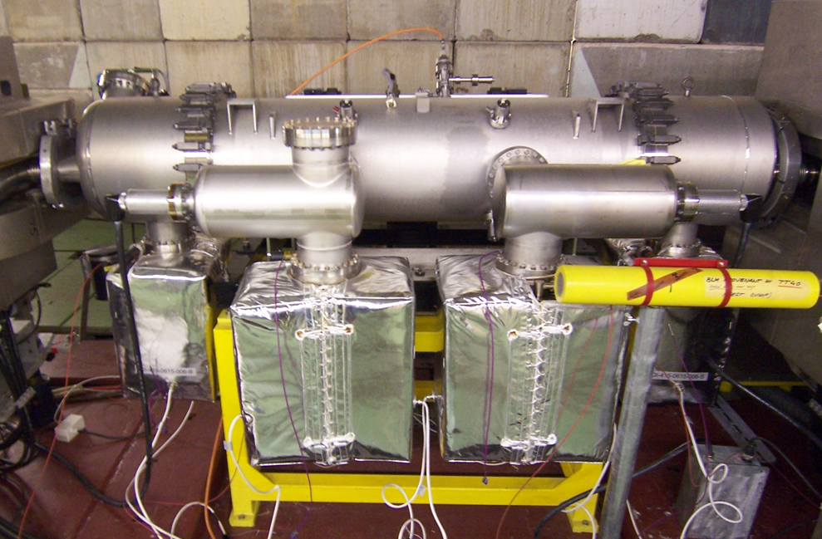
PS Ring – Replacement of Septa
Septum: Device used to transfer beam, into & out of synchrotrons.
Injection of a particle beam into a circular accelerator.
Extraction of particles from an accelerator to a transfer line.
SEH 31
Why the need to replace?
Pulsed systems – Finite number of pulses before fatigue sets in leading to failure.
Removed septa refurbished ready for installation at a later date.
SMH 42
SMH 16

Slide 3
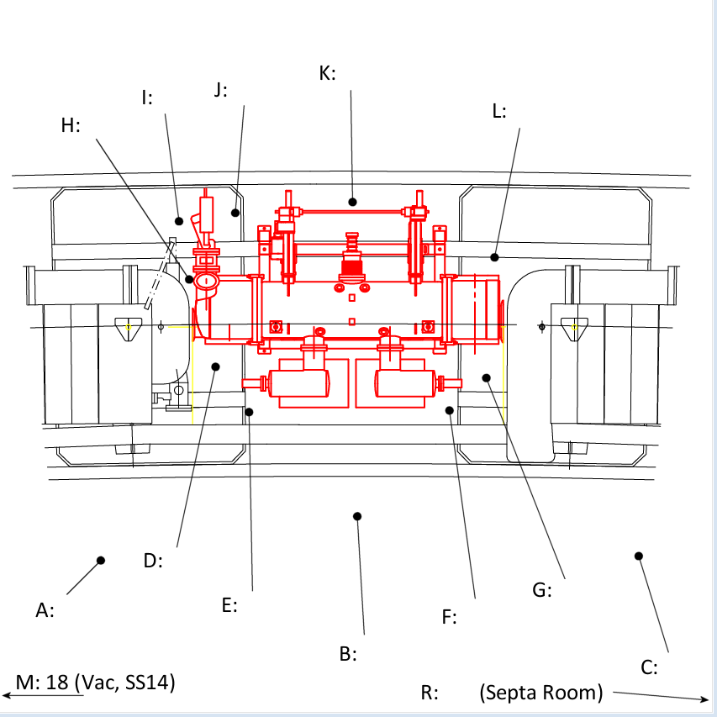
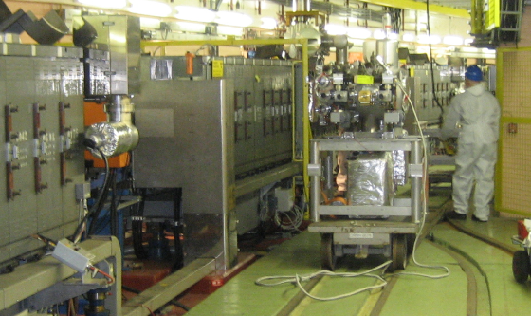
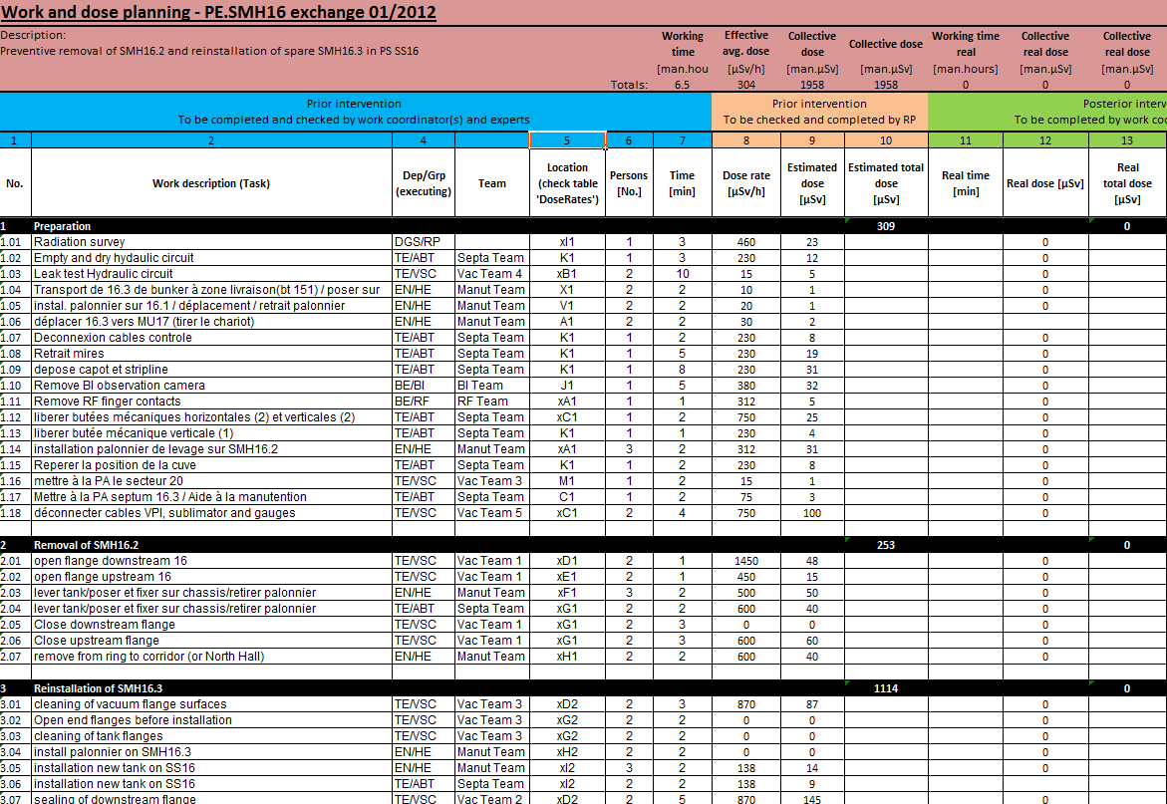
PS Ring - Replacement of Septa - Planning
Due to the function of these magnets the radiation dose rate is normally high, 1 mSv/h.
A Radiation Dose Map is made of equipment and area.
Logistics:
Movement - Rail track system & overhead crane.
Personnel - VSC, ABT, RF, Transport & RP.
Radiation Dose Plan (DIMR).
A detailed plan with calculated time and exposure.
Personnel & equipment in correct sequence, time & position in order to reduce staff radiation exposure to a minimum.

Slide 4
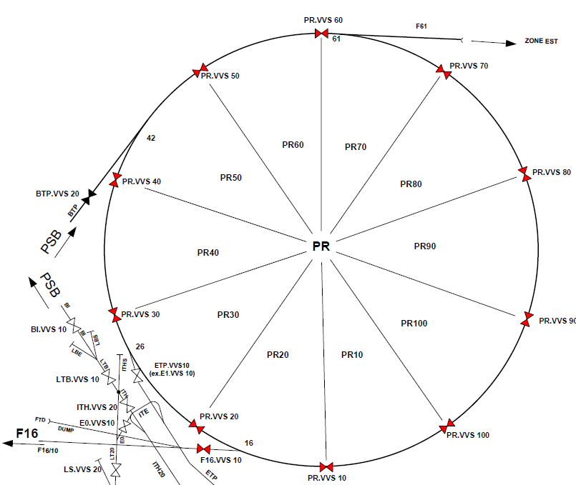
PS Ring - Replacement of Septa
SMH 42
Injection from the PSB
SEH 31
Preparation for ejection
by SMH 16
SMH 16
Ejection to SPS, AD and n-Tof via TT2

Slide 5
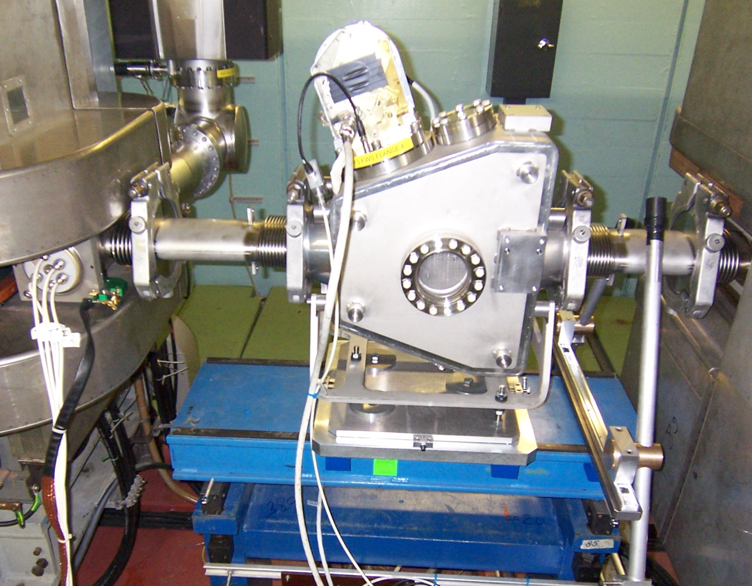
PS Ring – Fast Wire Scanner Replacement
FWS - Provides information on beam profile and position
Replaced - FWS.54, 64, 65 & 85
Modified design: Larger aperture to avoid contact with the beam and a more robust mechanism.

Slide 6
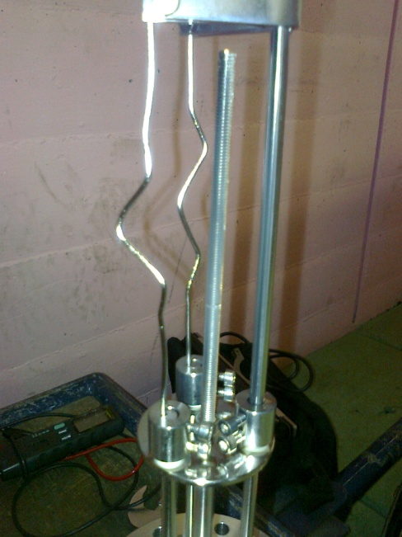
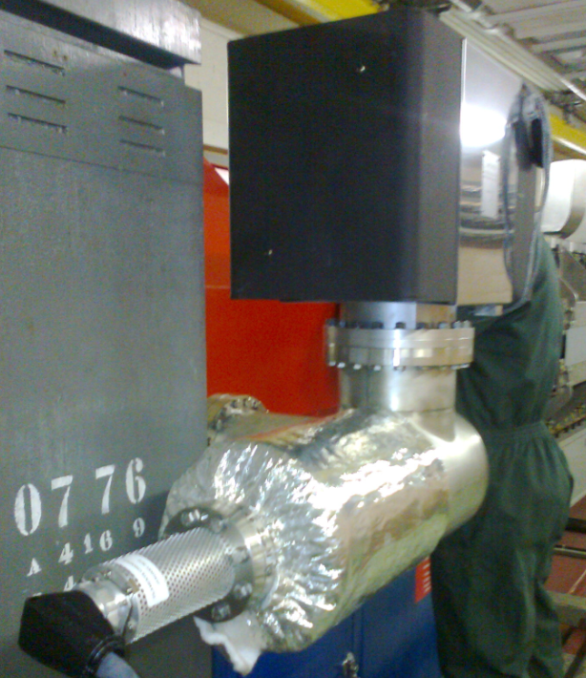
PS Ring – Sublimator Filaments & VPI Replacement
Replacement of Sublimator Filaments.
Replaced on sectors 20, 40, 50 & 100 opened during the shutdown.
Total of 44 sublimators replaced.
Replacement of 3 Ion pumps on sector 90.
VPI 84, VPI 85 & VPI 86.

Slide 7
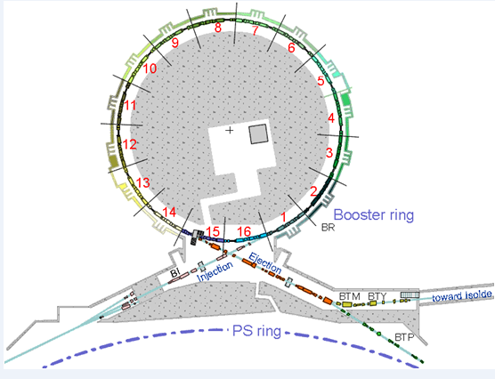
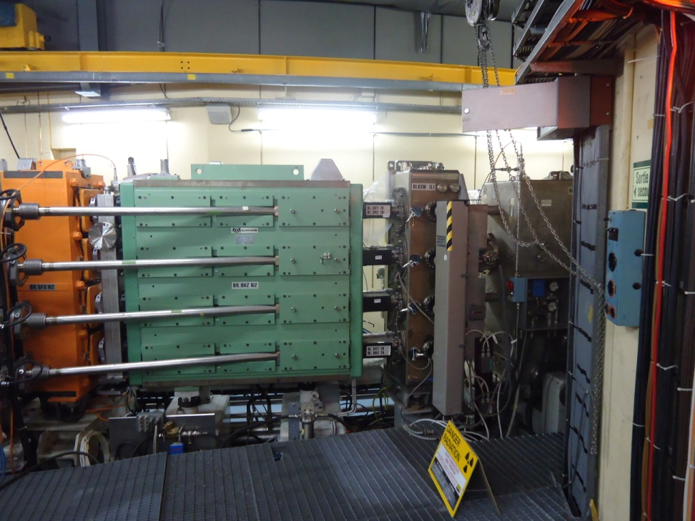
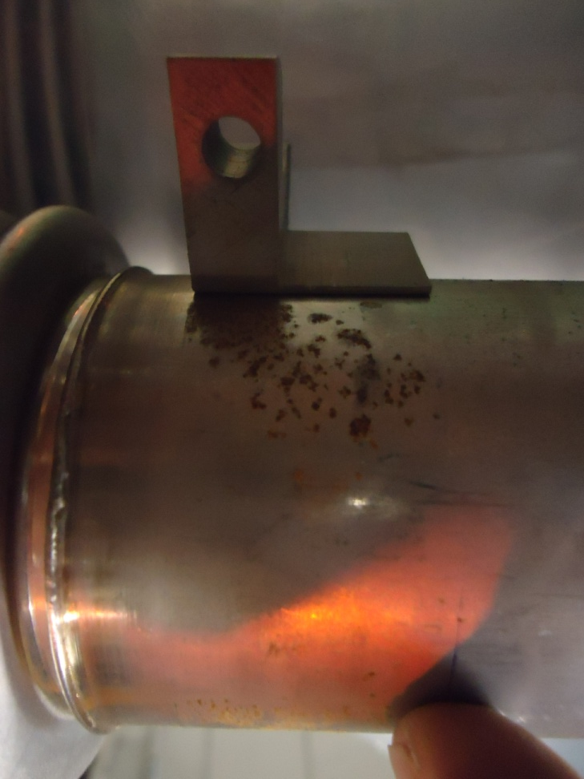
PSB – Replacement of Injection Chambers BHZ162
July 2011 - Leak developed on one of the four injection chambers – Temporary repair with vac seal.
Due to corrosion on the stainless steel chamber, the result of chemical reaction with PVC clamp used for mounting corrector magnets.
All four chambers replaced - Evidence of corrosion on all chambers.
Magnet re-shimmed by MCN to prevent any movement and fatigue of the coils during pulsing.
Replacement magnet clamps now manufactured from charged epoxy resin.
L2

Slide 8
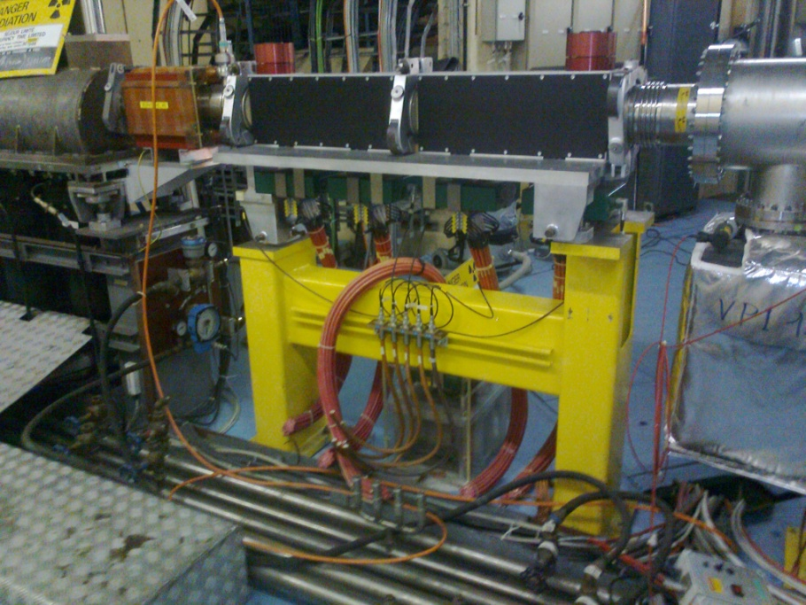
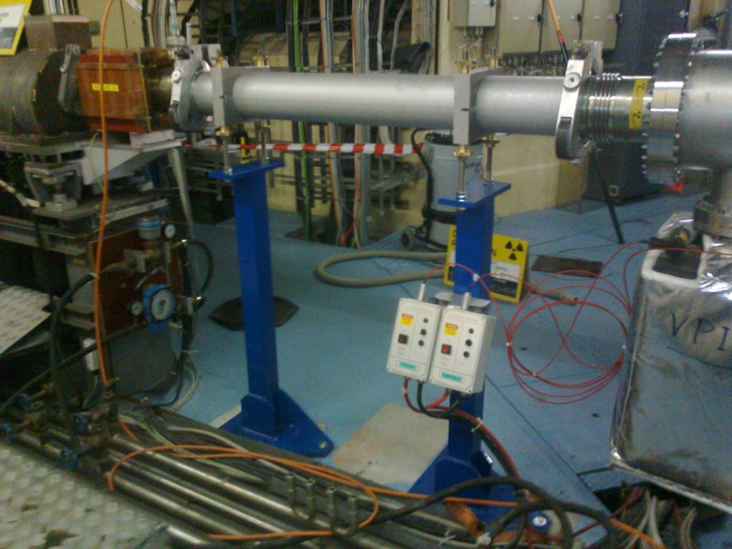
PSB – BI.DIS Magnet removal
BI.DIS
The BI.DIS magnet was removed and replaced with a plain vacuum chamber.
No longer required as now ions are generated at Linac 3 and LEIR.
This magnet was used when ions were fed to the PS via Linac 2 & the booster.

Slide 9
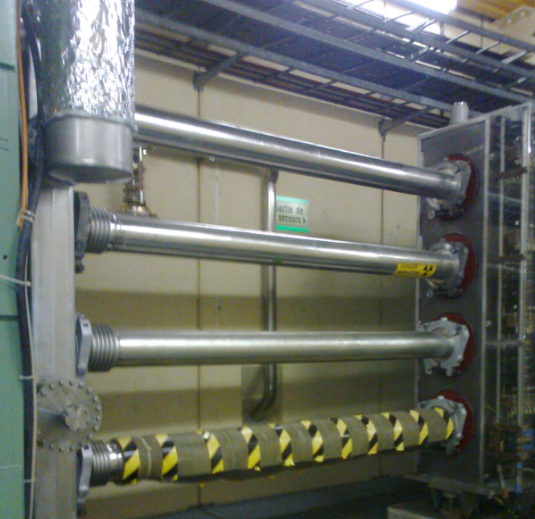
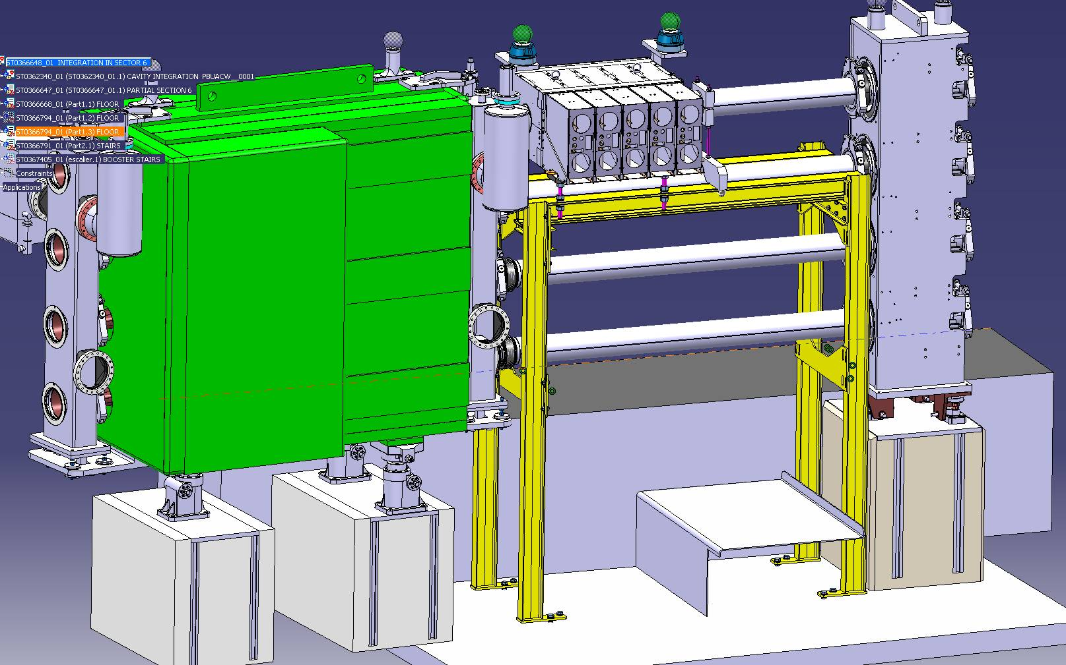
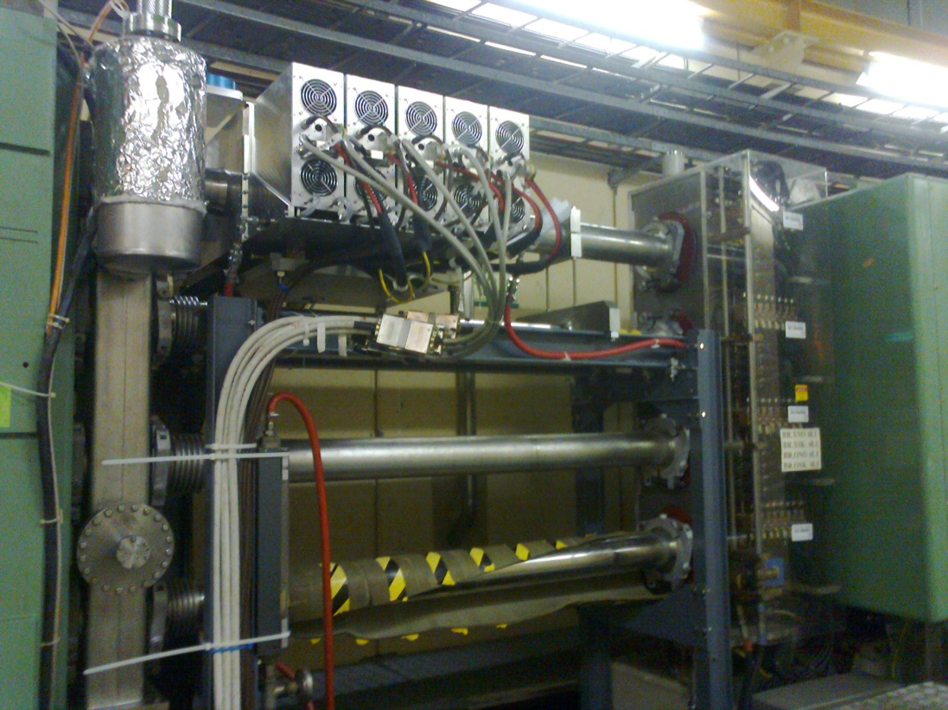
PSB – Finemet® Cavity Installation
Experimental RF cavity installed in BR20.
Replacing a vacuum chamber in Sector 6L1.
On one ring only.
Installed for testing with the view of replacing the existing RF cavity system in the future.
Only to be tested during non-experimental beam time.

Slide 10
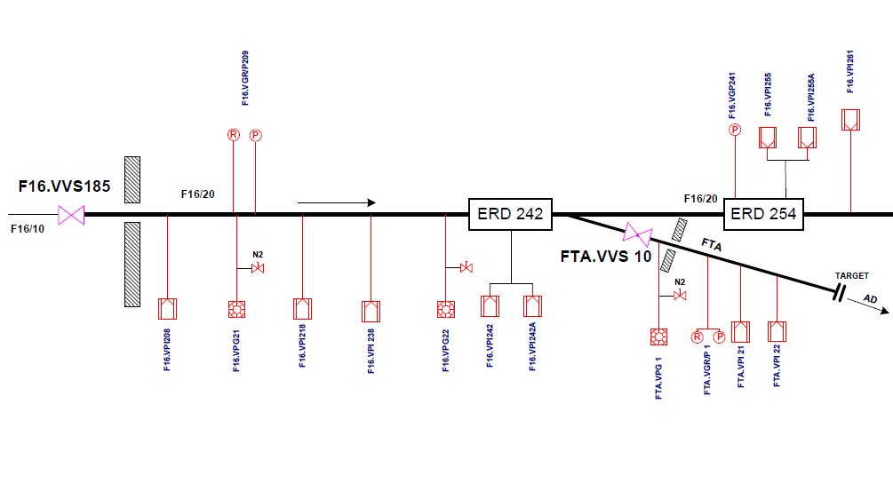
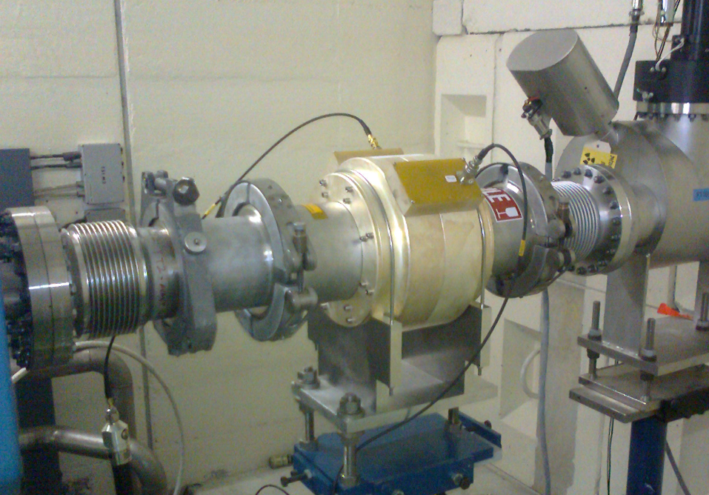
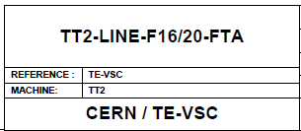
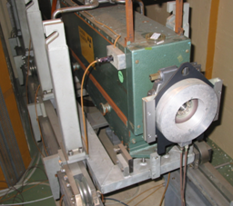
TT2 - Transfer Tunnel 2
Replacement of Transformer
Replacement of FTA Vacuum window
AD target area.
Following a leak detection on the FTA line of TT2 a leak
of 4.0x10⁻⁷mbar.l/sec was detected on the window.

Slide 11
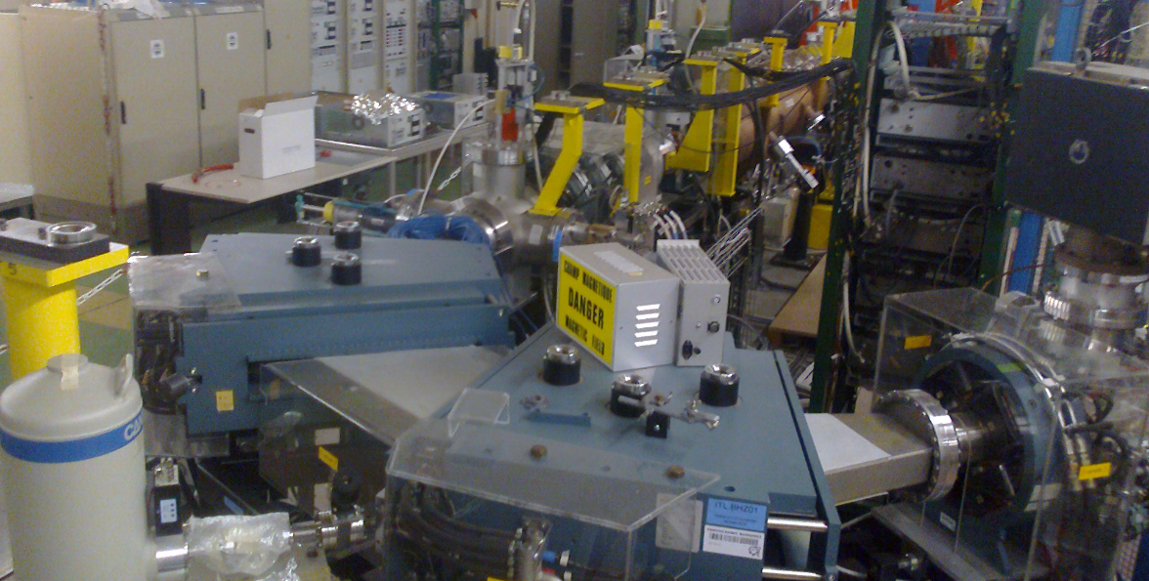
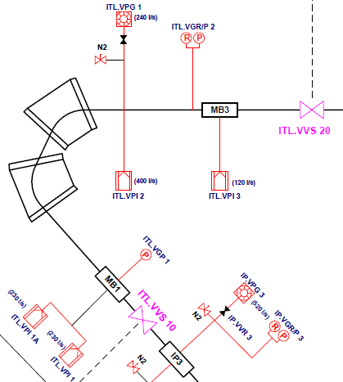
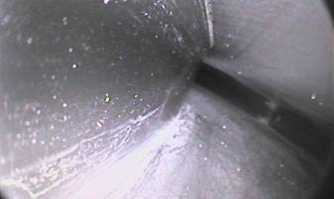
Linac 3 – Bending Chamber Inspection
Inspection and cleaning of the ITL bending chamber.
Evidence of dust particles but no obvious damage to the inside of chamber.
Cleaning required to reduce the possibility of damaging pumps and instruments.
Carried out with vacuum cleaner in conjunction with endoscope camera.

Slide 12
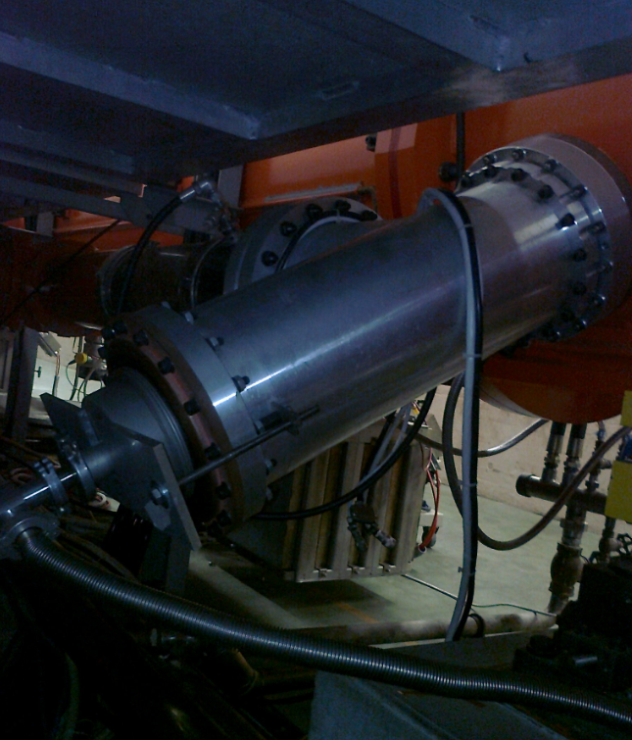
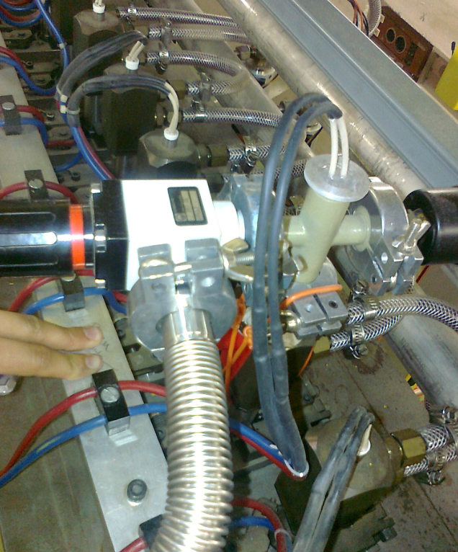
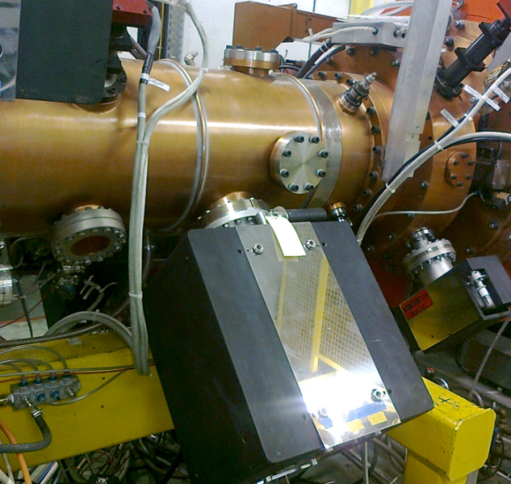
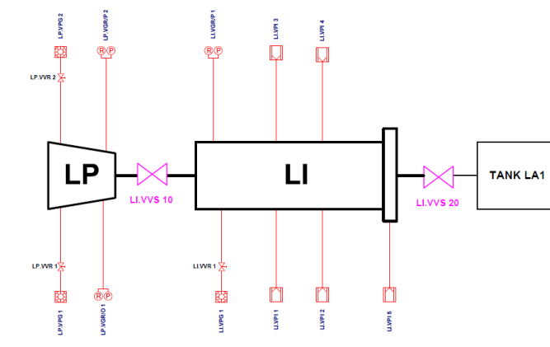
Linac 2 – Leak Detection & VPI Replacement
Searching for additional vacuum leaks.
A single additional leak found:
Drift-tube 6 of Tank 3 Section 4.
2.0x10⁻⁷mbar.l/s
Checking known vacuum leaks.
All leaks checked with no discernable increase in leak rate.
Managed leaks.
Pressures stable inside additional/secondary vacuum containment.
RF feeder loop – Tank 2
Bell installed – Rotary Pump
Drift-tube 11 – Tank 1
Cooling line - Scroll Pump
Ion pump LI. VPI 4 replaced on the RFQ

Slide 13
Conclusion & Acknowledgements

Slide 17
PS Ring – Septum replacement procedure
Procedure for removal and replacement of a Septum.
Disconnect power and cooling water – blow down.
Vent the sector with nitrogen.
Remove RF Bypass – By RF group (Ceramic coated flange)
Disconnect vacuum flange at either end of septum, apply foil and protective covers.
Septum lifted out of ring via overhead crane and installed on rail chariot – removed from ring (where stored?)
Replacement septum vented with nitrogen, blank flanges removed – seal faces (x4) and seals (x2) prepared – Then moved alongside installation location.
Septum lifted into position with overhead crane – Pre set mounting to ensure correct position (kinematic mount).
Vacuum flanges assembled with seals.
Check clamp is open circuit (Cannot have a DC connection but require RF contact)
The RF bypass provides the correct circuit to allow RF to pass.
Start pump down - Carry out leak test.
Re-connect power and cooling supplies.

