Slide 1


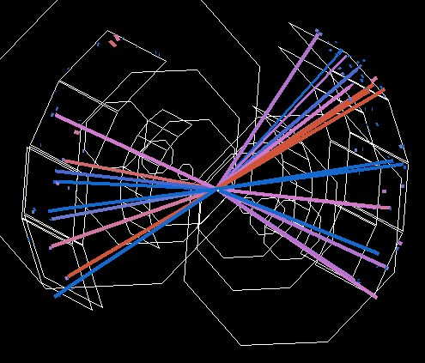
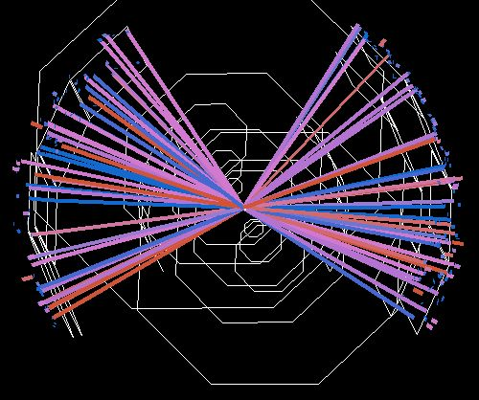
The RHIC Beam Energy Scan Program: Results from the PHENIX Experiment
Jeffery T. Mitchell
Brookhaven National Laboratory
and the PHENIX Collaboration
39 GeV Au+Au
7.7 GeV Au+Au

Slide 2
The RHIC Beam Energy Scan Program: Overview
sqrt (s_{NN}) [GeV] | 2001 | 2002 | 2003 | 2004 | 2005 | 2006 | 2007 | 2008 | 2009 | 2010 | 2011 | 2012
200
130
62.4
39
27
22.5
19.6
11.5
7.7
5.0
STAR
only
Test
run
Au+Au
U+U
Cu+Au
Cu+Cu
d+Au

Slide 3
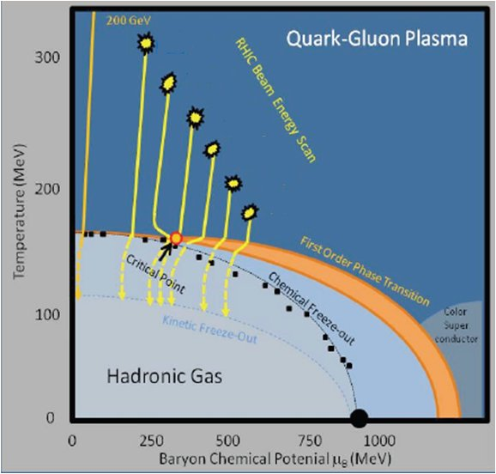
The RHIC Beam Energy Scan Program:
Probing the Nuclear Matter Phase Diagram
By systematically varying the RHIC beam energy, heavy ion collisions will be able to probe different regions of the QCD phase diagram.
PHENIX is searching for signatures of the onset of deconfinement and searching for signatures of the critical point.
Outline:
Charged Particle Multiplicity
Transverse Energy
Multiplicity Fluctuations
Net Charge Fluctuations
Pion HBT
Flow
R_{AA}
decreasing √s_{NN}

Slide 4
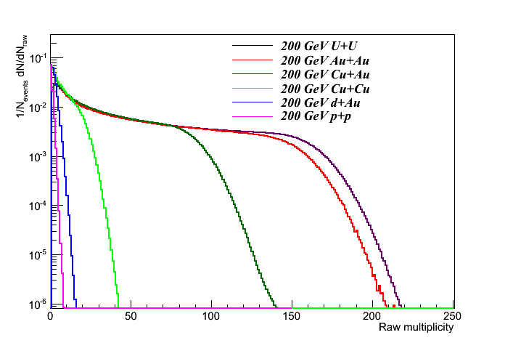
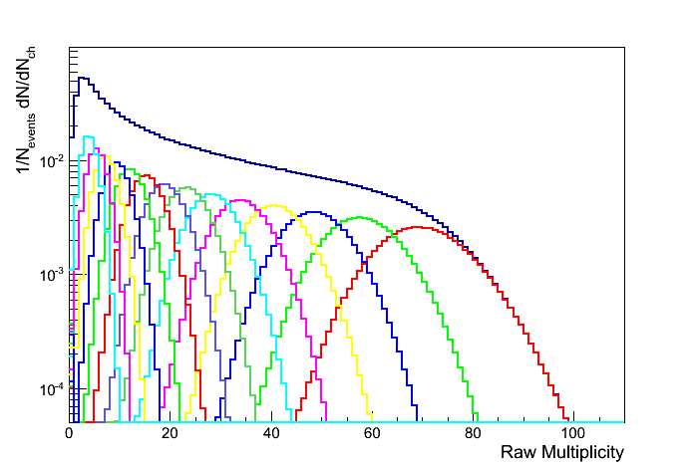
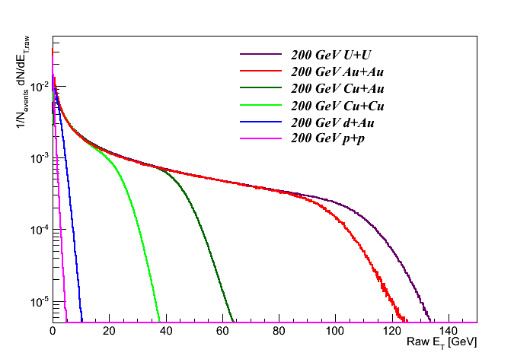
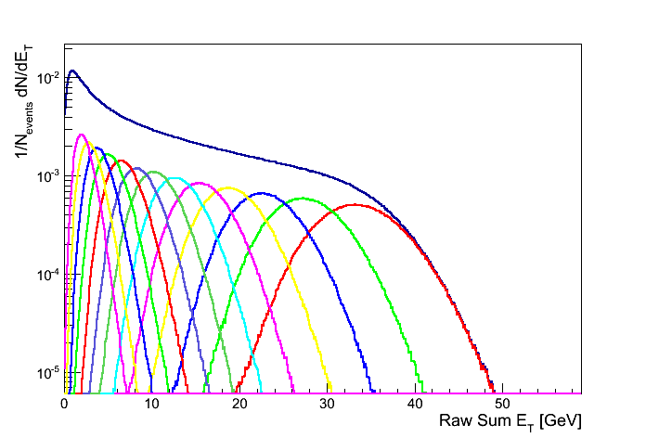
Global Observables: Charged Particle Multiplicity and Transverse Energy Production
Min. Bias
27 GeV Au+Au
Min. Bias and 5% centrality distributions
N_{ch}
N_{ch}
Min. Bias
27 GeV Au+Au
Min. Bias and 5% centrality distributions
E_{T}
E_{T}

Slide 5
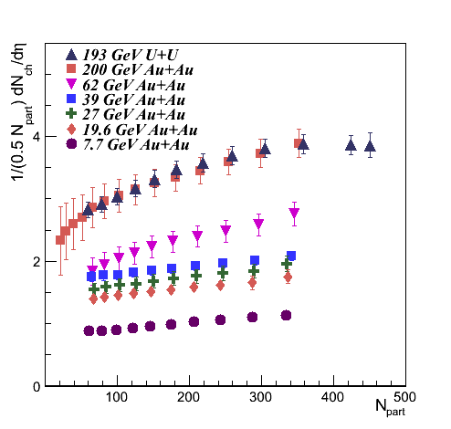

Charged Particle Multiplicity
The 200 GeV Au+Au analysis is described in Phys. Rev. C71 (2005) 034908
Mid-rapidity
The particle density increases with increasing collision energy.
There is an increase in particle density for more central collisions at all collision energies.
The Au+Au and U+U particle densities are similar.

Slide 6
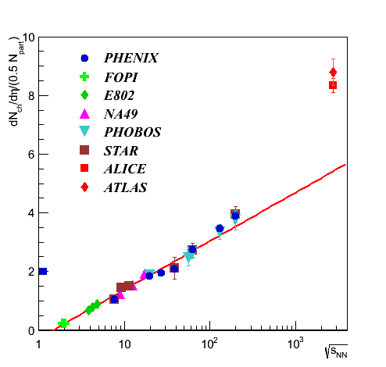
Charged Particle Multiplicity:
Excitation Function
Mid-rapidity
Central collisions
The red line is a logarithmic fit to all data points excluding the LHC points.
At or below RHIC energies, the multiplicity per participant pair increases linearly with log(sqrt(s_{NN})).

Slide 7
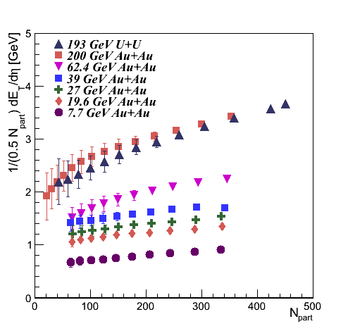
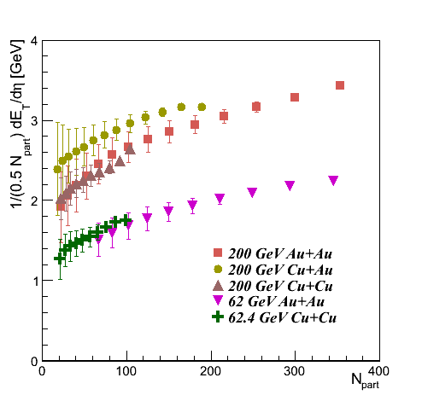
Transverse Energy Production
Mid-rapidity
Transverse energy production increases with increasing collision energy.
There is an increase in transverse energy production for more central collisions at all collision energies.
Transverse energy production in Cu+Cu at the same N_{part} is similar to that in Au+Au at the same collision energy.

Slide 8
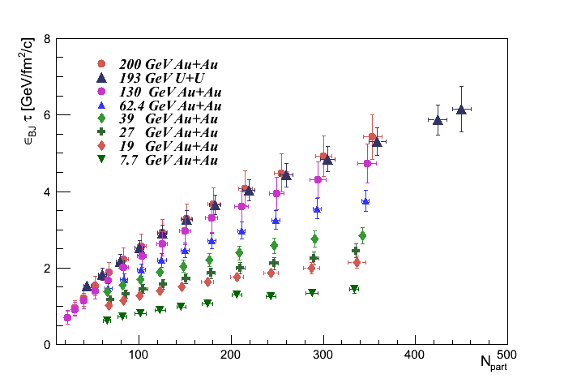

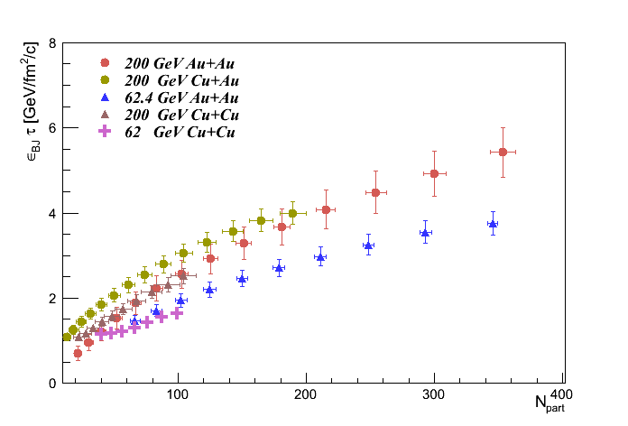
Bjorken Energy Density
Mid-rapidity
New RHIC energy density record in U+U collisions = 6.15 GeV/fm²/c. The upper U+U point is for the upper 1% centrality bin. All other points are 5% centrality bins.
Mid-rapidity
N_{part}
ε_{BJ} increases by a factor of 3.8 when going from 7.7 to 200 GeV.

Slide 9
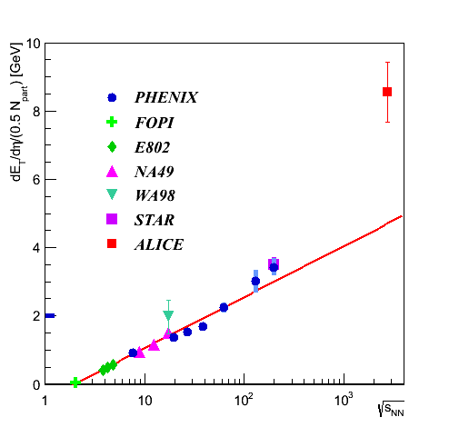
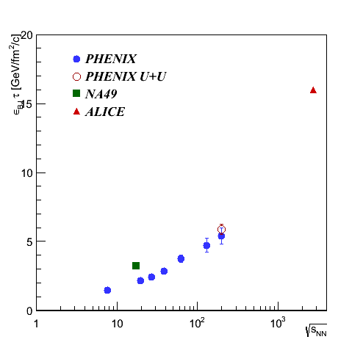

Transverse Energy Production:
Excitation Function
Mid-rapidity
Central collisions
ε_{BJ} τ
E_{T}
Central collisions
Monotonic behavior is observed in E_{T} production in 0-5% central Au+Au collisions. The red line is a logarithmic fit to all points excluding the ALICE point. ε_{BJ} increases by a factor of 11.1 when going from 7.7 GeV to 2.76 TeV.

Slide 10
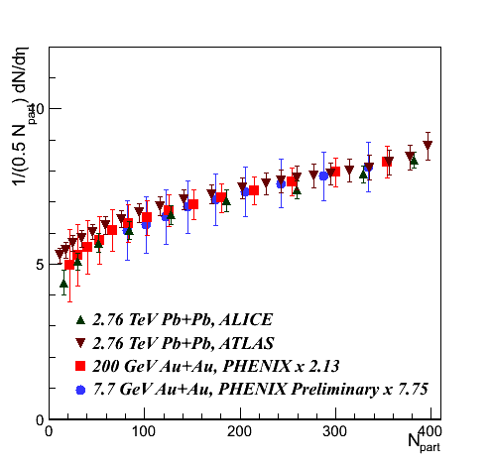
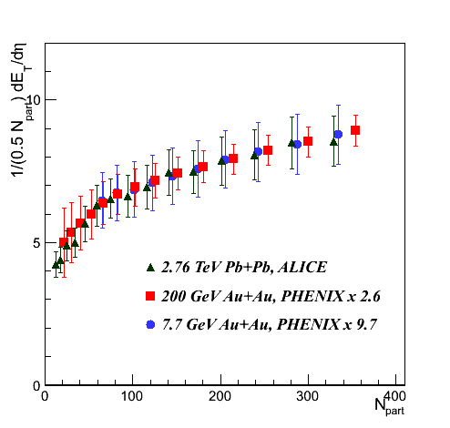
RHIC and LHC Comparisons
E_{T}
N_{ch}
There is no significant change in the shape of the centrality-dependence of the particle density or transverse energy from 7.7 GeV Au+Au collisions up to 2.76 TeV Pb+Pb collisions.
It appears that the collision geometry is driving the centrality dependence.

Slide 11
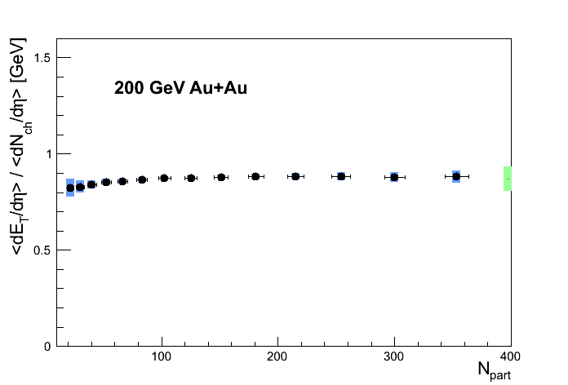
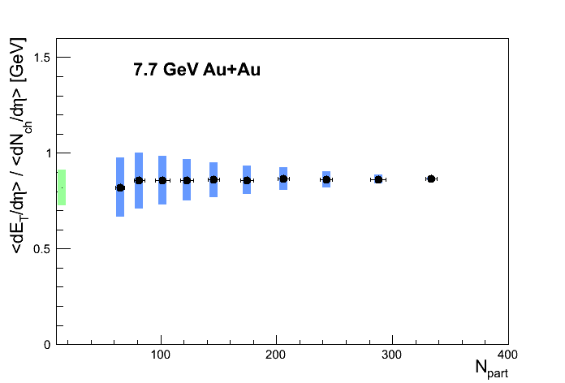
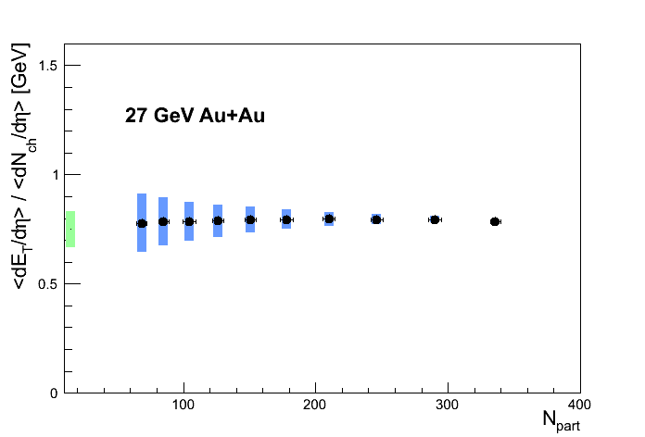
Transverse Energy per Charged Particle
Mid-rapidity
The transverse energy per charged particle is flat as a function of centrality for all collision energies from 7.7 GeV to 200 GeV.

Slide 12
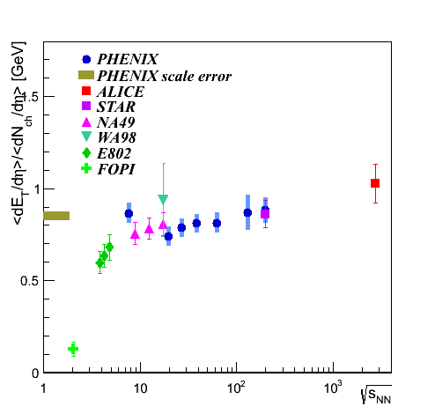
Transverse Energy per Charged Particle: Excitation Function
Mid-rapidity
Central collisions
There is very little change in the transverse energy per charged particle from 7.7 GeV to 200 GeV.
There is only a slight increase at LHC energies (16%).

Slide 13
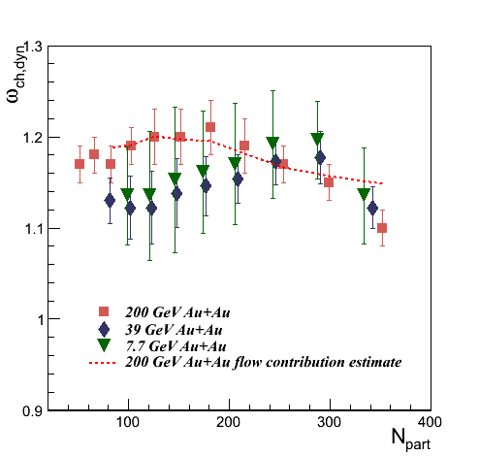
Multiplicity Fluctuations
Multiplicity fluctuations may be sensitive to divergences in the compressibility of the system near the critical point.
Grand Canonical Ensemble
ω_{N} → “Scaled Variance”
The scaled variance is quoted within the PHENIX acceptance and has been corrected for contributions from impact parameter fluctuations (ω_{ch,dyn}).
The centrality-dependent shape of the fluctuations is primarily driven by contributions from flow.

Slide 14
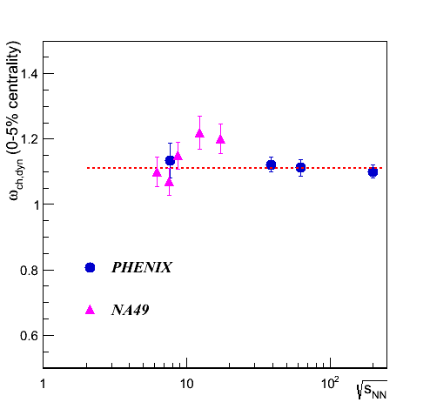
Multiplicity Fluctuations:
Excitation Function
The NA49 data is from C. Alt et al., Phys. Rev. C78, 034914 (2008).
The dashed red line is a constant fit to the PHENIX data only.
No significant increase in multiplicity fluctuations have been observed.
Stay tuned for new results at 19.6 and 27 GeV. It would be interesting to add a point at 15 GeV.
Central collisions

Slide 15
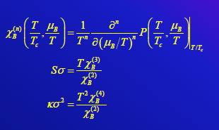
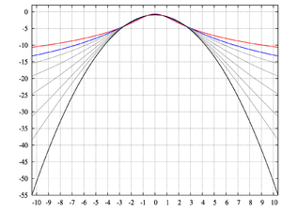
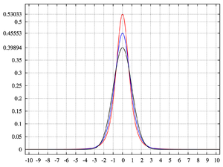
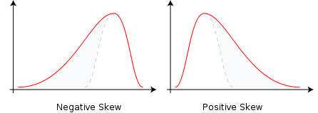
Higher Moments of Net Charge Distributions
The correlation length (ξ) is related to various moments of conserved quantities:
Variance: σ² = <(Ν−<Ν>)²> ~ ξ²
Skewness: S = <(Ν−<Ν>)³>/σ³ ~ ξ^{4.5}
Kurtosis: κ = <(Ν−<Ν>)⁴>/σ⁴-3 ~ ξ⁷
The quantities Sσ and κσ² are related to the quark number susceptibilities (χ):
Sσ ~ χ⁽³⁾ /χ⁽²⁾ and κσ² ~ χ⁽⁴⁾ /χ⁽²⁾.
Since the correlation length is expected to diverge at the critical point, it is expected that the quantities Sσ and κσ² will be large there.
Kurtosis → “bulging”
Skewness
Black: κ=0
Red: κ=∞

Slide 16
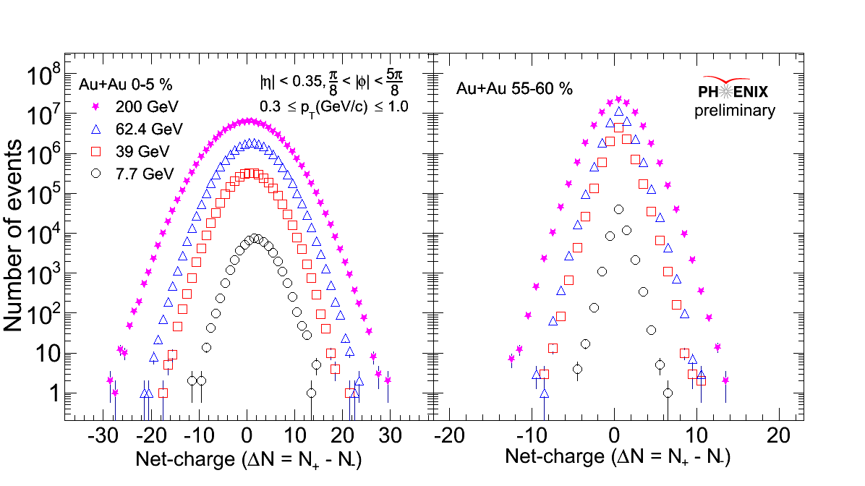
Higher Moments of Net Charge Distributions
All datasets cover several orders of magnitude.

Slide 17
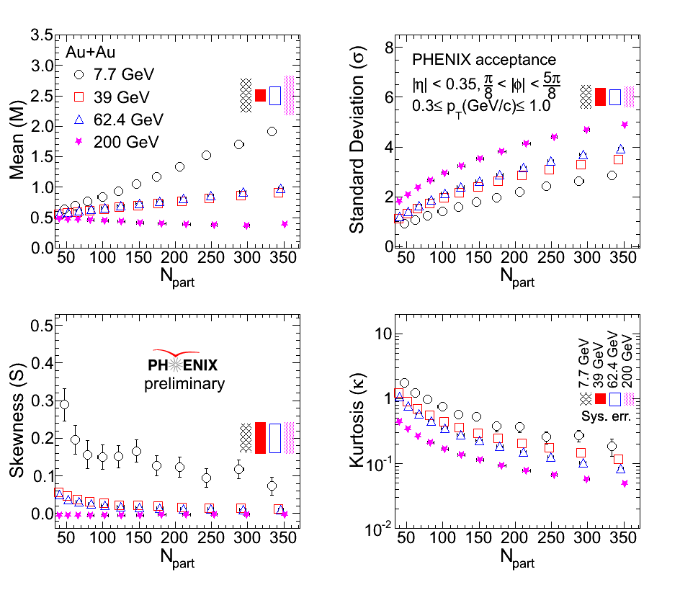
Net Charge Moments vs. Centrality
(<N>)
The skewness and kurtosis tends to increase with decreasing beam energy.
The skewness and kurtosis tends to decrease in more central collisions.

Slide 18
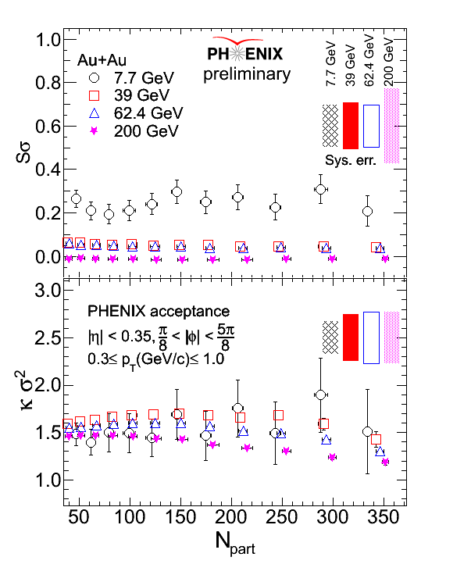
Net Charge Sσ and κσ² vs. Centrality
The products of the moments are relatively flat as a function of centrality.

Slide 19
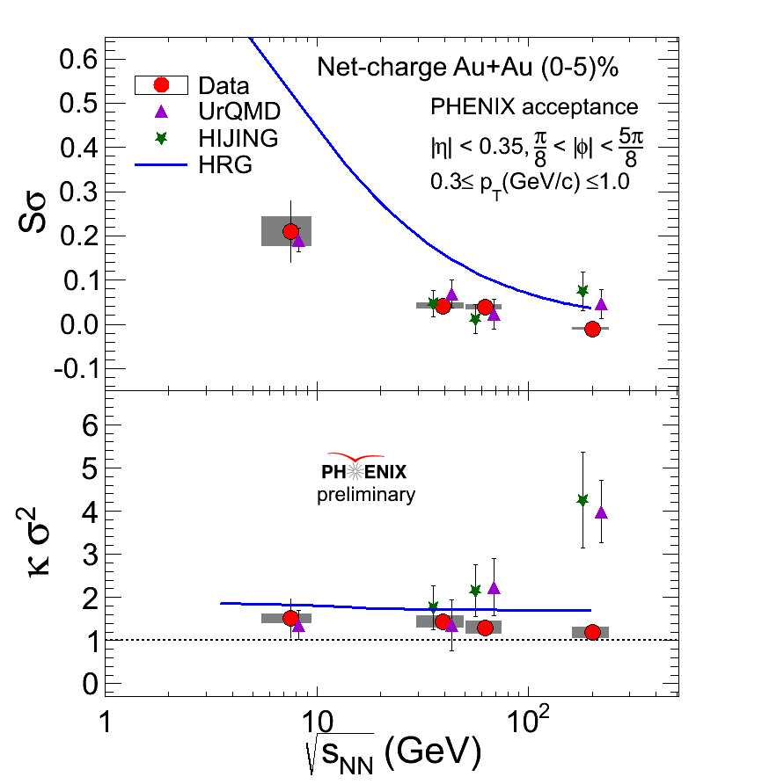
Net Charge Sσ and κσ² Excitation Function
The products of the net charge moments show no significant increase above URQMD, HIJING, or Hadron Resonance Gas predictions.
Stay tuned for new results at 19.6 and 27 GeV.

Slide 20
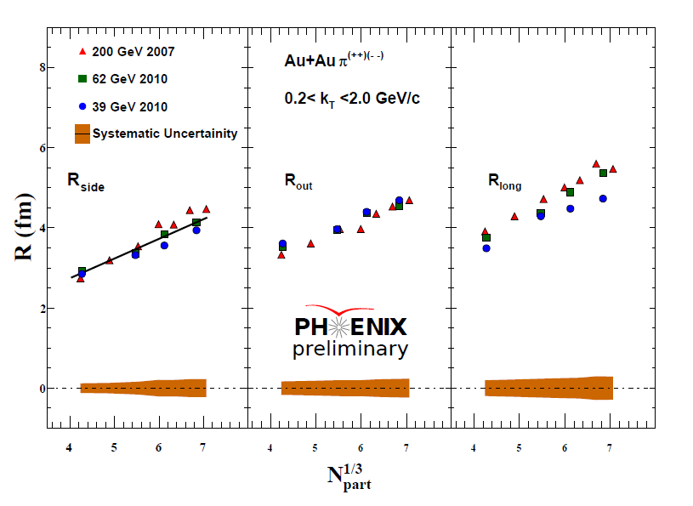
HBT Radii vs. Centrality
R_{out}, R_{side}, and R_{long} all increase with increasing centrality.

Slide 21
HBT Radii: Excitation Function
R_{out}
There is no significant change in R_{out} and R_{side} vs. sqrt(s_{NN}) from 39 to 200 GeV.
R_{long} increases with sqrt(s_{NN}).
R_{side}
R_{long}

Slide 22
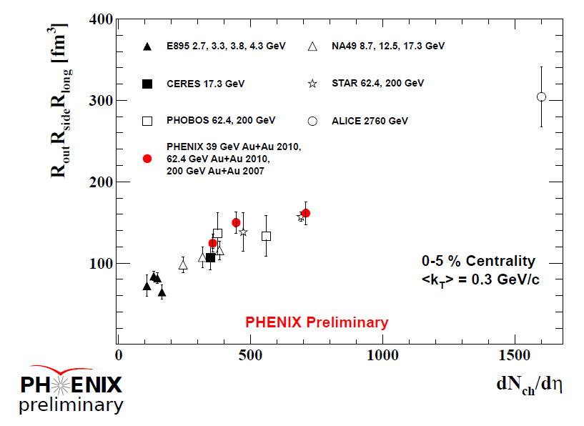
Pion freeze-out Volume: Excitation Function
The quantity R_{out}*R_{side}*R_{long} estimates the pion freeze-out volume, V_{f}.
The PHENIX data are consistent with the trend displayed by previous results.

Slide 23
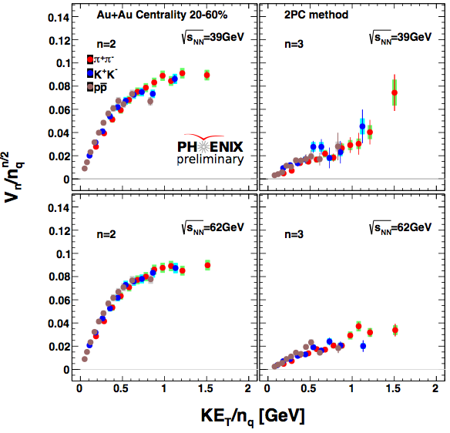
Identified Particle Flow
Scaling of v₂ and v₃ by the number of constituent quarks is preserved at 62 GeV and 39 GeV.

Slide 24
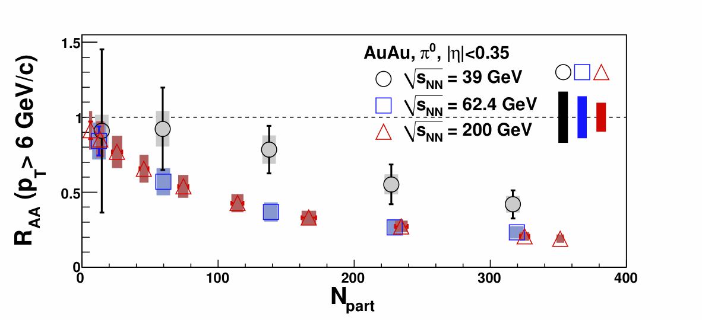
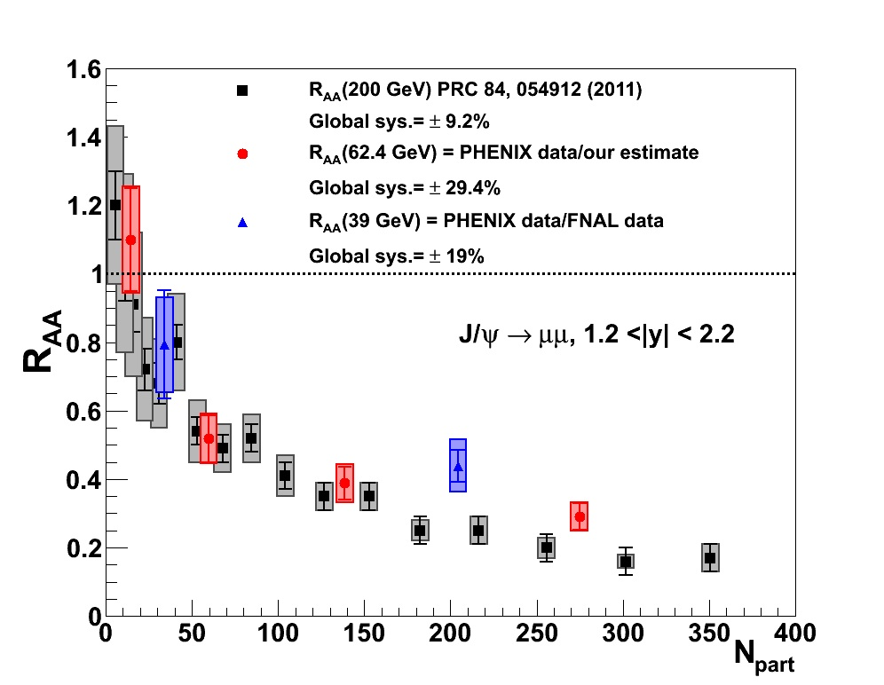
Energy Loss Measurements
arXiv:1204.1526v1
R_{AA} at 62 GeV is similar to that at 200 GeV.
Strong suppression is still observed at 39 GeV, but it is less than at higher energies. π⁰ R_{AA} results at 27 GeV are coming soon.

Slide 25
Summary
New results from 39, 27, 19.6, and 7.7 GeV Au+Au collisions are shown.
Charged particle multiplicity and transverse energy production tend to scale logarithmically with sqrt(s_{NN}) up to the top RHIC energy.
The centrality-dependent shape of multiplicity and transverse energy production shows little change from 7.7 GeV to 2.76 TeV.
No increases in charged particle multiplicity fluctuations are observed at 7.7 or 39 GeV.
No significant excess in the moments of net charge are observed above URQMD, HIJING, or Hadron Resonance Gas predictions at 7.7 or 39 GeV.
The pion freeze-out volume at 62.4 and 39 GeV is consistent with trends established in previous measurements.
Constituent quark scaling of v₂ holds at 62.4 and 39 GeV.
Strong suppression is observed at 62.4 and 39 GeV, although less suppression is seen at 39 GeV.
So far, PHENIX observes no signs of the critical point. Stay tuned for much more soon.

Slide 26
Auxiliary Slides

Slide 27
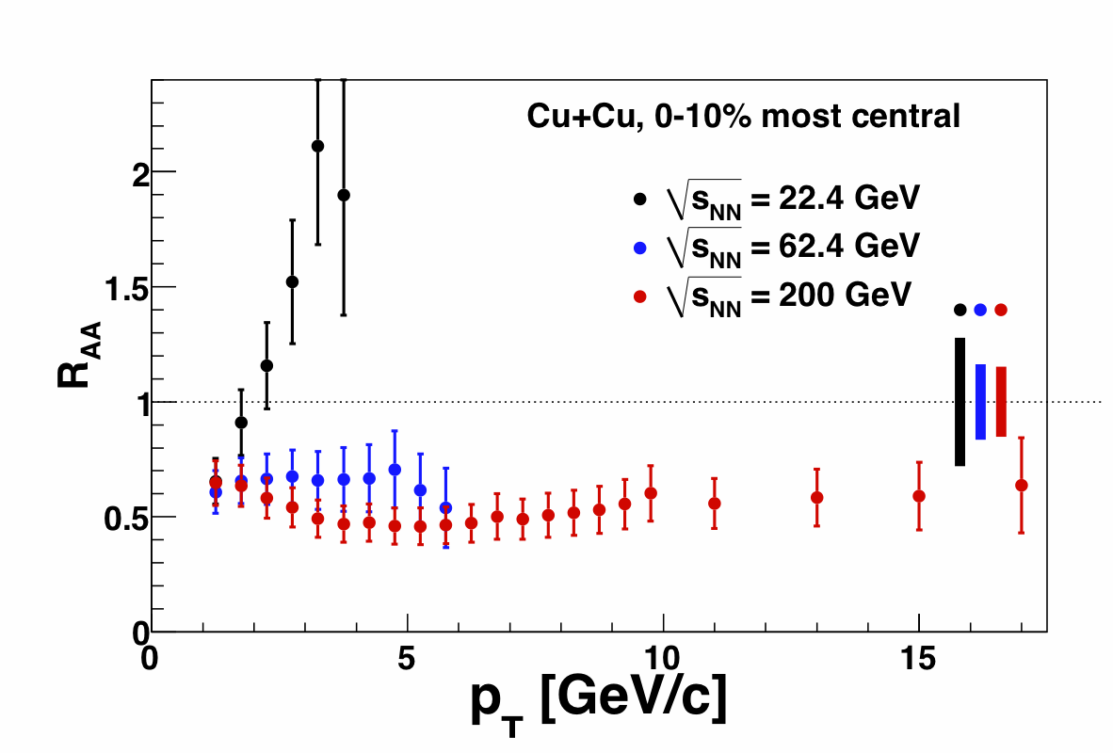
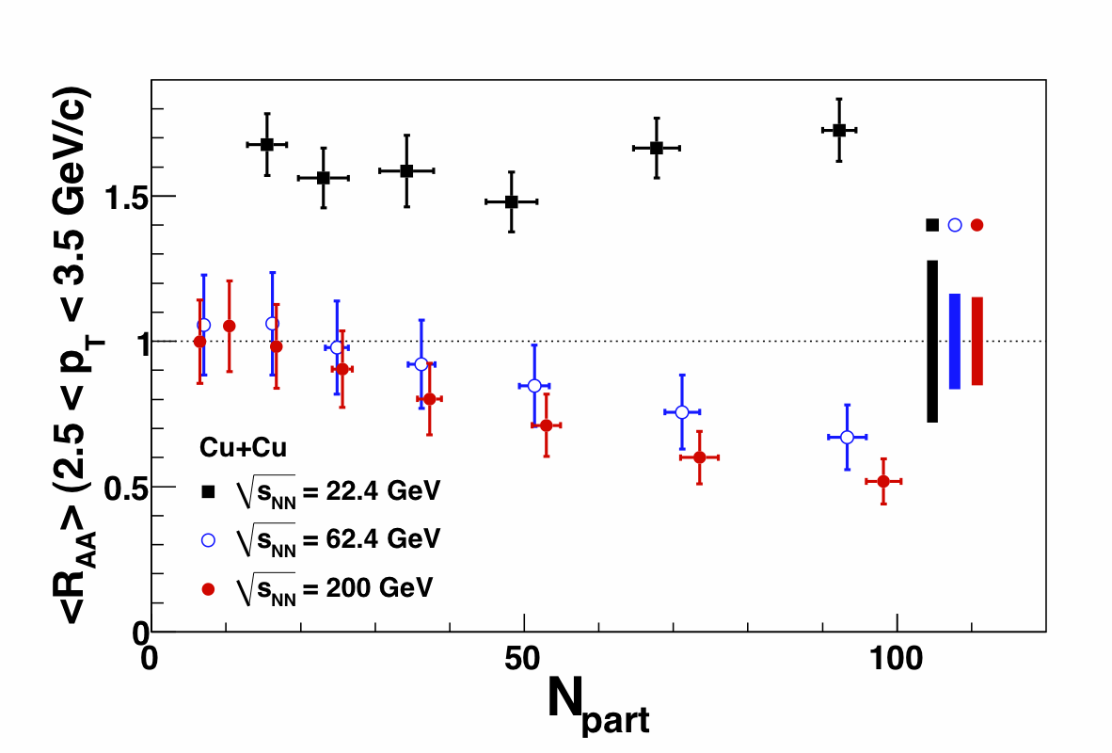
PHENIX π⁰ Energy Loss Measurements in Cu+Cu Collisions
PRL101, 162301
From the Cu+Cu energy scan:
Significant suppression at √s_{NN} = 200 and 62.4 GeV
Moderate enhancement at √s_{NN} = 22.4 GeV

Slide 28
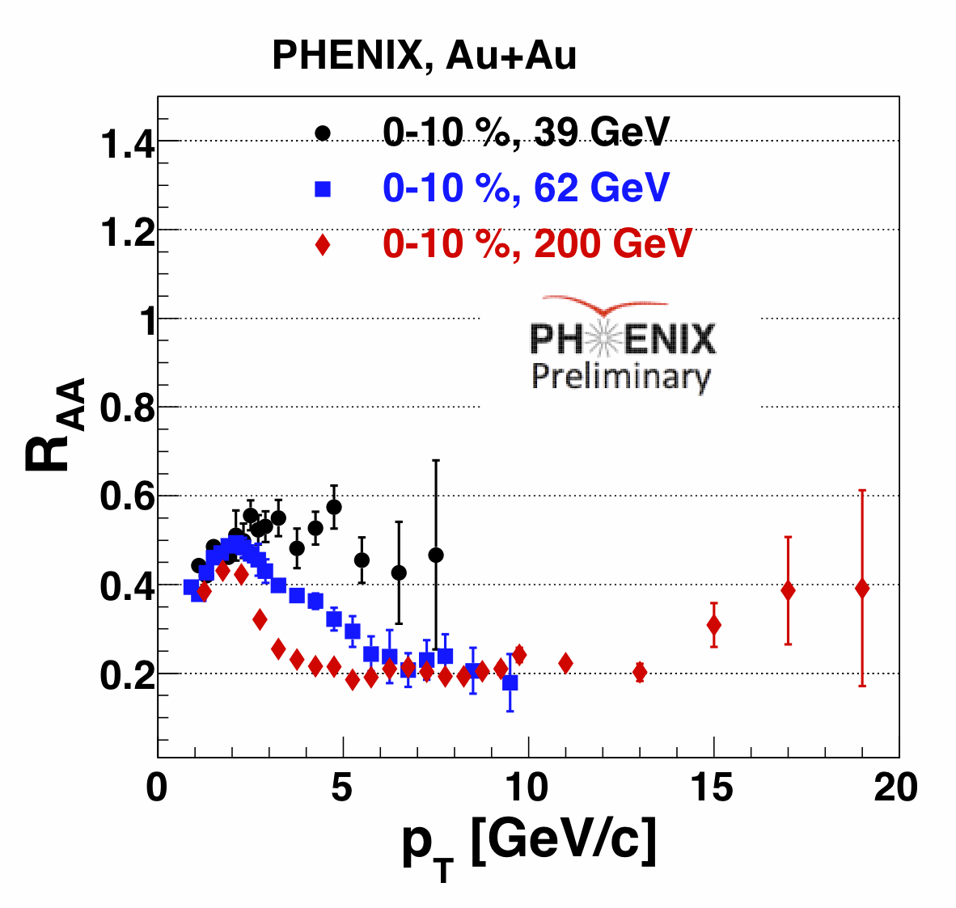
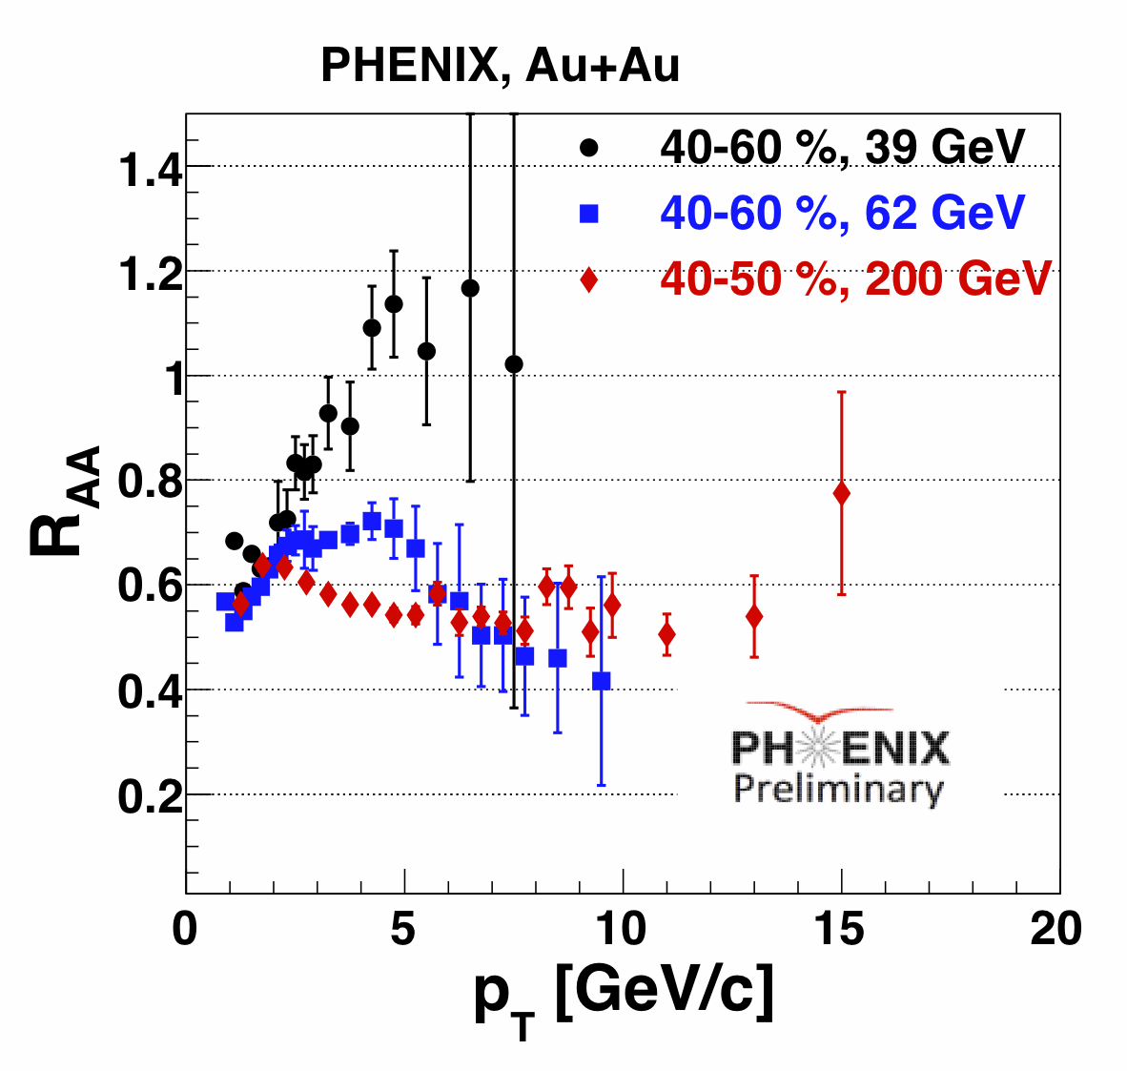
π⁰ R_{AA} in Au+Au at 39 and 62 GeV
π⁰ R_{AA} as a function of p_{T} in PHENIX at √s_{NN} = 39, 62 and 200 GeV.
Still observe a strong suppression (factor of 2) in the most central √s_{NN} = 39 GeV collisions.
R_{AA} from √s_{NN} = 62 GeV data is comparable with the R_{AA} from √s_{NN} = 200 GeV for p_{T} 6 >GeV/c.
Peripheral √s_{NN} = 62 and 200 GeV data show suppression, but the √s_{NN} = 39 GeV does not.

Slide 29
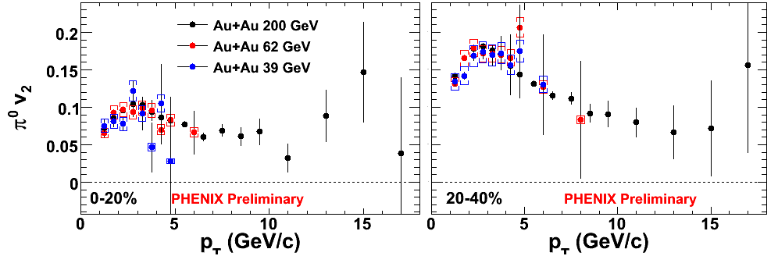
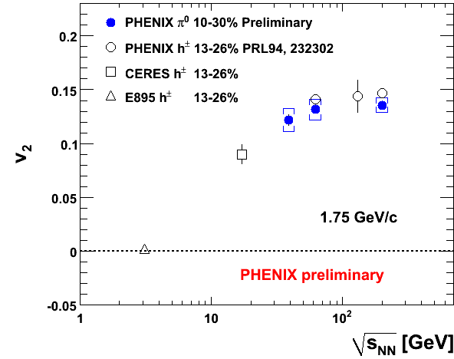
Elliptic Flow at 62 and 39 GeV: π⁰
There is little change in the magnitude of v₂ from 39 GeV to 200 GeV.

Slide 30
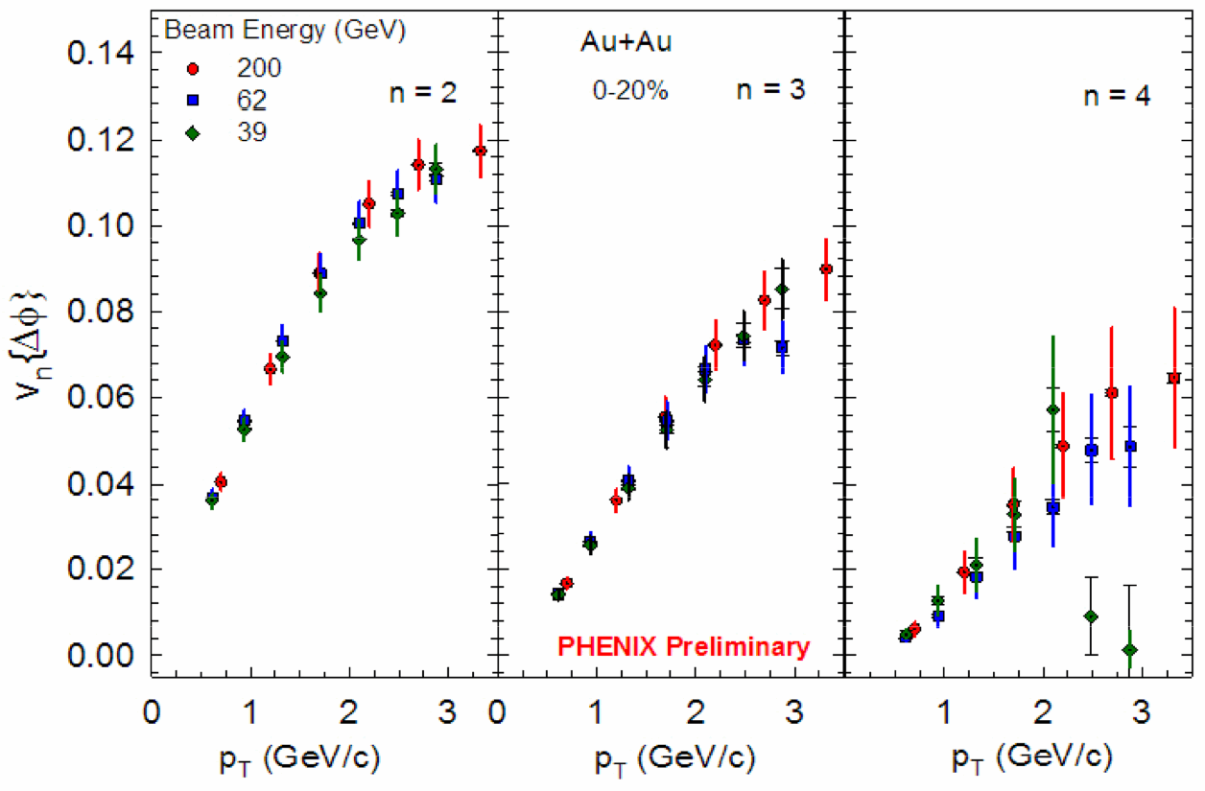
v₂, v₃, v₄ as a function of √s_{NN}

Slide 31
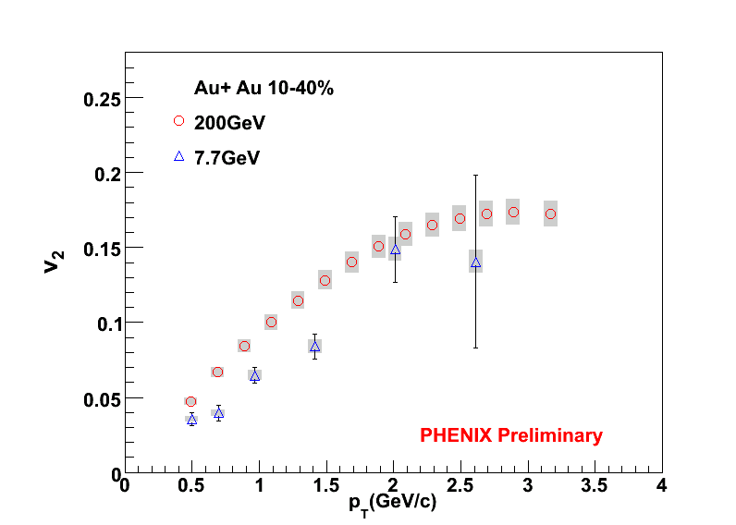
v₂ in 7.7 GeV Au+Au Collisions
The magnitude of v₂ at 7.7 GeV is significantly lower than the magnitudes at 39, 62 and 200 GeV

