Slide 1
Measurements of identified hadron flow in Au+Au, Cu+Au and U+U collisions
Shengli Huang
Vanderbilt University

Slide 2
Outline
Motivation and analysis methods
N_{q} scaling in Au + Au at 200 GeV
Pion and proton v₂ in U + U at 193 GeV
Pion and proton v₁ and v₂ in Cu + Au at 200 GeV
Summary and outlook

Slide 3
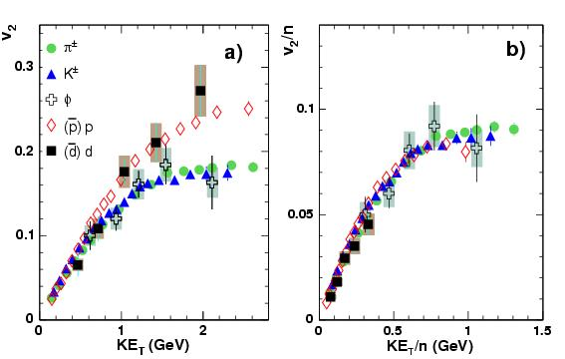
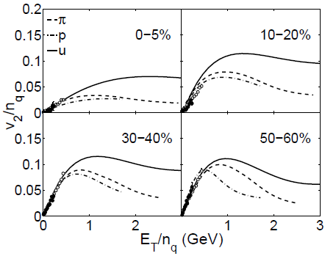
Motivation : nq scaling
Baryon and meson elliptic flow follow the number of constituent quark (n_{q}) scaling
N_{q} scaling will break at intermediate p_{T} and peripheral centrality, if we assume that π is mainly from the recombination of thermal (T) and shower (S) partons but proton is mainly from TTS or TSS .
Can we test dependence of the centrality and p_{T} for n_{q} scaling breaking?
PHENIX, PRL. 99, 052301 (2007)
C. B. Chiu, R. C Hwa et al. PRC.78.044903

Slide 4
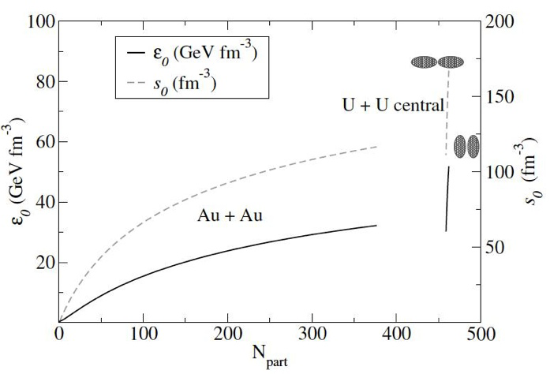
Flow in U + U (1):
The geometry and density effect
U + U 193 GeV
Body-body
The geometry is significantly different for body-body and tip-tip collisions
The medium density in U + U at 193 GeV is around 30~60% higher than that in central Au + Au at 200GeV
Tip-tip
U. Heinz and A. Kuhlman,
PRL 94, 132301 (2005)

Slide 5
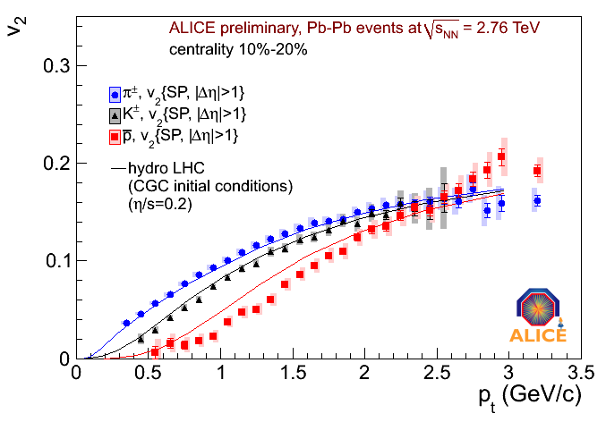
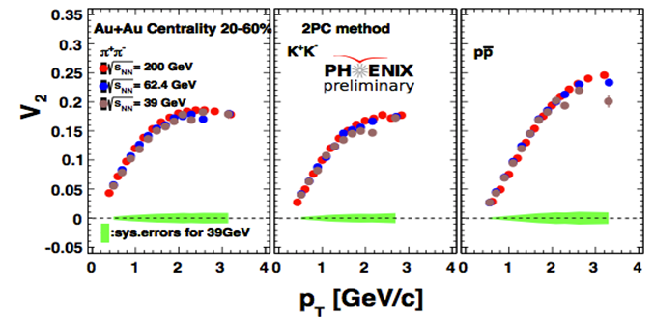
Flow in U + U (2): Mass ordering
Strong mass ordering is observed from v₂ of identified particles in LHC (2.76 TeV), where the density increases by 2.5 compared to RHIC (200 GeV).
In RHIC, the proton v₂ almost keeps consistent while medium density almost increases a factor of 2 in Au + Au collision from 39 GeV to 200 GeV
How about ultra-central U + U collisions at 193 GeV?
M. Krzewicki@ALICE QM2011

Slide 6
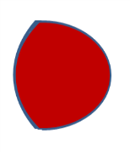
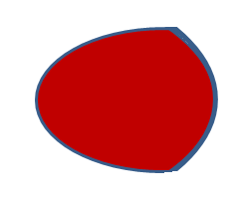
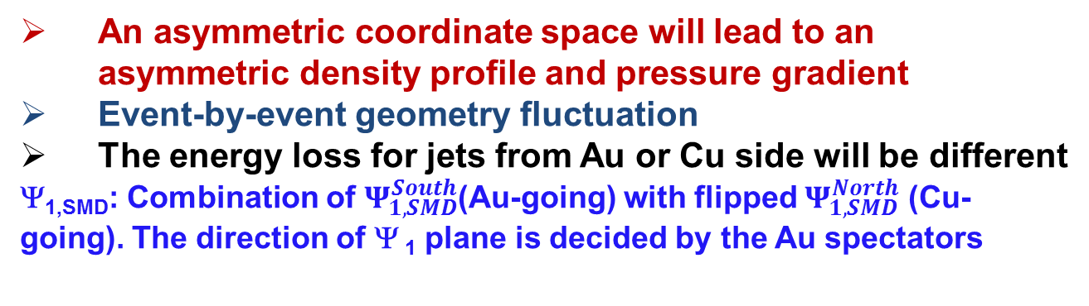
Flow in Cu + Au (I) : flow in an asymmetric collision
Coordinate space asymmetry
Momentum space?
p_{x}
Cu
Au
or
Ψ_{1,SMD} (shower max detector)
x
p_{x}
An asymmetric coordinate space will lead to an asymmetric density profile and pressure gradient
Event-by-event geometry fluctuation
The energy loss for jets from Au or Cu side will be different
Ψ_{1,SMD}: Combination of $Ψ_{1,SMD}^{South}$(Au-going) with flipped $Ψ_{1,SMD}^{North}$ (Cu-going). The direction of Ψ ₁ plane is decided by the Au spectators
Measurements v₁, v₂ in Cu + Au will help us to understand the effect of the asymmetric density, geometry and their fluctuation.

Slide 7
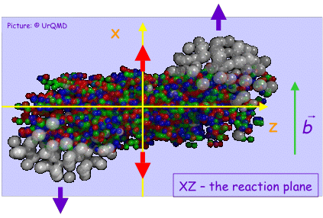
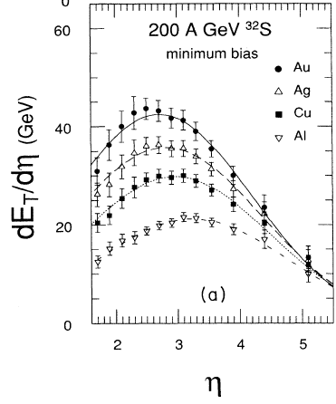
Flow in Cu + Au (2) : anti-flow effect in Cu + Au
South
Ψ₁: by Au-going spectators on the south side
Au
Cu
North
v₁
v₁
η
η
Au + Au
Cu + Au
Large v₁ is observed at forward and backward rapidity in Au + Au, which may be due to anti-flow effect
Shift of mass center may bring this anti-flow effect into mid-rapidity |η|<0.35 in Cu + Au collisions
Measure the v₁ of identified particle will further help us to address the dynamic mechanisms under this asymmetric distribution
WA80 PRC 44 (1991) 2736

Slide 8
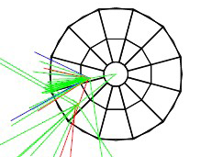
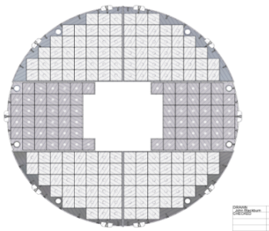
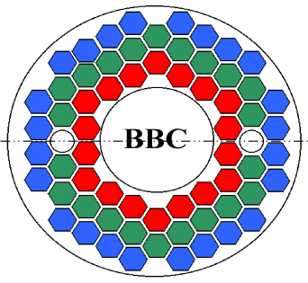
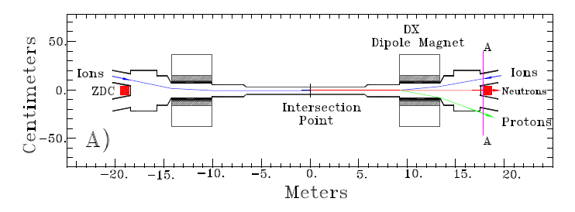
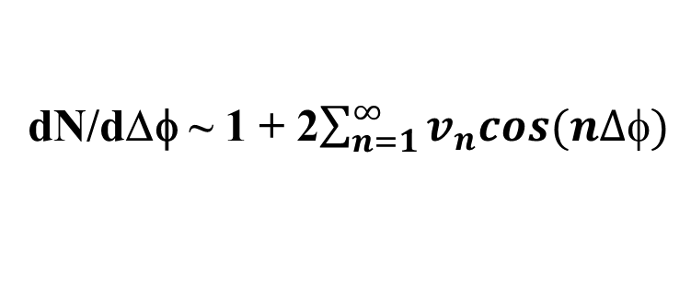
PHENIX Detectors for Event Plane
Event plane detectors:
Reaction plane detector
  RXN_{IN} (1.5<|η|<2.8)
  RXN_{OUT} (1.0<|η|<1.5)
beam
reaction plane
x
Muon piston Calorimeter
  MPC (3.1<|η|<3.9)
y
dN/dΔφ ~ 1 + 2$\sum_{n=1}^{∞}{v_{n}cos(n∆φ)}$
Beam-beam counter
  BBC (3.1<|η|<3.9)
Zero Degree Calorimeters(ZDC)
Shower Max Detectors(SMD)
ZDC-SMD (|η|>6.5)
Ψ₁ by spectator
8
Notes:
8

Slide 9
Identified particles flow in Au +Au at 200 GeV:
The centrality and p_{T} dependence for n_{q} scaling breaking

Slide 10
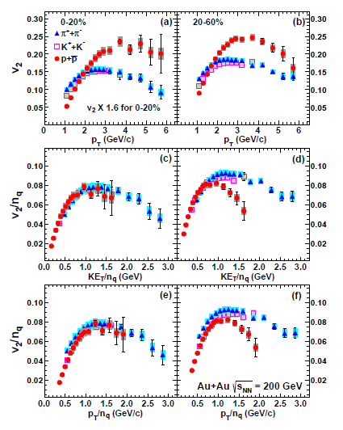
V₂ of identified hadrons in 200 GeV AuAu
In 0-20% central Au + Au collisions at 200 GeV, the v₂ proton is higher than that of pion still p_{T} of 6 GeV/c. While in 20-60% centrality, they approach each other.
A break of n_{q} scaling is observed in 20-60% centrality at KE_{T} > 0.7 GeV. But in the 0-20% centrality, this break is still roughly held.
It indicates the mechanisms for pion and proton production are different at intermediate p_{T} for different centralities
PHENIX Phys. Rev. C 85, 064914 (2012)

Slide 11
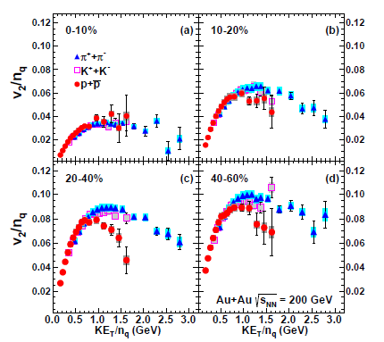
The centrality dependent n_{q} scaling
C. B. Chiu, R. C Hwa et al. PRC.78.044903
The n_{q} scaling shows strong centrality dependence. In 0-10% centrality class, the n_{q} scaling appears to hold to KE_{T} /n_{q} = 1.5 GeV, supporting parton recombination. It starts to break as KE_{T}/n_{q} > 0.7 GeV in 10-20% centrality.
It is consistent with recombination model calculation qualitatively

Slide 12
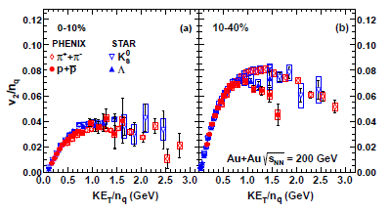
Comparing with v₂ of K_{s} and Lambda
Phys. Rev. C 77, 054901 (2008)
The v₂ of pions and protons measured from PHENIX are consistent with v₂ of K_{s} and Lambda from STAR in overlap p_{T} region.
The more accurate measurements from PHENIX indicates a clear breaking of n_{q} scaling in KE_{T} > 0.7 GeV in 10-40% centrality

Slide 13
(II) Identified particles flow in U + U 193 GeV:
The geometry and density effect

Slide 14
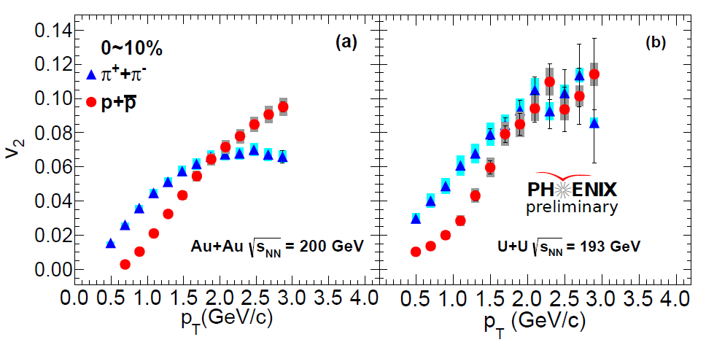
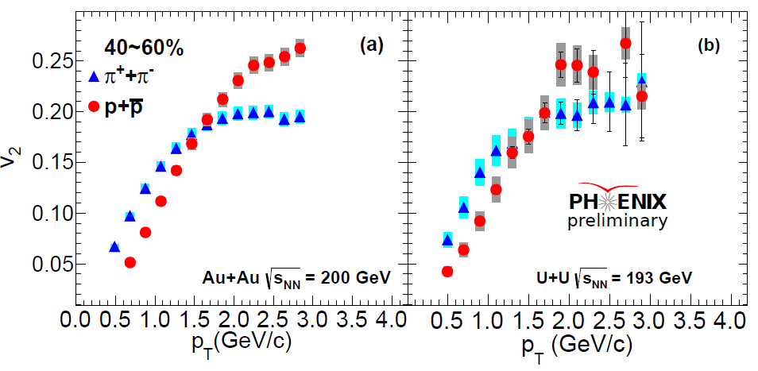
π & p v₂ in U + U at 193 GeV
10% of full statistics
In 0-10% U + U collisions at 193 GeV, the slope of proton v₂ is a little bit different with that in 0-10% Au + Au collisions at 200 GeV
But this behavior disappears in peripheral collision such as 40-60% centrality

Slide 15
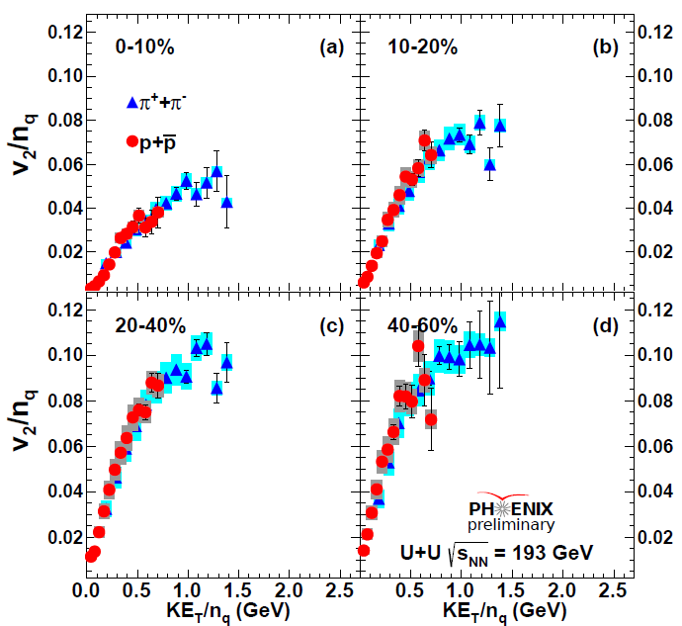
N_{q} scaling in U + U at 193 GeV
The n_{q} scaling is still held in U + U collision at 193 GeV with v₂ of pions and protons in each centrality bin
In the future, the measurement for v₂ of pion at more lower p_{T} < 0.5 GeV/c will be done to further test the n_{q} scaling

Slide 16
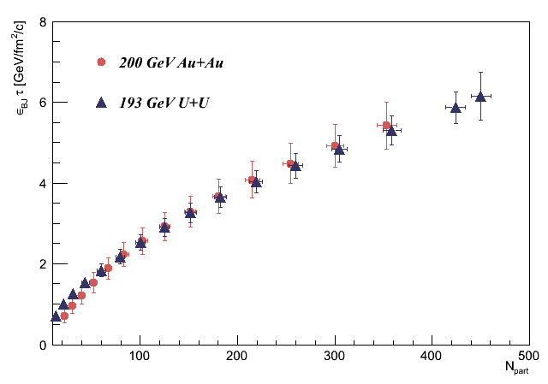
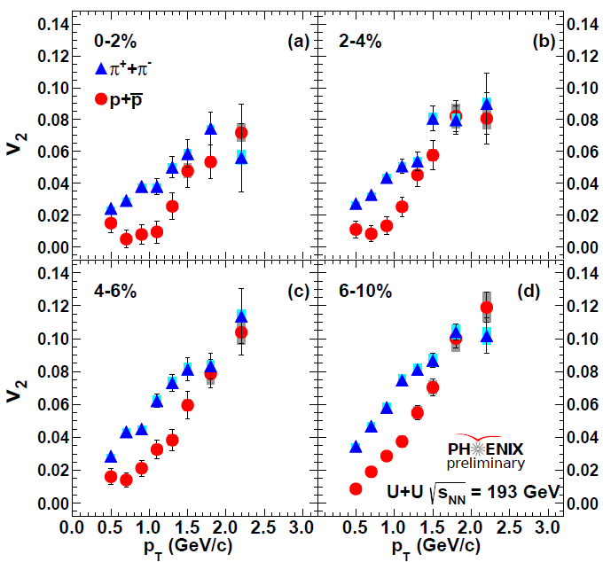

π & p v₂ in 0-2% central U + U collision
0-1%
ετ (GeV/fm²/c)
preliminary
N_{part}
The ετ only increases around 20% from 0-10% Au + Au to 0-1% U + U collision.
Strong mass ordering for π & p v₂ in 0-2% central U + U collision at 193 GeV are observed even though the increase in ετ is relatively small. Radial flow or geometry?
The geometry separation will be done in near future

Slide 17
(III) Identified particles flow in Cu + Au at 200 GeV:
Flow in an asymmetric collisions

Slide 18
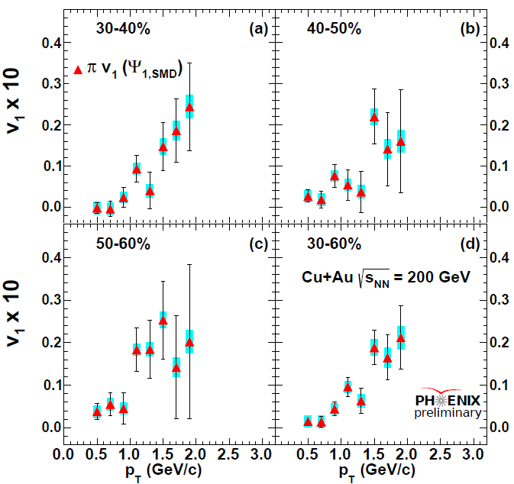
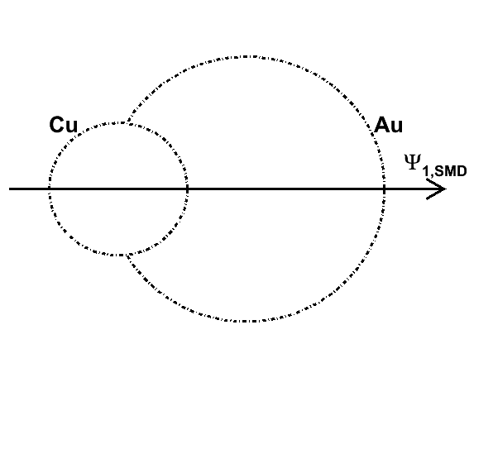
π v₁ in Cu + Au at 200 GeV
20% of full statistics
Sizeable positive v₁ is observed at p_{T} > 1GeV/c with Ψ_{1,smd}, which direction is decided by the Au spectators. It indicates that there are more particles emitted from the Au side than from the Cu side .
It may be due to asymmetric density profile, pressure gradient and anti-flow effect
The v₁ of protons will be measured in near future after production of full statistics. It will help us to further address the physics of this positive v₁

Slide 19
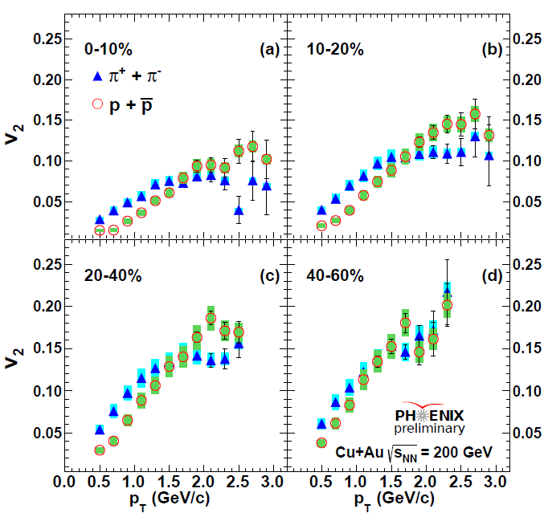
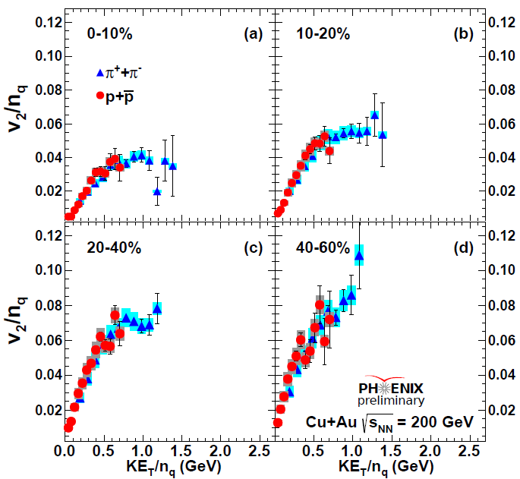
π & p v₂ in Cu + Au at 200 GeV
The v₂ of pions and protons are measured as a function of p_{T} and centrality
The n_{q} scaling is held in Cu + Au collisions at 200 GeV

Slide 20
Summary and Outlook
In Au + Au collisions, the n_{q} scaling is broken as KE_{T}/n_{q} > 0.7 GeV in 10-20% centrality. Alternatively, in 0-10% centrality class, the universal n_{q} scaling appears to hold to KE_{T} /n_{q} = 1.5 GeV. It is consistent with calculation of recombination model.
In the ultra-central U + U collision such as 0-2%, strong mass ordering is observed for the v₂ of pions and protons, even though the density of ετ only increases by around 20% when compared to 0-10% centrality Au + Au collisions
A sizeable positive v₁ for charged pion are observed at p_{T} > 1GeV/c in Cu + Au collision at 200 GeV with Ψ_{1,SMD}, which indicates that there are more particles emitting from the Au side than from the Cu side in middle rapidity |η|<0.35. The v₁ and v₃ of pions and protons will be measured in near future after production of full statistics
N_{q} scaling is held in Cu + Au and U + U collisions. In U + U 0~2% centrality, more detailed testing will be done with full statistics

Slide 21
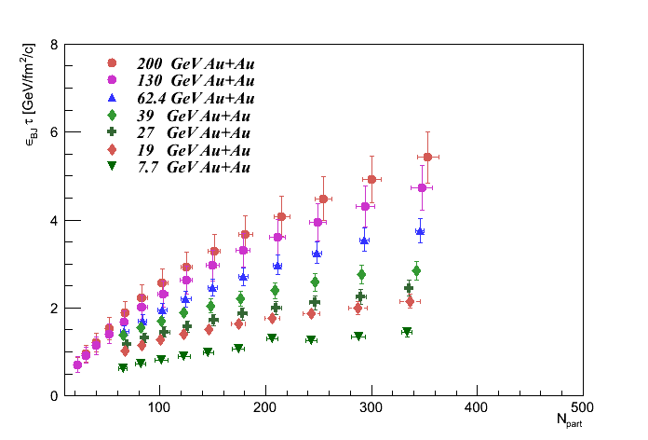
Backup 1
preliminary

Slide 22
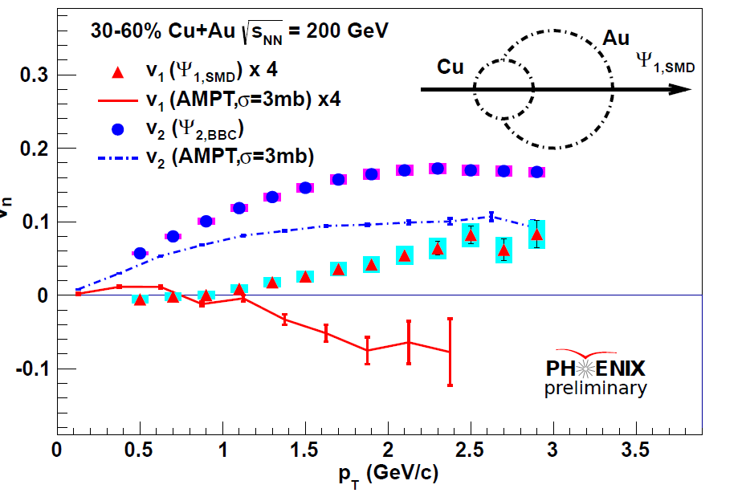
Backup 2

