Slide 1
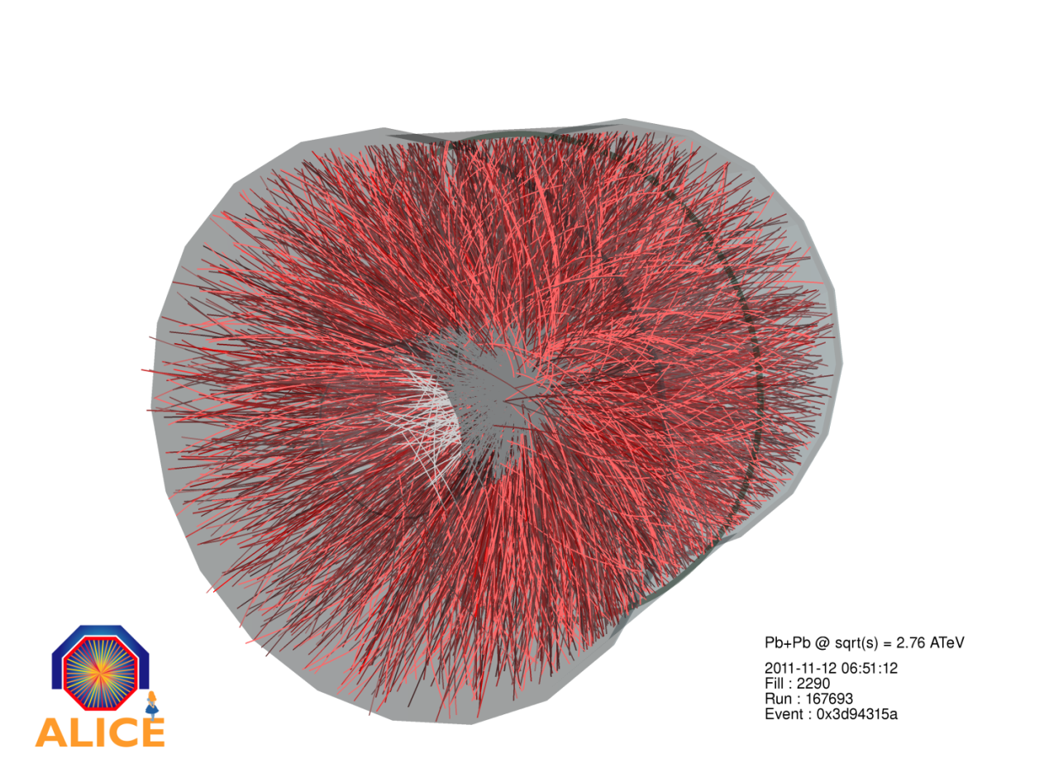

Overview of recent
ALICE results
Karel Šafařík for the ALICE Collaboration

Slide 2
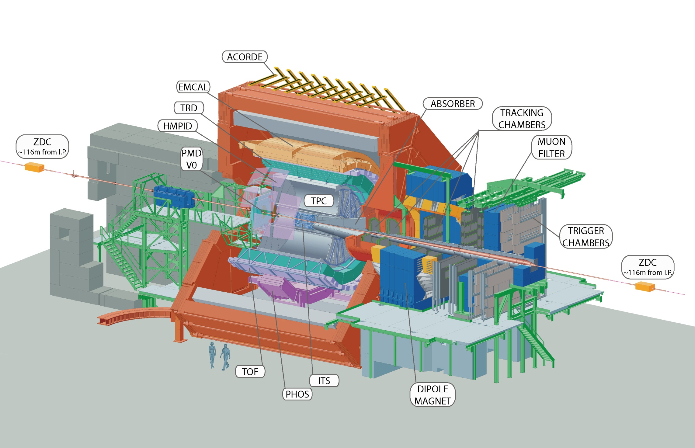
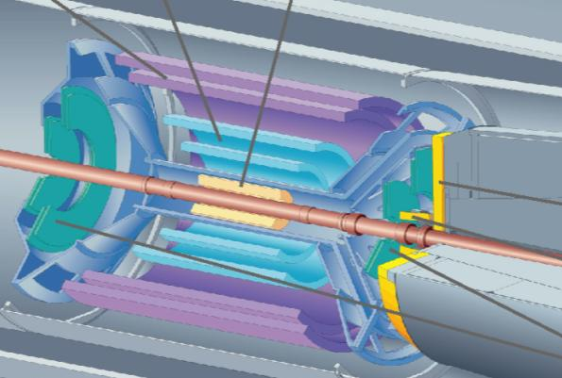
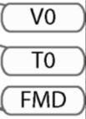
Central Barrel
2 π tracking & PID
|η| < 1
ALICE detector
ACORDE (cosmics)
V0 scintillator centrality
η: -1.7– -3.7, 2.8–5.1
T0 (timing)
ZDC (centrality)
FMD (N_{ch} -3.4<η<5)
PMD (Nγ, N_{ch})
Muon Spectrometer
-2.5 > η > -4
Detector:
Length: 26 meters
Height: 16 meters
Weight: 10,000 tons
Collaboration:
> 1000 Members
> 100 Institutes
> 30 countries

Slide 3
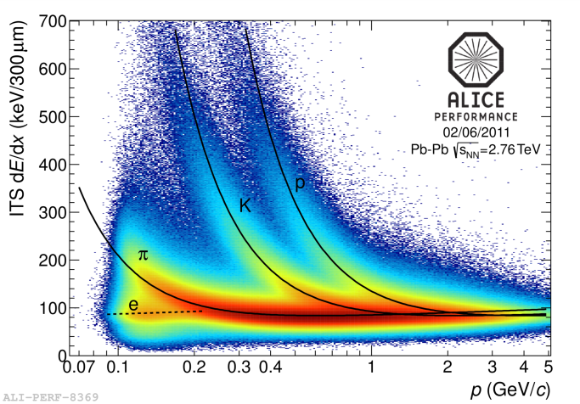
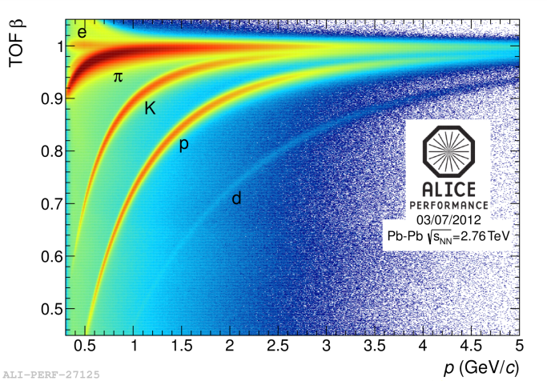
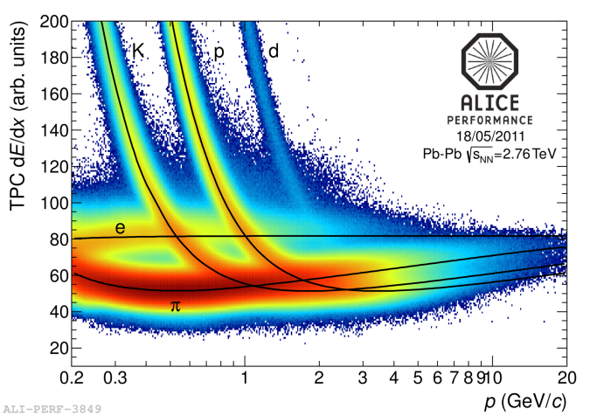
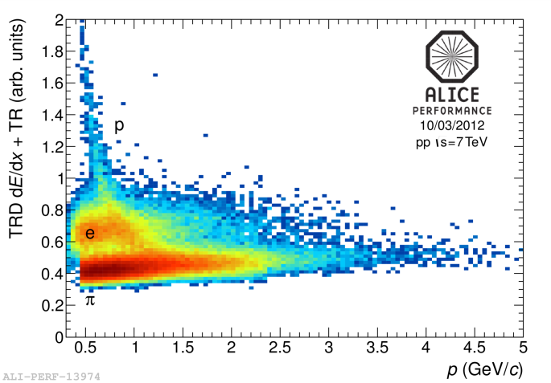
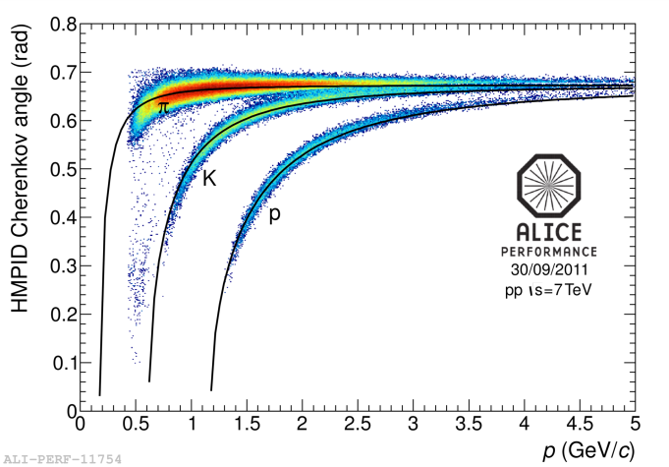
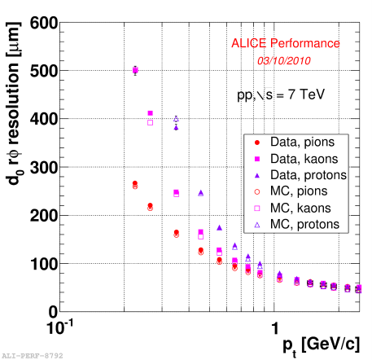
ALICE – dedicated heavy-ion experiment at the LHC
ITS
TPC
TOF
TRD
HMPID
vertexing
  particle identification (practically all known techniques)
  extremely low-mass tracker ~ 10% of X₀
  excellent vertexing capability
  efficient low-momentum tracking – down to ~ 100 MeV/c

Slide 4
LHC Heavy-Ion running
Two heavy-ion runs at the LHC so far:
  in 2010 – commissioning and the first data taking
  in 2011 – already above nominal instant luminosity!
p–Pb run moved to beginning of next year
  plan for ~ 30 nb⁻¹
    (for rare-probe statistics equivalent to ~0.15 nb⁻¹ of Pb–Pb)
Followed in 2013 by Long Shutdown–1 (LS1)
year | system | energy √s_{NN} TeV | integrated luminosity
2010 | Pb – Pb | 2.76 | ~ 10 μb⁻¹
2011 | Pb – Pb | 2.76 | ~ 0.1 nb⁻¹
2013 | p – Pb | 5.02 | ~ 30 nb⁻¹

Slide 5
ALICE @ QM2012
6 more plenary talks:
S Voloshin ID Flow overview Mon 16:50
A Morsch IIA Jets and structure Tue 09:10
M Ivanov IIA Identified particle spectra Tue 10:10
Z Conesa del Valle IIB Heavy flavour Tue 11:55
E Scomparin IVB Quarkonia production Thu 11:25
A M Adare VA Correlations Fri 10:30
Global and collective dynamics
M R J Guilbaud P2A dN/dη at large pseudo-rapidity Tue 17:25
M Broz P4A Anti-baryon to baryon ratio Wed 12:00
L Milano P5A Identified particle production Thu 14:00
S Singha P5A Strangeness production Thu 14:40
B Doenigus P5A (Anti-)hyper nuclei Thu 15:20
30 parallel talks
Azimuthal flow
A F Dobrin P1C Event shape engineering Tue 15:35
Y Hori P2C Charge dependent azimuthal flow Tue 17:45
F Noferini P6D Identified particle azimuthal flow Fri 14:00
A Bilandzic P7D Multi-particle azimuthal correlations Fri 17:10
A Hansen P7D Anisotropic flow in pseudo-rapidity Fri 17:50
Correlations and fluctuations
M Weber P2C Charge fluctuation and balance function Tue 17:05
M P Szymanski P1C Baryon and meson femtoscopy Tue 14:55

Slide 6
ALICE @ QM2012
High p_{T} identified particles
D Peresunko P4B Neutral meson production Wed 12:00
A Ortiz Velasquez P5C High p_{T} PID spectra Thu 14:20
Jets
N Arbor P1B Photon–charged hadron correlations Tue 15:15
R Reed P2B Inclusive jet spectra Tue 18:05
L Cunqueiro Mendez P3B Jet structure Wed 08:50
F Krizek P4B Jet fragmentation with particle correlations Wed 11:20
J G Ulery P4B Jet–medium correlations Wed 11:00
Heavy flavours
G M Innocenti P4A D_{s} production Wed 12:20
A Grelli P6A D meson R_{AA} Fri 14:00
D Caffarri P6A D meson elliptic flow Fri 14:40
X Zhang P7A Heavy flavour muons R_{AA} and elliptic flow Fri 17:50
S Sakai P7A Heavy flavour electrons R_{AA} and elliptic flow Fri 16:30
Quarkonia
R Arnaldi P1D J/ψ and ψ’ in forward region Tue 14:35
I Ch Arsene P2D J/ψ at mid-rapidity Tue 17:25
H Yang P7A J/ψ elliptic flow in forward region Fri 17:30
Direct photons
M R Wilde P3C Direct photons Wed 10:10
Detector upgrade
Th Peitzmann P6C Upgrade of ALICE detector Fri 14:40
R C Lemmon P6C ITS upgrade Fri 15:20
… and 45 posters

Slide 7
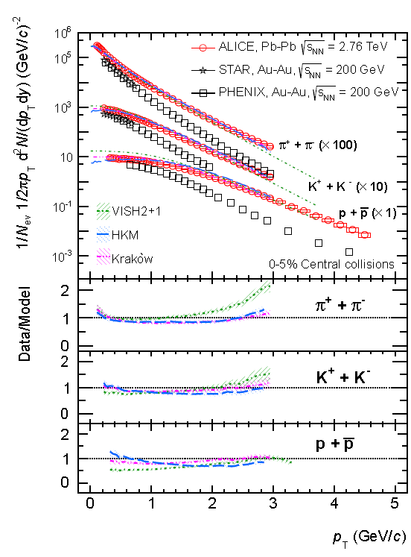
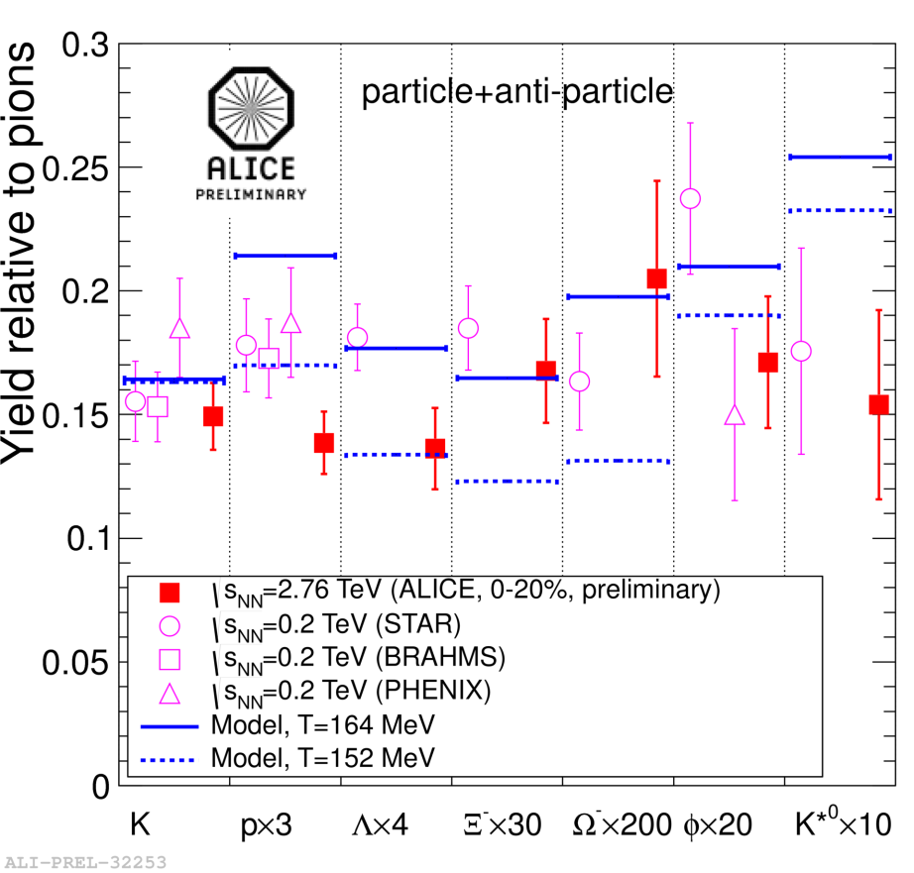
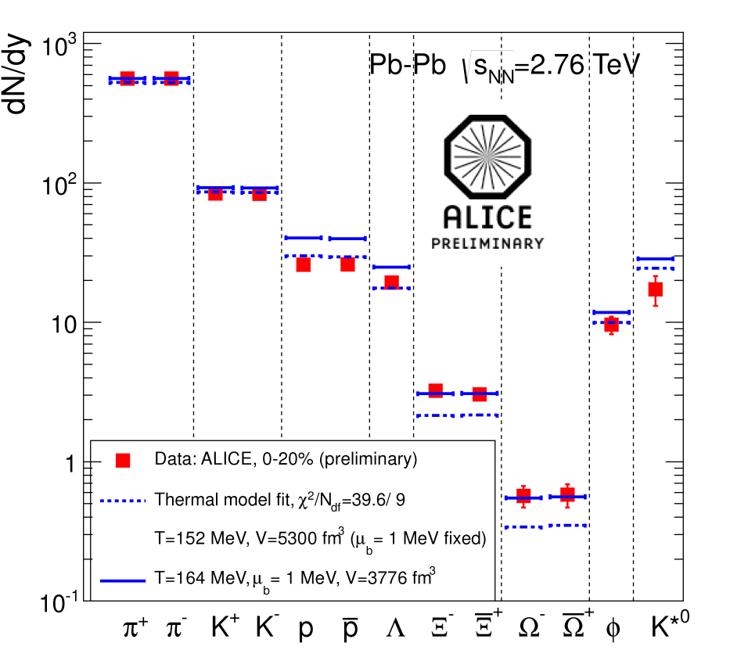
Low-p_{T} particle production
Talks by
M.Ivanov
L.Milano
S.Singha
Predicted temperature T=164 MeV
A.Andronic, P.Braun-Munzinger, J.Stachel NP A772 167
Thermal fit (w/o res.): T=152 MeV (χ²/ndf = 40/9)
Ξ and Ω significantly higher than statistical model
p/π and Λ/π ratios at LHC lower than at RHIC
Hadronic re-interactions ?
F.Becattini et al. 1201.6349 J.Steinheimer et al. 1203.5302
arXiv:1208.1974 [hep-ex]

Slide 8
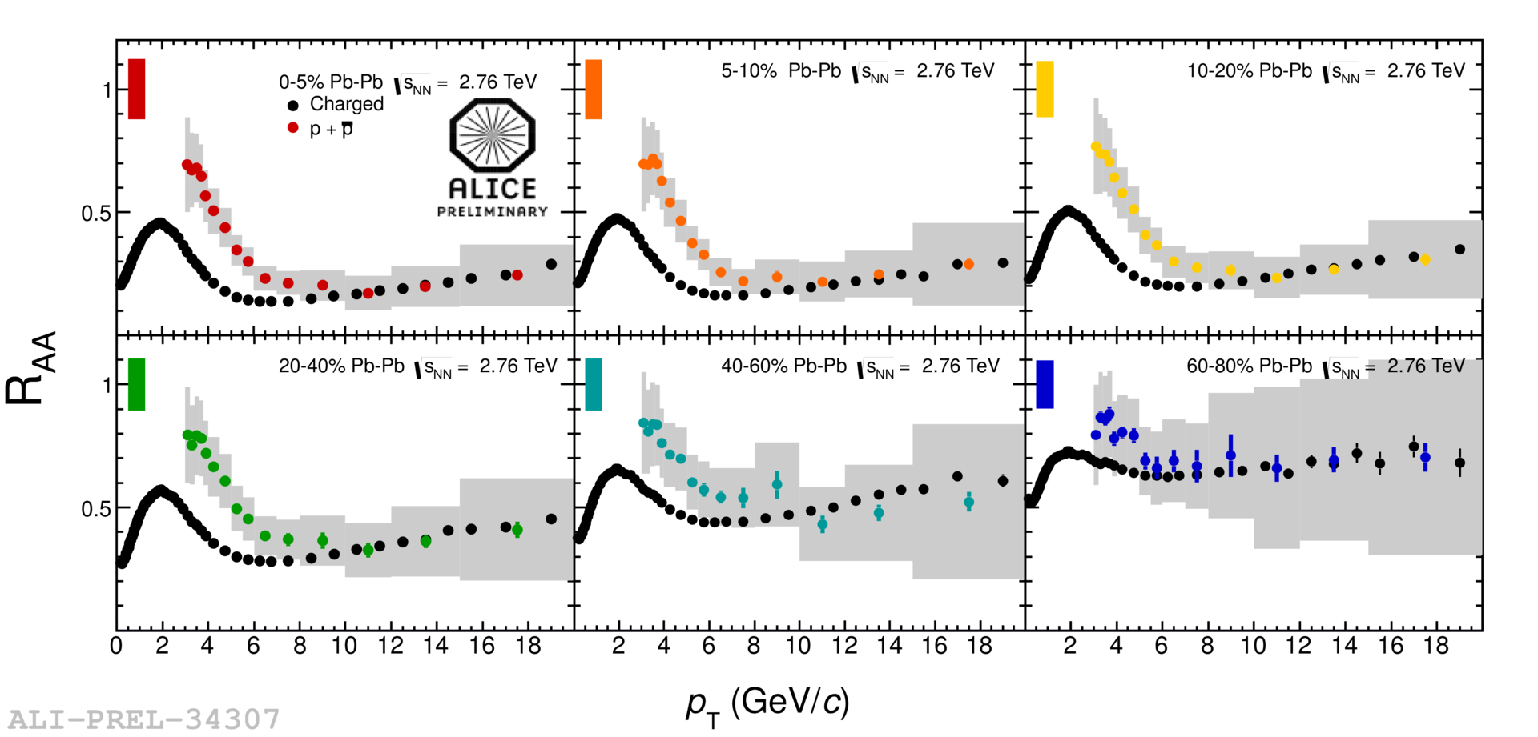
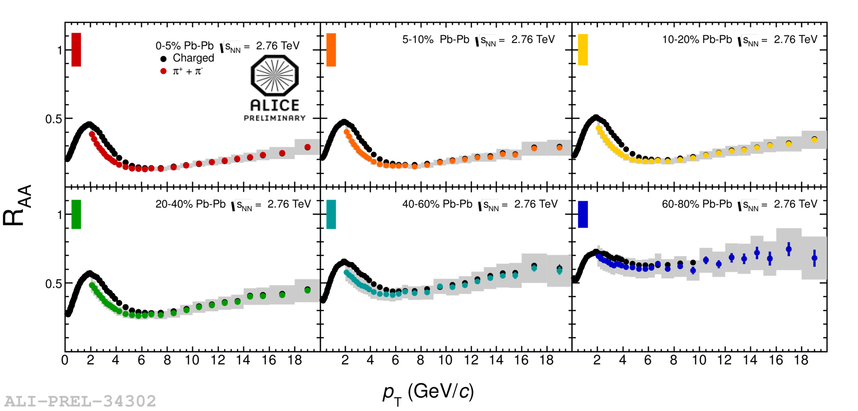
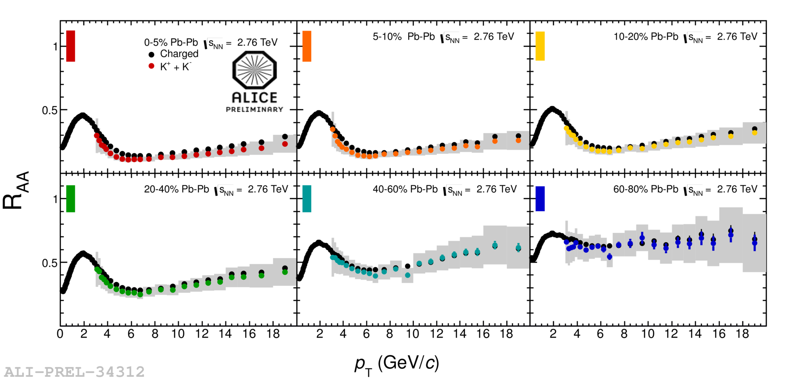
Identified particles at intermediate p_{T}
● charged particles ●●●●●● different centralities for identified particles
Talks by
M.Ivanov
A.Ortiz
Velasquez
K⁺ + K⁻
p + p
π⁺ + π⁻
0–5%
5–10%
10–20%
40–60%
60–80%
20–40%
For p_{T} below ~ 7 GeV/c: R_{AA}(π) < R_{AA}(h±), R_{AA}(K) ≈ R_{AA}(h±)
For p_{T} below ~ 7 GeV/c: R_{AA}(π) < R_{AA}(h±), R_{AA}(K) ≈ R_{AA}(h±), R_{AA}(p) > R_{AA}(h±)
For p_{T} below ~ 7 GeV/c: R_{AA}(π) < R_{AA}(h±)
At higher p_{T}: R_{AA} are compatible

Slide 9
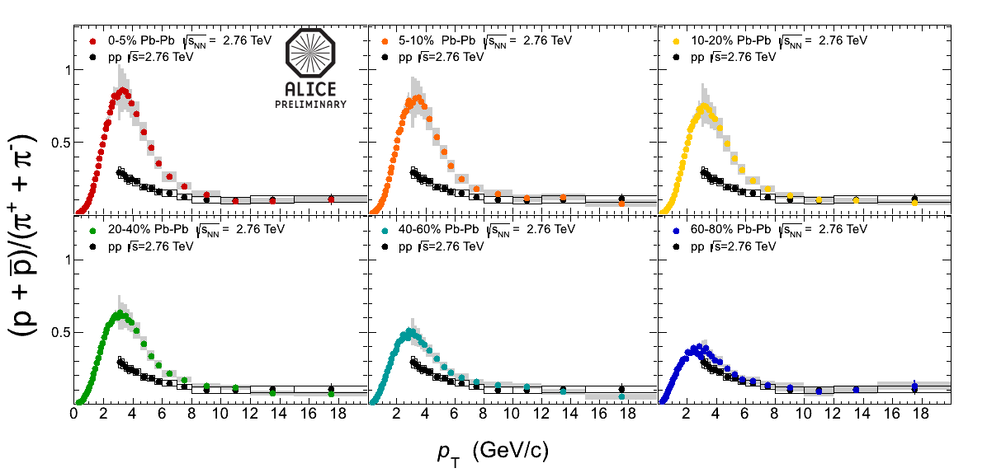
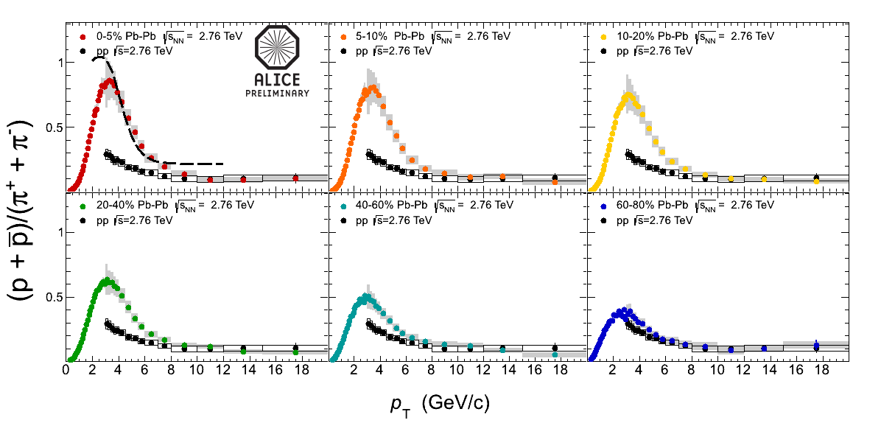
Baryon-to-meson ratio: p/π
● proton–proton ●●●●●● Pb–Pb different centralities
Talks by
M.Ivanov
A.Ortiz
Velasquez
0–5%
5–10%
10–20%
recombination
model
20–40%
40–60%
60–80%
p/π ratio at p_{T} ≈ 3 GeV/c in 0–5% central Pb–Pb collisions factor ~ 3 higher than in pp
at p_{T} above ~ 10 GeV/c back to the “normal” pp value
recombination – radial flow ?
R.J.Fries et al., PRL 90 202303; PR C68 044902

Slide 10
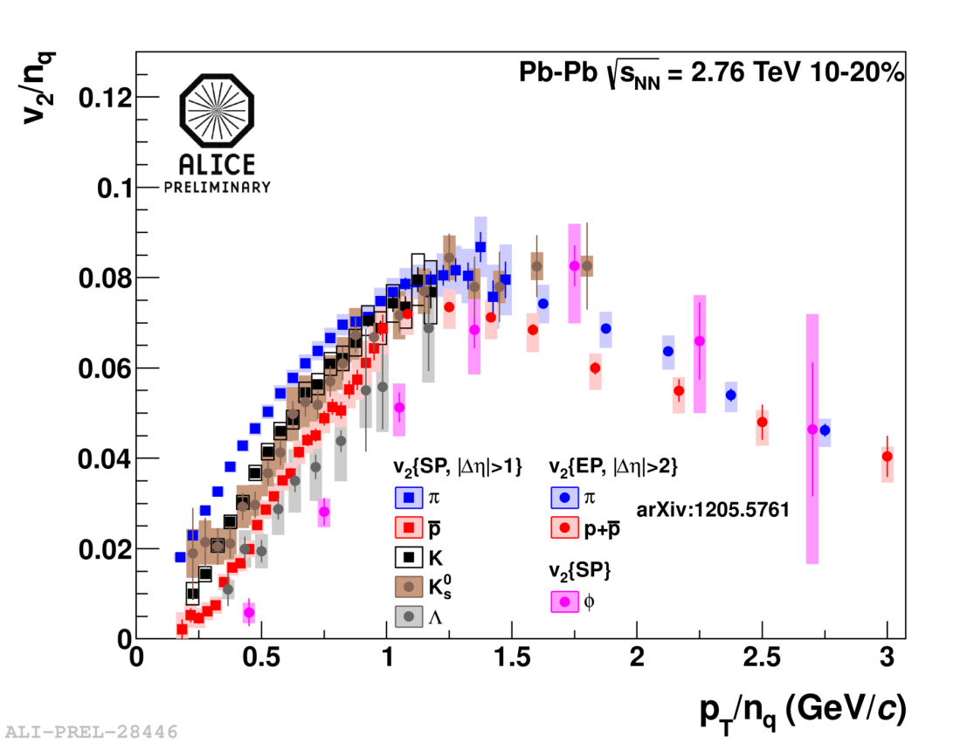
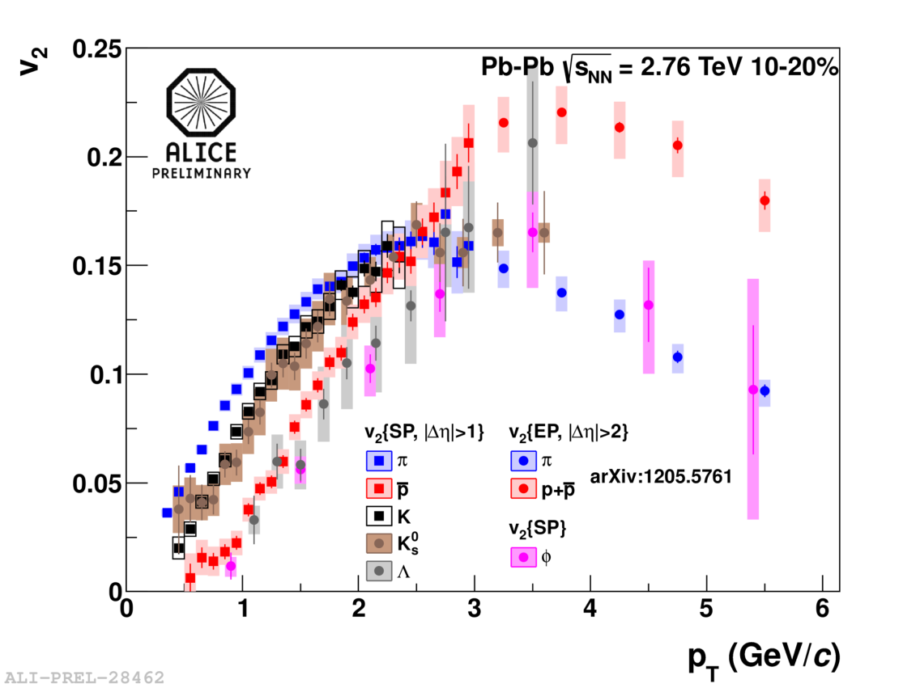
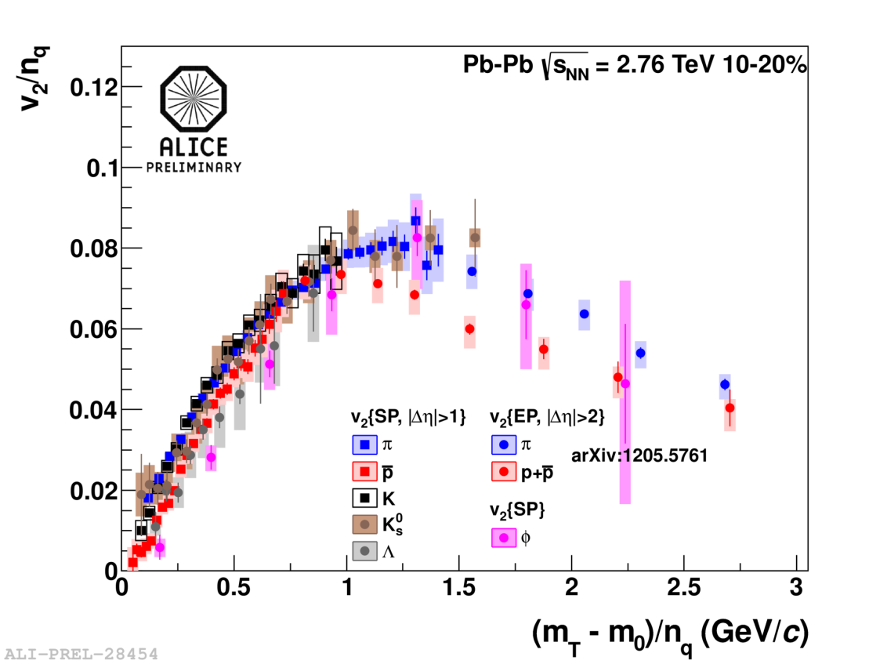
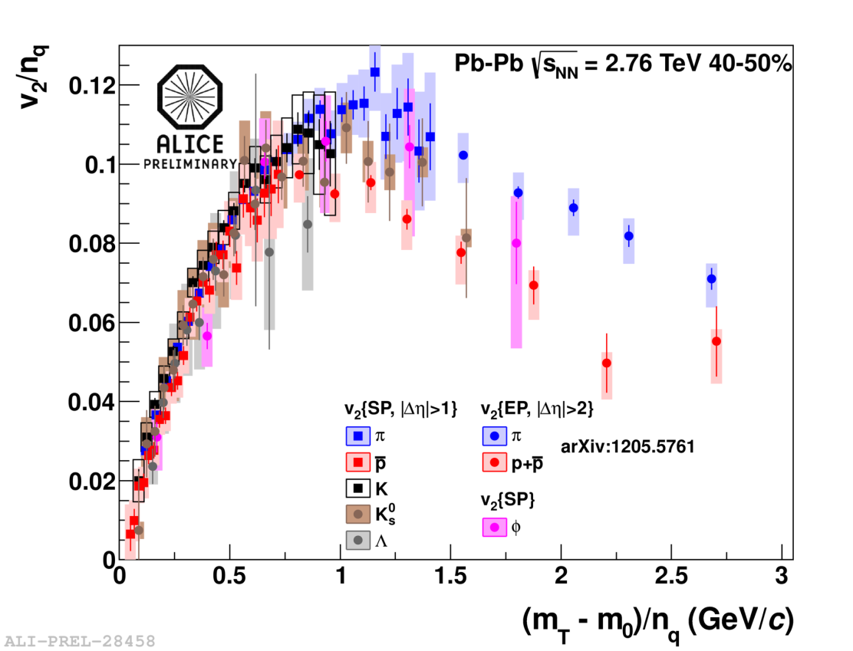
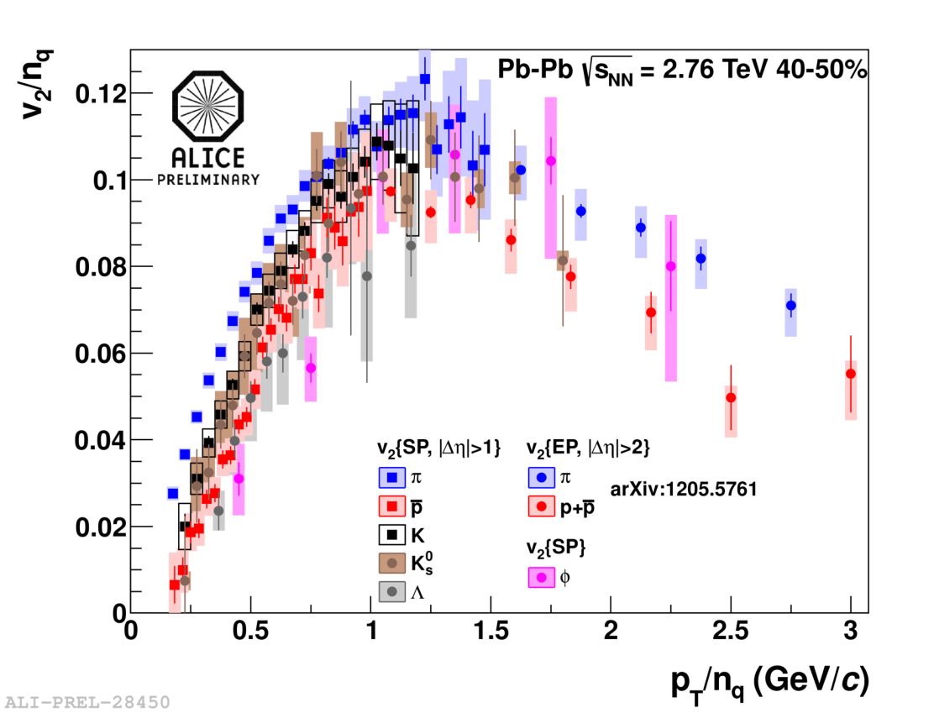
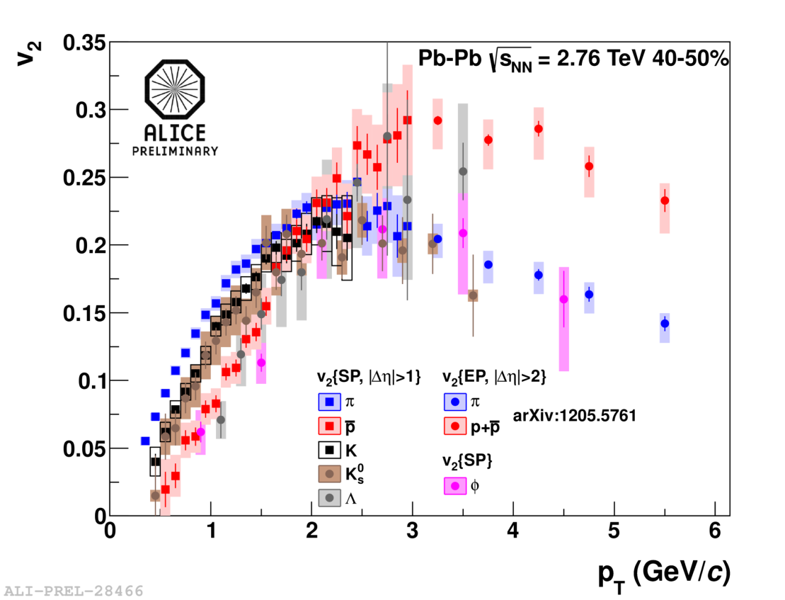
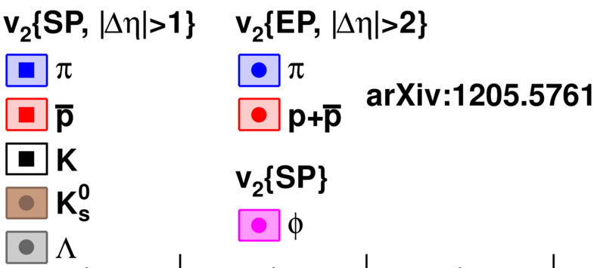
Identified-particle v₂
v₂ for π, p, K±, K⁰_{s}, Λ, φ (not shown for Ξ, Ω)
φ at low p_{T} (<3 GeV/c) follows mass hierarchy
– at higher p_{T} joins mesons
overall qualitative agreement with hydro up to p_{T} 1.5–3 GeV/c (π–p); quantitative precision needs improvements – hadronic afterburner
Talks by
S.Voloshin F.Noferini
n_{q}(m_{T})-scaling worse than at RHIC
n_{q}(p_{T})-scaling at p_{T} > 1.2 GeV/c violation 10–20%

Slide 11
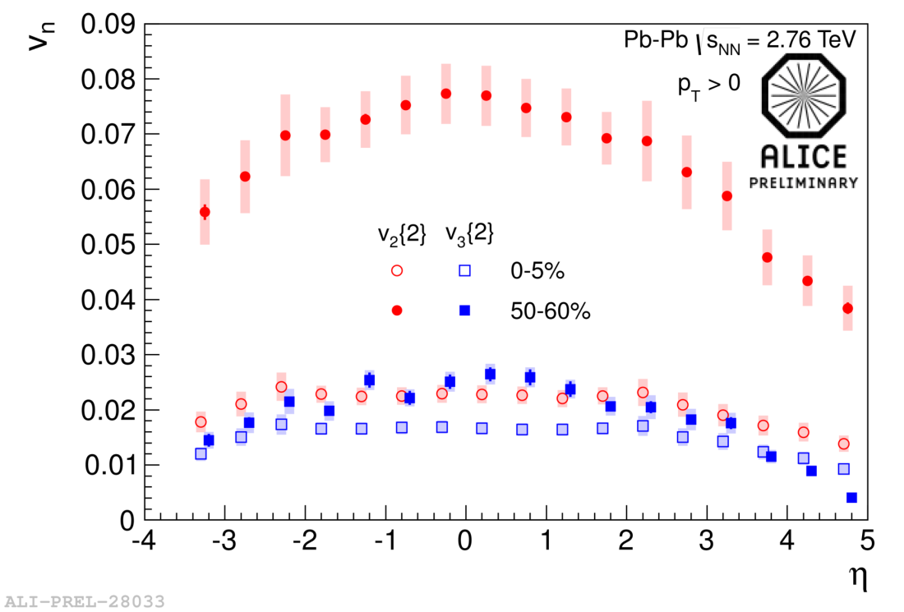
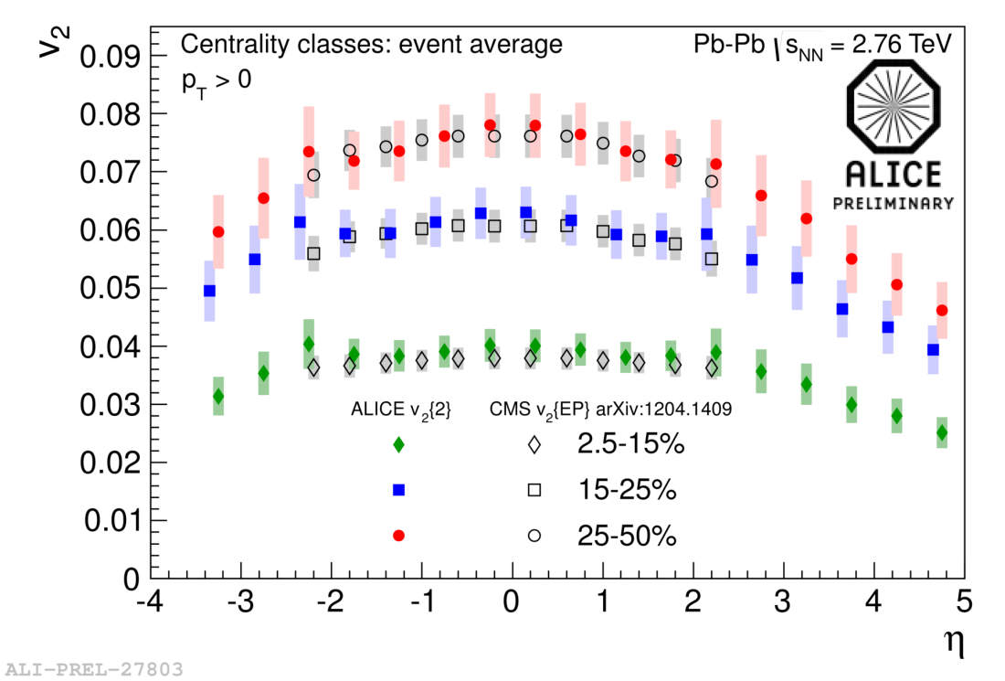
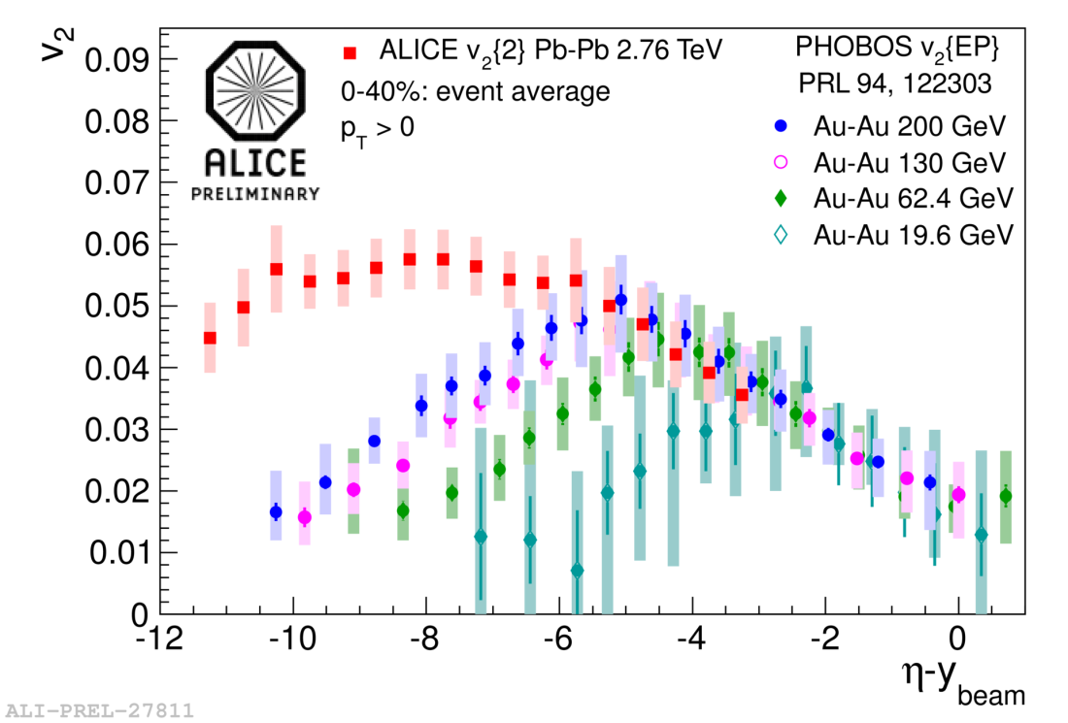
v₂ and v₃ versus η
v₂ and v₃ measurements extended up to η = 5
observed plateau in pseudorapidity (|η| < 2)
very good agreement between ALICE and CMS for v₂ in |η| < 2.4
Talks by
S.Voloshin A.Hansen
consistent with longitudinal scaling in η – y_{beam} with PHOBOS data

Slide 12
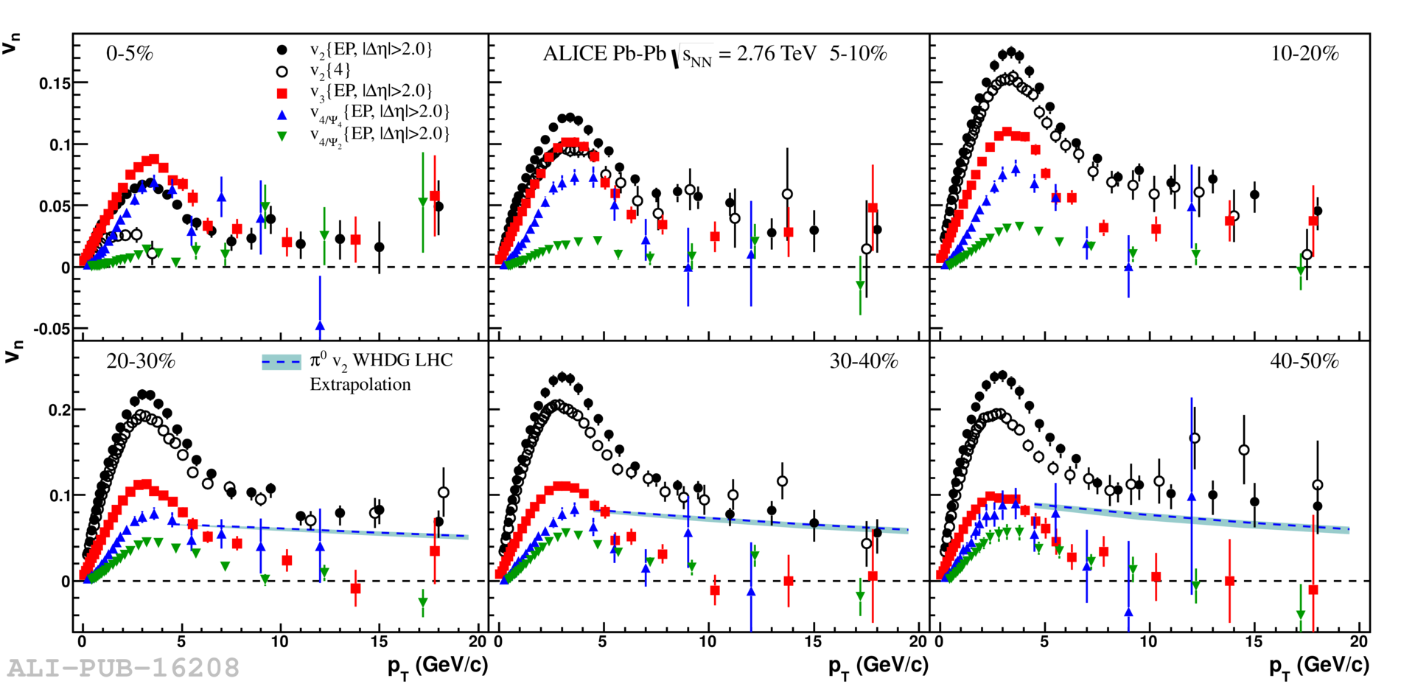
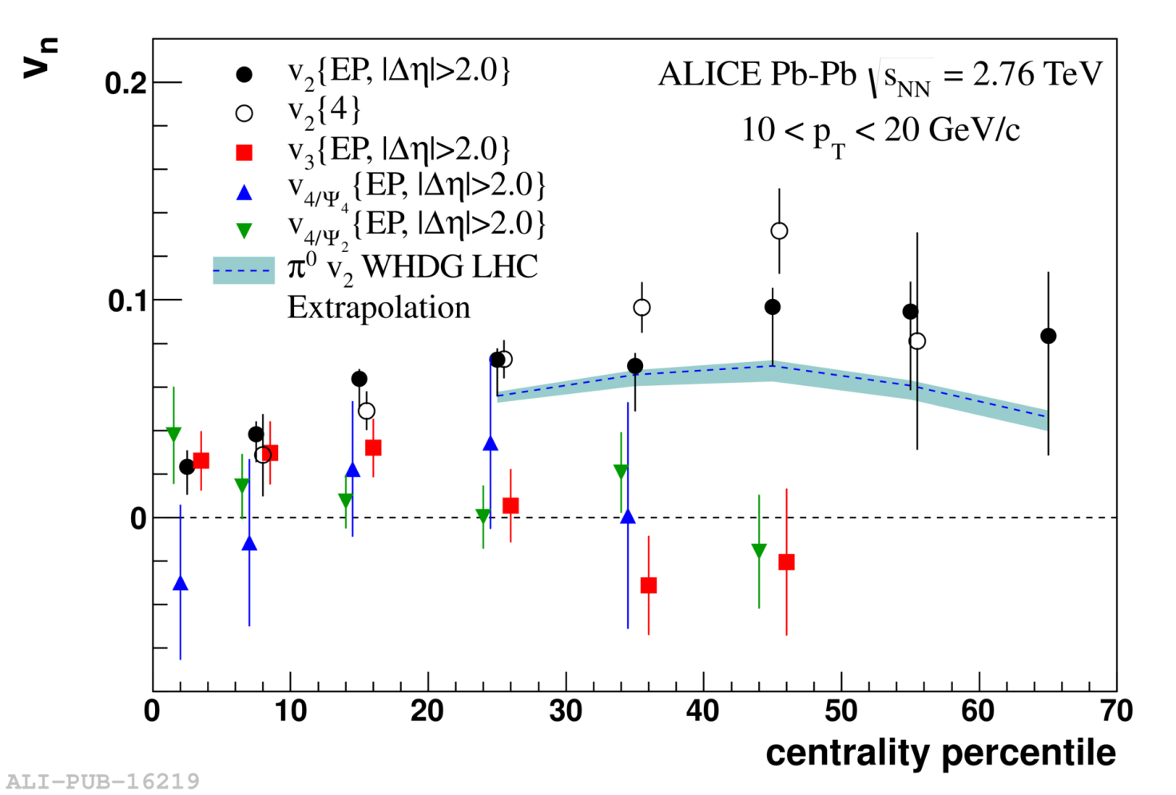
v₂ , v₃, v₄ versus p_{T}
arXiv:1205.5761 [hep-ex]
W.Horowitz,M.Gyulassy, J.Phys. G38 124114
0–5%
10–20%
5–10%
30–40%
40–50%
20–30%
v_{n} measurements up to 20 GeV/c – where dominated by jet quenching
Non-flow effects suppressed by rapidity gap or using higher cumulants
Non-zero value of v₂ at high p_{T} both for Δη > 2 and 4-particle cumulant
Talk by
S.Voloshin
v₃ and v₄ diminish above 10 GeV/c – indication of disappearance of fluctuations at high p_{T}

Slide 13
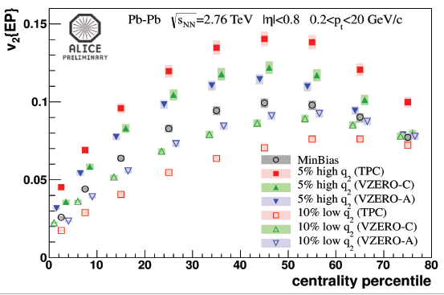
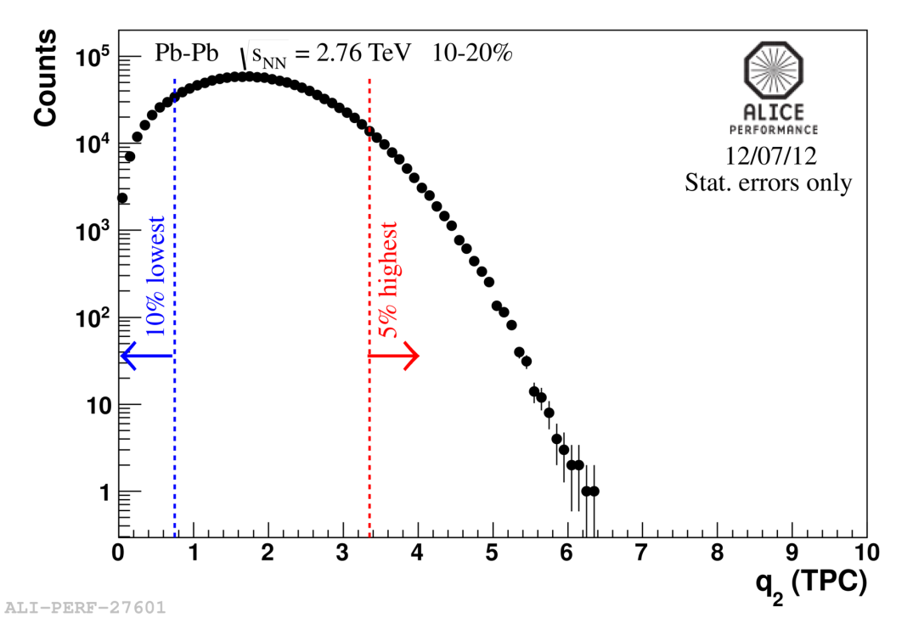
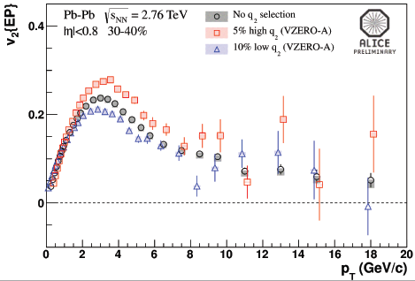
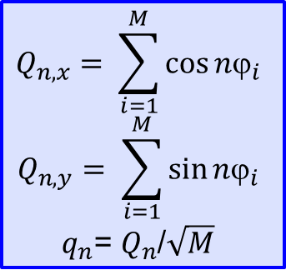
Event Shape Engineering
$$Q_{n,x}= \sum_{i=1}^{M}{\cos{nϕ_{i}}}$$
$$Q_{n,y}= \sum_{i=1}^{M}{\sin{nϕ_{i}}}$$
$q_{n}$= $Q_{n}$/$\sqrt{M}$
Talks by
S.Voloshin A.Dobrin
L.Milano
At fixed centrality large flow fluctuations:
Select events of given v₂ by means of
q₂-vector length in a subevent and
study another region (subevent)
v₂ splits by factor of two for semi-central
events (30–50%)
Initial shape fluctuation effect very similar
up to p_{T} ~ 6–8 GeV/c

Slide 14
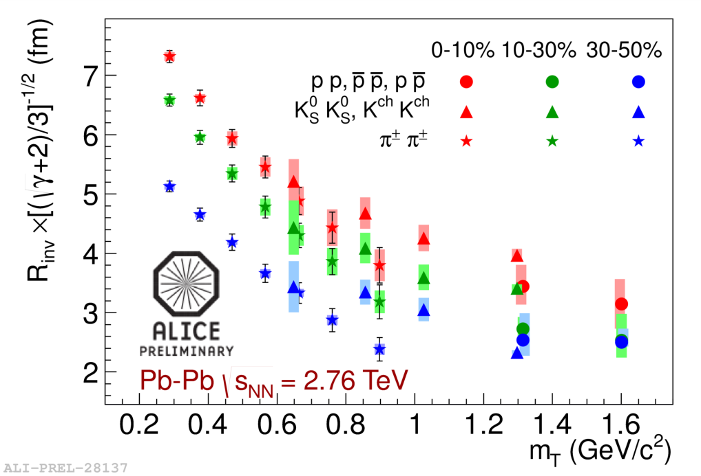
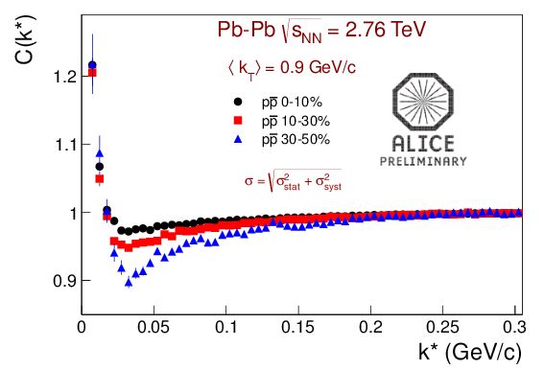
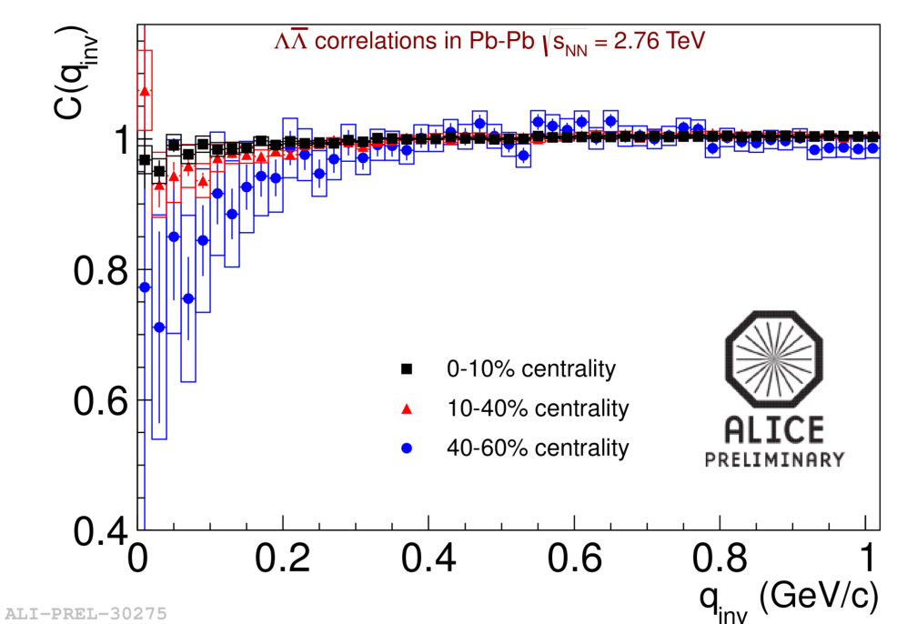
Baryon femtoscopy
Talks by
A.M.Adare M.Szymanski
For the first time m_{T}-scaling of homogeneity
length for all particle species
– consistent with hydro
Baryon–antibaryon correlation function has
large contribution from final state interaction
– measurement of annihilation cross section
Because of large density, p and Λ may be
suppressed due to annihilation ?

Slide 15
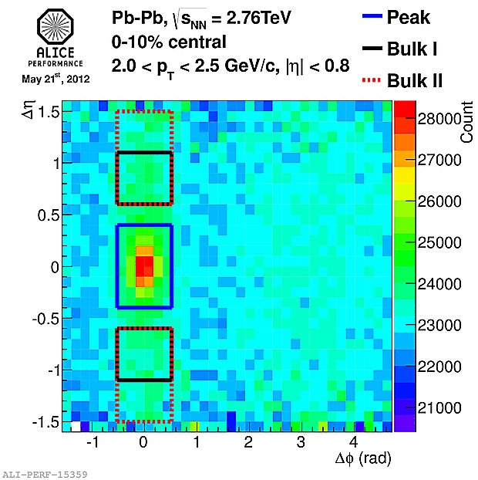
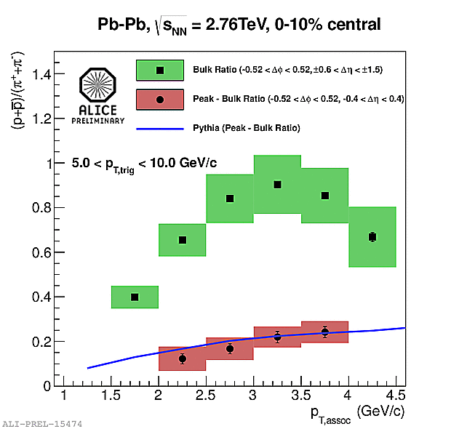
PID in jet structures
Talks by
A.M.Adare
J.G.Ulery
PYTHIA pp
Near-side peak (after bulk subtraction): p/π ratio compatible with that of pp (PYTHIA)
Bulk region: p/π ratio strongly enhanced – compatible with overall baryon enhancement
Jet particle ratios not modified in medium? Could this still be surface bias?

Slide 16
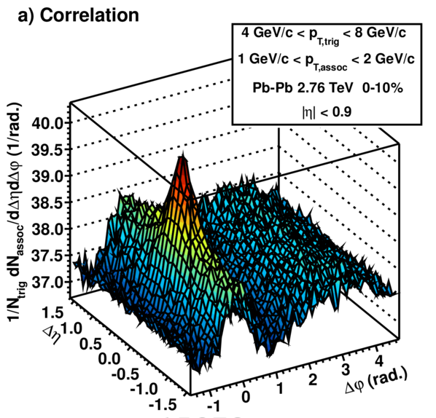
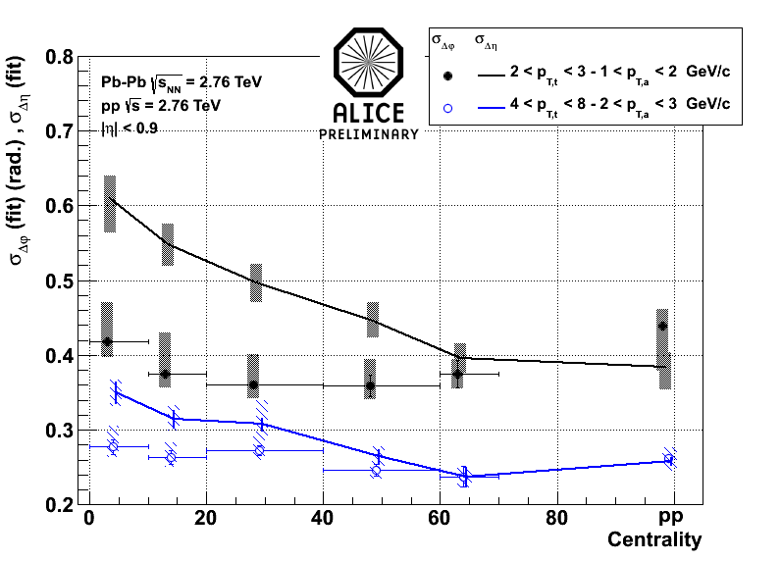
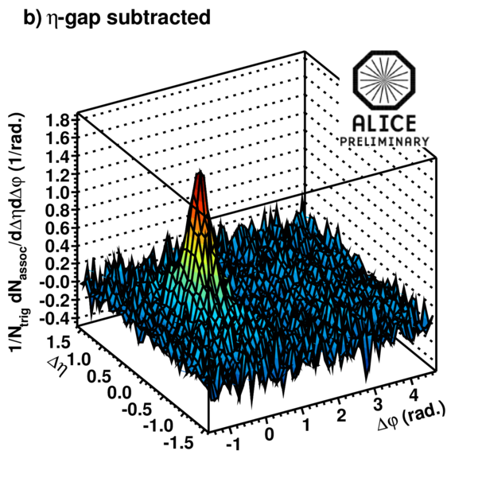
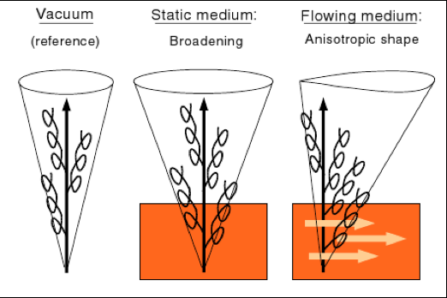
Near-side (jet-like) structure
Isolation of near-side peak:
Δη–Δϕ correlation with trigger
Long-range (large Δη) correlation
used as proxy for background
Talks by
A.M.Adare
F.Krizek
σ_{η}
σ_{ϕ}
Evolution of near-side-peak
σ_{η} and σ_{ϕ} with centrality:
Strong σ_{η} increase for central
collisions
Interestingly: AMPT describes
the data very well
Influence of flowing medium?
N.Armesto et al., PRL 93, 242301

Slide 17
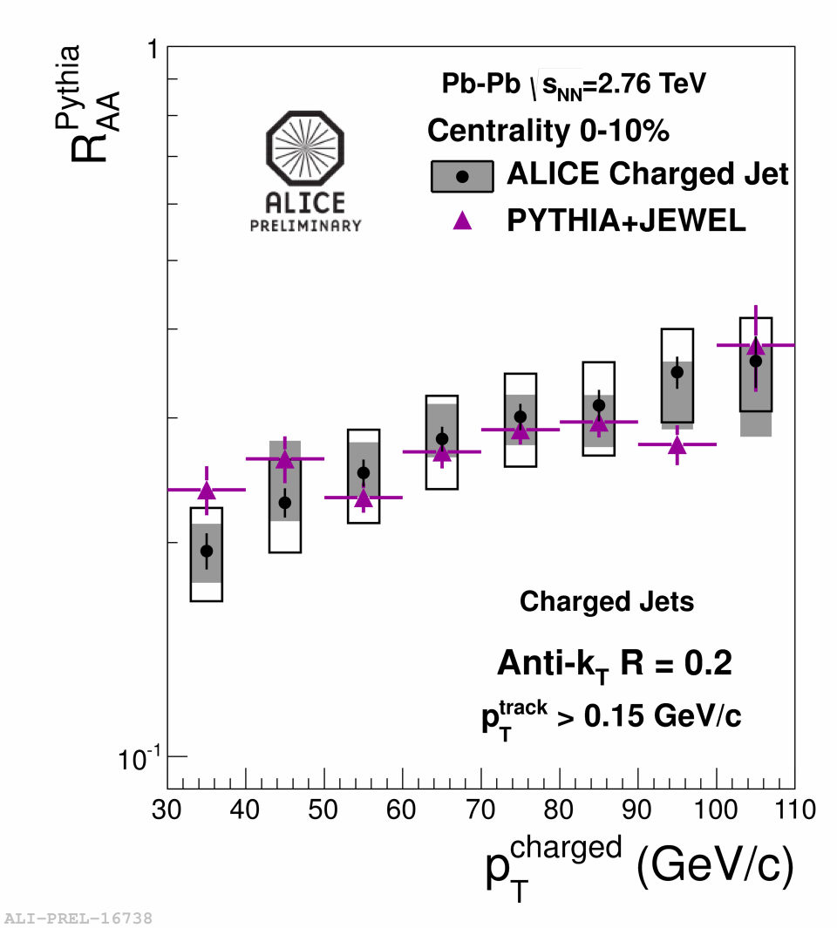
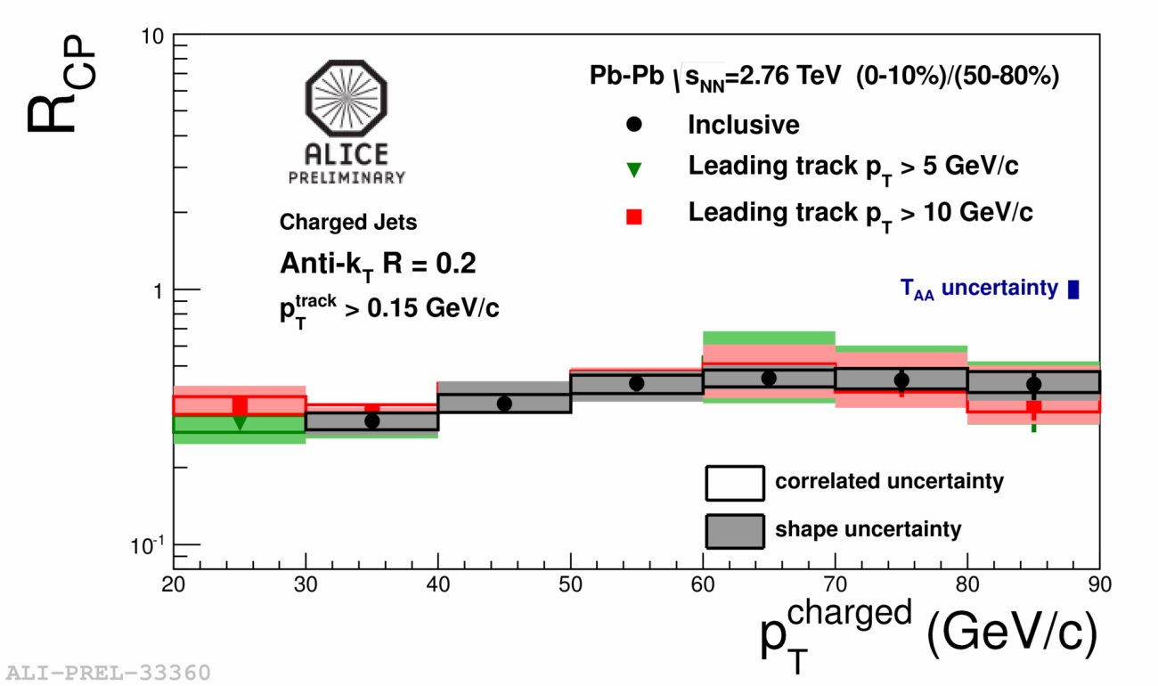
Charged jet R_{AA} and R_{CP}
Talks by
A.Morsch
R.Reed
Strong jet suppression observed for jets reconstructed with charged particles
– R_{AA} (jet) is smaller than inclusive hadron R_{AA}(h±) at similar parton p_{T}
– data are reasonably well described by JEWEL model
K.Zapp, I.Krauss, U.Wiedemann, arXiv:1111.6838

Slide 18
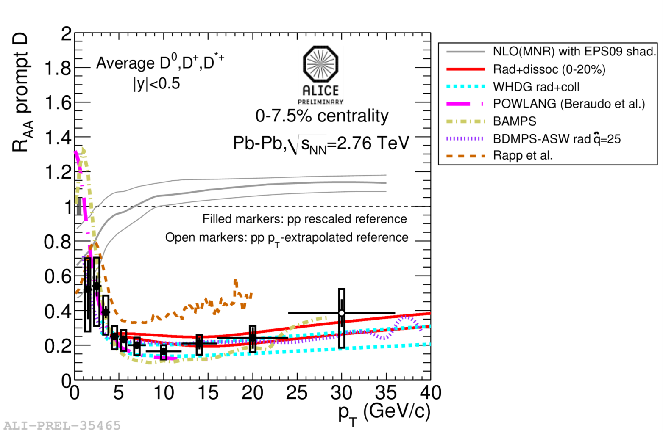
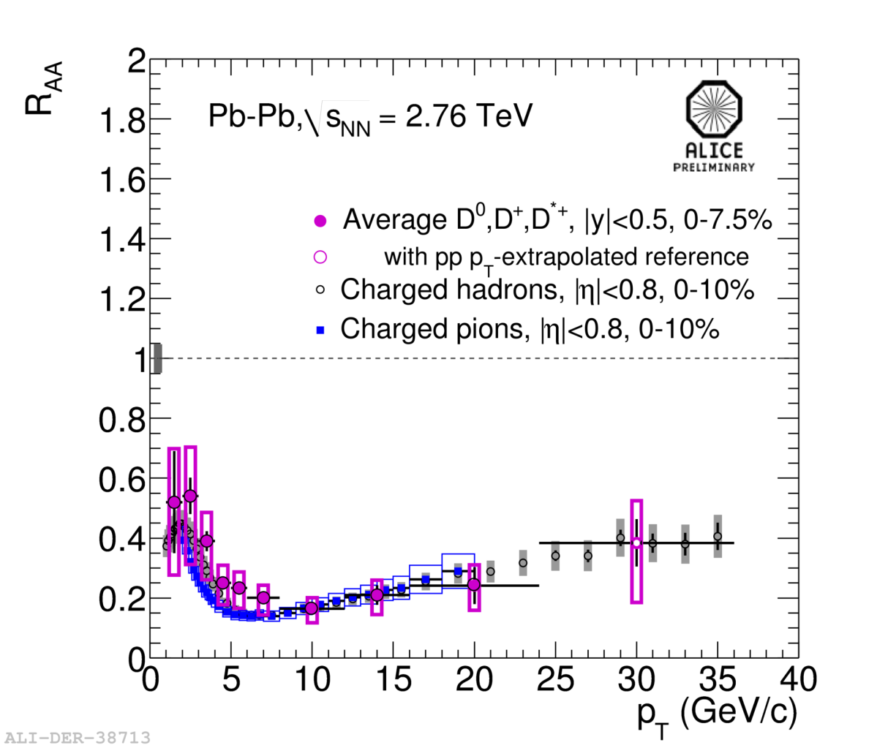
D meson R_{AA}
Talks by
Z.Conesa del Valle
A.Grelli
Average D-meson R_{AA}:
– p_{T} < 8 GeV/c hint of slightly less
suppression than for light hadrons
– p_{T} > 8 GeV/c both (all) very similar
no indication of colour charge dependence

Slide 19
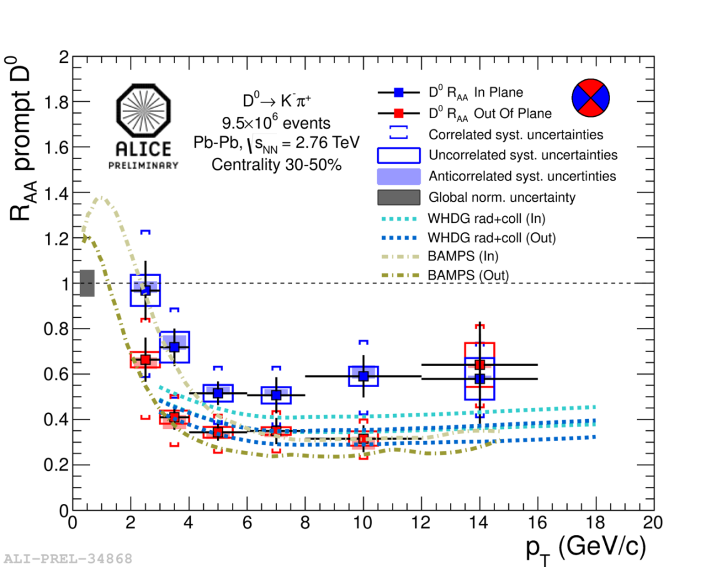
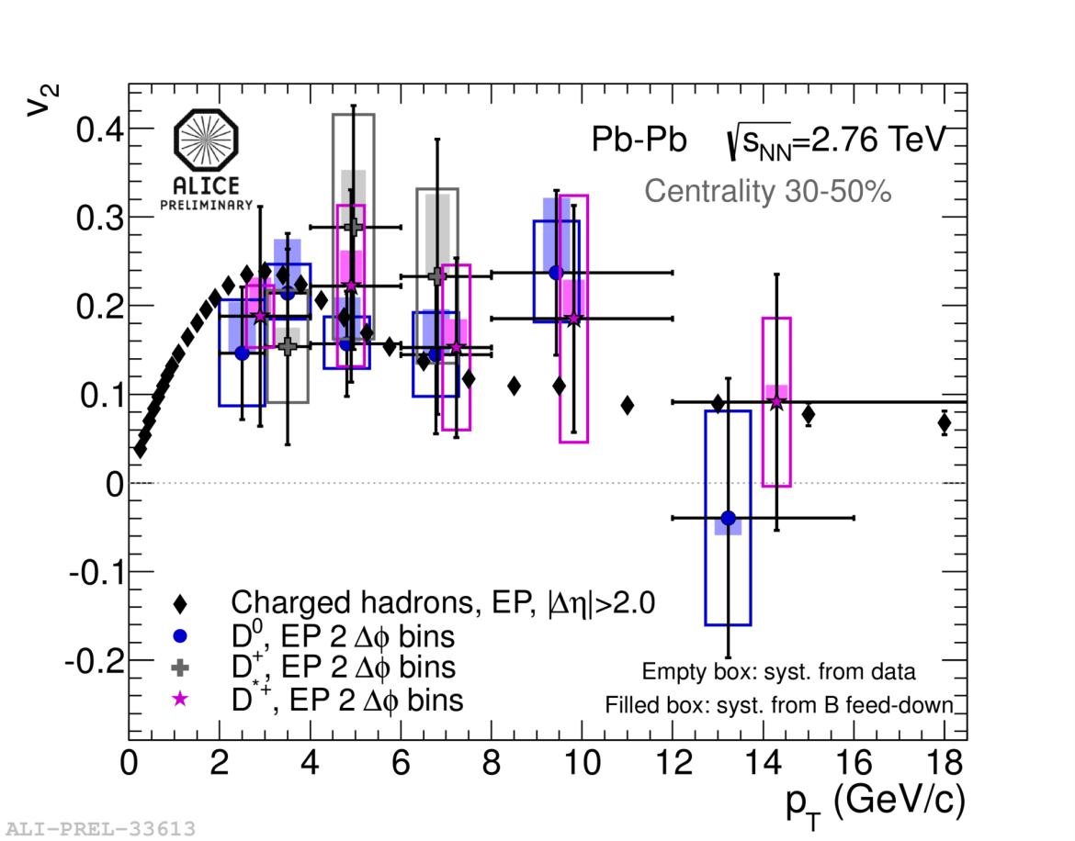
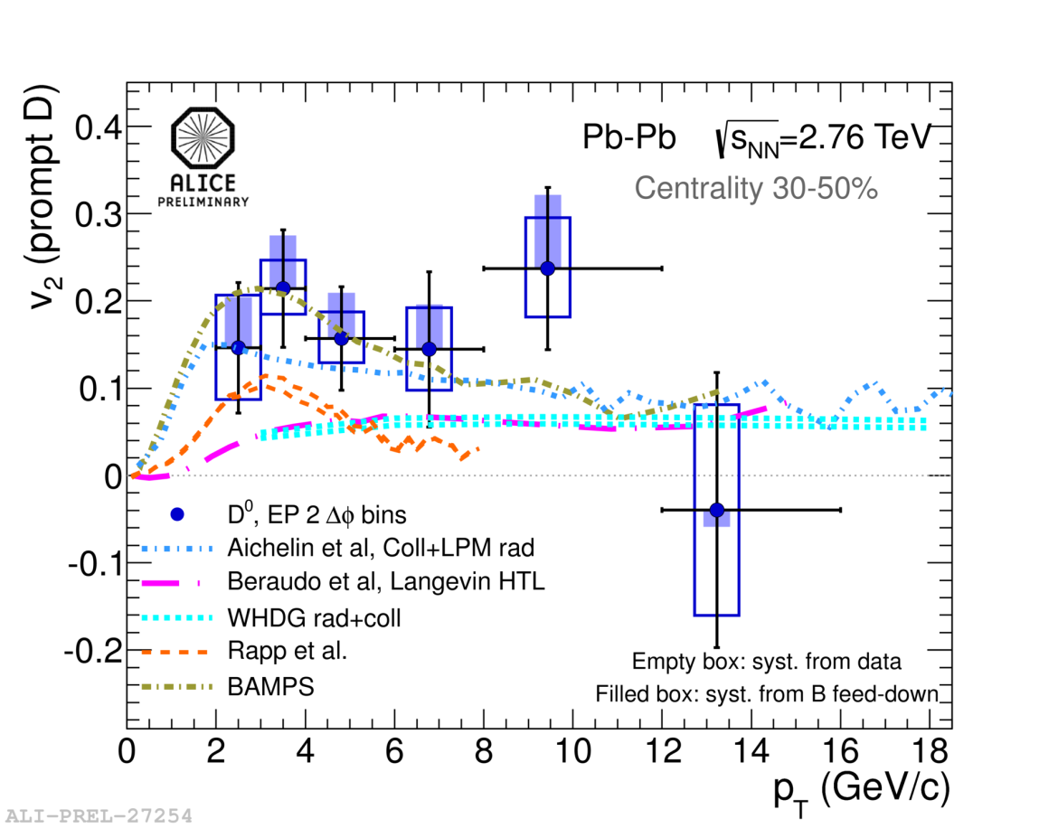
D meson v₂
Talks by
Z.Conesa del Valle
D.Caffarri
Non-zero D meson v₂ observed
Comparable to that of light hadrons
Expressed as event-plane dependent R_{AA}
Simultaneous description of R_{AA} and v₂
c-quark transport coefficient in medium

Slide 20


Heavy-flavour e(μ) R_{AA} & v₂
Strong suppression of heavy-flavour e up to p_{T} 18 GeV/c in
0–10% centrality and non-zero v₂ in 20–40% centrality class
Ongoing effort to separate beauty contribution…
Talks by
Z.Conesa del Valle
X.Zhang, S.Sakai
Suppression of heavy-flavour μ in forward region very similar to that of e

Slide 21

Heavy- flavour R_{AA}: D, e, μ
Talks by
Z.Conesa del Valle
X.Zhang, S.Sakai
Comparison of heavy-flavour R_{AA}:
– p_{T} < 8 GeV/c all measurements
close together
– p_{T} > 8 GeV/c heavy-flavour e
systematically above D meson

Slide 22



… adding D_{s} to charm R_{AA}
Strong suppression (~ 4–5 )
at p_{T} above 8 GeV/c
Uncertainty will improve with
future pp and Pb–Pb data taking
Talks by
Z.Conesa del Valle
G.M.Innocenti

Slide 23


J/ψ R_{AA} centrality dependence
0<p_{T}<2 GeV/c
5<p_{T}<8 GeV/c
J/ψ suppression measurements both in central and forward regions
– from N_{part} > 100 suppression independent of centrality
– in central collisions, less suppression than at RHIC
– at low p_{T} (< 2 GeV/c) less suppression than at high p_{T}, especially
in more central collisions
Indication of J/ψ regeneration at low p_{T} ?
Talks by
E.Scomparin
R.Arnaldi
I.Ch.Arsene

Slide 24



J/ψ R_{AA} vs. centrality and p_{T}
total
primordial
total
regeneration
primordial
regeneration
Comparison to regeneration model:
X.Zhao, R.Rapp NPA 859 114
Different suppression pattern at low/high-p_{T}
At low p_{T} ~50% J/ψ from recombination
Fair agreement for different centralities
Statistical hadronization model also
describes the data: P.Braun-Munzinger et al.
0–20%
40–90%
total
total
regeneration
Talks by E.Scomparin, R.Arnaldi

Slide 25


J/ψ elliptic flow
J/ψ produced by recombination of thermalized c-quarks should have
non-zero elliptic flow
– measurements give a hint for non-zero v₂
– qualitative agreement with transport models, including regeneration
– complementary to indications obtained from J/ψ R_{AA} studies
Talks by
E.Scomparin
H.Yang

Slide 26

ψ’ to J/ψ double ratio
No firm conclusion on ψ’ enhancement
or suppression with centrality within
current stat. and syst. uncertainties
Large ψ’ enhancement with respect
to J/ψ reported by CMS at p_{T} above
3 GeV/c not confirmed
Talks by
E.Scomparin
R.Arnaldi

Slide 27


Direct photon production
Exponential fit for p_{T} < 2.2 GeV/c
inv. slope T = 304±51 MeV
for 0–40% Pb–Pb at √s 2.76 TeV
PHENIX: T = 221±19±19 MeV
for 0–20% Au–Au at √s 200 GeV
http://www.guinnessworldrecords.com/world-records/10000/highest-man-made-temperature
p_{T} < 2 GeV/c
~20% excess of direct photons
p_{T} > 4 GeV/c
agreement with N_{coll}-scaled NLO
Talk by M.R.Wilde

Slide 28















… and much more…

Slide 29
ALICE programme
ALICE heavy-ion programme approved for ~ 1 nb⁻¹:
  2013–14 Long Shutdown 1 (LS1)
    completion of TRD and CALs
  2015 Pb–Pb at √s_{NN} = 5.1 TeV
  2016–17 (maybe combined in one year) Pb–Pb at √s_{NN} = 5.5 TeV
  2018 Long Shutdown 2 (LS2)
  2019 probably Ar–Ar high-luminosity run
  2020 p–Pb comparison run at full energy
  2021 Pb–Pb run to complete initial ALICE programme
  2022 Long Shutdown 3 (LS3)
This will improve statistical significance of our main results by a factor about 3
  physics reach extended by the new energy and completion of TRD and CALs
Order/choice of nuclei
may change

Slide 30
ALICE future plans
Precision measurement of the QGP parameters at μ_{b} = 0
to fully exploit scientific potential of the LHC – unique in:
  large cross sections for hard probes
  high initial temperature
Main physics topics, uniquely accessible with the ALICE detector:
  measurement of heavy-flavour transport parameters:
    study of QGP properties via transport coefficients (η/s, q)
  measurement of low-mass and low-p_{T} di-leptons
    study of chiral symmetry restoration
    space-time evolution and equation of state of the QGP
  J/ψ , ψ’, and χ_{c} states down to zero p_{T} in wide rapidity range
    statistical hadronization versus dissociation/recombination
ˆ

Slide 31
ALICE upgrade
  luminosity upgrade – 50 kHz target minimum-bias rate for Pb–Pb
  run ALICE at this high rate, inspecting all events
  improved vertexing and tracking at low p_{T}
  preserve particle-identification capability
  high-luminosity operation without dead-time
  new, smaller radius beam pipe
  new inner tracker (ITS) (performance and rate upgrade)
  high-rate upgrade for the readout of the TPC, TRD, TOF, CALs, DAQ-HLT, Muon-Arm and Trigger detectors
  target for installation and commissioning LS2 (2018)
  collect more than 10 nb⁻¹ of integrated luminosity
    implies running with heavy ions for a few years after LS3
  for core physics programme – factor > 100 increase in statistics
    (maximum readout with present ALICE ~ 500 Hz)
  for triggered probes increase in statistics by factor > 10
Talks by
Th.Peitzmann
R.C.Lemmon

Slide 32
Summary
ALICE is obtaining a wealth of physics results from the first two LHC heavy-ion runs:
  bulk, soft probes:
    spectra and flow of identified particles, thermal photons
  high-p_{T} probes:
    jet quenching and fragmentation, particle-type dependent
  heavy-flavour physics:
    suppression and flow of D mesons, leptons, J/ψ
Entering the precision measurement era – charmed era of the QGP
  before LS2 (2018): p–Pb and Pb–Pb, higher energy and complete approved ALICE detector
Long-term upgrade for high-luminosity LHC based on:
  ambitious physics programme
  clear detector upgrade plan for improved vertexing and tracking
  high-rate capability of all subdetectors

