Slide 1
Baryon anomaly in heavy-ion collisions & colour correlations in QGP
E.M.Levin, Tel Aviv University , UTFSM Valparaiso
M.G.Ryskin, St.Petrsburg LNPI, Durham University
Karel Šafařík, CERN, Geneva
G.Matulewicz, Ecole Polytechnique, Paris

Slide 2
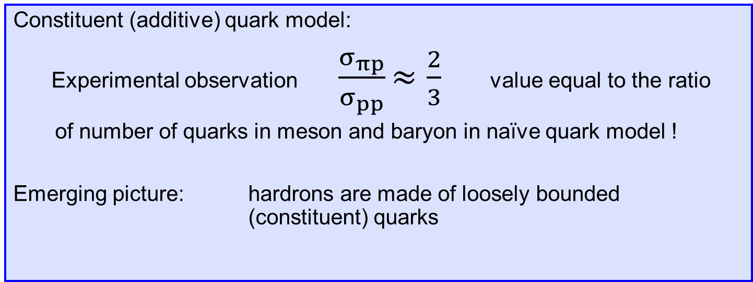
Constituent quark model
Constituent (additive) quark model:
  Experimental observation $\frac{σ_{πp}}{σ_{pp}}$ $≈\frac{2}{3}$ value equal to the ratio
of number of quarks in meson and baryon in naïve quark model !
Emerging picture: hardrons are made of loosely bounded (constituent) quarks
E.M.Levin, L.L.Frankfurt J. of Exp. and Theor. Phys. Lett. 2 105 (1965)
π⁺
p
p
p
d
d
d
d
u
u
u
u
u
u
u

Slide 3

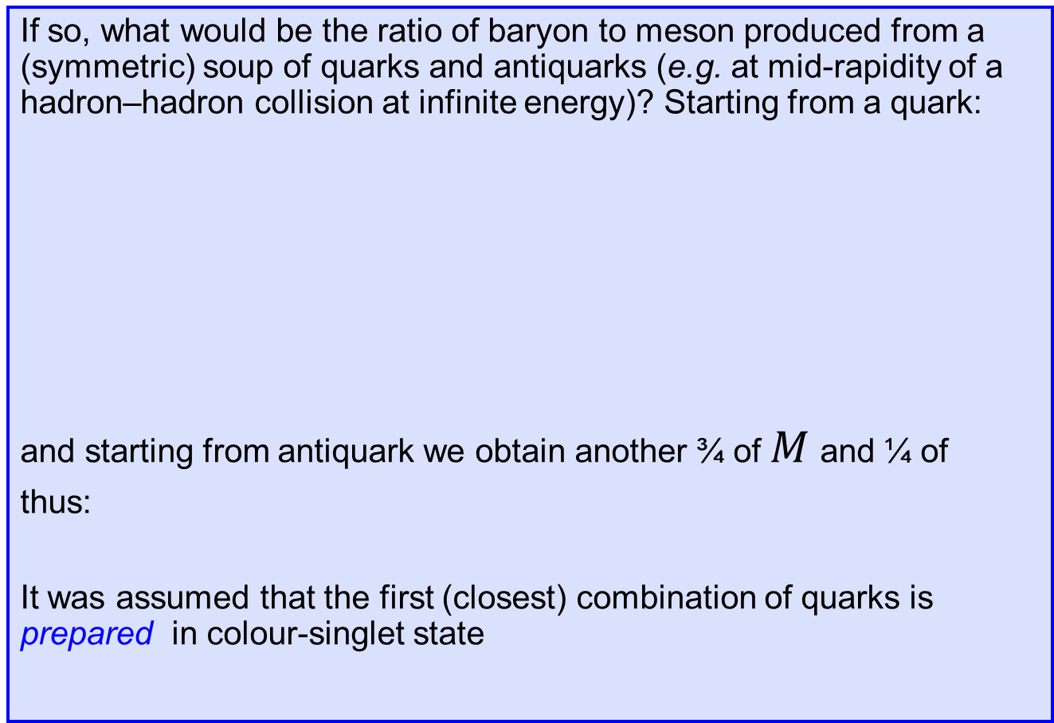


Baryon-to-meson ratio
If so, what would be the ratio of baryon to meson produced from a (symmetric) soup of quarks and antiquarks (e.g. at mid-rapidity of a hadron–hadron collision at infinite energy)? Starting from a quark:
and starting from antiquark we obtain another ¾ of $M$ and ¼ of
thus:
It was assumed that the first (closest) combination of quarks is prepared in colour-singlet state
q $\left\{\begin{aligned} \text{q}\frac{1}{2} \left\{ \begin{aligned}\text{q}\frac{1}{4}→B \\ \overline{\text{q}}\frac{1}{4}→M\end{aligned}\right. \\ \overline{\text{q}}\frac{1}{2} →M \end{aligned} \right.$
$$\overline{B}$$
$$B:\overline{B}:M=1:1:6$$
V.V. Anisovitch, V.M. Schekhter Nucl. Phys. B55 455 (1973)

Slide 4


… without colour correlations
Let’s assume that colour states of quarks are completely random, then:
  only 1/9 of qq pairs will bound into a meson $3⊗\overline{3}=1⊕8$
  1/3 of qq pairs will became a di-quark $3⊗3=\overline{3}⊕6$
  1/9 of diquark–q will bound into a baryon $3⊗3⊗3=1⊕8⊕8⊕10$
Summing all that up…
q $\left\{\begin{aligned} \text{q}\frac{1}{2} \left\{ \begin{aligned}\frac{1}{6} →\text{qq}\left\{ \begin{aligned}\text{q}\frac{1}{12} \left\{ \begin{aligned}\frac{1}{108}→B \\ \frac{8}{108}→\text{qq}\text{ ...}\end{aligned}\right. \\ \overline{\text{q}}\frac{1}{12} \left\{ \begin{aligned}\frac{1}{108}→M \\ \frac{8}{108} →\text{qq} \text{...}\end{aligned}\right.\end{aligned}\right. \\ \frac{2}{6} →\text{q} … \end{aligned}\right. \\ \overline{\text{q}}\frac{1}{2} \left\{ \begin{aligned}\frac{1}{18}→M \\ \frac{8}{18}→\text{q} … \end{aligned}\right. \end{aligned} \right.$

Slide 5


Random colour:
Correlated colour:
Colour de-correlation favours baryon production up to a factor 9/5 (=1.8)
This would be hardly applicable for hadron–hadron collisions because:
  average number of steps needed to find correct colour partner(s) is
  for a meson 9.99 (exactly 899/90)
  for a baryon 13.5
  consequently we would get very high inv. masses, e.g. ≈ 30 GeV mesons for quarks with the mean distance in rapidity of Δy ≈ 0.5
Proposed solution was:
soft gluon exchange to adjust colours with probability ~ α_{s}² ≈ O(0.1)
  to penalize each step by factor ~ exp(-Δy) due to a quark (spin-½) t-channel exchange
This brings baryon-to-meson ratio practically back to 1 : 6 value…
$$B:\overline{B}:M=3:3:10$$
$$B:\overline{B}:M=1:1:6$$
E.M.Levin, M.G.Ryskin, K.Safarik 1979, unpublished

Slide 6
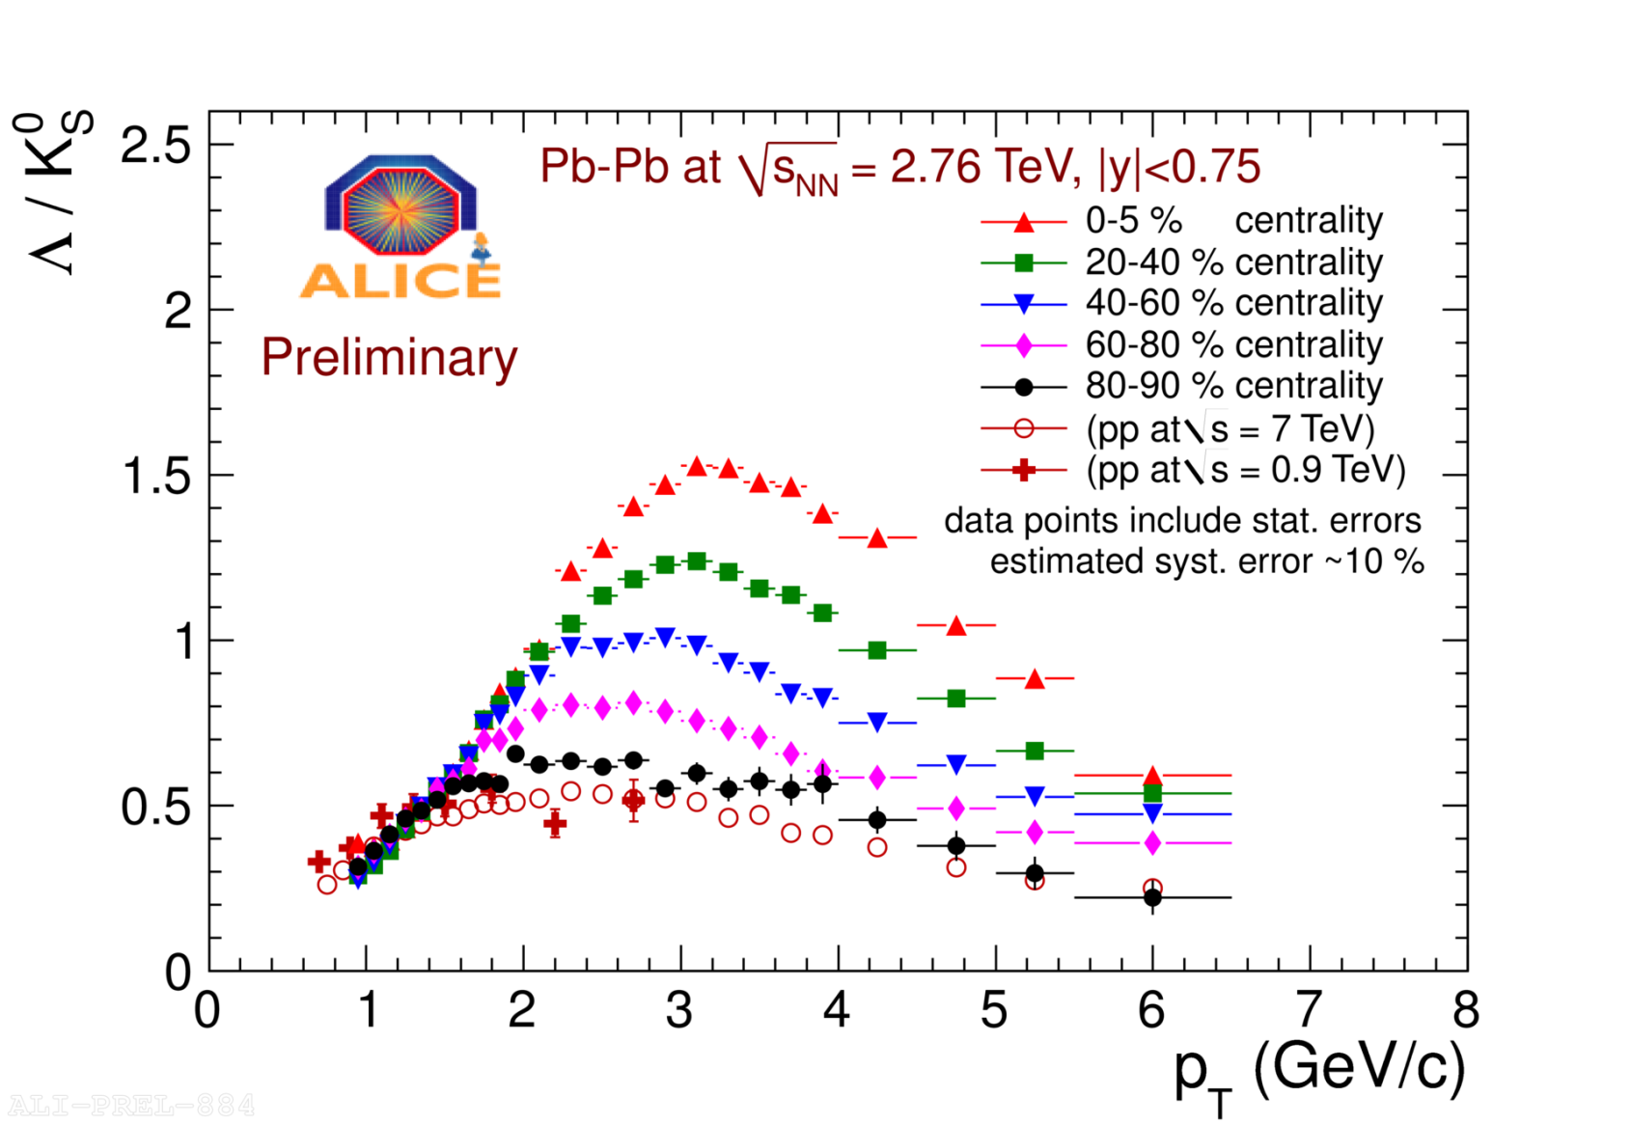
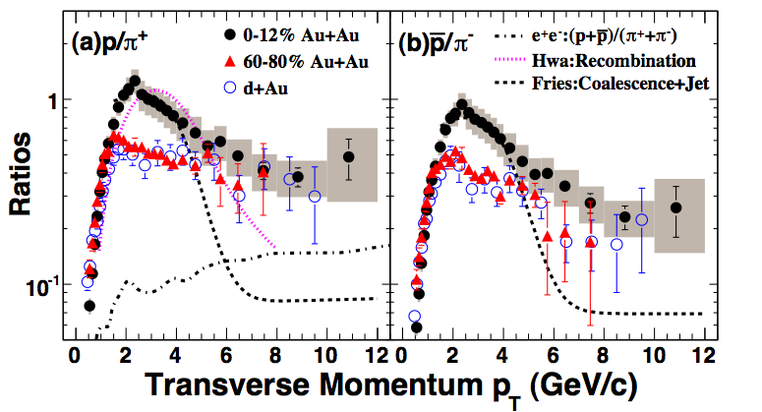
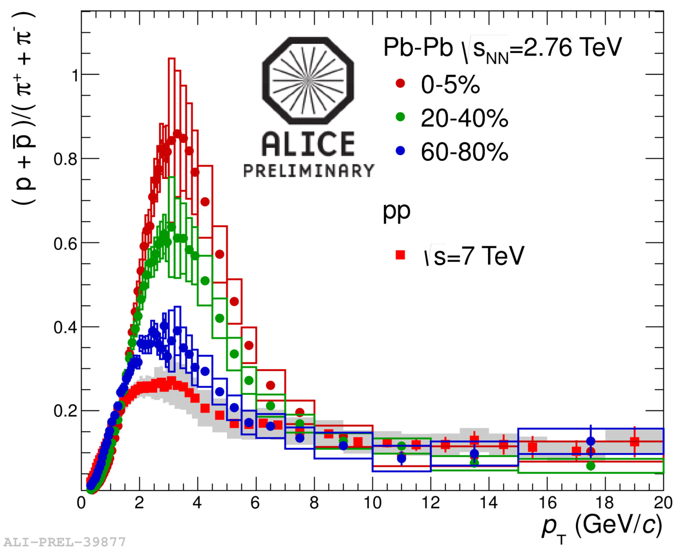
Heavy-ion collisions
B/M ratio at p_{T} ≈ 2–3 GeV/c in central heavy-ion collisions is ~ 2–3 times higher
than that in pp; at p_{T} above ~ 7–10 GeV/c back to the “normal” pp value

Slide 7
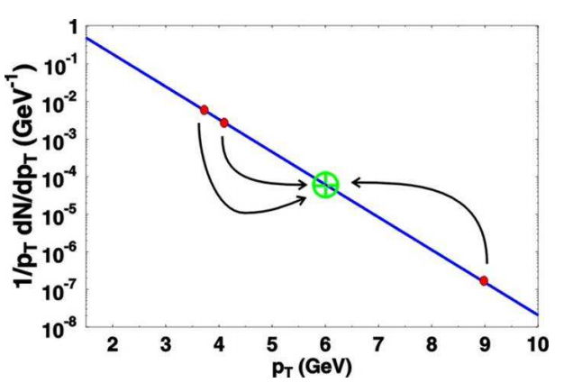
Recombination – coalescence
Up to some (intermediate) p_{T} [< O(10 GeV)] recombination will be favourable compared to fragmentation
This is even more true for baryons
Recombination explains the
enhancement of baryons, i.e.
baryon anomaly
However, colour de-correlation
can enhance baryons even
further, in the region where it is
dominant production process
This is plausible for heavy-ion
collisions, contrary to h–h, where
in string fragmentation colours are naturally adjusted (i.e. correlated)
M
B
R.C.Hwa, C.B.Yang Phys. Rev. C67 064902, 2003
R.J.Fries et al., Phys. Rev. Lett. 90 202303; Phys. Rev. C68 044902

Slide 8



Baryon to meson from QGP
In previous study, when di-quark was created, we do not consider the possibility that the original quark can meet later another quark suited to be in di-quark combination and at the same time not to form a baryon
  di-quark was assumed to be a well-bounded state
  thus only the first di-quark combination was kept and should eventually end up in a baryon
For the recombination from QGP we search for the “closest” colour singlet combination to coalesce, thus we keep track of more than one di-quarks
This assumption favour baryons even more
  baryon-to-meson ratio become
  compared to or
The relative increase of probability for baryons between the two extreme scenaria (“always adapted colours” and “completely random colours”) is 87/41 (≈ 2.122)
$$B:\overline{B}:M=29:29:82$$
$$B:\overline{B}:M=3:3:10$$
$$B:\overline{B}:M=1:1:6$$
G.Matulewicz, K.Safarik 2012, unpublished

Slide 9
Simple model
In our simple model at each step, when comes a quark with an unsuitable colour, we consider with some probability p_{g} (so called “gluon probability”) that the colour is adjusted to the suitable one, by some sort of soft gluon emission
  thus for p_{g} = 0 and p_{g} = 1 the two
  extreme cases are recovered
In order to calculate the final baryon-to-
meson ratio we assign to quarks flavour
(s quark being suppressed by factor 0.3)
Hadrons from lowest (l = 0) multiplets
are constructed with weights according
the number of spin states, and decayed
2-d model assuming thermal distribution
for quark p_{T} is under construction,
utilizing for quark ordering inv. mass
0.6
baryon/meson
0.4
0.2
direct
after decays
0
0
0.2
0.4
0.6
0.8
1
G.Matulewicz, K.Safarik 2012, unpublished
gluon probability

Slide 10
Conclusions
Colour correlations among nearby quarks and antiquarks in QGP can alter the baryon-to-meson ratio, resulting from their recombination, by a factor:
~ 2 (for directly produced particles)
~ 3 (taking into account decays)
Random distribution of colours in QGP favour baryon production
Contrary, when colours are adjusted to form white state with a neighbour, the baryon-to-meson ratio is lowered
Simple model is being prepared to calculate the p_{T}-dependence of baryon-to-meson ratio (and of different particle species) taking into account assumptions about degree of colour correlations in QGP

