Slide 1


Measurement of R_{AA} and v₂ of electrons from heavy flavour decays in Pb-Pb collisions
at √s_{NN} = 2.76 TeV with ALICE
Shingo Sakai for the ALICE collaboration
Lawrence Berkeley National Laboratory

Slide 2
Outline
Introduction
Electron identification
pp results
  Heavy flavour decay electron cross section at √s = 2.76 TeV
  & 7 TeV
Pb-Pb results
  Nuclear modification factor (R_{AA})
  Azimuthal anisotropy (v₂)
Summary

Slide 3
Introduction
collective flow
parton energy loss
=> measurements of transport properties of the medium
Heavy quarks in heavy-ion collisions
  Created in the initial parton-parton scatterings
  Traverse and interact with the hot and dense QCD matter
Nuclear modification factor (R_{AA})
  Sensitive to parton energy loss within the QCD matter
  Sensitive to colour charge and mass dependence
Azimuthal anisotropy in non-central collisions
  Sensitive to parton-QCD matter interactions and thermalization

Slide 4
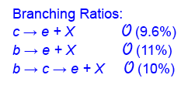
Heavy flavour study via electrons
Signal Electrons:
  From semileptonic decay of charm & beauty hadrons
Background Electrons:
  From photon conversions
  From Dalitz decays of neutral mesons
  From quarkonia decays
Background subtraction
  A cocktail method
    Background calculated using measured hadron production cross section
  Invariant mass method – electrons from ‘photonic’ sources
    Reconstruction of electron pairs from the decays of neutral mesons & photon conversions
  Heavy Flavour decay Electrons (HFE) dN/dp_{T} obtained via subtraction of the background from the inclusive electron spectrum

Slide 5
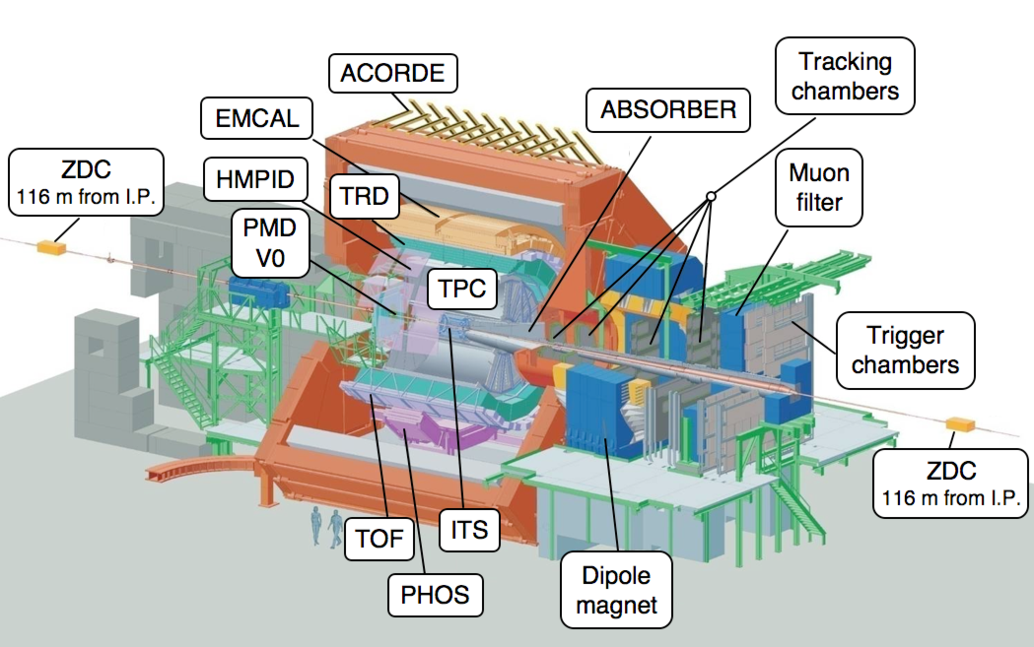
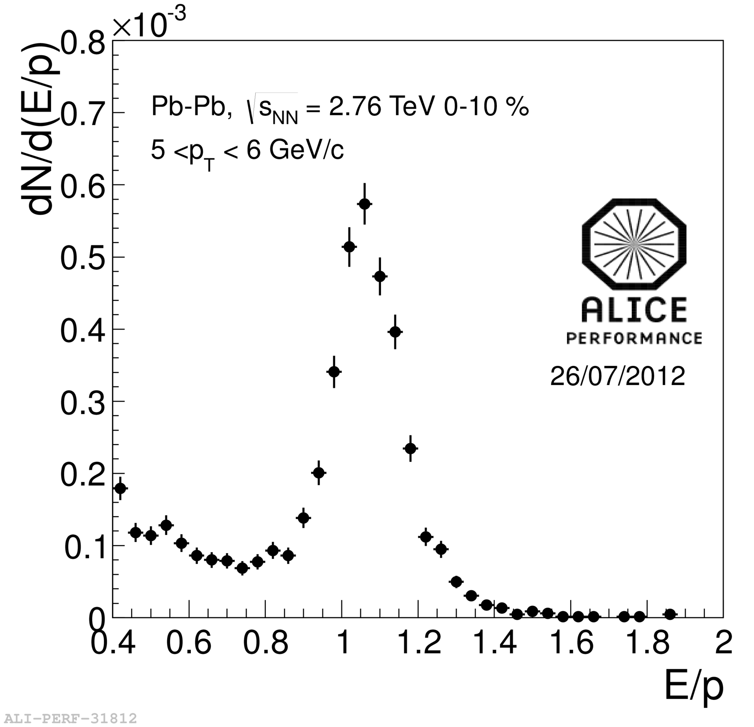
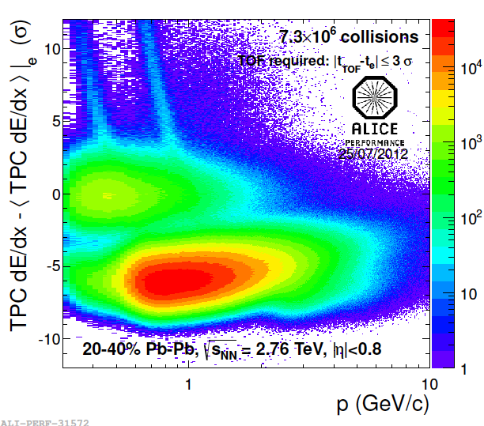
Electron identification in ALICE
TPC + EMCal (dE/dx+E/p)
Pb-Pb
TPC --- measures dE/dx
TOF --- measures time of flight
TRD --- measures transition radiation
(only in pp collisions now)
EMCal --- measures energy
  trigger (single shower)
ITS --- reconstruct photon conversions
charm & beauty separation with
impact parameter (done in pp for now)
TPC +TOF (dE/dx+TOF)
Pb-Pb

Slide 6
pp results
Heavy flavour decay electron cross section at
√s = 2.76 TeV & 7 TeV
  7 TeV : L_{int} = 2.6 nb⁻¹ (MB), arXiv : 1205.5423
  2.76 TeV : L_{int} = 0.5 nb⁻¹ (MB) , L_{int} = 11.9 nb⁻¹ (EMCal trigger)
Cross section of beauty decay electron at
√s = 2.76 TeV & 7 TeV
  7 TeV : L_{int} = 2.2 nb⁻¹ (MB)
  2.76 TeV : L_{int} = 0,5 nb⁻¹ (MB), L_{int} = 11.9 nb⁻¹ (EMCal trigger)
  See posters : B. Hicks, D. Thomas, M. Kweon
* MB : minimum-bias trigger

Slide 7
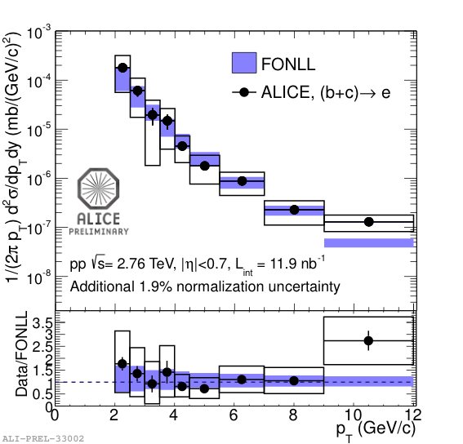
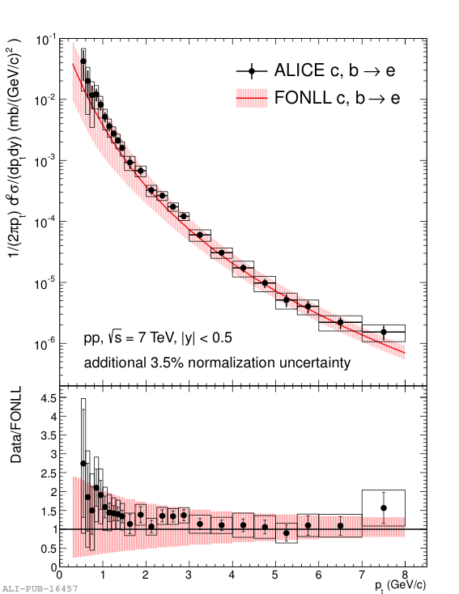
HFE production cross section in pp collisions at √s = 2.76 and 7 TeV
Poster ; B. Hicks (2.76 TeV HFE cross section)
arXiv : 1205.5423
Well described by FONLL pQCD
calculations (M. Cacciari et al. arXiv:1205.6344)
7 TeV measurement is scaled to 2.76 TeV and used as R_{AA} reference

Slide 8
Pb-Pb results
HFE R_{AA}
  Centrality 0-10 %
    17 M events (MB) & 0.7 M events (EMCAL trigger)
    3 < p_{T} < 18 GeV/c , |η| < 0.6
  Background estimate : Invariant mass method
HFE v₂
  Centrality 20-40 %
    3M (2010) + 8.5 M (2011) events (MB) & 1.3 M events (EMCAL trigger)
    1.5 < p_{T} < 13 GeV/c, |η| < 0.7
  Background estimate : Cocktail method
Centrality & Event Plane determination
  VZERO (2.8<η<5.1, -3.7<η<-1.7) scintillators signal amplitude

Slide 9
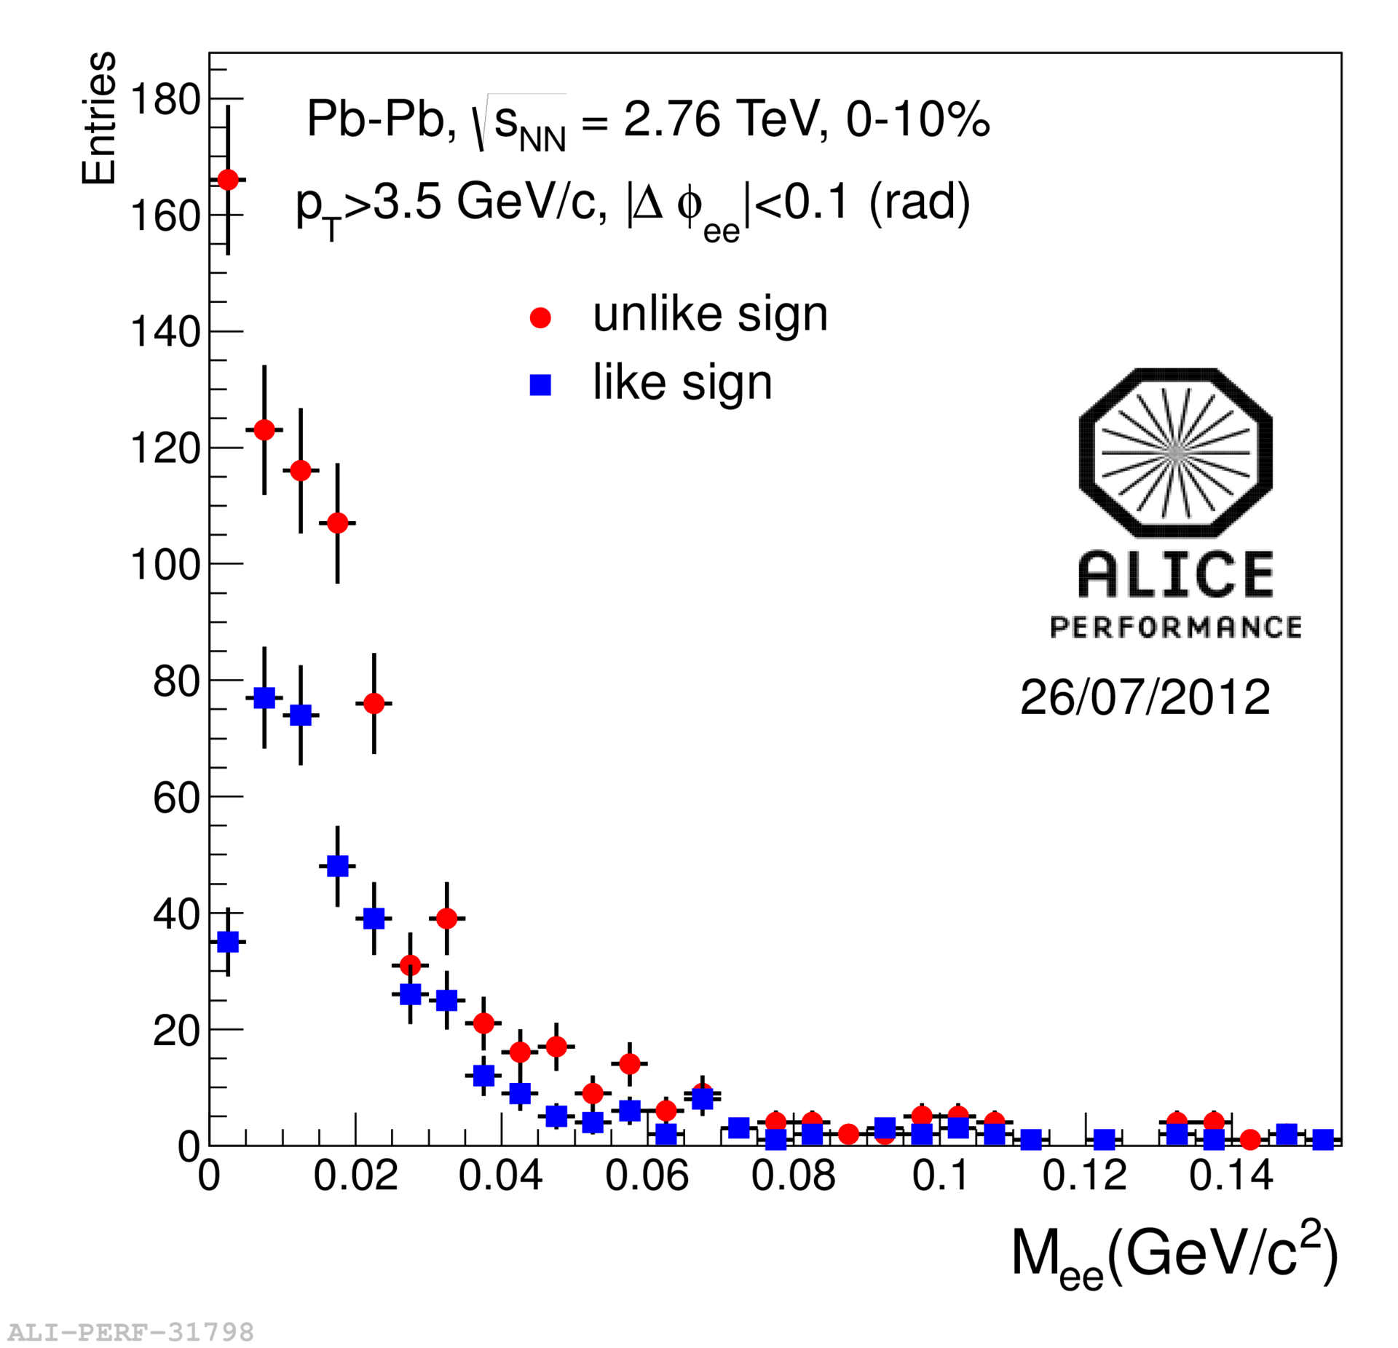
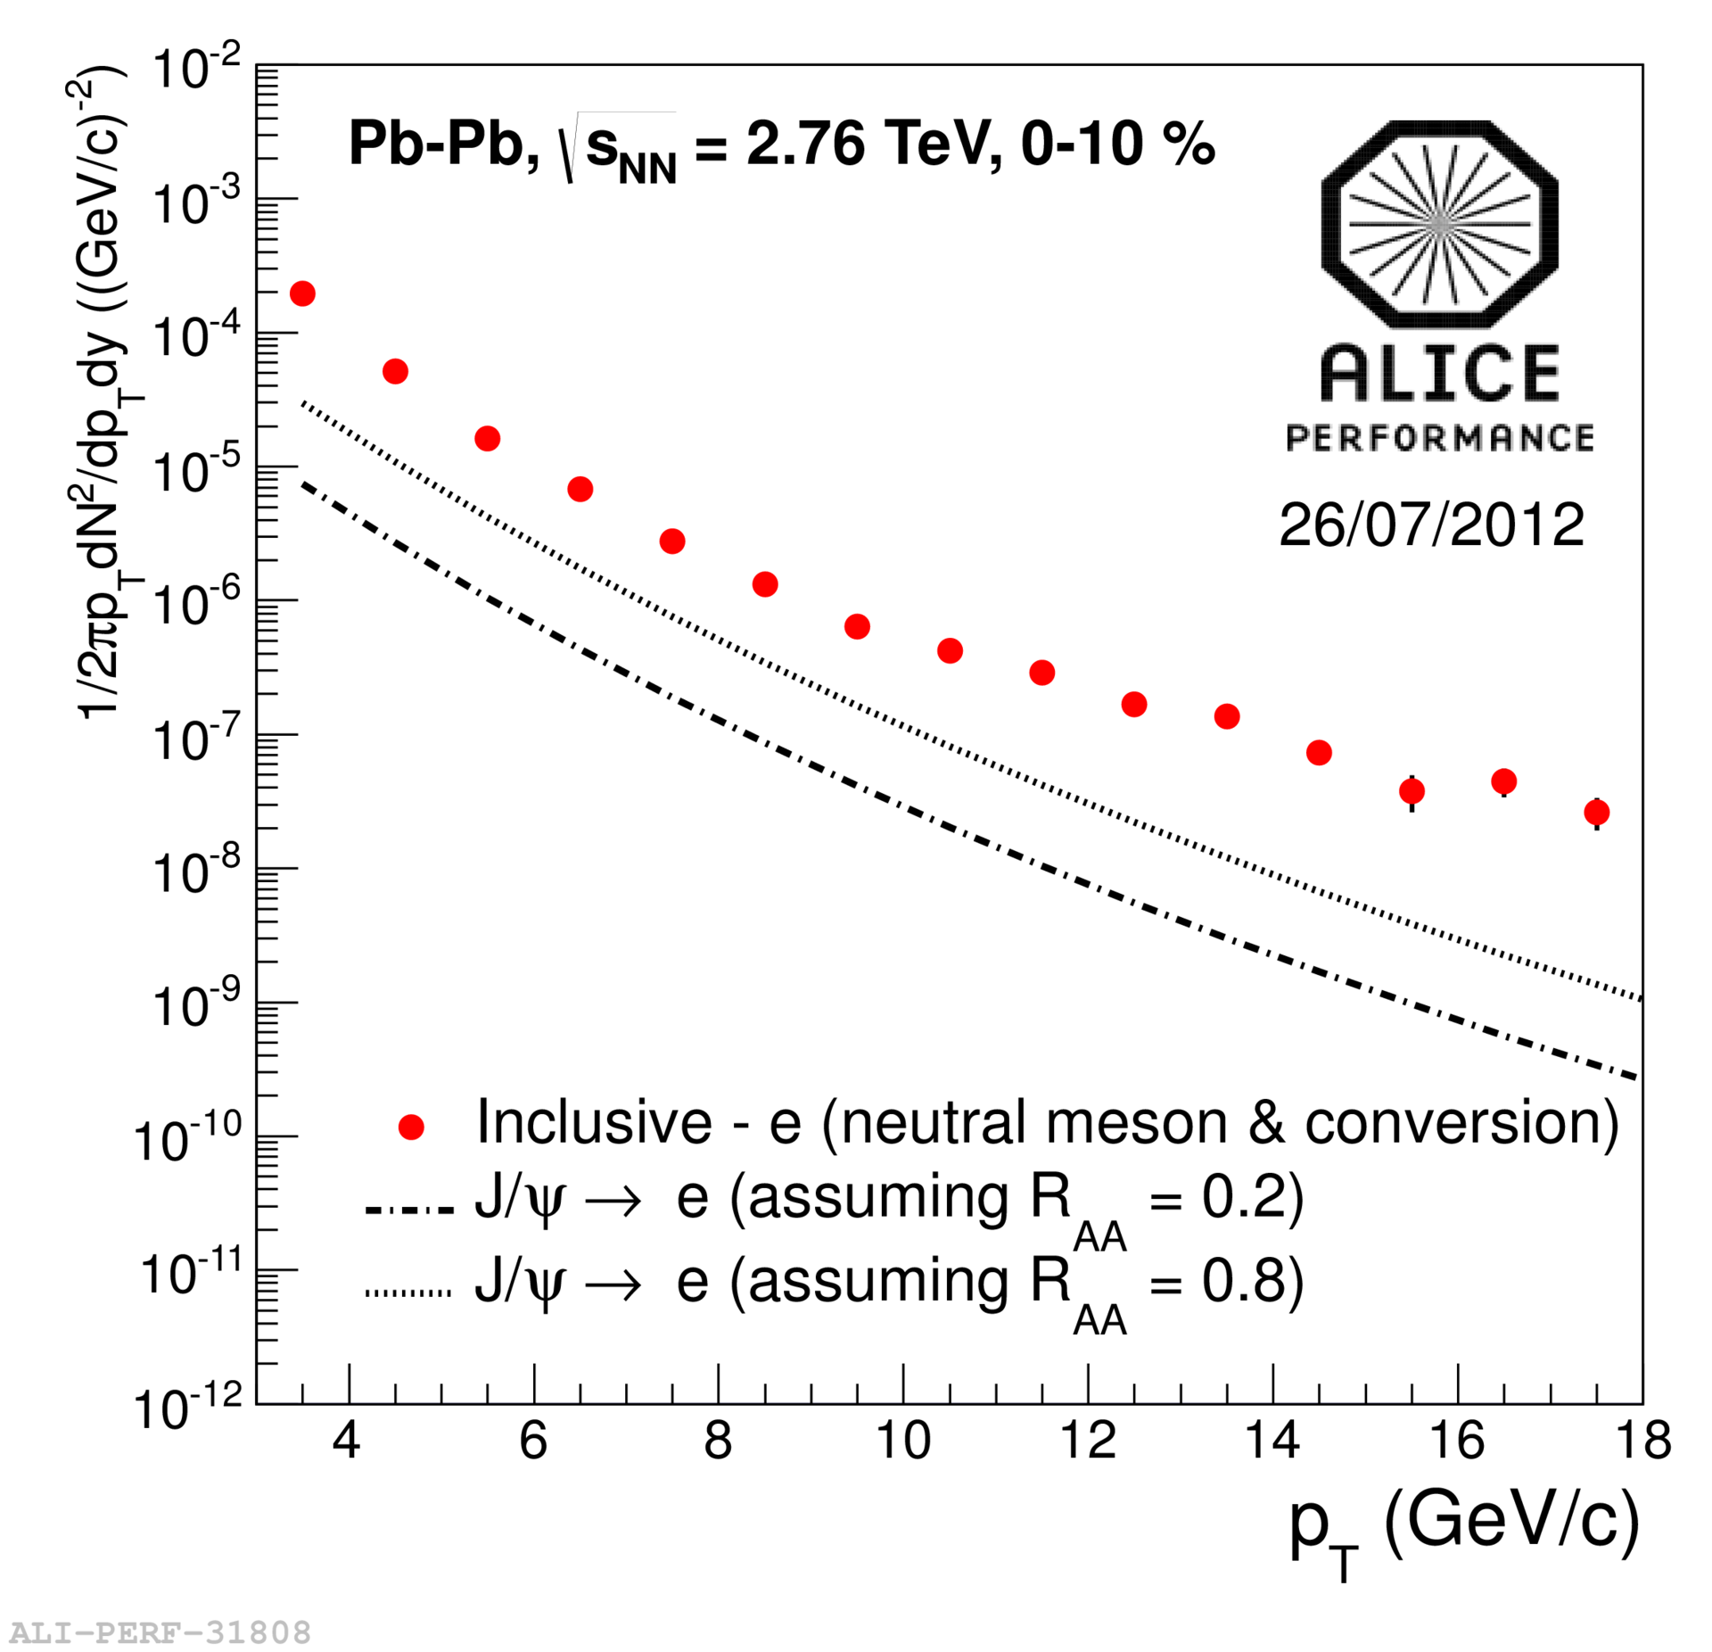
Background electrons in 0-10% central
Pb-Pb collisions at √s_{NN} = 2.76 TeV
‘Photonic’ background electrons: mainly π⁰, Dalitz decays & photons
  Estimated via the invariant mass reconstruction : unlike – like sign
  Efficiency estimated by MC
  Inclusive/photonic : ~ 6
Subtract dominant remaining background: electrons from J/ψdecays
J/ψ input ; ALICE PLB 704:442-455, CMS EPJ C71:1575 (pp 7 TeV -> 2.76 TeV)

Slide 10
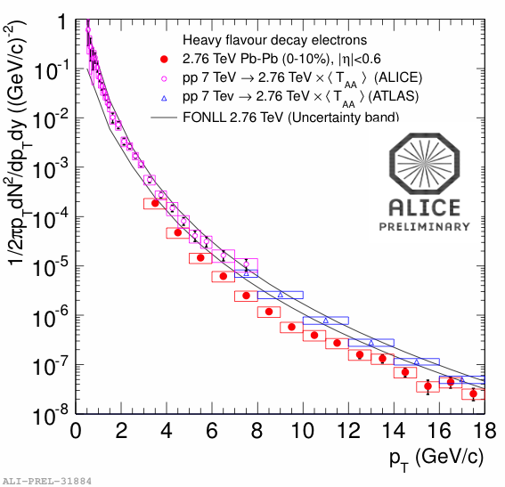
HFE dN/dp_{T} in 0-10% central Pb-Pb collisions at √s_{NN} = 2.76 TeV
HFE dN/dp_{T} in Pb-Pb and
pp references (<T_{AA}> scaled):
  HFE pp 7 TeV:
  ALICE & ATLAS
  => Scaled to 2.76 TeV
  (arXiv 1107.3243)
  FONLL calculation :
  M. Cacciari et al.
  JHEP 0103 (2001) 006
Good description of ALICE/ATLAS
scaled cross section by FONLL
ATLAS PLB 707:438-45
Notes:
M.~Cacciari, M.~Greco and P.~Nason, JHEP {\bf 0103} (2001) 006

Slide 11
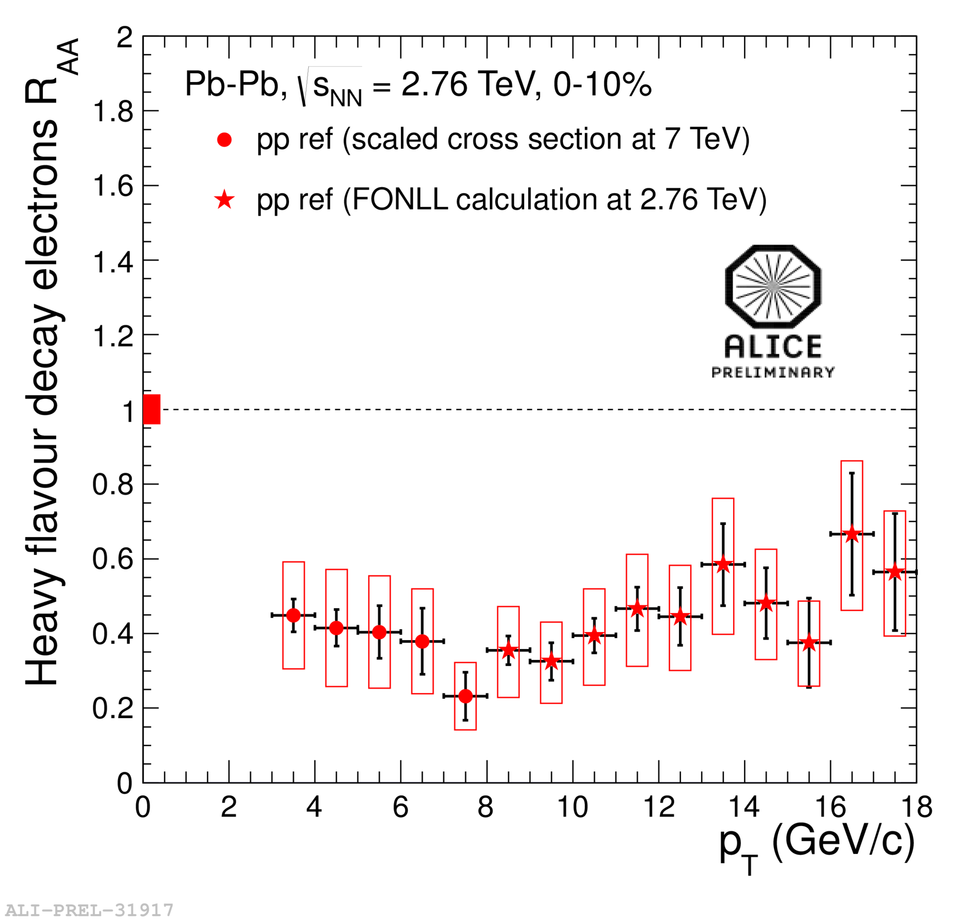
HFE R_{AA} in 0-10% central Pb-Pb collisions at √s_{NN} = 2.76 TeV
T_{AA} : the nuclear thickness function
pp references used:
p_{T} < 8 GeV/c :
  ALICE 7 TeV (scaled to 2.76 TeV)
p_{T} > 8 GeV/c :
  FONLL calculation for 2.76 TeV
Clear suppression of
heavy flavour decay electrons
w.r.t. scaled pp references
up to p_{T} = 18 GeV/c

Slide 12
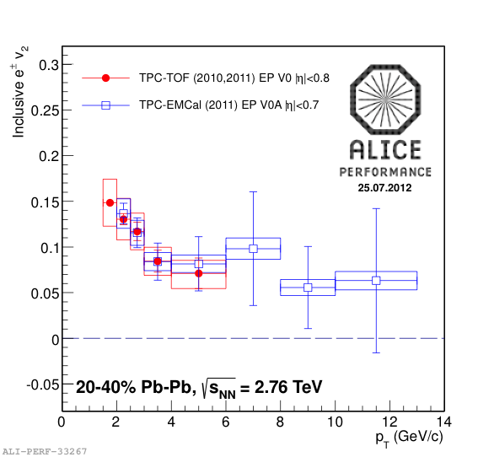
Azimuthal anisotropy of electrons
Two complementary
Analysises :
TPC+TOF
TPC+EMCal
Poster ;
- Moreira de Godoy
(TPC+EMCAL)
T. Rascanu
(TPC+TOF)
Elliptic flow (v₂) ; dN/d(φ-ψ) = N (1 + 2v₂^{obs}cos(2(φ-ψ_{EP})))
Event plane determined with the VZERO detectors (2.8<η<5.1, -3.7<η<-1.7)
HFE v₂ obtained by subtraction of the background electron v₂:

Slide 13
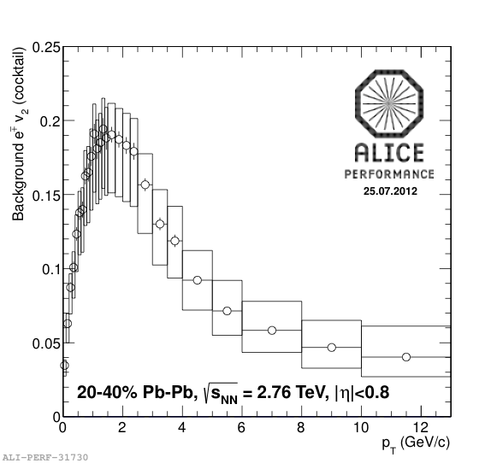
Background electron v₂ – cocktail method
Poster ; T. Rascanu
Background v₂ : decay electrons from neutral meson & converted photons;
  calculated from parent v₂ and p_{T} spectrum
  Assume : π⁰ = π⁺(talk: F.Noferini), m_{T} scaling for η , direct γ v₂ = 0

Slide 14
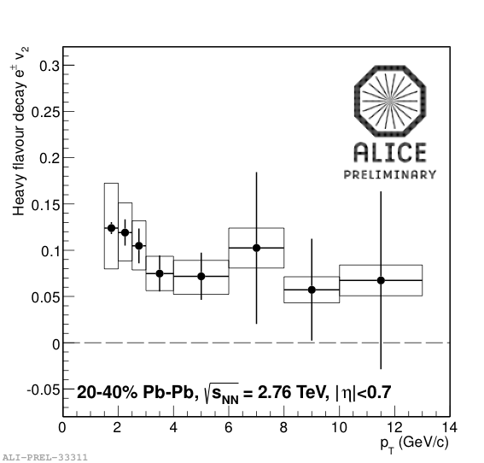
Heavy flavour decay electron v₂
Poster ; Moreira de Godoy, T. Rascanu
Heavy flavour decay electron v₂ after subtracting background electron v₂
Combined result from
TOF+TPC & TPC+EMCal
measurements
HFE v₂ > 0 observed in
20-40 % centrality class
  > 3σin 2 < p_{T} < 3 GeV/c

Slide 15
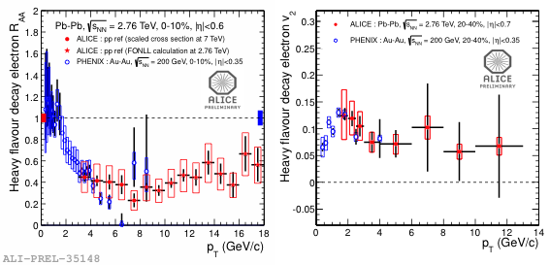
Comparison with 200 GeV Au-Au collisions at RHIC (PHENIX |y|<0.35)
Magnitude of R_{AA} (3<p_{T}<9 GeV/c) and v₂ (1.5<p_{T}<4 GeV/c)
comparable at the two energies
PHENIX; PRC84, 044905

Slide 16
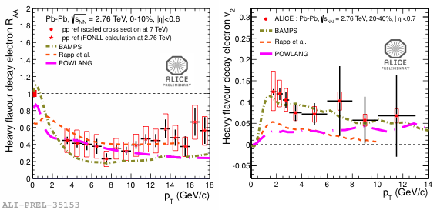
Comparison with models
BAMPS⁽¹⁾ model : HQ transport with collisional energy loss in expanding QGP
  Seems to underpredict HFE R_{AA} , consistent with HFE v₂
Rapp⁽²⁾ : heavy quarks transport with in-medium resonance scattering and coalescence
  Consistent with HFE R_{AA}, seems to underestimate HFE v₂
POWLANG⁽³⁾ : Heavy quark transport (Langevin eq.) with collisional energy loss
  Seems to underpredict HFE R_{AA} and to underestimate HFE v₂ at high p_{T}
(1) J. Uphoff et al. arXiv 1205.4945 (2)R. Rapp et al. arXiv 1208.0256 (3)A. Beraudo et al J.Phys.G G38 124144
Notes:
J. Uphoff et al. arXiv 1205.4945

Slide 17
Summary
Strong suppression of the HFE yield up to
18 GeV/c in 0-10% most central events (R_{AA} ~ 0.4)
    Clear indication for substantial energy loss of heavy quarks in the hot and dense medium
Non-zero HFE v₂ observed in 20-40% central events:
    Suggests strong re-interactions within the medium
Outlook
  Beauty decay electrons separated in pp
    Ongoing analysis for Pb-Pb
  Address mass dependence of energy loss and flow

Slide 18
BackUp

Slide 19
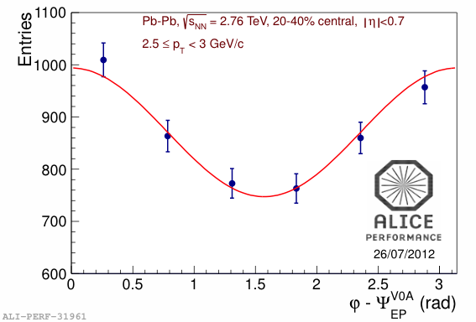
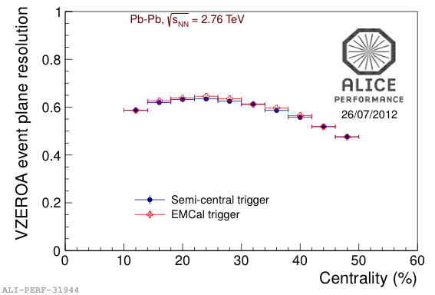
Electron v₂ measurement
v₂ is obtained with reaction plane method
Used V0 detector to determine the plane
  reduce non-flow effect
19
Poster ; D. Godoy & T. Rascanu

Slide 20
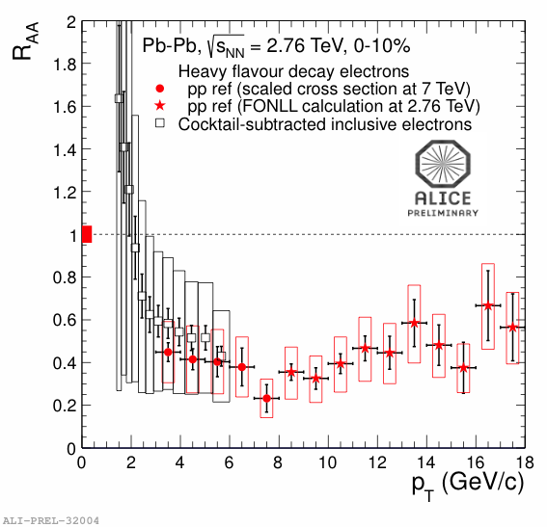
R_{AA} with TOF+TPC (2010)

Slide 21
Charm & Beauty Energy Loss
Theoretical prediction : R_{AA}^{charm} < R_{AA}^{beauty}
See e.g. “Last call for LHC predictions” arXiv:0711.0974
  Radiative energy loss (dead cone effect)
  Collisional dissociation
  Large elastic scattering cross section associated with
  resonance states of D & B mesons in QGP

Slide 22
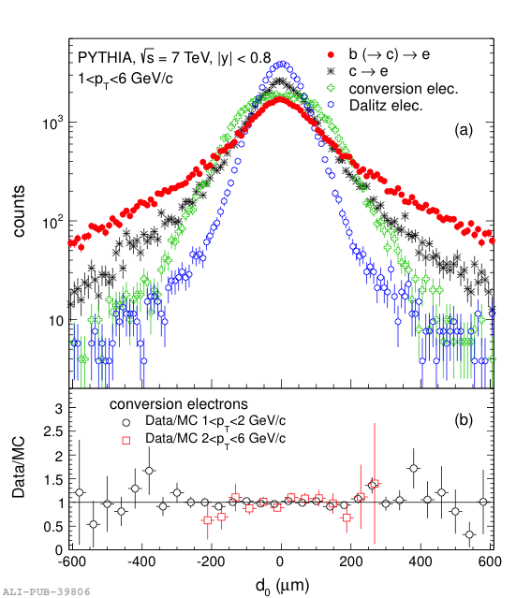
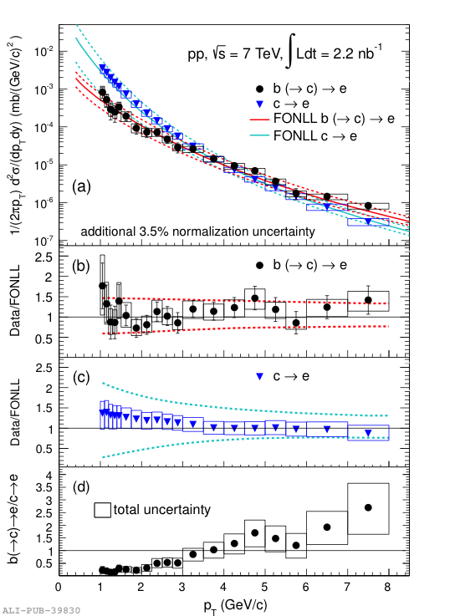
Beauty and charm separation in pp collisions at √s = 7 TeV
Poster ; M. Kweon
arXiv : 1208.1902
Separation based on displacement from primary vertex
  ITS ; impact parameter resolution <75 μm for p_{T}>1 GeV/c
Cross sections well described by FONLL calculation

Slide 23
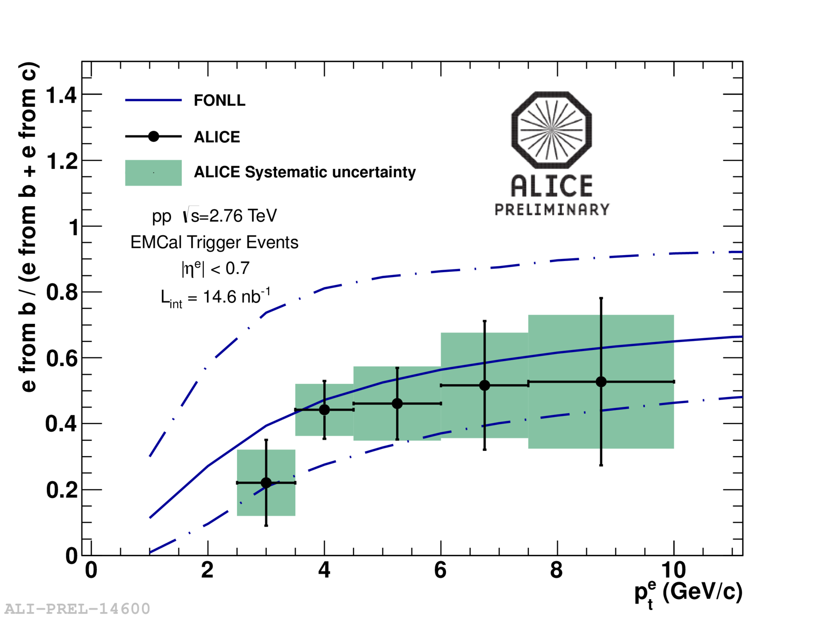
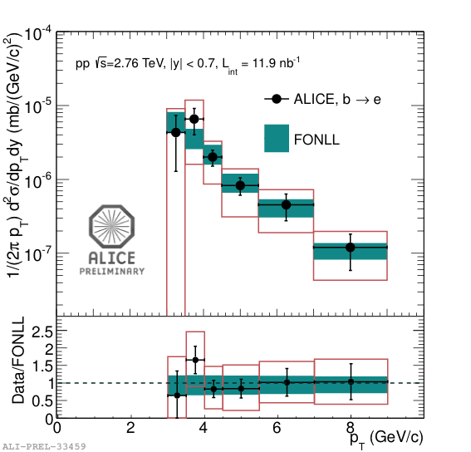
B-decay electrons in pp collisions at
√s = 2.76 TeV
Poster ; B. Hicks (2.76 TeV HFE cross section) & D. Thomas (e-h correlation)
Beauty fraction measured via azimuthal correlations
and comparison to PYTHIA templates
Measurement consistent with FONLL calculation

