Slide 1
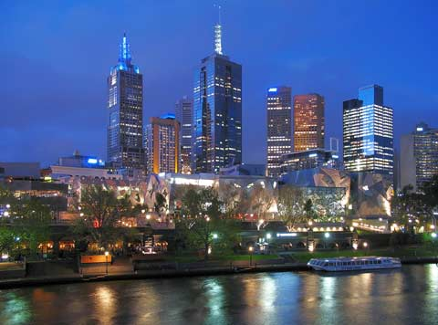

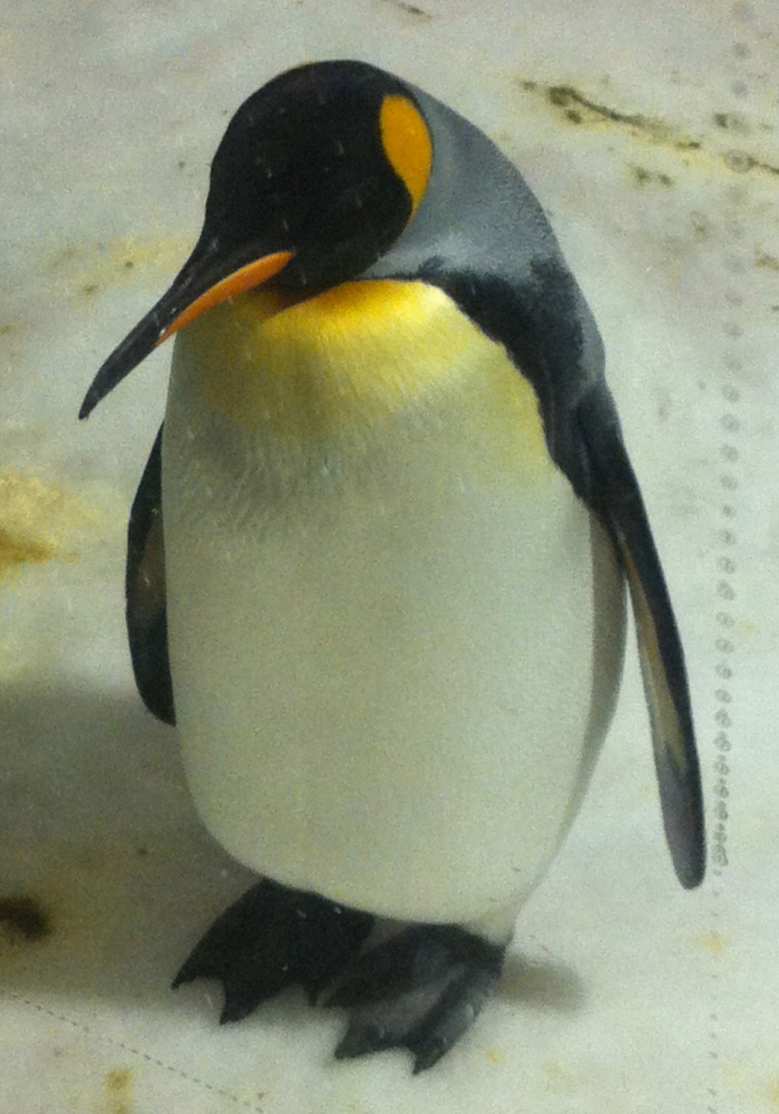

B→X_{s}γ and
B→X_{s}l⁺l⁻
at BABAR
G. Eigen, University of Bergen
representing the BABAR collaboration
G. Eigen, ICHEP12 Melbourne, 13/07/2012

Slide 2
New BABAR Results in 2012
Study of B→X_{s+d}γ with 347 fb⁻¹ using a fully inclusive method
  γ energy spectrum and γ energy moments
  CP asymmetry
Study of B→X_{s}γ with 424 fb⁻¹ using a sum of exclusive modes
  γ energy spectrum
Rate analysis of B→K l⁺l⁻ and B→K* l⁺l⁻ modes with 424 fb⁻¹
  Branching fractions
  Isospin asymmetries
  CP asymmetries and Lepton flavor ratios
Angular analyses of B→K* l⁺l⁻ with 424 fb⁻¹
  K* longitudinal polarization
  Lepton forward-backward asymmetries
Search for lepton-number violating processes in B⁺→K⁺ l⁺l⁻ (S. Robertsen)
BABAR: arXiv:1204.3933 (2012)
BABAR: arXiv:1202.3650 (2012)
G. Eigen, ICHEP12 Melbourne, 13/07/2012

Slide 3
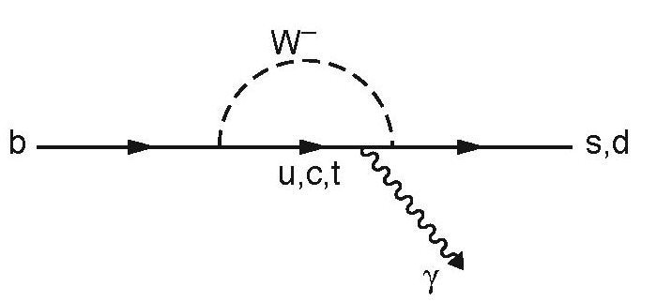
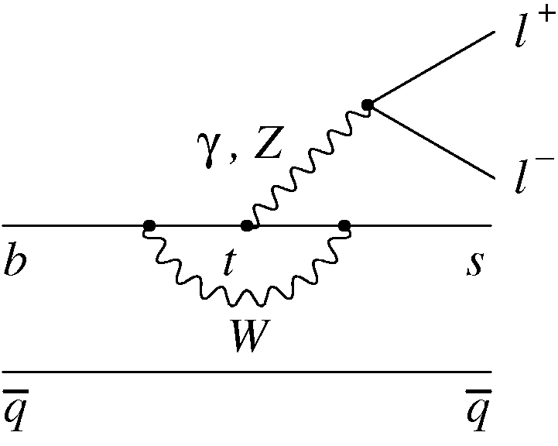
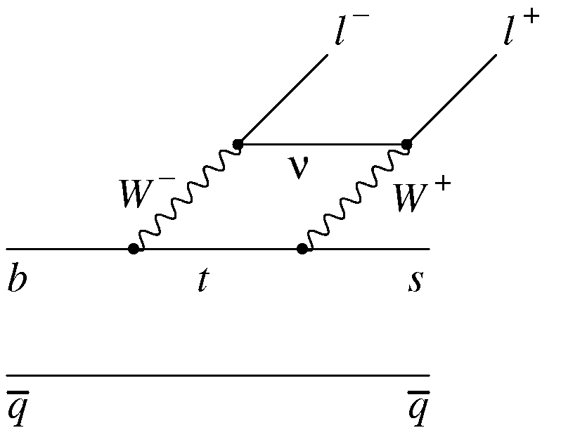
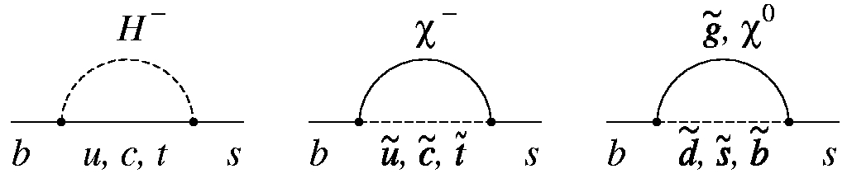
Introduction
B→X_{s}γ & B→K^{(*)} l⁺l⁻ are flavor-changing neutral current
(FCNC) processes, forbidden in SM at tree level
Effective Hamiltonian factorizes short-distance
from long-distance effects [O(α_{S})]
3 effective Wilson coefficients contribute
  C₇^{eff} from EM penguin diagram
  |C₇^{eff}| ≈ 0.33 from B(B→X_{s}γ)
  C₉^{eff} from vector part of electroweak diagrams
  C₁₀^{eff} from axial-vector part of EW diagrams
New Physics adds new loops with new particles
➔ modifies SM values values of C₇^{eff}, C₉^{eff}, C₁₀^{eff}
➔ introduces new coefficients C_{S} and C_{P}
Need to measure many observables
to extract complex Wilson coefficients
Probe here New Physics at a scale of a few TeV
G. Eigen, ICHEP12 Melbourne, 13/07/2012

Slide 4
B→X_{s}γ Analyses
B →X_{s}γ is largest EM FCNC loop process
The SM prediction at NNLL (4 loop) is
The shape of the photon energy spectrum is important for determining
the b quark momentum distribution
The shape function is similar to that in B→X_{u}lν and thus helps in
determining |V_{ub}|
In the kinetic scheme, measure m_{b}, energy moments, and HQET
parameter μ_{π}² (kinetic energy of b quark)
The B →X_{s+d}γ CP asymmetry is sensitive for new physics processes
BABAR updates results on
  fully inclusive analysis (383±4)x10⁶ BB events
  semi inclusive modes (471±1)x10⁶ BB events
Misiak et al., PRL98, 022002 (2007)
G. Eigen, ICHEP12 Melbourne, 13/07/2012

Slide 5
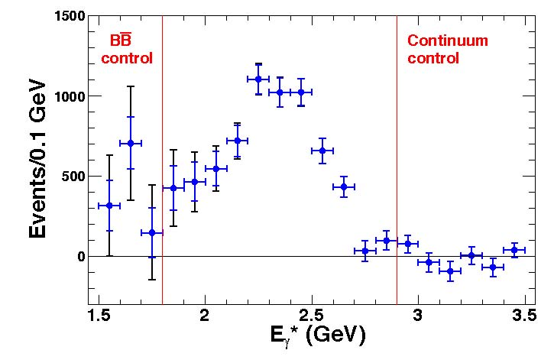

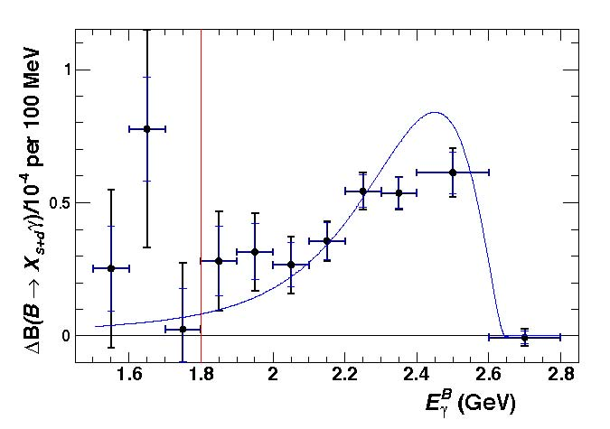
Inclusive B→X_{s}γ: E_{γ} Spectrum
Measured background
subtracted E_{γ} spectrum
Tag recoiling B via Xe±ν or Xμ±ν decay to
suppress continuum background
Use optimized π⁰ and η vetoes, E_{miss},
and 2 neural networks (for e, μ each)
based on event shape variables
Signal efficiency is ε_{s} ~2.5% compared to
ε_{continuum}=0.0005% and ε_{BB}=0.013%
Estimate remaining continuum background
from qq continuum sample
From measured E_{γ} spectrum yield branching
fraction after correcting for calorimeter
resolution, Doppler smearing and ε_{signal}
Partial branching fraction
HFAG
Kinetic model with HFAG averages
G. Eigen, ICHEP12 Melbourne, 13/07/2012
HFAG: arXiv:1010.1589v3 (2011)

Slide 6
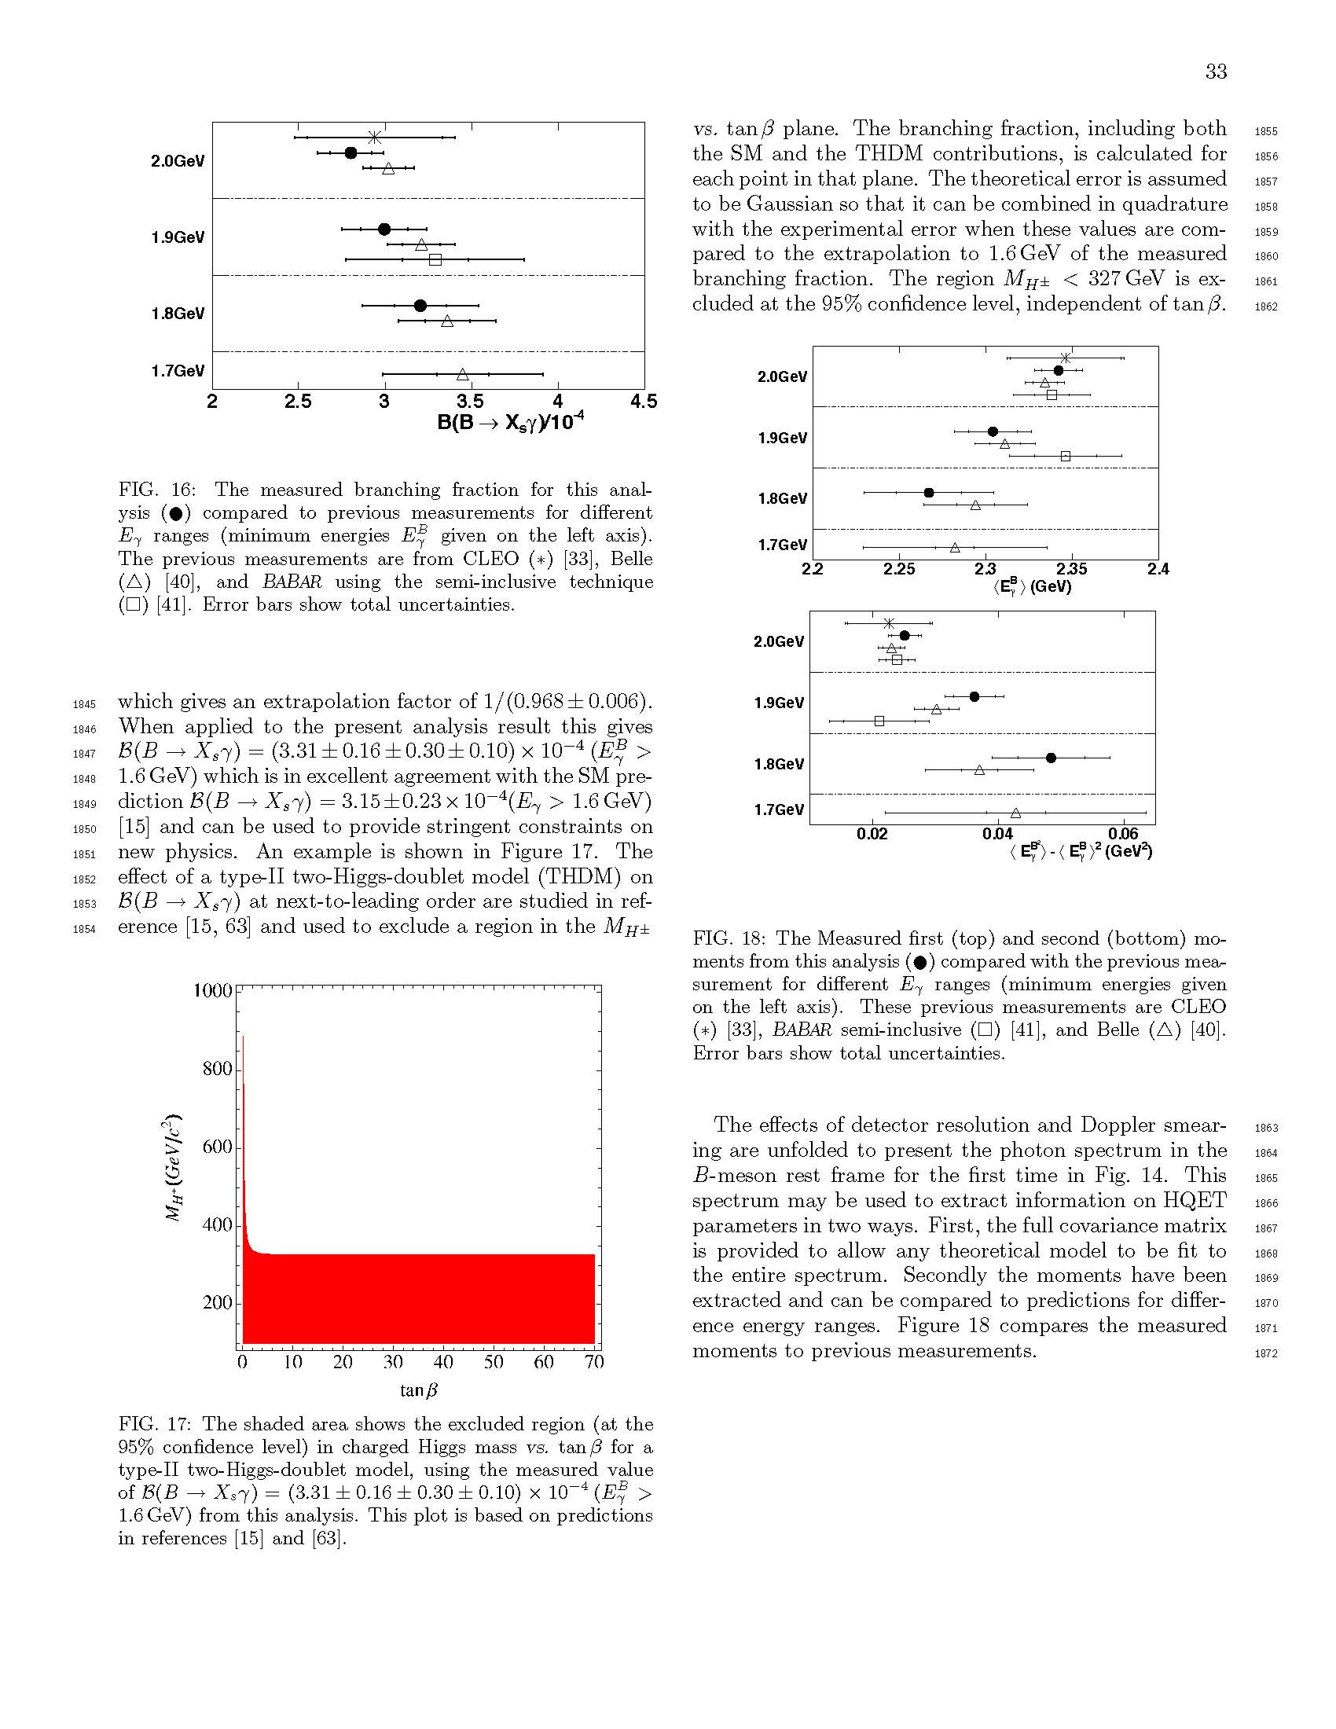
Inclusive B→X_{s}γ: Energy Moments
Total branching fraction from BABAR,
Belle and CLEO for different E_{γ} selection
are in good agreement
Measure energy moments
Energy moments from BABAR, Belle and CLEO
for different E_{γ} selection are consistent
CLEO: PRL 87, 251807 (2001)
Belle: PRL 103, 241801 (2009)
BABAR: PRD 72, 052004 (2005)
•
☐
this analysis
BABAR semi-
inclusive
Belle
CLEO
G. Eigen, ICHEP12 Melbourne, 13/07/2012

Slide 7
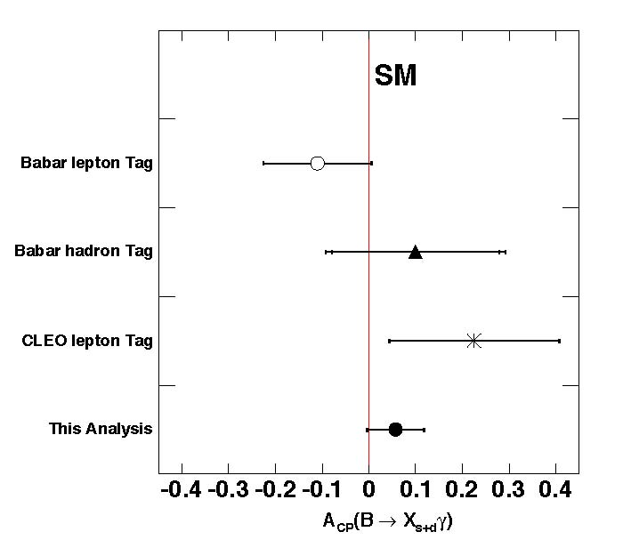
Inclusive B→X_{s}γ: A_{CP} and New Physics
Determine B/B from the tag charge
Define CP asymmetry
Measure A_{CP} after correcting for
charge bias and mistagging
Extrapolate corrected B(B→Xγ) from
E_{γ} > 1.8 GeV to E_{γ} > 1.6 GeV (1.033±0.006)
Use this result to constrain new physics
in type II two-higgs doublet model
m_{H±} < 327 GeV is excluded at 95% CL
independent of tan β
PRL 97, 171803 (2006)
PRD 77, 051103 (2008)
PRL86, 5661 (2001)
HFAG: arXiv:1010.1589v3 (2011)
G. Eigen, ICHEP12 Melbourne, 13/07/2012
Haisch: arXiv:0805.2141 (2008)

Slide 8
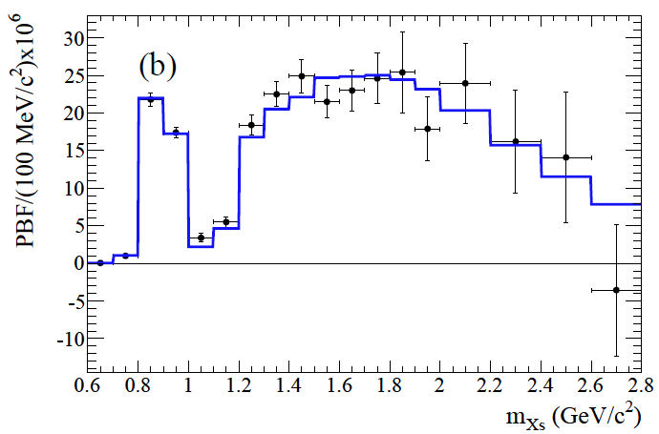
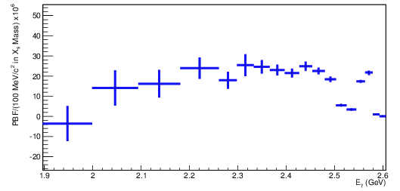
B→X_{s}γ Semi-Inclusive Analysis
Hadronic mass spectrum
Use sum of 38 exclusive X_{s}γ modes
with ≤4π (≤2π⁰), 1(3)K (≤1K⁰_{s}), ≤1η
Measured m_{Xs} is fitted to kinetic
and shape function models
Reconstruct X_{s}➔
Sum of partial branching fractions
in each m_{Xs} bin is summed to
to yield total branching fraction
BABAR
Fit to kinetic model
Benson et al., Nucl.Phys B710, 371 (2005)
Lange et al., Phys Rev D72, 073006 (2005)
World average
Photon energy spectrum
HFAG: arXiv:1010.1589v3 (2011)
G. Eigen, ICHEP12 Melbourne, 13/07/2012

Slide 9
Analysis Methodology for B→K^{(*)} l⁺l⁻
Fully reconstruct 8 B→K^{(*)} l⁺l⁻ final states (471x10⁶ BB)
  K, K⁰_{S}, K±π , or K⁰_{S} π± recoiling against e⁺e⁻ or μ⁺μ⁻
  Select e± with p>0.3 GeV/c; μ± with p > 0.7 GeV/c
  Require good particle ID for e, μ, K, π;
  select K⁰_{S} →π⁺π⁻
Utilize kinematic variables and
Suppress combinatorial BB & qq backgrounds with
8 boosted decision trees
Veto J/ψ and ψ(2S) mass regions and use vetoed samples as controls
samples for various checks
For rate asymmetries do 1D (2D) fits in m_{ES} (m_{K*}) for B→K^{(*)} l⁺l⁻,
for angular analyses fit m_{ES} and 1D angular distributions
Use pseudo experiments to study performance
All analyses are blinded
±
G. Eigen, ICHEP12 Melbourne, 13/07/2012

Slide 10
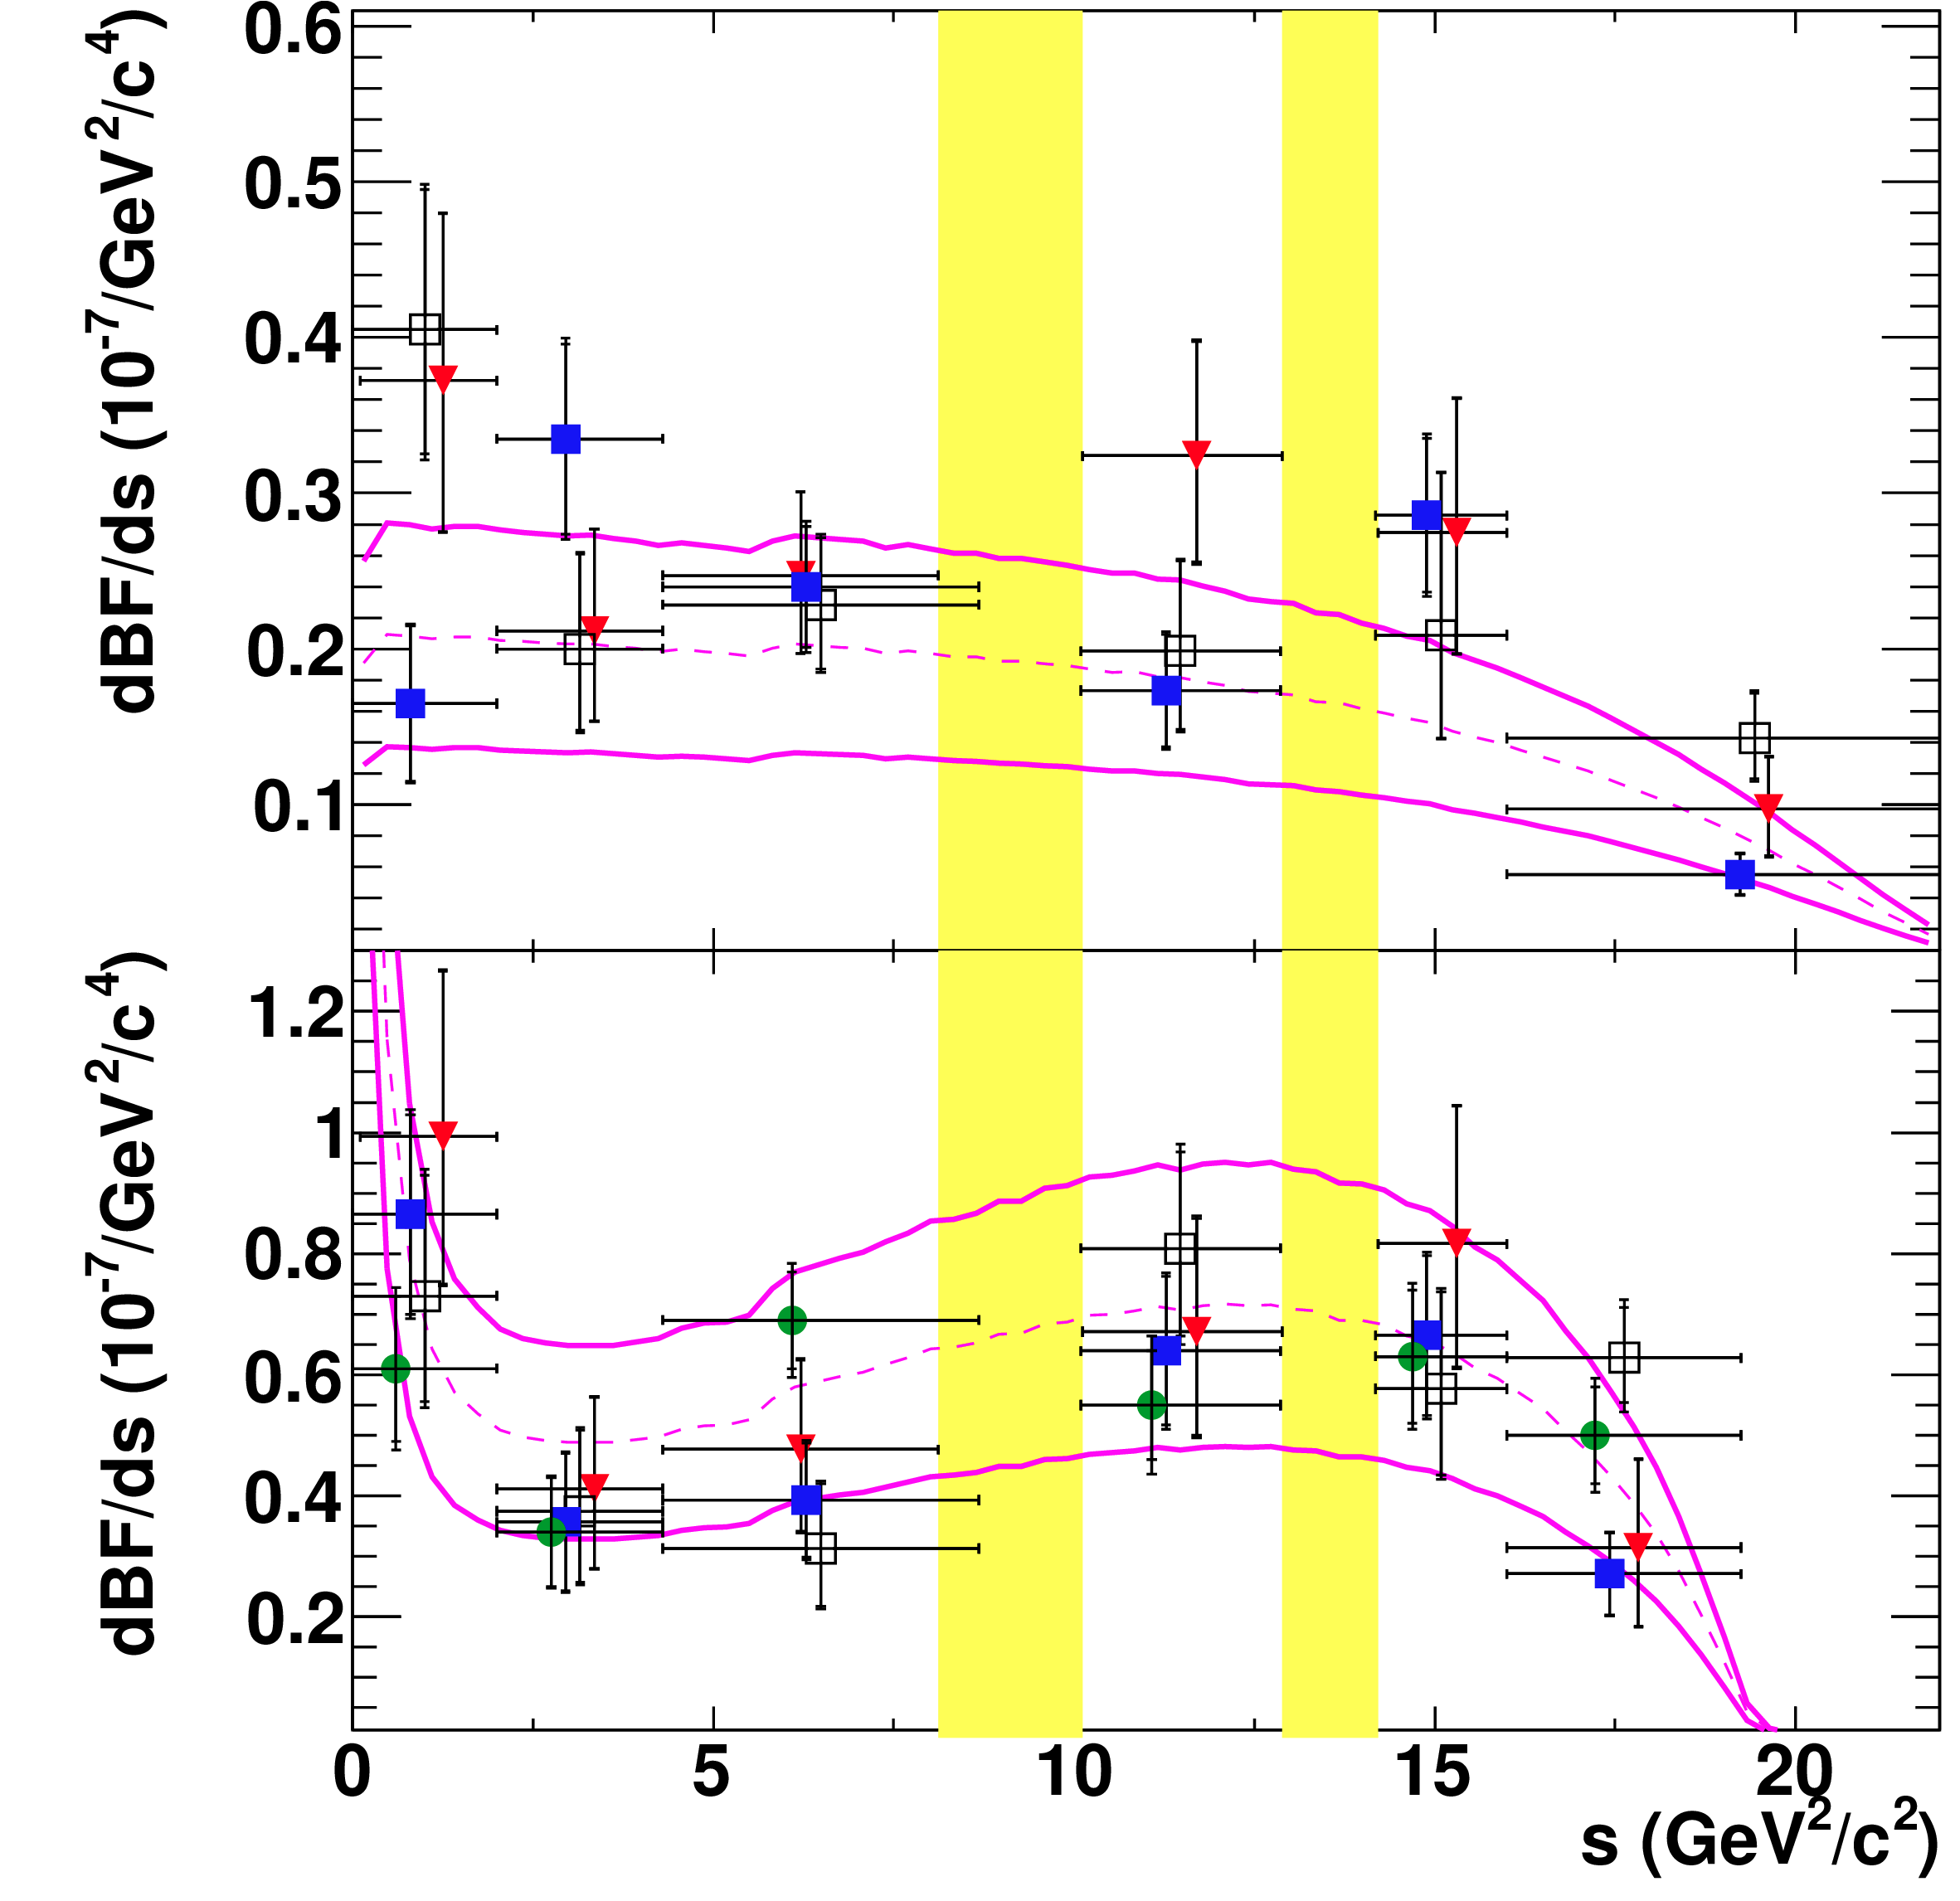
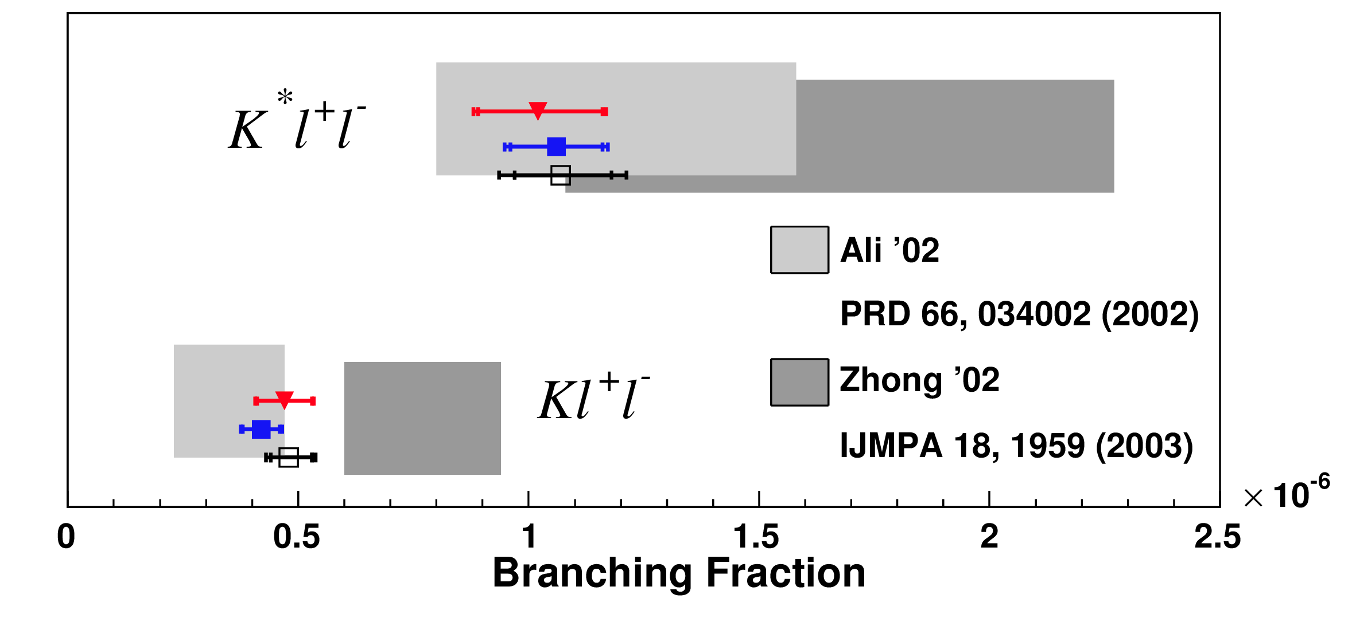
B→K^{(*)} l⁺l⁻ Branching Fractions
BABAR B_{tot} measurements
BABAR total and partial branching fraction measurements are in good agreement with results from Belle, CDF, LHCb, and the SM predictions
dB(B→K l⁺l⁻)/ds
dB(B→K* l⁺l⁻)/ds
SM based prediction
plus uncertainties
(solid line) from
Form factor models *
Ali et al PRD 66, 034002 (2002)
* Ball and Zwicky, PRD 71, 014015 (2005);
ibid 014029 (2005)
G. Eigen, ICHEP12 Melbourne, 13/07/2012

Slide 11
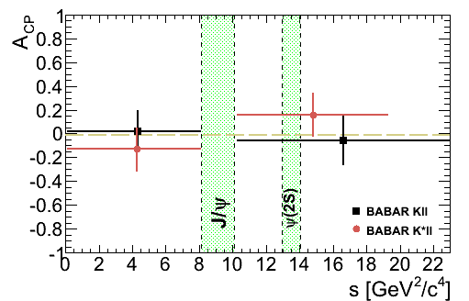
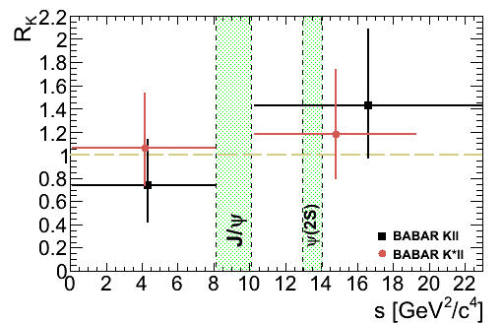




B→K^{(*)} l⁺l⁻ Rate Asymmetries
All A_{CP} results are consistent with
zero ➔agree with small SM value
All s
All R_{K(*)} results are consistent
with unity ➔agree with SM
All s
s ≥ (2*m_{μ})²
BABAR: arXiv:1204.3933 (2012)
Krüger et al., PRD 61, 114028 (2000)
Bobeth et al., JHEP 807,106, (2008)
Ali et al., PRD 61, 074024 (2000)
BABAR: arXiv:1204.3933 (2012)
G. Eigen, ICHEP12 Melbourne, 13/07/2012
c/f Belle: PRL 103, 171801 (2009)

Slide 12
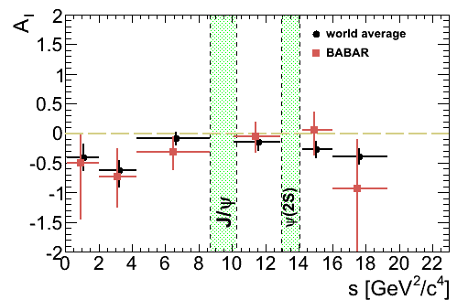
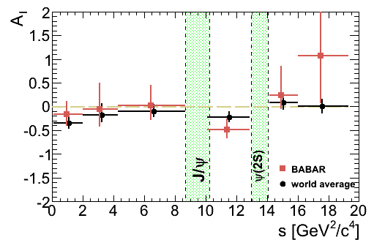
B→K^{(*)} l⁺l⁻ Isospin Asymmetry
BABAR: arXiv:1204.3933 (2012)
Kll
In the SM, A_{I} is expected at O(+1%)
Below J/ψ(0.1<s<8.12 GeV²/c⁴)
BABAR measures:
This is consistent with the SM
at the 2.1σ and 1.2σ levels
WA confirms low A_{I} at low s
BABAR results agree with
those from Belle and LHCb
Feldmann & Matias JHEP 0301, 074 (2003)
K*ll
➔ WA: new BABAR, Belle, LHCb
BABAR: arXiv::1204.3933 (2012)
Belle: PRL 103, 171801 (2009)
LHCb: arXiv::1205.3422 (2012)
G. Eigen, ICHEP12 Melbourne, 13/07/2012

Slide 13
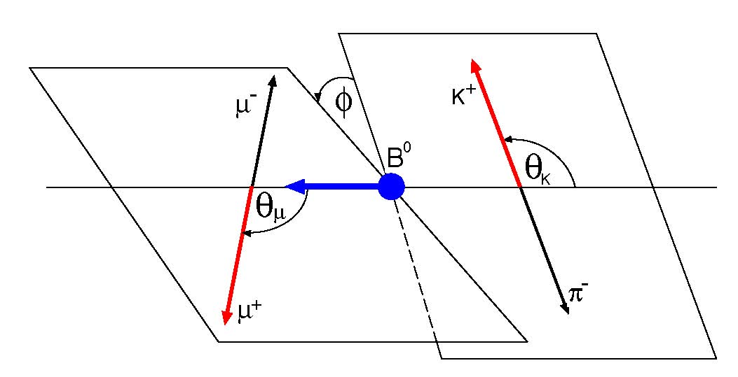
Angular Observables in B→K* l⁺l⁻
Fit to lepton and K angular distributions to extract K* longitudinal
polarization fraction F_{L} and lepton forward-backward asymmetry A_{FB}
F_{L}:
A_{FB}
θ_{K}: angle of K⁺
and B in K*
rest frame
l⁻
θ_{l}: angle of l⁺
and B in l⁺l⁻
rest frame
l⁺
Ali et al., PRD 61, 074024 (2000)
Bobeth et al., JHEP 0712, 040 (2007)
G. Eigen, ICHEP12 Melbourne, 13/07/2012

Slide 14
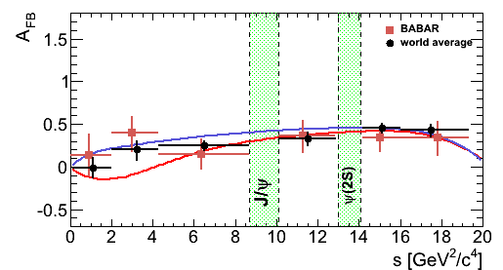
B→K*l⁺l⁻ Forward-Backward Asymmetry A_{FB}
BABAR A_{FB} measurements
in B→K* l⁺l⁻ are the most
precise except for LHCb
results (K^{*0}μ⁺μ⁻)
Results from BABAR, Belle,
CDF and LHCb are in good
agreement
Results are consistent with
the SM, but do not rule out
the C₇=-C₇SM model
In low mass region (1<s<6 GeV²/c²) measure
BABAR:
world average: SM:
C₇=-C₇SM
SM
CDF: Note 10047 (2010)
Belle: PRL 103, 171801 (2009)
LHCb: arXiv:1112.3515 (2012)
➔WA: new BABAR, Belle, CDF, LHCb
Ali et al. PRD 61, 074024 (2000)
Buchalla et al. PRD 63, 014015 (2000)
Ali et al. PRD 66, 034002 (2002)
Krüger et al. PRD 61, 114028 (2002)
Krüger & Matias PRD71, 094009 (2005)
  C. Bobeth et al. JHEP 1007, 098 (2010)

Slide 15
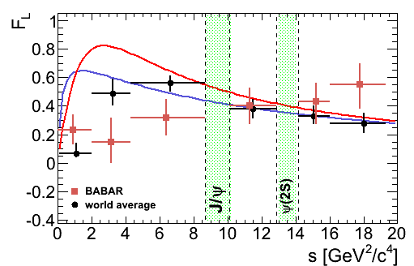
K* Longitudinal Polarization F_{L} in B→K*l⁺l⁻
BABAR F_{L} measurements
in B→K* l⁺l⁻ are the most
precise except for LHCb
results (K^{*0}μ⁺μ⁻)
Results from BABAR, Belle,
CDF and LHCb are in good
agreement
Results are consistent with
the SM, but do not rule out
the C₇=-C₇SM model
In low mass region (1<s<6 GeV²/c²) measure
BABAR:
world average: SM:
SM
C₇=-C₇SM
➔WA: new BABAR, Belle, CDF, LHCb
CDF: Note 10047 (2010)
Belle: PRL 103, 171801 (2009)
LHCb: arXiv:1112.3515 (2012)
  C. Bobeth et al. arXiv:1006.5013
Krüger & Matias PRD71, 094009 (2005)

Slide 16
Conclusion
New BABAR B →X_{s}γ results
  branching fractions from inclusive and semi-inclusive analyses
  are in good agreement with SM prediction
  CP asymmetry is consistent with zero
  New measurements on photon energy moments
  New measurements on m_{b} and μ_{π}²
  Set limit on charged Higgs boson m_{H±} > 327 GeV @ 95% CL
New BABAR B→K(*)l⁺l⁻ results
  Partial and total branching fractions are in good agreement with SM
  CP asymmetries and lepton-flavor ratios agree SM prediction
  Isospin asymmetry is consistent with SM, but is lower at small s
  A_{FB} and F_{L} are consistent with the SM prediction, but do not rule
  out flipped C₇ (C₇=-C₇SM) model
Significant progress will come from LHCb and the Super B-factories
➔idea: probe new angular observable that help in revealing small
discrepancies wrt the SM
G. Eigen, ICHEP12 Melbourne, 13/07/2012

Slide 17
Backup Slides
G. Eigen, ICHEP12 Melbourne, 13/07/2012

Slide 18
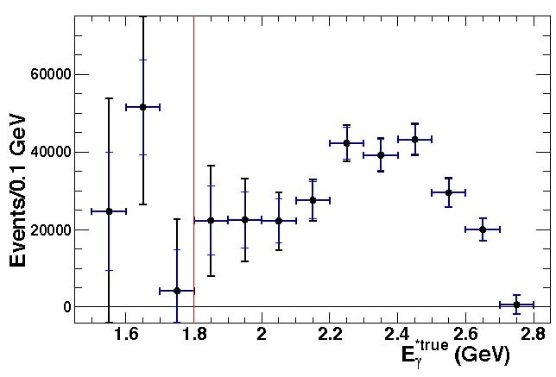
B→X_{s}γ: Corrected E_{γ} Spectrum
First, correct measured E_{γ} spectrum
for selection efficiency taking into
account the additional correlated
errors between the selection
efficiency and background estimation
Next, unfold the resolution
smearing and correct resultant
spectrum for detector acceptance
Resulting E_{γ} spectrum still includes
Doppler smearing
➔ this spectrum is used for comparison
with theory
Dominant uncertainty in the bins of
the unfolded E_{γ} spectrum result from
a shift of photon energy scale by ±0.3%
signal
region
error bars: statistical and total (stat +
sys+model added in quadrature)
G. Eigen, ICHEP12 Melbourne, 13/07/2012

Slide 19
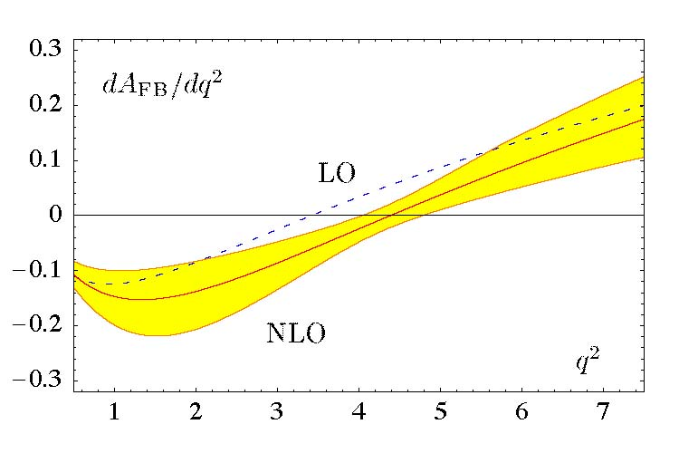
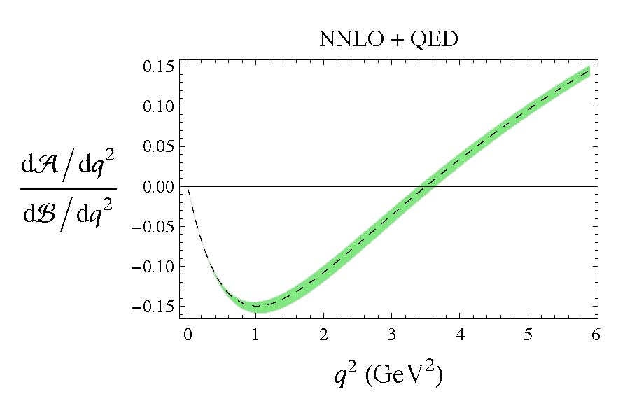
Angular Distributions for B→K^{(*)} l⁺l⁻
A_{FB} results from interplay between C₉(q²)C₁₀ and C₇C₁₀/q²
Recent SM calculations focus on low q²-region
In the SM, A_{FB} crosses zero around q²₀ =3.5-4.5 GeV²
K* l⁺l⁻
form factors
K* l⁺l⁻
X_{s} l⁺l⁻
O(α_{s})
O(α_{s}²)
q²₀=4.2±0.6
q²₀=3.5±0.12
(μ⁺μ⁻)
Feldmann & Matias JHEP 0301, 074 (2003)
Huber, Hurth & Lunghi, Nucl.Phys B802, 40 (2008)
G. Eigen, ICHEP12 Melbourne, 13/07/2012

