Slide 1
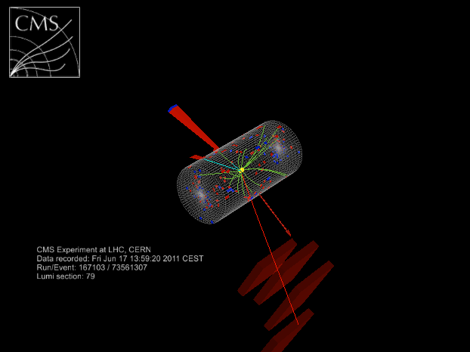

New Heavy Gauge Bosons at CMS
Claudia-Elisabeth Wulz
On behalf of the CMS Collaboration
Institute of High Energy Physics Vienna
Austrian Academy of Sciences
7 July 2012

Slide 2

New heavy gauge bosons
To solve known shortcomings of the Standard Model, extensions have been proposed. The SM gauge group SU(3)_{C}xSU(2)_{L}xU(1)_{Y} can be extended by:
- An extra U(1) group, giving rise to a neutral heavy vector boson Z’
- An extra SU(2) group, giving rise to a charged heavy vector boson W’
Model examples:
- Sequential Standard Model (SSM): new bosons have similar couplings as W, Z in SM
- Left-right symmetric models: SU(2)_{L}xSU(2)_{R}
- Superstring-inspired E₆ models: E₆ → SO(10)xU(1)_{ψ} → SU(5)xU(1)_{χ}xU(1)_{ψ}. Only one linear combination G leads to particles at the TeV scale:
G = cosθ U(1)_{χ}- sinθ U(1)_{ψ}. θ = 0: ψ-model
- More complicated scenarios predict a tower of new gauge bosons (W^{n}, Z^{n}, or gravitons G^{n}), such as technicolor or extra dimension models.
Notes:
More complicated scenarios can also arise in composite Higgs models. SU(5) breaks to the SM gauge group.

Slide 3
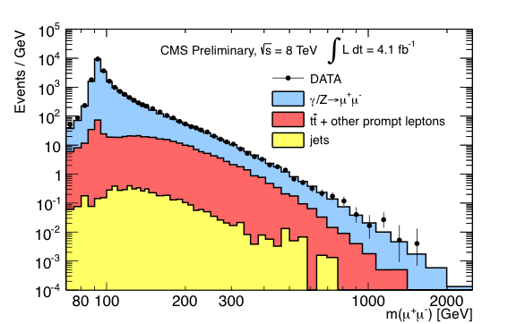
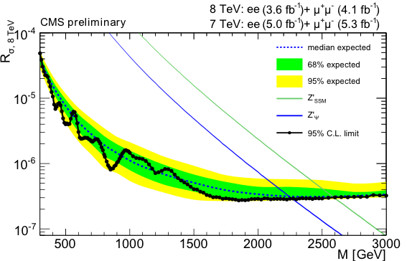
Z’ → l⁺l⁻ (l = e,μ)
Many Z’ models predict narrow resonances decaying to dileptons.
Event selection:
E_{T} (e₁,e₂) > 35 GeV, p_{T} (μ₁,μ₂) > 45 GeV, plus isolation criteria
Backgrounds:
- Z/γ*, tt, tW, VV, Z → ττ, multijets with ≥1 jet reconstructed as lepton
- estimated by fitting data with appropriate function
_
M(Z’_{SSM}) > 2590 GeV
M(Z’_{ψ}) > 2260 GeV
R_{σ} = σ_{ll}(Z’)/σ_{ll}(Z)
CMS PAS EXO-12-015, hep-ex 1206.1849, CMS PAS EXO-11-019
Notes:
For a mass of 1 TeV the widths are 30 and 6 GeV in the 2 models presented. Knowledge of trigger and lepton ID efficiency is necessary for specific models but not for ratio (only energy dependence).

Slide 4
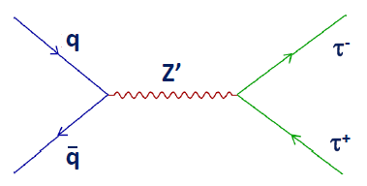
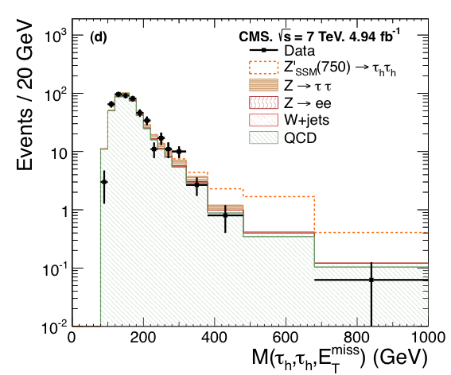
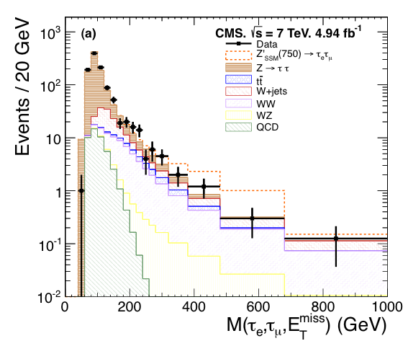
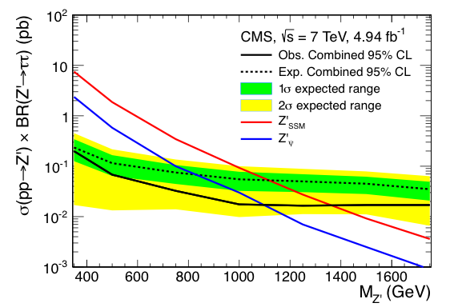
Z’ → ττ
There are non-universal scenarios in which the Z’ couples preferentially to third-generation fermions. Final states studied: τ_{e}τ_{μ}, τ_{e}τ_{h}, τ_{μ}τ_{h}, τ_{h}τ_{h}. ν’s in final state do not allow to reconstruct mass of ττ system.
Event selection:
2 τ candidates with p_{T} between 15 and 35 GeV, η < 2.1,isolation criteria, no b-jets
Backgrounds:
DY Z → ττ, W+jets, tt, VV, QCD
Backgrounds are estimated from data where possible.
_
Effective visible mass
τ_{e}τ_{μ}
τ_{h}τ_{h}
M(Z’_{SSM}) > 1.4 TeV
M(Z’_{ψ}) > 1.1 TeV
hep-ex 1206.1725
submitted to PLB
CMS PAS EXO-11-031
Notes:
Usually generation-independent couplings of Z’ to fermions are assumed. Sensitivity is increased with tau channel in non-universal models.

Slide 5
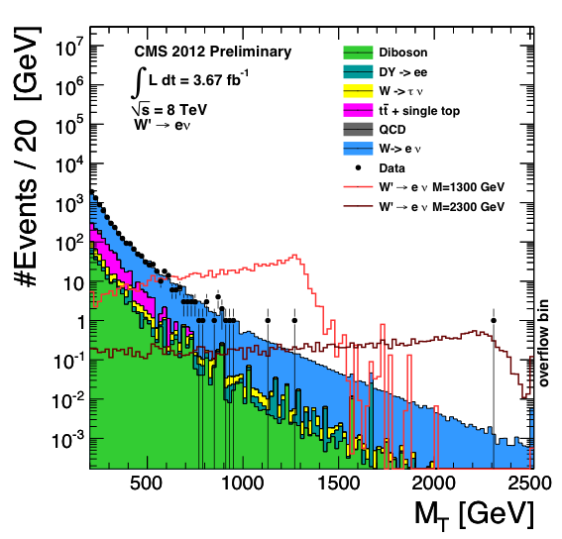
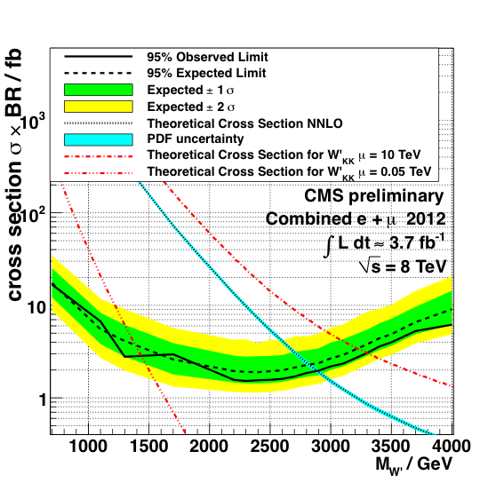
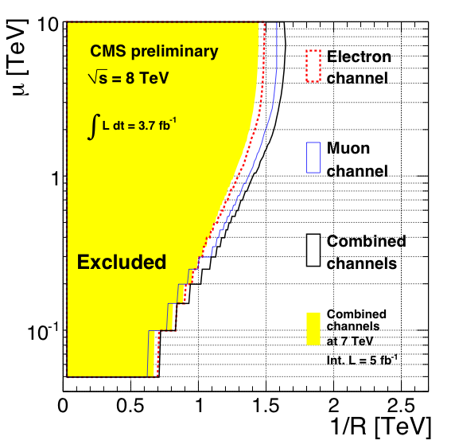
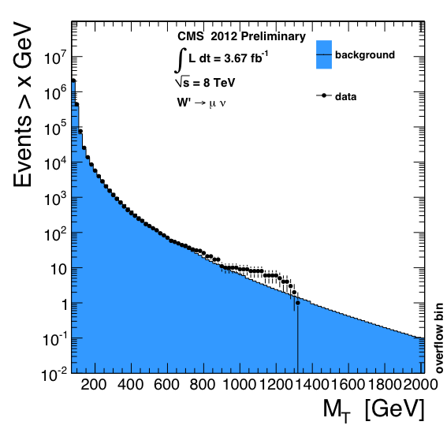
W’ → lν without W-W’ interference
Models studied:
- W’_{SSM} with SM-like couplings, with W’_{SSM} → tb allowed
- Kaluza-Klein W²_{KK} in split UED framework
Event selection: ~back-to-back isol.l+E_{T}^{miss}, energy-balanced
Backgrounds: W → lν, QCD, tt+single top, DY, VV from data
_
W’→eν
W’→μν
M(W’_{SSM}) > 2.8 TeV
M(W²_{KK}) > 1.25 TeV (μ = 0.05 TeV)
M(W²_{KK}) > 3.3 TeV (μ = 10 TeV)
CMS PAS EXO-12-010
ICHEP, July 2012
Notes:
Μαιν οβσερϖαβλε: τρανσϖερσε μασσ. Slight excess (1.1 sigma) in muon channel. μu: bulk mass parameter of fermion field in 5 dimensions, R is radius of compact 5th dimension. Assuming a non-zero mu one increases the cross section sufficiently to be measurable at LHC. Only even KK modes couple to SM fermions.
Background estimation: sideband method and also fit to data, with normalization in non-signal region 200 – 600 GeV.

Slide 6
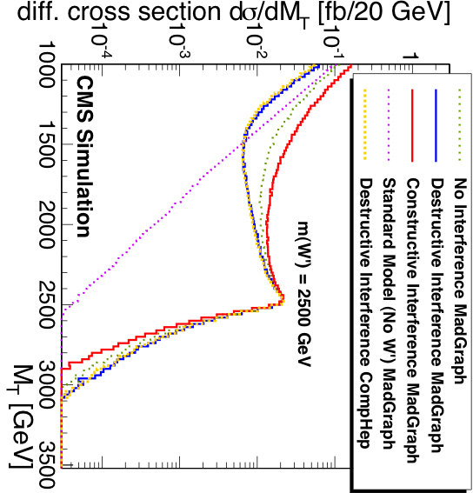
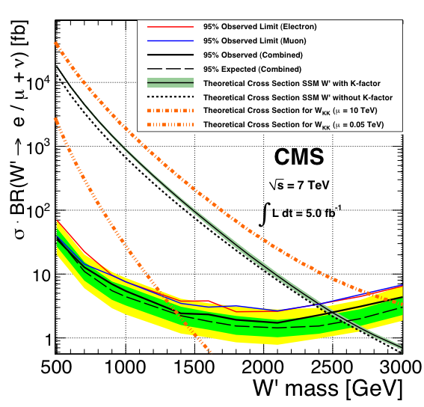
W’ → lν with W-W’ interference
A left-handed W_{L}’ can interfere with the W. Studies were performed with 7 TeV data. Limits for a W_{R}’ have also been derived.
M(W_{R}’_{SSM}) > 2.5 TeV
M(W_{L}’_{SSM}) > 2.63 TeV (constructive interference)
M(W_{L}’_{SSM}) > 2.43 TeV (destructive interference)
hep-ex 1204.4764
submitted to JHEP
Notes:
Intermediate region around 1 TeV shows variation of shape with interference.

Slide 7
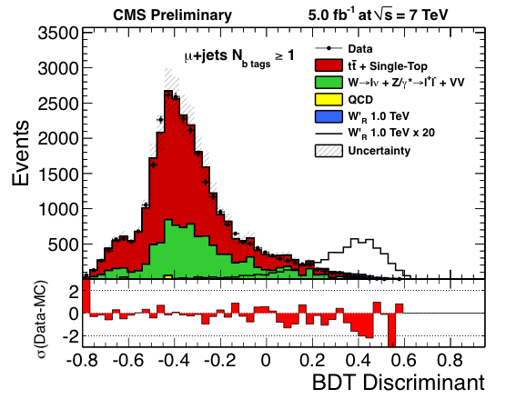
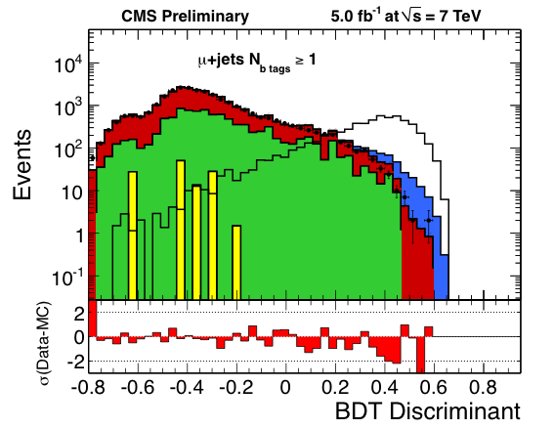
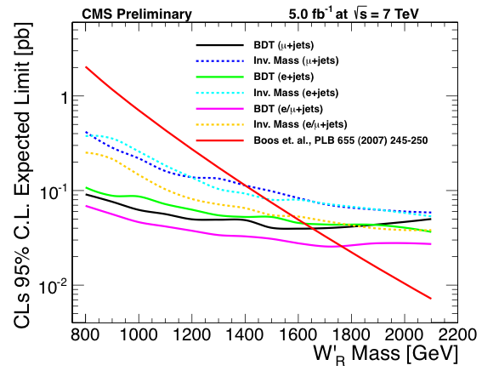
W’ → tb
W_{R}’ decays to leptons suppressed if M(ν_{R}) > M(W’) → search in hadronic final states important. Decay chain: W’ → tb → Wbb → lνbb.
Event selection: isol.e(μ) with p_{T} > 35(32) GeV, E_{T}^{jet1(jet2)} > 100(40) GeV, ≥ 1 b-tag
Backgrounds: tt+single top, W(→ lν)+jets, Z/γ* (→ ll)+jets, QCD, VV
_
New BDT analysis for signal/background discrimination with ~50 variables (object and event kinematics, top reconstruction, angular correlations).
Comparison of BDT and
invariant mass analyses
CMS PAS EXO-12-001
Notes:
In many models the third generation is coupled more strongly to the W’ than the other two generations.
Invariant mass reconstruction of top from lepton, ETmiss and best jet to get top mass, then add jet2. Sensitivity for BDT analysis increases mass reach by about 200 GeV.

Slide 8
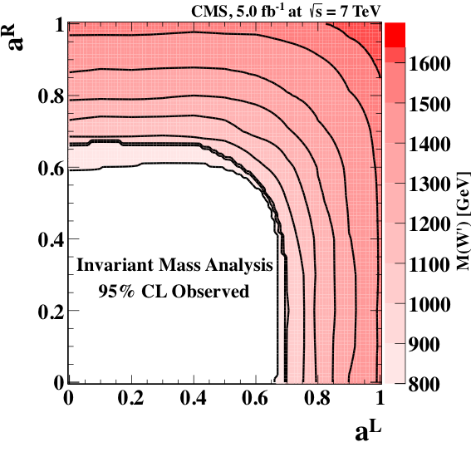
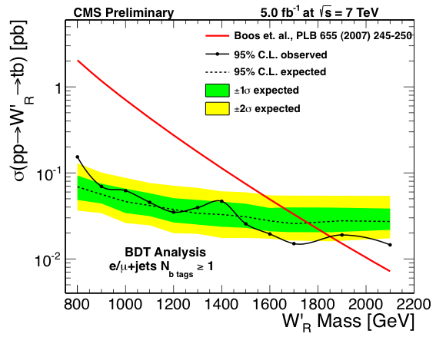

W’ → tb
Most general model-independent LO Lagrangian for a W’ coupling to SM fermions:
Mass limit and constraints of W’ gauge coupling for a set of left- and right-handed coupling combinations have been set:
M(W_{R}’) > 1.85 TeV
Contours of W’ mass at which the observed 95% CL cross-section upper limit equals the predicted cross-section
Notes:
Limit for W’R is also valid for left-handed couplings to fermions, when no interference with SM W is included. aud = atb is assumed.

Slide 9
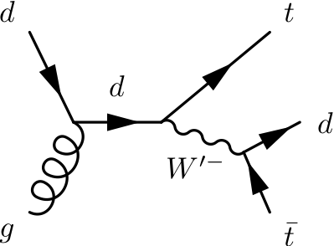
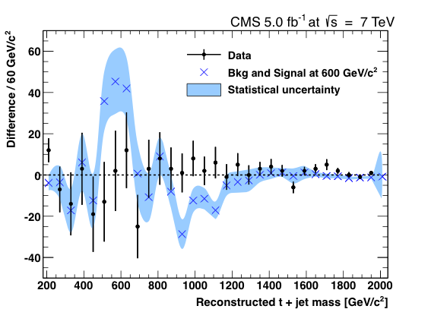

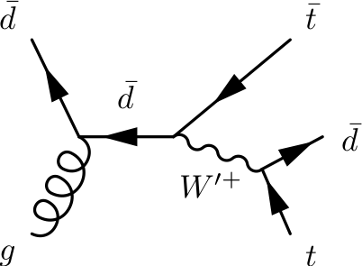
W’ → td
_
Tevatron measurement of forward-backward asymmetry at high tt inv. mass
Possible explanation: light W’
N(W’⁻) > N(W’⁺) at LHC -> aids in reconstructing the W’
Decay chain:
pp → tW’ → ttd,
with semileptonic t-decays plus a jet in final state.
Difference of yields for t⁻+d and t⁺+d invariant mass distributions (charge assignment from leptonic top decay):
hep-ex 1206.3921, CMS PAS EXO-11-056
Notes:
Shown are the dominant s-channel production modes. Choice of semileptonic t decays due to large BR and relatively clean signature.
W’ mass between 200 and 600 GeV to explain Tevatron measurement.

Slide 10
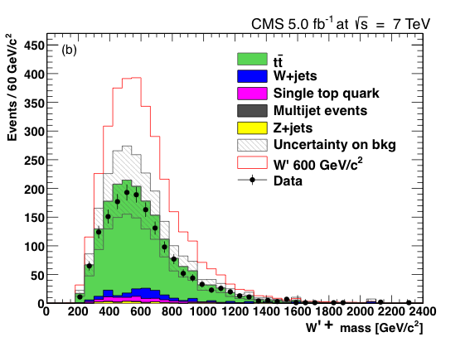
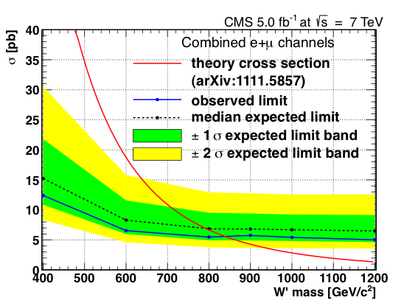

W’ → td
M(W’) > 839 GeV

Slide 11
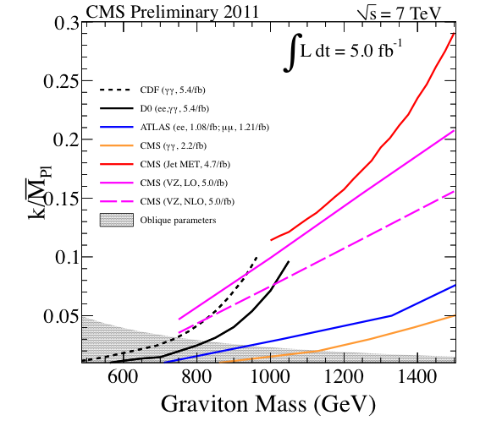
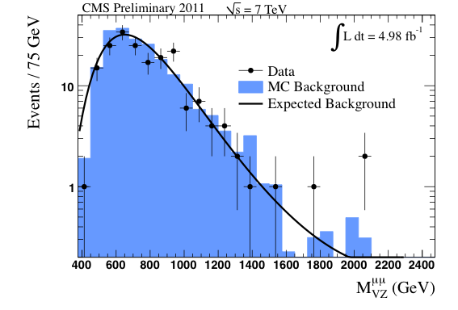
W’, G_{RS} → VZ → wide jet + lepton pair
l
W’_{SSM} → ZW → lljj, G_{RS} → ZZ → lljj
2-fermion systems boosted for heavy resonance
Event selection:
based on high-p_{T} Z candidates from lepton pair and wide jet well separated from leptons
Backgrounds: from data
W+jets, tt, γV+jets, Z/γ*+jets, ZZ, VV+jets
l
W’, G
Z
W, Z
merged
jet
95% CL exclusion limits
_
CMS PAS EXO-11-081
ICHEP, July 2012
Notes:
Leptons: have to remove second lepton to determine isolation.
The jj system will often appear as a wide single jet (compatible with V mass), and the leptons will have small opening angles.
Mass limits between 800 and 900 GeV for the 2 particles (NNLO, NLO).

Slide 12
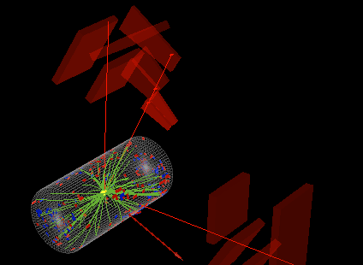
Conclusions
CMS has studied scenarios for new heavy gauge bosons.
Although no signals for new physics have been found yet,
limits on masses and other quantities have been set.
Details may be found here:
https://twiki.cern.ch/twiki/bin/view/CMSPublic/PhysicsResultsEXO
We are looking forward to more LHC data!
ICHEP, July 2012

