Slide 1

Progress of MICE, the International
Muon Ionization Cooling Experiment
On behalf of the MICE collaboration

Slide 2
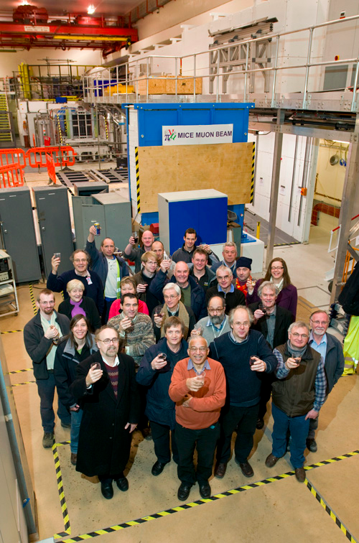
Acknowledgements:
Many thanks to those who provided information or material:
  And in particular the MICE collaboration

Slide 3
Contents:
Motivation
Ionization cooling
Overview of MICE
Status of MICE
Conclusions

Slide 4
Motivation
Progress of MICE,
the international
Muon Ionization Cooling Experiment

Slide 5

Neutrino Factory:
https://www.ids-nf.org/wiki/FrontPage
Optimise discovery potential for CP and MH:
  Detailed study of
  sub-leading effects
Unique:
  Large high-energy
  ν_{e} (ν_{e}) flux
    Optimise CP
    sensitivity
    Optimise MH
    sensitivity
    Optimise event
    rate
Ionization cooling
increases useful muon
flux by a factor of
two to ten
IDS-NF 2012/3.0

Slide 6
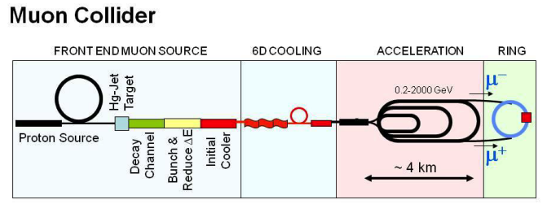
Muon Collider:
http://map.fnal.gov/
Muon mass ≈ 200 × electron mass
Consequences:
  Negligible synchrotron radiation (and beam
  strahlung)
    Rate ∝ m⁻⁴
    ⇒ reduction:
    5 × 10⁻¹⁰
    Can determine
    beam energy
    precisely
    (0.003%)
  Strong
  coupling to
  the Higgs:
    Rate ∝ m²
    ⇒ enhancement:
    5 × 10⁴
    Efficient production of Higgs
Ionization cooling essential to deliver requisite flux

Slide 7
Ionization cooling
Progress of MICE,
the international
Muon Ionization Cooling Experiment

Slide 8
Muon front-end:
Neuffer, Rogers
Optimised bunching,
phase-rotator, and ionisation-cooling lattice

Slide 9
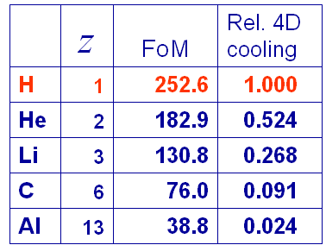
Ionisation cooling: principle:
Exponential decrease in normalised emittance:
Competition between:
  dE/dx [cooling] and MCS [heating]
Optimum:
  Low Z, large X₀
  Tight focus
  H₂ gives best
  performance

Slide 10
Overview of MICE
Progress of MICE,
the international
Muon Ionization Cooling Experiment

Slide 11
MICE:
ISIS
RAL
MICE

Slide 12
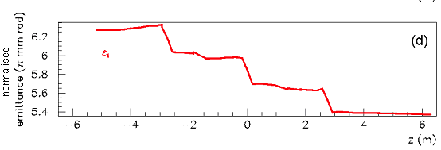
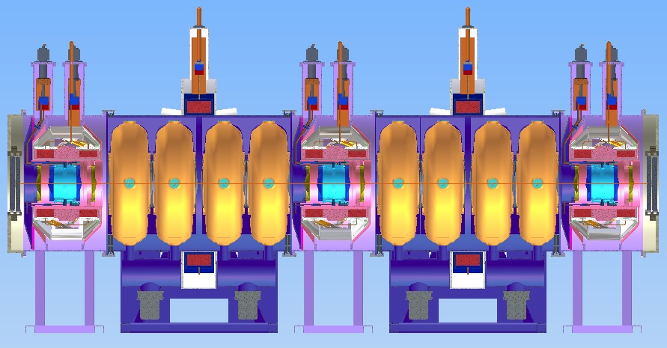
Cooling performance:
15% cooling in MICE channel from 5% E loss per absorber
Particle-by-particle measurement, accumulate ≈ 3 × 10⁵ muons
⇒ Δ[ (ε^{in}- ε^{out})/ε^{in} ] = 10⁻³

Slide 13
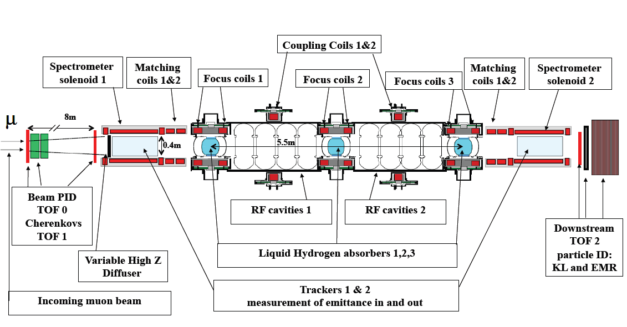
The Muon Ionization Cooling Experiment:

Slide 14
The Muon Ionization Cooling Experiment:

Slide 15
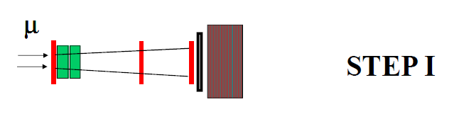
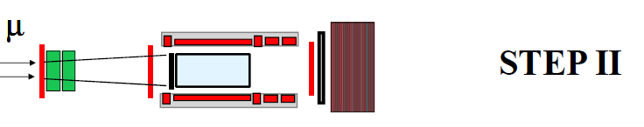
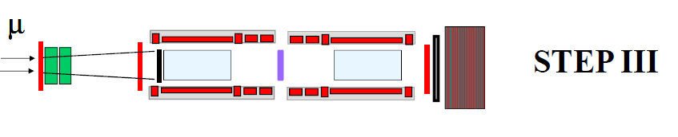
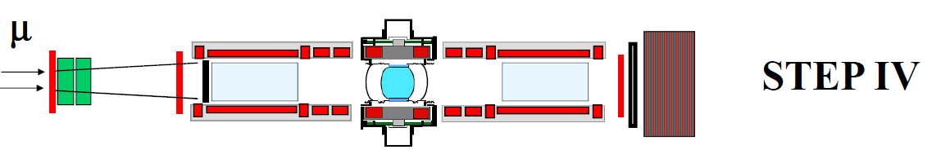
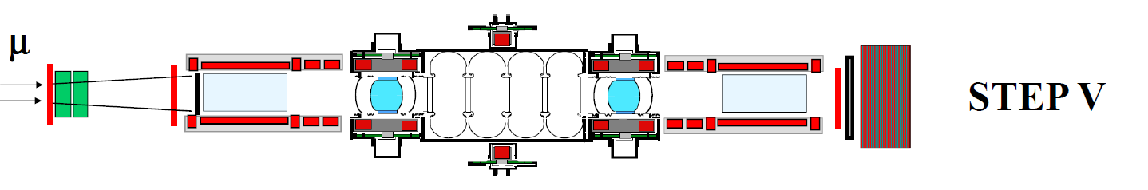
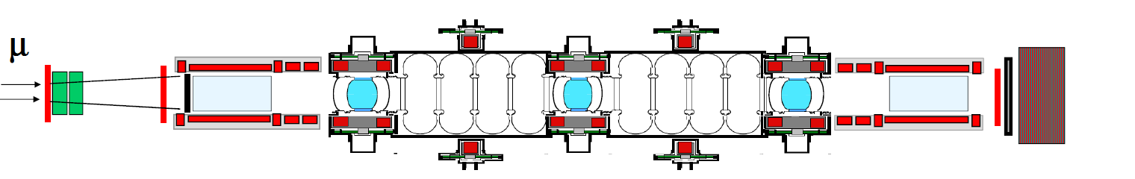
Implementation in “Steps”:
Incremental understanding
of equipment; and
Staging implied by funding
profile
COMPLETED
2013
STEP VI
Aim: 2016

Slide 16
Status of MICE
Progress of MICE,
the international
Muon Ionization Cooling Experiment

Slide 17
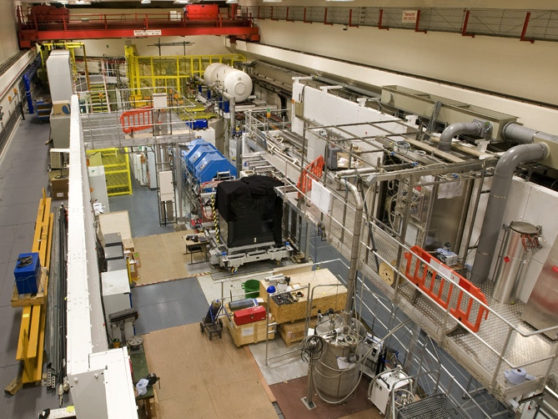
Step I [complete]:
MICE Muon Beam: fit to serve the experiment

Slide 18
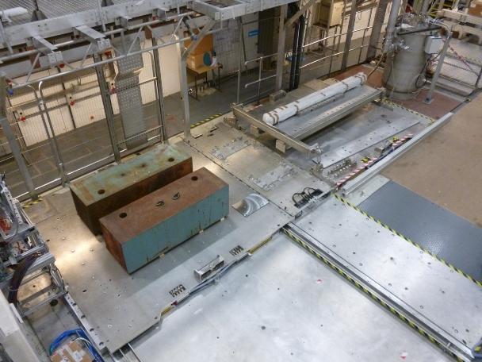
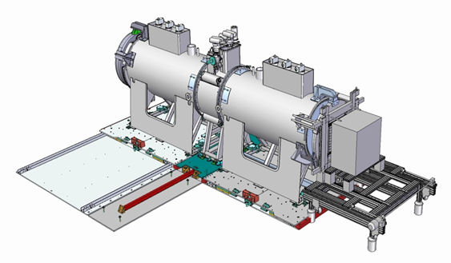
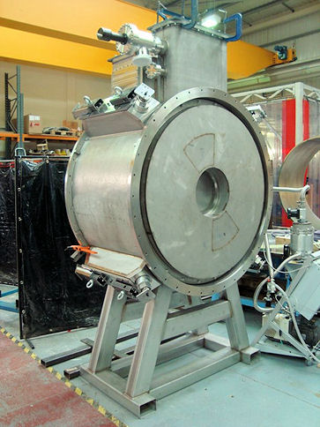
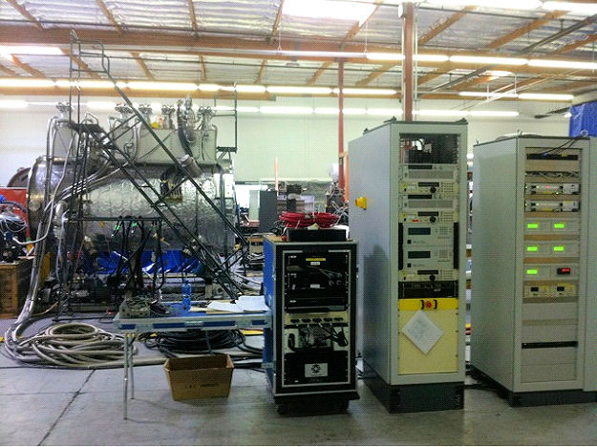
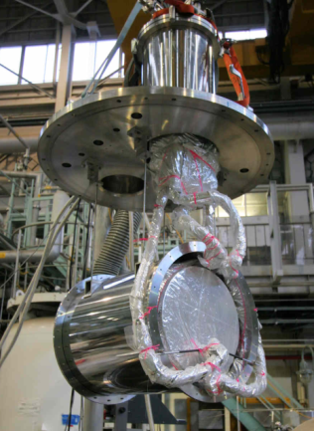
Step IV [under construction]:
Will take delivery of spectrometer solenoids and focus coil over the coming months
Liquid-hydrogen absorber already tested and present at RAL

Slide 19
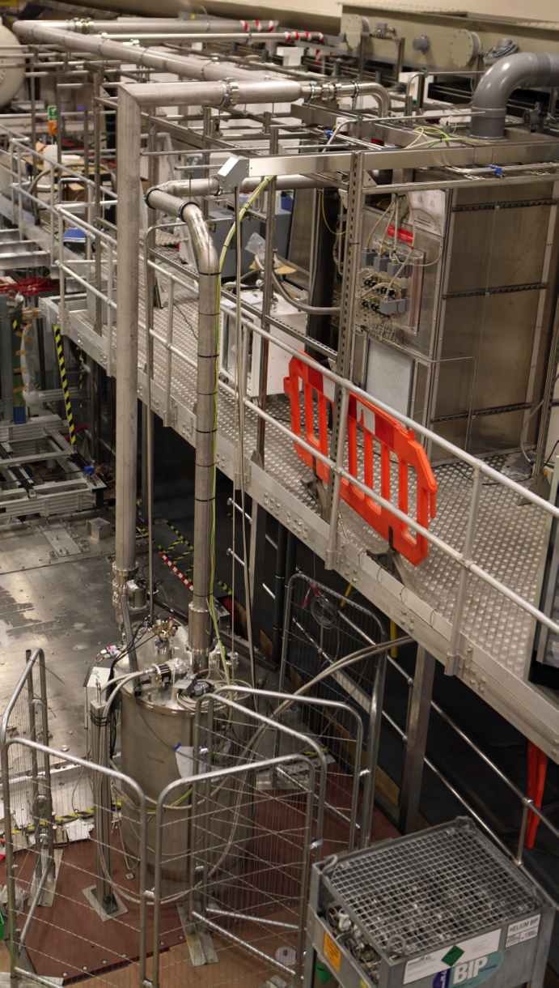
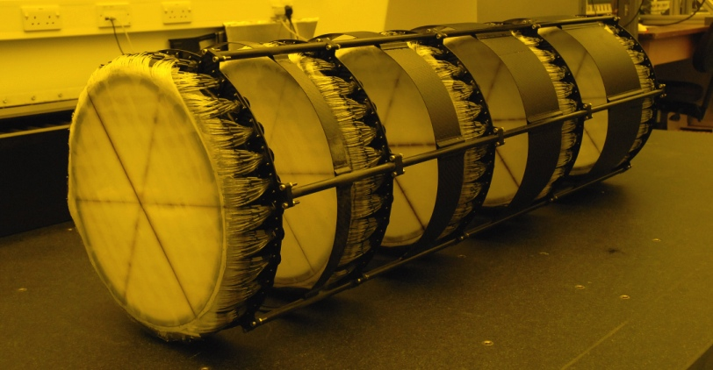
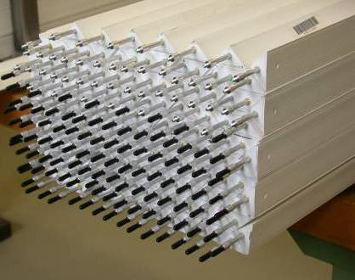
Step IV [under construction]:
Instrumentation:
[see P. Soler: MICE instrumentation; Track 13; Sat. 15:30]
  Trackers commissioned
  EMR commissioned with beam
    Full device in production
Hydrogen-delivery system
  Commissioned with He
  Ready for commissioning with H₂

Slide 20
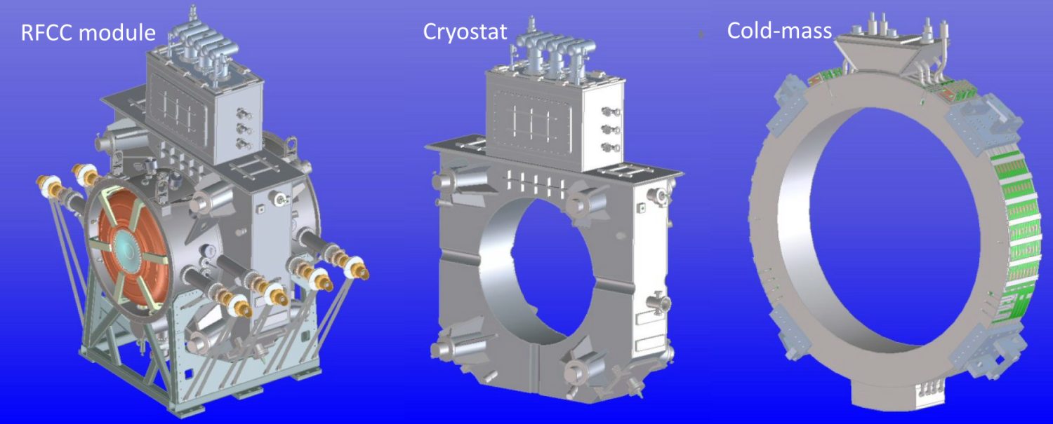
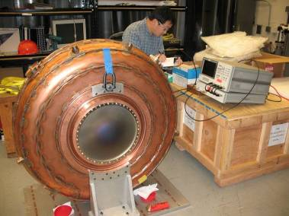
Step VI [in preparation]:
Plans for fabrication of RFCC modules advanced
Cavity production going well
  Prototype cavity under test at the MTA at FNAL

Slide 21
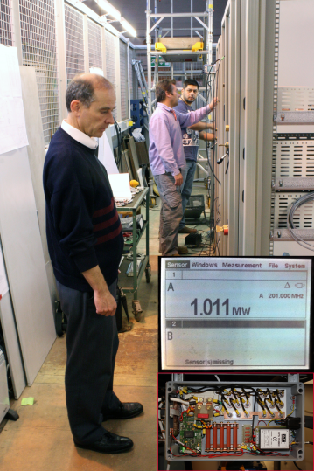
Step VI [in preparation]:
First RF amplifier has delivered 1 MW
  Push to specified 2 MW this month
Components for all 4 amplifiers available
Layout complete and procurement started

Slide 22
Conclusions
Progress of MICE,
the international
Muon Ionization Cooling Experiment

Slide 23
Conclusions:
Step I data taking successfully demonstrated:
  Excellent performance of instrumentation;
  MICE Muon Beam meets requirements;
Equipment required for Step IV either available at RAL, or to be delivered over the next six months:
  Anticipate running in Step IV configuration in spring 2013;
    First measurements of material properties with MICE
Collaboration energetically working toward demonstration of cooling in the Step VI collaboration on the timescale of 2016

