Slide 1
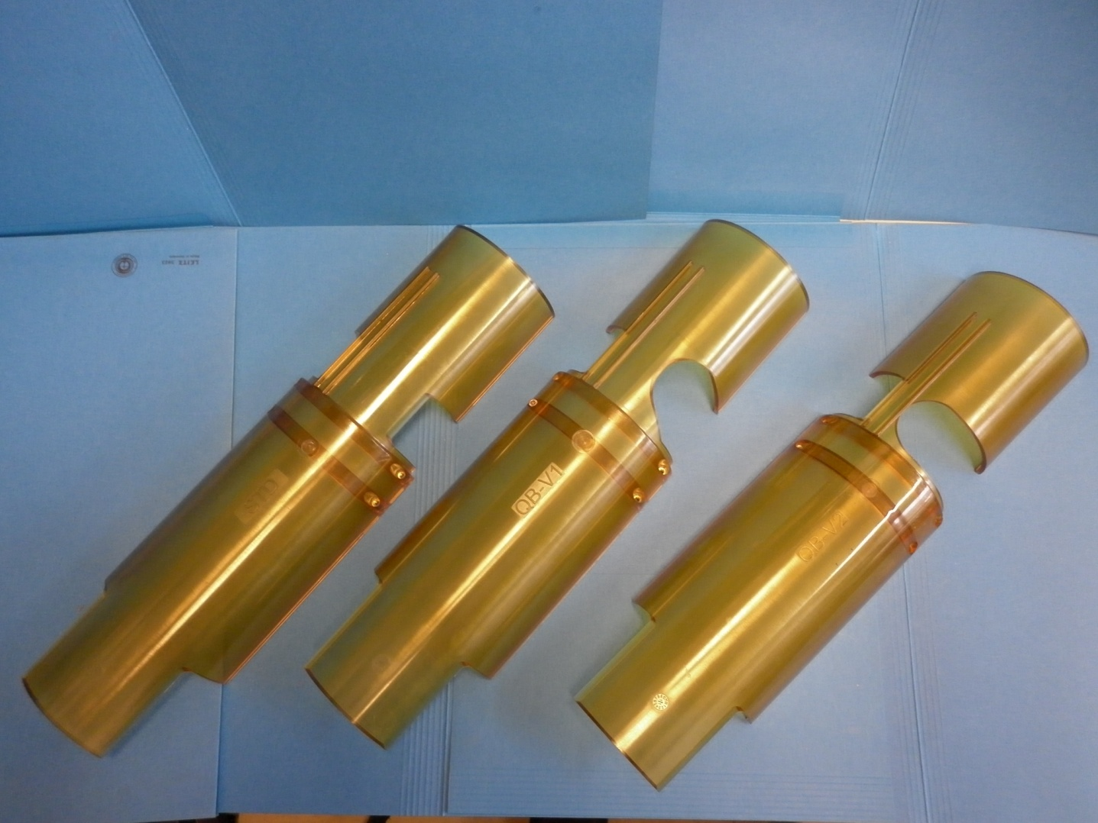
PROTECTION SHELLS

Slide 2
WHERE ?
WHY ?
HOW ?
WHEN ?
In LHC Interconnections
To limit damage on cold vacuum line interconnections:
- Bellows buckling
Electrical arcs on thin walled shells
Gas and external particulate inrush
By protecting the bellows to electrical arcs with dielectrical shells
For operation and installed during the Long Shutdown 1

Slide 3
-ULTEM®
The material chosen is polyetherimide (PEI) or commonly ULTEM (not charged)
Already used in LHC (DFBA, …)
Radiation resistant: (no significant damage up to 10 MGy)
[Tavlet, Compilation of radiation damage test data, Part 2, CERN 98-01]
Cryogenic resistant
Dielectric properties
Good vacuum properties: Low outgassing polymer
Amorphous polymer: Geometrical stability during molding process, especially for long pieces

Slide 4
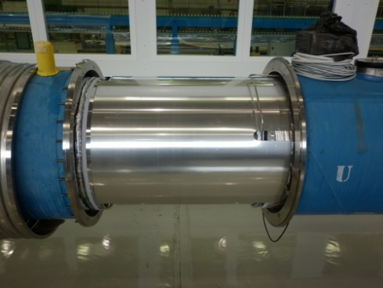
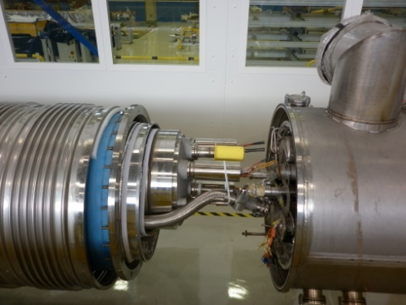
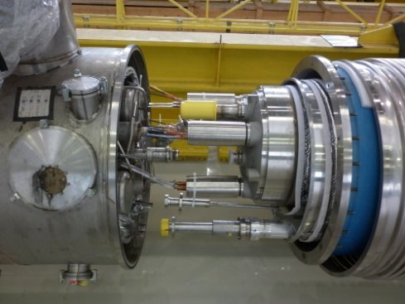
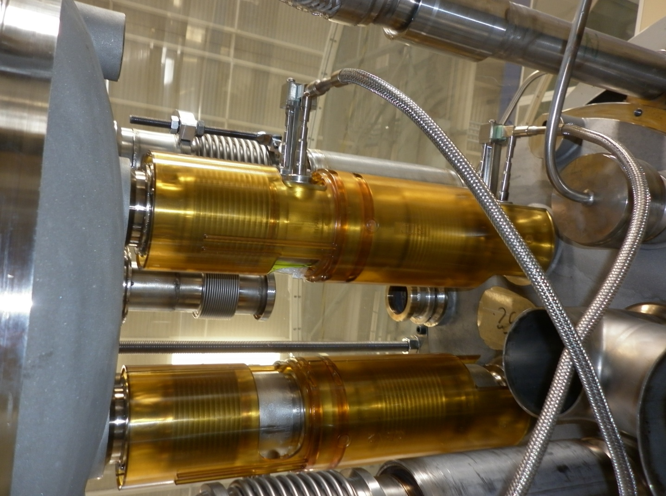
Three models of parts for twelves types of interconnections
Dipole-Dipole Dipole-Quadrupole Quadrupole-Dipole
In LHC: #764 #468 #468
Total quantity: (764+468+468)x4= 6800 pcs
View from underneath
4 positions

Slide 5
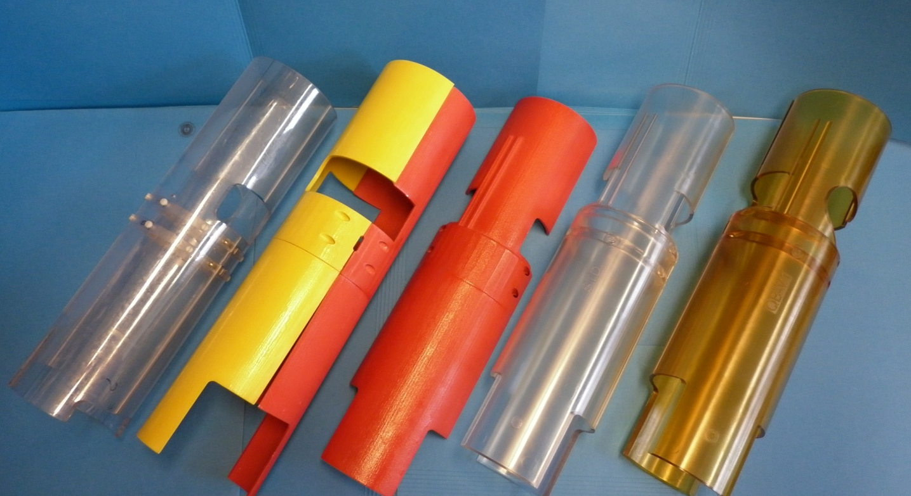
Design and prototype evolution
Forming and machining
Molding prototypes (polycarbonate)
Rapid prototypes
(CERN polymer labo)
Pre-production series

Slide 6
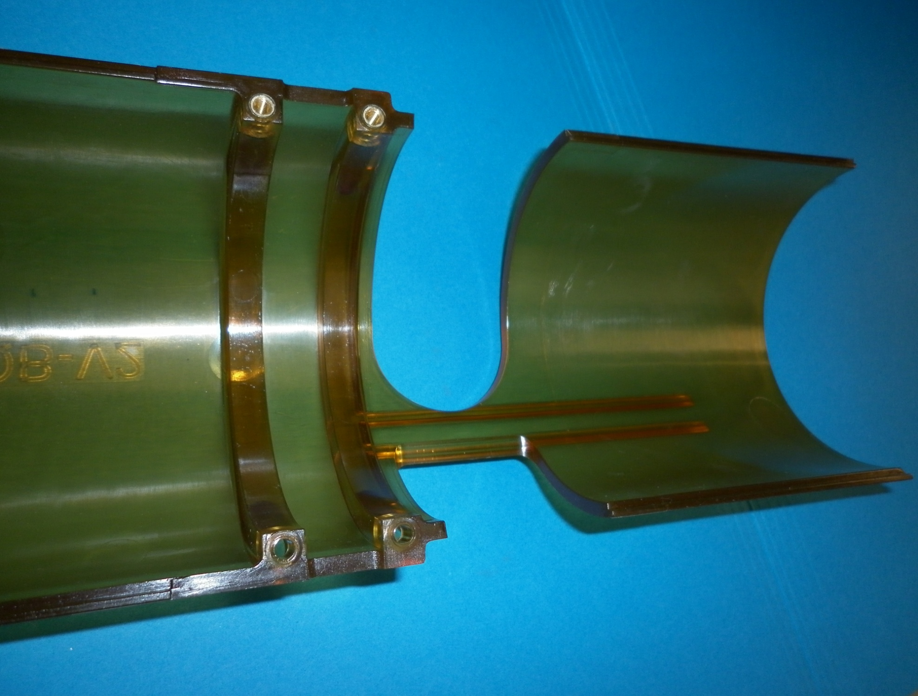
Functional design
Window rescue
Positioning ribs
Inserts
Reference
Functional gap
For different geometrics weld
Stiffeners
Gap for magnet geometrical tolerances and misalignement
Screw holes
Interlocking ribs

Slide 7
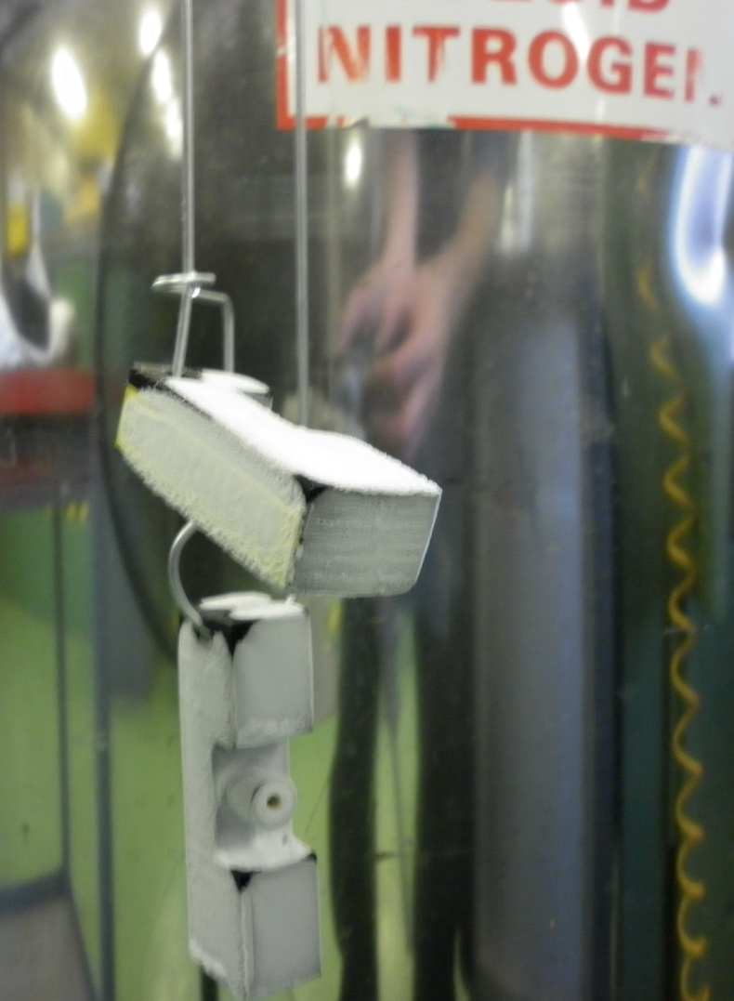
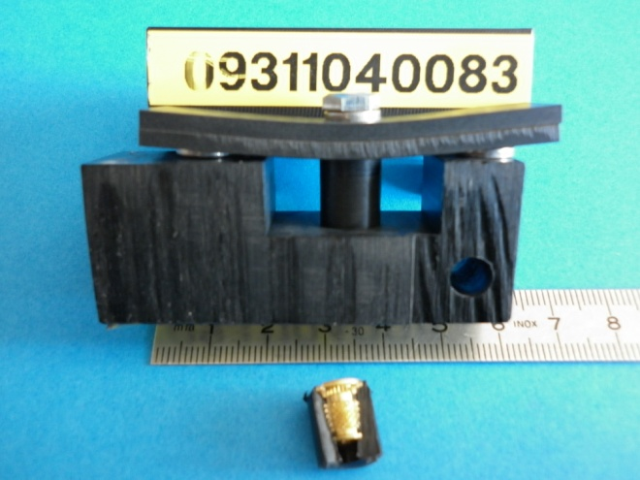
Tests
Good mechanical strength of threaded insert at room and cryogenic temperature (77 K and 4.2 K).
Test of thermal shocks have been carried out at 77 K and threaded assemblies have been subjected to thermal cycles between 4.2 K and room temperature at cryolab.
No damage has been observed.

Slide 8
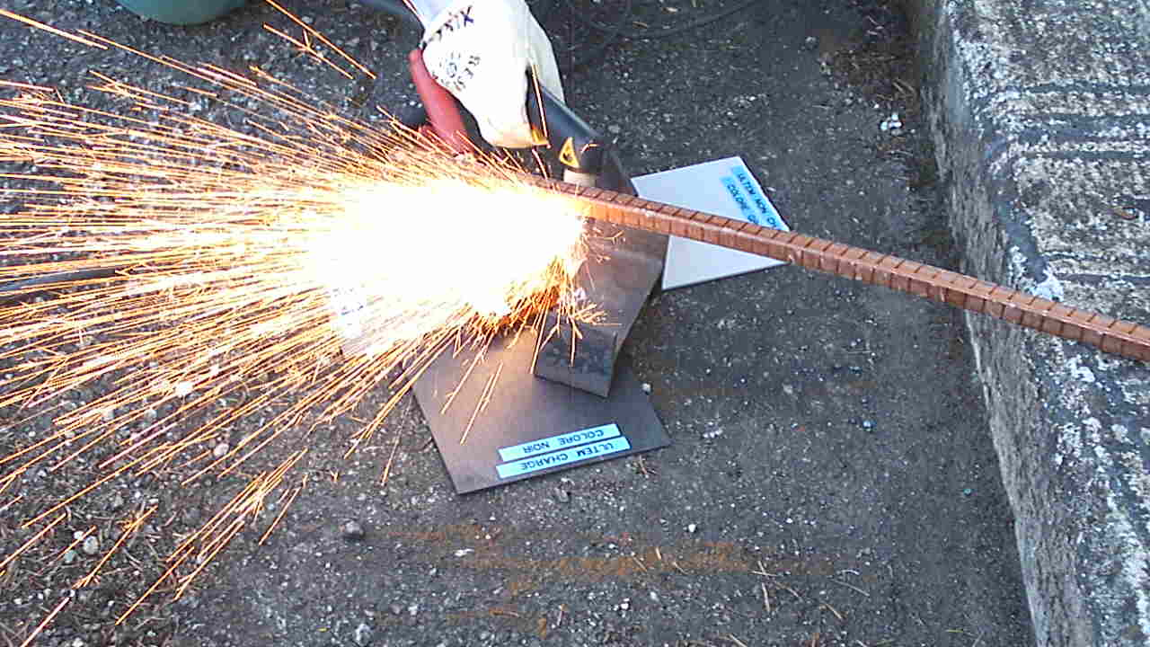
Tests
Resistance to metallic projections at 1200°C!

Slide 9
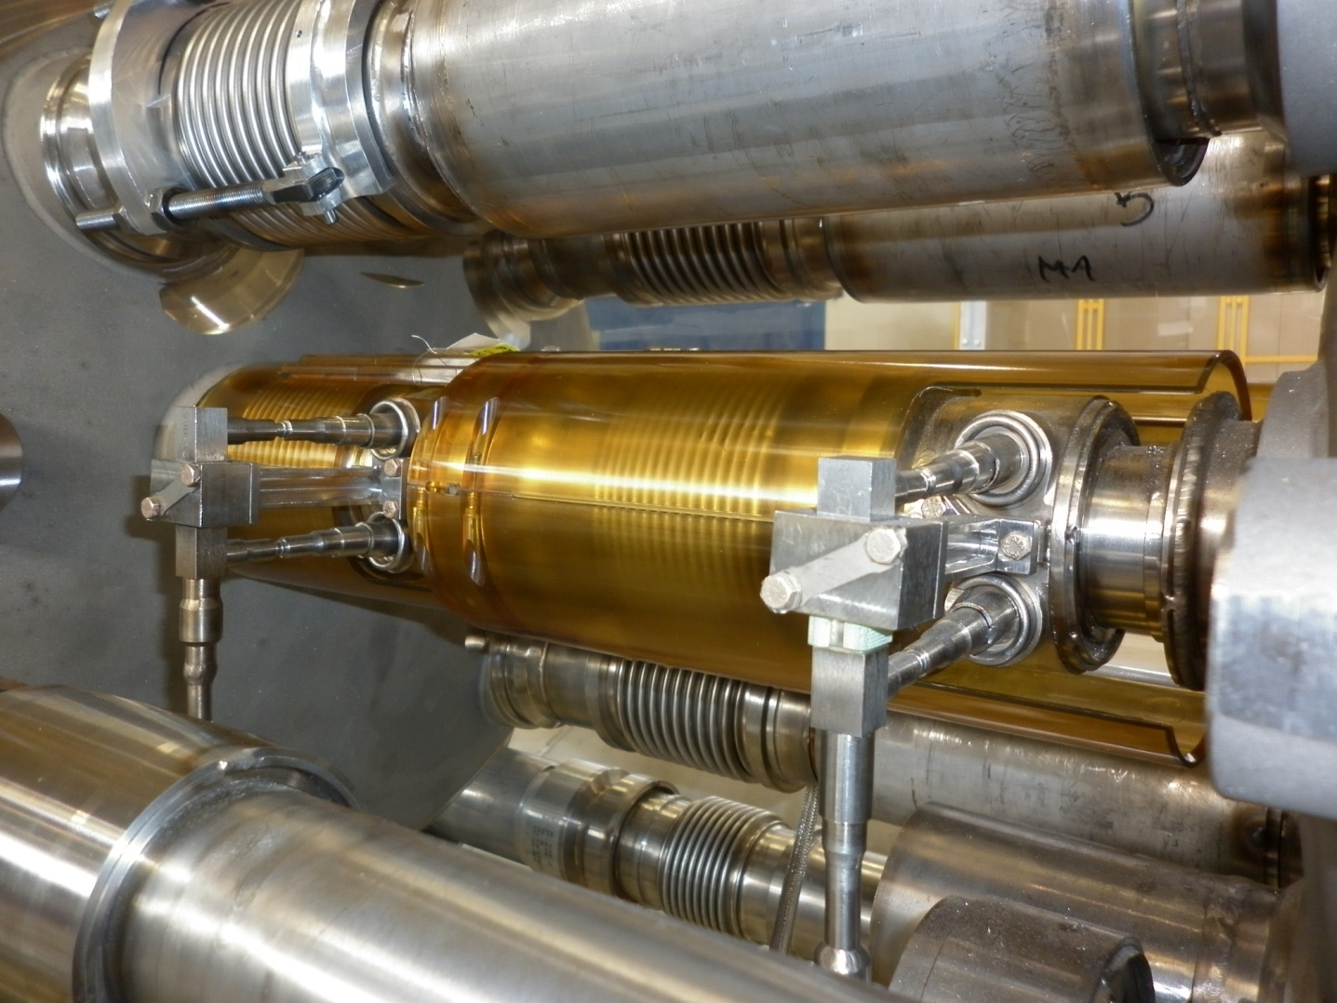
Test of pre-series
Assembly test in an interconnect mock up
Geometrical measurements
Thermal shock cycles (77 K)
Mechanical shock (hammer)

Slide 10
Next Steps
Modification ongoing other pre-production inspection tests.
Second pre-production reception and qualification.
Series production (2 batches).

