Slide 1
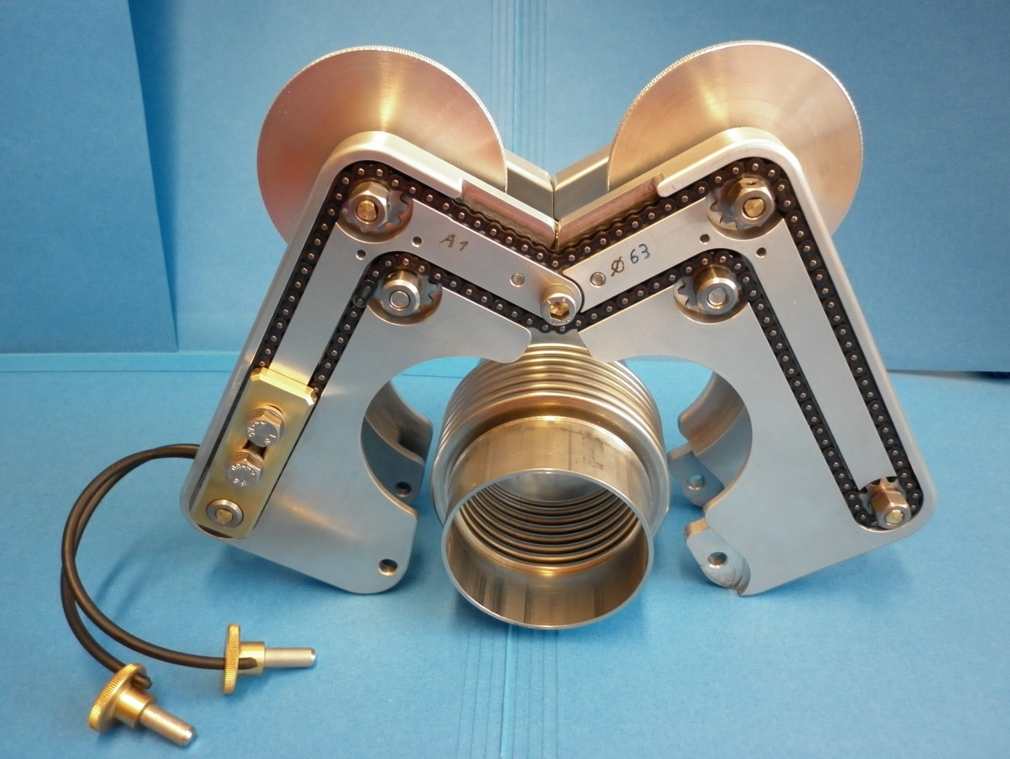
Rapid bellows compression tool

Slide 2
SPECIFICATIONS
Initially developed in the framework of the CLIC modules, the aim was to compress bellows:
Easily
Quickly
Light
Not bulky
With a minimum number of tools
Easy to manipulate and to maintain
Low risk of damaging surrounding elements

Slide 3
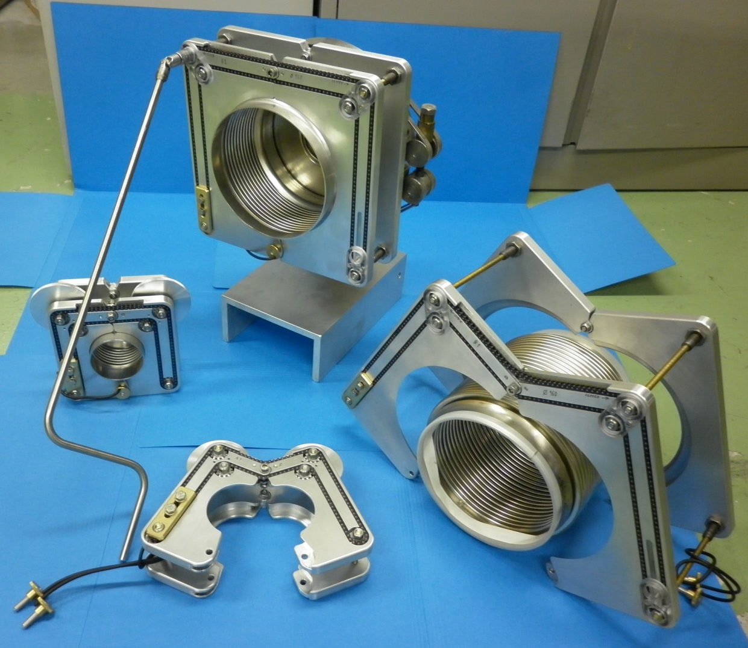
FAMILY OF TOOLS

Slide 4
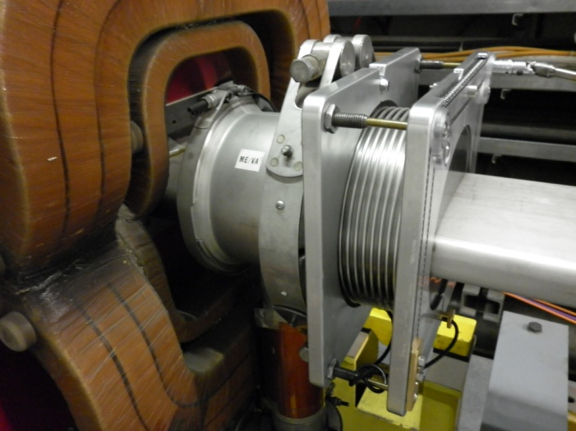
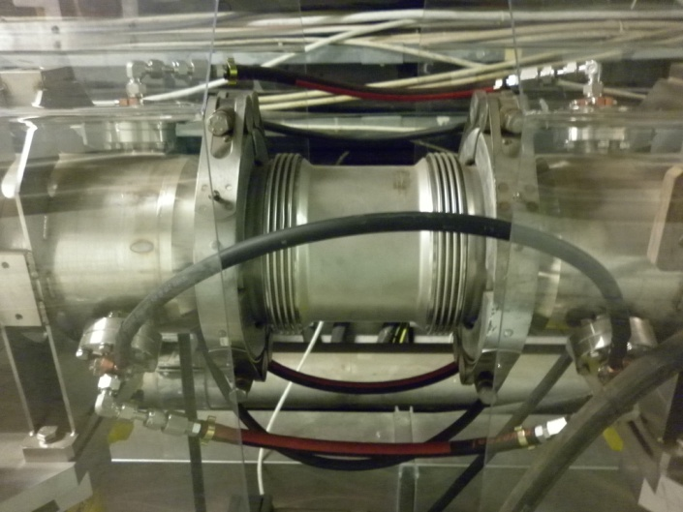
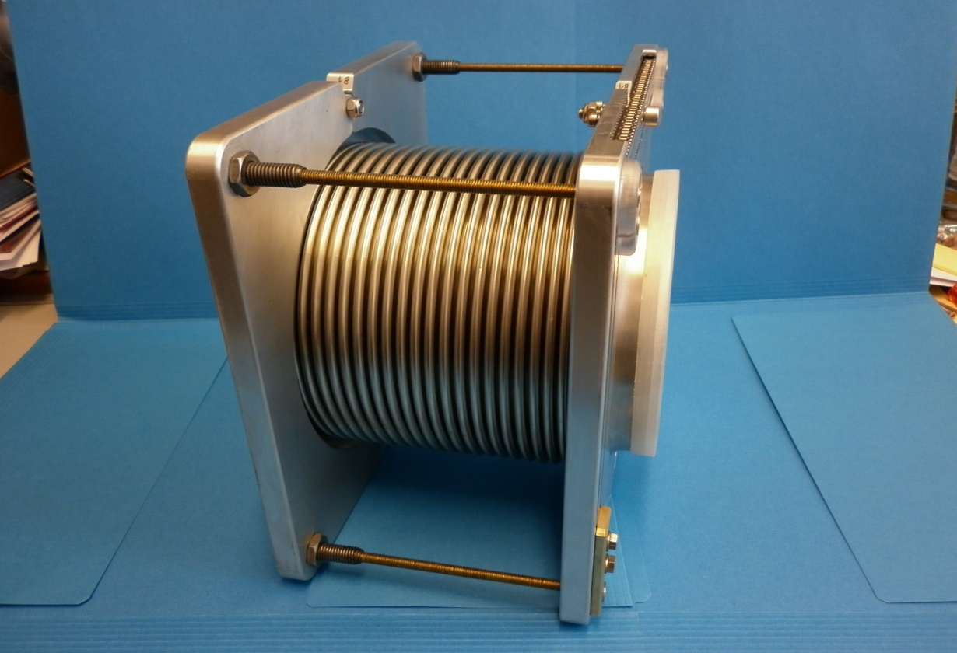
ONE BELLOWS DIAMETER:
ONE TOOL AVAILABLE FOR DIFFERENT BELLOWS LENGHTS
Application in the SPS

Slide 5
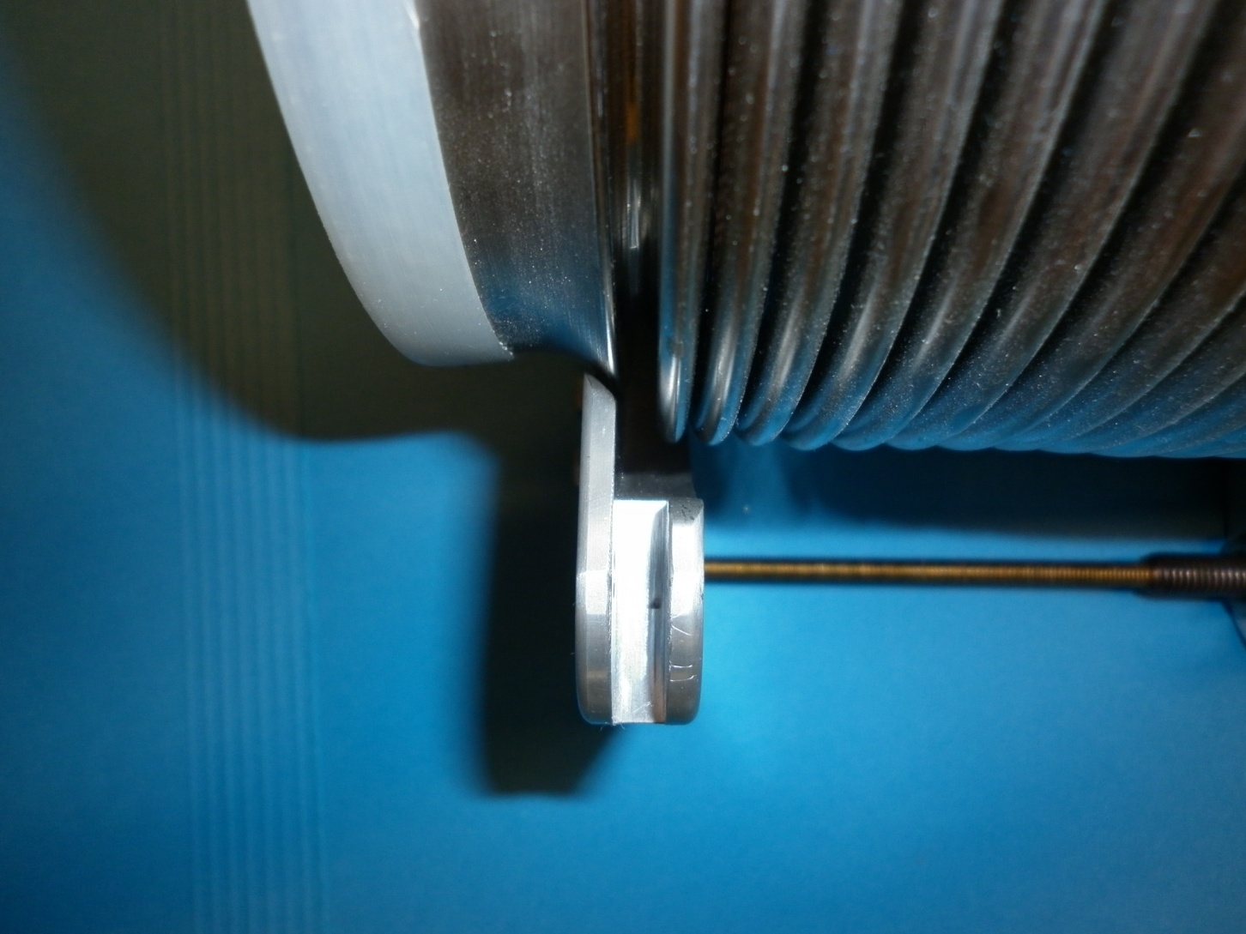
Interface with the vacuum chamber and module
Conical contact

Slide 6
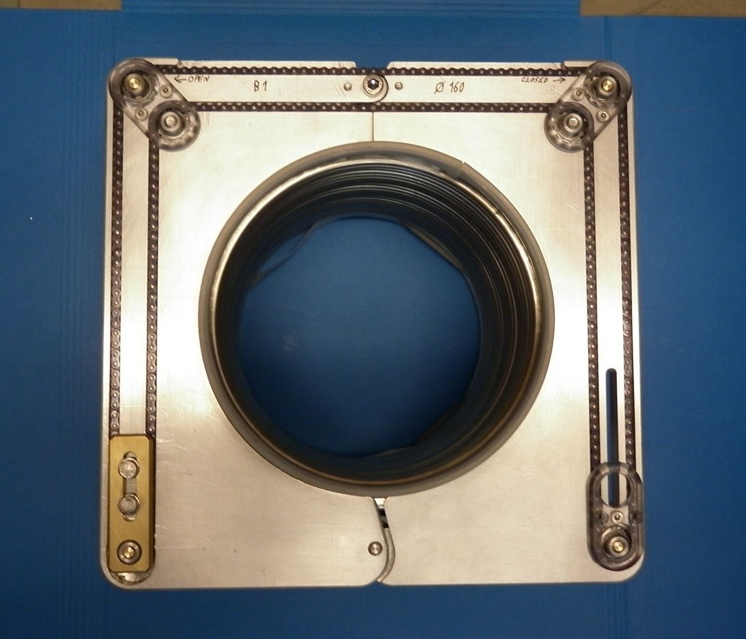
Open Close
Principle Function

Slide 7
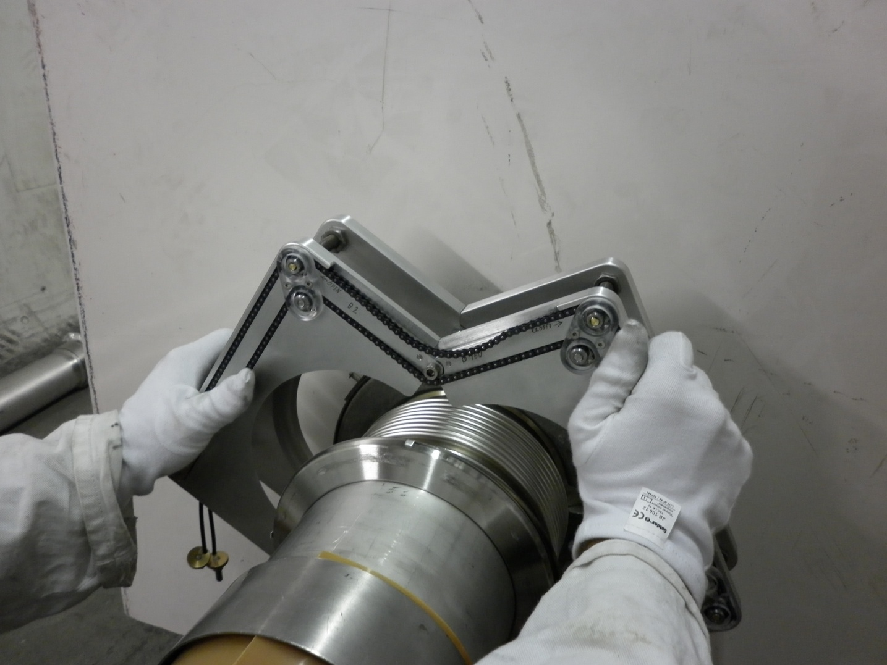
SIMPLE USAGE mounting

Slide 8
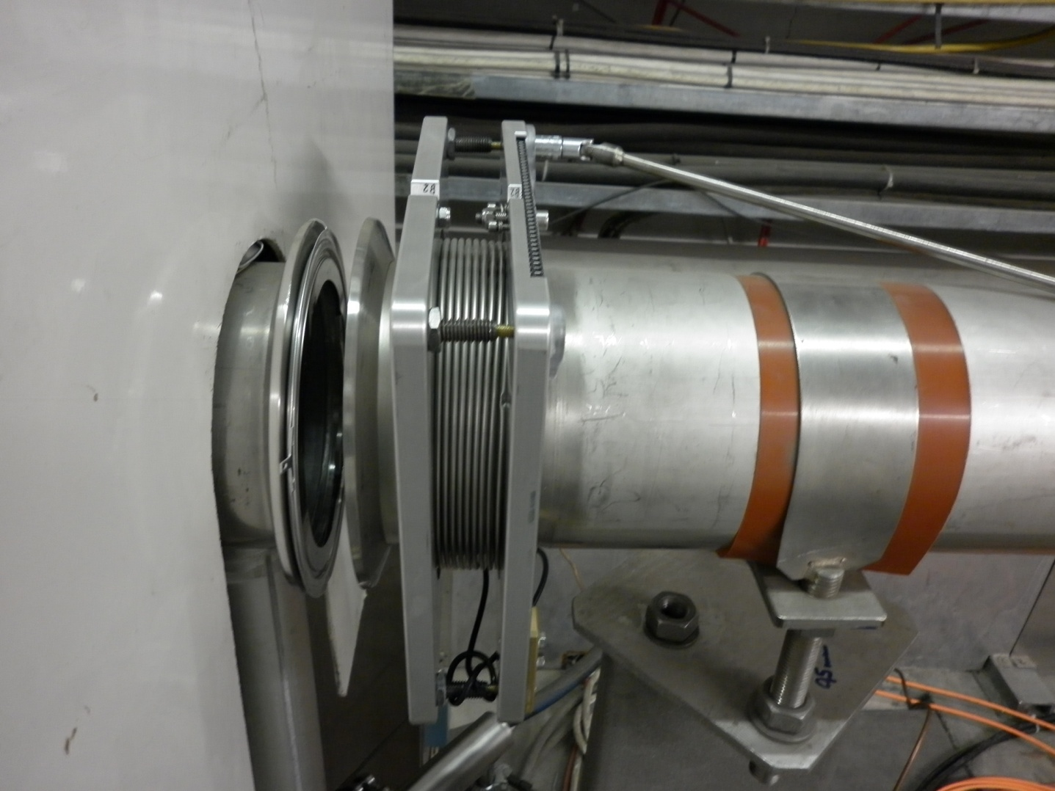
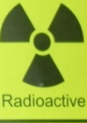
COMPRESSION OF THE BELLOWS AT DISTANCE
Operate at distance:
Reduction of the radiation dose
movement

Slide 9
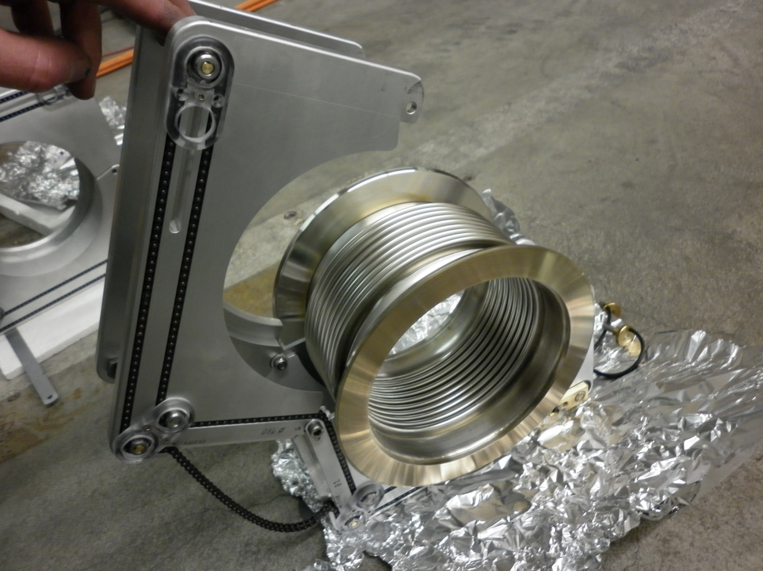
PREPARATION OF THE NEW BELLOW

Slide 10
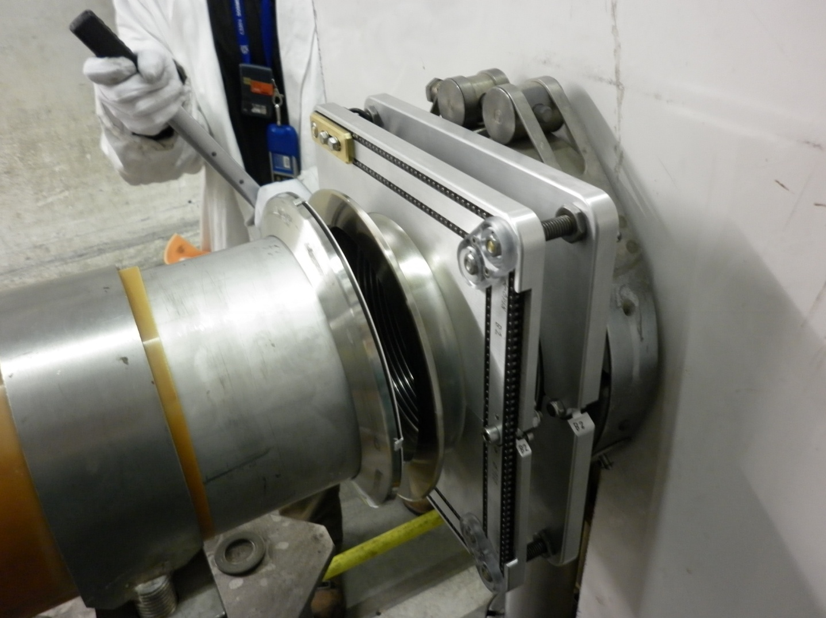
INSERTION OF THE COMPRESSED BELLOW
No collision

Slide 11
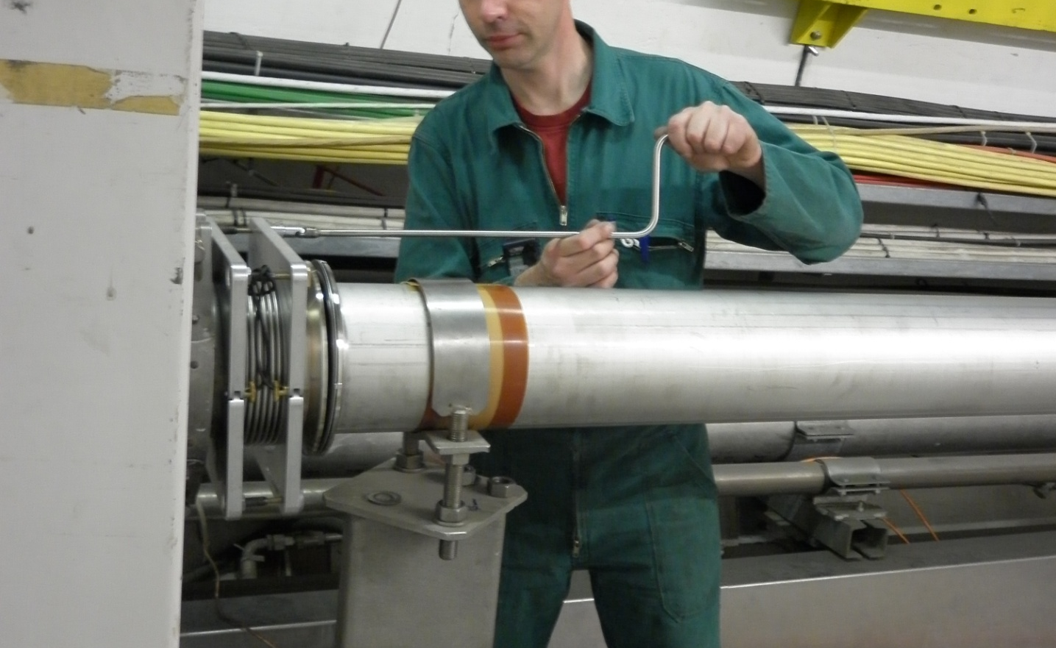
REATTACHMENT OF THE BELLOW
Controlled engagement of the seal
Gimbal Joint
Working at Distance
Progressive contact

Slide 12
Conclusions
A bellows compression tool has been developped with the aim to facilitate manipulation in confined and radiation environments.
It has been trialed successfully in the SPS, except for magnet vacuum chamber (available space not sufficiant).
Next step : -Study of tooling for SPS magnet vacuum chamber. -Design for LSS warm modules.

