Slide 1


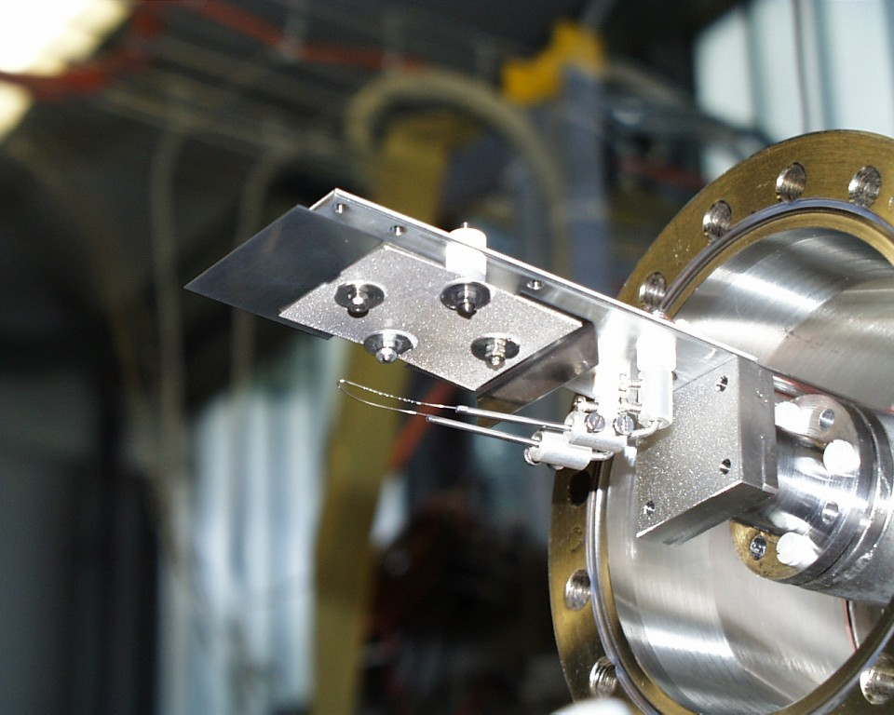
Zr-V NEG coatings studied by ESD

Slide 2
Overview
Introduction
  NEG coatings
  Aim of project
  Characterization methods
Coating process
Scanning Electron Microscopy / X-ray Photoelectron Spectroscopy results
Calibrated leaks method
Electron stimulated desorption
Results: Sticking factor and ΔP
Conclusion – Future work

Slide 3
Introduction
NEG coatings are already used in LHC (6 km long section parts)
NEG coatings will be used to the new
Extra Low Energy Antiproton Ring (ELENA)
Important to continue the research and development of the NEG coatings

Slide 4
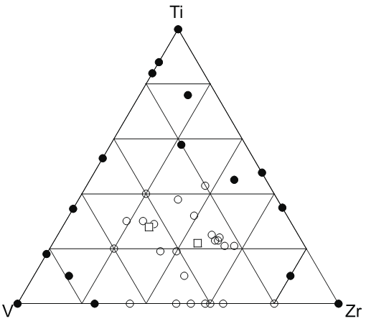
Introduction
Aim:
To study the effect of excluding Ti from the coating, on the sticking probability and the surface cleanliness
To evaluate the optimum ZrV composition in terms of sticking probability and the surface cleanliness
Quality composition map of TiZrV films by AES
30%,30%,40%
In this study were used/made:
10 different cathodes
: R>0.5
(after 200ºC for 1hr)
: R<0.5

Slide 5
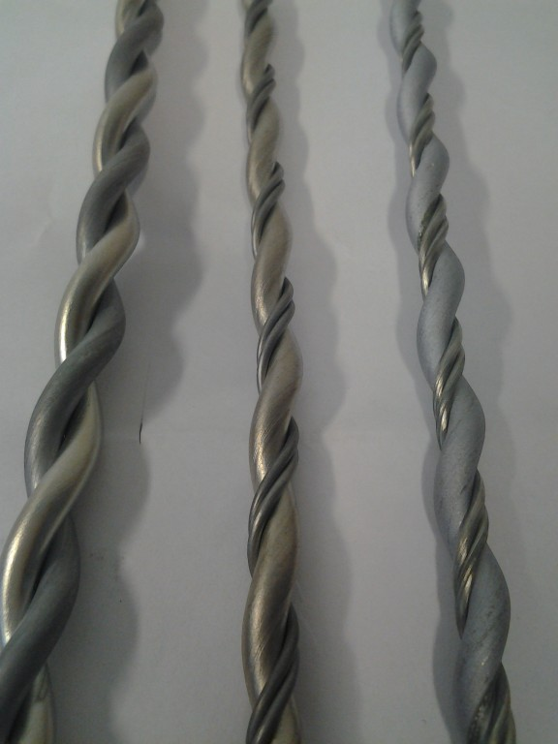
Introduction
Cathodes
Characterization methods:
Electron Stimulated Desorption (ESD)
Sticking Factor Evaluation using the
calibrated leaks (H₂ & CO)
X-ray Photoelectron Spectroscopy (XPS)
  Activation temperature evaluation
Scanning Electron Microscopy (SEM)
  Morphology
  Thickness
  Composition
Special thanks to the team of M.Taborelli and S. Sgobba for the XPS and SEM analysis of the samples

Slide 6
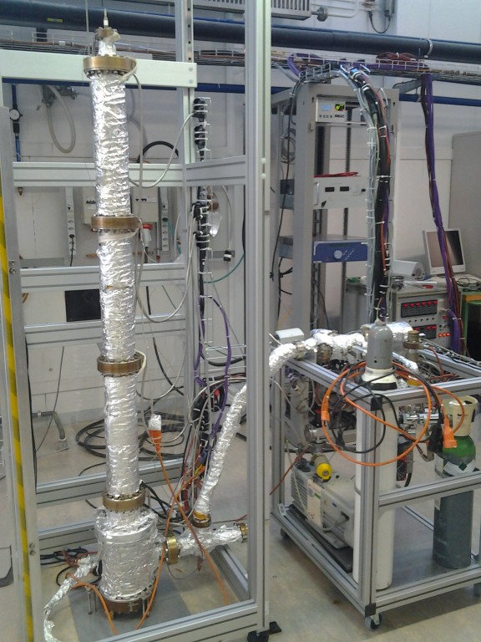
Coating Process
E
Parameters
Est. Thickness: 1μm
Substrate: SS tube
T_{substrate}: 100 ºC
Pressure range:
4x10⁻³ to 9x10⁻³ mbar
Average coating
duration: 9 hours
Magnetic field:
225 Gauss
B
Kr
e⁻

Slide 7
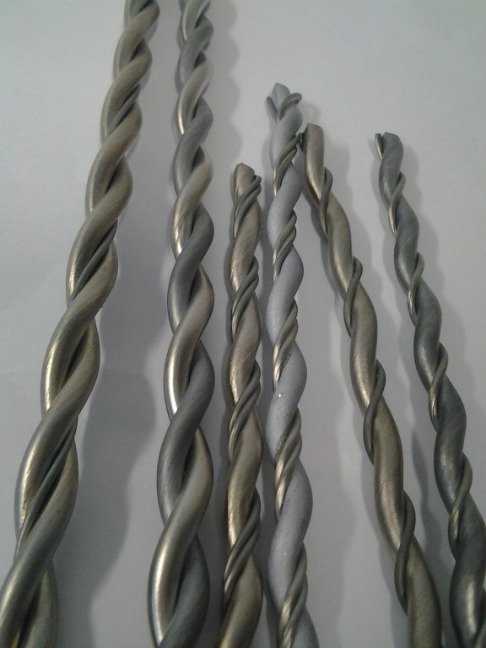
Results: SEM (EDX)
30%,30%,40%

Slide 8
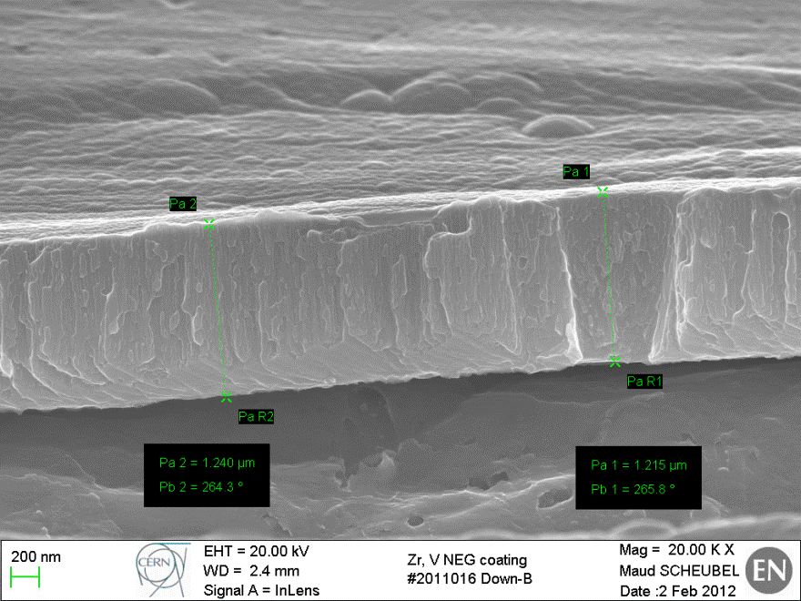
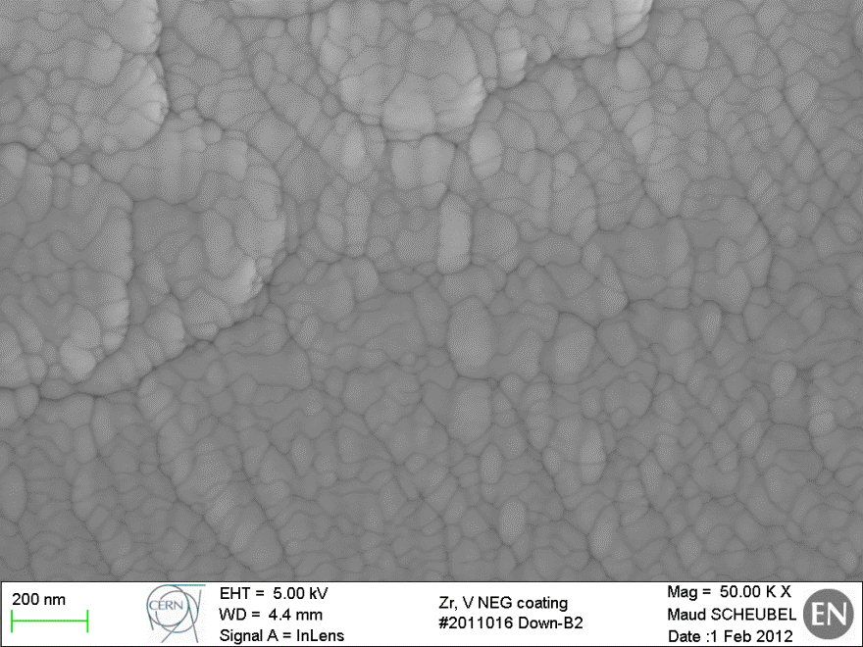
Thickness-Morphology-XPS Results
The estimated thickness for all the coatings was 1μm.
The average measured thickness was between 0.6μm and 2 μm.
The XPS analysis of the samples is confirming the results from the ESD and sticking factor measurements.

Slide 9
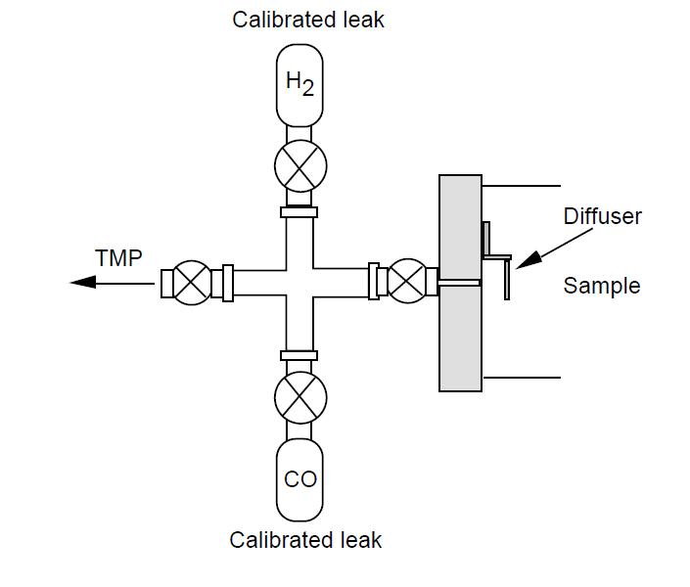
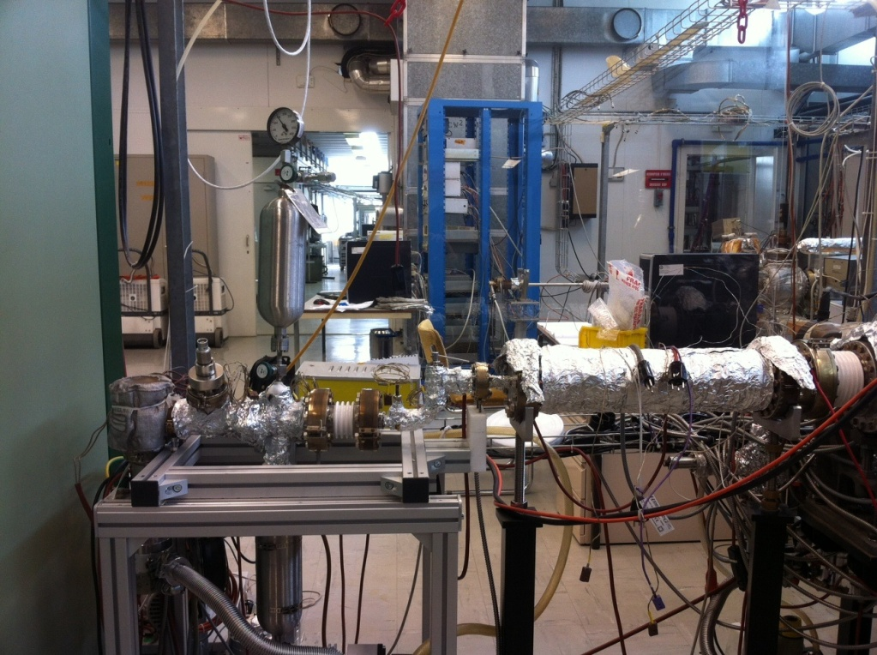
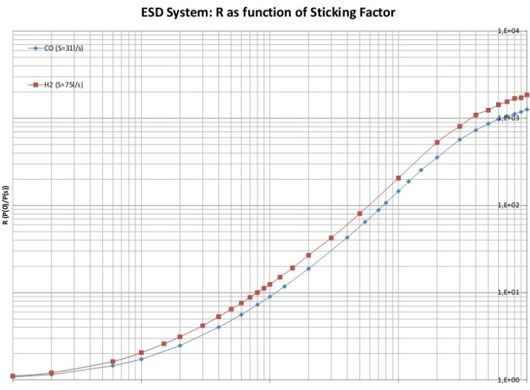
Calibrated leaks method
Q=2,31E-7 Torr·l/s
Calibrated leaks(H₂&CO)
Q=3.192E-6 Torr·l/s
Monte Carlo simulation
At 120ºC (no Pumping)
Seff = Q / ΔP(120ºC)
H₂
R
R = ΔP(120ºC) / ΔP(xºC)
ΔP(120ºC) = P₁₂₀(inj)-P₁₂₀(res)
ΔP(xºC) = P_{x}(inj)-P_{x}(res)
CO
Sticking factor

Slide 10
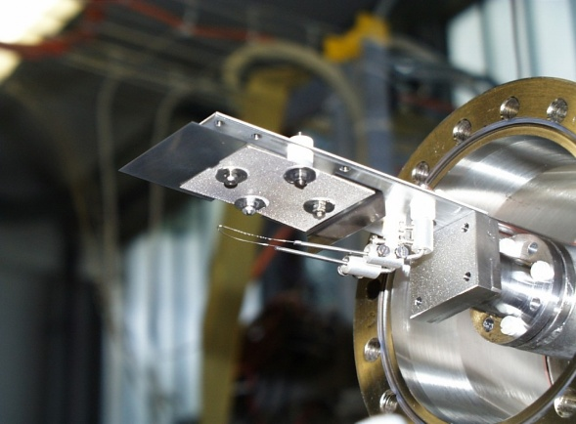
Electron Stimulated Desorption
Bombardment of the tube for 100 sec at 1mA
-100V
+50V
e ⁻
+550V
ΔP = P(100sec) - P(res)
Tungsten filament

Slide 11
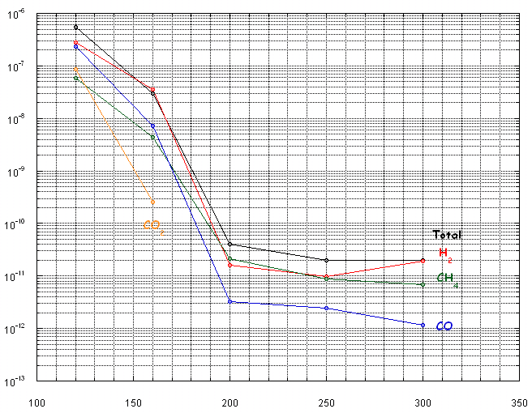
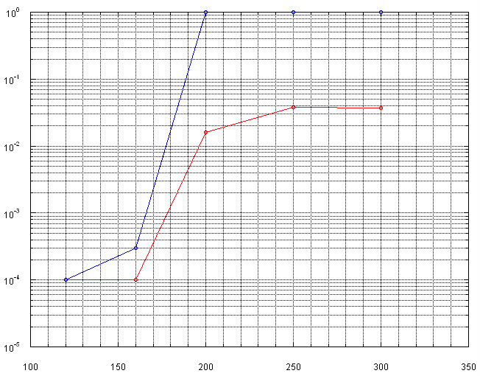
Results from each coating
CO
H₂
ΔP (Torr)
Sticking probability
ΔP by ESD
S.F by calibrated leaks
Heating Temperature [ºC] (for 2 hours)
Heating Temperature [ºC] (for 2 hours)

Slide 12
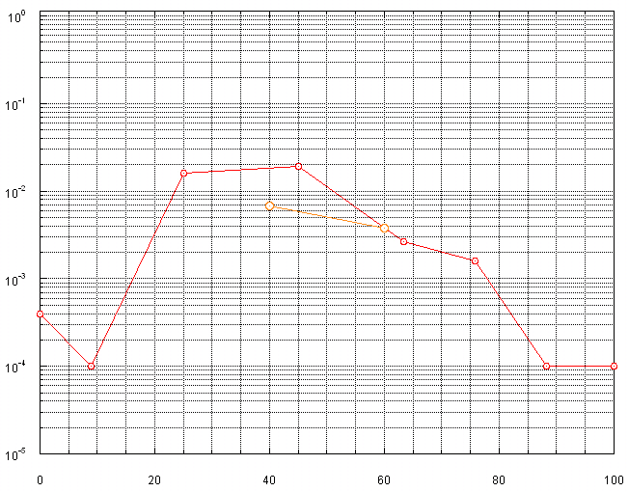
Results: Sticking Factor for H₂
Sticking probability
TiZrV
Ti(5%)ZrV
Heating for 2 Hr at 200 ºC
Zr
% Vanadium
V

Slide 13
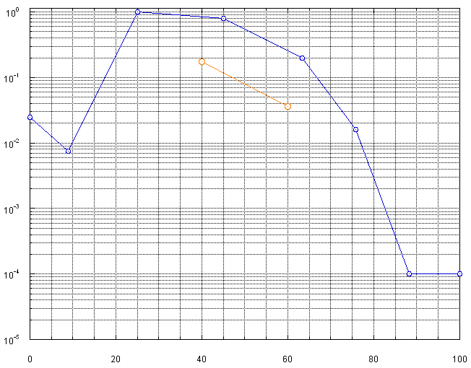
Results: Sticking Factor for CO
TiZrV
Ti(5%)ZrV
Sticking probability
Heating for 2 Hr at 200 ºC
Zr
% Vanadium
V

Slide 14
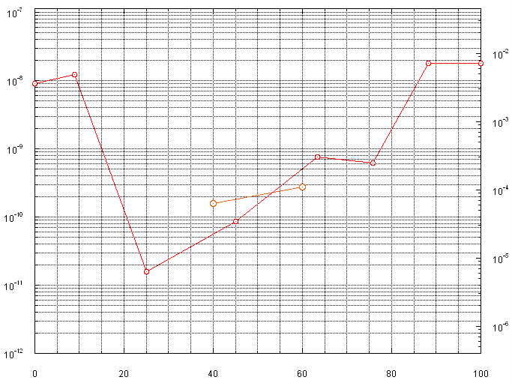
Results: ΔP for H₂
Effective Desorption Yield
[molecules/electron]
ΔP (Torr)
TiZrV
Ti(5%)ZrV
Heating for 2 Hr at 200 ºC
Zr
% Vanadium
V

Slide 15
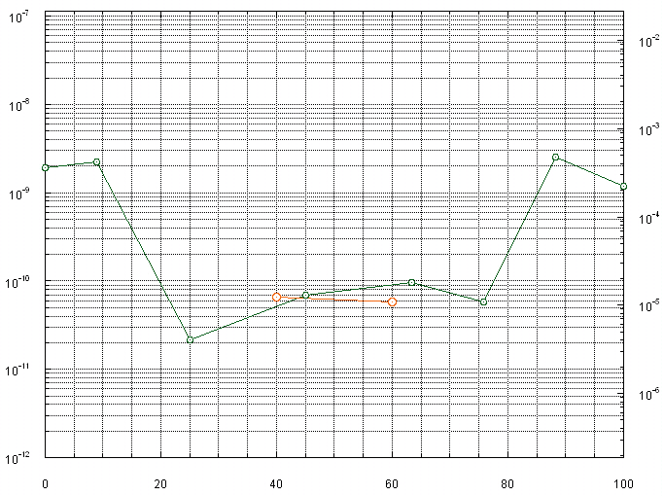
Results: ΔP for CH₄
Effective Desorption Yield
[molecules/electron]
ΔP (Torr)
TiZrV
Ti(5%)ZrV
Heating for 2 Hr at 200 ºC
Zr
% Vanadium
V

Slide 16
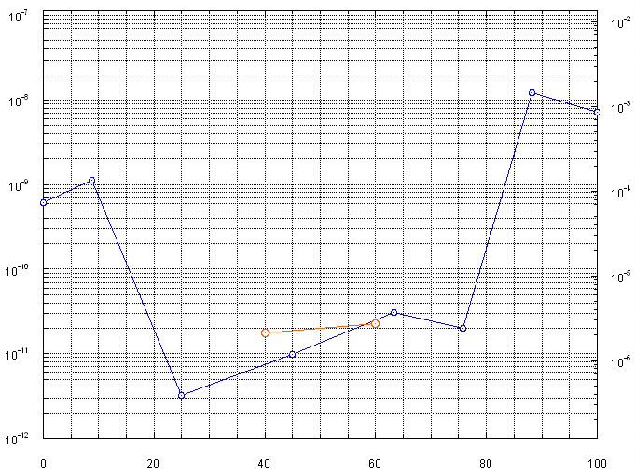
Results: ΔP for CO
Effective Desorption Yield
[molecules/electron]
ΔP (Torr)
Ti(5%)ZrV
TiZrV
Heating for 2 Hr at 200 ºC
Zr
% Vanadium
V

Slide 17
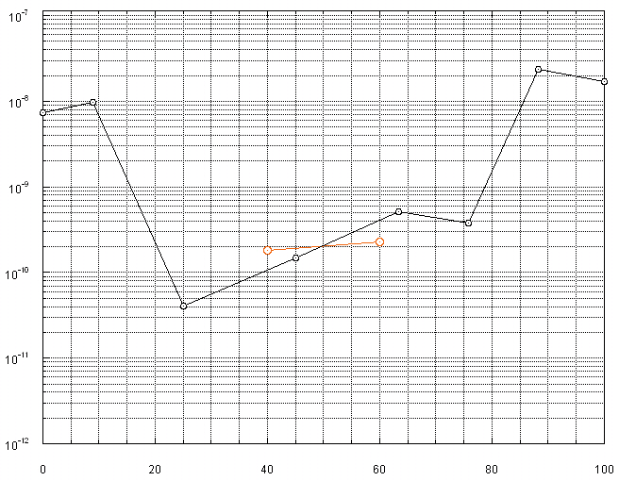
Results: Δp Total
TiZrV
ΔP (Torr)
Ti(5%)ZrV
Heating for 2 Hr at 200 ºC
Zr
% Vanadium
V

Slide 18
Conclusions - Future work
TiZrV may not be the best composition
Necessary to continue the R&D for NEGs
To make more functional measurements (pumping speed, ageing, etc) for the best ZrV composition (30-40%V)
To introduce new materials (Hf, Y) for NEG coatings

Slide 19
Thank you for
your attention!
Thanks:
to the people working in the lab for their help

