Slide 1


Slide 2
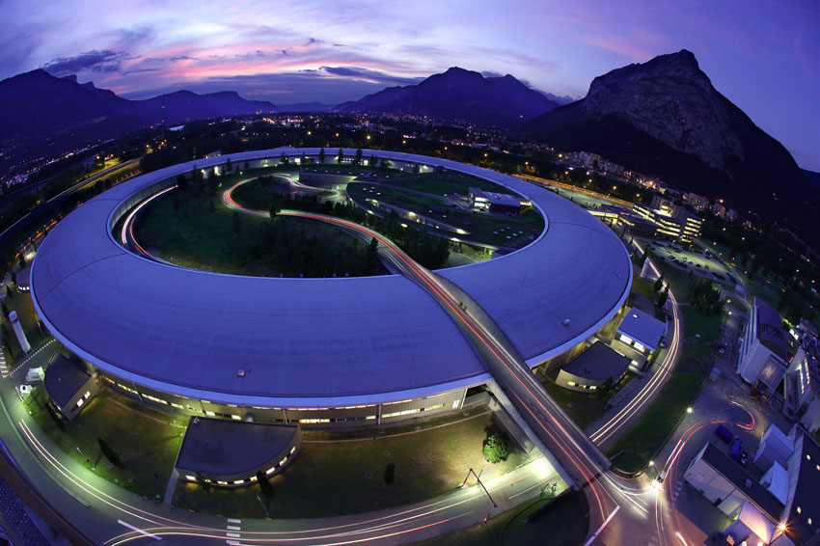
Michael Hahn: Reporting for the ESRF TID Vacuum Group

Slide 3
Overview
Objectives of the ESRF upgrade program
New buildings, time schedule for construction
Modification of the accelerator vacuum systems
Some words about new beamlines
First data from intermediate accelerator restart 3-2012
Conclusions, discussion

Slide 4

ESRF upgrade objectives

Slide 5
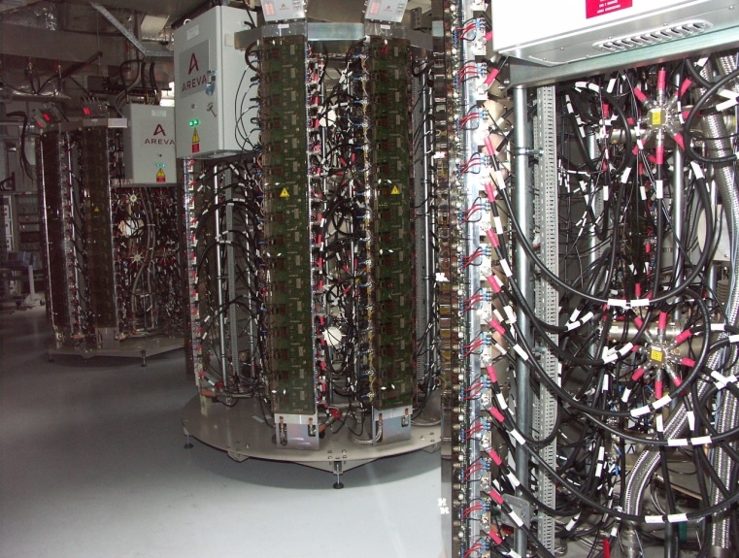
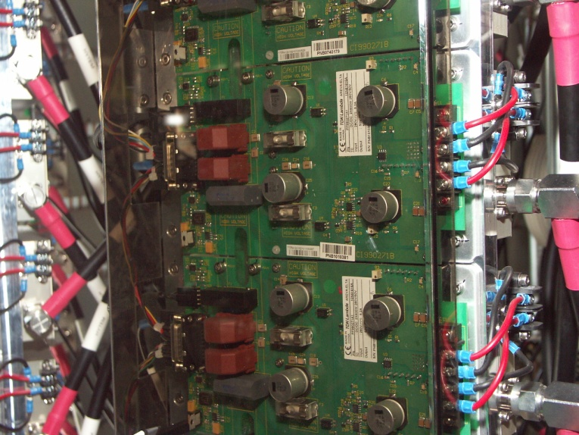
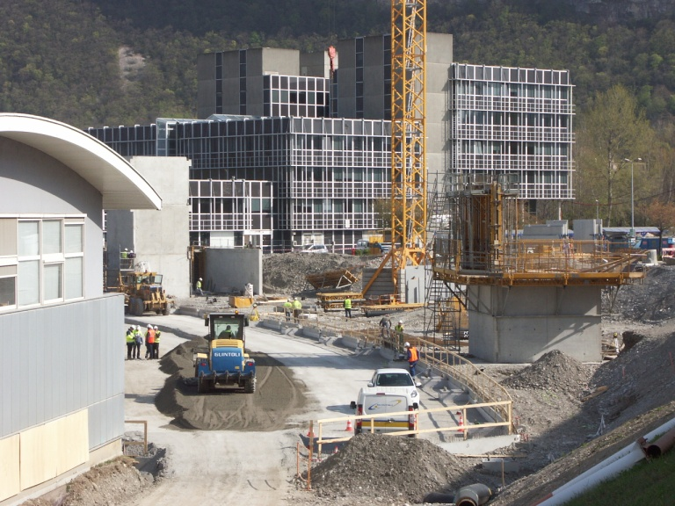
ESRF upgrade objectives
Accelerator: Smaller source size and technologic update (HOM damped cavities, Solid state amplifier replace klystrons), longer straight sections
Longer beamlines to project small source on the sample
New buildings to house these long beamlines and provide space for labs and offices, low vibration floor “golden slab”
New X-Ray detectors, main objective to increase efficiency

Slide 6
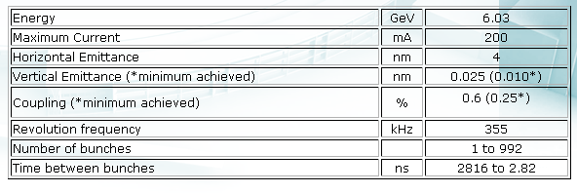
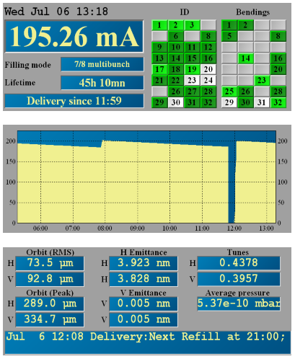
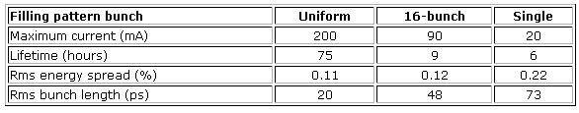
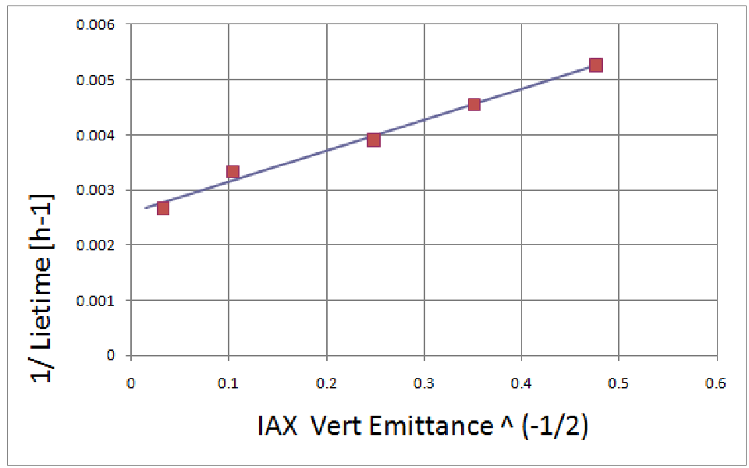
Reminder: The Source
Tau_V = 387 hrs

Slide 7
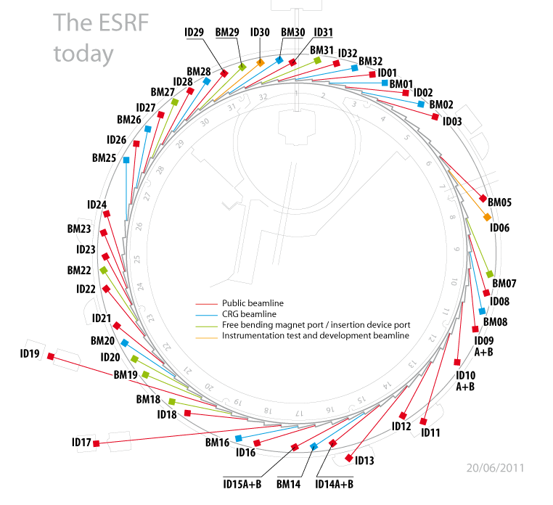
Beamlines
Info Beamlines
A number of beamlines will be extended in length to project a smaller source size to obtain an increased spatial resolution of the sample (nano-science).
There will two big new buildings between ID27 and ID3.
There will be one new building for ID16 extension

Slide 8
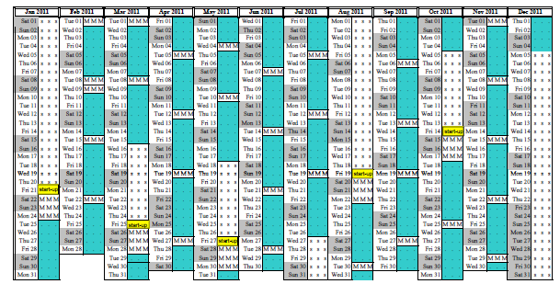
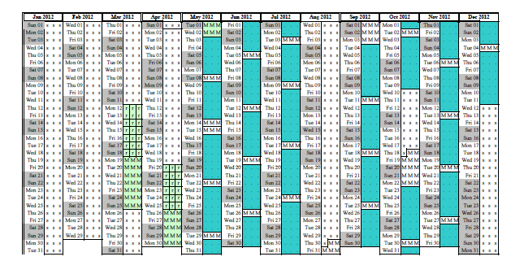
Long shutdown to allow construction of buildings has been used intensively to carry out modifications on accelerators and beamlines (phase 1 of the upgrade)
Vent 6 sectors for 2 new 6m sections
Vent 6 sectors for 2 new 6m sections
Intervene on 2 cavities
Cryogenic In Vacuum undulator,
Prepare 7m section
Alignment
Intermediate restart
Install new NEG-coated chamber,
Exchange varnished chambers

Slide 9

Reminder: Storage ring vacuum system: 32 cells
“Standard”: 5m straights equipped with three out-of-air Insertion devices (picture) or two in-vacuum undulators
Summer 2011

Slide 10
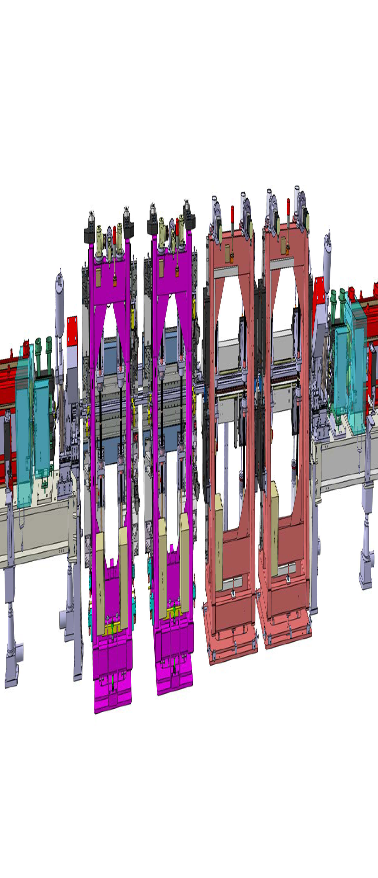
ESRF upgrade program – 6m ID sections
The 6m Al 6061 chamber is made of the same extrusion like the 5m chambers (beam chamber 57 x 8 mm² for an outside vertical height of 10 mm
They are coated at ESRF with about 800nm TiZrV
A first series of 6m chambers had been done with a small SIP in the middle, the actual model doesn’t

Slide 11
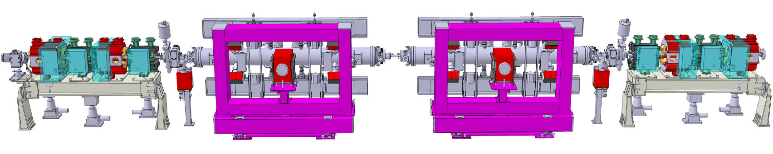
ESRF upgrade program – 6m ID sections
A six-meter straight section can be filled with two in-vacuum undulators (RT or cryogenic ones), in difference to what is shown on the image the upstream and downstream ion pumps would go on the girdeur and would be consequently above the electron beam plane.
Due to careful assembly, massive pumping speed installed and quick vacuum conditioning in vacuum undulators can be installed without bake-out. This is important for certain qualities of NdFeB magnet material with lower Curie-temperature (de-magnetization)

Slide 12
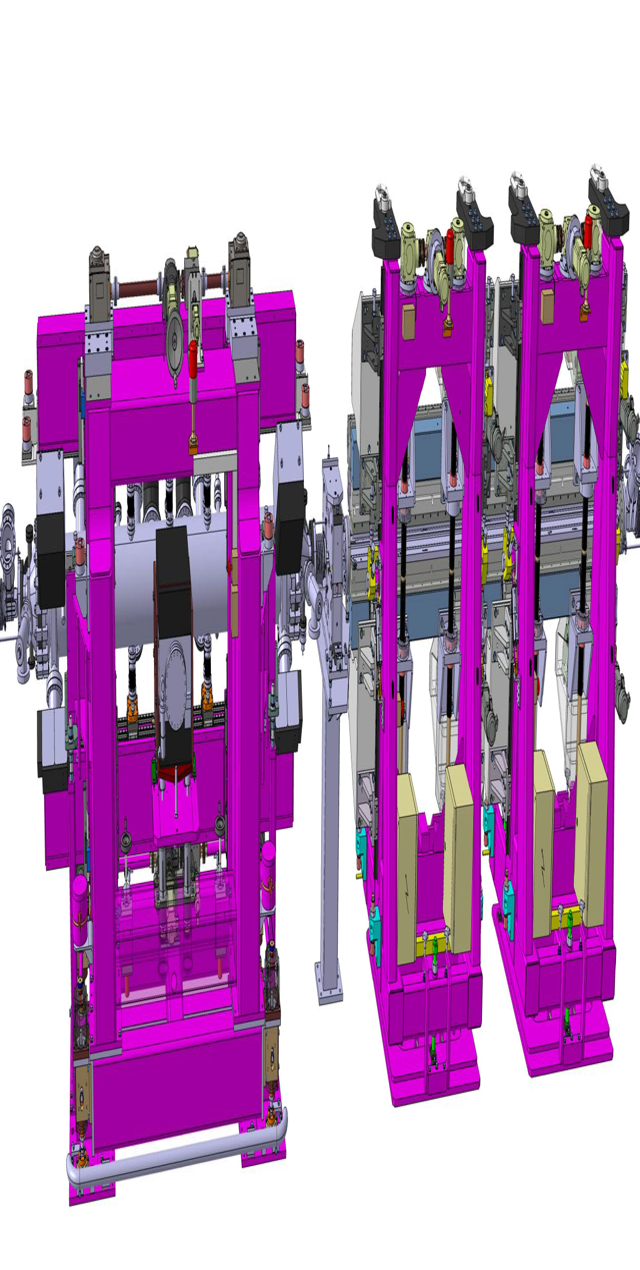
ESRF upgrade program – 6m ID sections

Slide 13
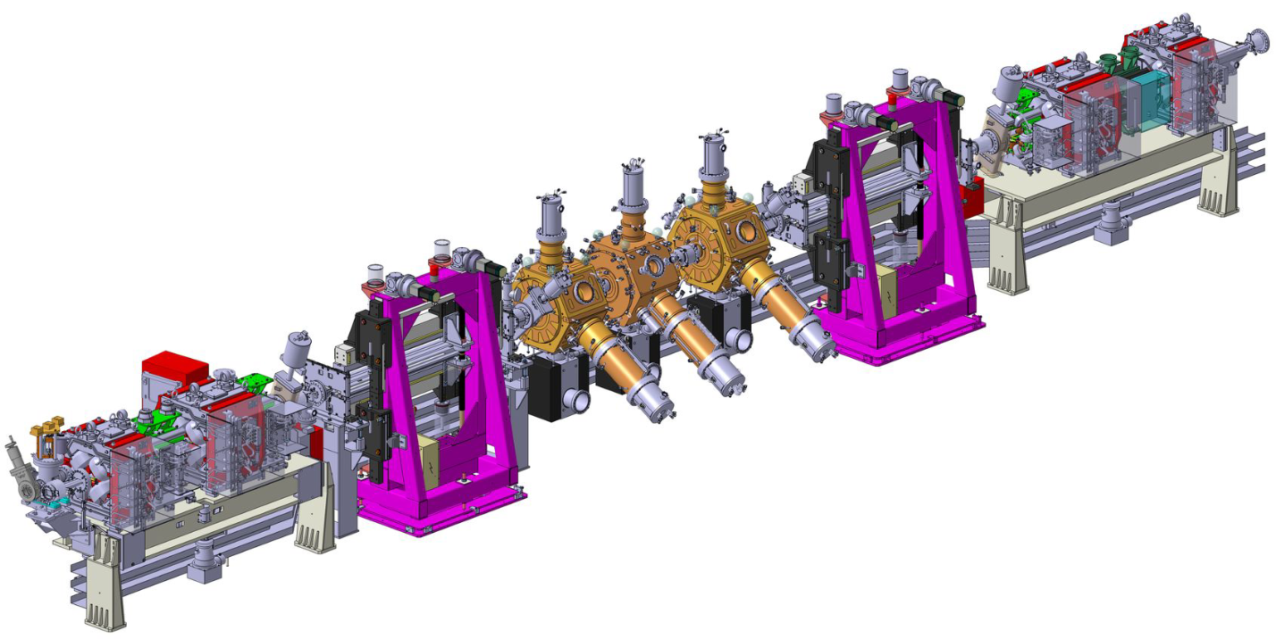
ESRF upgrade program – 7m straight section
7m section under preparation

Slide 14
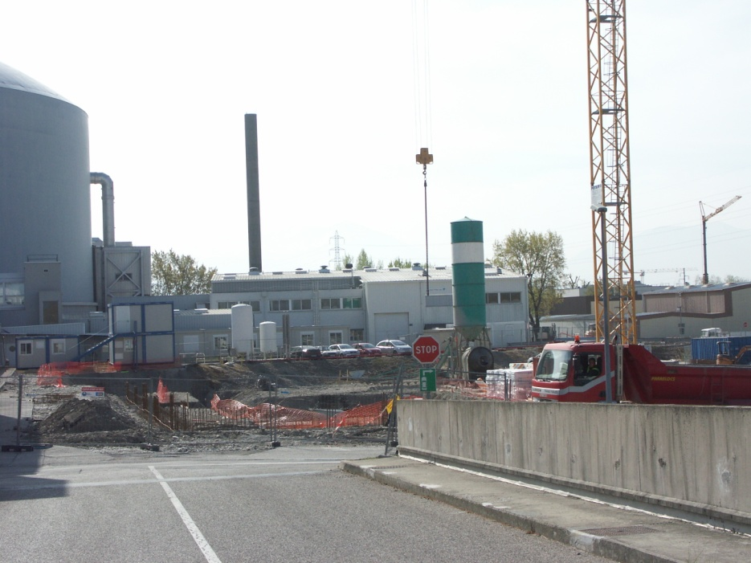
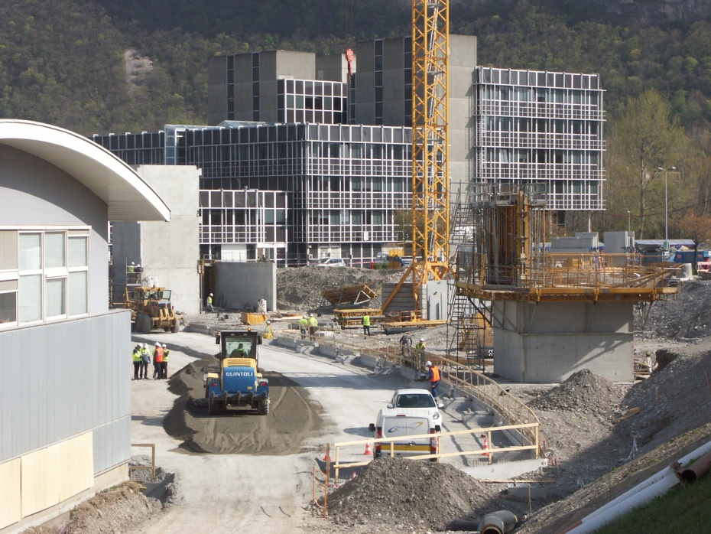
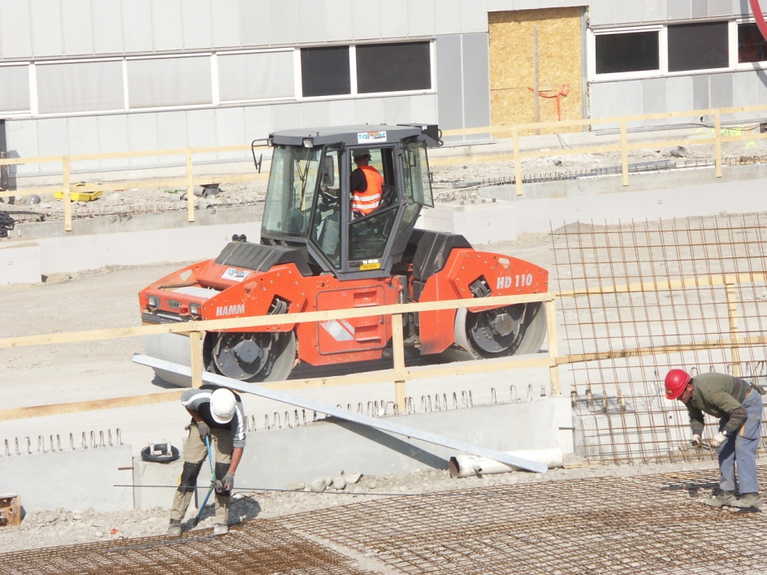
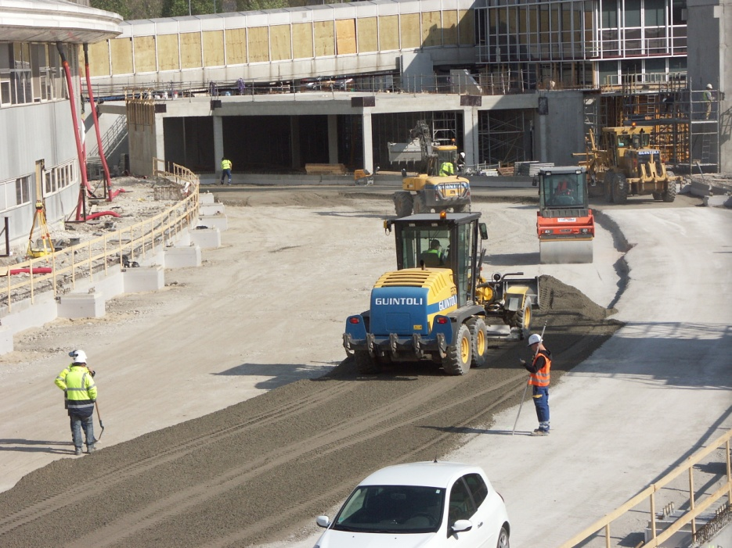
Impressions of upgrade activity / buildings

Slide 15
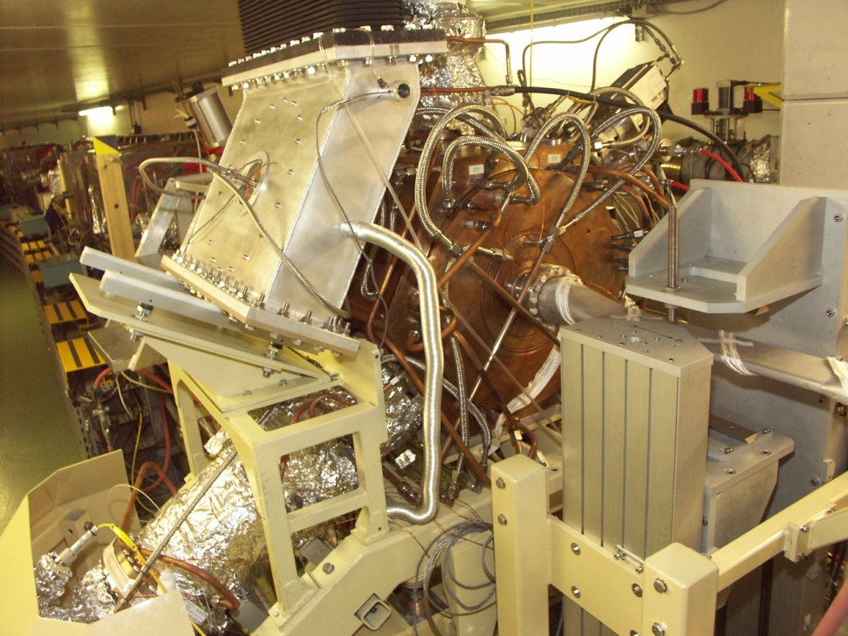
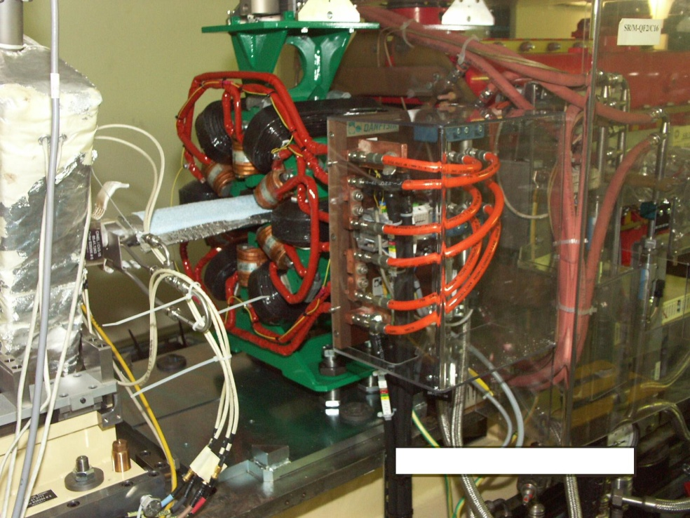
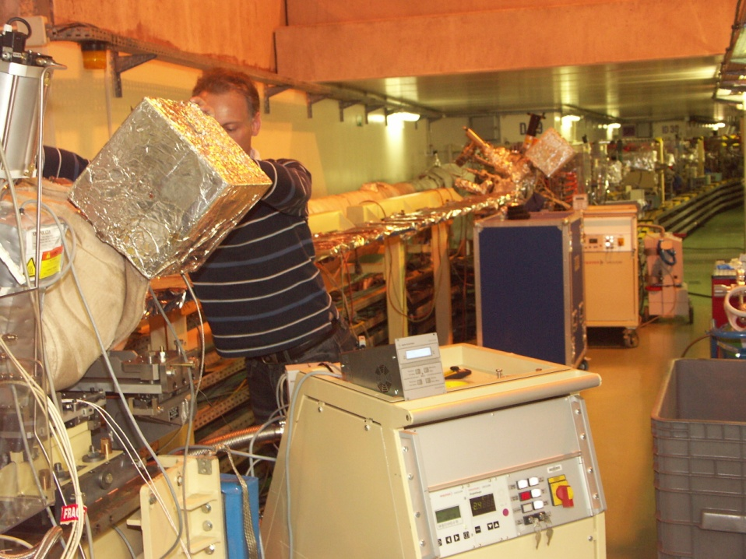
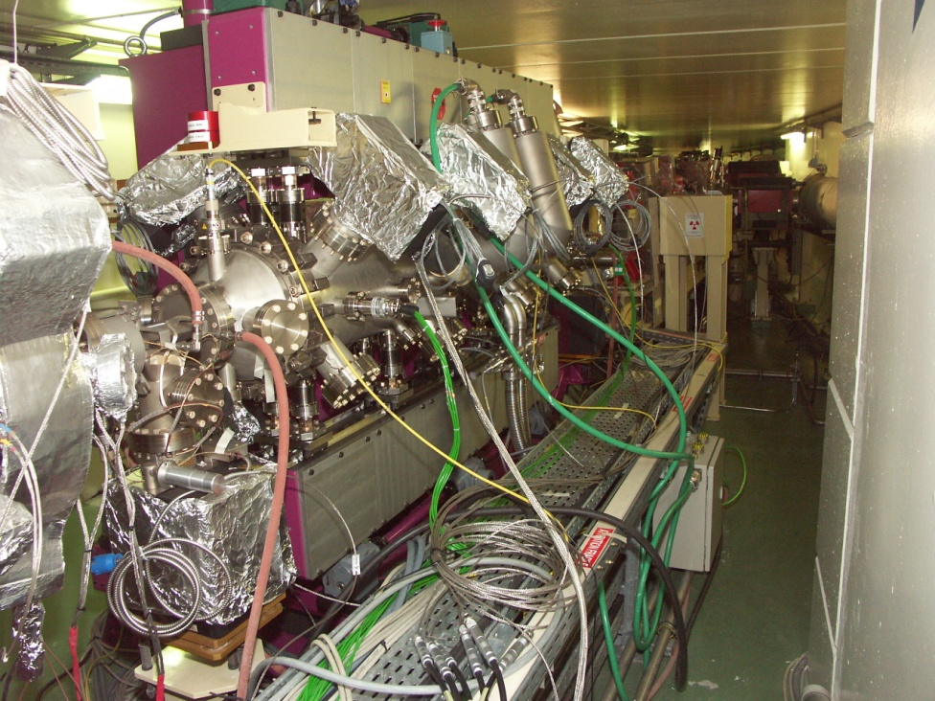
Impressions of upgrade activity / storage ring

Slide 16
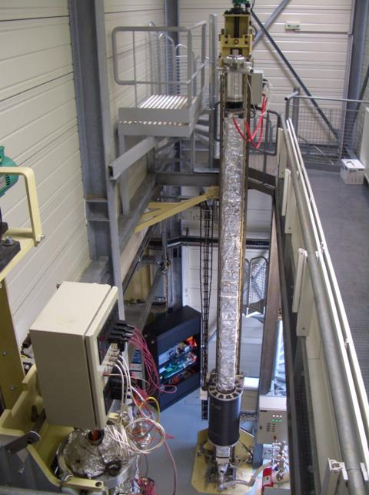
ESRF upgrade program – NEG coating
Two NEG deposition tools (5m and 6m) are operating to produce chambers for upgrade of SR and (later) beamlines
Passing from 5m to 6m several production methods and parameters had to be reviewed, new quality controls had to be injected (X-Ray fluorescence check)
The in-situ activation procedure and first exposure to SR is critical for the result

Slide 17
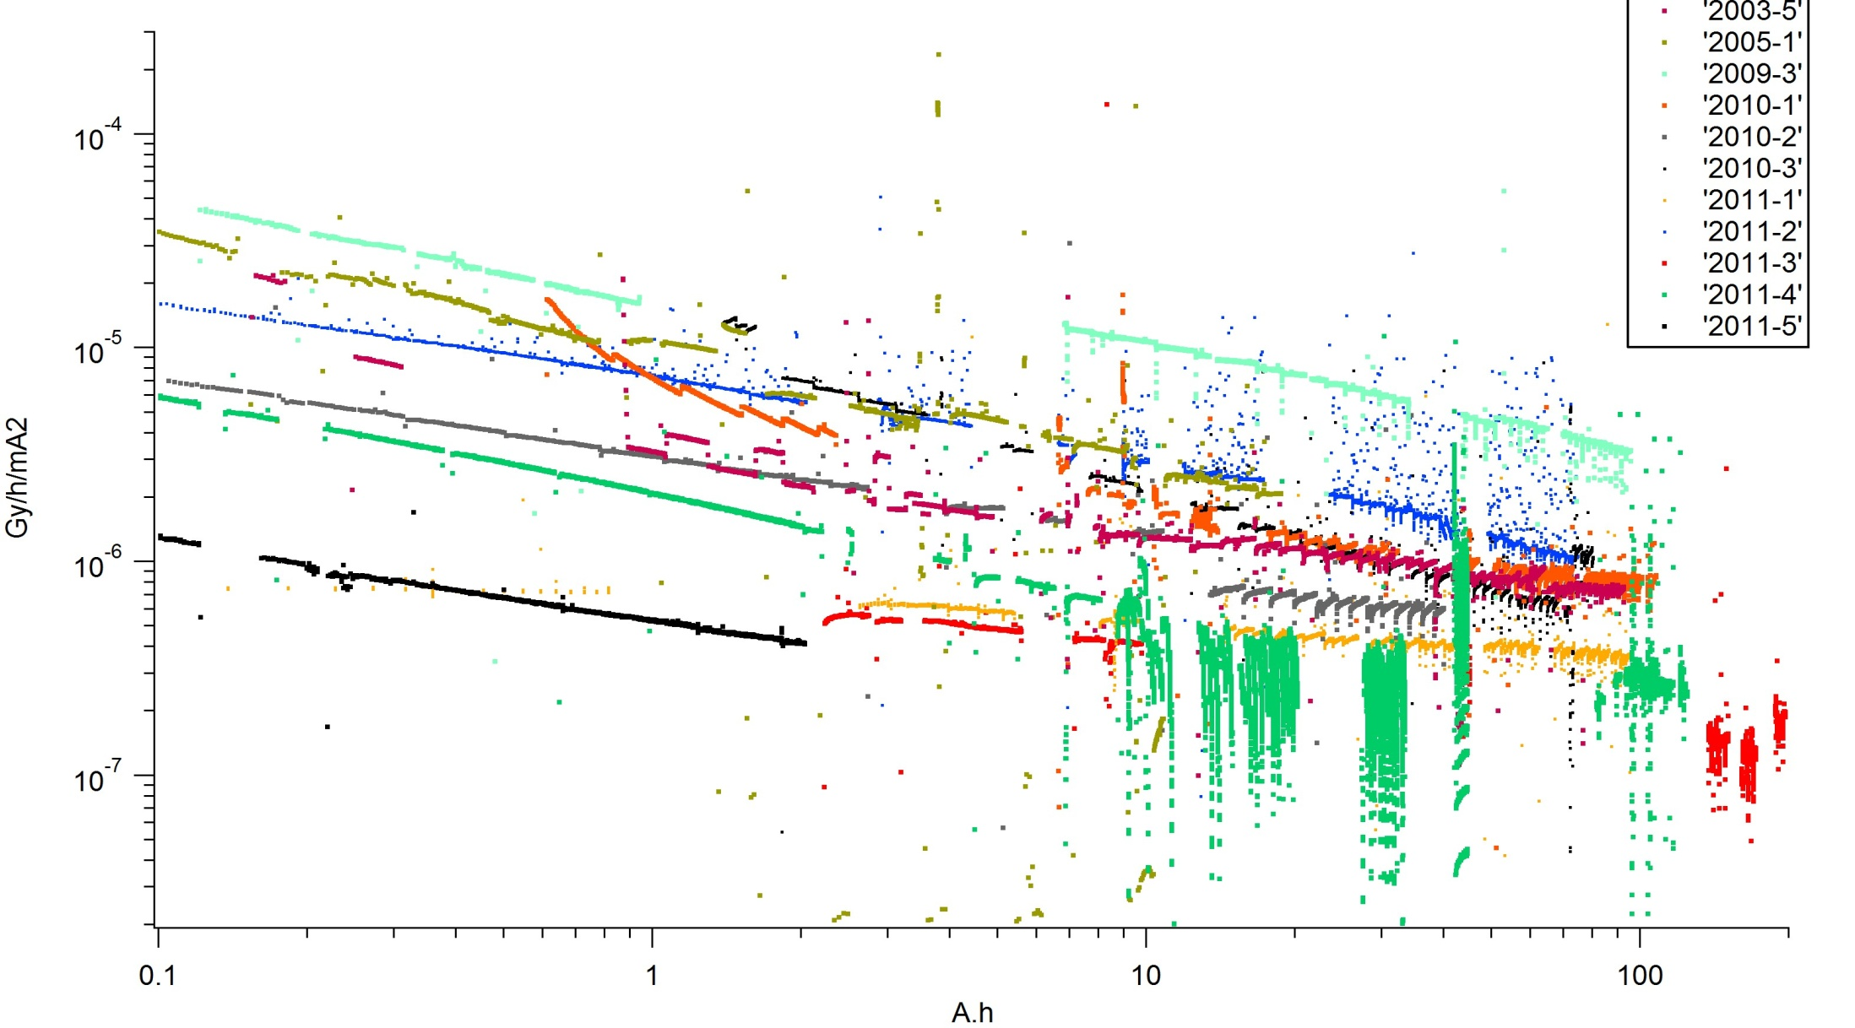
Today, 8 six meter chambers are installed. After activation test and X-Ray fluorescence check they went all through a final pre-qualification by Bremsstrahlung measurement on sector ID30.

Slide 18
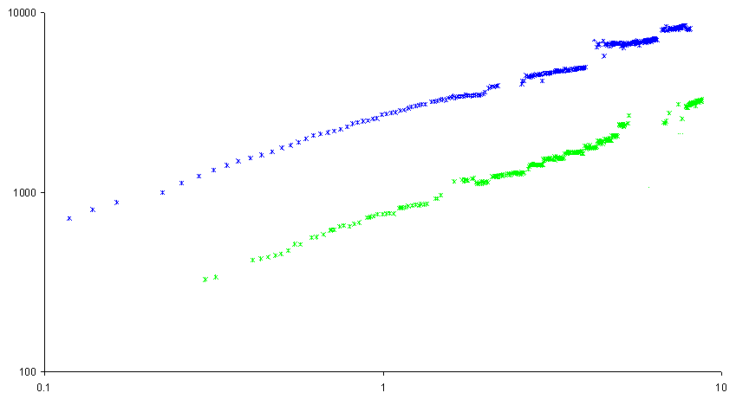
Data from intermediate restart (March 2012): Lifetime conditioning, RUN04-2011 compared with RUN01-2012
8100
3200
Lifetime * Current / A hr
90 meters of the SR vented
230 meters of the SR vented
Integrated dose / A hr

Slide 19
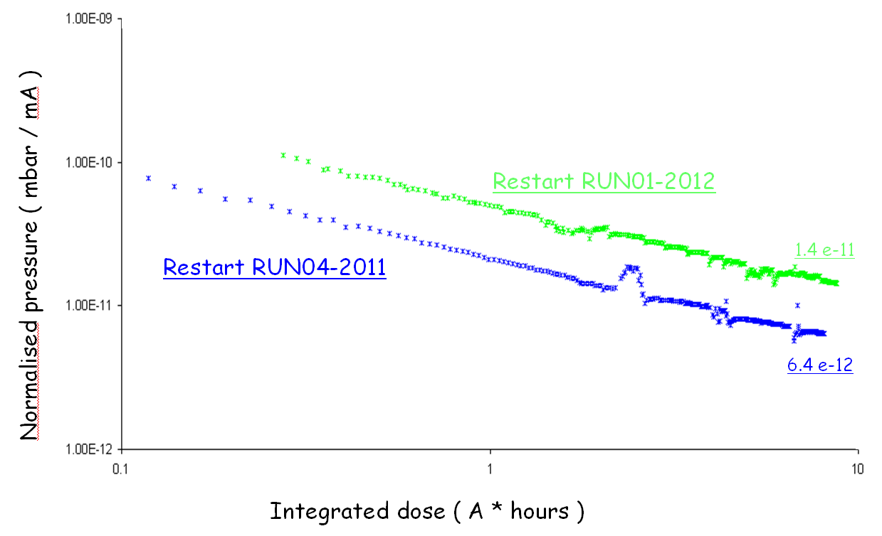
Data from intermediate restart (March 2012): SR average Pressure Vacuum conditioning RUN04-2011 compared with RUN01-2012

Slide 20
Conditioning of a “clean” chamber during intermediate restart
CELL1 : 6 meters NEG coated Straight Section
Spectrum after 1 A*hours stored
Spectrum after 8 A*hours stored
Normalised partial pressure ( mbar/mA )
Conditioning effect ( % )
45%
40%
50%
36%
30%

Slide 21
Conditioning of a “not so clean” chamber during intermediate restart
CELL11 : Cryogenic Invacuum device
Spectrum after 1 A*hours stored
Spectrum after 8 A*hours stored
Normalised partial pressure ( mbar/mA )
Conditioning effect ( % )
39%
37%
55%
50%
35%

Slide 22
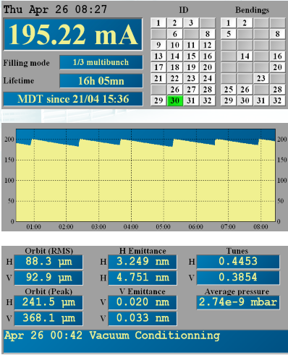
Conditioning data of yesterday
The 2nd part of the long shutdown has been completed, a new NEG coated 6m chamber has been installed, a varnished chamber has been replaced
The new NEG coated chamber confirms the good results we got in terms of Bremsstrahlung on ID30 for the last 8 chambers
We are preparing USM (User service mode) for begin of May.

Slide 23
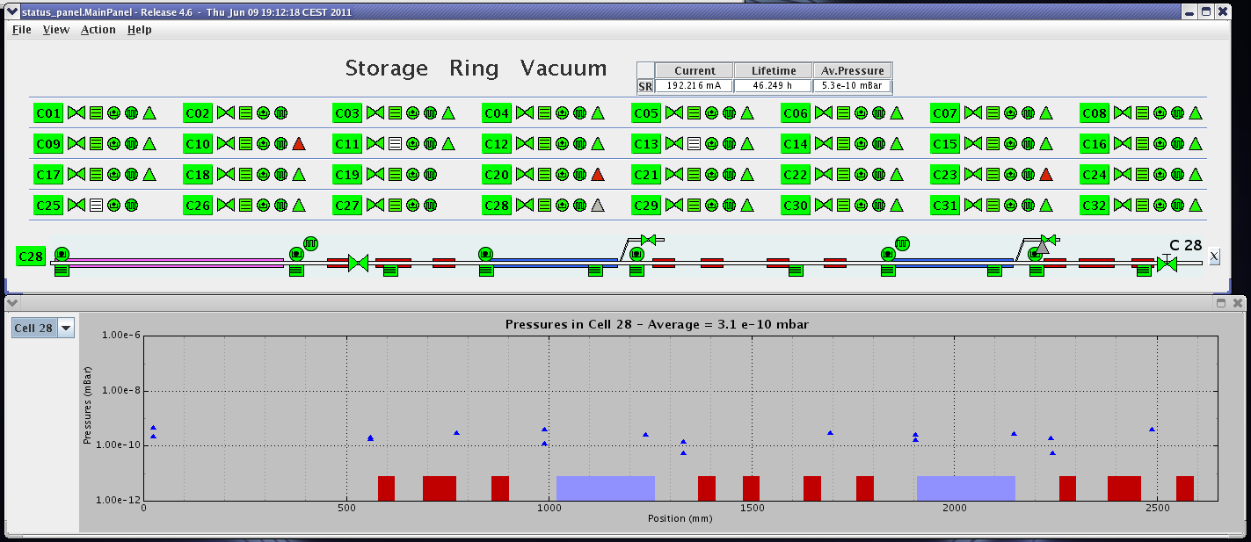
ESRF upgrade program – Accelerator vacuum control
More modern RGA electronics and IPPS allow a detailed analysis of the accelerator vacuum
New TANGO-based applications and interfaces have been produced, global commands speed up restart time

Slide 24
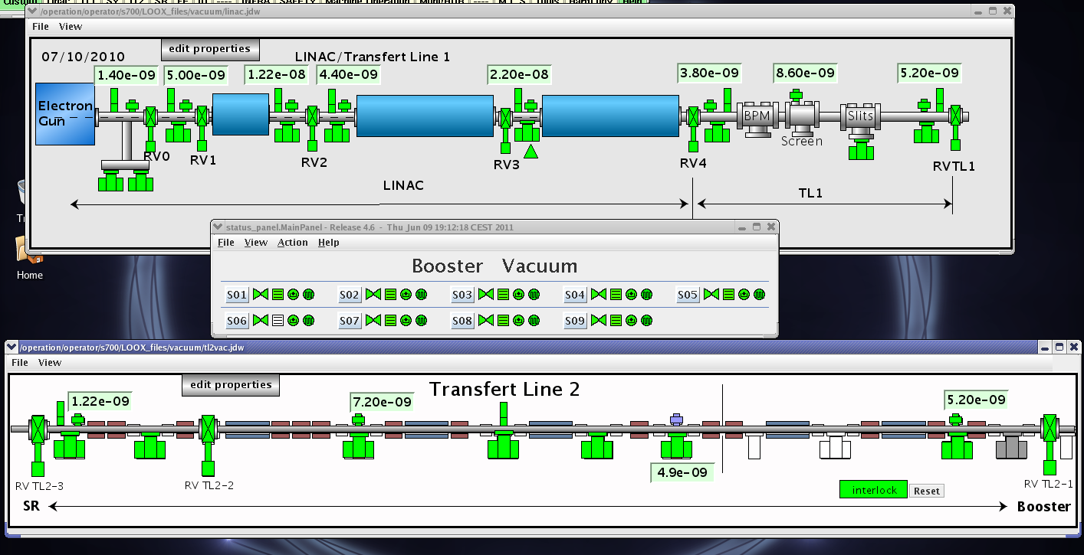
ESRF upgrade program – Accelerator vacuum control
The UI design concept for the SR is used also for pre-acclerators and transfer line: Quicker learning curve

Slide 25
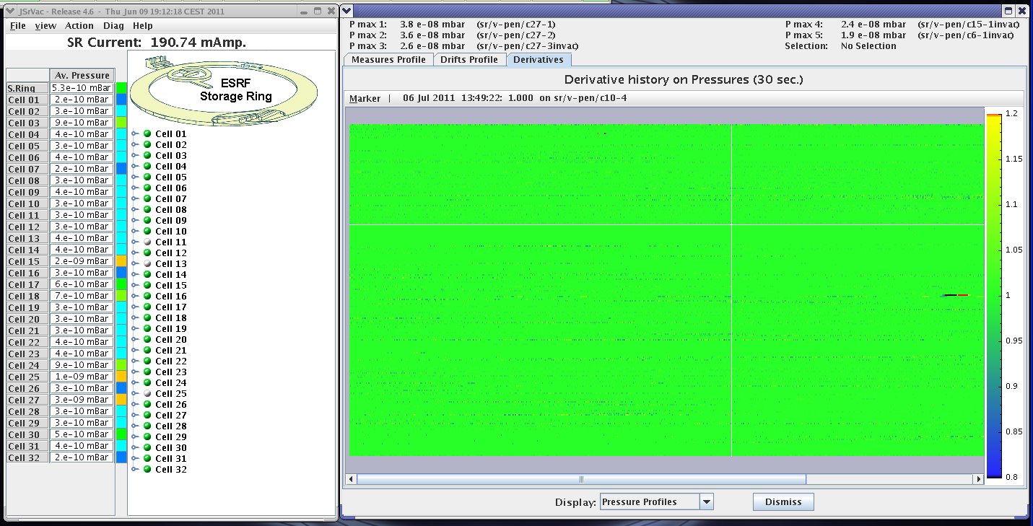
ESRF upgrade program – Accelerator vacuum control
Follow-up of derivatives of pressures and temperatures helps to trace problems
Summer 2011

Slide 26
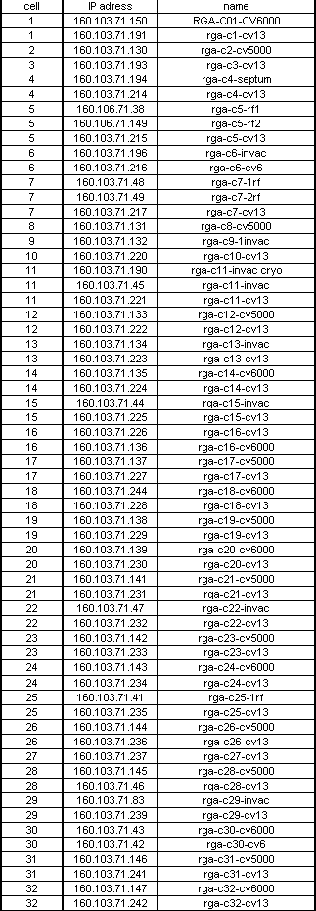
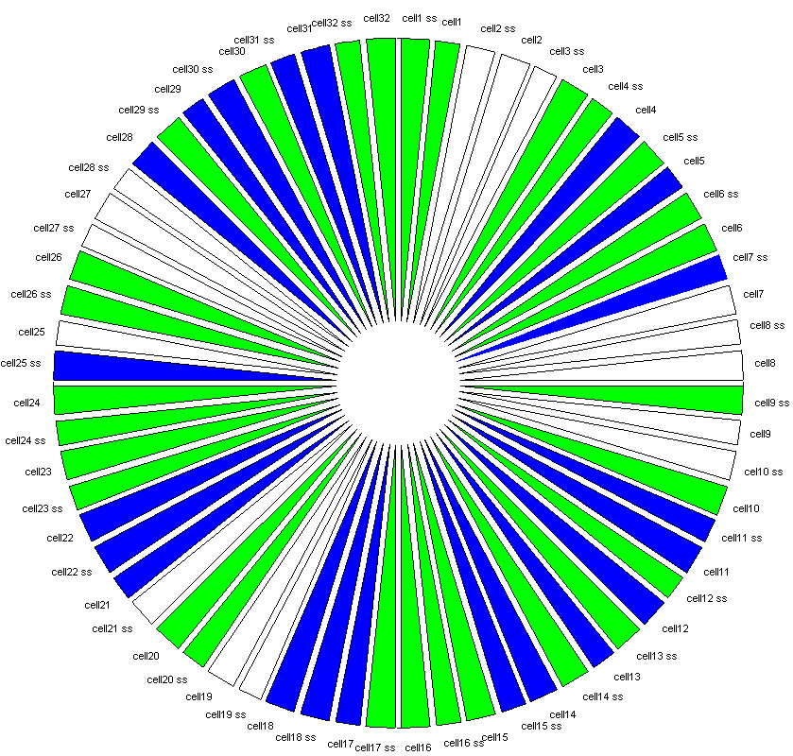
ESRF upgrade program – Accelerator vacuum control
Equipment with MV-II and MV-IP RGA electronics
146
241
147
242
150
191
130
42
43
193
239
194
83
IP address : 160.103.71.xxx
214
46
149
145
215
237
196
216
236
48
144
217
235
131
41
MV2
IP
234
132
143
233
142
220
232
190
47
221
231
133
141
222
230
134
139
223
229
138
224
135
228
244
227
137
226
136
225
44

Slide 27
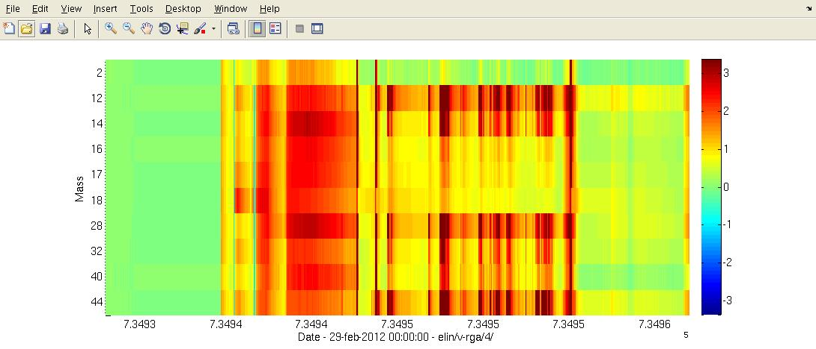
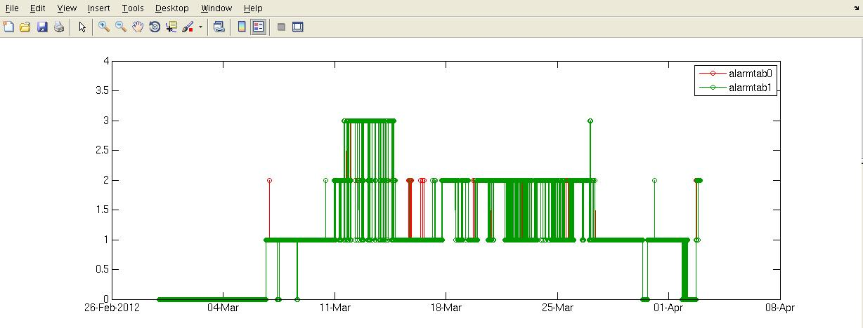
ESRF upgrade program – Accelerator vacuum control
Partial pressure alarm system (A. Meunier)
Alarm
Air leak
outgassing
Summer 2011

Slide 28
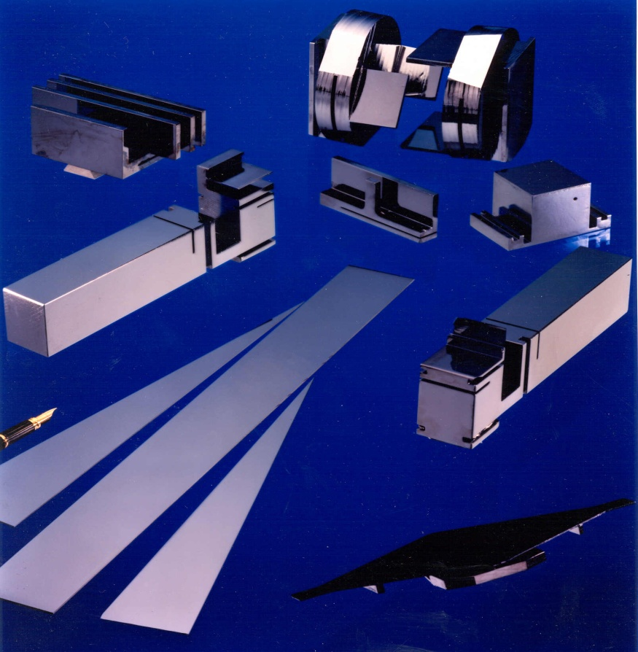
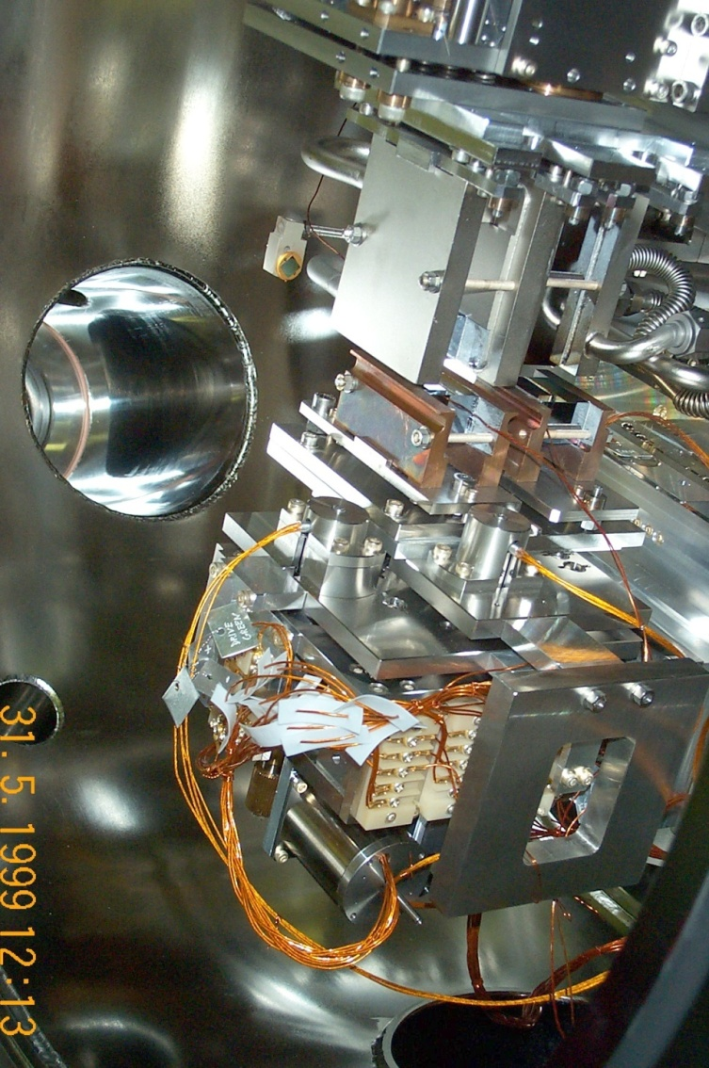
ESRF upgrade program – Beamline vacuum control
More and more upgrade beamlines would like to use (also) low energy photons, therefore the beryllium windows separating beamline from accelerator vacuum need to be removed
Therefore the VG installs systematically a RGA at the principal separation valve RV0
The beamline total and partial pressure data will be stored in a Historical Database (HDB) like accelerator data
With the use of low energy photon absorption by carbon deposit developing on X-Ray optics due to “dirty” vacuum becomes more important
The VG looks into this

Slide 29
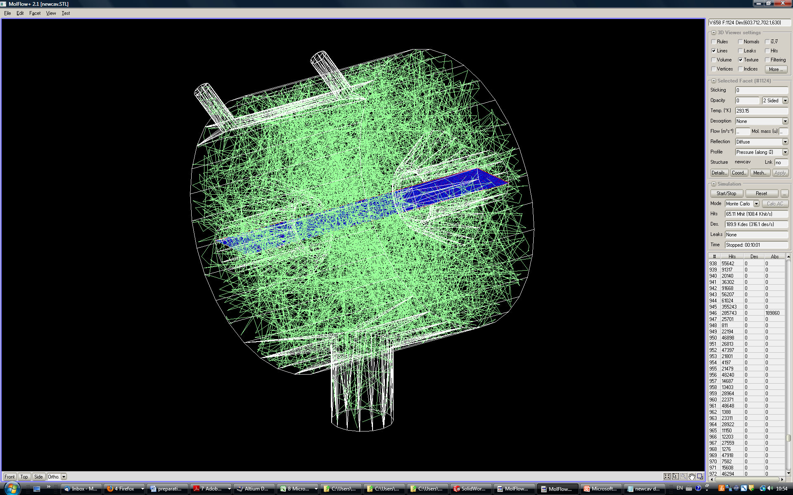
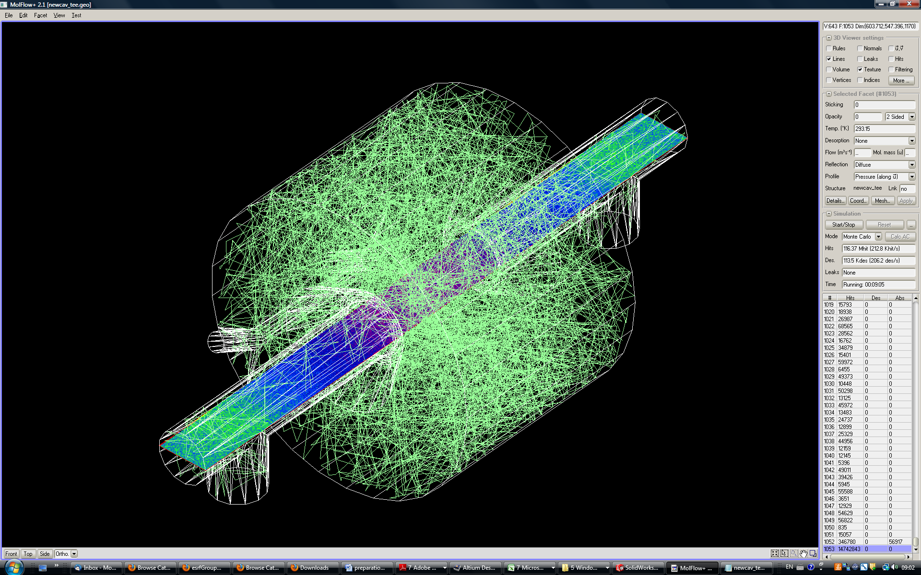
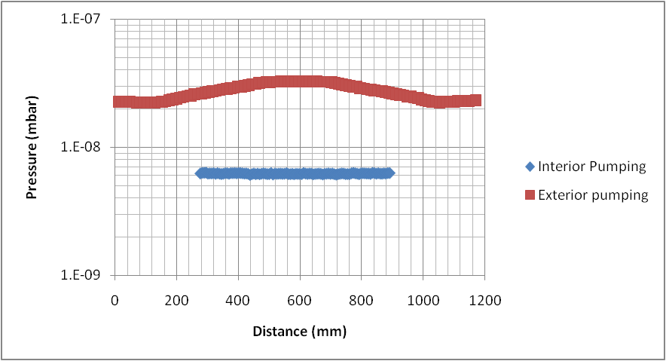
Vacuum calculation, simulation: Molflow approach
Molflow+ by R. Kersevan (CERN) and J.L. Pons (ESRF)
Simulation of the HOM damped cavity by H.P. Marques (ESRF)

Slide 30
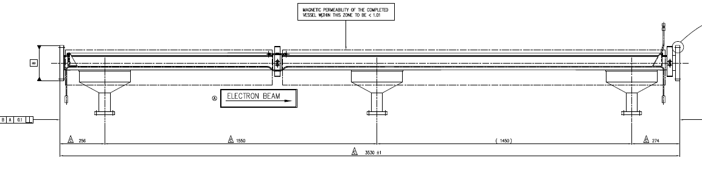
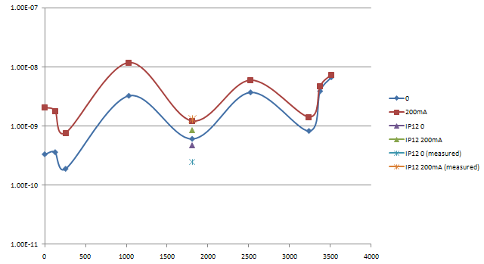
Vacuum calculation, simulation: electric analogy approach (ALTIUM)

Slide 31
Conclusions
During the 5 months shutdown ESRF carried out a lot of maintenance and vacuum interventions within two time slots on the storage ring
The 6m sections will replace some of the 5m ones, today there are eight of them: There will be one 7m section (HOM-damped cavities)
A huge part of the (old) vacuum system remains on the SR, due to aging systematic analysis and maintenance become priority
Construction of the new beamlines has started, will continue for the next years, NEG coating may be interesting for long flight tubes
More and more beamlines remove the Be windows to profit from low energy photon beam: We extend our vacuum control philosophy towards the beamlines
More info on ESRF vacuum upgrade: Check JACOW for I. Parat, H.P. Marques, A. Meunier, M. Hahn (IPAC11;IPAC12)
Thank you very much for your attention

