Slide 1
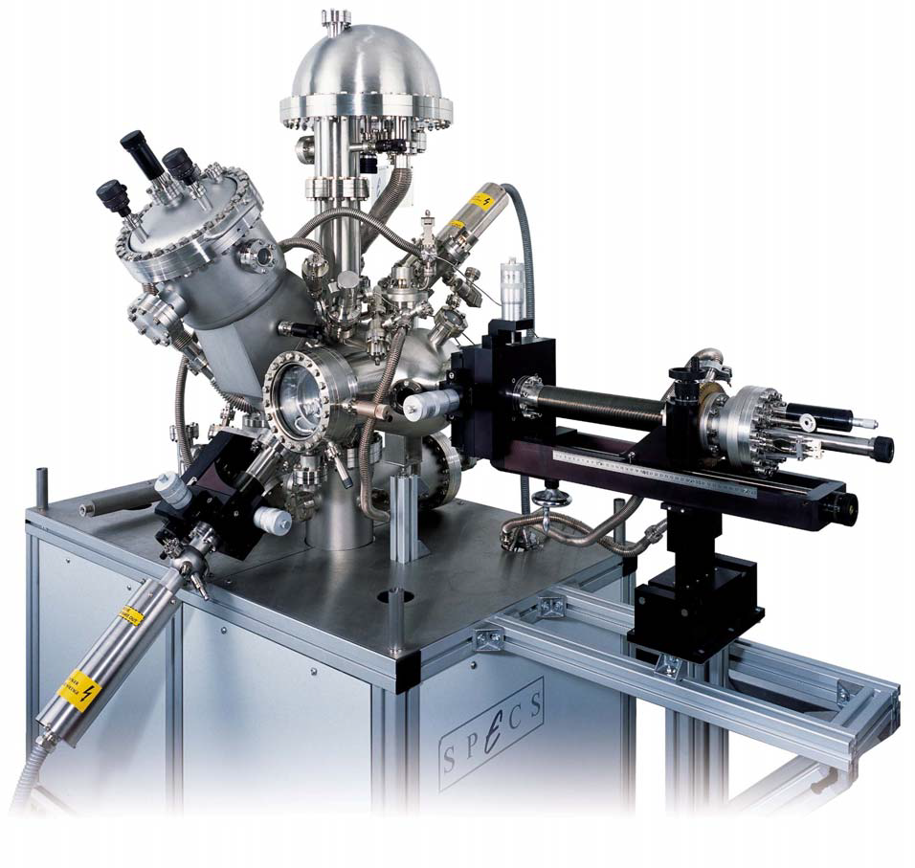
Commissioning of the new XPS
SPECS system
Section:
Surface Coating &Chemistry
Elise USUREAU
October 2011 – May 2012

Slide 2
Contents
XPS presentation
Commissioning
Comparison with older system (ESCA5400) + Issues
Future work
Conclusion

Slide 3
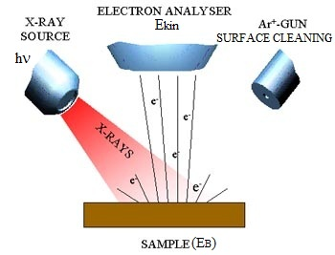
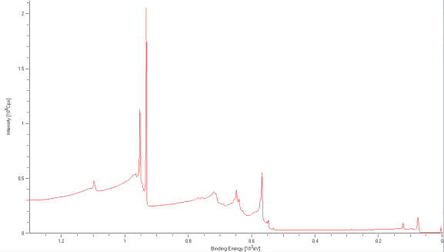
XPS presentation
XPS: X-ray Photoemission Spectroscopy
– Φ
E_{K} = hν – E_{B}
Photoelectric effect
Photoelectrons from Soft X-rays
→ Surface analysis (0.3 – 3.0 nm)
Sweep in Kinetic Energy to know the Binding Energy of the photoelectrons, which is specific to the elements:
→ Spectrum: elemental composition…

Slide 4
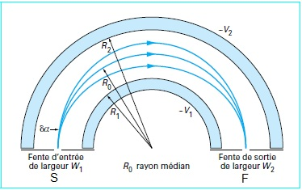
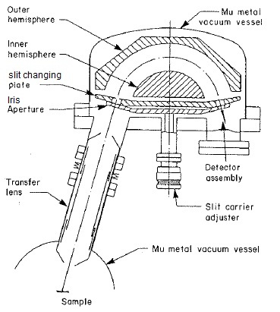
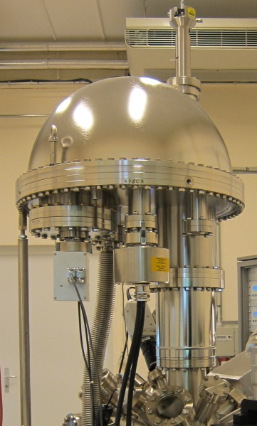
Parts of XPS system
HSA: Hemispherical Analyser
Two hemispheres (R₁, R₂) concentric
Potentials applied (V₁ <V₂)
→ Electrons arriving at S can reach F
if they have the correct energy E_{K}
→ HSA at constant energy: Pass Energy E_{P}
Analyser Components
Entrance and Exit slits: Energy resolution
Iris aperture: Lateral resolution
Entrance lens system: angular and spatially resolved studies through lens modes
Combinations possible
Detector Assembly : 9 MCD
(Multi Channel Detectors)

Slide 5
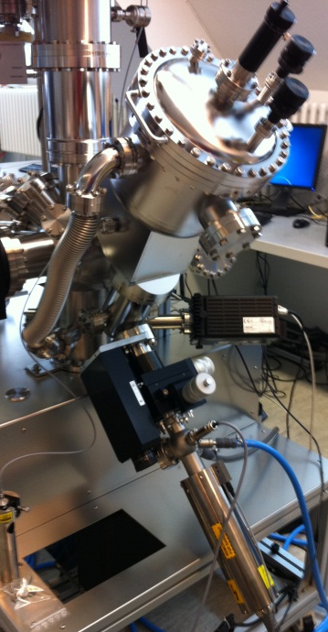
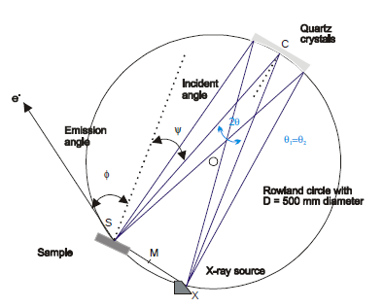
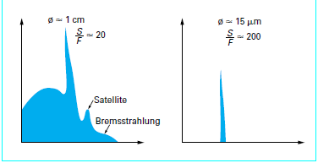
Parts of XPS system
Source / Monochromator
XR Sources:
Al: E_{exc} = 1486.74 eV; P_{max} = 400 W
Ag: E_{exc} = 2984.3 eV; P_{max} = 600 W
→ spot size on the sample: 1x3.5 mm²
Monochromator principle:
Bragg diffraction
Advantages of monochromatic XR
Non-monochromatic
rays
Monochromatic
rays
Settings:
Source position
Cristal settings (Focus, Roll, Pitch)

Slide 6
Contents
XPS presentation
Commissioning
Comparison with older system (ESCA5400) + Issues
Future work
Conclusion

Slide 7
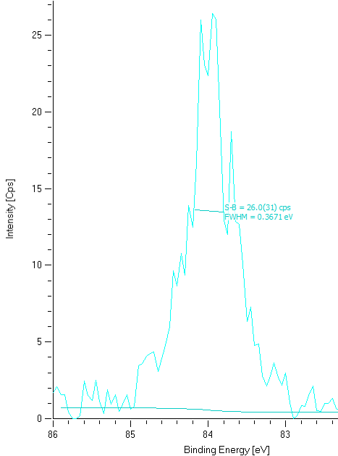
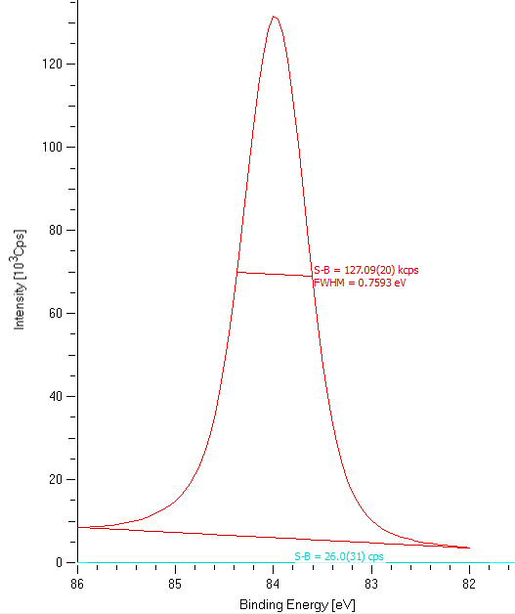
Commissioning
Energy Resolution: Minimum FWHM (monochromator)
with good intensity (Analyzer MCD)
 | Nominal (Ag3d_{5/2}) | C1s | Au4f_{7/5} (slit Ø1, Iris 5) | Au4f
FWHM (eV) | 0.6 | 0.52 | 0.37 | 0.76
Intensity (kcps) | 400 | 99 | 0.03 | 266
Ratio | 667 | 160 | 0.08 | 350

Slide 8
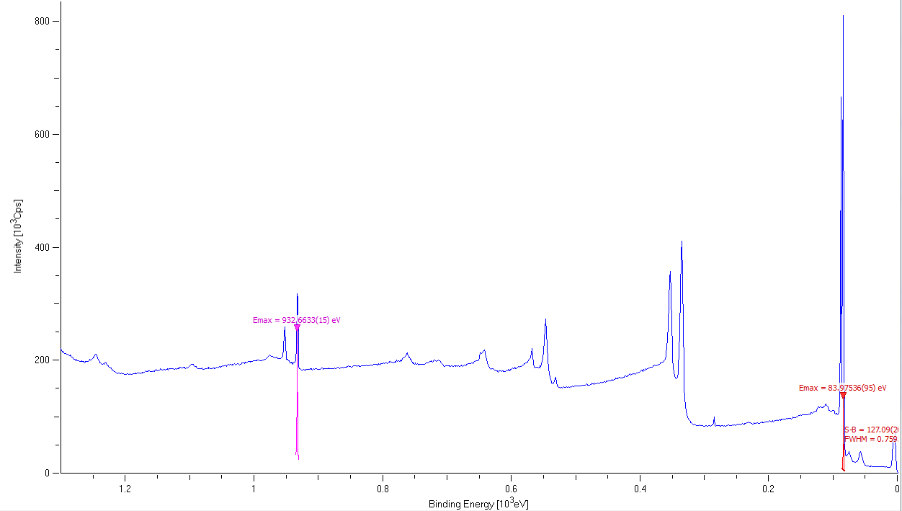
Commissioning
Energy scale calibration
Gain setting: stretch the scale – G↗ Δ↘
Offset setting: shift – offset ↗ E_{B}↗
E_{B}_Cu-2p_{3/2} | 932.67 eV
E_{B}_Au-4f_{7/5} | 83.98 eV
Δ E_{B} | 848.69 eV
Gain = stretch parameter

Slide 9
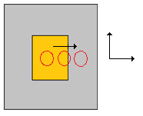
Commissioning
Spatial Resolution
Square gold foil on stainless steel
At “High Magnification” Lens Mode for different slit/iris combinations
Displacement in x & z directions (Au→St-st)
Au-4f_{7/5} line measurement for each value
Area calculation (after Shirley background subtraction) then plotted according to direction value
d = from 80% to 20% max intensity
Combination | d_{x} (mm) | d_{z} (mm) | Nominal
Slit 7x30 – Iris 30 mm | 1.2 | 0.49 | 0.7 (slit 7)
Slit Ø3 – Iris 20 mm | 0.3 | 0.24 | 0.30
Slit Ø1 – Iris 10 mm | 0.12 | 0.18 | 0.1 (iris 5)

Slide 10
Contents
XPS presentation
Commissioning
Comparison with older system (ESCA5400) + Issues
Future work
Conclusion

Slide 11
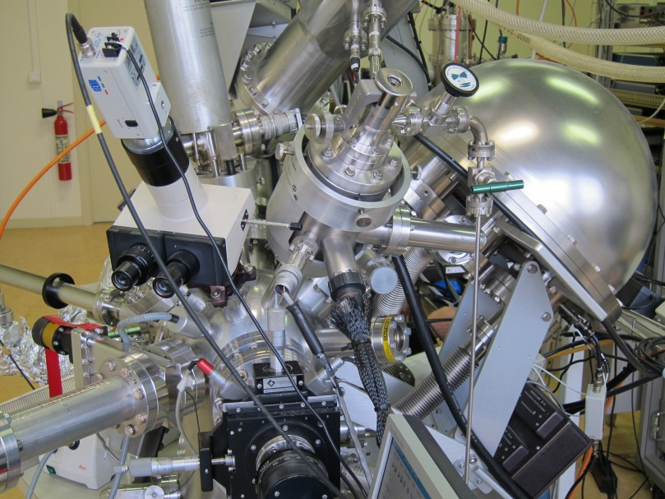

Comparison
Non-monochromatic source
Signal to noise/Intensity –
Energy Resolution – Spatial Resolution:
 | Old | New
FWHM (eV) | 1 | 0.76
Signal to noise | 12 | 22
Source spot area (mm²) | 100 | 1x3.5
Photon density | 5.10¹³ ph.s⁻¹.cm⁻² | 10¹³ ph.s⁻¹.cm⁻²
Spatial resolution | 0.4x0.6 mm | 0.12x0.18 mm
 | Old | New
Anode | Mg | Al (shift -0.5eV)
E_{P} (eV) | 17.9 | 10

Slide 12
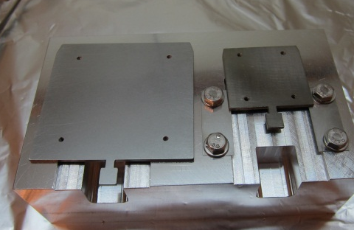
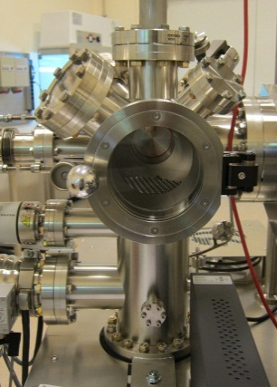
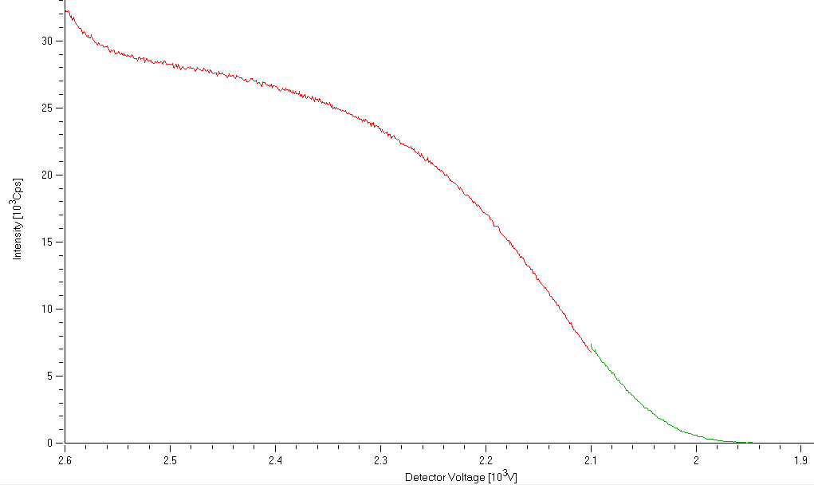
Practical comparison
Larger sample
Bigger chamber
Local heating
Disadvantage: Analysis time (load lock venting time + software to set)
Others disadvantages:
Peak energy instability < 0.1 eV
More frequent calibration: DVS monthly
→Detector voltage = CEM (channeltrons) voltage
Need to be adjusted according to dose
Maximum 3.5 kV then CEM need to be changed

Slide 13

Quantification
Concentration of an element A in the sample
Transmission function
Specific to the system
Non-linear but different approximations
Approximation within software: Tr = a.E_{P}.(E_{P}/E_{K})^{b}
Original settings: a = 1; b = 0.5
Acquisition software: change a, b
Data handling software: any function
Need to be calculated according to lens mode
$I_{A}=J.N_{A}.σ_{A}.{\text{l}}_{AB}.T$r
Transmission Function
Peak intensity
of the element
Inelastic Mean
Free Pass
Incident XR flux
Concentration
of the element
Cross-section
of the element

Slide 14
Transmission function
Series of measurements
Cu sample: 2s, 2p, 3s, 3p lines
Variable E_{P}: 5, 10, 20, 50, 100 eV
Lens Modes surveys: Large Area, Medium Magnification, Medium Area → only Medium Magnification is “linear”
Area calculations: after Shirley background subtraction
Plot: log(A/E_{P}) = f (log(E_{P}/E_{K})) for each line then scale
Slope = b of Tr = a.E_{P}.(E_{P}/E_{K})^{b}

Slide 15
Quantification
Comparison
Same sample for two systems: Cu + O + Ag + C
XPS-Specs: sample set at 45° to the analyser (same configuration as XPS old)
XPS old: Mg-source
Moreover: Cu(OH)₂ visible with XPS Specs
Component | XPS old | XPS new
C | 56.4 | 51.7
Cu | 13.1 | 11
O | 26.3 | 25.7
Ag | 4.2 | 11.6

Slide 16
Contents
XPS presentation
Commissioning
Comparison with older system (ESCA5400) + Issues
Future work
Conclusion

Slide 17
Future work
RSF (relative sensitivity factor) calculations & verification
RSF = σ_{A}.λ_{A}.Tr specific to the system
Measure intensity of pure elements and compare with σ.λ literature values with measured Tr
Extrapolate to other elements: RSF database
Ag-source commissioning
To be installed
UPS source
Ion gun (Ar gas line already installed)

Slide 18
Conclusion
First part of commissioning done
Energy calibration E_{B}_Cu2p_{3/2} = 932.66 eV / E_{B}_Au4f_{7/5} = 83.98 eV
Energy resolution as expected
Spatial resolution = 0.12 x 0.18 mm
Transmission function (Medium Magnification, Iris = 15 mm):
Tr = a.E_{P}(E_{P}/E_{K})^{b} : a = 1, b = 0.41
New system much more efficient than the older
Monochromatic X-rays
Better resolution, signal to noise, precision
However need more attention (time, calibration)
Good perspectives
Future install more devices, precise quantification (RSF)

Slide 19
Merci de votre attention…
Questions?
Acknowledgments: SCC section, especially colleagues in the lab…

