Slide 1
Vacuum Control for AD/ELENA
G. Pigny TE/VSC/ICM
May 11th 2012

Slide 2
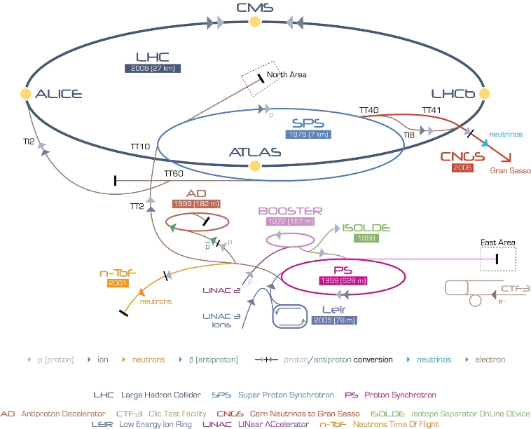
AD in the CERN Accelerators complex
Notes:
AD, the Antiproton Decelerator is situated after PS, in the Meyrin site in the building 193.
Construction was started in 1997, and the physics program was started in 2000.
AD provides low-energy antiprotons for studies of antimatter, in particular for creating anti-atoms and delivering them to the experiments.

Slide 3
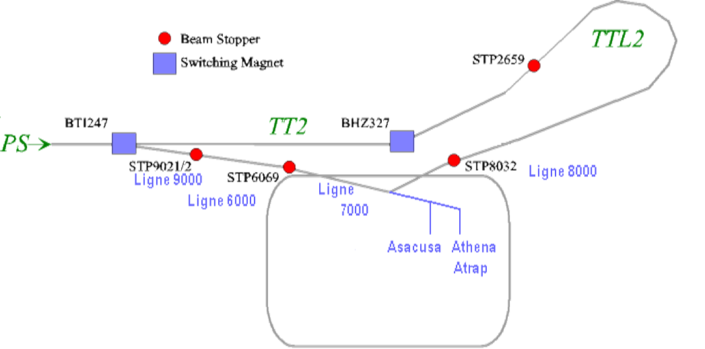
AD: Antiproton Decelerator
AD
Experiments
Notes:
A beam of protons from the PS is fired into a block of metal (target).
The energy of the collisions is enough to create a new proton-antiproton pair.
The antiprotons have too much energy to be useful for making anti-atoms.
They also have a range of energies and move randomly in all directions.
AD decelerates and “cools” these particles into a useful, low-energy beam, by using strong electric field and electron cooling.
It takes about 90 seconds to decelerate the antiprotons down to 10% of light velocity.
The line 7000 is for the p/ ejection into the experimental areas at 100MeV/c.

Slide 4
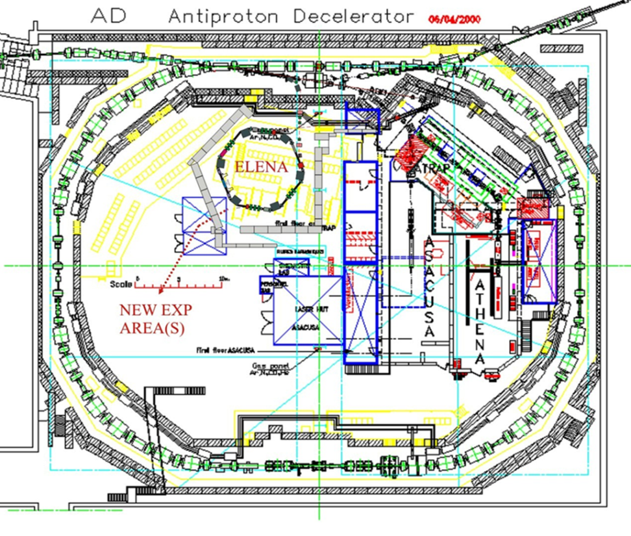
ELENA: Extra Low ENergy Antiproton
A small decelerator ring between AD and experimental area will be built at the present kickers area
Produce dense P̅ beams at very low energies (100keV)
Use the existing AD ejection line for the transfer of P̅ to ELENA
Increase the number of P̅ trapped in the experiments
Deliver beams almost simultaneously to all experiments
Possibility to accomodate an extra experimental zone

Slide 5
AD consolidation
Needed to continue operation for the next 25 years
Minimise risk of failures and maintenance costs
AD Items considered for consolidation:
Magnets
Power converters
Beam cooling
RF equipment
Beam transfer equipment
Diagnostics
Target area and associated equipment
Control system
Infrastructure
Vacuum

Slide 6
AD Vacuum consolidation
Replace the cryo-pumps [6]
Upgrade the bakeout system
Install Ion pump feedthrough heating system [65]
Replace ion pumps [10]
Maintenance
Fast valves
Gas injection system
Vacuum control system upgrade (Started)

Slide 7
Old AD vacuum control architecture
Notes:
Architecture with two layers connected together by a local X25 network.
The lower layer consists of custom controllers in G64 crates and industrial controllers.
G64 crates contains custom controllers for: Valves (VVS), ion pumps (VPI), sublimation pumps (VPS) and Bayard-Alpert gauges (VGI).
Industrial controllers for VGR/P, TMP are directly connected through RS232.
X25/RS232 is used to multiplex data from several RS232 channels and transfers data over distances up to 300m.
The upper layer is composed of a VME (Versa Module European) crate provided and maintained by PS-CO group.
It is used for the acquisition of all the vacuum data and the communication with the main control system of the accelerator.
The connection to the main control system of the accelerator is made via ethernet.
Monitoring and control can be performed by running Working Sets (Java based interface).
Since 2011, monitoring can be performed also on PVSS, via CMW (Common Middle Ware).

Slide 8
AD vacuum control architecture (2012)
Notes:
At the last winter technical stop, we have changed all the Bayard-Alpert controllers and replaced all the RS232 communications cards by profibus communication cards for all Pirani/Penning gauges controllers (TPG300).
These controllers are no more accessible by RS232 but by profibus.
We have installed a PLC master to address them and remotely control the gauges via PVSS.
Presently, only the gauges are controlled by PLC and PVSS, the other equipment are still controlled by working set and visible in PVSS.

Slide 9
AD vacuum control architecture (after LS1)
Notes:
The PLC S400 is used for data acquisition and communication with the main control system of the accelerator.
The PLC will communicate directly with the equipment equiped with a profibus port like TPG300, Volotek.
If not, we have to make an intermediate chassis remote I/O and accessible by profibus.
It allows to read and write analog/digital signals to control the equipment and send the data throught the profibus network.
This architecture is the same used at LEIR, LHC and SPS.
For the AD consolidation, no new architecture will be developped.
LS1 will allow the upgrade of the rest of the old architecture remaining in the complex PS, uniformising the vacuum control architecture at CERN.

Slide 10
AD Control equipment upgrade
Instrument (Machine) | Equipment (Rack) | Equipment Number | Unit price [kCHF] | Total price [kCHF]
VPGF [16] | VPGF ctrl | 16 | 5 | 80
VVS [15] | VVS ctrl | 15 | 0.8 | 12
CRYO [6] | CRYO ctrl | 6 | 0.8 | 5
VPI [65] | VPI ctrl | 65 | 2.8 | 182
VGR [35] VGP [37] | VGR/P ctrl (profibus card) | 22 | 0.8 | 18
VGI [19] | VGI ctrl | 19 | 4.4 | 84
VPS [99] | VPS ctrl | 13 | 4.5 | 58
 | PLC master | 1 | 10 | 10
 | Rack power | 58 | 0.23 | 14
 | Cabling | 42 (L=200m) | 0.011 | 93
 | Total [kCHF] |  |  | 556 (454)
Notes:
The green lines represent the equipments already bought last year.
VGR/P profibus card, VGI controllers and master PLC have already been installed at the last Xmas technical stop.
The other lines represent the equipements to be bought this year.
Replace fixed vacuum pumping groups controller (VPG ctrl)
Replace vacuum valve sector controller (VVS ctrl)
Add crate for remotly control the cryo-compressor
Replace the sputter ion pumps controller (VPI ctrl)
Replace communication crate for the sublimation pumps (VPS ctrl)
Renew the main power of the racks and cabling
The total amount of these changes is estimated to 556kCHF (remaining 454 kCHF).

Slide 11
Control equipment to be installed for ELENA
Instrument (Machine) | Equipment (Rack) | Equipment Number | Unit price [kHF] | Total price [kCHF]
VGPM [2] | VPGM | 2 | 6 | 12
VVS [8] | VVS ctrl | 1 | 1.7 | 13
VPI [12] | VPI ctrl | 12 | 4 | 48
VGR [8] VGP [8] | VGR/P ctrl | 4 | 4 | 16
VGI [8] | VGI ctrl | 8 | 4.4 | 35.2
 | Cabling | 46 (L=80 m) | 0.011 | 42
 | Total [kCHF] |  |  | 210.2
Notes:
For ELENA, the vacuum pumping groups will be mobile,
Need to control 8 vacuum valves, 12 VPI, 8 VGP/R pair and 8 VGI.
Cabling of the new instruments.
The total amount to control the vacuum part of ELENA is estimated to 210kCHF.
Two racks are available for ELENA control, possibility to have three racks with rearrangement of AD racks.
Attention les chiffres ne sont pas définitifs!
ELENA – An Updated cost and Feasibility Study (2010)/ T.Eriksson et al.

Slide 12
AD/ELENA Project milestones
Years | Milstones
2012 | Ring optics and layout: March/2012 Manpower/budget profiles and schedule: April/2012 Transfer lines: Mai/2012 TDR (Technical Design Review): June/2012 Magnets design: December/2012
2013 | AD Hall preparations: 01/2013-12/2013 Delivery of the new building: 10/2013 Moving the kicker platform: 11/2013-03/2014
2014 | Moving the kicker platform: 11/2013-03/2014 ELENA Installation: 01/2014-03/2015 AD Start-up: 05/2014
2015 | ELENA Installation: 01/2014-03/2015 ELENA commissioning: from 04/2015
ELENA and AD status 8th March 2012, IEFC Workshop/S.Maury
Notes:
2012 for design, budget, review
2013 for AD Hall preparation and new building.
2014 for ELENA installation and AD start up.
2015 for ELENA commissioning.
These milestones allow us to schedule the ICM activities for AD/ELENA during LS1 and beyond.
ELENA and AD status 8th March 2012, IEFC Workshop/S.Maury

Slide 13
Controls milestones
Years | Milstones
2012 | Hardware ordering (June 2012) Hardware development (VPS com crate) (Nov. 2012) Software development (PLC/PVSS/DB) (Nov. 2012) Equipment manufacturing and cabling (Dec. 2012)
2013 | EN/EL rack power upgrade and cabling (AD) (Feb. 2013) Old crates dismounting (AD) (March. 2013) New crates installation, cabling (AD) (June2013) PLC Software upload, PVSS and DB (AD) (Sept. 2013) Vacuum control equipment commissioning and test (AD)
2014 | Vacuum control equipment commissioning and test (AD) EN/EL rack power upgrade and cabling (ELENA) (March 2014) Crates installation, cabling (ELENA) (May 2014) PLC Software upload, PVSS and DB (ELENA) (June 2014) Vacuum control equipment commissioning and test (ELENA)
2015 | Vacuum control equipment commissioning and test (ELENA)
Notes:
2012 for the preparation, coordination and following in order to be ready for the LS1.
2013 will be dedicated to the AD consolidation of the new control system and test at the end of 2013.
2014 will be dedicated for the commissioning and test of the AD new equipment as well as the ELENA control installation.
The commissioning and test of ELENA will be executed at the end of 2014 and at the beginning of 2015.

Slide 14
ICM people involved in the project
Notes:
I am the responsible for the controls consolidation project.
Mainly 2 other people in ICM are involved.
Helder will be in charge of the Data Base, PLC programming and PVSS with the help of Henrik, Leonid (IHEP), and Sebastien
Myself and Henrik will be in charge of the Hardware, helped by the FSU.

Slide 15
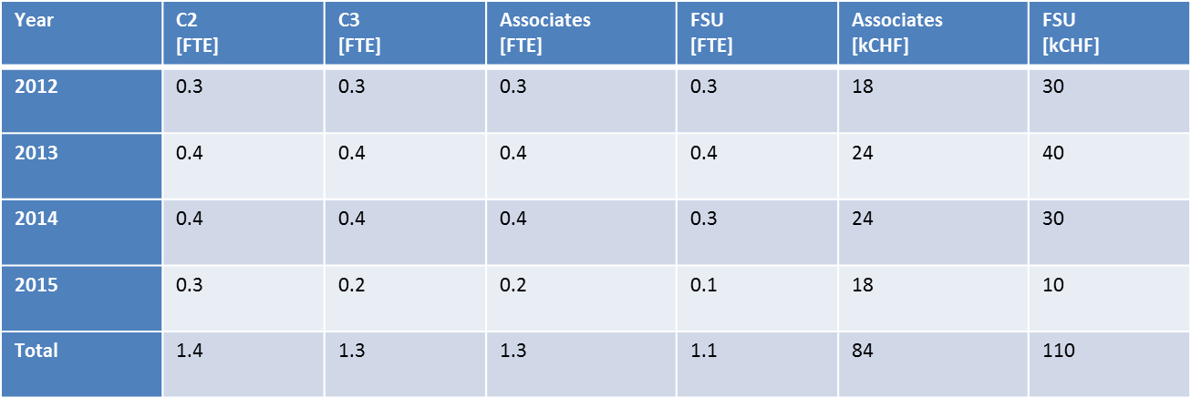
ICM manpower AD/ELENA
Notes:
FTE (Full Time Equivalent) for each staff categories, Associate and FSU.
The second table shows the budget spent (ICM) for associate and FSUs until 2015 for this project.

Slide 16
Conclusion
Architecture standardized in accordance with the other machines (PS, SPS, LHC)
Fully integrated in PVSS
Hardware upgrade planned:
New remote control for VPS
Remote control for Cryo-pump
New VPG controllers
New VGI controllers
New VPI controllers
Racks main power supply upgrade

