Slide 1
Electropolishing of Niobium cavities SPL R&D work frame

Slide 2
Outline
SPL R&D work frame
Electropolishing
Main parameters
Polishing Plant
Cathode design
Feedback

Slide 3
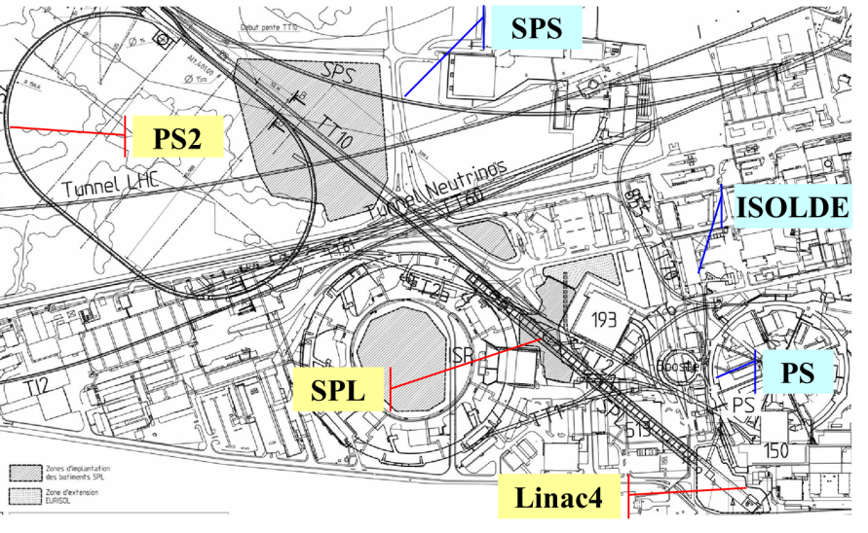

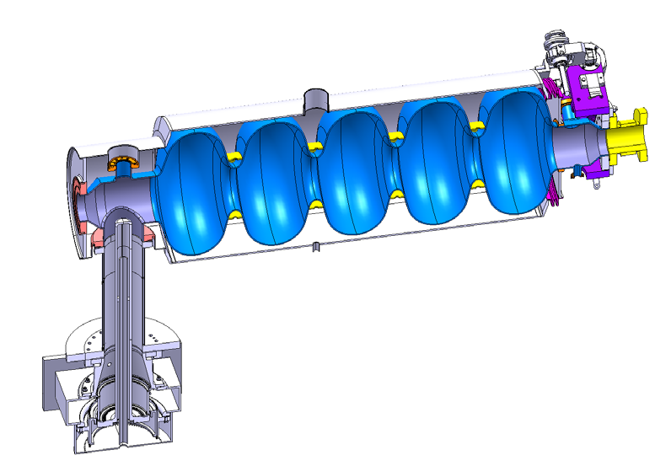
SPL R&D work frame
SPL (Superconducting Proton Linac)
Nb SRF cavities
β-1 (25 MV/m)
β-0.65
First SPL Collaboration Meeting 11-12 December, 2008 – CERN, R. Garoby
Eacc↑ -> Surface treatment needed
Most promising technique: Electropolishing
Roughness < 0,1 μm
Eacc up to 45 MV/m
“Conceptual design of the SPL II: A high-power superconducting H⁻ linac at CERN” Baylac et al.

Slide 4

Electropolishing
+
DC Power supply
-
A
V
H₂SO₄ _{(96% m/m)}: 90 % v/v
HF _{(40% m/m)}: 10 % v/v
Cathode (Cu)
Anode
(Nb)

Slide 5
Electropolishing
DC Power supply
A
V
Cathode (Cu)
Anode
(Nb)
1 µm

Slide 6
Electropolishing
The imposed anodic potential allows the water molecule to break into Hydrogen and Oxygen and enhances the diffusion of Oxygen to form Niobium Oxide.
Anodic reaction: 2 Nb_{(s)} + 5 H₂O_{(l)} → Nb₂O_{5(s)} + 10 H⁺_{(aq)} + 10 e⁻
Cathodic reaction: 2 H⁺_{(aq)} + 2 e⁻ → H_{2(g)}
HF reacts with Niobium oxide under anodic potential and forms soluble products
Nb₂O₅ + 14 HF → 2 H₆NbO₂F₇ + H₂O
Nb₂O₅ + 12 HF → 2 HNbF₆ + 5 H₂O
Nb₂O₅ + 10 HF → 2 H₂NbOF₅ + 3 H₂O
Nb₂O₅ + 10 HF → 2 NbF₅ + 5 H₂O
Thin viscous layer rapidly forms at the anode surface transforming a charge controlled into a mass control process. Under these conditions, the removal rate of metal is higher on “peaks” and lower on “valleys”.

Slide 7
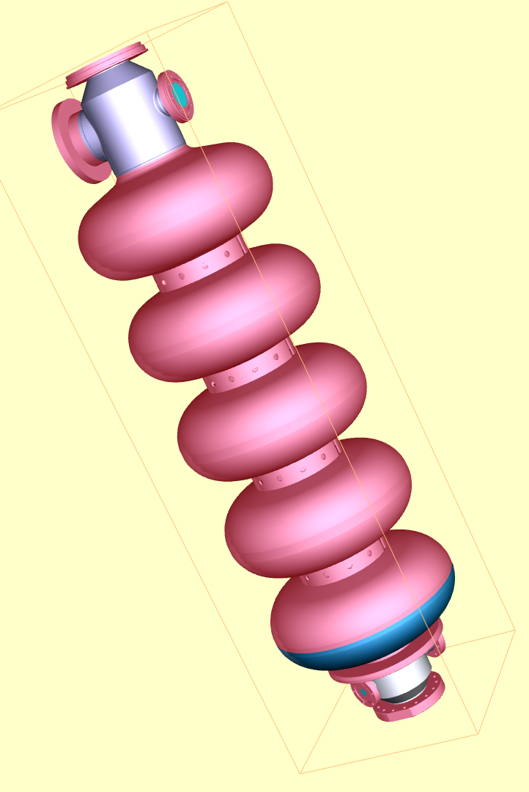
Main Parameters
Quite straightforward?
Cathode
~ 400 mm diameter
Primary current distribution
R
Secondary current distribution
R
J = f(η(Overpotential))
~ 1400 mm in length
Temperature
J = f( T, Qv, S_{c}/S_{a}, [F⁻], [H₂O])
Bath flow rate
S_{c}/S_{a}
Current density (A/m²)
[HF]
[H₂O]
Overpotential (V)
Notes:
Different parameters to take into account
Not so simple if the geometry is complex:
shape, internal surface, agitation, cooling, power input...

Slide 8
The Polishing Plant
Horizontal
or
Vertical
+ flexible in terms of working parameters
Proven setup
+ complex setup (axial rotary motion)
Axial motion
Electrical contact
Rotary sealed Interfaces
Pivot motion
+ Surface needed
“On/Off” EP
SRF WP 5.1.1.4 : “Electropolishing of Niobium : best EP Parameters” F. Eozénou , A. Aspart, C. Antoine, B. Malki
+ EP time (same parameters)
Notes:
Main design parameter for the setup.
Define an installation for high performance but simple.
Installations performing well at DESY and KEK

Slide 9
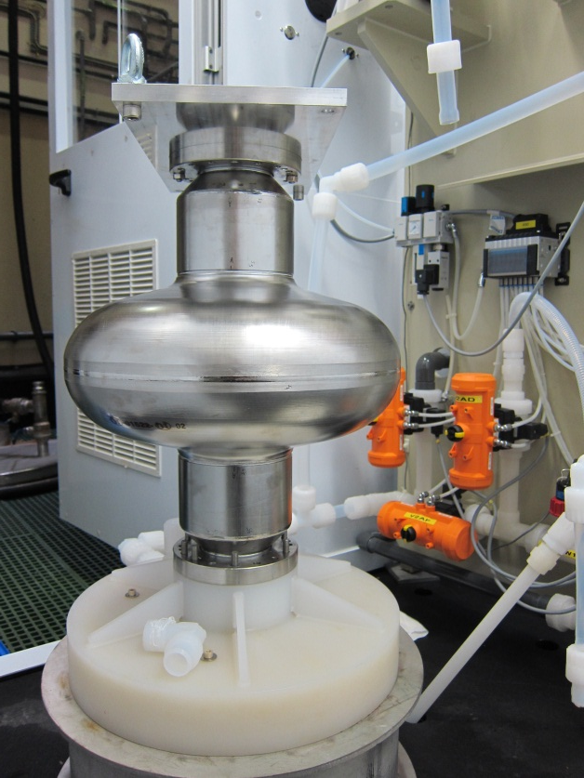
The Polishing Plant
Horizontal
Vertical
+ flexible in terms of working parameters
- Flexible in terms of working parameters
Proven setup
Cathode geometry and working parameters must be well defined
+ complex setup (axial rotary motion)
Axial motion
- complex setup ( without axial rotary motion)
Electrical contact
Rotary sealed Interfaces
No pivot motion
Pivot motion
- Surface needed
+ Surface needed
Continuous EP
“On/Off” EP
- EP time (same parameters)
+ EP time (same parameters)
Notes:
Vertical because:
Let’s make it simpler and better
Approach for an industrial setup: cheaper and easy to operate
Fermilab already did it
Saclay has one vertical setup as well

Slide 10
The Polishing Plant
Where:
B.254
Chemicals compatible building/room;
B.102
Services:
Air extraction;
Air washers;
Waste water recovery/processing;
Chemicals storage facility;
Demineralised water;
Compressed air;
Power connections.
B.118
- and enough space available;

Slide 11
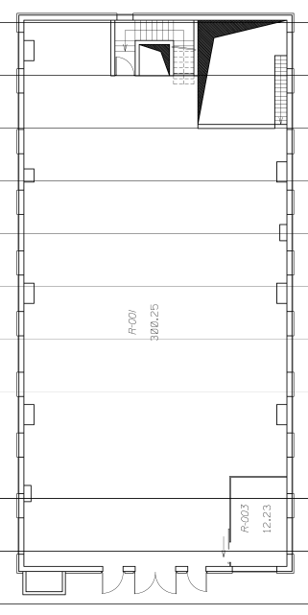
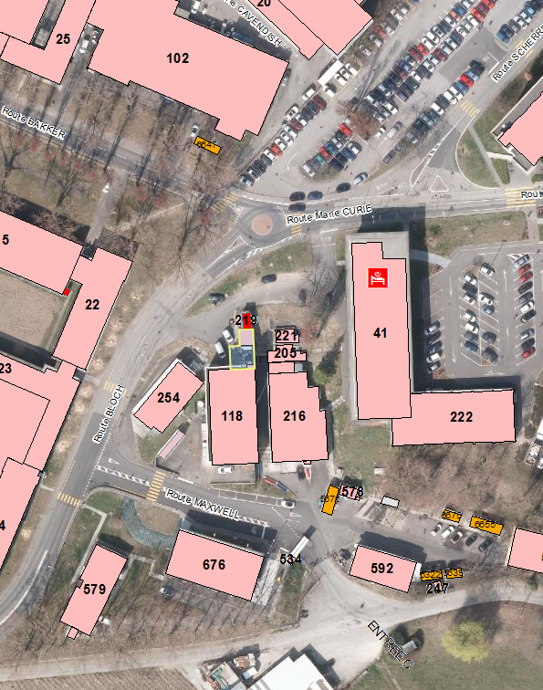
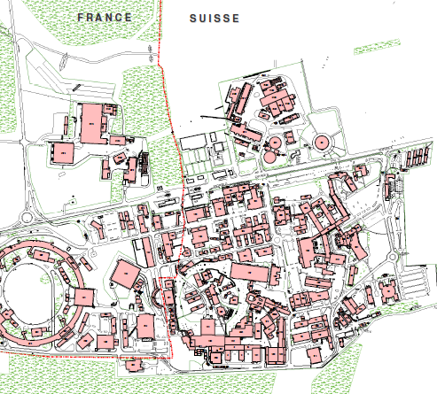
The Polishing Plant
Where:
Here!

Slide 12
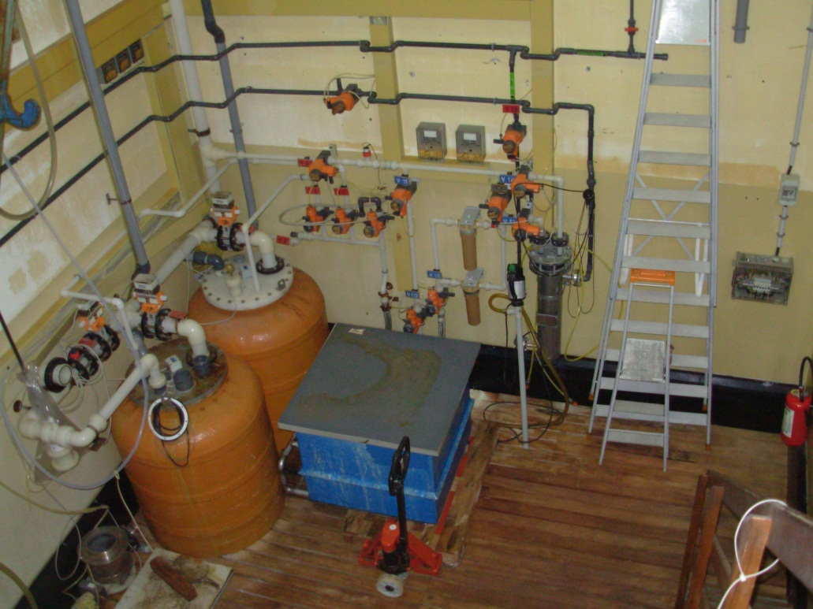
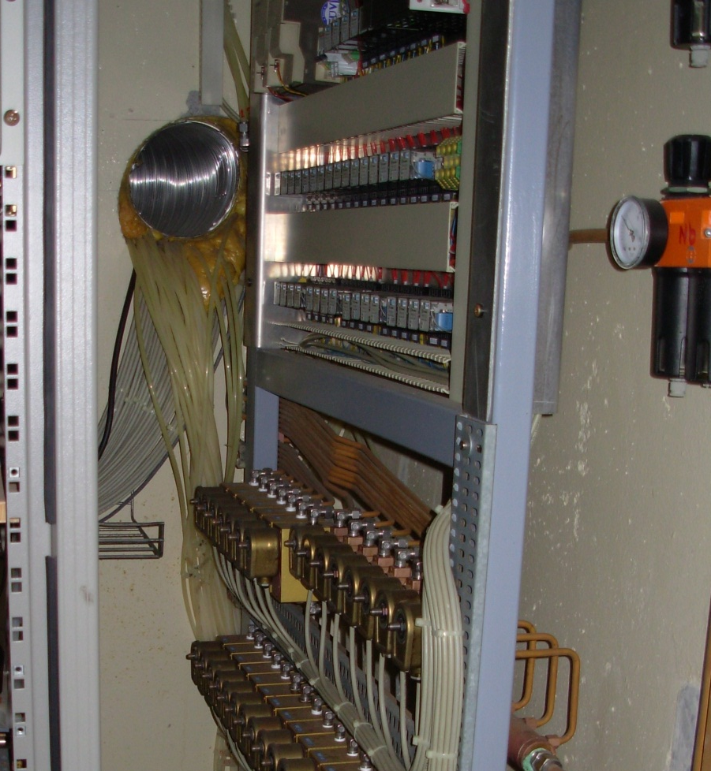
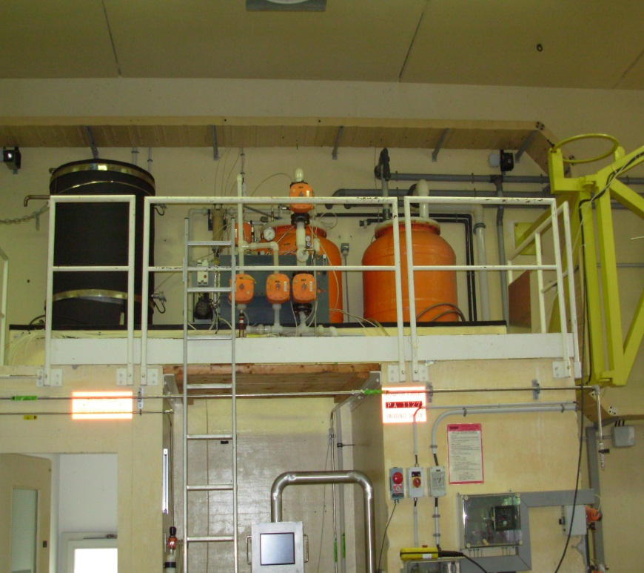
The Polishing Plant
Where:
Make space: Removal and disposal of unused Nb BCP plant

Slide 13
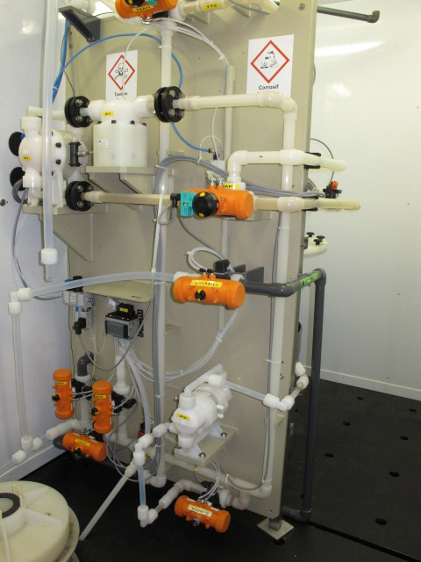
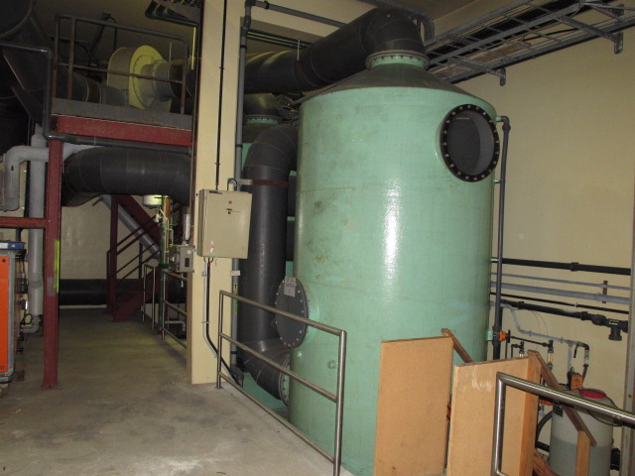
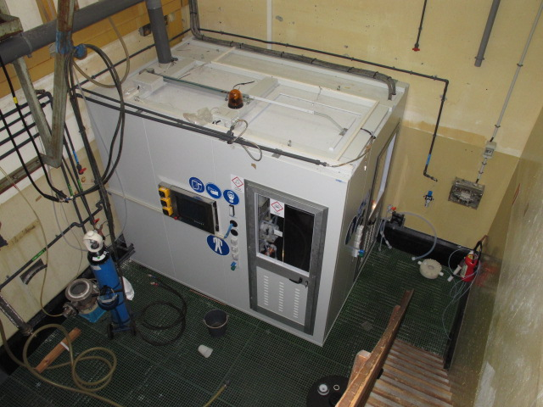
The Polishing Plant
Equipment:
Materials
Air Washers
Cavity geometrie
PVDF
Surface
PFA
Volume
Confined working space
FPM
PTFE
Retention
Processing time
Flow
Type of bath
Power input
Working parameters
Procedure

Slide 14
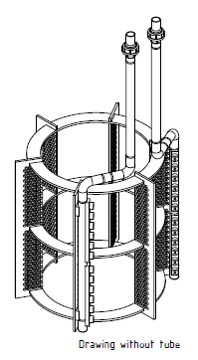
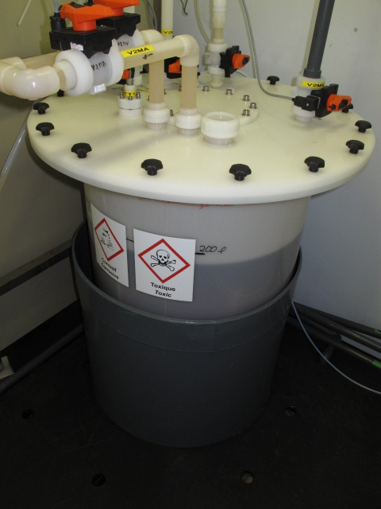
The Polishing Plant
Equipment:
Materials
Storage tank
Cavity geometrie
PVDF
Surface
PFA
Pumps
Volume
FPM
PTFE
Heat exchanger
Cathode
Processing time
Flow
Type of bath
Power input
Working parameters
Procedure

Slide 15
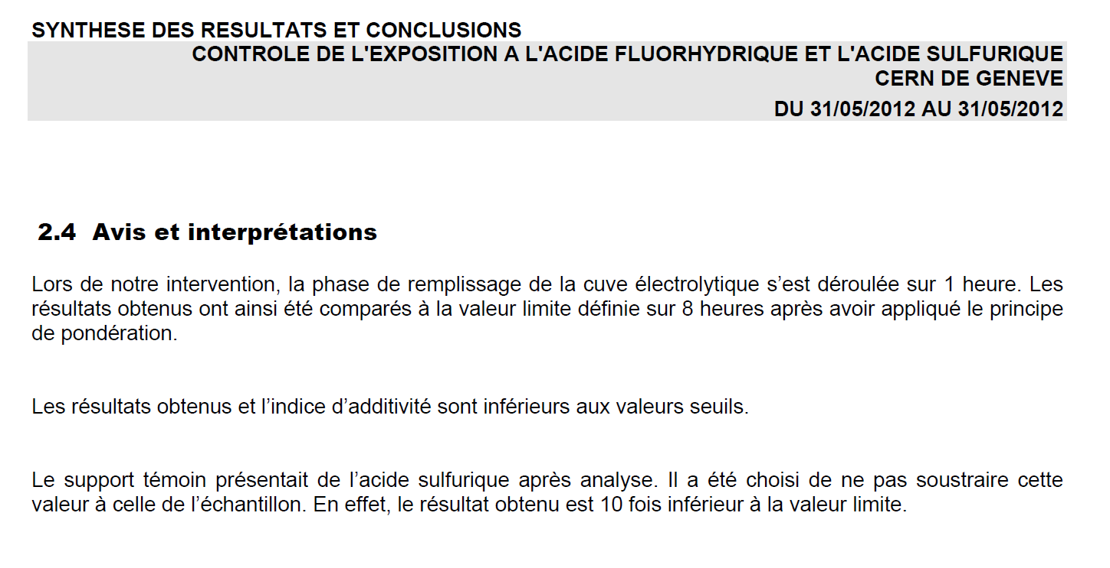
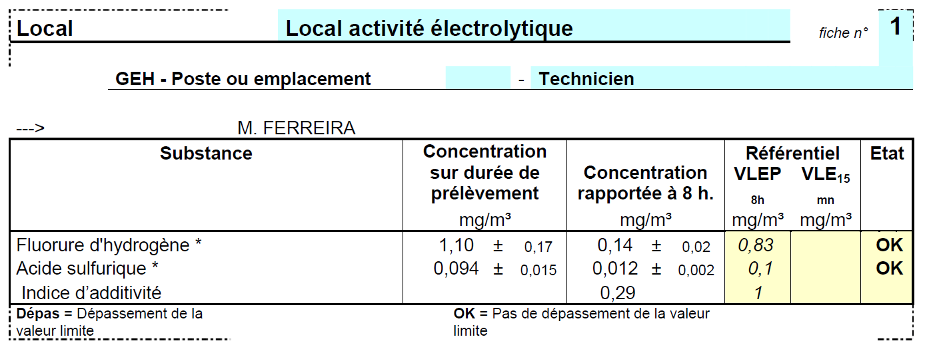
The Polishing Plant
Paper work:
Purchasing procedures (DO, specifications,...)
Safety:
Safety file:
https://edms.cern.ch/document/1178723/1
Exposition monitoring:
https://edms.cern.ch/document/1240840/1
Budget:
~ 260 kCHF (Material)
Manpower: ...

Slide 16
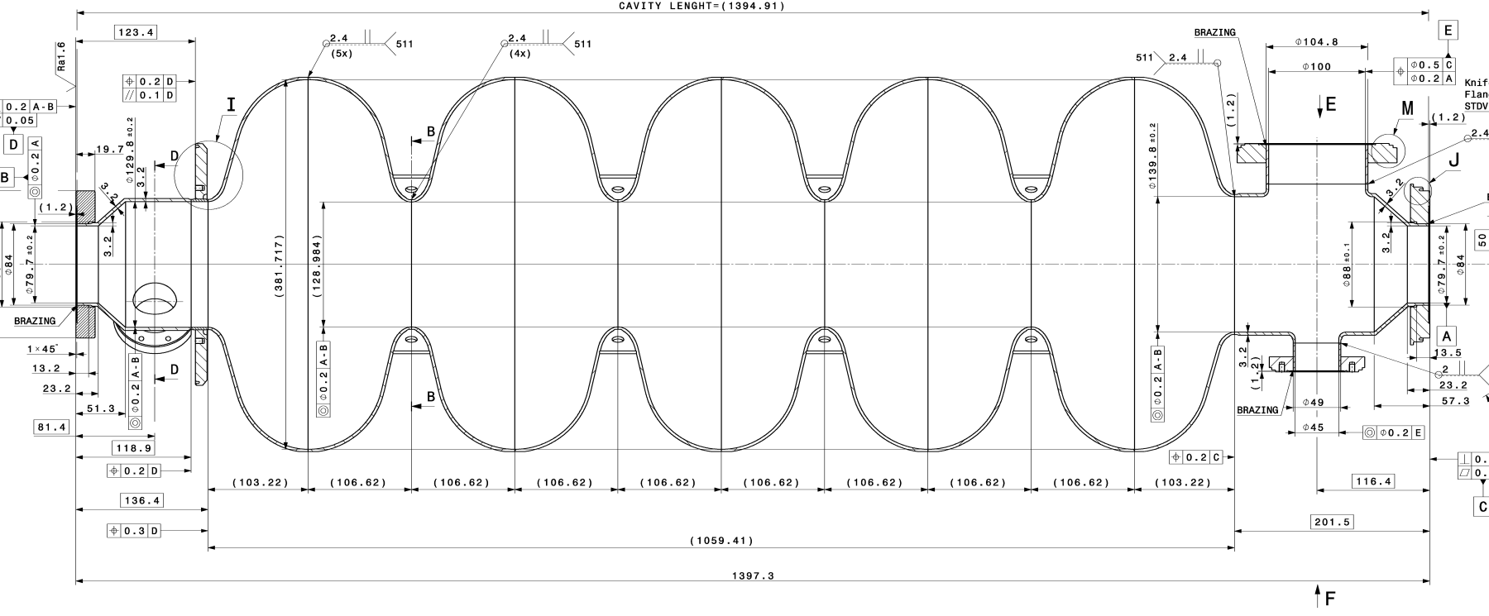
Cathode Geometry
Cathode geometry optimisation:
Geometry constraints
80 mm diameter
129 mm diameter

Slide 17
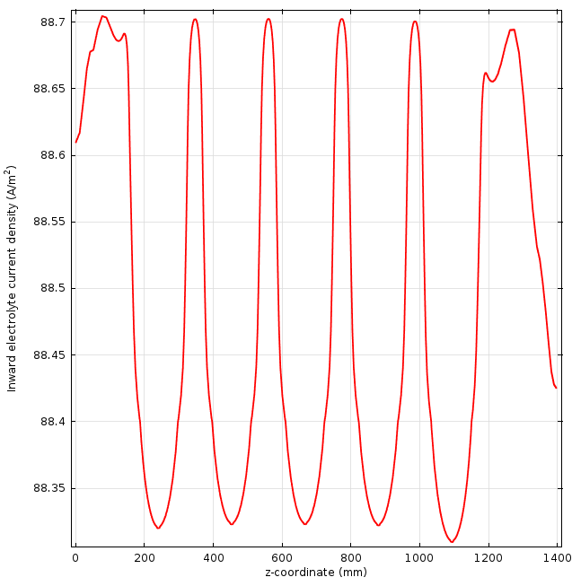
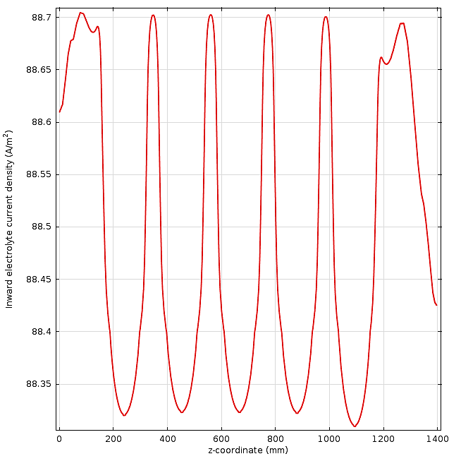
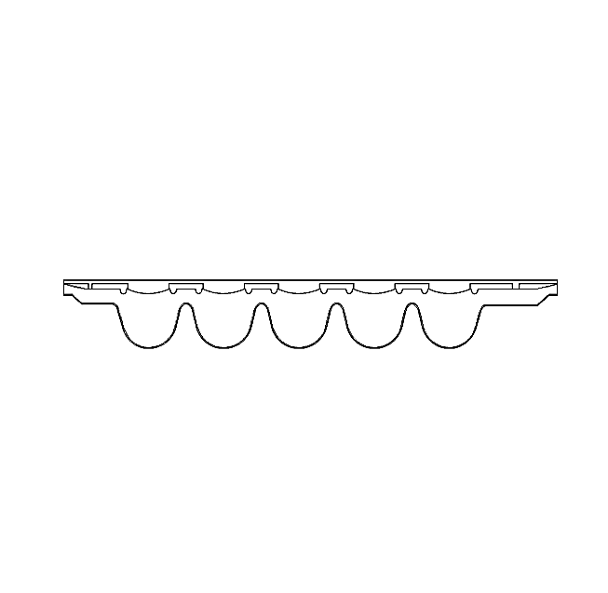
Cathode Geometry
Cathode geometry optimisation:
Even current density distribution on the cavity surface
Anodic current distribution within 1% difference
9 November, 2012
TE-VSC
17

Slide 18
Cathode Geometry
Cathode geometry optimisation:
Minimum power input
Cathode
Distance between cathode and anode
R
Ratio S_{cathode} / S_{anode}
R
Minimum potential for even current density distribution

Slide 19
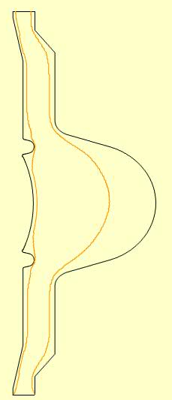
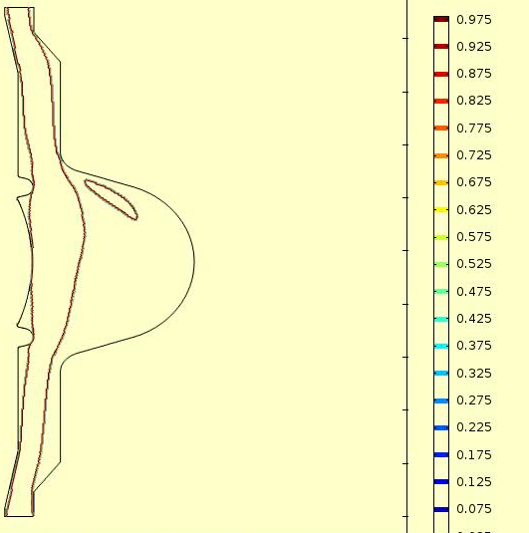
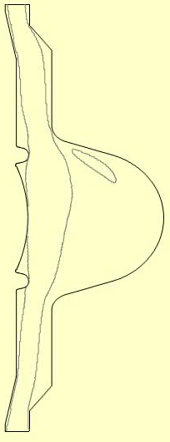
Cathode Geometry
Cathode geometry optimisation:
Bath flow dynamics
v = 0.8 * V_mean
Maximum Flow Rate:
20lpm
Minimum Flow Rate: 1lpm
TE-VSC
19

Slide 20
Feedback
Data from operation:
Assembly | Cavity | Qv/ l.min⁻¹ | T/°C | E/V | I / A | Duration/h
1 | ASH b0.65 | 8 | 11 | 16 | 26 | 1.5
2 | ASH b0.65 | 21 | 10 | 16 | 28 | 1.5
3 | ASH b0.65 | 21 | 11 | 16 | 29 | 0.3
4 | SPL m b1 | 20 | 12 | 12 | 37 | 7
5 | SPL m b1 | 20 | 10 | 12 | 33 | 7.2
6 | SPL m b1 | 15 | 12 | 12 | 37 | 5
 |  |  |  |  |  | 22.5 hours
20

Slide 21
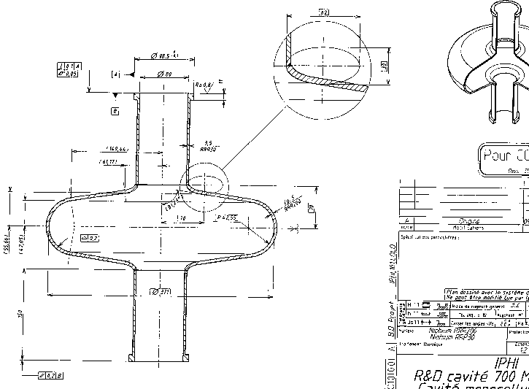
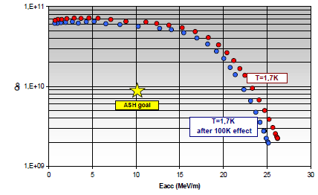
Feedback
First Results:
ASH Nb cavity beta 0.65
BCP polished (before EP)
After < 20 microns EP
25 MV/m @ Q₀= 1E+10
To be confirmed
Processing equipement is performing well:
HPWR & EP
1st time EP on beta < 1 sucessfully electropolished
21

Slide 22
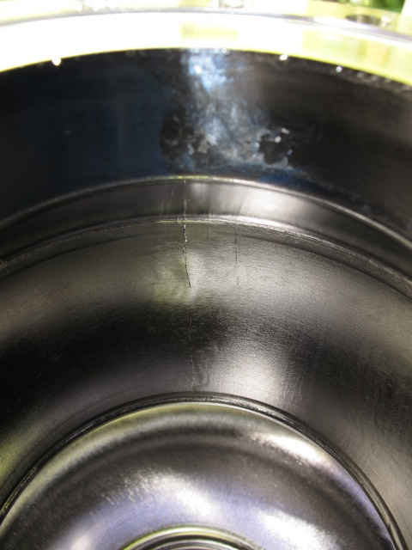
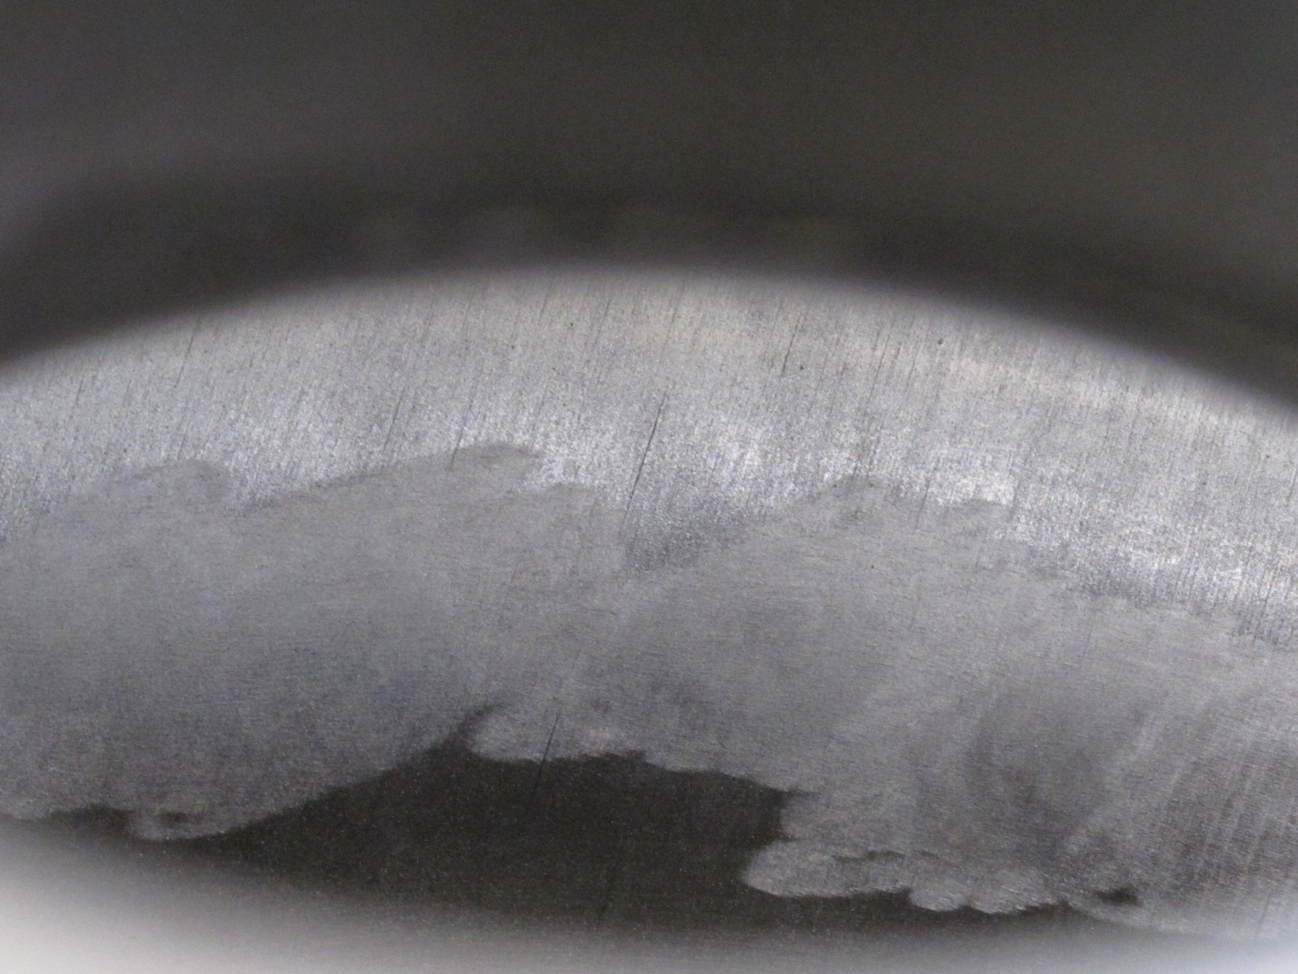
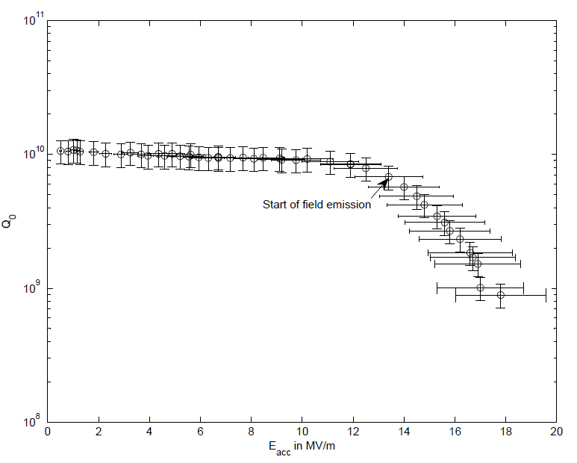
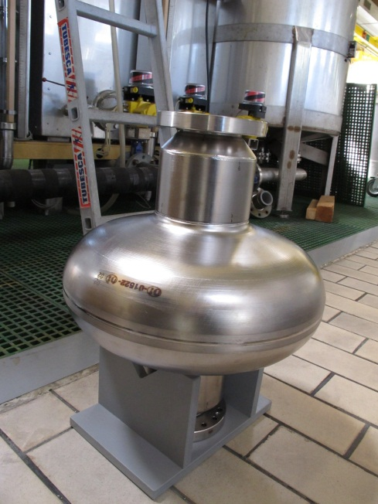
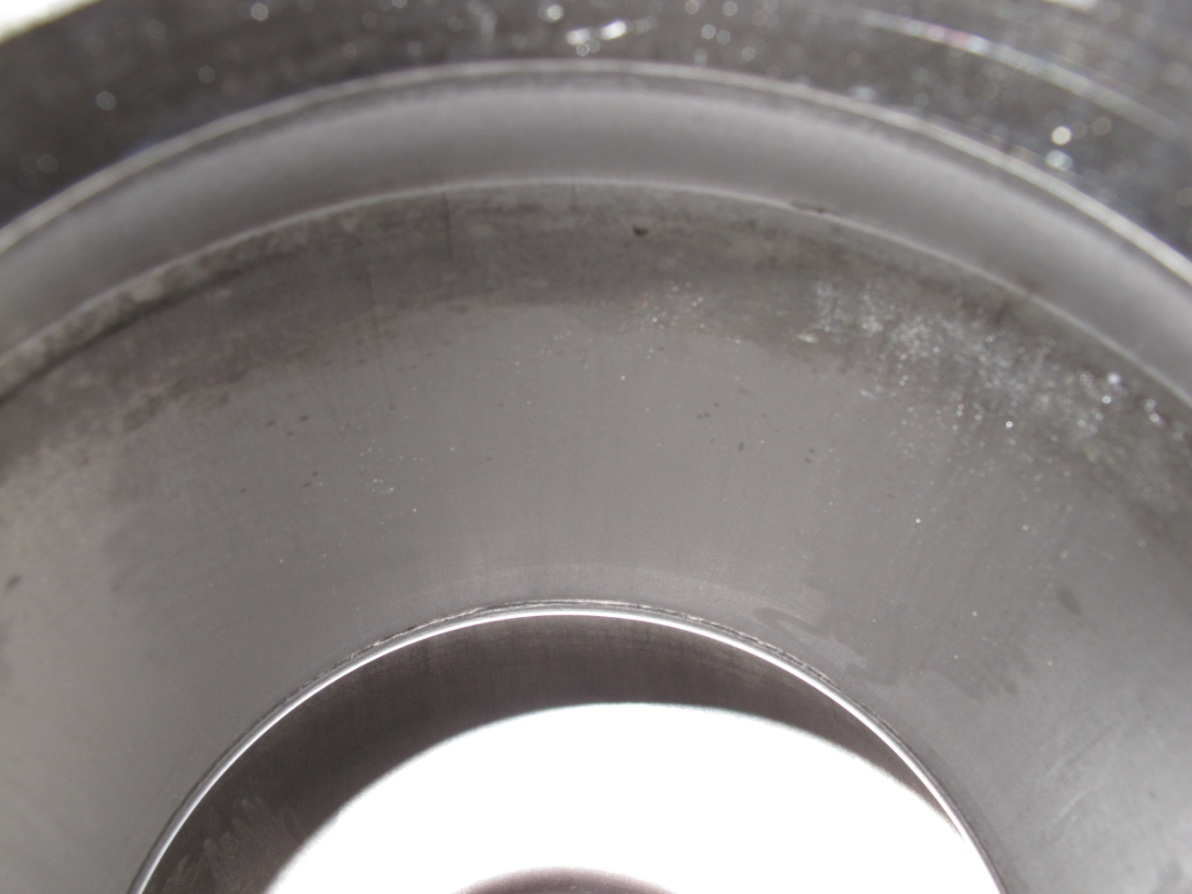
Feedback
First Results:
SPL mono cell beta 1
As received
After < 100 microns EP
13 MV/m @ Q₀= 8 E+09
22

Slide 23
Thank You Questions?

Slide 24
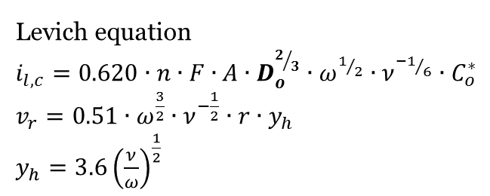

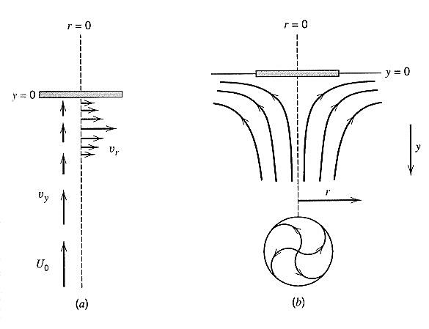


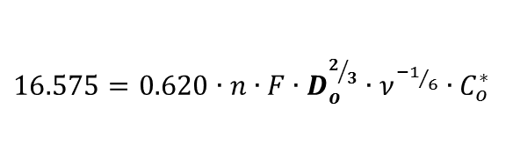
Theory
A | Cross Sectional Area (cm²) | n | Number of Electrons Transferred (-)
C_{o} | Concentration (mol/cm³) | v_{r} | r component of velocity (cm/s)
D_{o} | Diffusion Coefficient (cm/s) | v_{y} | y component of velocity (cm/s)
F | Faraday Constant (C/mol) | y_{h} | Boundary layer thickness (cm)
i_{l,c} | Levich Current (A) | ν | Kinematic Viscosity (cm²/s)
j | Current Density (A/m²) | ω | Angular Velocity (s⁻¹)
Notes:
Identified laboratory paramaters → characterised → actual cavity →

