Slide 1
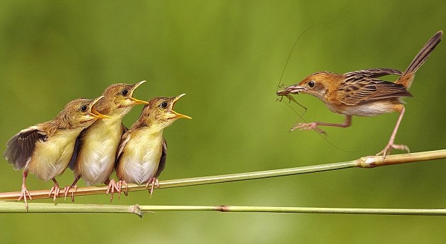
LHC beam operation past, present, future
Mike Lamont
for the LHC team

Slide 2
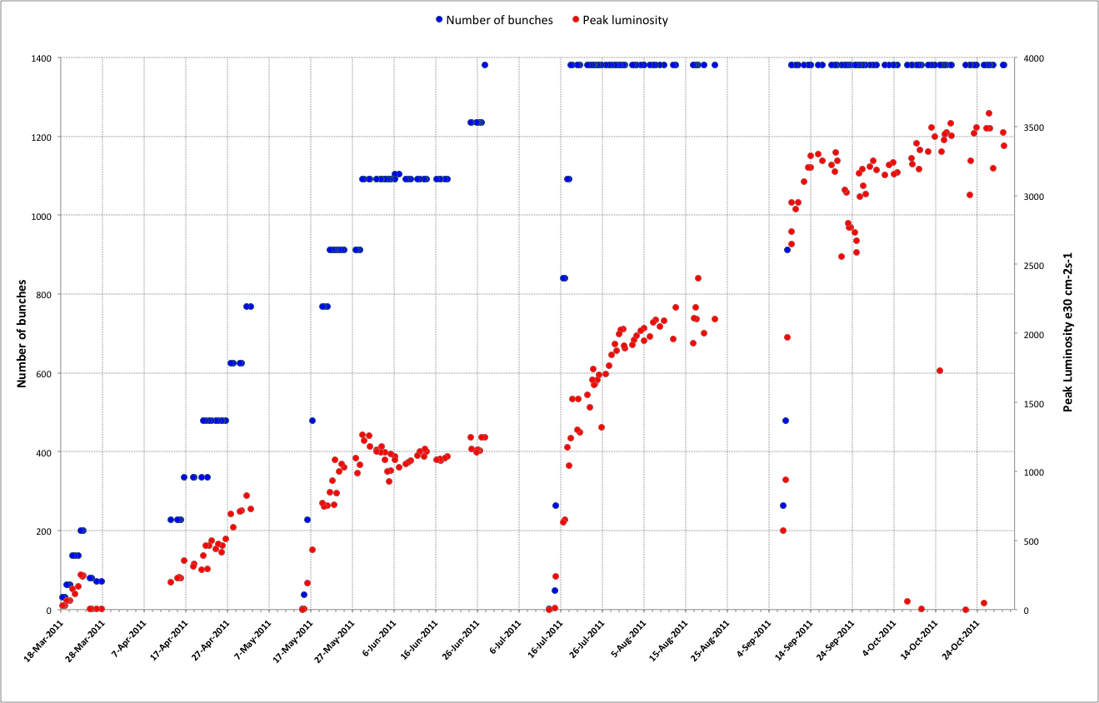
2011 – recap
75 ns
50 ns
Squeeze further
Increase number of bunches
Increase bunch intensity
Scrubbing
Reduce beam size from injectors
Initial
commissioning

Slide 3
2011
Another remarkable year
It was nearly always a battle…
Remarkably no real show stoppers
Successfully took on:
  Total intensity
  Bunch spacing
  Bunch intensity
  Emittance
  Beta* & aperture

Slide 4
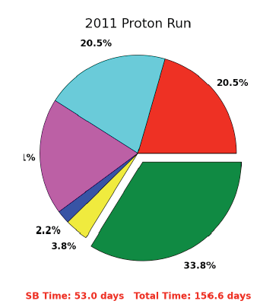
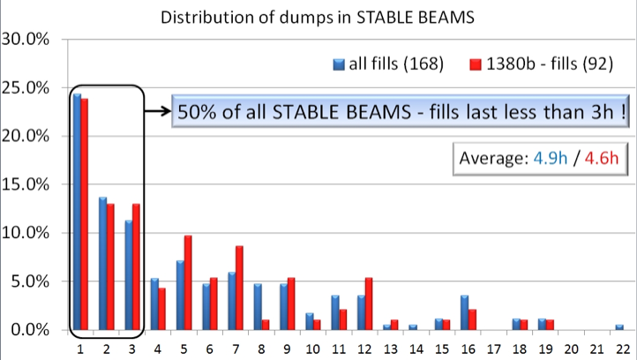
Operation efficiency
Overall efficiency
  Pretty good considering that this is the LHC
  Overall time in stable beams 34%
Premature dumps
  50% of all STABLE BEAMS fills lasted less than 3 hours
34%

Slide 5
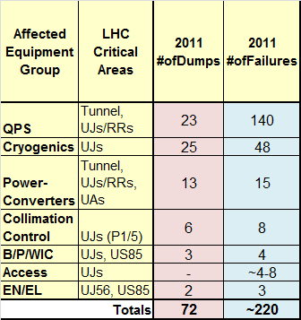
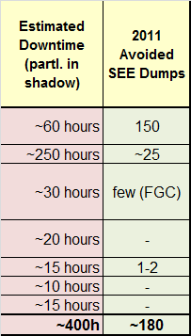
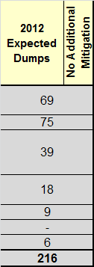
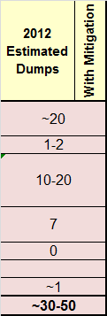
Radiation to electronics (R2E)
xMas-Mitigation crucial: patch, shielding, relocat.
Patches to continue during 2012
Particular emphasis (analysis) of ‘new’ failures

Slide 6
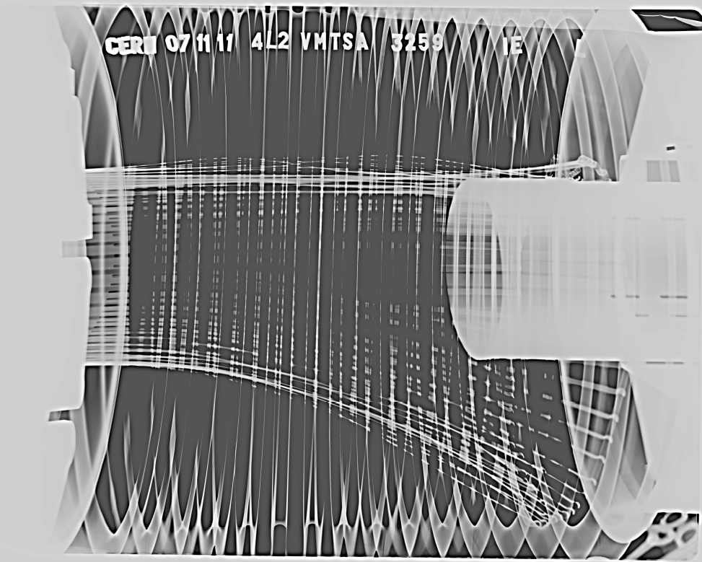
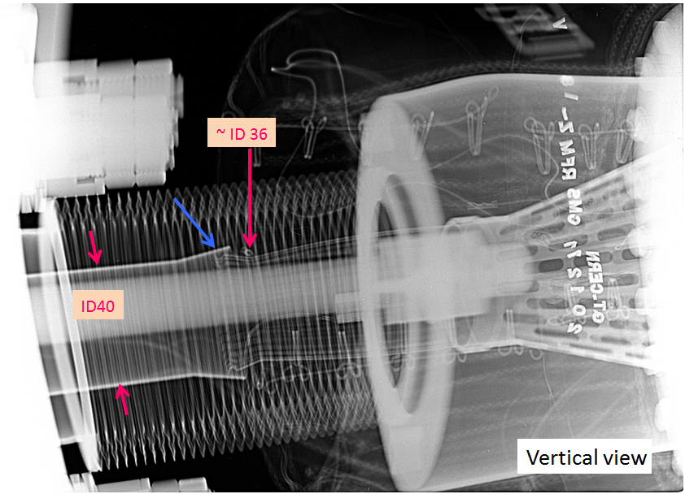
Vacuum
Unexpected pressure rise (10⁻⁶ mbar) observed in LSS2-LSS8 (D1) and close to CMS: bad RF contact (x-rays inspection) ➔interventions done in 2 & 8 & CMS to resolve RF finger issues - shouldn't be a problem in 2012.
CMS
LSS2

Slide 7
2011 to 2012
Well organized, productive Xmas technical stop
  Lot of R2E related work
  Plus consolidation and improvements of many systems
Vacuum consolidation to address successfully diagnosed causes of instabilities in 2011
Injection collimators issues diagnosed and understood - spare in preparation - fingers crossed in the meantime
Cool-down of machine exactly on schedule - cryogenics demonstrating full mastery…
Very smooth hardware commissioning including careful quench-less commissioning of main circuits to 4 TeV
Machine checkout proceeding well - good for beam next Tuesday afternoon
First beam yesterday evening without major problems

Slide 8
2012 strategy
4 TeV
β*=0.6m→0.7m→0.9m
50 ns
∫Ldt = 5 fb⁻¹ in June?
∫Ldt = 15-19 fb⁻¹
Dumps=30-50
Pile-Up=26-35
LHCb ∫Ldt=1.5 fb⁻¹
L_{peak}=5-6.8 10³³ cm⁻²s⁻¹
TCP gap=2.2mm
IP1 β*=500m
SPS ε= 2 μm
SPS N_{p}= 1.6 10¹¹
p-Pb: 3.5 TeV or 4 TeV
∫Ldt = 15- 23 nb⁻¹
β*=(0.6,0.6,0.6,3)m
Rogelio Tomas

Slide 9
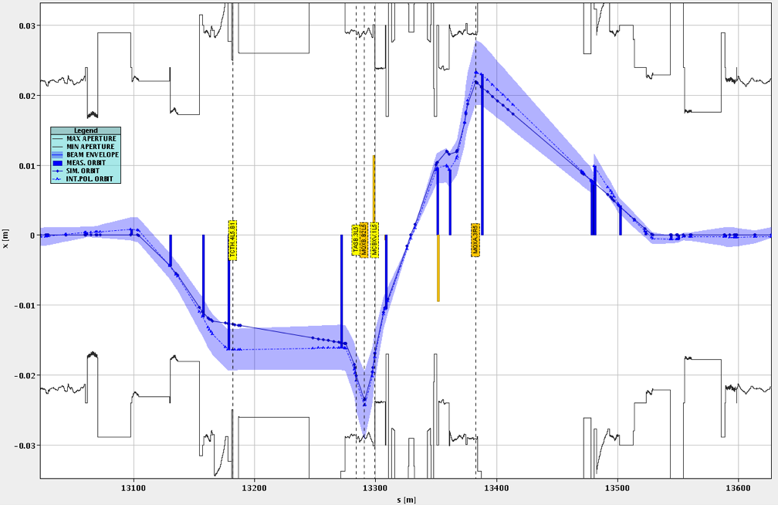
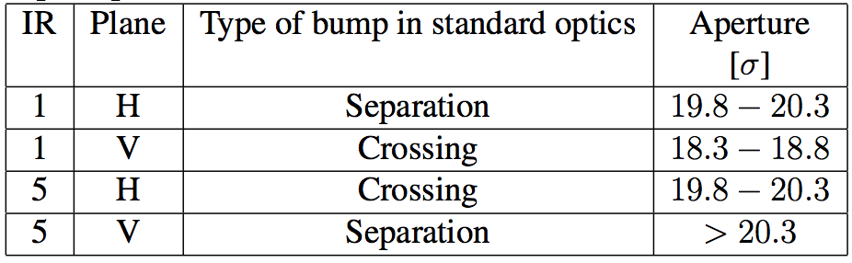
IR1 and IR5 aperture at 3.5 TeV
CMS
2011’s “platinum mine”
We got 4-6 sigmas more than the expected 14 sigma
Triplet aperture compatible with a well-aligned machine, a well centred orbit and a ~ design mechanical aperture (small tolerance)
~3 cm
~600 m
Stefano Redaelli

Slide 10
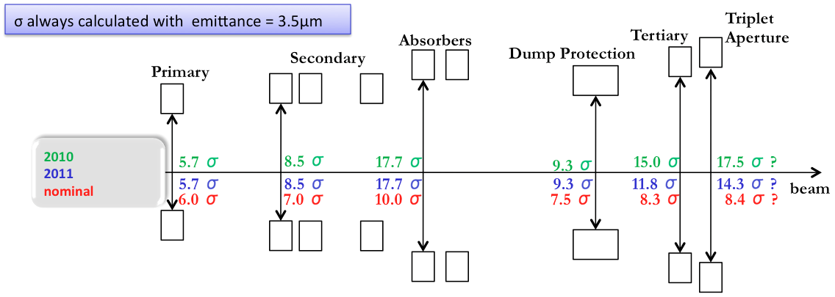
Collimator settings 2012
2012: tight settings
Collimation hierarchy has to be respected in order to achieve satisfactory protection and cleaning.
Aperture plus tighter settings allows us to squeeze even further..
 | σ
TCP 7 | 4.3
TCSG 7 | 6.3
TCLA 7 | 8.3
TCSG 6 | 7.1
TCDQ 6 | 7.6
TCT | 9.0
Aperture | 10.5

Slide 11


How tight?
Norway
Iberian
peninsula
Intermediate settings (2011):
~3.1 mm gap at
primary collimator
Tight settings:
~2.2 mm gap at
primary collimator

Slide 12
2012 run configuration
Energy – 4 TeV
  Low number of quenches (as in 2011) assumed
Bunch spacing - 50 ns
Collimator settings – tight
  As discussed – NB not yet proven operationally
Atlas and CMS beta* - 60 cm
  with 70 cm and 90 cm as fallbacks
Alice and LHCb beta* - 3 m
  Natural satellites versus main bunches in Alice

Slide 13
Bunch spacing
Performance from injectors
Bunch spacing | From Booster | Protons per bunch (ppb) | Emittance H&V [mm.mrad]
150 | Single batch | 1.1 x 10¹¹ | 1.6
75 | Single batch | 1.2 x 10¹¹ | 2.0
50 | Single batch | 1.45 x 10¹¹ | 3.5
50 | Double batch | 1.6 x 10¹¹ | 2.0
25 | Double batch | 1.2 x 10¹¹ | 2.7

Slide 14
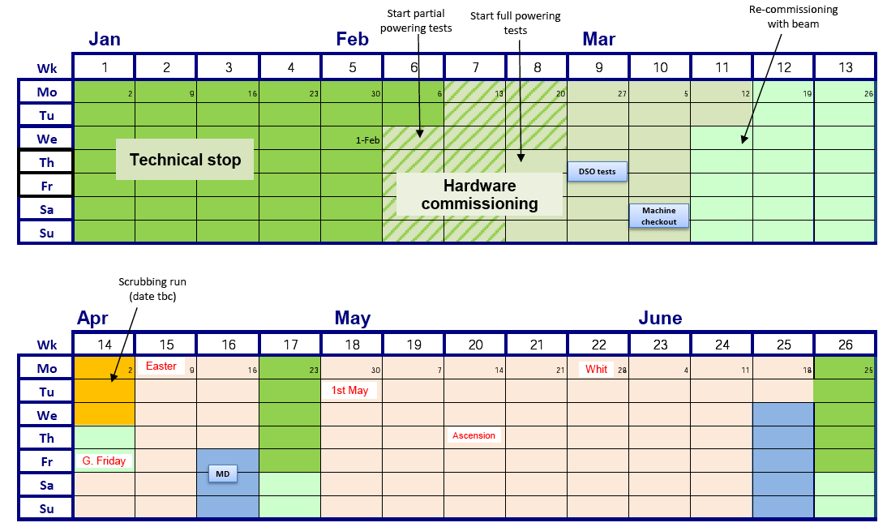

2012 LHC schedule Q1/Q2
1
2
3
4

Slide 15
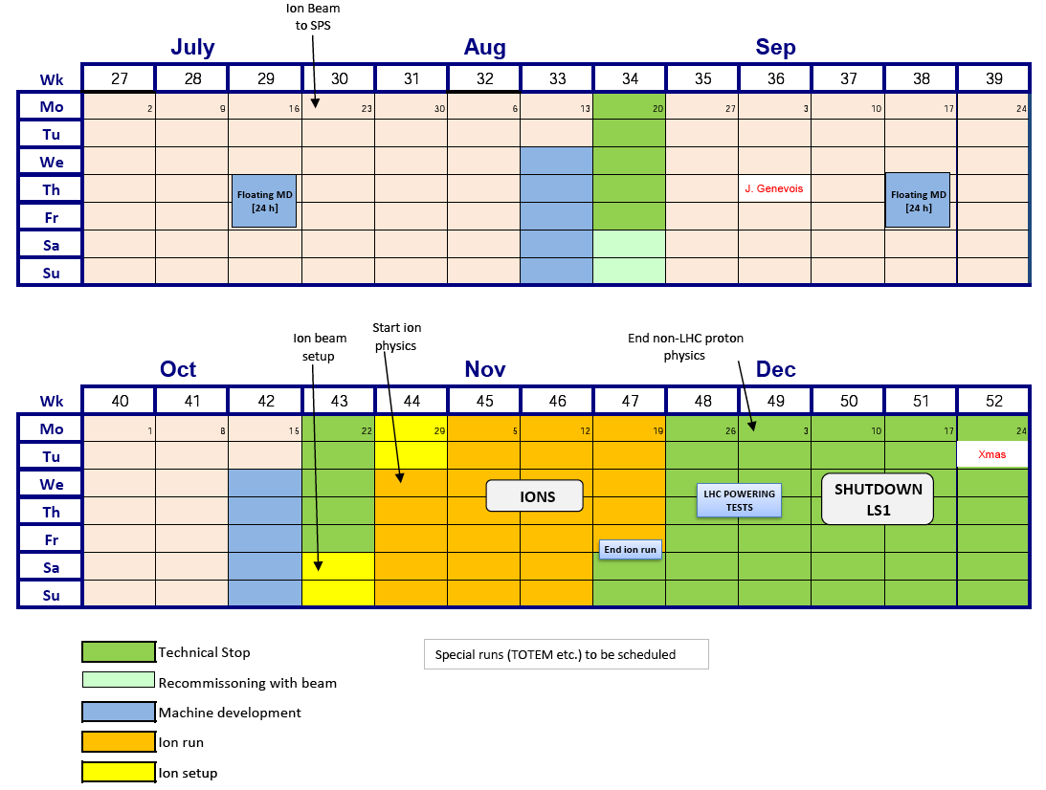
2012 LHC schedule Q3/Q4
6
5
High beta* runs for ALFA and TOTEM
Van der Meer scans

Slide 16
2012 - breakdown
 | Days
Machine check-out | 2
Commissioning with beam | 21
Machine development | 22
Technical stops | 20
Scrubbing (25 ns) | 3
Technical stop recovery | 6
Initial intensity ramp-up | ~21
Proton running | ~126
Special runs | ~8
Ion setup | 4
Ion run | 24
~150 days

Slide 17
50 ns performance estimate
4 TeV, 50 ns, 1380 bunches, 1.6e11, 2.5 microns
150 days of proton physics (assuming similar efficiencies to 2011)
Beta* [cm] | Collimators | Peak Lumi [cm-²s⁻¹] | Int. Lumi [fb⁻¹] | Pile-up | Increase in peak
90 | Intermediate | 5.1e33 | 12.1 – 14.5 | 26
70 | Tight | 6.2e33 | 14.7 – 17.6 | 31 | +22%
60 | Tight | 6.8e33 | 16.2 – 19.3 | 35 | +10%

Slide 18
25 ns performance estimate
4 TeV, 25 ns, 1380 bunches, 1.6e11, 2.5 microns
140 days of proton physics (extra scrubbing required)
Beta* [cm] | Collimators | Peak Lumi [cm-²s⁻¹] | Int. Lumi [fb⁻¹] | Pile-up
80 | Tight | 3.8e33 | 8.3 | 10
Conclusion: 25 ns not competitive with 50 ns

Slide 19
Conclusions
Good performance in 2011 from working on all available parameters
Very definitely exploring the effects of high intensity beams
  SEUs, beam induced heating, vacuum instabilities…
  Operational efficiency suffering as a result
Main gain in 2012 is use of tight collimator settings and reduced beta*
  5 to 6 x 10³³ cm⁻²s⁻¹ and 15 fb⁻¹ should be possible
Hope for improved operational efficiency
  R2E mitigation measures
  but partially countered by increased peak performance
Another long, interesting year in prospect…

