Slide 1

Data Quality
Concept of tolerable vs. intolerable defects

Slide 2
The Idea of “Defects”
2010: the DQ shifters had to flag the data green or red for their system / CP object
  Green: used for physics analysis
  Red: bad for physics, should not be used
Problem
  There are analyses which are very sensitive to certain data flaws (e.g. little inefficiencies in tracking)
  No way to find these “little flaws” as no information available after the DQ checks
Data is not black or white – There are a lot of shades of grey in-between!
Solution
  Put everything out of the ordinary (defect = primary flag) directly into a database
  Decide further downstream (virtual flags) if it is good for physics (tolerable) or not (intolerable)

Slide 3
What is “Tolerable”?
There is a little flaw in data (e.g. a very small fraction of the detector is off)
The detector / CP group thinks it is good for MOST analyses (let’s assume 90%)
This is only a guesstimate!
We assume it is BAD for SOME analyses!
  These analyses need to carefully check the effects of tolerable defects and exclude them from their data sample!
Who are the 10%?
  OR of all ~600 defects
  Sort of EVERY analysis is “special” for one defect or the other!

Slide 4
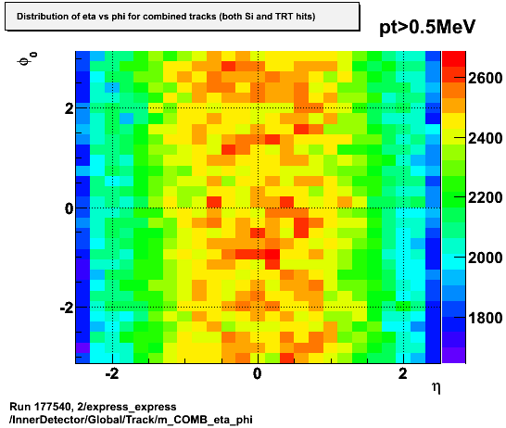
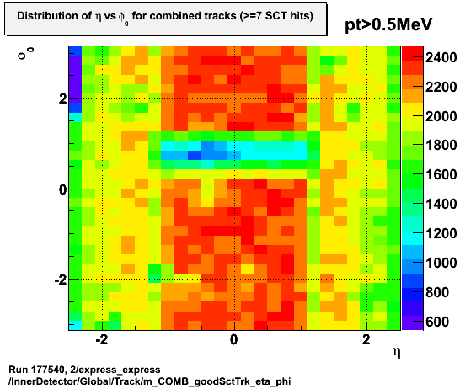
An SCT Example
SCT cooling loop failure
  Combined tracking looks fine
  SCT >= 7 Hits clearly shows affected region
  Pretty sure that few analyses very sensitive to tracking will see an effect

Slide 5
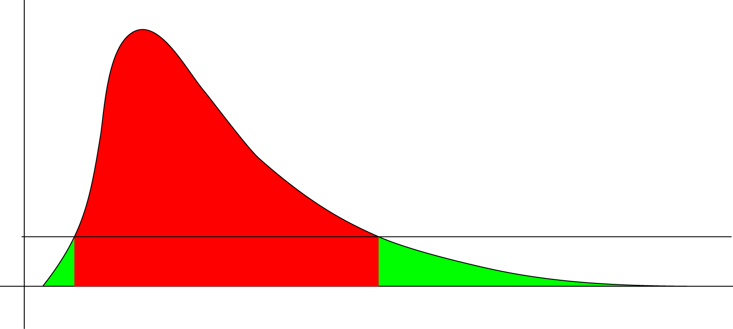
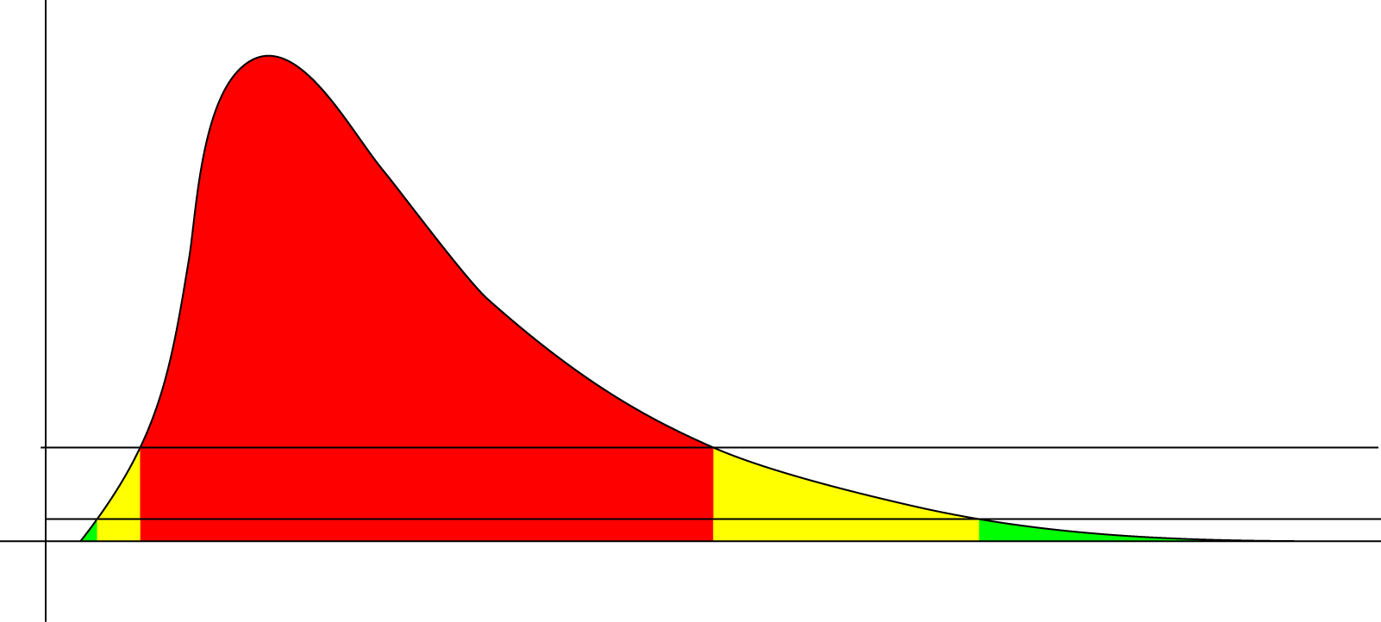
A LAr Example
(long) LAr noise burst
  2010: data green, if noise fell below some threshold
  Some analyses did see an effect coming from the tails → excluded additional lumiblocks
  2011: bulk → intolerable, tail → tolerable
  (tailtail: no defect)

Slide 6


The General Problem
Analyzers:
  cannot check 600 defects, if they have an effect
  Detector / CP people should tell what’s important!
Detector / CP people:
  cannot know what hardware effect is relevant to which of the hundreds of analyses
  Analyzers are responsible for their analysis!

Slide 7
Good Run Lists
GRLs exclude intolerable defects for certain detectors / CP objects
Templates provided for CP groups / Physics Groups based on signature / requirements
General GRLs
  AllGood: excludes all intolerable defects in any detector
  AllGoodTight: exludes (most) tolerable defects as well
Systematic Check
  ALL analyses should use AllGoodTight GRL as cross check to their normal group GRL
  If no difference in physics output (within statistical uncertainty) → go ahead
  If difference found → try to trace back which tolerable defect(s) cause problems and exclude them
  If searches find a signal, all event candidates should be checked for their tolerable defects!

Slide 8
GRL Luminosities 2011
ATLAS Ready
5193.99 pb⁻¹
AllGood
4626.84 pb⁻¹
AllGoodTight
2954.47 pb⁻¹
B-K only:
~2270 pb⁻¹
975 pb⁻¹
GRL | Lumi (pb-1) | Gain to AllGood
GammaJet | 4896,20 | 5,8%
GammaBJet | 4837,69 | 4,6%
SMjets | 4725,04 | 2,1%
WZjets | 4713,11 | 1,9%
Z_tautau_lh | 4628,06 | 0,0%
Top_all | 4713,11 | 1,9%
Top_all + tau | 4628,06 | 0,0%
Top_all + btrig | 4707,11 | 1,7%
Higgs_4l_2e2mu | 4811,47 | 4,0%
Higgs_4l_4mu | 4811,51 | 4,0%
Higgs_tautau_lh | 4661,32 | 0,7%
Susy | 4713,11 | 1,9%
Susy_ph_met | 4816,68 | 4,1%
DiMuonsPhoton | 4811,47 | 4,0%
WRHN_main | 4746,36 | 2,6%
WRHN_fake | 4713,11 | 1,9%
Flag | Higgs_4l_2e2mu | Higgs_4l_4mu | Susy_ph_met | DiMuonsPhoton
atlsol | X | X | X | X
atltor | X | X | X | X
trig_muo | X | X | O | X
cp_mu_mmuidcb | X | X | X | X
cp_mu_staco | X | X | X | X
global_all_calo_cg_no_fcal | O | X | O | O
trig_ele | X | O | X | O
cp_eg_electron_barrel | X | O | X | O
cp_eg_electron_crack | X | O | X | O
cp_eg_electron_endcap | X | O | X | O
cp_eg_electron_forward | O | O | X | O
trig_gam | O | O | X | O
cp_eg_photon_barrel | O | O | X | X
cp_eg_photon_crack | O | O | X | X
cp_eg_photon_endcap | O | O | X | X
trig_jet | O | O | O | O
cp_jet_jetb | O | O | X | O
cp_jet_jetea | O | O | X | O
cp_jet_jetec | O | O | X | O
cp_jet_jetfa | O | O | X | O
cp_jet_jetfc | O | O | X | O
trig_met_metcalo | O | O | O | O
cp_met | O | O | X | O
pix0 | O | O | X | O
cp_tracking | O | O | X | O
idvx | X | X | X | X
idbs | X | X | X | X
lumi | X | X | X | X
~ half of 2011 data in periods L,M!
Tight GRL issue fixed
  Tile defect was set for every run in L,M
  Removed that defect in the GRL HEAD
  Only defects “out of the ordinary” data taking should be in tight GRL!

Slide 9
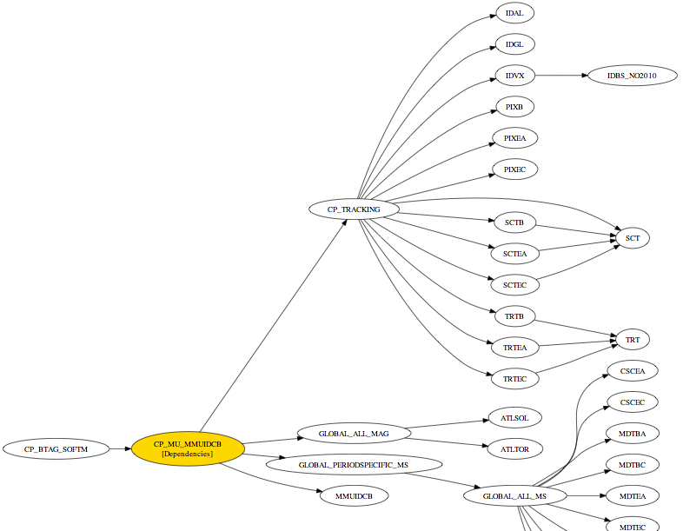
CP Muon Defect

Slide 10
Advantages of Tolerable Defects
Gives you a possibility to flag little data flaws
  Readily available data for further studies
  Defect can turn intolerable easily later on
Possibility of adding a second threshold
  “Warning” threshold vs. “rubbish” threshold
  Do not throw too much data away if not needed
Physics analyses can test their sensitivities
  Check all event candidates in low statistics samples
  Make systematic checks (via Tight GRL) in high statistics analyses

Slide 11
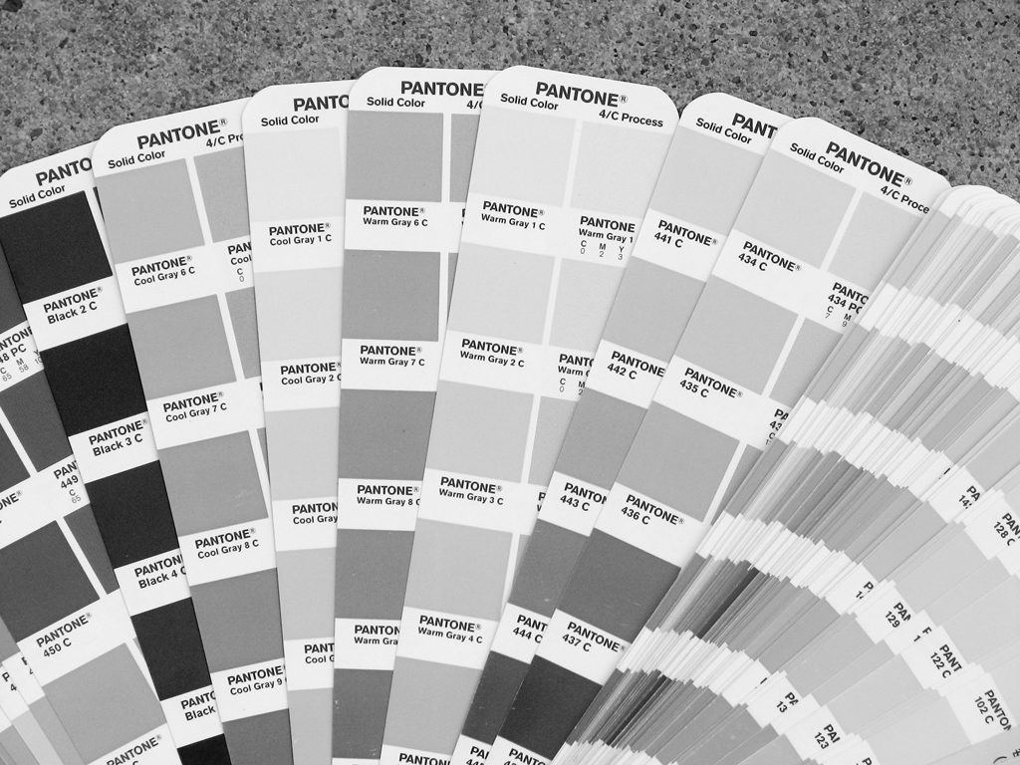
Data is not Black’n’White – there are a lot of shades of grey in-between!

