Slide 1
RPC DQA 2012
Status and prospective
Marcello Bindi
on behalf of RPC & LVL1 Muon BarrelWorking Group
ATLAS Muon Week - March 21st, 2012

Slide 2
Outline
New features and Open issue in 2012:
  DCS
  Online RPC & LVL1 Muon Barrel Monitoring
    Gnam, OHP & DQMD
  Offline RPC & LVL1 Muon Barrel Monitoring
    via using Tier0 monitoring package
  Offline RPC Detector monitoring by using the comparison with DCS

Slide 3
DCS

Slide 4
Developments for the 2012
DQA/LVL1 with DCS
Ratio Trigger Rates / Luminosity Monitoring
  Commit of general overview panels with Trigger Tower granularity
  Monitoring of the ratios respect to Luminosity (Proper Alarm not yet set)
  Unfortunatelly LowPT and HighPt differenciation not yet possible!!
Ratio Detector Currents / Luminosity Monitoring
  Commit of general overview panels with Gas Gap granularity
  Monitoring of the ratios respect to Luminosity
Relative Ratios Detector Currents/Trigger Rates
  Commit of general overview panels with Trigger Tower granularity
  Monitoring of the ratios respect to Luminosity
  Work only partially done due to the fact that energies were focused on
  maintenance operation in the cavern
  → Everything will be ready before start of Luminosity (Easter?)

Slide 5
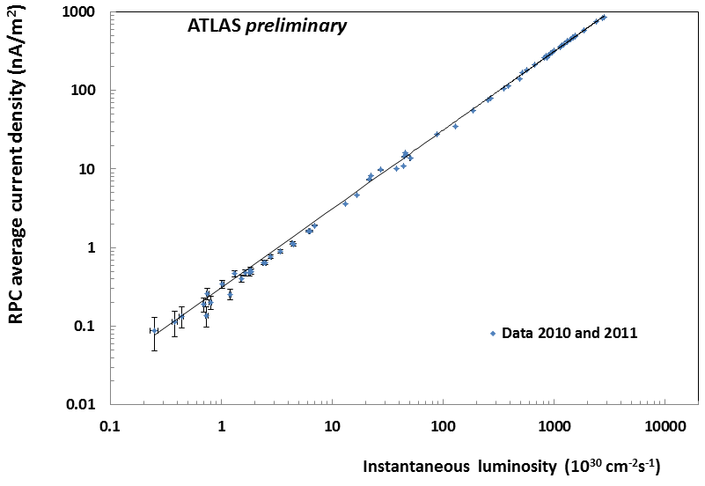
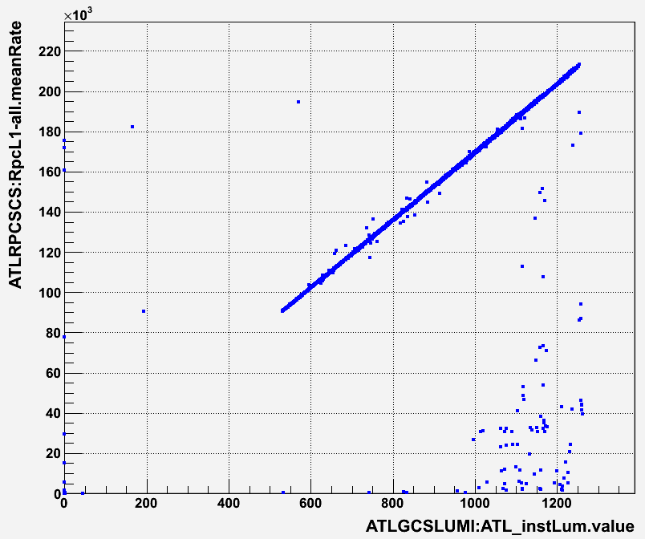
Monitoring of the detector current and trigger rates as a function of Luminosity
About 1.7 MHz of Mu0 Rate extrapolated at L=10^34

Slide 6
ONLINE

Slide 7
Online RPCGnam in 2011/2012
Many improvements triggered by problems during 2011 data
taking:
  New plot vs Lumiblock
  New evaluation of Errors:
    Synchronization errors for the whole sector;
    Decoding and histogramming of all internal checks performed by CMs, PADs, SLs, RODs
  Online trigger rate coming from SL output

Slide 8
DQMD and OHP Online Monitoring in 2011/12
New DQMD segment created for LVL1 Muon Barrel Trigger with all information coming from gnam monitoring at SFI level
  Check of Synch. for each sector
  Check of data integrity
  Trigger proposal occupancy
New plots and controls have been added following the RPCGnam features; most of the plots have a related algorithm
The RPC DQMD has been moved to the TDAQ-04-00-01
A. Bruni

Slide 9
DQMD and OHP Online Monitoring in 2011/12
Offline tool to “emulate” (using online MDA stored data) how OHP panels would be appeared at the end of the RUN to a shifter.
  Code running on Naples Tier2 Farm
  Parsing of the OHP configuration file to produce an output like OHP Remote Monitoring web pages
    https://atlasop.cern.ch/tdaq/web_is/ohp/
  List of runs available in
      http://atlasui02.na.infn.it:8088/~romano/
A. Bruni and M. Romano

Slide 10
RPC – LVL1 Online Monitoring
Activity during winter shutdown:
  Complete review of all online histos
    Some histos have been removed or only published at EndOfRun;
    Many histos have been slightly modified, changing labels, binning, etc. in order to fulfil some requirements/comments of shifters/experts;
    Some histograms added to quantify the fraction of detectors having errors/problems
      Still under commissioning with cosmics/beam splashes.
      To be installed in few days
Slide from M. DellaPietra

Slide 11
Action items for 2012: RPC Online
Find a better way to summarize synchronization errors:
  Define the fraction of RPC detectors with synch errors:
    Look at CMs, Towers, or Global Sector?
  The DQMD should clearly report the actions that shifter have to be done in case of problems. As soon these actions will be clarified, the info will be inserted in the RPC shifter twiki.
  Twiki page to be updated accordingly with more comments/explanations
Take into account DCS and DAQ status to know which part of the detector is inside the partition.

Slide 12
OFFLINE

Slide 13
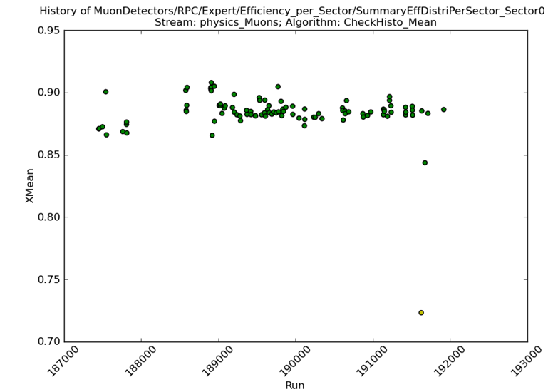
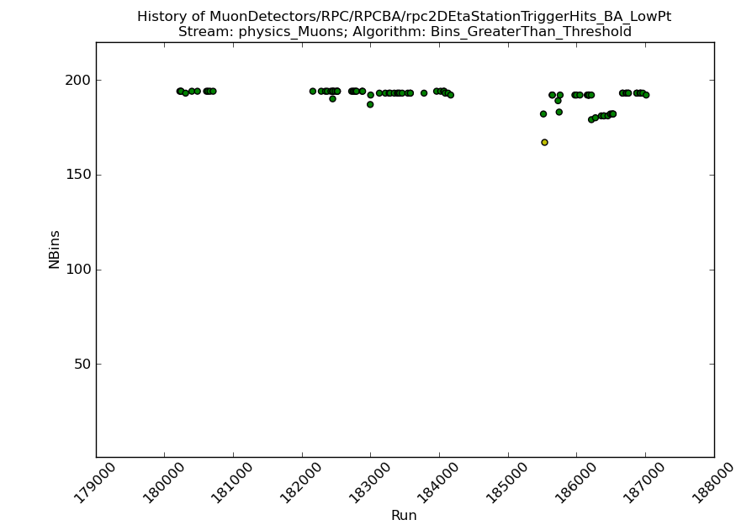
RPC Offline Monitoring
2011 Status
Slide from M. Bianco
Detector very stable and well monitored, but probably not enough, some problem (as synchronization problem) at the moment can be easily spot only at the Online level
RPC very raw efficiency
(Dead Pannel, dead strips, disconnected gas volume included)
RPC trigger coverage
(Active trigger tower (one side))

Slide 14
Offline Status
Slide from M. Bianco
New RPC webdisplay configuration developed and submitted
Algorithms to check “Plots vs Lumiblock” tested
Instructions and plots descriptions on twiki page in progress

Slide 15
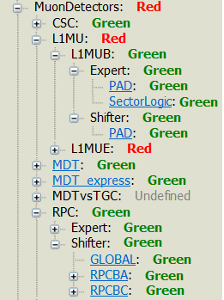
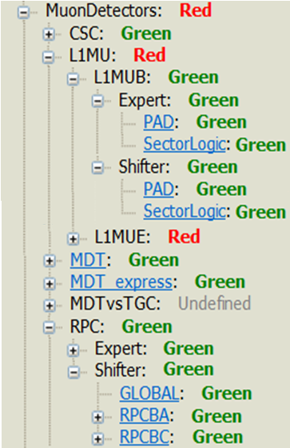
Offline Status
Slide from M. Bianco
New RPC webdisplay configuration developed,
certified plots under SectorLogic Expert Folder and moved under Shifter folder

Slide 16
Offline Status
Slide from M. Bianco
List of plots selected for historical trend,
to be produced after each RUN
RPC/Shifter/GLOBAL/Phi_ClusterSize_Distribution
RPC/Shifter/GLOBAL/Eta_ClusterSize_Distribution
RPC/Shifter/RPCBA/Efficiency_Distribution_sideA
RPC/Shifter/RPCBC/Efficiency_Distribution_sideC
RPC/Shifter/RPCBA/CS_Distribution_sideA
RPC/Shifter/RPCBC/CS_Distribution_sideC
L1MU/L1MUB/Shifter/PAD/rpc2DEtaStationTriggerHits_BC_LowPt
L1MU/L1MUB/Shifter/PAD/rpc2DEtaStationTriggerHits_BC_HighPt
L1MU/L1MUB/Shifter/PAD/rpc2DEtaStationTriggerHits_BA_LowPt
L1MU/L1MUB/Shifter/PAD/rpc2DEtaStationTriggerHits_BA_HighPt

Slide 17
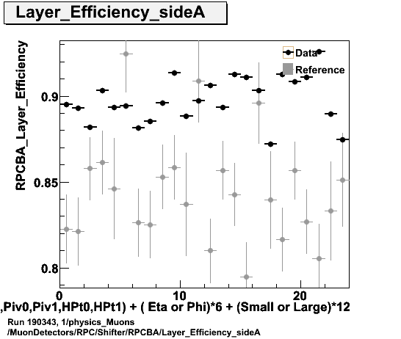
Offline Status (new defect flag)
Slide from M. Bianco
MuonDetectors/RPC/Shifter/RPCBA/Layer_Efficiency_sideA
Algorithm: Bins_Less_Than_Threshold (0.8) → Yellow/Red if 8/12 bins are below
Defect Flag:
  RPC_BA(BC)_LowEfficiency_PROBLEM (If the algo results is YELLOW)
  RPC_BA(BC)_LowEfficiency_PROBLEM (if the algo results is RED)

Slide 18
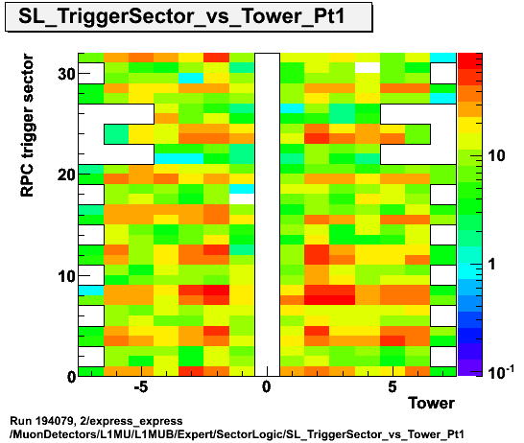
Offline Status (new defect flag)
Slide from M. Bianco
To apply new defect flag to this plots some refinements are needed to the plots layout
(Not yet implemented)
MuonDetectors/L1MU/L1MUB/Expert/SectorLogic/SL_TriggerSector_vs_Tower_PtXX
(7 Plots like this, 6 for each Trigger Thresholds and 1 with all trigger)
Algorithm: Bins_GreaterThan_Threshold
Defect Flag:
  SL out of Sinc Problem (If all tower of a single SL disappear)
  SL out of Sinc Problem (If all tower of more than 4 SL disappear)

Slide 19
OFFLINE – DCS comparison

Slide 20
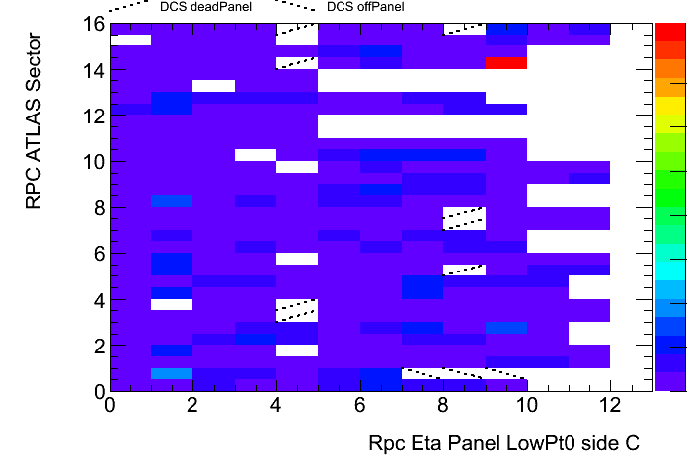
Offline – DCS integration
  The idea is to use the DCS info in the Offline plots, in order to cross-check the info, help the shifter to understand the problem and validate both system.
  Plan to use the information written by the DCS also in simulation
  → validation is urgent !
Monitoring offline can retrieve info from RPC DCS from condition database (filled by DCS expert) using muon condition service (M. Verducci)
The code, developed by G.Chiodini, is still under debug, it should be run routinely in 2012 data taking.
Actually this comparison is already done for offline analysis.

Slide 21
DCS vs Offline status
Work done but not in the release
Info used is Deadpanel and Offpanel
Deadpanel and Offpanel from RPC DCS
are plotted similarly to single hits RPC
Two kind of 2D plots ready:
Sector vs Eta station
Panel vs Lumiblock
Not clear when in the release and than to tier0 !!

Slide 22
Validation of COOL DB information
Trigger Tower granularity:
  ☺ already done through the experience of 2 years of data taking;
  a bug has been found few month ago with a mismatch between SIDE A and C (when de-sync of one full side appeared)
ROPanel granularity:
  ☹ still to be commissioned; maybe a preliminary validation of the information is needed before the start of the 2012 data taking;
  no need to do it after implementing the code and the visualization plots at Tier-0 (by simply comparing a text files with Off-Dead Ropanels list from DCS and VeryLowEfficiency ROPanels list from DQOffline)

Slide 23
LVL1 MU Barrel:
Trigger Efficiency Monitoring

Slide 24
Open issues for 2012: LVL1 Muon Barrel Offline
Slide from U. Schnoor, P. Anger
TU Dresden
Plan for 2012:
Main task: provide efficiency plots similar to TGC's efficiency monitoring
Current Status:
● new algorithm RpcLv1RawDataEfficiency has been created in the
RpcRawDataMonitoring package
● filling denominator and nominator histograms for turn-on curves and efficiency maps
● implemented ratio processing for turn-on curves and efficiency maps reading RPC coincidence data
● implemented Post processor for adding efficiency plots (to be tested)
Next steps:
● Test the algorithm: Reco_trf.py AMI=q122
● Include in SVN
● Create documentation (twiki page, ...)

Slide 25
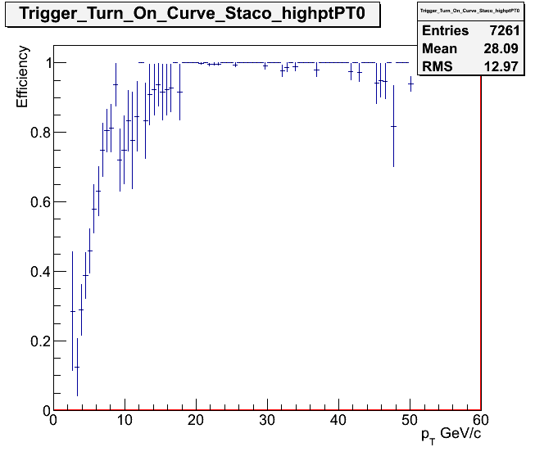
Open issues for 2012: LVL1 Muon Barrel Offline
Slide from U. Schnoor, P. Anger
TU Dresden
Plan for 2012:
Efficiency map of Eta vs Phi for each pt threshold created
Efficiency curve vs Pt for each pt threshold
Each efficiency evaluated for both positive and negative muons with both Staco or Muid reconstruction algorithms
TGC plots
RPC plots: implemented but still not deployed !!

Slide 26
Conclusion
Some improvements respect to 2011 have been seen especially for Detector/LVL1 Online Monitoring and for part of the Offline Monitoring
Many useful plots have been added: a better evaluation of some algorithms is needed so far.
It should sufficient the experience of 2011 (for both shifter and expert folders)
3 main hot items still pending:
  DCS-OFFLINE comparison at Tier0 Monitoring (we would be the first to do this kind of fast cross-check). Very important to understand and justify our possible holes!!
  Offline trigger effiency curves (TGC-like).
  Choice of Flagging criteria for DQMD Online (trigger the ACR-shifter follow-up) and Offline Monitoring (more refined algorithms to help Muon DQ Shifter)

Slide 27
Back-Up

Slide 28
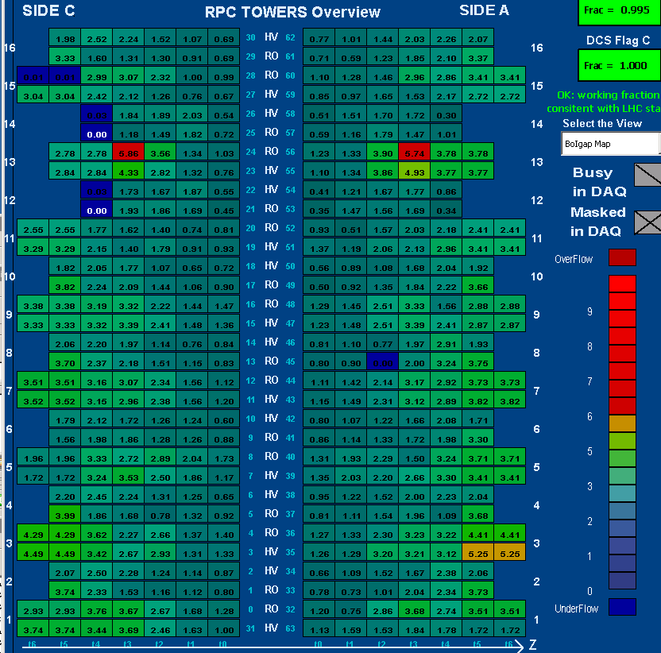
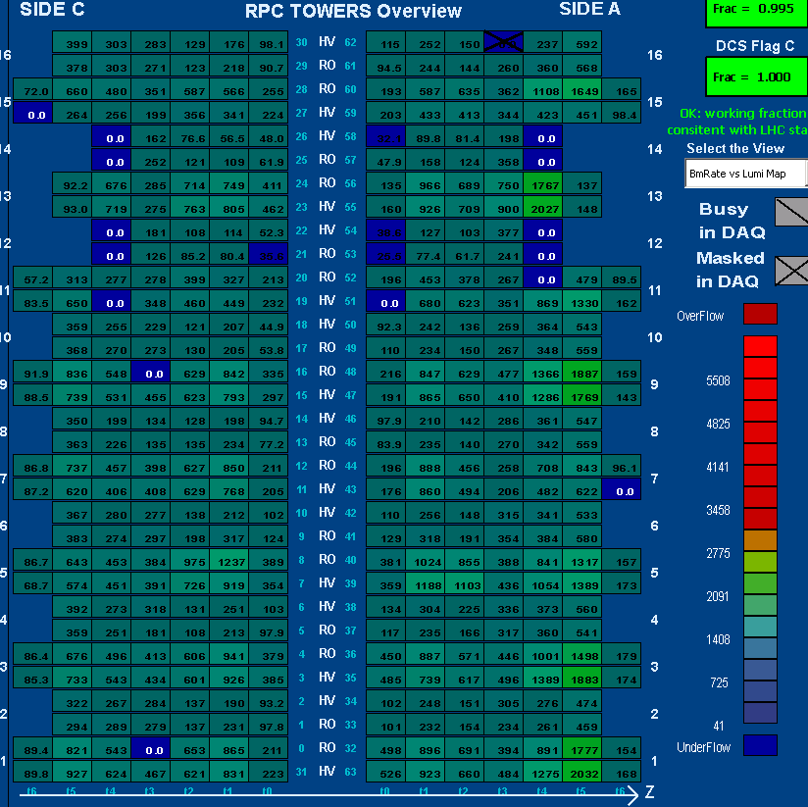
Map of Detector Currents
(μA/m²)
Barrel Outer Gap Currents
Map of LVL1 rates or Gap currents /Lumi (Hz/10³³cm⁻²sec⁻¹)
MU4 rate/ATLAS Lumi
These numbers will have to be constantly monitored via DCS scripts/alarms (maybe also by MUON shifter) to spot new problems/bad behavior ( f.e. Gap currents or LVL1 rates during a fill that do not follow the luminosity trend) .
Very crucial is to check the ratio Rate/Current for each ETA-PHI region (Monitoring of background currents and LVL1 noise)!

Slide 29
DCS and Offline Cross-Check
First look (8/16 sectors) at the DCS information written into COOL DB via OFFLINE monitoring
The association between Trigger Towers (masked or killed during a run) and Offline ROPanels during a run seems to be correct. This has been tested only for the sectors were killed/masked towers were present.
  Ideally we may think to use a run during HI period to test the system by killing and recovering sequentially every tower and look at the data in the DB afterward.

Slide 30
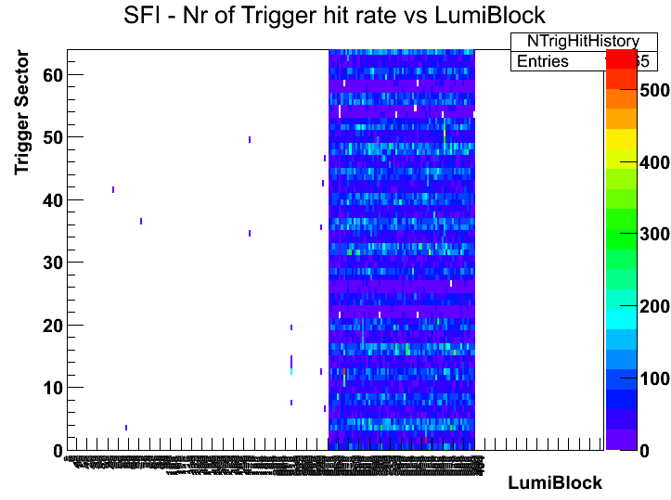
Online RPCGnam in 2011
Need to know when a problem appear (and/or disappear) during the run
New histograms implemented of several quantities vs. Lumiblock
Synchronization error (LVL1 and BCID)
Occupancy of the detector
Trigger output to the MuCTPI

Slide 31
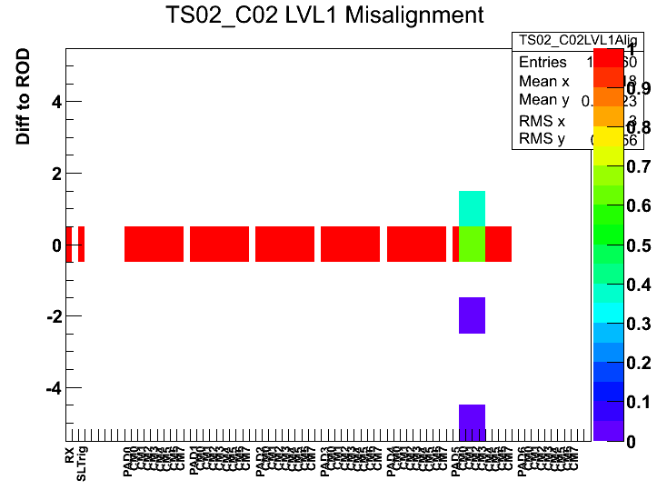
Online RPCGnam in 2011
Shifters and experts need to evaluate the fraction of events with errors (mainly synch. errors)
For each trigger sector the fraction of “out of synch” event is normalized
Red flags in DQMD are generated only if the whole sector is out of synch
Improvements on this item are needed (see next slides)

Slide 32
DCS and Offline Cross-Check
The check of DEAD ROPanels (140 /8545 due to disconnected gaps ) read out by OFFLINE algorithm have finally started.
Detector or LVL1 →OFFLINE
In the odd sectors (1-3-5-7) we found a perfect correspondence between foreseen detector holes and the OFFLINE one’s (empty bins in occupancy plots).
In the even sectors (2-4-6-8) we found some mismatches in S2-S3 special chambers and in BOS.
OFFLINE →Detector or LVL1
However we found few holes that were not foreseen by the Detector or LVL1 information available to DCS; this is exactly what we want to have under control. They maybe single ROPanels (ETA or PHI view) not properly working.
To be further investigated!

Slide 33
Mauro’s concern
DCS
ok
OHP
ok
DQMD
Policy of flag propagation. Same Configuration is used for shifters and also for detailed online Expert monitoring. Need to separate shifter and expert Subfolder ?
Complete the transfer of information to Trigger DQ
OFFLINE
Implementation of algorithms on some plots.
Logic of “defect suggestion” related to Trigger issues needs to be redirected to Trigger DQ

Slide 34
Online and Offline: lessons from 2011
Man power issues: only 1 person for each item (if one person is not working full time, delay in the work flow)
The experts have to keep updated Twiki and instruction for shifters.
Moreover:
information (both technical and that the state of the detector) must be shared as far as possible at list between the expert. The elog entries probably are not enough to propagate the information.

