Slide 1

Razor Analysis of R-Parity Conserving SUSY Events
By: Sagar Vijay
Advisors: Maurizio Pierini (CERN)
Maria Spiropulu (CERN, CalTech)

Slide 2
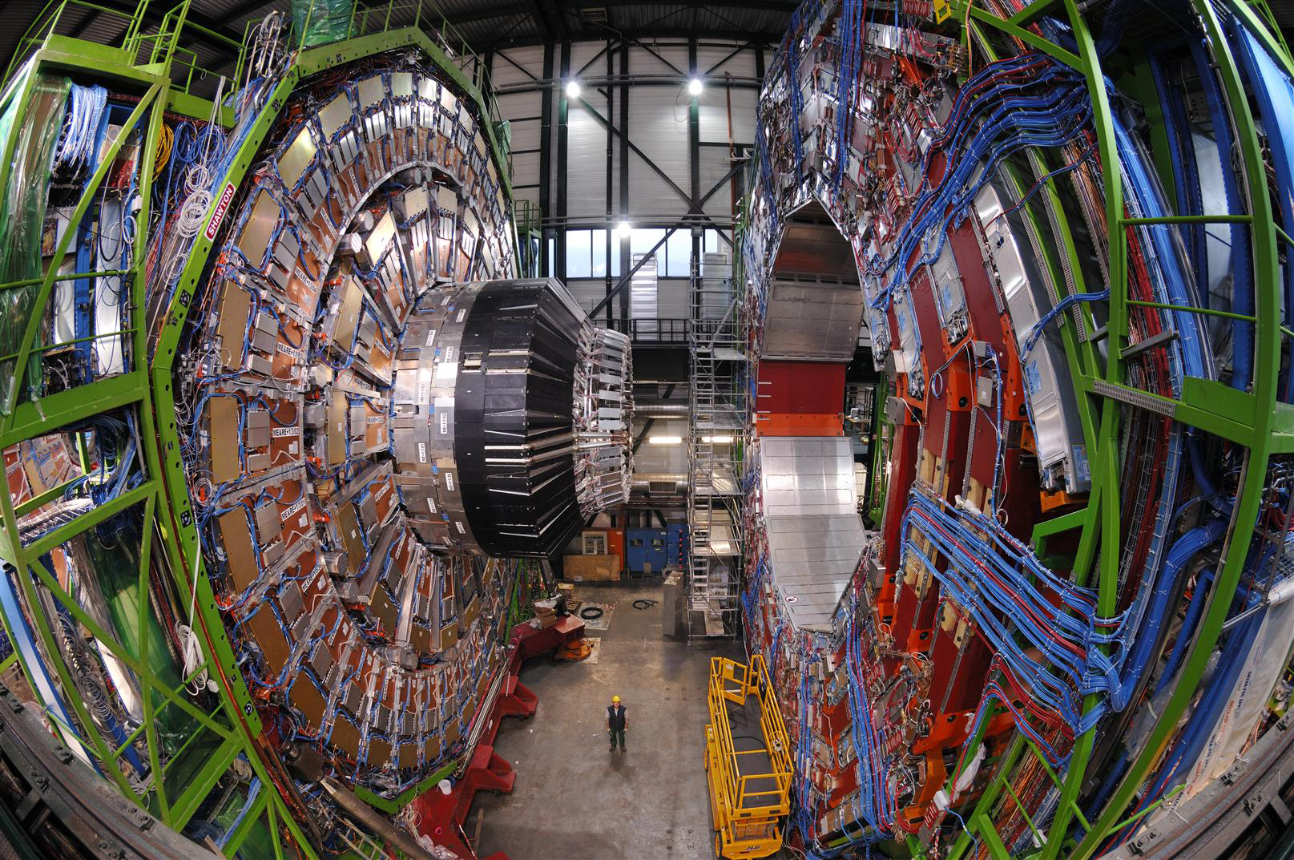
The CMS Experiment
Importance beyond Fundamental Physics: Grid Computing, Medical Physics, Superconductors

Slide 3
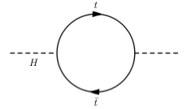

The Big Picture – Why SUSY?
Supersymmetry
  In theory – postulated symmetry linking bosonic and fermionic states
Physical Significance
  Unification of the Strong, Weak, and Electromagnetic Forces
  Solution to the Hierarchy Problem – quantum corrections to the Higgs mass diverge quadratically in the Standard Model
+

Slide 4
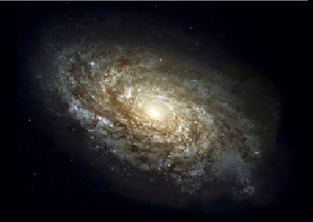
Dark Matter
Conserved discrete R quantum number in the Minimal Supersymmetric Standard Model (MSSM)
Consequences of R-parity conservation
  SUSY particles are pair-produced from SM decay events
  The lightest SUSY particle (LSP) is stable (dark matter candidate)

Slide 5
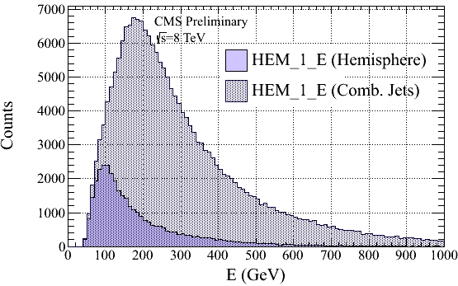
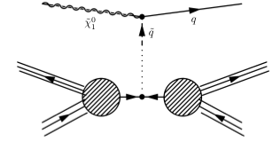
My Project
Missing E_{T} from SUSY events and background both fall exponentially
Project: collapse events into dijet topologies and use kinematic variables R and M_{R} to search for MSSM SUSY signals. Determine whether initial-state radiation (ISR) can be used to distinguish SUSY events from background.
Future Challenges – appropriate cuts on large QCD multijet background (e.g. )

Slide 6



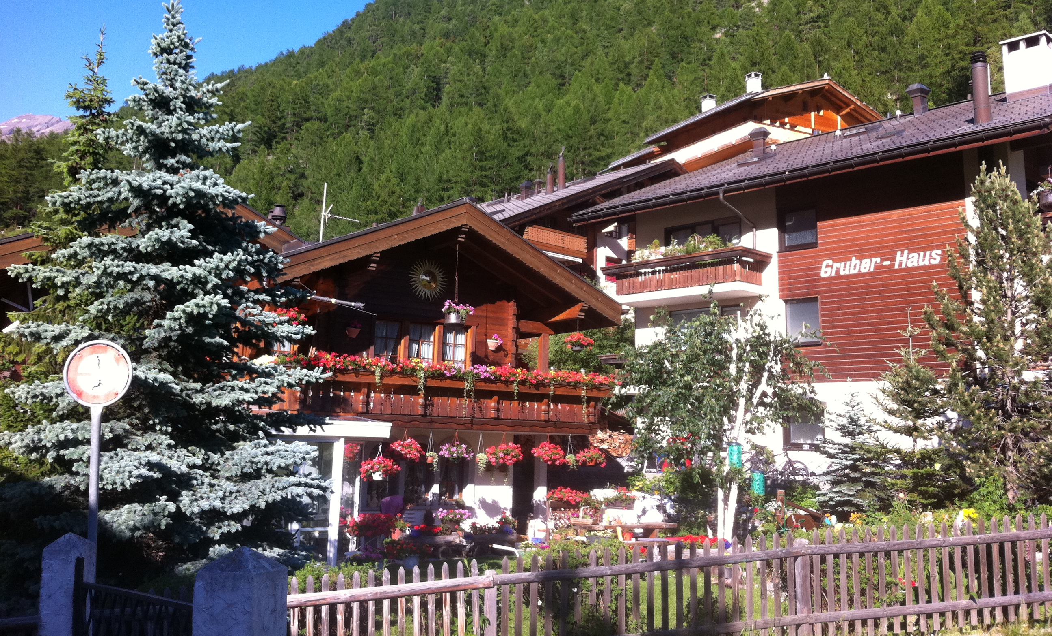
Adventures

