Slide 1
ADC Development and R&D
Simone Campana
CERN IT-ES

Slide 2
ATLAS Computing Model
Global computing within a hierarchy of Tiered centers organized in (primarily) regional ‘clouds’
  Optimize data flow in an environment of expensive, limited-bandwidth networks
Cloud model has limitations that are avoidable in the era of abundant networking
  Cloud boundaries negatively impact efficient data processing, data placement and access, disk space usage, network bandwidth, …
Exploit ability of our networks to move data effectively between as well as within clouds

Slide 3
Operational Experience
Our Tier 1s have been very effective – as expected – as flexible, efficient processing and data serving centers
A lesson of experience is that Tier 2s are extremely effective and flexible as well – and not just as an appendage of a Tier 1
Greater equivalency between Tier 1s and Tier 2s can lead to fuller and more efficient resource utilization
Trend today and for the future: flattening of the hierarchy

Slide 4
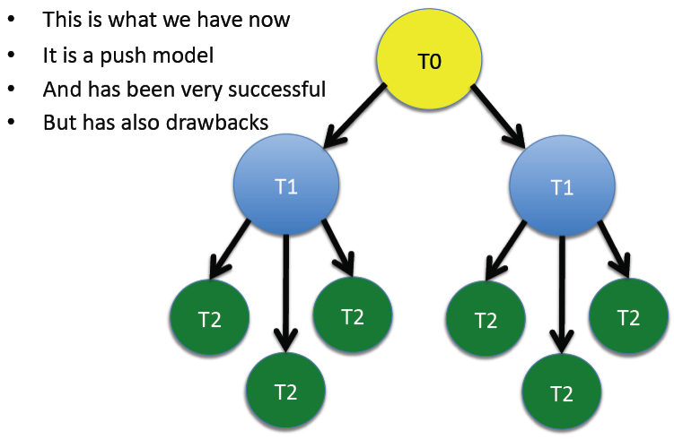
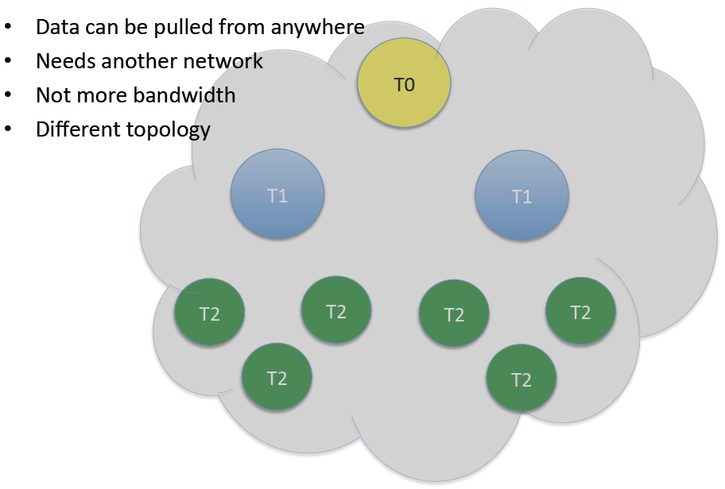
Steps toward a new model
PD2P: Dynamic Data Placement
  Automatically spread in-demand data across resources
Tier2D: Tier2s directly connected to Tier 1s, Tier 2Ds and CERN
Evolve the model; not a discontinuous change
  Network monitoring becomes essential
  Tier2 connectivity vital; T2s becomes T2Ds when capable and validated
  Utilize a hybrid approach of strategic pre-placement and dynamic usage-driven placement; continuously optimize
Nordic Grid didn’t deploy MONARC model and NDGF model is very close to one we are considering now
A. Klimentov

Slide 5
Growing Importance of Tier 2s
Nearly half are now T2Ds – can service data requests across ATLAS
  Target is all Tier 2s are T2Ds
T2Ds can join clouds other than their home cloud – multi-cloud mode – so clouds are fluid and flexible rather than static to respond to production needs
  eg. grow a cloud beyond its regional bounds to pump a high priority task through quickly
  T1s can join another cloud in the same way
T2s as primary replica repositories under study
T2s hosting more and more group production activities, using dedicated group space at T2s

Slide 6
Evolution of Data Placement
Move towards intelligent caching of data rather than solely planned placement
Decrease number of primary replicas. N primary replicas are always guaranteed
2011 began with no planned data placement at Tier2s, only dynamic caching
    T2 analysis activities dropped; strategic planned placement reintroduced to complement caching
Use data popularity and data age information to regulate number of replicas ATLAS wide
Use planned placement for the data samples, formats known to be popular (D3PDs, AODs)
Allow users to drive placement themselves (DaTRI)
Use both Tier1s and Tier2Ds as data sources

Slide 7
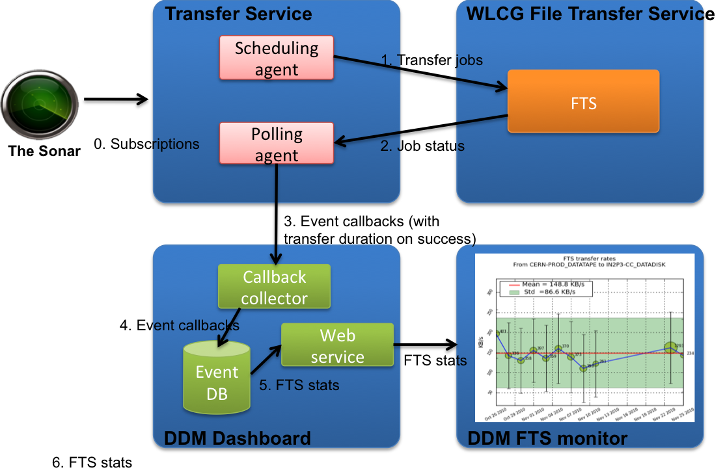
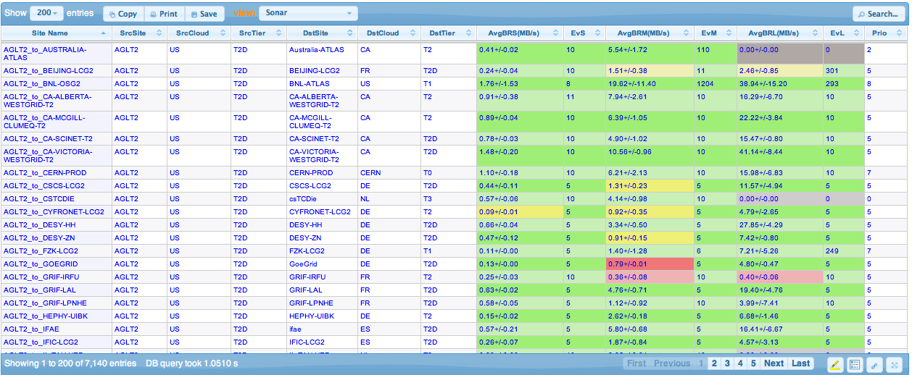
Network monitoring: sonar
http://dashb-atlas-ssb.cern.ch/dashboard/request.py/siteview#currentView=Sonar

Slide 8
Network Monitoring: perfSONAR
ATLAS suggests the deployment of perfSONAR at all T1s and T2s.
  Point to point network monitoring based on iperf.
  Latency and throughput
Details in: https://twiki.cern.ch/twiki/bin/view/LHCONE/SiteList
We consider network monitoring a key aspect of the infrastructure
  We asked WLCG to support this initiative as part of the project. Very positive feedback.

Slide 9
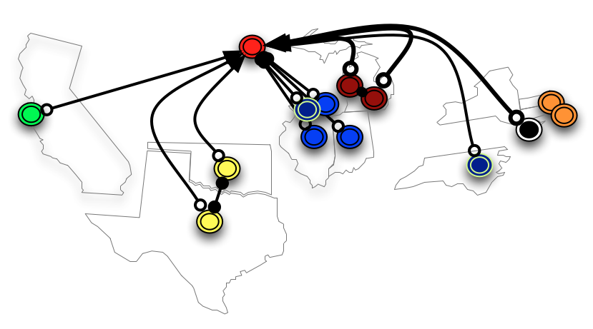
Data Federations
Slides by
R. Gardner
ATLAS and CMS started an R&D on storage federations 2 years ago.
Currently, the only usable technology is xrootd
Basically all storages offer LAN and WAN access capabilities through xrootd

Slide 10
Xrootd Federation R&D to Production
Positive experience in USATLAS
Will extend to pilot sites in Europe.
  UK and DE volunteered to try regional federations
Use cases of increasing complexity
  Fallback solution for I/O issues at with the local storage
  Brokering at sites with no complete data sample

Slide 11
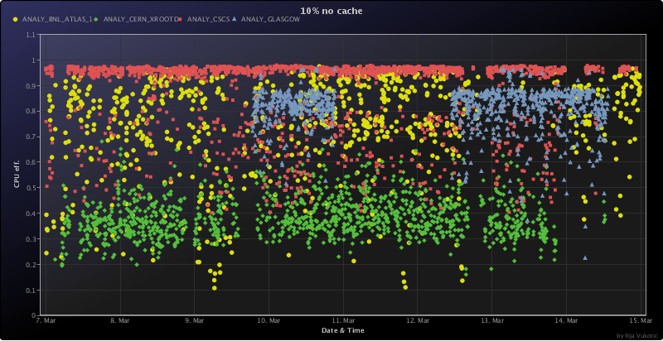
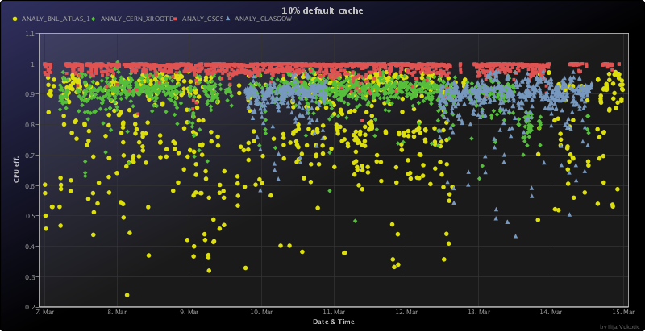
Federations and WAN access
Obviously, need good WAN access performance
TTreeCache increases performance in avg of 3x
Studies ongoing.
http://http://ivukotic.web.cern.ch/ivukotic/WAN/index.asp

Slide 12
Evolving Distributed Data Management:
The Next-Generation DDM System
Objective: streamline & simplify the system based on operational experience and new developments
  Eliminate unused features, focus on performance and scalability of critical functions, add new needed capabilities, track evolution of middleware, leverage newly available technologies
Impact: DDM has many dependent clients, from end users to distributed analysis to the production system
  Boundary condition: no interruption to ongoing DDM operations (present version supported through transition)
  The largest single ADC development project for the near future
Status: conceptual model for the next-gen system ‘Rucio’ documented and currently under discussion with the many user communities
Timeline:
  Architecture document & detailed design ~Jan 2012
  Iterative development throughout 2012
  Validation and deployment for production in 2013

Slide 13
SRM and protocols
ATLAS is in line with the outcome of the WLCG TEG:
  SRM will still be needed as interface to Mass Storage
  In general, the access to storage will rely less and less on SRM
  ATLAS already by-passes SRM whenever possible (i.e. local access)
Development in pipeline
  ATLAS tools being able to leverage other protocols for storage access
    gridFTP w/o SRM, xrootd, http
  Grid tools being able to leverage other protocols for storage access
    gridFTP is already there, need FTS-3 for others.

Slide 14
CVMFS
Software installation, database releases and conditions data
  CERNVM File System as a common technology
ATLAS invites all sites to migrate to CVMFS ASAP
  Sometime soon, no more need of HOTDISK
  Thanks to CVMFS we can run on nightlies on the Grid
Very soon, ATLAS SW installation will move away from WMS and use Panda
  No more need of special high priority queues

Slide 15
AGIS
ATLAS is developing a Information Service (AGIS)
  Used for some use-cases already
AGIS caches information from various sources
  Including the BDII
Correctness of infos in the BDII is very important
  Queue status
  Disk Space
  Pledges and HEPSPEC benchmarks

Slide 16
Multicores
Multicore or whole-node scheduling coming
  64 bit reco memory footprint & AthenaMP
  local batch system scaling - otherwise #slots blows up
  cloud computing - whole-node (VM) by definition
  Reduce number of transient files and access to storage
but not there yet … : deployment
  dedicated multi-core resources wasted when only serial jobs
  serial-to-Ncore is expensive – drain last job
  Ok for steady stream of Ncore jobs
But not there yet… : software
  AthenaMP for Reco and G4sim, but not digi (prevents MC reco usage)
  File merging is still serialized …
Need to get more experience. Not ready for production.

Slide 17
gLexec
ATLAS si not particularly fan of gLexec …
  We believe it creates more problems than it solves
Nevertheless, WLCG Security TEG provided quite clear indications
  In addition we can leverage the identity switching to optimize resource usage
Two possibilities under evolution:
  handle gLexec from the ATLAS pilot
    Original idea, was fragile but many problems could be fixed by now. Re-testing.
  Handle gLexec through glideinWMS
    It works, but introduce a considerable overlay and complication
If gLexec is broken at your site today, we will not complain…

Slide 18
Cloud Computing
Buzz word or powerful tool?
Could be the latter if it offers the uniform homogeneity across computing resources that grids never quite gave us
Potential to complement and augment the grid
Adoption of virtualization by facilities has begun
Academic clouds already exist, commercial clouds may (sooner or later) be cost-effective for peak processing
  CERN has one! lxcloud
Funding agencies have started asking us about cloud utilization
Prudent course: cloud-enable our processing so we can evaluate utility of clouds and be able to leverage them
  Answer for ourselves: are they useful? Will they be?
  Effective integration with storage is a central issue

Slide 19
ATLAS Cloud Computing R&D
Condor Cloud Scheduler (U Victoria)
  Leverage Condor to run PanDA pilots on CERNVM VMs, no PanDA changes required
  Cloud Scheduler manages VM creation and proxy based authorization/authentication
  Proof of concept working, needs pilot factory for real-world use
Cloud Factories (CERN)
  Understand how to run PanDA sites in the cloud
  Manage VMs directly using a cloud API
  Running example on CERN’s lxcloud with CERN SE data access
  Target use case: a personal cloud factory
    Eg. Amazon + credit card = analysis done by conference deadline

Slide 20
Cloud Futures
Many of the activities are reaching a point where we can start getting feedback from users
  Should focus in the next months on eliminating options, and determine what we can deliver in production
Cloud Storage
  This is the hard part. Some free S3 endpoints are just coming online, so effective R&D is only starting now.
  Looking forward to good progress in caching (Xrootd/HDFS in cloud) and DDM S3 Evaluation (Rucio incubator proposal)
Support the grid sites who want to offer private cloud resources
  Develop guidelines, best practices
  Good examples already, e.g. LxCloud, PIC, BNL, and others.

Slide 21
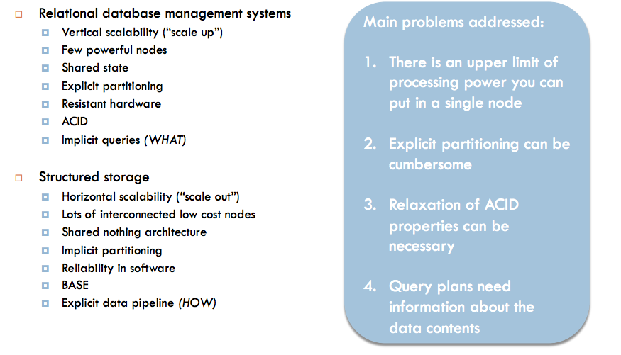
NoSQL (ops, Structured Storage)

Slide 22
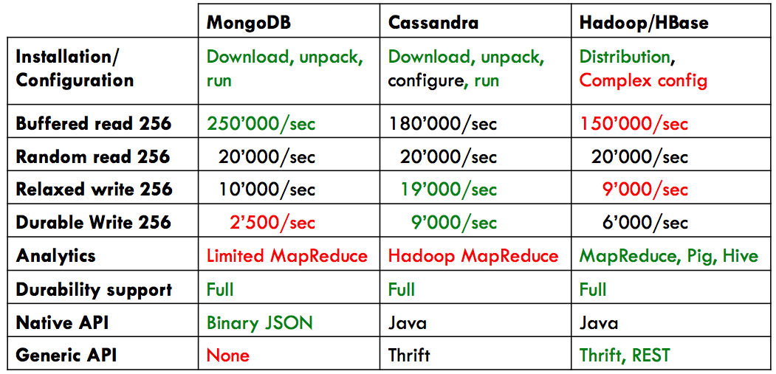
Comparison of technologies
ATLAS and the WLCG Database TEG decided for Hadoop

Slide 23
NoSQL: “Big data processing”
DDM use cases
  disk pool access, log file analysis, trace mining, file sharing, accounting, search
  Leveraging an existing Hadoop installation at CERN
Panda use cases
  Data Mining and Monitoring
  Currently running on Cassandra@BNL
    will be ported to Hadoop@CERN

Slide 24
Summary
Operations is Key, but some amount of computing development and R&D is essential to keep up with the state-of-the-art in scalability and efficiency
In the short term we expect to see some concrete deliverables in production
Work is still ongoing in all of these activities – some activities are closer to wrapping up than others.
Thank you to all who help prepare these slides!

