Slide 1
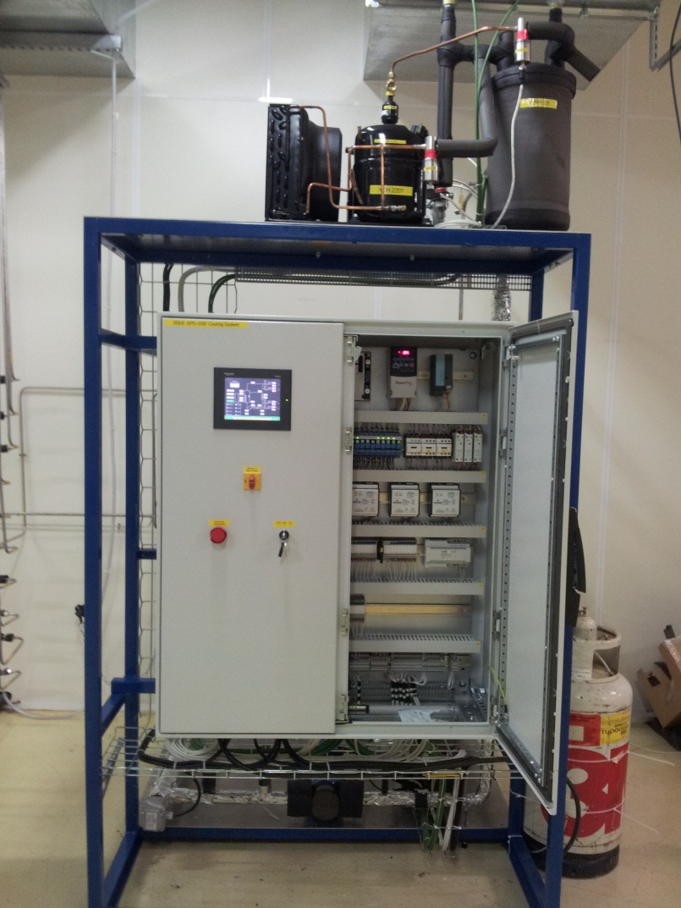
DSF activities update
A. Francescon, V. Altini
ITS cooling meeting 20/03/12

Slide 2
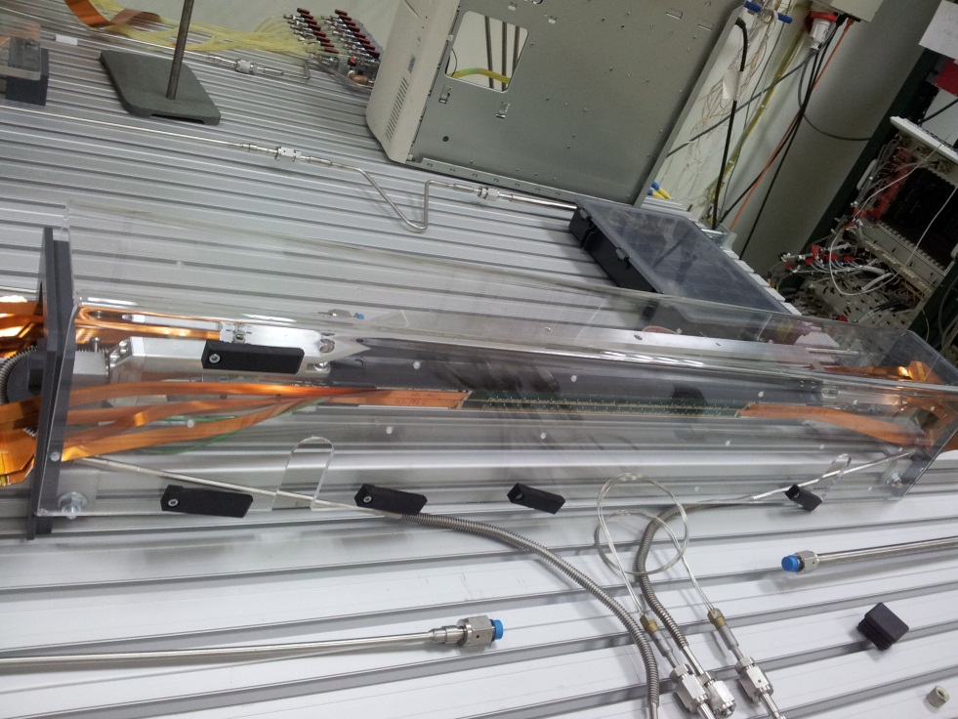
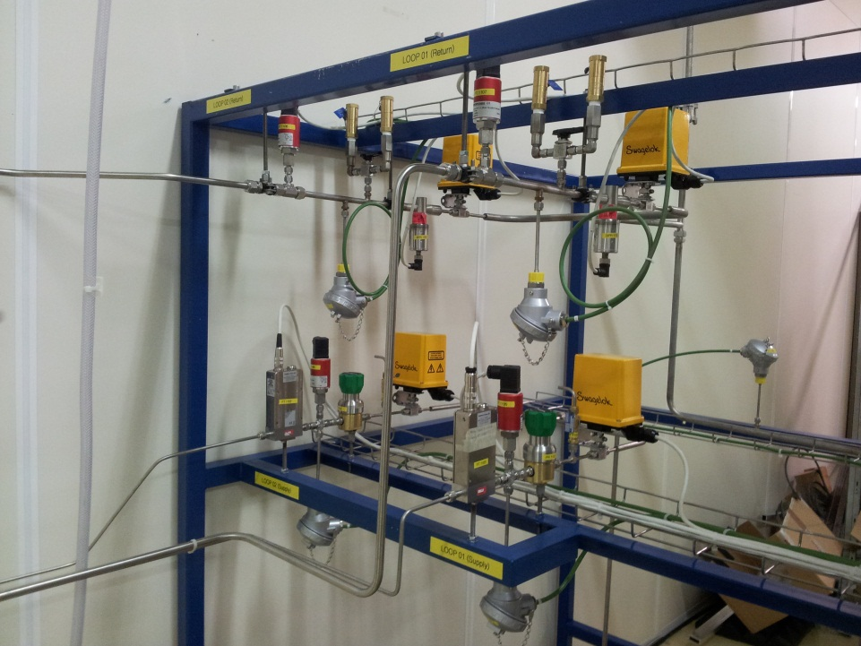
Aim of the activities
Set up one of the two lines of the DSF cooling plant to allow the characterization of the SPD spare sector.

Slide 3
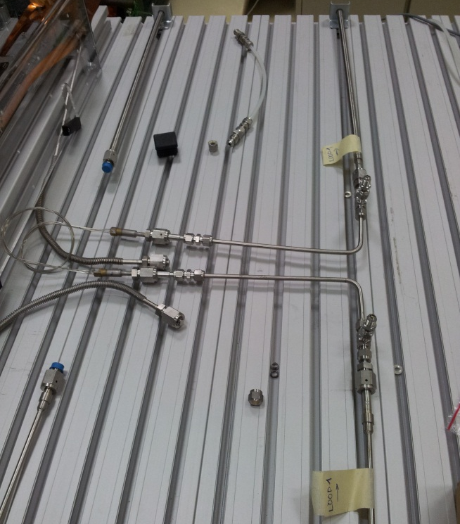
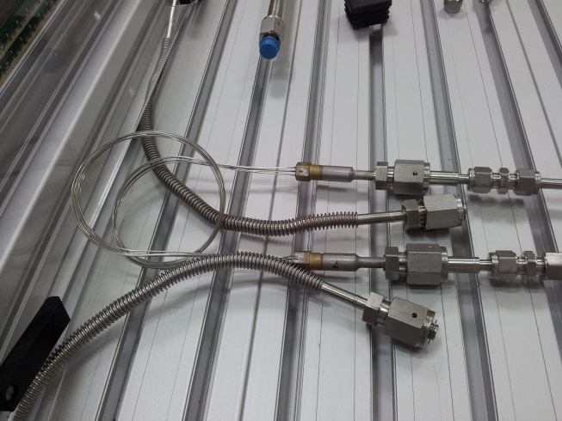
Interventions
Connection of the SS lines with the sector’s tombaks
Cleaning of the lines
Analysis of the filters installed before the cleaning(EN/MME lab)
Safety valves’ installation (to be done)

Slide 4
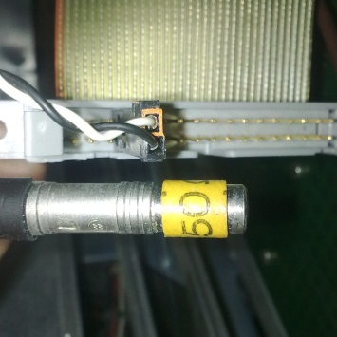
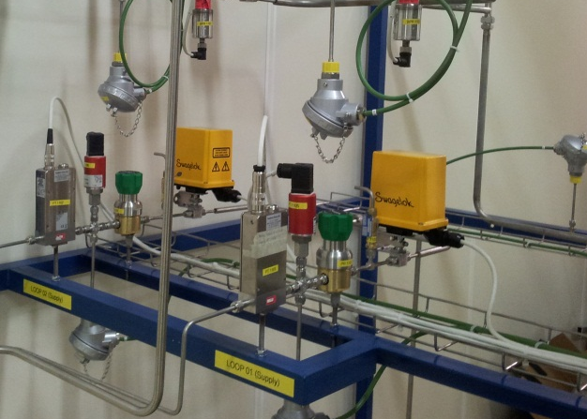
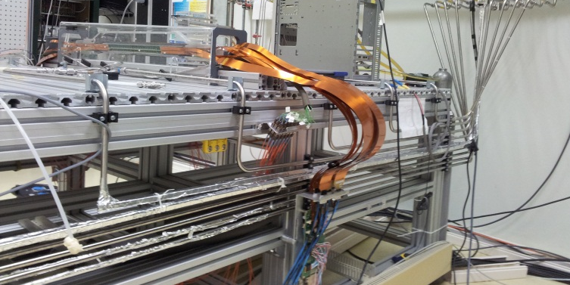
Modifications needed
signal from the plc to rack in DSF in order to build the redundant interlock logic
  +voltage Interlock NOT asserted
  0 Interlock asserted
modification of the electrically driven on/off valves;
Installation of an interlock on the heater

