Slide 1
Controlled Transverse Blowup with ADT
from first tests in 2011
to plans for Quench Margin tests
presented by
W. Hofle
T. Levens, S. Redaelli, F. Roncarolo, R. Schmidt, D. Valuch
M. Zerlauth
OP crew: L. Ponce, R. Giachino

Slide 2
Motivation for transverse blow-up
using ADT
efficient loss maps
tailoring emittances for special MDs
probing aperture
Quench Margin tests
…

Slide 3
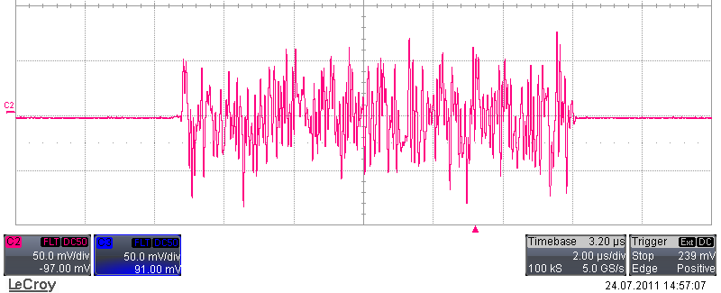
Method: apply excitation with gated noise
(D. Valuch, M. Jaussi, D. Jacquet, T. Levens)
gate, 11 μs (example)
white noise generated on FPGA running at 40 MS/s
deployed on a test crate in SR4 with gating
connected to all dampers of beam 2 (H and V plane)
noise can be filtered by IIR lowpass filter
noise triggered for up to 1 second, repetitively also, typically 5x
2011 status

Slide 4
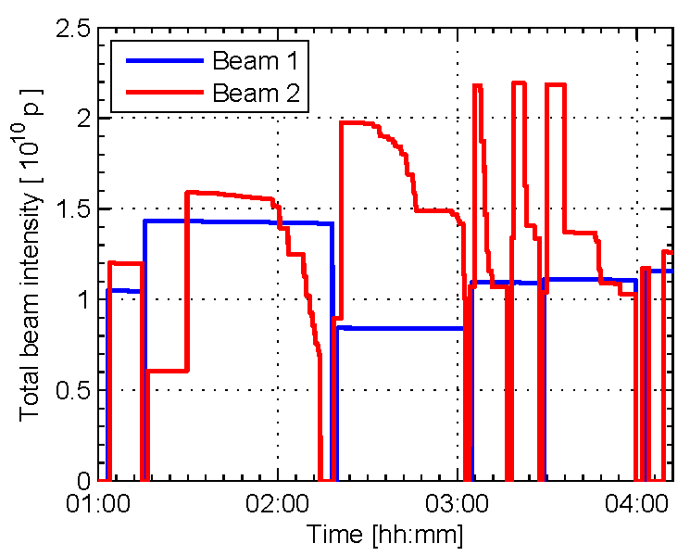
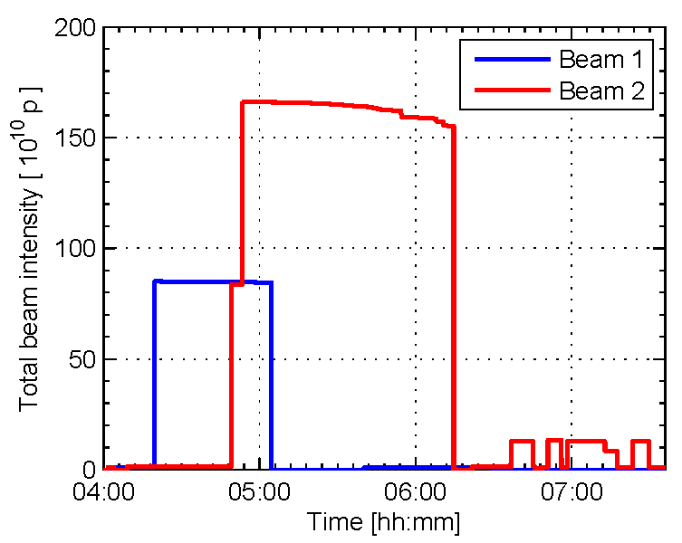
First tests in August 2011
(only beam 2 available)
Part 1, 2 pilot bunches
Part 2, 12 nominal bunches
Part 3, loss maps (one nominal bunch)

Slide 5
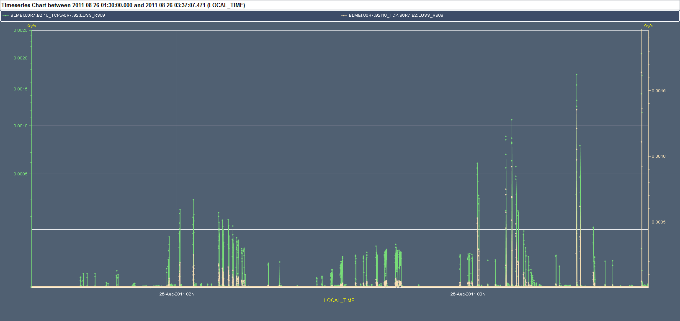
BLMs at B2 TCP A6.R7 (RS09)
log/lin scale
part 1: setting-up
with pilots
(gating delay)
testing
Adjustment of system
Excitation full bandwidth,
Amplitude 0.2, v-plane
Beam 2
Excitation reduced bandwidth 500 kHz,
Amplitude 0.2, v-plane
Beam 2
Excitation full bandwidth,
Amplitude 1.0, v-plane
Beam 2
Excitation full bandwidth,
Amplitude 1.0, h-plane
Beam 2
1:30
Excitation full bandwidth,
Amplitude 1.0, h-plane
Beam 2
3:36

Slide 6
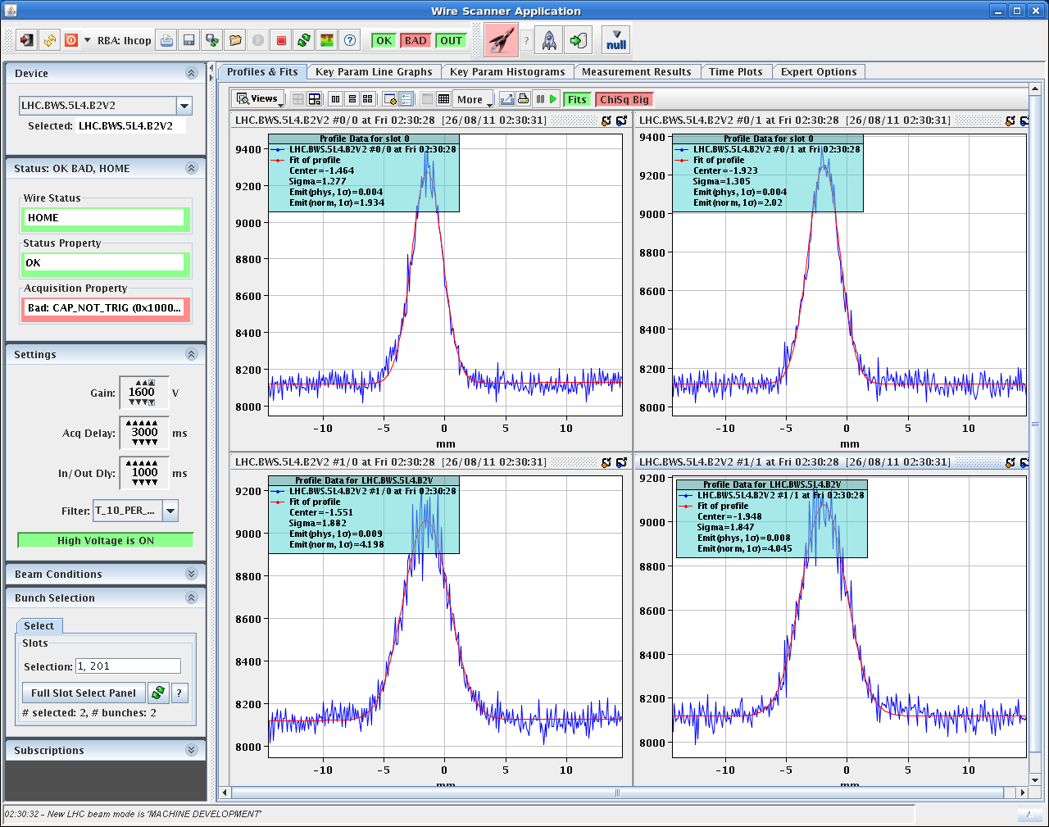
Selective blow-up (2 pilots)
2 μm
4 μm

Slide 7
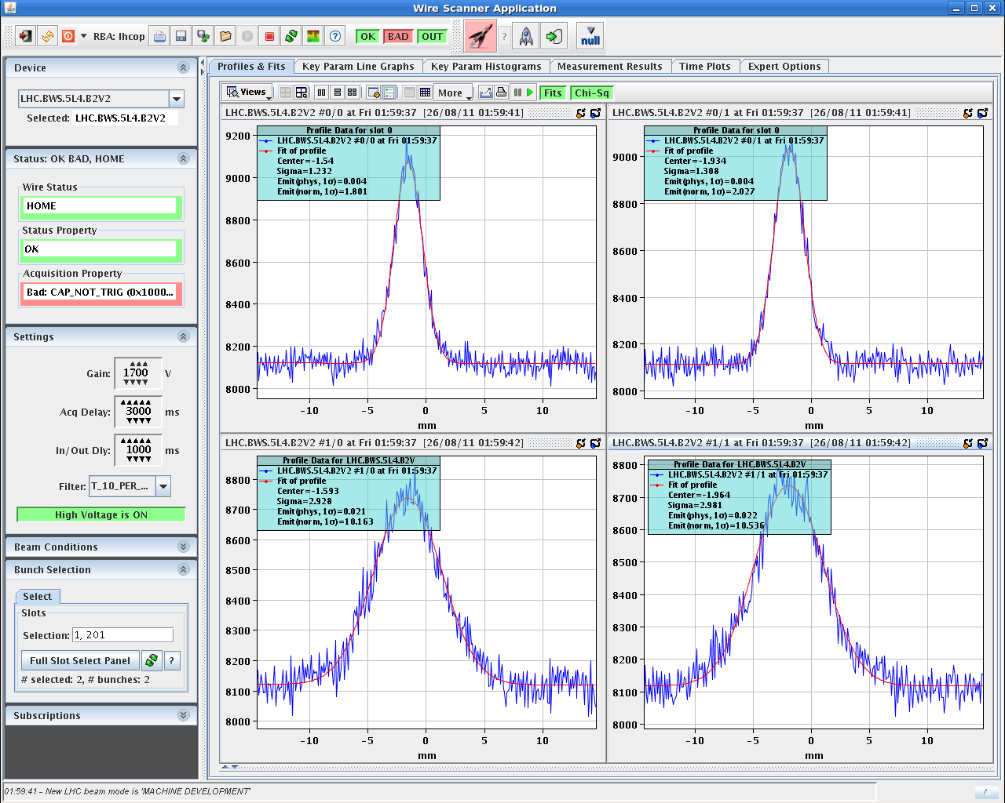
Selective blow-up (2 pilots)
2 μm
10 μm

Slide 8
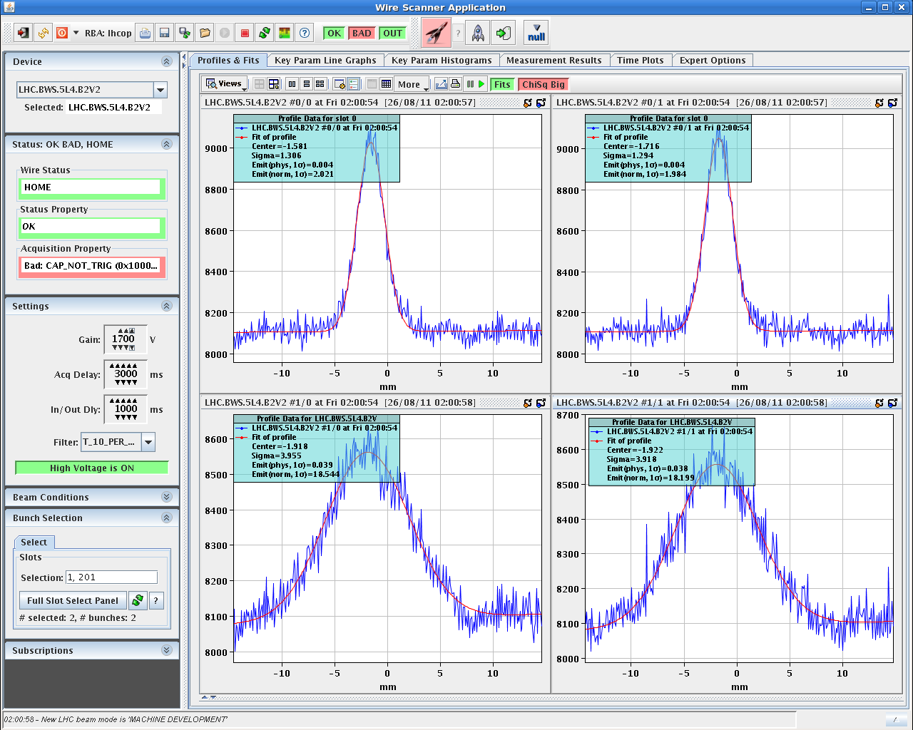
Selective blow-up 2 pilots)
2 μm
18 μm
stops at 18 μm

Slide 9
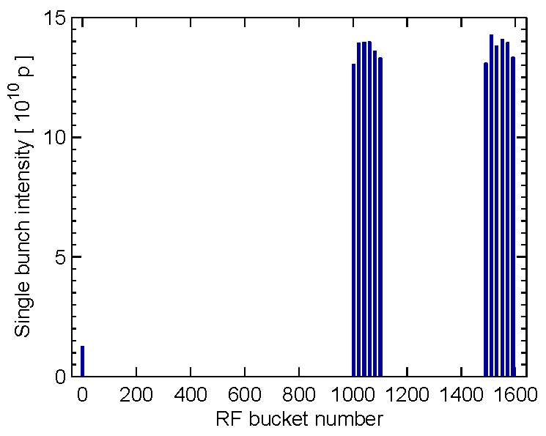
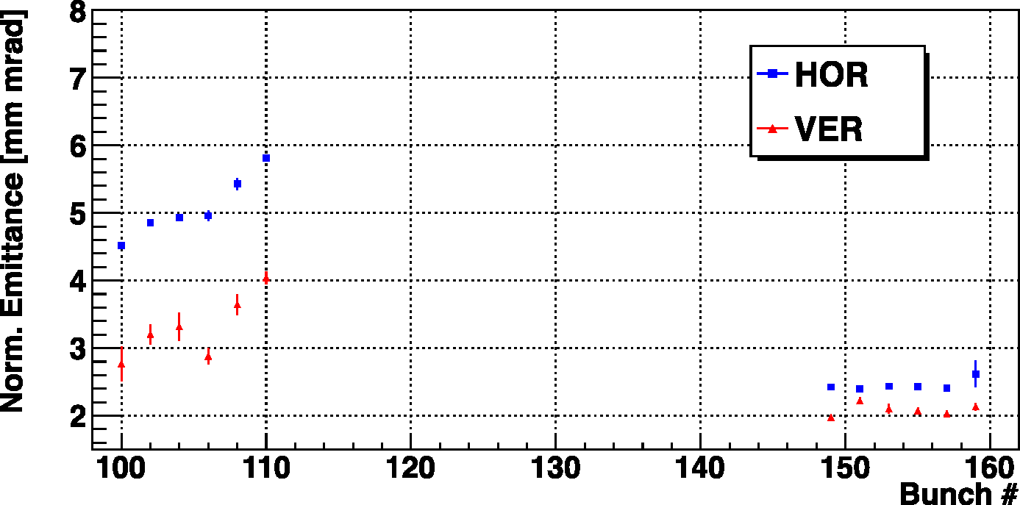
batch selective
blow-up
2x6 bunches spaced 925 ns
(+pilot)
blow-up
no blow-up

Slide 10
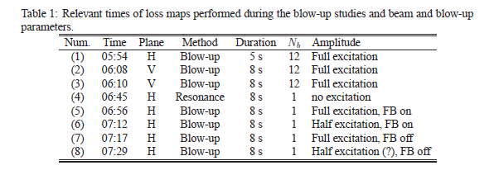
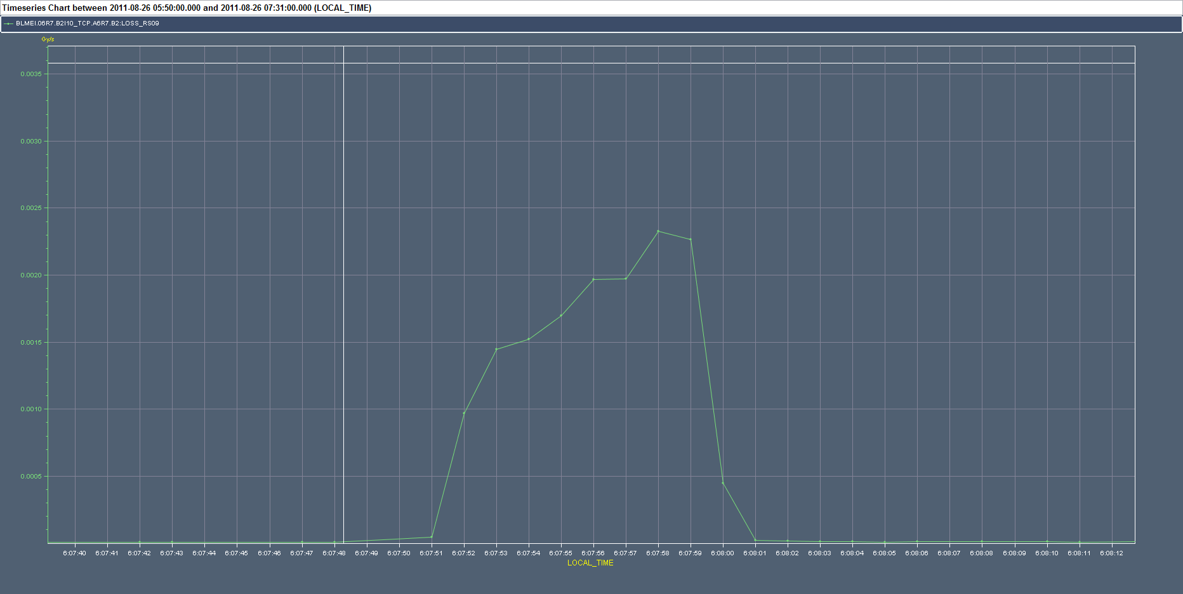
Losses seen on BLMs (example)
8 s
losses at TCP A6.R7.B2
(M. Sapinski)

Slide 11
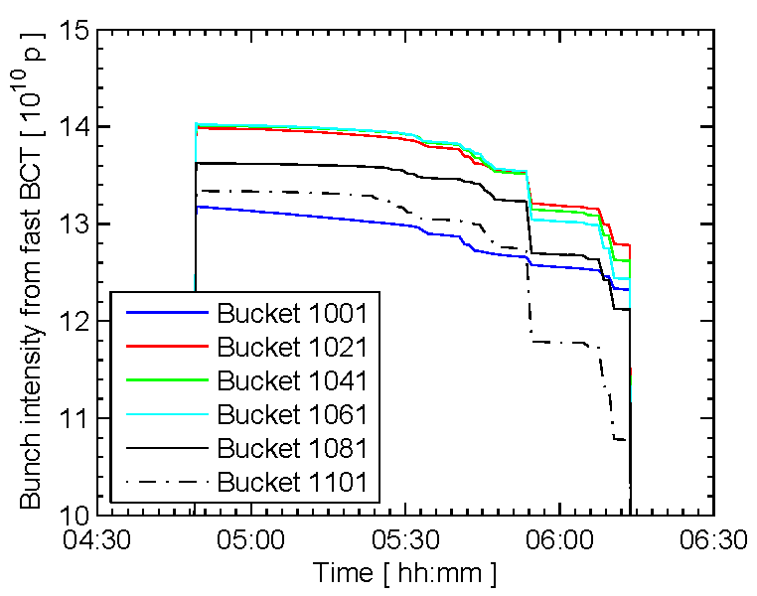
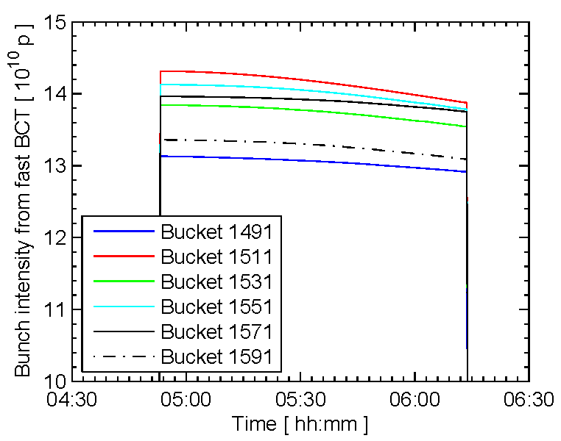
Batch selective blow-up - losses
blow-up / loss
no blow-up
6:08

Slide 12
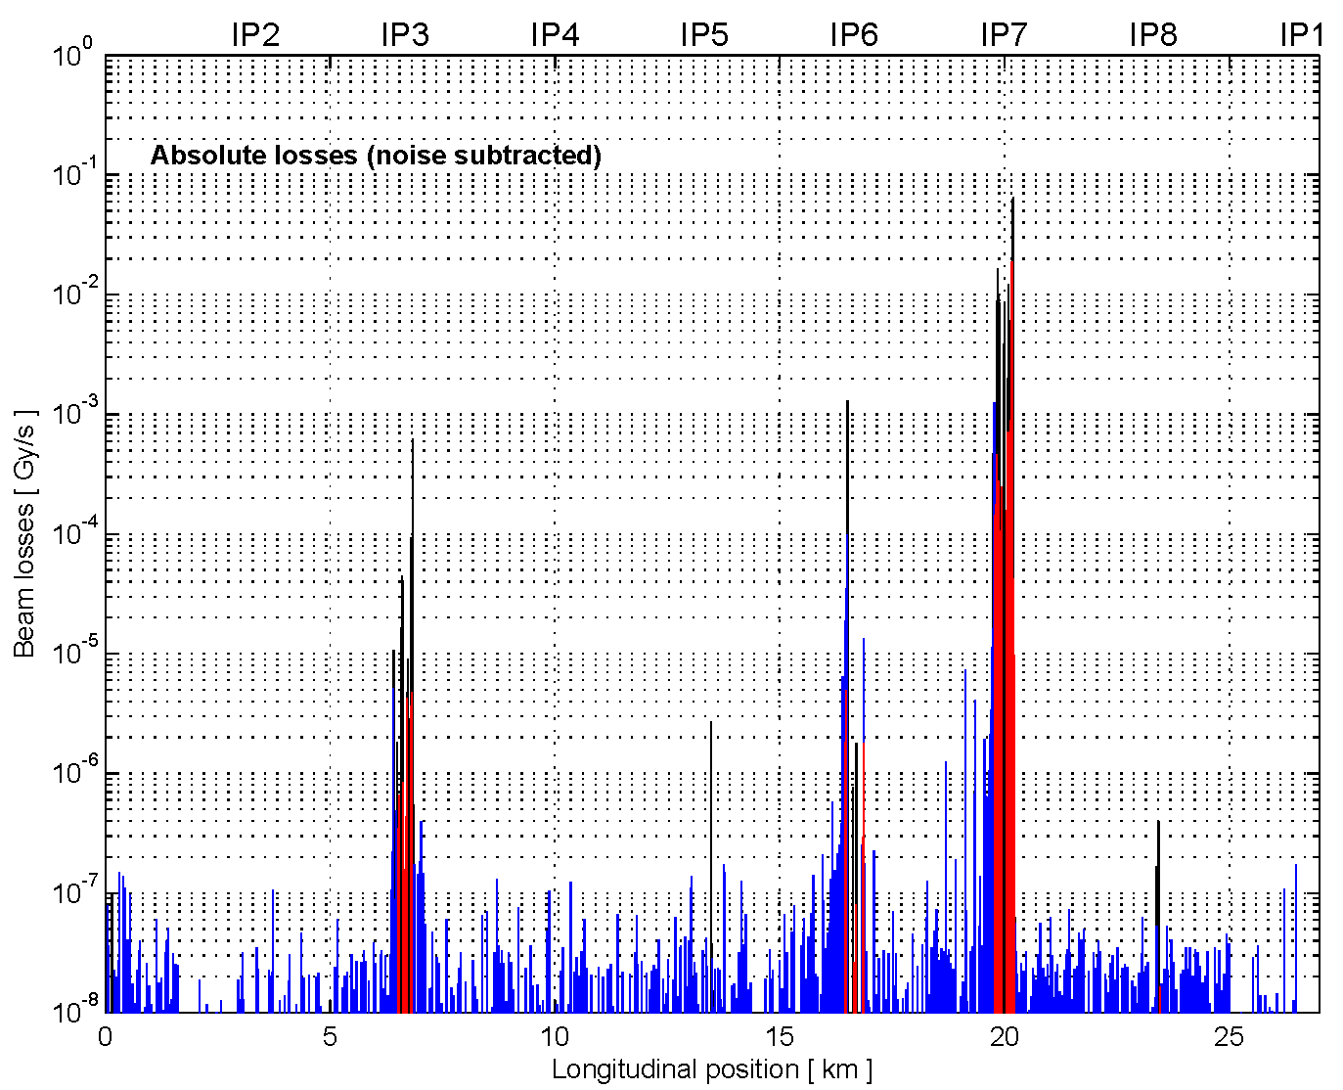
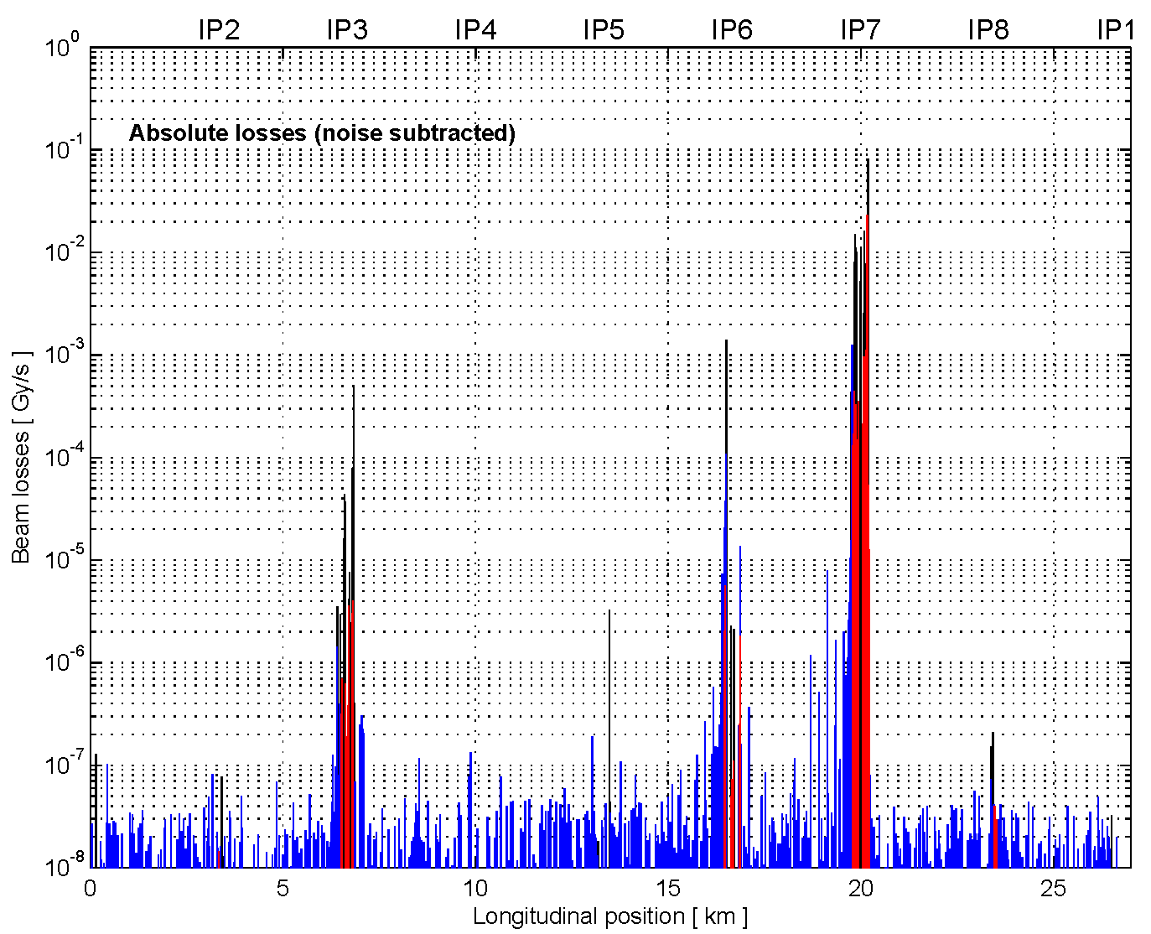
Comparison loss maps
damper loss map
3rd order resonance

Slide 13
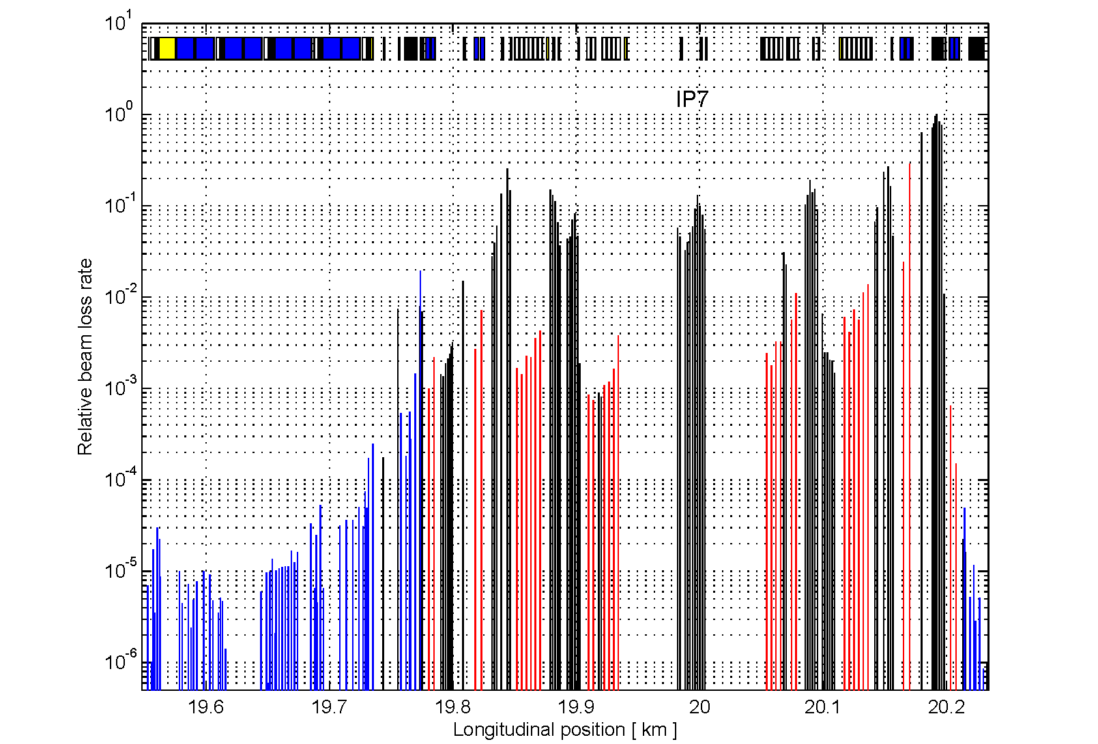

Comparison loss maps
(details)
new software interface for ADT blow-up
under commissioning (March 2012)
damper loss map
3rd order resonance

Slide 14
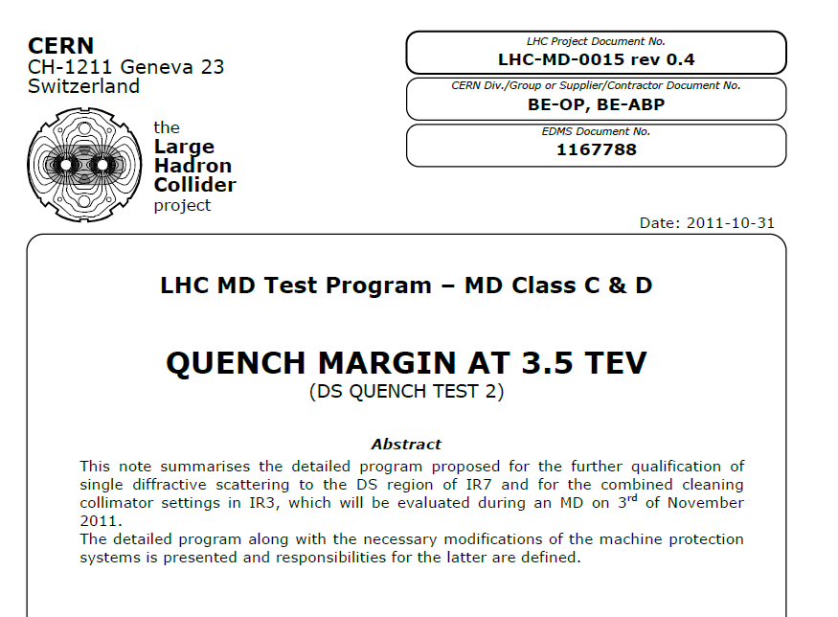
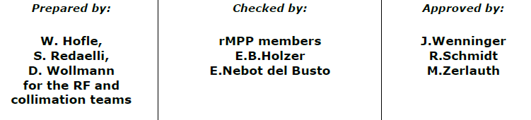
EDMS document 1167788

Slide 15
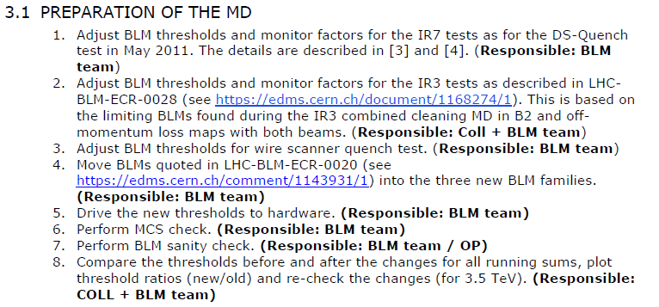
EDMS document 1167788
achieve loss rates of 9x10¹¹ protons/s

Slide 16
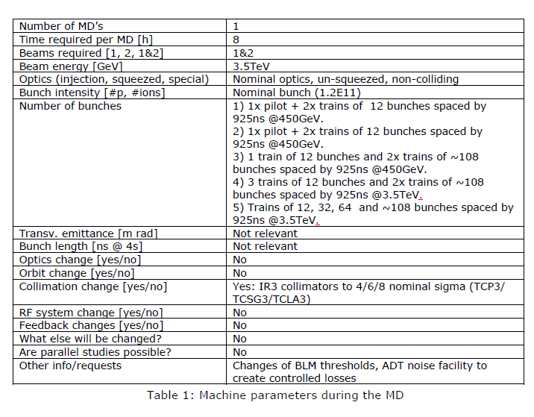
EDMS document 1167788

Slide 17
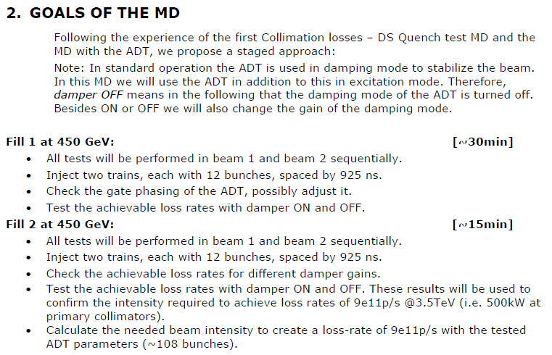
EDMS document 1167788

Slide 18
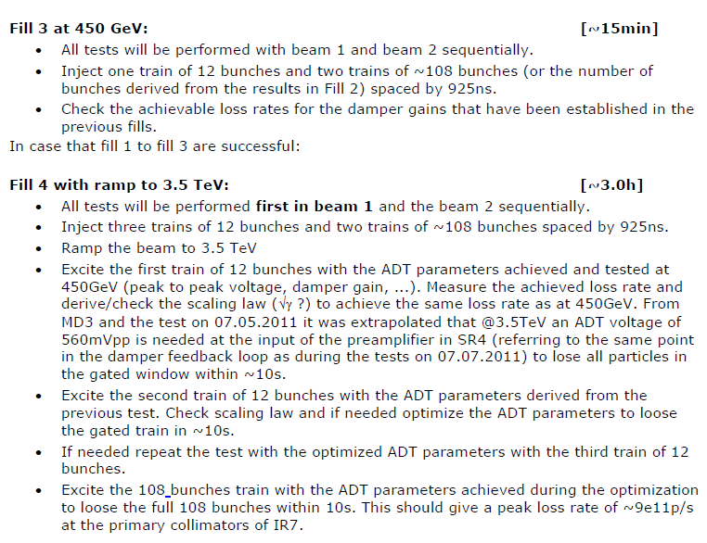
EDMS document 1167788

Slide 19
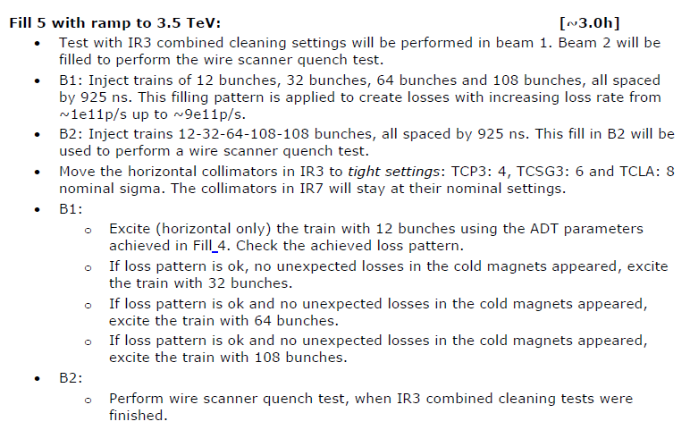
EDMS document 1167788

Slide 20
Summary
2011 tests of ADT blow-up successfull
new software being commissioned
first application → loss maps
procedure for Quench Margin test established
Quench Margin test will likely take place only
at the end of 2012 run → ample time to gain experience with the
system during loss maps (calibration of losses)

