Slide 1

_{SCSWT’2012}
South Caucasus Software / Computing Workshop & Tutorial
_{Oct 23, 2012}
Checking the overlaps in G4 geometry baseline
_{Archil Surmava}
_{Georgian Technical University}
_{SCSWT}
_{Oct 23, 2012}

Slide 2
Outline
ATLAS Generic Detector Description (AGDD) visualization in PERSINT, VP1, CATIA V5
Overlap Checking of AGDD Geometry in CATIA V5
Summaries and next steps
_{SCSWT}
_{Oct 23, 2012}

Slide 3
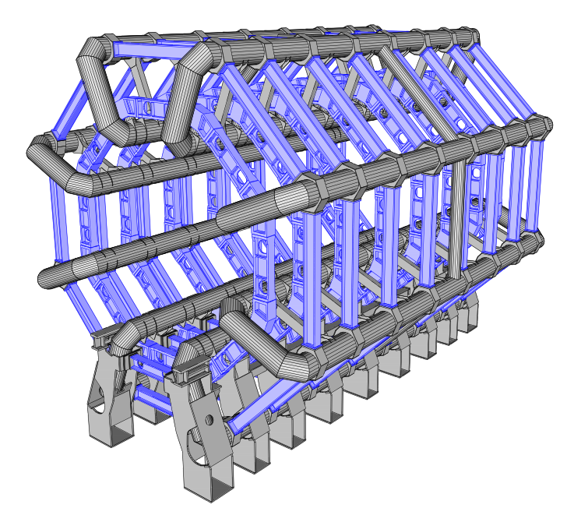
ATLAS Generic Detector Description (AGDD)
Elementary Solids
  Box , tube, etc...
Boolean Solids
  Union, Subtraction, etc...
Logical grouping of Volumes
  Composition, stack, etc...
_{SCSWT}
_{Oct 23, 2012}

Slide 4
AGDD Geometry visualization
Manual build
.XML
AGDD
VP1
(Virtual Point 1)
CATIA V5
PERSINT
(Perspective Interactive)
.iv file
.wrl file
Converter
_{SCSWT}
_{Oct 23, 2012}

Slide 5
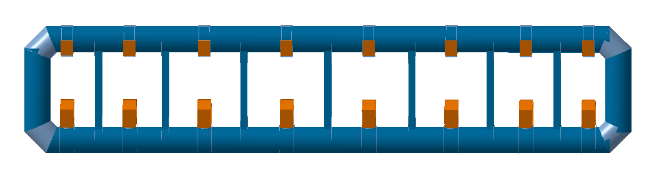
Coil overlap checking in CATIA V5
Clash |  | Coil (Out Tubes)
Vol. I Parts |  | Sector 2
C3 | L2 | 267.11mm
C3 | S2 | 0.03mm
C2 | L2 | 0
C2 | S1 | 267.49mm
C1 | L1 | 0.04mm
C1 | S1 | 0.03mm
C4 | L1 | 269.61mm
C4 | S2 | 267.49mm
Clash 267.49mm
Clash 267.11mm
L2
C2
C3
S1
S2
C1
C4
L1
Clash 269.61mm
Clash 267.49mm
_{SCSWT}
_{Oct 23, 2012}
Sector 2

Slide 6
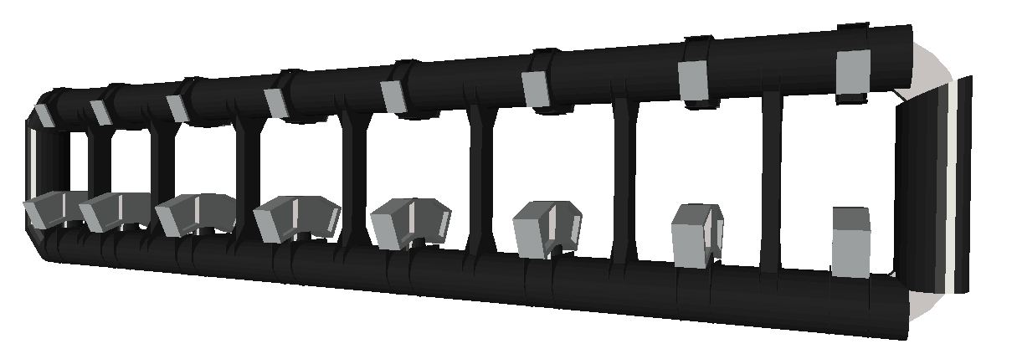
L1 (BAR_CryoTubAlongZ_Down)
Sector 2
L2
C2
C3
Image from CATIA
S2
S1
C1
L1
C4
This part is not cutted.
Clash 269.61mm
Image from VP1
_{SCSWT}
_{Oct 23, 2012}

Slide 7

L2 (BAR_CryoTubAlongZ_Up)
Image from VP1
This part is not cutted.
Clash 267.11mm
L2
C2
C3
Image from CATIA
S1
S2
C1
C4
L1
_{SCSWT}
_{Oct 23, 2012}
Sector 2

Slide 8
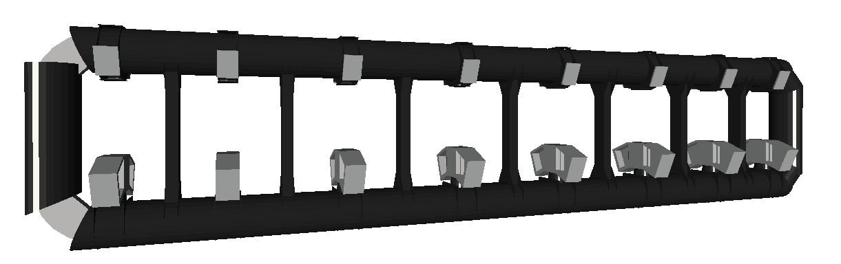
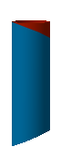
S1 (BAR_CryoTubAlongR_Plus)
Image from VP1
This part is not cutted.
Clash 267.49mm
Image from CATIA
L2
C2
C3
S1
S2
C1
C4
L1
_{SCSWT}
_{Oct 23, 2012}
Sector 2

Slide 9

S2 (BAR_CryoTubAlongR_Plus)
Image from VP1
This part is not cutted.
Clash 267.49mm
Image from CATIA
L2
C2
C3
S1
S2
C1
C4
L1
_{SCSWT}
_{Oct 23, 2012}
Sector 2

Slide 10
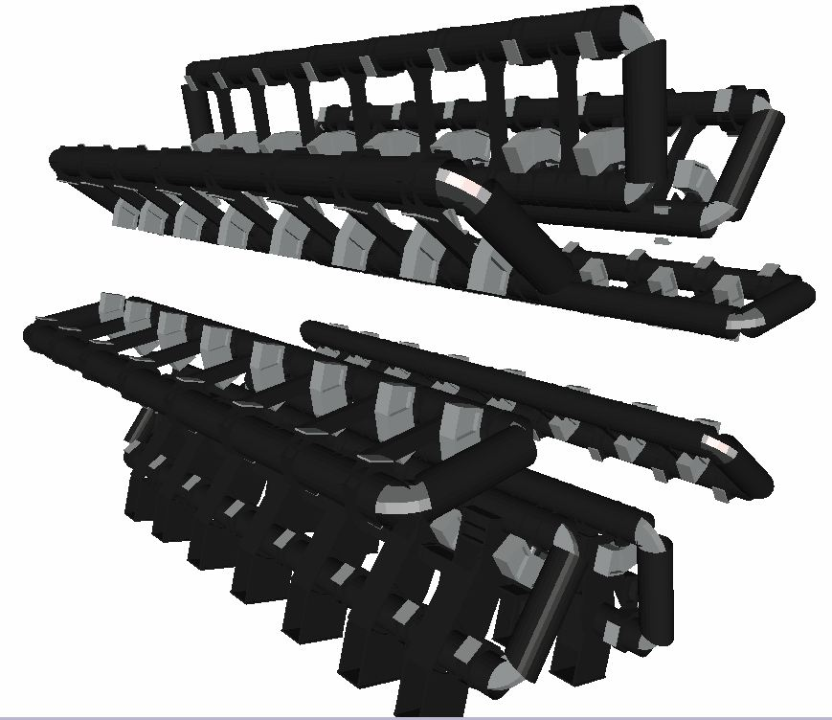
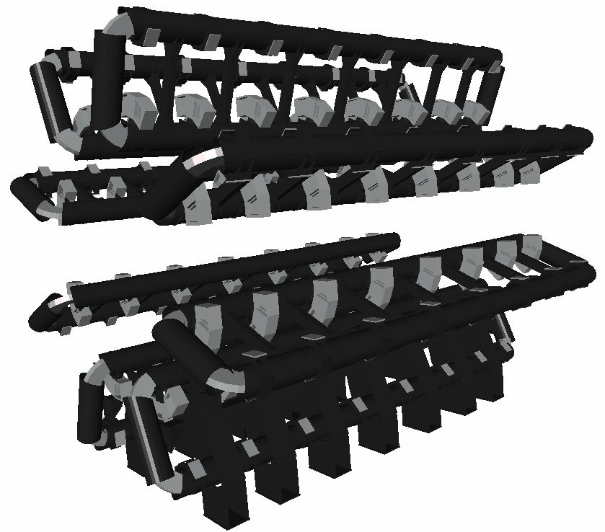
COIL (All Sectors)
The clashes are fixed in all sectors
Side A
Side C
Imeges from VP1
_{SCSWT}
_{Oct 23, 2012}

Slide 11
Part of COIL (XML code)
<tubs name="BAR_CryoTubAlongZBase" material="Iron1" Rio_Z="ABRT_CryoRadi_Radius - ABRT_CryoRadT_RadThick; ABRT_CryoRadi_Radius;
2.*ABRT_CryoZmax - 2.*ABRT_CryoRadi_Radius - ABRT_CryoRcur*sqrt(2.) + 2.*GENV_Ta225*ABRT_CryoRadi_Radius" nbPhi="25" />
<box name="BAR_CryoTubCutBox" material="Iron1" X_Y_Z="2.*ABRT_CryoRadi_Radius/GENV_Co225; 2.*ABRT_CryoRadi_Radius/GENV_Co225; 2.*ABRT_CryoRadi_Radius/GENV_Co225 " />
----------------------------------------------------------------------------------
<subtraction name="BAR_CryoTubAlongZ_Up" >
<posXYZ volume="BAR_CryoTubAlongZBase" X_Y_Z=" ABRT_CryoRmax - ABRT_CryoRadi_Radius; 0. ; 0. "/>
<posXYZ volume="BAR_CryoTubCutBox" X_Y_Z=" ABRT_CryoRmax - ABRT_CryoRadi_Radius - ABRT_CryoRadi_Radius*GENV_Ta225 ; 0. ;
ABRT_CryoZmax - ABRT_CryoRcur/sqrt(2.) - GENV_Eps " rot=" 0. ; -22.5 ; 0. "/>
<posXYZ volume="BAR_CryoTubCutBox" X_Y_Z=" ABRT_CryoRmax - ABRT_CryoRadi_Radius - ABRT_CryoRadi_Radius*GENV_Ta225 ; 0. ;
-(ABRT_CryoZmax - ABRT_CryoRcur/sqrt(2.) - GENV_Eps)" rot=" 0. ; 22.5 ; 0. "/>
<foreach index="Irib" begin="0" loops="7" >
<posXYZ volume="BAR_CryoRibIn" X_Y_Z=" (ABRT_CryoRmax+ABRT_CryoRmin)/2. ; 0. ; ABRT_Zrib[Irib] " />
</foreach>
</subtraction>
_{SCSWT}
_{Oct 23, 2012}

Slide 12
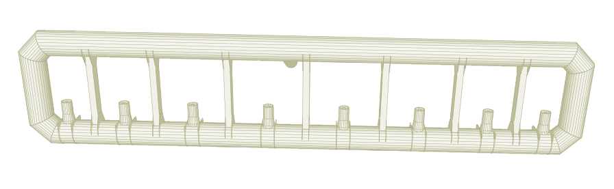
COIL (Visualization in PERSINT)
Image from PERSINT
Image from VP1
_{SCSWT}
_{Oct 23, 2012}

Slide 13
Summary and next steps
From AGDD xml code were fixed 84 parts of detector, which contains Boolean operation
we are going to do overlap analysis for each parts of detector
_{SCSWT}
_{Oct 23, 2012}

