Slide 1
ATLAS TIER 3 in Georgia
2nd ATLAS-SouthCaucasus Software/Computing Workshop & Tutorial
    PC farm for ATLAS Tier 3 analysis
    First activities on the way to Tier3s center in ATLAS Georgian group
    Plans to modernize the network infrastructure
    ATLAS Tier-3s
    Minimal Tier3gs (gLite) requirements
    Tier 3g work model
Archil Elizbarashvili
Ivane Javakhishvili Tbilisi State University

Slide 2
PC farm for ATLAS Tier 3 analysis
Arrival of ATLAS data is imminent. If experience from earlier experiments is any guide, it’s very likely that many of us will want to run analysis programs over a set of data many times. This is particularly true in the early period of data taking, where many things need to be understood. It’s also likely that many of us will want to look at rather detailed information in the first data – which means large data sizes. Couple this with the large number of events we would like to look at, and the data analysis challenge appears daunting.

Slide 3
PC farm for ATLAS Tier 3 analysis
Grid Tier 2 analysis queues are the primary resources to be used for user analyses. On the other hand, it’s the usual experience from previous experiments that analyses progress much more rapidly once the data can be accessed under local control without the overhead of a large infrastructure serving hundreds of people.
However, even as recently as five years ago, it was prohibitively expensive (both in terms of money and people), for most institutes not already associated with a large computing infrastructure, to set up a system to process a significant amount of ATLAS data locally. This has changed in recent years. It’s now possible to build a PC farm with significant ATLAS data processing capability for as little as $5-10k, and a minor commitment for set up and maintenance. This has to do with the recent availability of relatively cheap large disks and multi-core processors.

Slide 4
PC farm for ATLAS Tier 3 analysis
Let’s do some math. 10 TB of data corresponds roughly to 70 million Analysis Object Data (AOD) events or 15 million Event Summary Data (ESD) events. To set the scale, 70 million events correspond approximately to a 10 fb⁻¹ sample of jets above 400-500 GeV in PT and a Monte Carlo sample which is 2.5 times as large as the data. Now a relatively inexpensive processor such as Xeon E5405 can run a typical analysis Athena job over AOD’s at about 10 Hz per core. Since the E5405 has 8 cores per processor, 10 processors will be able to handle 10 TB of AODs in a day. Ten PCs is affordable. The I/O rate, on the other hand, is a problem. We need to process something like 0.5 TB of data every hour. This means we need to ship ~1 Gbits of data per second. Most local networks have a theoretical upper limit of 1 Gbps, with actual performance being quite a bit below that. An adequate 10 Gbps network is prohibitively expensive for most institutes.

Slide 5
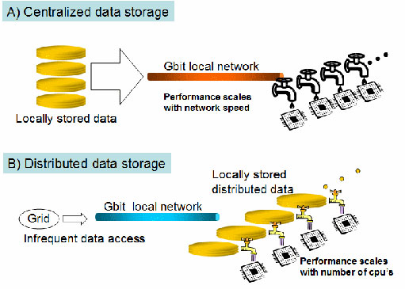
PC farm for ATLAS Tier 3 analysis
Enter distributed storage. Figure 1A shows the normal cluster configuration where the data is managed by a file server and distributed to the processors via a Gbit network. Its performance is limited by the network speed and falls short of our requirements. Today, however, we have another choice, due to the fact that we can now purchase multi-TB size disks routinely for our PCs. If we distribute the data among the local disks of the PCs, we reduce the bandwidth requirement by the number of PCs. If we have 10 PCs (10 processors with 8 cores each), the requirement becomes 0.1 Gbps. Since the typical access speed for a local disk is > 1 Gbps, our needs are safely under the limit. Such a setup is shown in Figure 1B.

Slide 6
First activities on the way to Tier3s center in ATLAS Georgian group
The local computing cluster (14 CPU, 800 GB HDD, 8-16GB RAM, One Workstation and 7 Personal Computers) have been constructed by Mr. E. Magradze and Mr. D. Chkhaberidze at High Energy Physics Institute of Ivane Javakhishvili Tbilisi State University (HEPI TSU). The creation of local computing cluster from computing facilities in HEPI TSU was with the aim of enhancement of computational power (resources). The scheme of the cluster network is following:
Cluster
Gateway
Internet

Slide 7
First activities on the way to Tier3s center in ATLAS Georgian group
The Search for and Study of a Rare Processes Within and Beyond Standard Model at ATLAS Experiment of Large Hadron Collider at CERN.
INTERNATIONAL SCIENCE & TECHNOLOGY CENTER (ISTC); Grant G-1458 (2007-2010)
Leading Institution : Institute of High Energy Physics of I. Javakhishvili Tbilisi State University (HEPI TSU), Georgia.
Participant Institution: Joint Institute for Nuclear Research (JINR), Dubna, Russia.
Participants from IHEPI TSU: L. Chikovani (IOP), G. Devidze (Project Manager),
T. Djobava, A.Liparteliani, E. Magradze,
Z. Modebadze, M.Mosidze, V.Tsiskaridze
Participants from JINR: G. Arabidze, V. Bednyakov, J. Budagov ( Project Scientific Leader),
E, Khramov, J.Khubua, Y. Kulchitski, I.Minashvili, P. Tsiareshka
Foreign Collaborators : Dr. Lawrence Price, (Senior Physicist and former Director of the High Energy Physics Division, Argonne National Laboratory, USA) Dr. Ana Maria Henriques Correia (Senior Scientific Staff of CERN, Switzerland)

Slide 8
First activities on the way to Tier3s center in ATLAS Georgian group
G-1458 Project Scientific Program:
1. Participation in the development and implementation of the Tile Calorimeter Detector Control System (DCS) of ATLAS and further preparation for phase II and III commissioning.
2. Test beam data processing and analysis of the combined electromagnetic liquid argon and the hadronic Tile Calorimeter set-up exposed by the electron and pion beams of 1 ÷ 350 GeV energy from the SPS accelerator of CERN.
3. Measurements of the top quark mass in the dilepton and lepton+jet channels using the transverse momentum of the leptons with the ATLAS detector at LHC/CERN.
4. Search for and study of FCNC top quark rare decays t → Zq and t → Hq (where q= u, c; H is a Standard Model Higgs boson) at ATLAS experiment (LHC).
5. Theoretical studies of the prospects of the search for large extra dimensions trace at the ATLAS experiment in the FCNC-processes.
6. Study of the possibility of a Supersymmetry observation at ATLAS in the mSUGRA predicted process gg → ğğ for EGRET point.

Slide 9
First activities on the way to Tier3s center in ATLAS Georgian group
ATLAS Experiment Sensitivity to New Physics
Georgian National Scientific Foundation (GNSF); Grant 185
Participating Institutions:
Leading Institution : Insititute of High Energy Physics of I. Javakhishvili Tbilisi State University (HEPI TSU), Georgia.
Participant Institution: E. Andronikashvili Institute of Physics (IOP)
Participants from IHEPI TSU: G. Devidze (Project Manager), T. Djobava ( Scientific Leader), J.Khubua, A.Liparteliani, Z. Modebadze, M.Mosidze, G.Mchedlidze, N.Kvezereli
Participants from IOP: L.Chikovani. V.Tsiskaridze, M.Devsurashvili, D.Berikashvili, L.Tepnadze, G. Tsilikashvili, N.Kakhniashvili

Slide 10
First activities on the way to Tier3s center in ATLAS Georgian group
The cluster was constructed on the basis of PBS (Portable Batch System) software on Linux platform and for monitoring was used “Ganglia” software. All nodes were interconnected using gigabit Ethernet interfaces.
The required ATLAS software was installed at the working nodes in SLC 4 environment.
The cluster have been tested with number of simple tests and tasks studying various processes of top quarks rare decays via Flavor Changing Neutral Currents t→Zq ( q= u,c quarks), t→Hq→bbar,q , t→Hq→WW*q (in top-antitop pair production) have been run on the cluster. Signal and background processes generation, fast and full simulation, reconstruction and analysis have been done in the framework of ATLAS experiment software ATHENA. ( L.Chikovani, T.Djobava, M.Mosidze, G.Mchedlidze)

Slide 11
First activities on the way to Tier3s center in ATLAS Georgian group
Activities at the Institute of High Energy Physics of TSU (HEPI TSU):
PBS consist of four major components:
Commands: PBS supplies both command line commands and a graphical interface. These are used to submit, monitor, modify, and delete jobs. The commands can be installed on any system type supported by PBS and do not require the local presence of any of the other components of PBS. There are three classifications of commands:
Job Server: The Job Server is the central focus for PBS. Within this document, it is generally referred to as the Server or by the execution name pbs_server. All commands and the other daemons communicate with the Server via an IP network. The Server's main function is to provide the basic batch services such as receiving/creating a batch job, modifying the job, protecting the job against system crashes, and running the job (placing it into execution).
Job executor: The job executor is the daemon which actually places the job into execution. This daemon, pbs_mom, is informally called Mom as it is the mother of all executing jobs.
Job Scheduler: The Job Scheduler is another daemon which contains the site's policy controlling which job is run and where and when it is run. Because each site has its own ideas about what is a good or effective policy, PBS allows each site to create its own Scheduler.

Slide 12
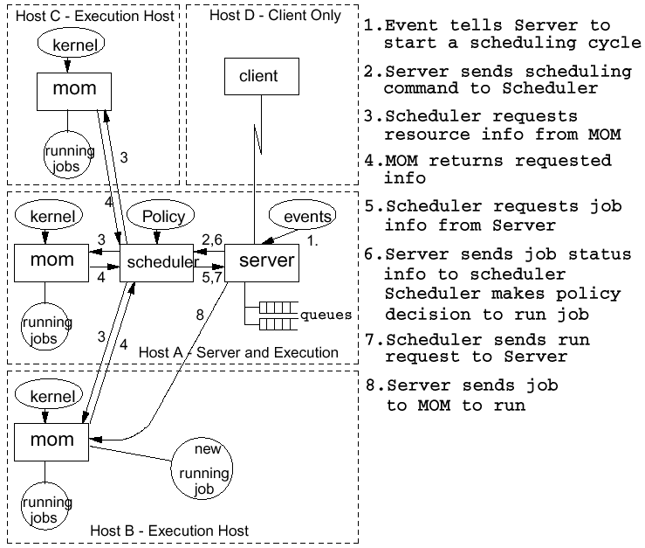
First activities on the way to Tier3s center in ATLAS Georgian group
Activities at the Institute of High Energy Physics of TSU (HEPI TSU):

Slide 13
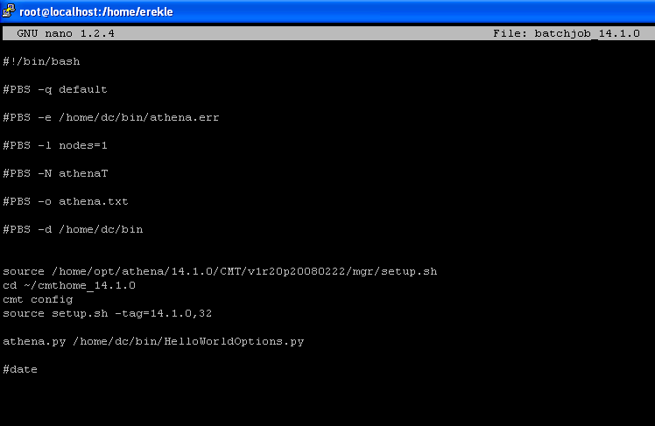
First activities on the way to Tier3s center in ATLAS Georgian group
Activities at the Institute of High Energy Physics of TSU (HEPI TSU):
On that Batch cluster had installed Athena software 14.1.0 and 14.2.21
The system was configured for running the software in batch mode and the cluster had been used on some stages of the mentioned ISTC project.
Also the system used to be a file storage.
Example of PBS batchjob file for athena 14.1.0:

Slide 14
Plans to modernize the network infrastructure
It is planned to rearrange the created the existing computing cluster into ATLAS Tier 3 cluster. But first of all TSU must have the corresponding network infrastructure.
Nowadays the computer network of TSU comprises 2 regions (Vake and Saburtalo). Each of these two regions is composed of several buildings (the first, second, third, fourth, fifth, sixth and eighth in Vake, and Uptown building (tenth), institute of applied mathematics, TSU library and Biology building (eleventh) in Saburtalo). Each of these buildings is separated from each other by 100 MB optical network. The telecommunication between the two regions is established through Internet provider the speed of which is 1 000 MB. Please see fig. 1.

Slide 15
Plans to modernize the network infrastructure
Servers and controllable network facilities are predominantly located in Vake region network. Electronic mail, domain systems, webhosting, database, distance learning and other services are presented at TSU. Students, administrative staff members and academic staff members, research and scientific units at TSU are the users of these servers. There are 4 (four) Internet resource centers and several learning computer laboratories at TSU. The scientific research is also supported by network programs. Total number of users is 3000 PCs. The diversity of users is determined by the diversity of network protocols, and asks for maximum speed, security and manageability of the network.
Initially, the TSU network consisted only from dozens of computers that were scattered throughout different faculties and administrative units. Besides, there was no unified administrative system, mechanisms for further development, design and implementation. This has resulted in flat deployment of the TSU network.

Slide 16
Plans to modernize the network infrastructure
This type of network:
Does not allow setting up of sub-networks and Broadcast Domains are hard to control. Formation of Access Lists of various user groups is complicated.
It is hard to identify and eliminate damages to each separate network.
It is almost impossible to prioritize the traffic and the quality of service (QOS).
Because there is no direct connection between the two above-mentioned regions it is impossible to set up an Intranet at TSU. In the existing conditions it would have been possible to set up an Intranet by using VPN technologies. However, its realization required relevant tools equipped with special accelerators in order to establish the 200 MB speed connection. This is the equipment that TSU does not possess.
The reforms in learning and scientific processes demands for the mobility and scalability of the computer network. It is possible to accomplish by using VLAN technologies, however in this case too absence of relevant switches hinders the process of implementation.

Slide 17
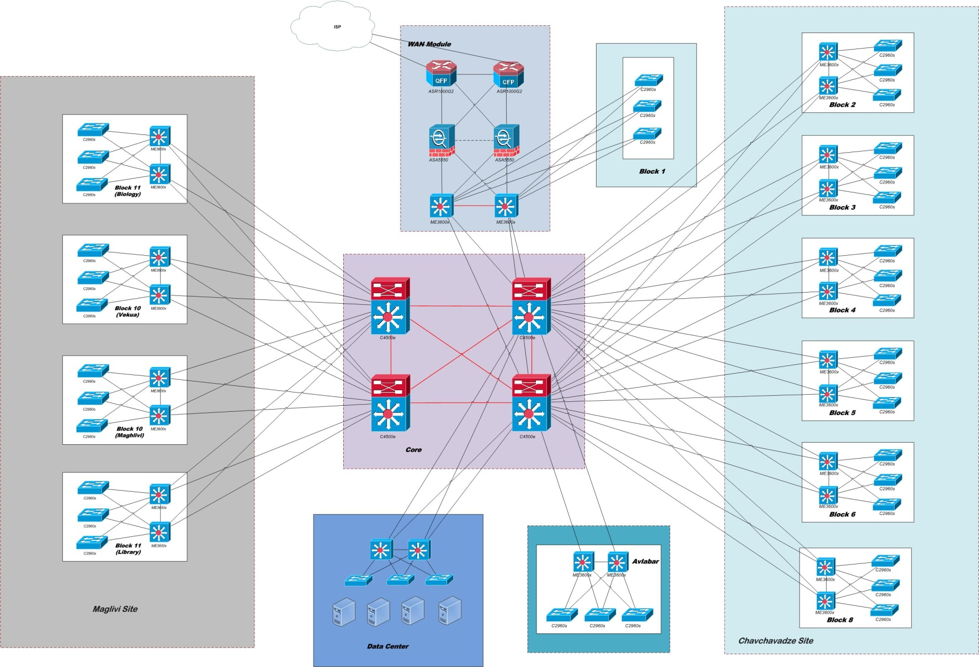
Plans to modernize the network infrastructure

Slide 18
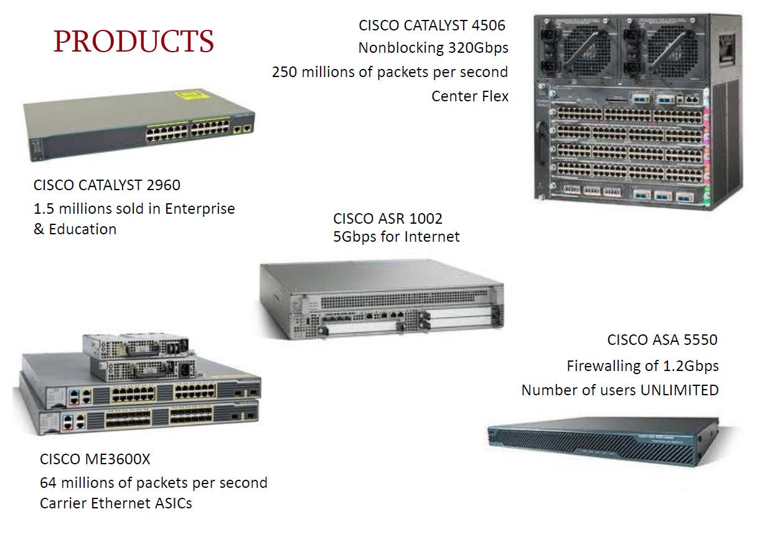
Plans to modernize the network infrastructure

Slide 19
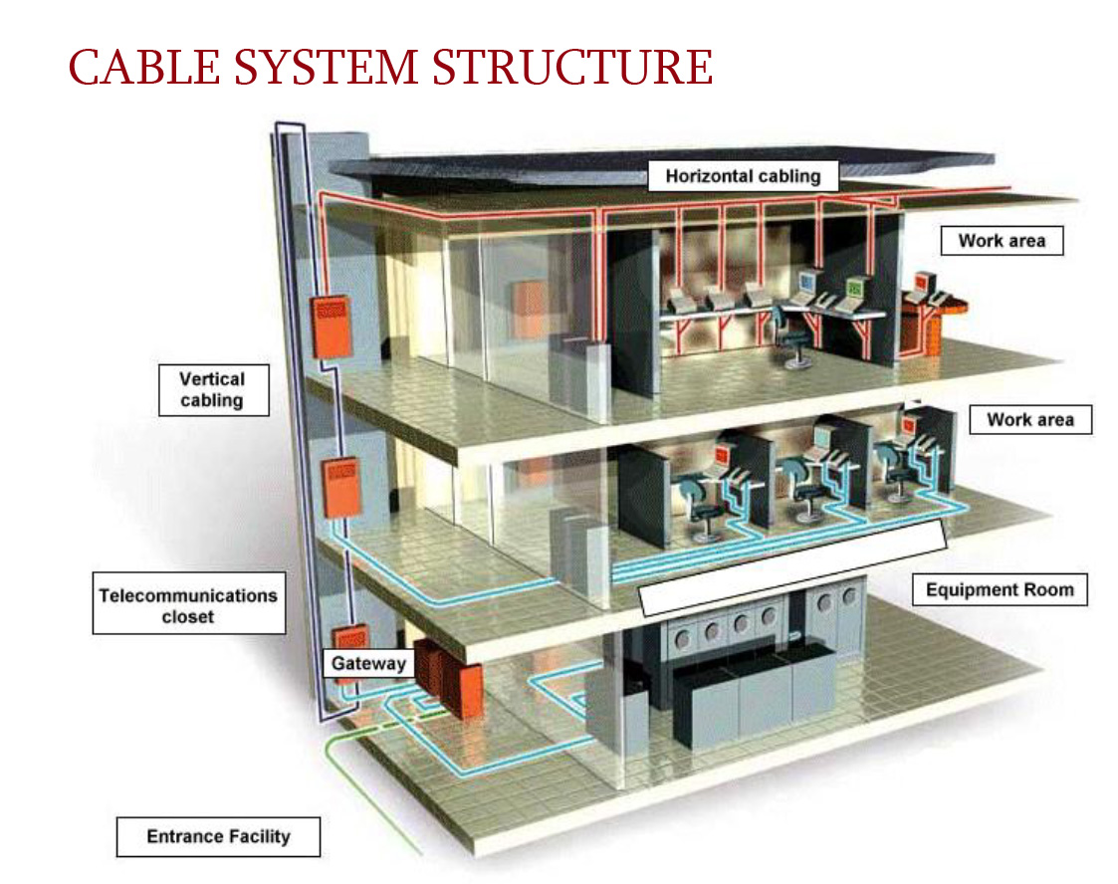
Plans to modernize the network infrastructure

Slide 20
Plans to modernize the network infrastructure
With all above-said, through implementing all of the devices we will have a centralized, high speed, secured and optimized network system.
Improving TSU informatics networks security - traffic between the local and global networks will be controlled through network firewalls. The communications between sub-networks will be established through Access Lists.
Improving communication among TSU buildings - main connections among the ten TSU buildings are established through Fiber Optic Cables and Gigabit Interface Converters (GBIC). This facilities increase the speed of the bandwidth up to 1 GB.
Improving internal communication at every TSU building - internal communications will be established through third-level multiport switches that will allow to maximally reducing the so- called Broadcasts by configuring local networks (VLAN). The Bandwidth will increase up to 1 GB.
Providing the network mobility and management - In administrative terms, it will be possible to monitor the general network performance as well as provide the prioritization analysis for each sub-network, post or server.
AND INSTALLING THE TIER 3g/s SYSTEM at TSU

Slide 21
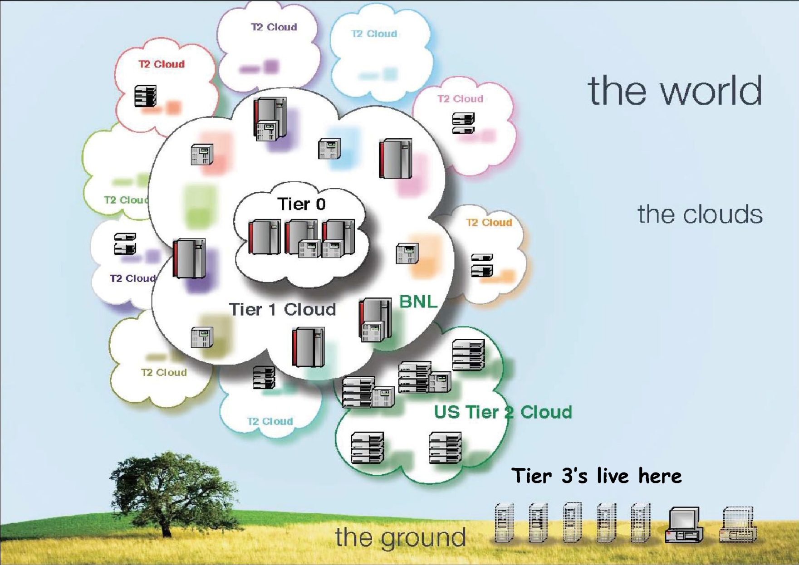
ATLAS Tier-3s

Slide 22
Minimal Tier3gs (gLite) requirements
The minimal requirement is on local installations, which should be configured with a Tier-3 functionality:
  ■ A Computing Element known to the Grid, in order to benefit from the automatic distribution of ATLAS software releases
    ➢ Needs >250 GB of NFS disk space mounted on all WNs for ATLAS software
    ➢ Minimum number of cores to be worth the effort is under discussion (~40?)
  ■ A SRM-based Storage Element, in order to be able to transfer data automatically from the Grid to the local storage, and vice versa
    ➢ Minimum storage dedicated to ATLAS depends on local user community (20-40 TB?)
    ➢ Space tokens need to be installed:
      ● LOCALGROUPDISK (>2-3 TB), SCRATCHDISK (>2-3 TB), HOTDISK (2 TB)
    ➢ Additional non-Grid storage needs to be provided for local tasks (ROOT/PROOF)
The local cluster should have the installation of:
  ■ A Grid User Interface suite, to allow job submission to the Grid
  ■ ATLAS DDM client tools, to permit access to the DDM data catalogues and data transfer utilities
  ■ The Ganga/pAthena client, to allow the submission of analysis jobs to all ATLAS computing resources

Slide 23
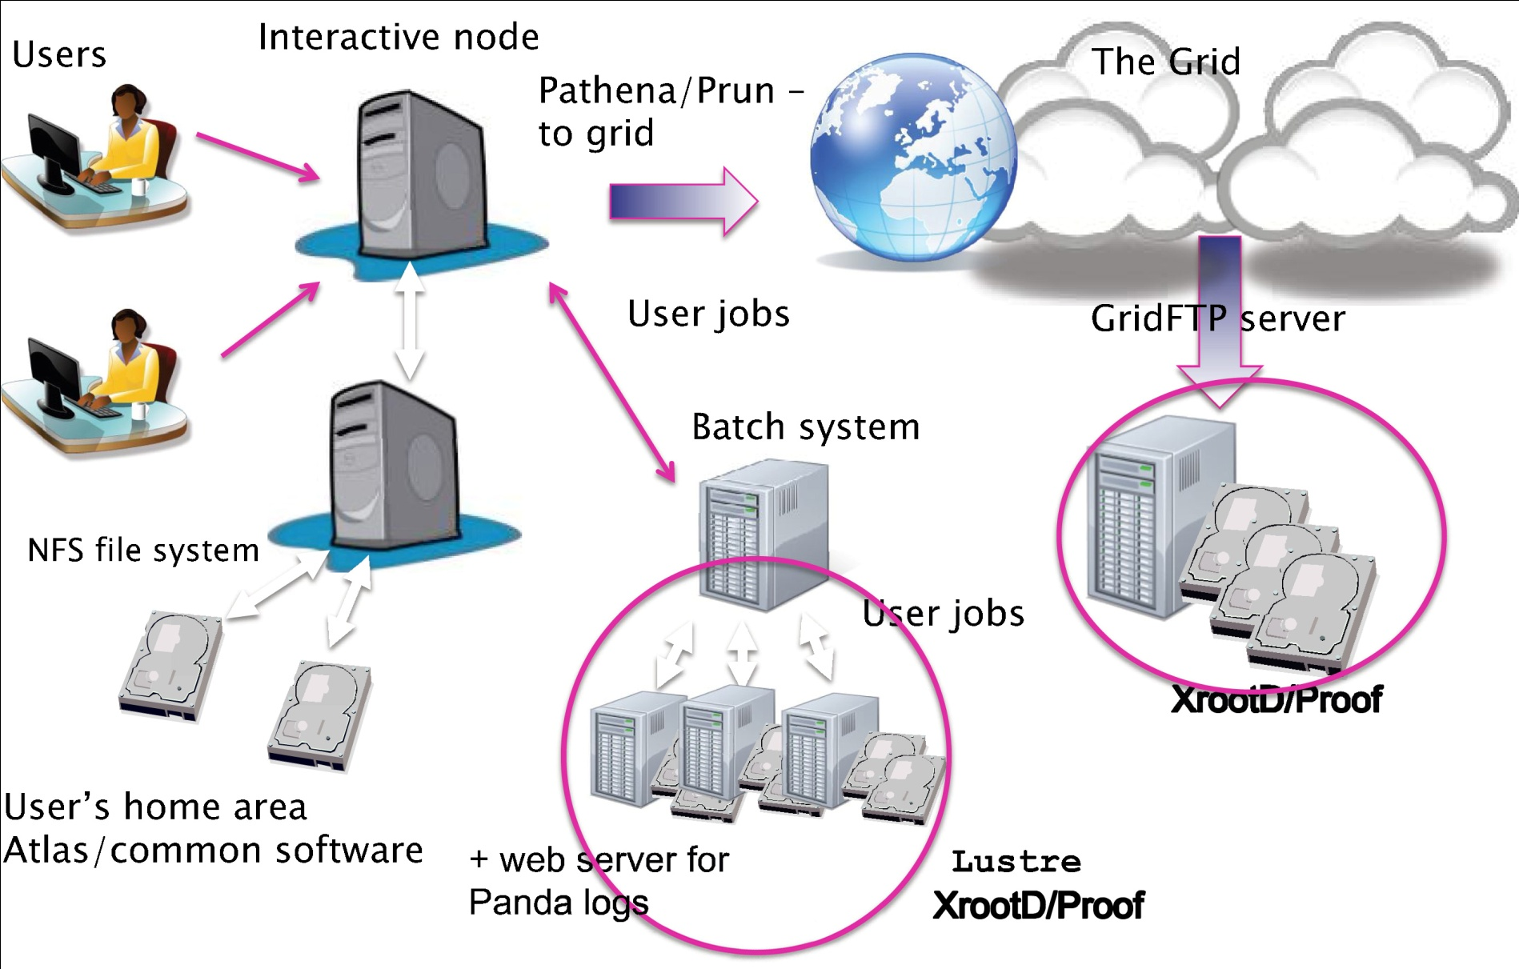
Tier 3g work model

Slide 24
I want to say thank you to Mr. Jemal Khubua, Mr. Erkele Magradze for preparing these slides.
Mr. Erkele Magradze and Mr. David Chkhaberidze as first constructor of PBS cluster in Georgia.
Dr. Tamar Djobava, Dr. Maia Mosidze, Dr. Leila Chikovani and Mrs. Gvantsa Mchedlidze as first active users of the cluster.
Thank you

