Slide 1
ATLAS Upgrade Report
(20/03/12)
Planning Assumptions
Phase-0 Plans
Phase-I Plans
- Letter of Intent
Phase-II
- LoI Planning
Conclusions

Slide 2
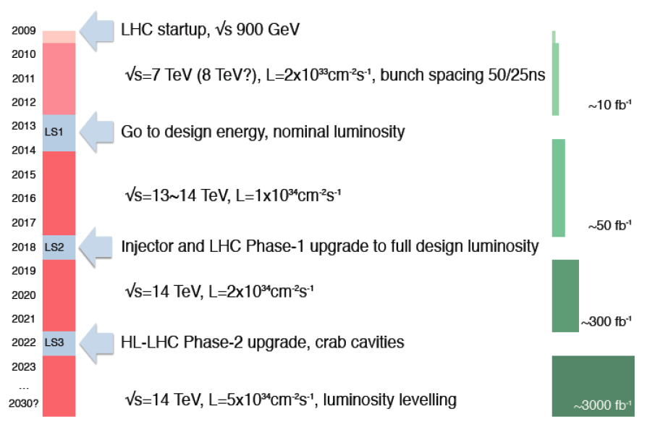
LHC Schedule Assumptions
https://indico.cern.ch/getFile.py/access?contribId=31&sessionId=5&resId=1&materialId=slides&confId=164089
LHC startup, √ s = 900 GeV
4x
, bunch spacing 50 ns
√ s=7~8 TeV, L=6x10³³ cm⁻² s⁻¹, bunch spacing 50 ns
~20-25 fb⁻¹
Go to design energy, nominal luminosity
√s=13~14 TeV, L~1x10³⁴ cm⁻² s⁻¹, bunch spacing 25 ns
, bunch spacing 25 ns
~75-100 fb⁻¹
Injector and LHC Phase-1 upgrade to full design luminosity
√ s=14 TeV, L~2x10³⁴ cm⁻² s⁻¹, bunch spacing 25 ns
, bunch spacing 25 ns
~350 fb⁻¹
HL-LHC Phase-2 upgrade, IR, crab cavities?
?, IR
√ s=14 TeV, L=5x10³⁴ cm⁻² s⁻¹, luminosity levelling
2

Slide 3
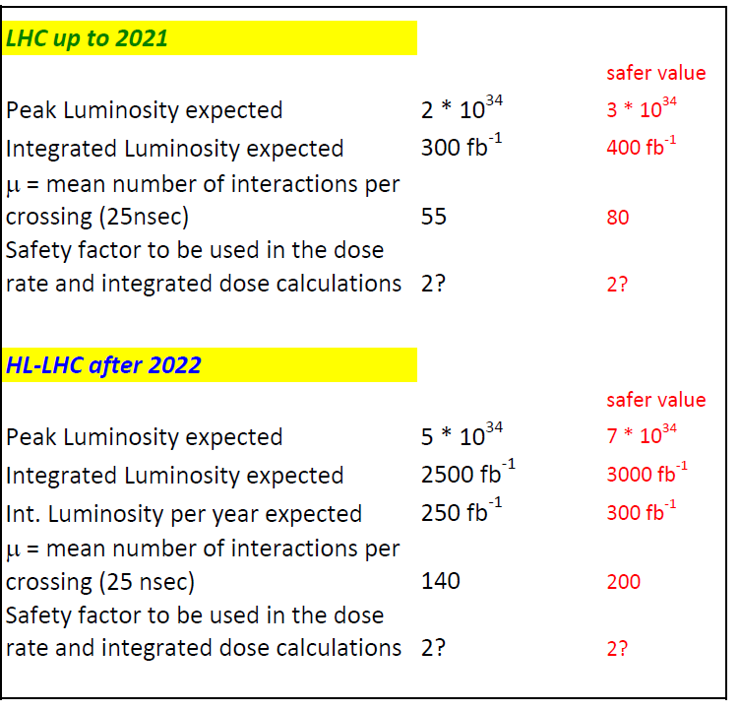
Draft Target Specifications
Plan for occupancy numbers based on this (see µ values below)
Plan integrated dose figures based on this
µ values going with the peak luminosity figure if achieved with 25ns beam crossing
When we calculate the dose figures which are used to specify the radiation hardness of components which can be reliably tested for post-irradiation performance (eg ASICs, silicon sensors, diamond, ...) apply this safety factor to the dose calculations in setting the radiation survival specification
(Still under discussion)
3

Slide 4
Phase-0 (installation 2013-14)
New Aluminum beam pipes to prevent activation problem and reduce BG
New Insertable pixel B-Layer (IBL) (drives shutdown schedule)
New pixel services (nSQP) (→ pending decision by mid 2012)
New small Be pipe
New evaporative cooling plant for Pixel and SCT + IBL CO₂ cooling plant
Replace all calorimeter Low Voltage Power Supplies
Finish the installation of the EE muon chambers staged in 2003 + additional chambers in the feet (new electronics) and elevators region
Exchange all broken TGCs where possible
Consolidate part of the LUCID system
Upgrade the magnets cryogenics with a new spare main compressor and decouple toroid and solenoid cryogenics
Add specific neutron shielding ( behind end-cap toroid, USA15)
Revisit the entire electricity supply network (UPS,…)
Repairs and maintenance work in general !!!
Preparations for Phase I upgrade (moveable b-pipe, AFP prototypes,… )
MBTS removal and possible replacement
4

Slide 5
Phase-I (installation in or before LS2)
  New muon small wheels with more trigger granularity and trigger track vector information
  Fast track trigger (FTK) using SCT and pixel hits (input to LVL2) expected installation before LS2
  Higher-granularity calorimeter LVL1 trigger and associated front-end electronics
  Topological trigger processors combining LVL1 information from different regions of interest (improvements starting well before LS2)
  Adapt central LVL1 trigger electronics to new needs
  AFP: New diffractive physics programme detector stations planned at ~210 m (full 3D edgeless + timing detectors, start taking data before LS2)
  New Tiles crack-gap scintillators and some new trigger electronics
  Adapt if proven necessary HLT hardware (in particular network) to the new needs/conditions
5

Slide 6

Phase-I LoI: A Brief History
22nd March: Phase-I plans presented to LHCC Review of Experiment Upgrades.
29th July: 2011 Phase-I Sub-committee report completed.
20th Sept: detailed plans shown at LHCC Upgrade Review.
29th Nov : Letter of Intent Draft-0 released on CDS for comment to collaboration.
6th Dec: LHCC status report including coordinates of LoI Draft-0.
13th Dec: Deadline for ATLAS comments to Draft-0.
20th Dec: Draft-1 released to ATLAS and LHCC for comment.
11th Jan: Deadline for ATLAS comments.
12^{h} Jan: EB endorsement of Draft-2.
3rd Feb: ATLAS CB approval of Phase-I LoI.
20th March: LHCC Upgrade Session
23rd April: Next LHC RRB
https://cdsweb.cern.ch/record/1402470/ (CERN-LHCC-2011-012 )

Slide 7
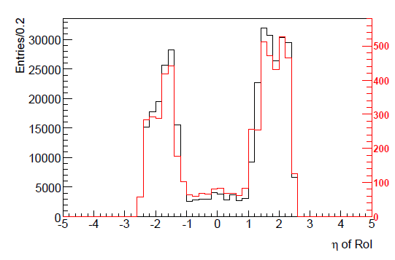
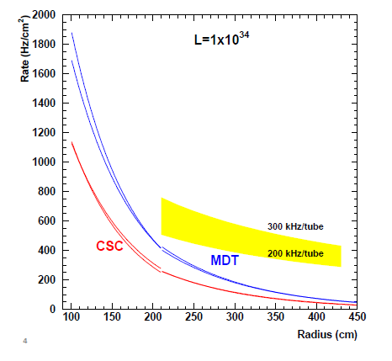
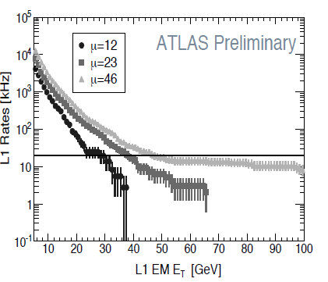
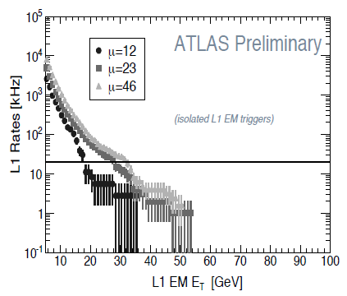
The Challenge
Raising muon thresholds becomes progressively less effective in reducing rates, particularly in the forward direction due to trigger chamber resolution limitations
ATLAS Preliminary
L =10³⁴ cm⁻²s⁻¹
Small Muon Wheel Hit Rates
ATLAS Preliminary
MDT efficiencies degrade at high tube hit rates for current diameter tubes
L1MU20 Rates
Non-isolated EM Object
Raising EM threshold reduces rates but thresholds needed at high µ start to eat into physics acceptance
Solution: Replace Small Muon Wheels, upgrade LAr R/O granularity at L1 to improve L1 threshold turn-on and corresponding upgrades to TDAQ system
7

Slide 8
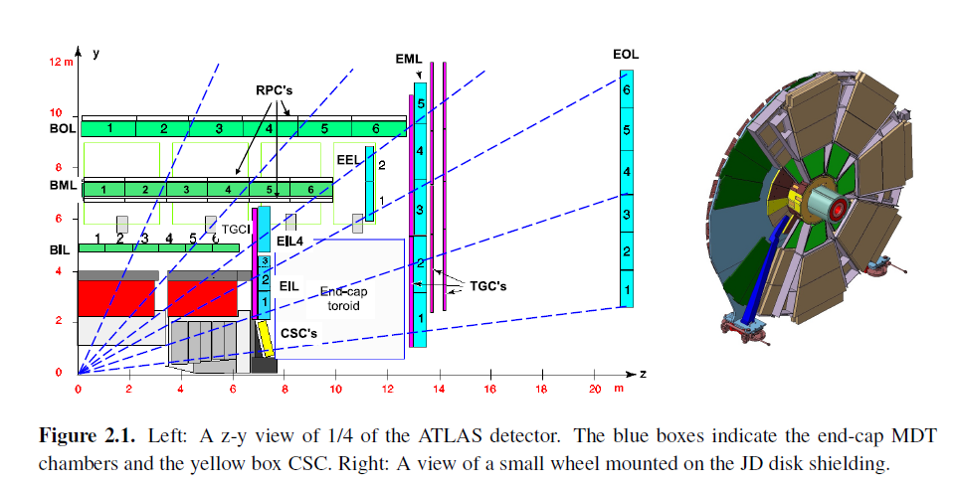
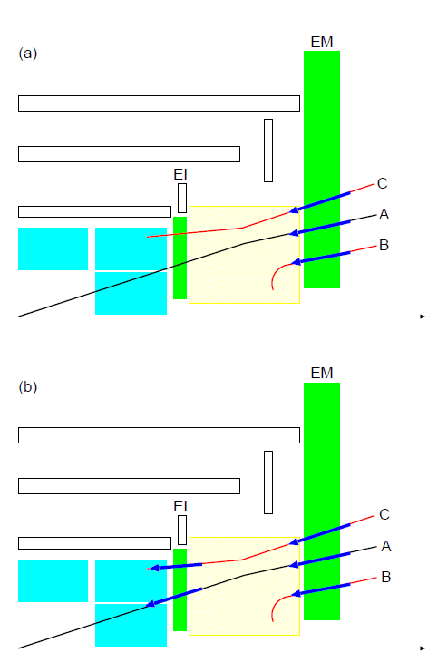
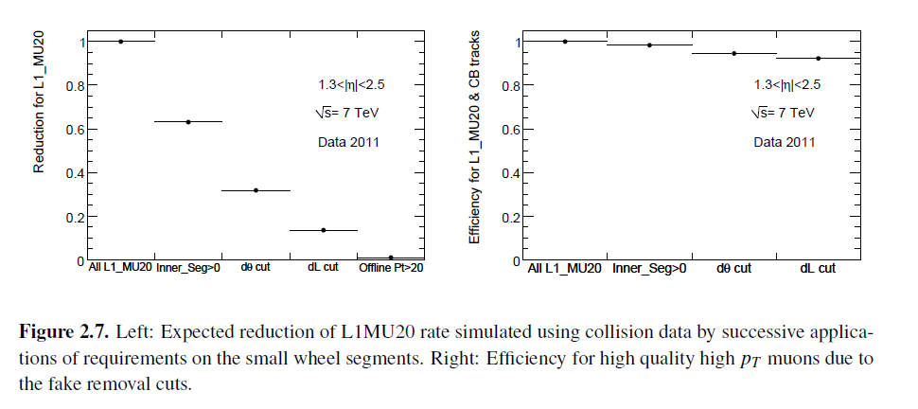
Level-1 Improvements with New Small Muon Wheel
The choice of technologies for the new small wheels is now narrowed to two solutions. The one being more strongly recommended is a homogeneous solution based entirely on TGC and Micromegas chambers. The other solution, still under consideration, employs sMDTs rather than Micromegas at higher radii (lower η)
i)
ii)
Rate
ATLAS Preliminary
iii)
Efficiency for true muons
ATLAS Preliminary
i) the presence of small wheel segments, ii) the small wheel segment points to IP in θ (< 10 mrad) and iii) the small wheel segment matches in (η−φ) to the triggering EML Muon Chamber segment
8

Slide 9
The Opportunity
If the Higgs were confirmed at low mass, measure ratios of its Yukawa couplings and use WH with trigger on W→ l ν to reduce biases in samples anticipating 10%-30% precision, depending on Higgs mass and channels considered (300fb⁻¹: hep-ph/0204087) .
Whether Higgs found at low mass or not, explore VV scattering to understand mechanism to prevent unitarity violation.
Extend high mass searches for non-SM Higgs and, if low mass Higgs becomes excluded, perform tests of Higgs-less models.
Search for SUSY in currently favoured scenarios with greater mass degeneracy and therefore low lepton p_{T} and E_{T}^{Miss} signals (also other BSM models with similar signals).
Extend mass reach for high mass SUSY, W’, Z’, “large” extra dimensions, ... (mSUGRA mass limits should improve by ~500GeV).
Everything else we haven’t thought of...
9

Slide 10
Phase-II (installation 2022-23)
  Integrated radiation levels and particle densities per beam crossing well beyond the design specifications of the experiment.
  Requirements include:
  New Inner Detector (strips and pixels) − very substantial progress in many R&D areas
  New LAr front-end and back-end electronics
  New Tiles front-end and back-end electronics
  TDAQ upgrade
  TAS and shielding upgrade
  Various infrastructure upgrades
  Common activities (installation, safety, …)
  New FCAL (if conditions require it)?
  LAr HEC cold electronics consolidation (radiation hardness)?
  L1 track trigger (latency budget and physics case)?
  Muon Barrel and Large Wheel system electronics upgrade?
  Further forward detectors upgrades?
10

Slide 11
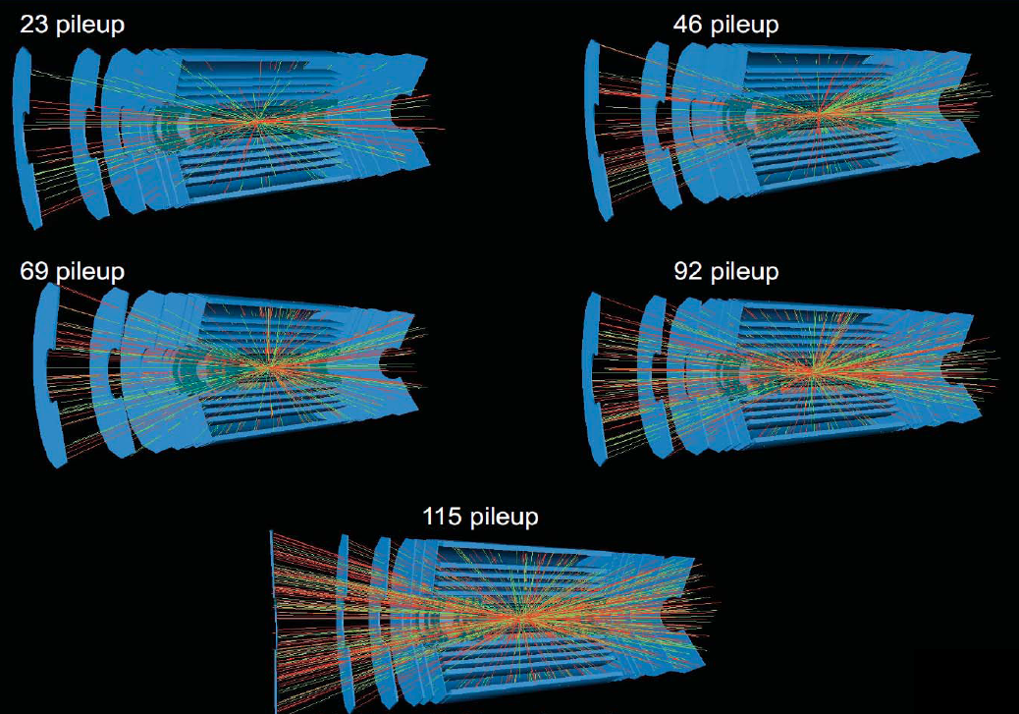

Slide 12
Phase-II LoI
Guidelines
  Concise document
  Strong emphasis on physics justification in addition to technical description
  Aim for around pp100; supported by detailed backup documents
Scope: describe proposed ATLAS Phase-II Upgrades
Upgrades currently under discussion
  Trigger DAQ
    L0+L1 vs L1 architecture
    Level 1 Calorimeter
    Muon trigger
    Level 1 track trigger
    Level 1 topological trigger
    HLT & Data flow
  Calorimeter
    Liquid Argon electronics
    Cold HEC electronics
    Forward calorimeter
    Tile calorimeter electronics
  Muon
    Electronics
    Trigger chambers
  Tracker
    Pixels
    Short-strips
    Outer radius tracker
  Computing & Software
    Use of GPUs
    Core software
    Architectures
Physics studies
  Justification for the Phase-II upgrade
  Performance studies
Technical and organizational issues
  Opening of ATLAS & working with active materials
  Plans for TDRs, MoUs, Cost estimate and schedule
12

Slide 13
Phase-II LoI
January: Global editors identified and strategy presented at ATLAS Week.
February: Identified chapter editors in consultation with Project Leaders.
March: Agreed outline & schedule of the LoI with chapter editors.
Discussion with TDAQ on L0/L1 vs L1 issue & latency.
Work with Upgrade Physics Sub-committee to identify physics topics and required simulation tools and samples.
May: Version-0 of the document ready.
Include summary of TDAQ strategy and list of physics channels to be explored for performance studies and physics justification.
June: Presentation at June ATLAS week of status of LoI.
Sept: First complete draft ready.
Oct: Presentation at October ATLAS week of draft LoI.
Comments from collaboration following ATLAS week.
Dec: Submit draft LoI to the LHCC.
2013
Jan/Feb: Submit LoI for approval by ATLAS CB.
Mar/April: Submission of the LoI to LHCC and RRB.

Slide 14
Conclusions
ATLAS has planning for a coherent overall upgrade programme up to and including Phase-II.
IBL programme progressing well and is on target to deliver a 4th, innermost, layer for the pixel system at Phase-0.
Detailed plans for Phase-I have been accepted within the collaboration and Letter of Intent produced.
Core costs have been estimated in the Phase-I LoI and presented to the RRB and national contact physicists.
LHCC questions on upgrade plans and Initial comments on LoI welcomed and responses provided: – more details in presentations on AFP and IBL today – formal feedback sought in time for April RRB.
ATLAS has started the usual formal process for approval of its upgrade plans through to 2022. The process is ongoing with first LoIs, then progressing through TDRs and MOUs for each of the major project components, including all necessary peer review processes.
14

