Slide 1


STAR Heavy Flavor Upgrades
Flemming Videbæk
Brookhaven National Laboratory
For the STAR collaboration

Slide 2
Overview
Introduction
  Heavy Flavor Physics
Upgrades
  Muon Telescope Detector (MTD)
  Realization & Planned Physics from MTD
  Heavy Flavor Tracker (HFT)
  Realization & Planned Physics from HFT
Status and Summary
Notes:
----- Meeting Notes (11/10/12 17:33) -----
overview of talks

Slide 3
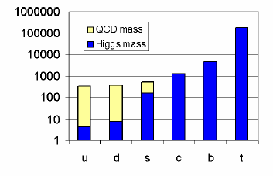
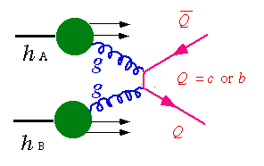
Motivation for Studying Heavy Quarks
Heavy quark masses are only slightly modified by QCD.
Interaction is sensitive to initial gluon density and gluon distribution.
Interaction with the medium is different from light quarks.
Suppression or enhancement pattern of heavy quarkonium production reveals critical features of the medium (temperature).
Cold Nuclear effect (CNM):
    Different scaling properties in central and forward rapidity region CGC.
    Gluon shadowing, etc.
K⁺
e⁻/μ⁻
ν_{l}
K⁻
Non-photonic electron
D⁰
π
Open heavy flavor
e⁻/μ⁻
e⁺/μ⁺
Heavy quarkonia
Notes:
If the quark motivation is in Huan’s talk I can save a slide. CNM which I do not discuss in the brief overview talks

Slide 4
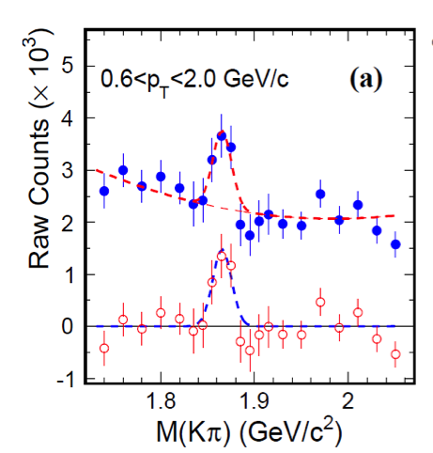
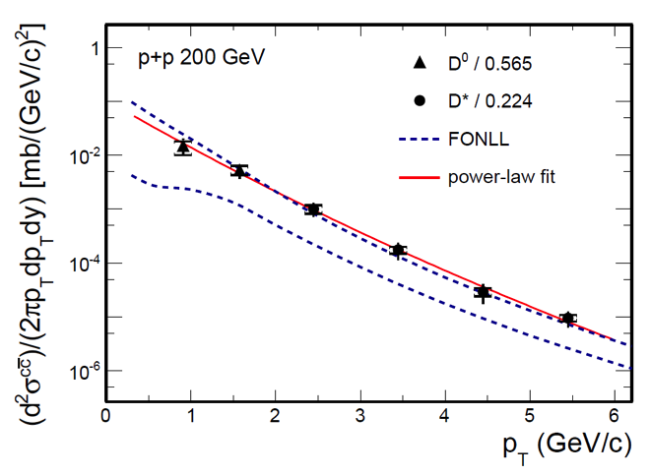
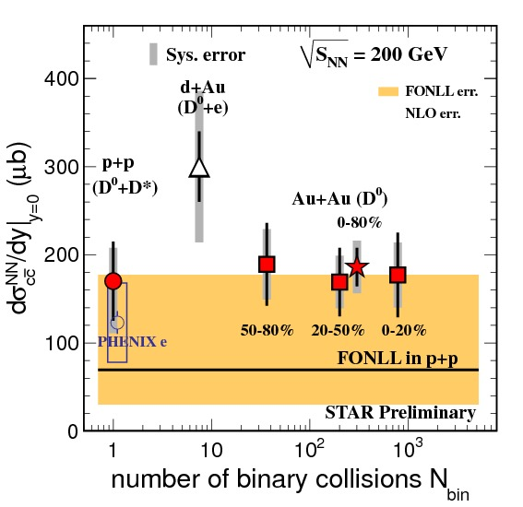
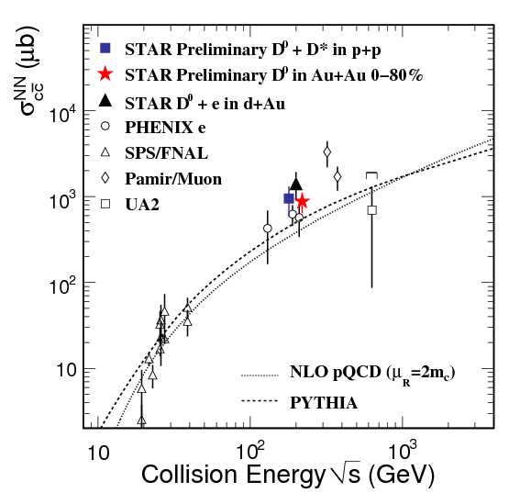
Some Recent STAR HF results
These were presented in preceding talk at the workshop. Significant results have been published.
D0 in p+p
Charm p_{T} spectra
Sigma_c vs Ncoll
Ypsilon signal e+e-
Cham cross section
Ypsilon centrality dep.
Notes:
----- Meeting Notes (11/10/12 17:33) -----
Recent star results already discussed in this meeting

Slide 5
STAR near term upgrades
Muon Telescope Detector (MTD)
  Accessing muons at mid-rapidity
  R&D since 2007, construction since 2010
  Significant contributions from China & India
Heavy Flavor Tracker (HFT)
  Precision vertex detector
  Ongoing DOE MIE since 2010
  Significant sensor development by IPHC, Strasbourg
Notes:
----- Meeting Notes (11/10/12 17:33) -----
Two upgrades to be discussed in psrticulr

Slide 6
STAR-MTD physics motivation
The large area of muon telescope detector (MTD) at mid-rapidity allows for the detection of
di-muon pairs from QGP thermal radiation, quarkonia, light vector mesons, resonances in QGP, and Drell-Yan production
single muons from the semi-leptonic decays of heavy flavor
hadrons
advantages over electrons: no γ conversion, much less Dalitz decay contribution, less affected by radiative losses in the detector materials, trigger capability in Au+Au collisions
trigger capability for low to high p_{T} J/ψ in central Au+Au collisions and
excellent mass resolution allow separation of different upsilon states
e-muon correlation can distinguish heavy flavor production from initial lepton pair production

Slide 7
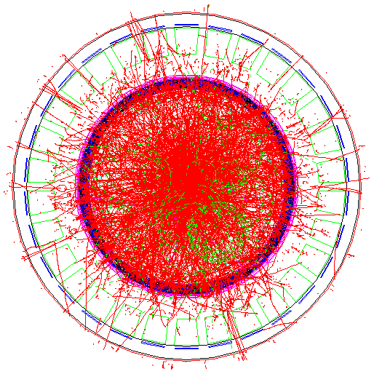
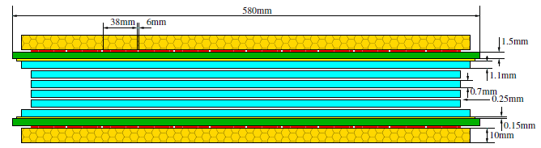
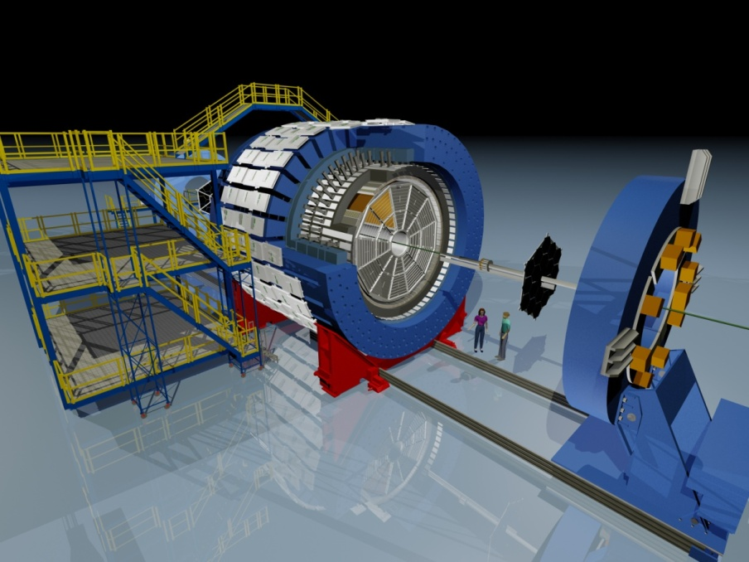
Concept of design of the STAR-MTD
Multi-gap Resistive Plate Chamber (MRPC):
gas detector, avalanche mode
A detector with long-MRPCs covers the
whole iron bars and leaves the gaps in-
between uncovered. Acceptance: 45% at
|η|<0.5
118 modules, 1416 readout strips, 2832 readout
channels
Long-MRPC detector technology, electronics
same as used in STAR-TOF
MTD

Slide 8
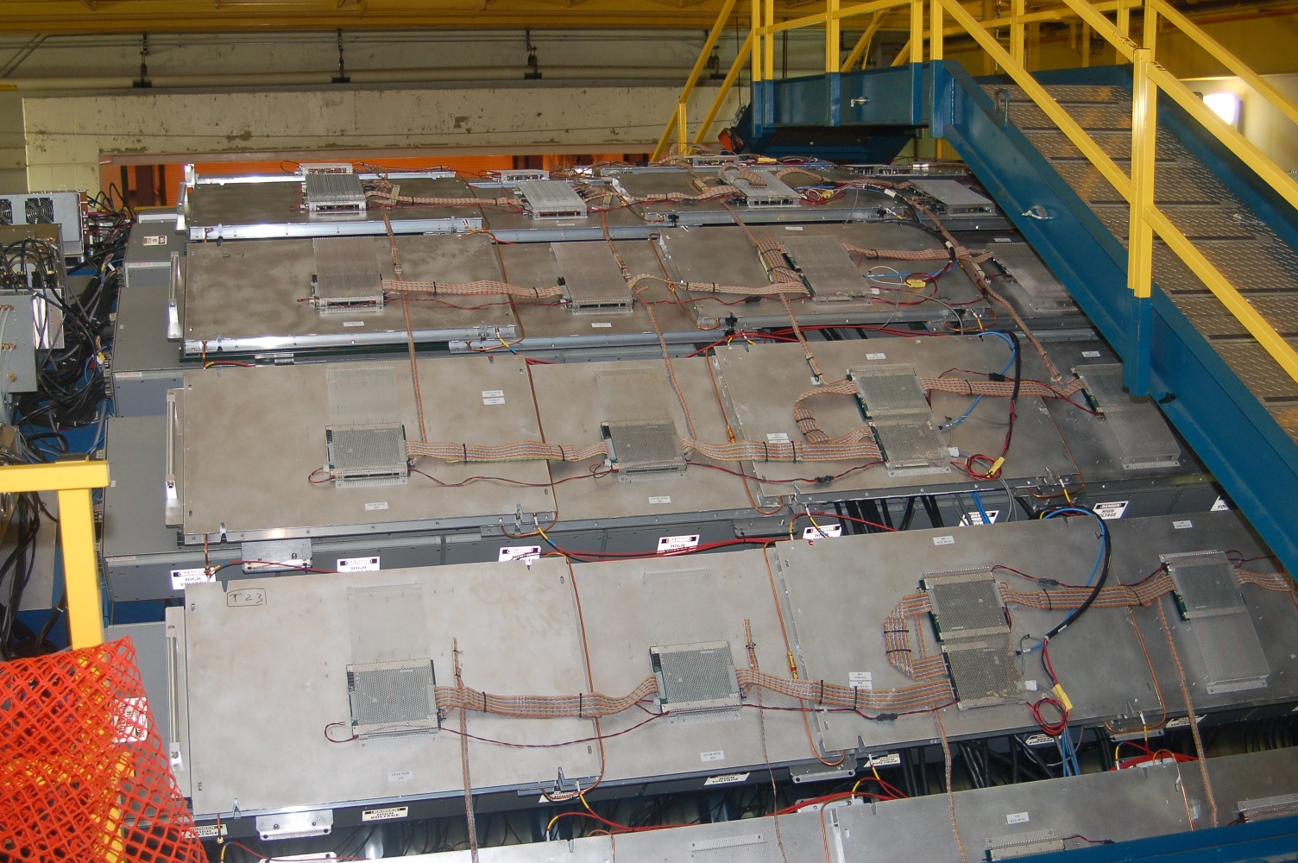
STAR-MTD

Slide 9
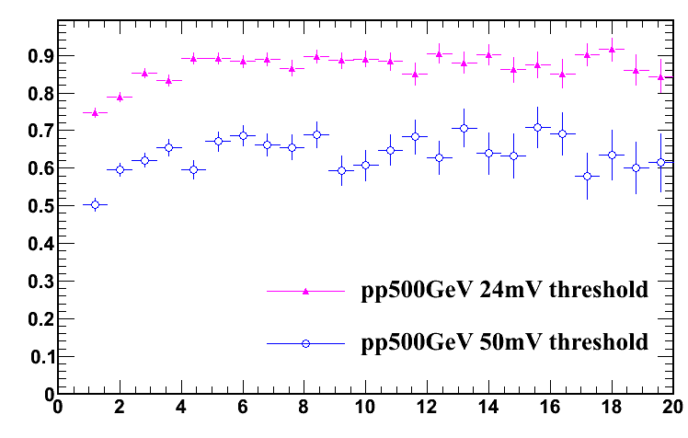
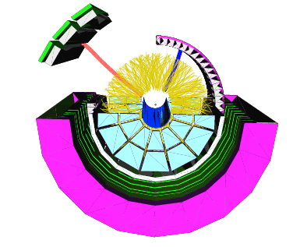
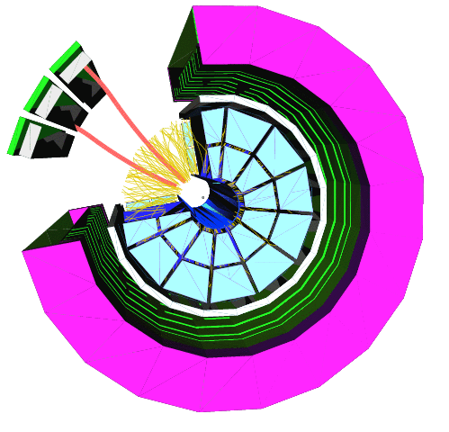
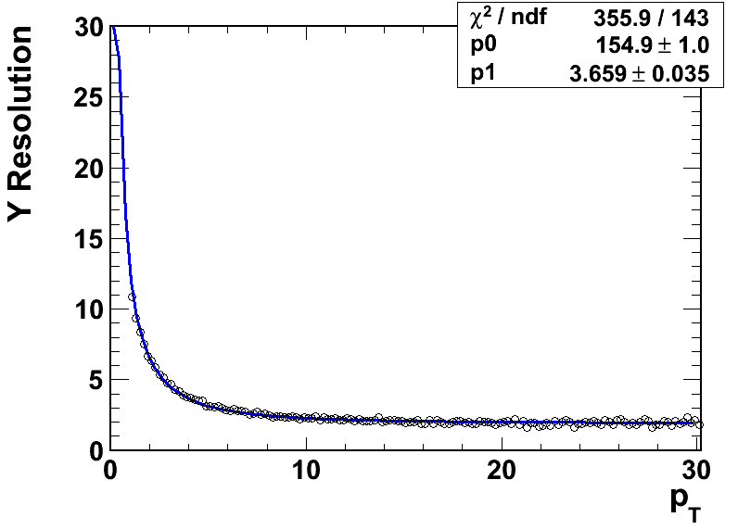
MTD Performance from Run 12
e-muon
di-muon
Efficiency
p_{T}(GeV/c)
Commissioned e-muon (coincidence of single MTD hit and BEMC energy deposition above a certain threshold) and di-muon triggers, event display for
Cu+Au collisions shown above.
Determined the electronics threshold for the future runs, achieved 90% efficiency at threshold 24 mV
Intrinsic spatial resolution: 2 cm
Y Resolution (cm)
p_{T}(GeV/c)

Slide 10
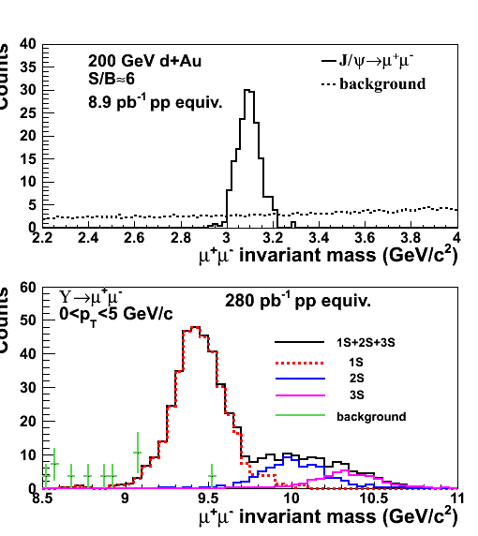
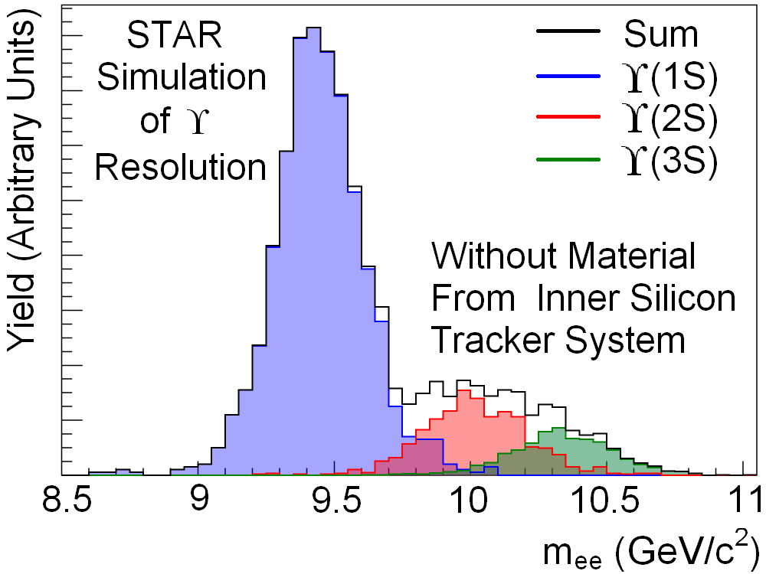
Quarkonium from MTD
J/ψ: S/B=6 in d+Au and S/B=2 in central Au+Au collisions
Excellent mass resolution: separate different upsilon states
With HFT, study B→J/ψ X; J/ψ→μμ using displaced vertices
Heavy flavor collectivity and color
screening, quarkonia production
mechanisms:
J/ψ R_{AA} and v₂; upsilon R_{AA} …
Z. Xu, BNL LDRD 07-007; L. Ruan et al., Journal of Physics G: Nucl. Part. Phys. 36 (2009) 095001

Slide 11
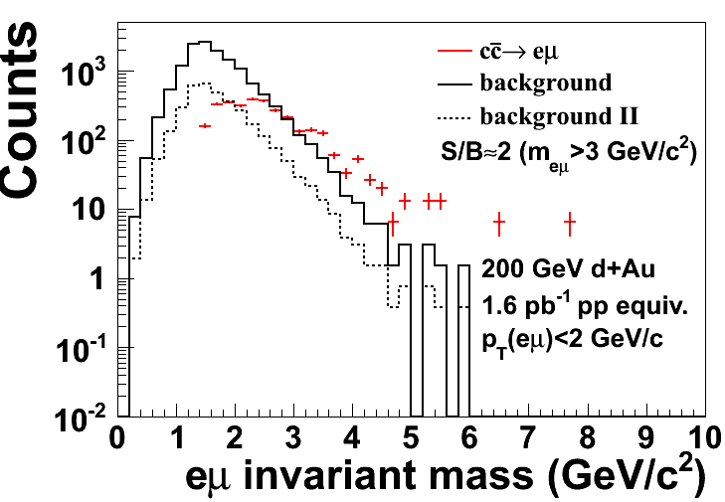
Measure charm correlation with MTD upgrade: ccbar→e+μ
An unknown contribution to di-electron mass spectrum is from ccbar, which can be disentangled by measurements of eμ correlation.
Simulation with Muon Telescope Detector (MTD) at STAR from ccbar:
S/B=2 (M_{eu}>3 GeV/c2 and p_{T}(eμ)<2 GeV/c)
S/B=8 with electron pairing and tof association

Slide 12
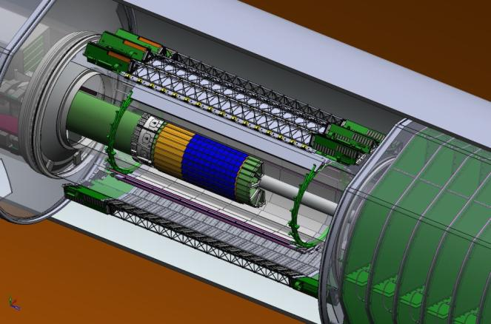
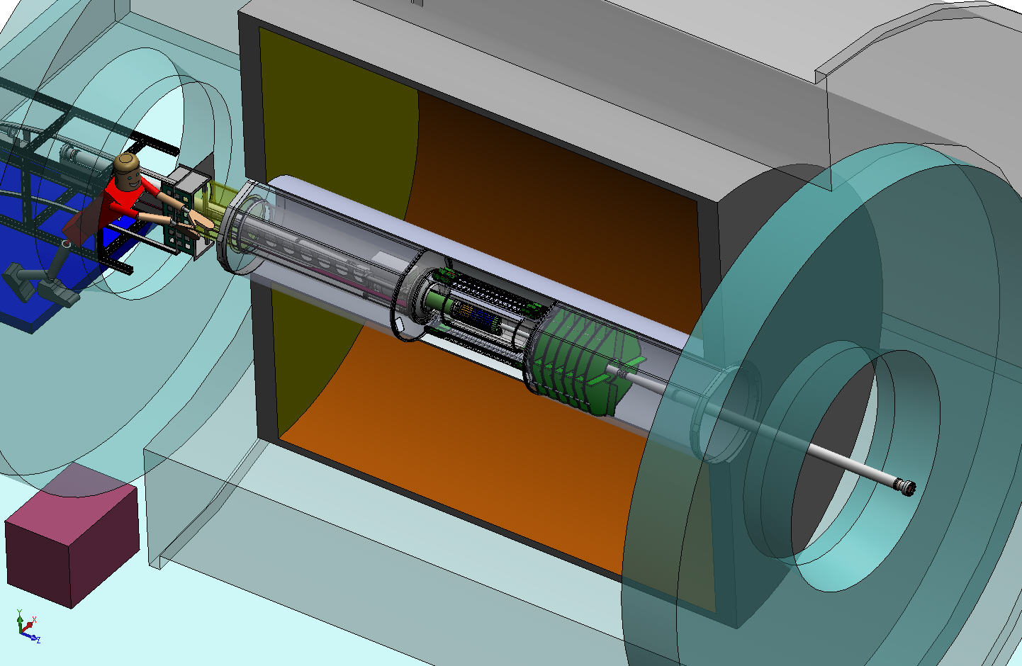
Heavy Flavor Tracker (HFT)
HFT
Detector | Radius (cm) | Hit Resolution R/ϕ - Z (μm - μm) | Radiation length
SSD | 22 | 20 / 740 | 1% X₀
IST | 14 | 170 / 1800 | <1.5 %X₀
PIXEL | 8 | 12/ 12 | ~0.4 %X₀
 | 2.5 | 12 / 12 | ~0.4% X₀
SSD
IST
PXL
Inner Field Cage
PIXEL
two layers
18.4x18.4 μm pixel pitch
10 sector, delivering ultimate pointing resolution that allows for direct topological identification of charm.
new monolithic active pixel sensors (MAPS) technology
Magnet
Return Iron
Outer Field Cage
FGT
SSD
existing single layer detector, double side strips (electronic upgrade)
IST one layer of silicon strips along beam direction, guiding tracks from the SSD through PIXEL detector. - proven strip technology
TPC Volume
Solenoid
EAST
WEST

Slide 13
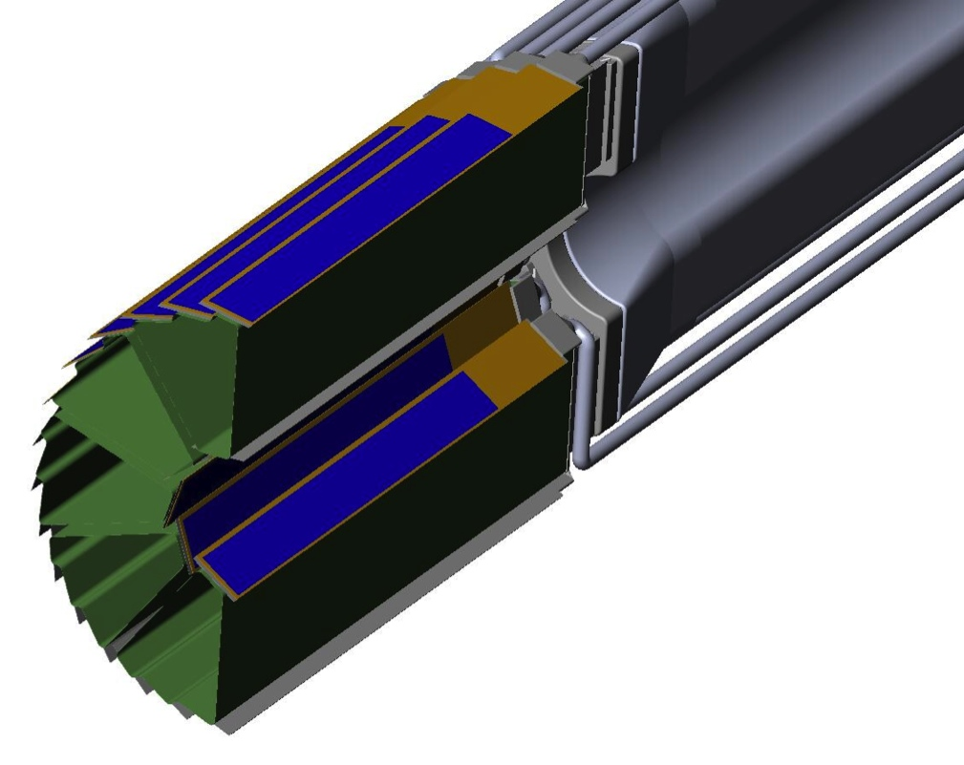
PXL Detector Design
Carbon fiber sector tubes (~ 200µm thick)
Ladder with 10 MAPS sensors (~ 2×2 cm each)
Aluminum conductor Ladder Flex Cable
20 cm
The Ladders will be instrumented with sensors thinned down to 50 micron Si.
Novel rapid insertion mechanism allows for dealing effectively with repairs.
Precision kinematic mount guarantees reproducibility to < 20 microns

Slide 14
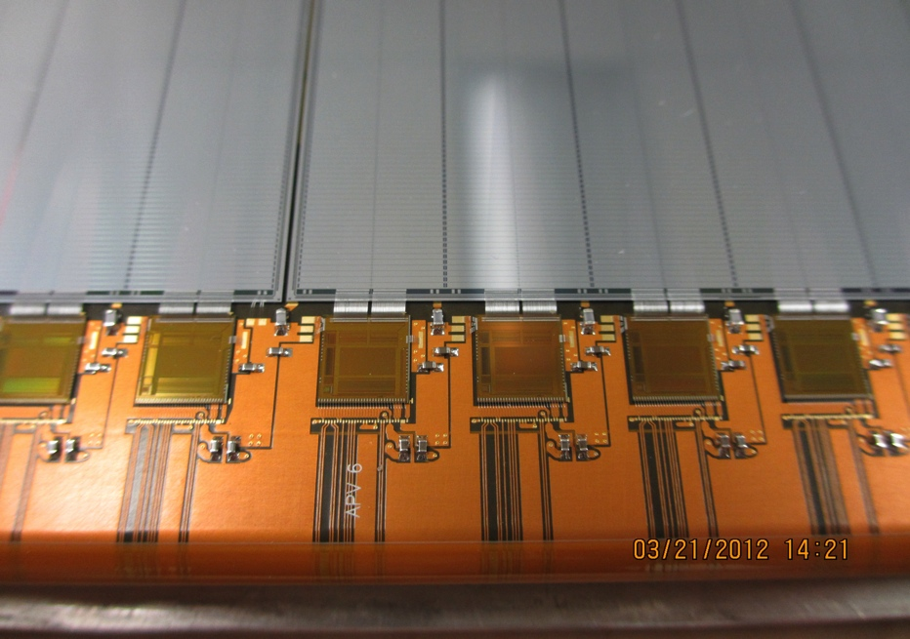
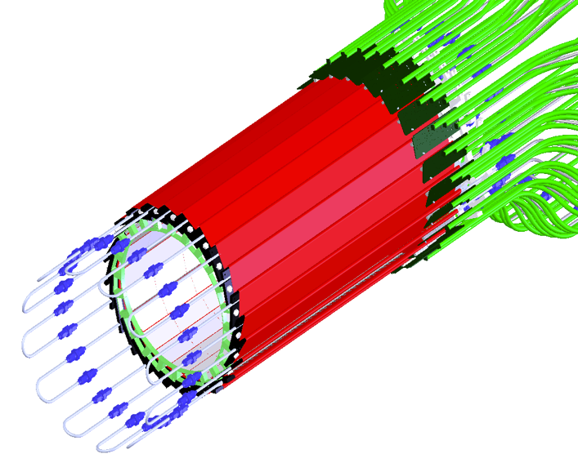
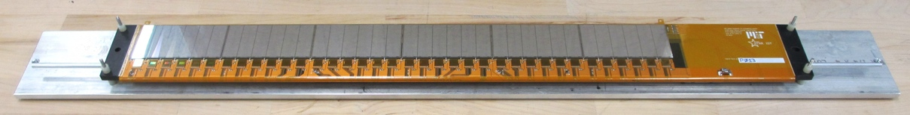
Intermediate Si Tracker
24 ladders, liquid cooling.
Details of wire bonding
Prototype Ladder
S:N > 20:1
>99.9% live and functioning channels

Slide 15
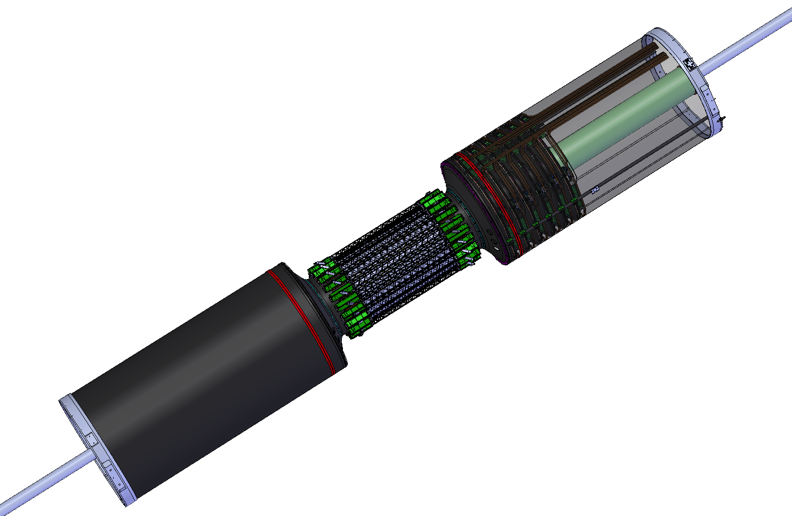
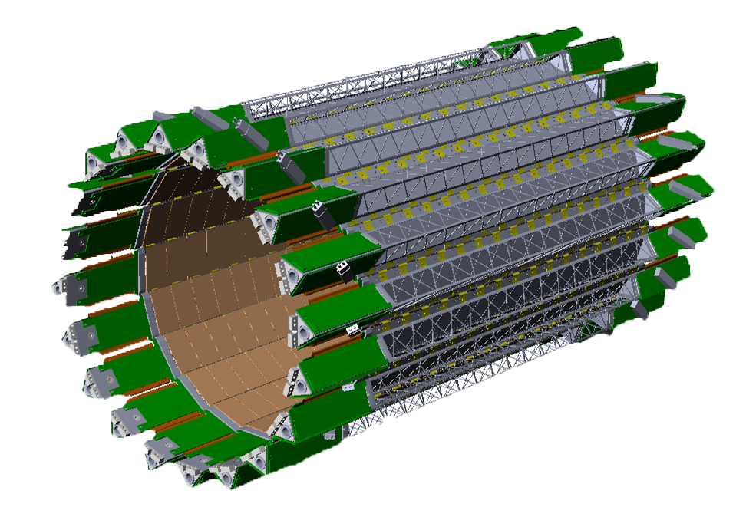
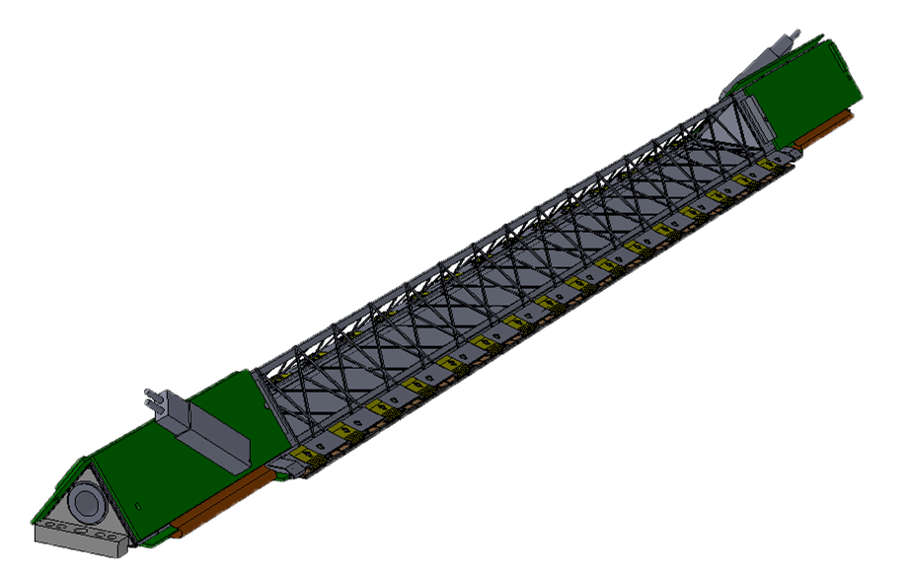
Silicon Strip Detector (SSD)
44 cm
20 Ladders
4.2 Meters
~ 1 Meter
Ladder Cards

Slide 16
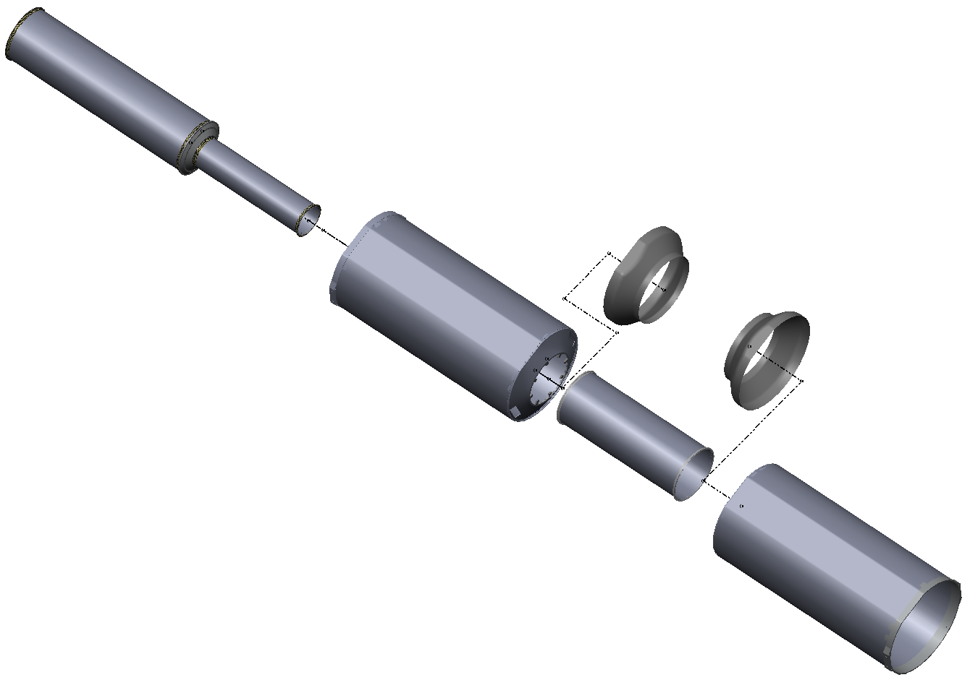
Inner Detector Support (IDS)
IDS
East Support Cylinder
Outer Support Cylinder
West Support Cylinder
PIT
Middle Support Cylinder
PST
MSC
Pixel Insertion Tube
Pixel Support Tube
ESC
Shrouds
Installed for run-12
OSC
Inner Detector Support
Carbon Fiber Structures provide support for 3 inner detector systems and FGT.
All systems are highly integrated into IDS.
WSC

Slide 17
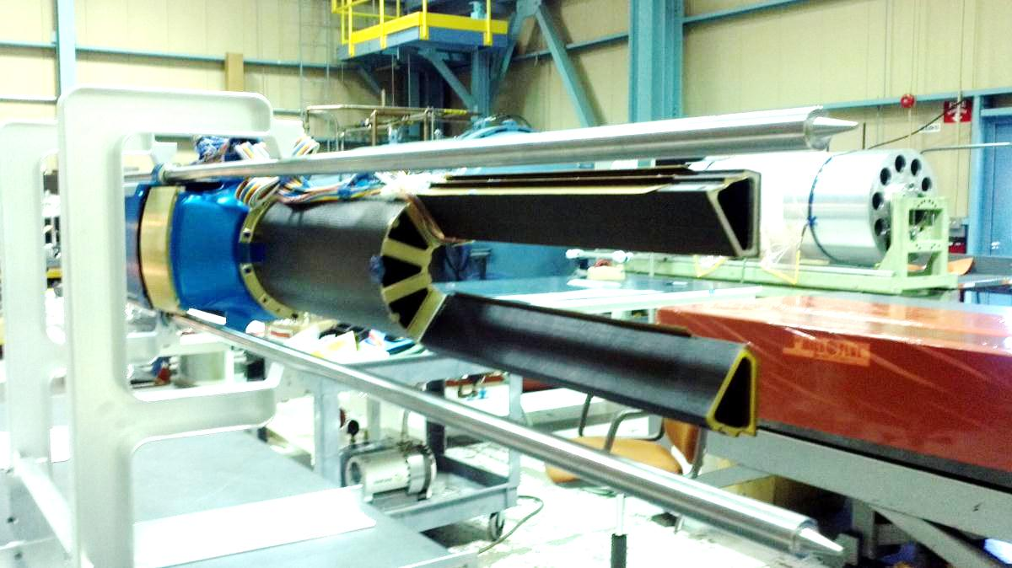
Insertion check setup
Two sector only shown in D-Tube (sector holding part). Next slides shows how this will be moved into position around the beam pipe (test setup).

Slide 18
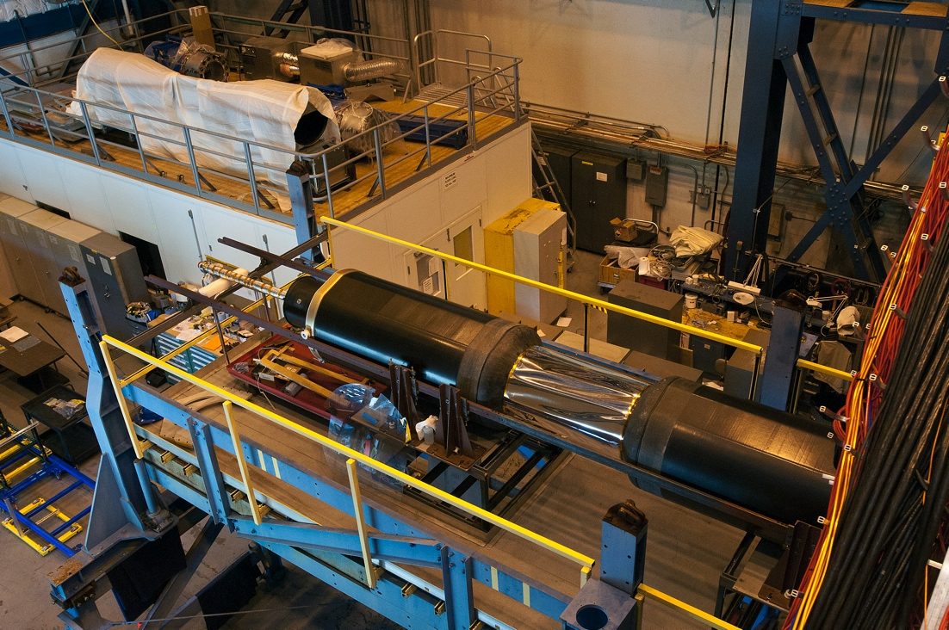
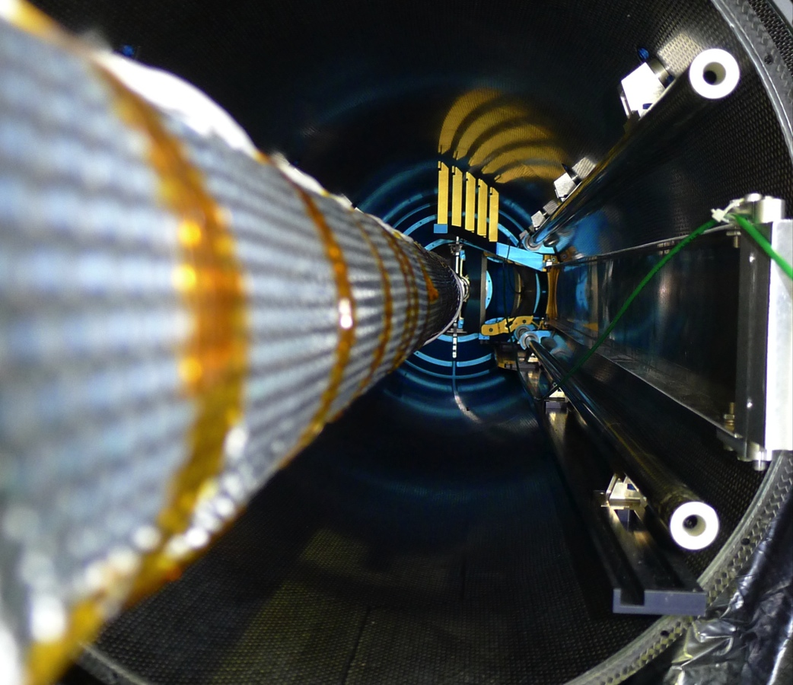
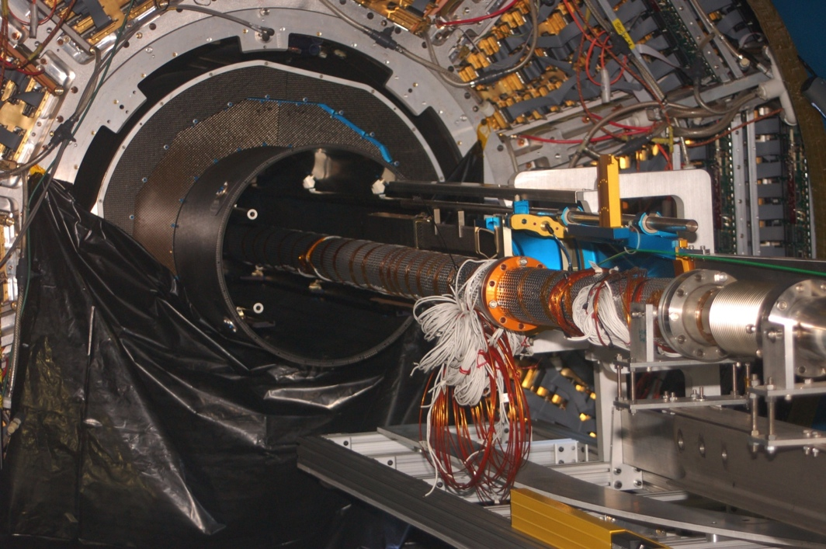
STAR inner detector Support

Slide 19
Physics of the Heavy Flavor Tracker at STAR
1) Direct HF hadron measurements (p+p and Au+Au)
  (1) Heavy-quark cross sections: D^{0±}*, D_{S}, Λ_{C} , B…
  (2) Both spectra (R_{AA}, R_{CP}) and v₂ in a wide p_{T} region: 0.5 - 10 GeV/c
  (3) Charm hadron correlation functions, heavy flavor jets
  (4) Full spectrum of the heavy quark hadron decay electrons
2) Physics
  (1) Measure heavy-quark hadron v₂, heavy-quark collectivity, to study the medium properties e.g. light-quark thermalization
  (2) Measure heavy-quark energy loss to study pQCD in hot/dense medium e.g. energy loss mechanism
  (3) Measure di-leptons to study the direct radiation from the hot/dense medium
  (4) Analyze hadro-chemistry including heavy flavors
Notes:
Need to go through formatting

Slide 20
DCA resolution performance r-phi and z
GEANT: Realistic detector geometry + Standard STAR tracking
including the pixel pileup hits at RHIC-II luminosity
Goal with Al-based cable (Cu cable -> 55 micron at 750 MeV/c K)
20

Slide 21
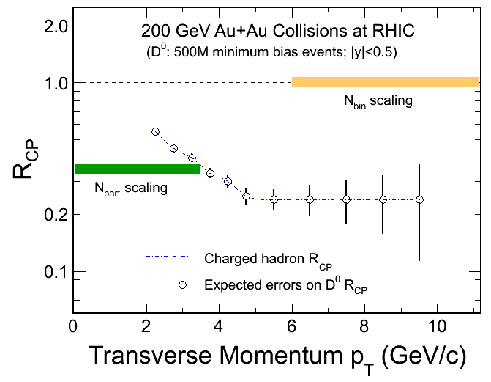
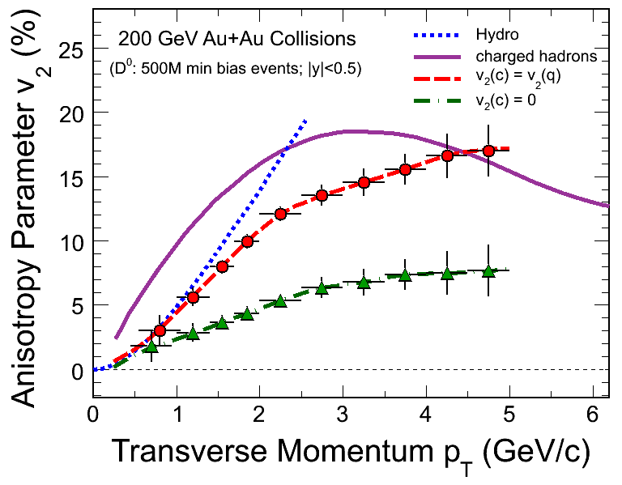
Physics – Run-13,14 projections
R_{CP}=a*N10%/N(60-80)%
Assuming D0 R_{cp} distribution as charged hadron.
500M Au+Au m.b. events at 200 GeV.
Charm R_{AA} 
Energy loss mechanism!
Color charge effect!
Interaction with QCD matter!
Assuming D0 v₂ distribution from quark coalescence.
500M Au+Au m.b. events at 200 GeV.
- Charm v₂ 
Medium thermalization degree
Drag coefficients!
21

Slide 22
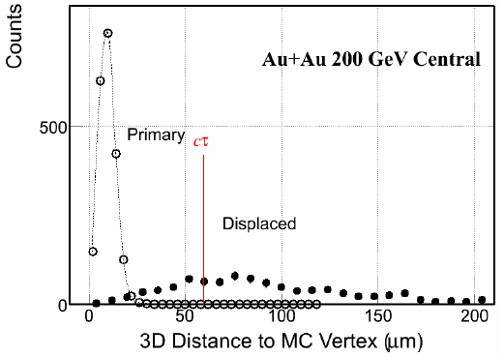
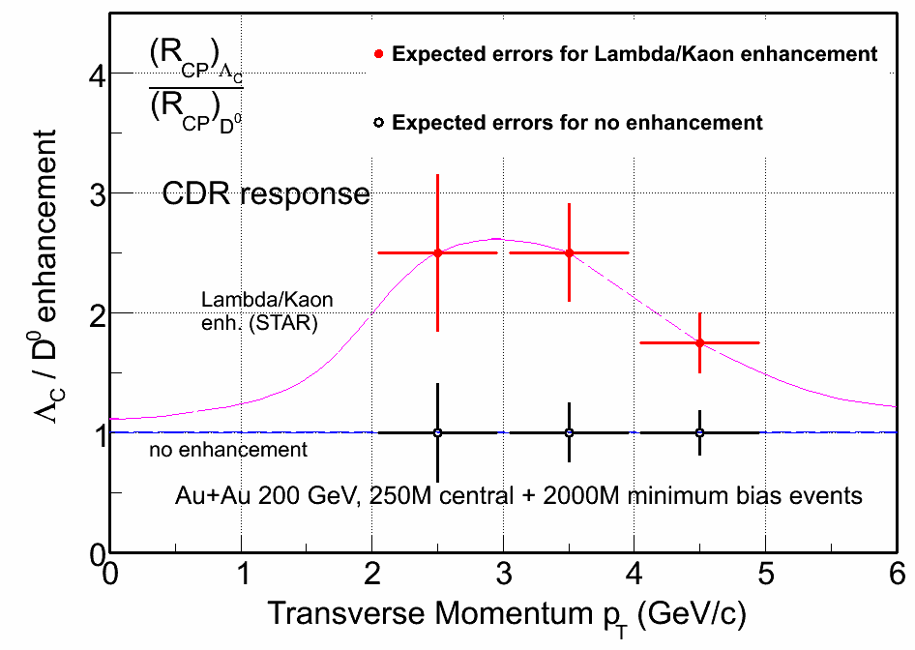
Charmed baryons (Lambda_{c)} – Run-16
Λ_{c}→pKπ Lowest mass charm baryons cτ = 60 μm
Λ_{c}/D enhancement?
0.11 (pp PYTHIA) → 0.4-0.9 (Di-quark correlation in QGP)
S.H. Lee etc. PRL 100, 222301 (2008)
Total charm yield in heavy ion collisions
22

Slide 23
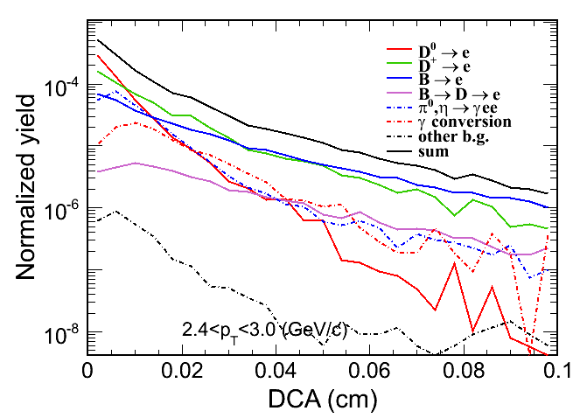
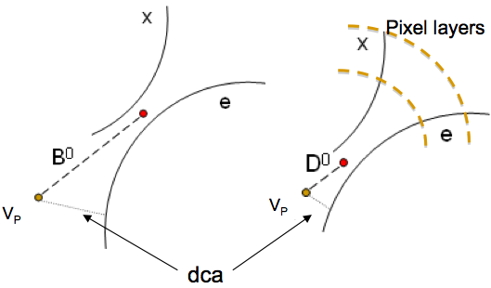
Access bottom production via electrons
particle | cτ (μm) | Mass | q_{c,b} →x (F.R.) | x →e (B.R.)
D⁰ | 123 | 1.865 | 0.54 | 0.0671
D± | 312 | 1.869 | 0.21 | 0.172
B⁰ | 459 | 5.279 | 0.40 | 0.104
B± | 491 | 5.279 | 0.40 | 0.109
Two approaches:
Statistical fit with model assumptions
  Large systematic uncertainties
With known charm hadron spectrum to constrain or be used in subtraction
23

Slide 24
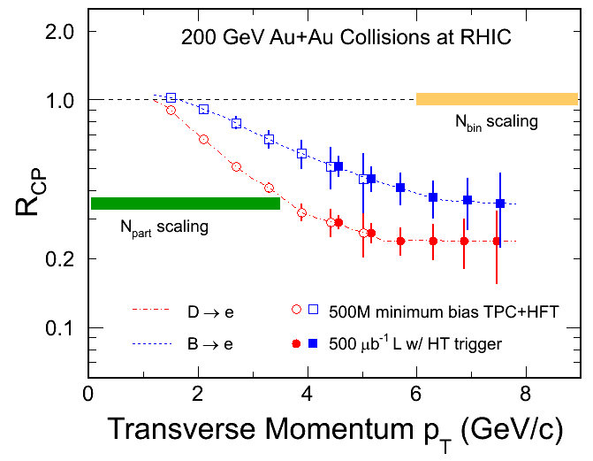
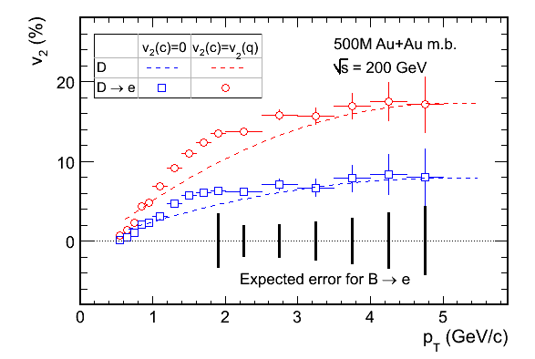
Statistic projection of e_{D}, e_{B} R_{CP} & v₂
Curves: H. van Hees et al. Eur. Phys. J. C61, 799(2009).
(B→e) spectra obtained via the subtraction of charm decay electrons from inclusive NPEs:
- no model dependence, reduced systematic errors.
Unique opportunity for bottom e-loss and flow.
- Charm may not be heavy enough at RHIC, but how is bottom?
24

Slide 25
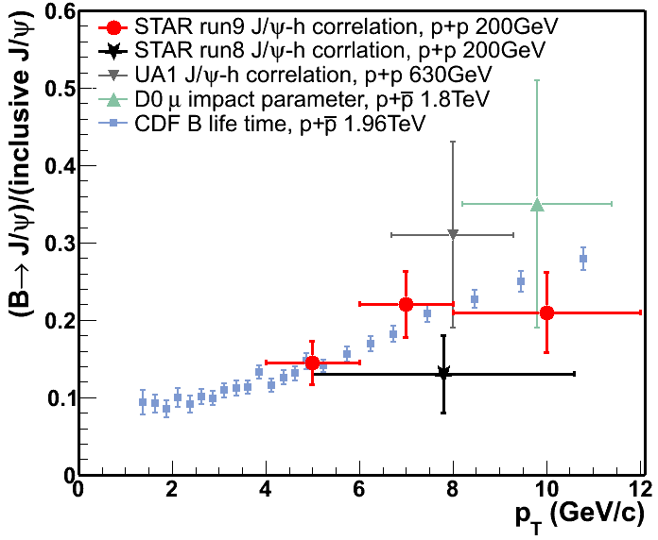
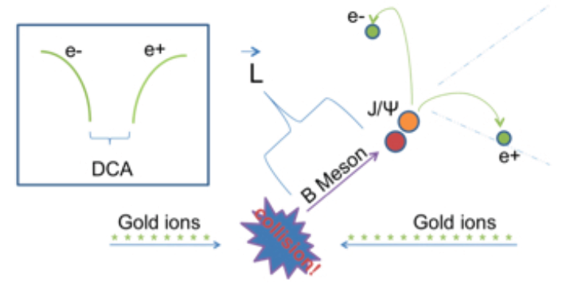
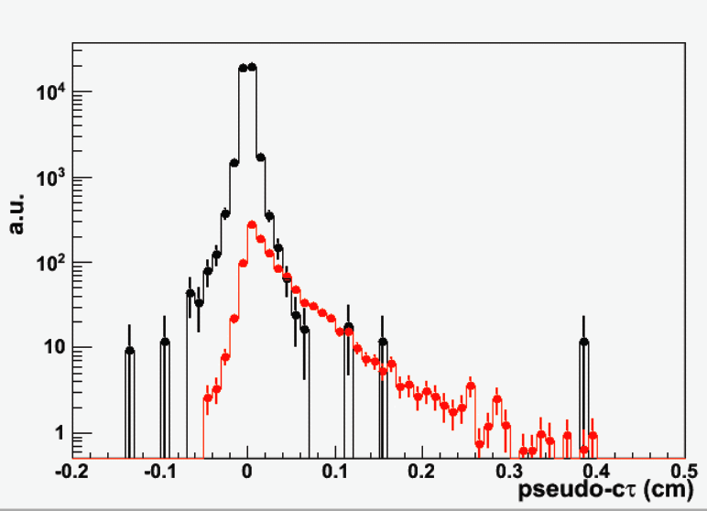
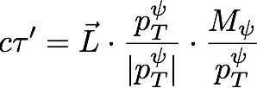
B tagged J/psi
Zebo Tang, NPA 00 (2010) 1.
STAR Preliminary
Prompt
Current measurement via J/ψ-hadron correlation with large uncertainties.
Combine HFT+MTD in di-muon channel
  Separate secondary J/psi from promptJ/psi
  Constrain the bottom production at RHIC
J/ψ from B
25

Slide 26
HFT project status
HFT upgrade was approved CD2/3 October 2011 and is well into fabrication phase.
All detector components have passed the prototype phase successfully.
A PXL prototype with 3+ sectors instrumented is planned for an engineering run and data taking in STAR in early 2013.
The full assembly including PXL, IST and SSD should be available for RHIC Run-14, which is planned to be a long Au-Au run

Slide 27
Summary
Initial heavy flavor measurements have been performed by STAR.
Further high precision measurements are needed.
HFT upgrades will provide direct topological reconstruction for charm.
MTD will provide precision Heavy Flavor measurements in muon channels.
Notes:
Work on this…

Slide 28
BACKUP

Slide 29
Physics run plan
HFT 3 sectors in run-13: pp 500 ,Au+Au 16 GeV
  Detector engineering run.
  First look at v₂ and R_{cp} of D/e.
Full HFT in run-14: >10 weeks Au+Au 200 GeV and p+p 200 GeV
  v₂ and R_{cp} of D/e with high precision. R_{AA} of D/e.
  Correlations: e-D, e-μ.
  B->J/ψ
Run-15 … Au+Au 200 GeV and pp 200 GeV high statistics, BES Phase-II …
  Systematic studies of v₂ and R_{AA}, centrality, path length, √S, etc…
  Λ_{c} baryon with sufficient statistics.
  Correlations: e-D, e-μ, D-Dbar.
  Di-lepton, top energy, BES.
29

Slide 30
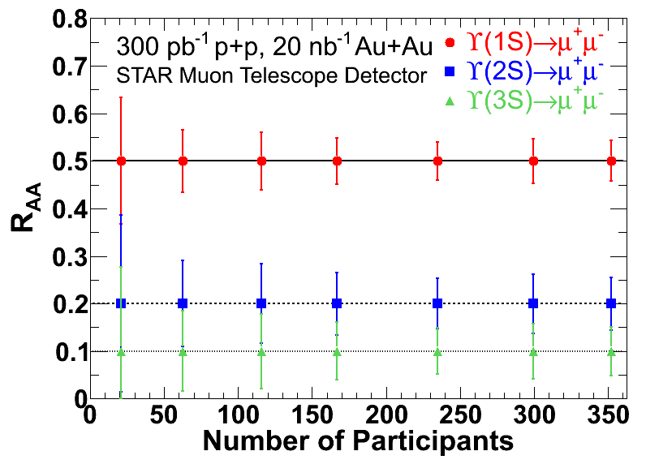
Expected sensitivity
The required sample luminosity is shown in the plot.
For the projection, R_{AA}(1S)=0.5, R_{AA}(2S)=0.2, R_{AA}(3S)=0.1, assuming no centrality dependence.
Notes:
Over all pt (the eff for Y is fairly flat, so weigthed at mean pt ~ 2 GeV/c

Slide 31
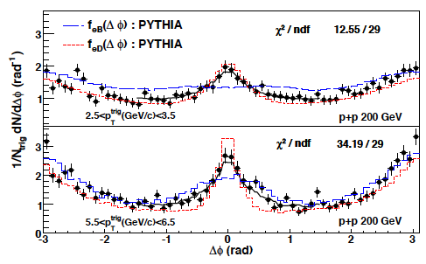
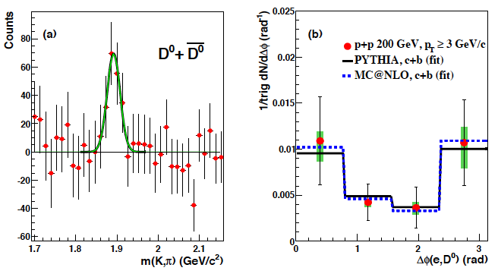
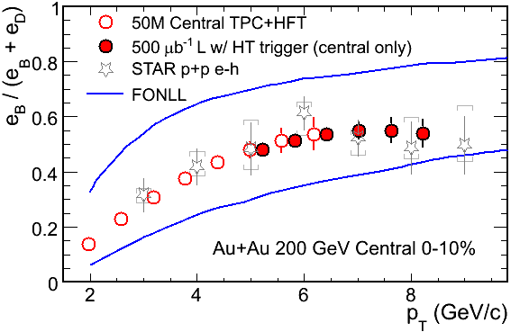
e-h, e-D correlations in p+p
Measure bottom fraction in NPE =>
Before:
Model dependent, large uncertainties.
After:
No model dependence, precise measurement.
31

Slide 32

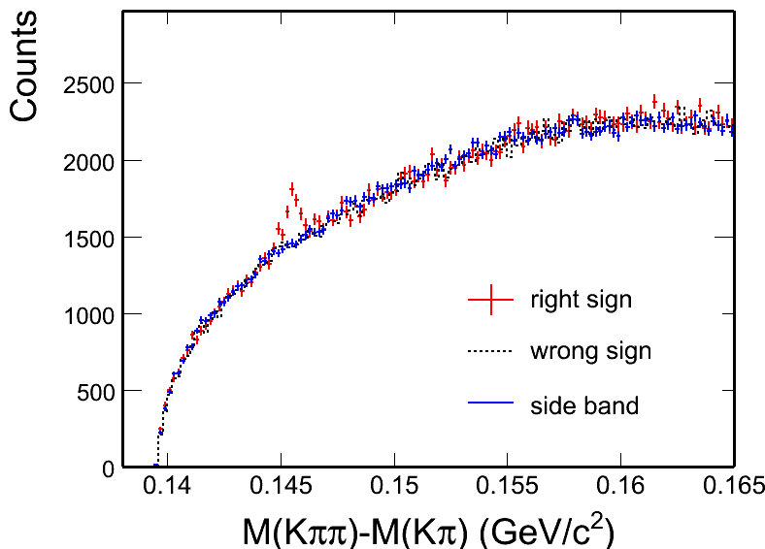
D meson signal in p+p 200 GeV
D⁰ -> K π
p+p minimum bias
4-σ and 8-σ signal observed
Different methods reproduce combinatorial background and give consistent results.
Combine D⁰ and D* results
arXiv: 1204.4244
D*

Slide 33
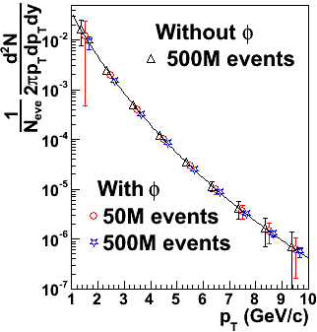
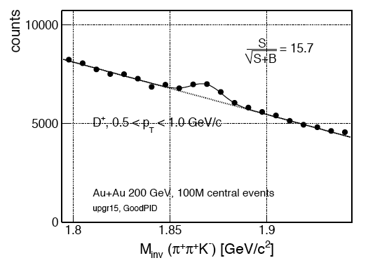

More hadronic channels …
D⁺→Kππ
mass = 1.869 MeV cτ=312μm
Important for charm total cross section and fragmentation ratio measurements.
33

Slide 34



D⁰ and D* p_{T} spectra in p+p 200 GeV
D⁰ scaled by N_{cc} / N_{D0} = 1 / 0.56^{[1]}
D* scaled by N_{cc} / N_{D*} = 1 / 0.22^{[1]}
Consistent with FONLL^{[2]} upper limit.
Xsec = dN/dy|^{cc}_{y=0} × F × σ_{pp}
F = 4.7 ± 0.7 scale to full rapidity.
[1] C. Amsler et al. (PDG), PLB 667 (2008) 1.
[2] FONLL: M. Cacciari, PRL 95 (2005) 122001.
The charm cross section at mid-rapidity is:
The charm total cross section is extracted as:
b
STAR arXiv:1204.4244.

Slide 35
Charm cross section vs. N_{bin}
YiFei Zhang, JPG 38, 124142 (2011)
arXiv:1204.4244.
All of the measurements are consistent.
Year 2003 d+Au : D⁰ + e
Year 2009 p+p : D⁰ + D*
Year 2010 Au+Au: D⁰
.
Charm cross section in Au+Au 200 GeV:
Mid-rapidity:
  186 ± 22 (stat.) ± 30 (sys.) ± 18 (norm.) μb
Total cross section:
  876 ± 103 (stat.) ± 211 (sys.) μb
[1] STAR d+Au: J. Adams, et al., PRL 94 (2005) 62301
[2] FONLL: M. Cacciari, PRL 95 (2005) 122001.
[3] NLO: R. Vogt, Eur.Phys.J.ST 155 (2008) 213
[4] PHENIX e: A. Adare, et al., PRL 97 (2006) 252002.
Charm cross section follows number of binary collisions scaling =>
Charm quarks are mostly produced via initial hard scatterings.
Notes:
Assuming N_{D0} / N_{cc} = 0.56 does not change (fragmentation functions.

Slide 36
Quarkonium Production
We have additional heavy probes, other than charms, to get a more complete picture of its properties, e.g. Upsilons as a probe of the temperature.
Cleaner Probe compared to J/psi:
recombination can be neglected at RHIC
Final state Co-mover absorption is small.
  Expectation ϒ(1S) no melting, ϒ(3S) melts
Consistent with the melting of all excited states.
Notes:
Example of the

Slide 37
Upsilon Statistics Using MTD at |y|<0.5
Delivered luminosity: 2013 projected;
Sampled luminosity: from STAR operation performance
Collision system | Delivered lumi. 12 weeks | Sampled lumi. 12 weeks (70%) | Υ counts | Min. lumi. precision on Υ (3s) (10%) | Min. lumi. precision on Υ (2s+3s) (10%)
200 GeV p+p | 200 pb⁻¹ | 140 pb⁻¹ | 390 | 420 pb⁻¹ | 140 pb⁻¹
500 GeV p+p | 1200 pb⁻¹ | 840 pb⁻¹ | 6970 | 140 pb⁻¹ | 50 pb⁻¹
200 GeV Au+Au | 22 nb⁻¹ | 16 nb⁻¹ | 1770 | 10 nb⁻¹ | 3.8 nb⁻¹
Upsilon in 500 GeV p+p collisions can also be measured with good precision.

Slide 38


Efficiency / Significance
D⁰ spectrum covering 0.5 - ~10 GeV/c in one RHIC run
Notes:
This may be a preliminary significance plot.

Slide 39


B tagged J/
A few percent detection efficiency, good enough for large triggered data sample.
The performance for prompt J/y rejection, depends on the topological cuts.
HFT+MTD simulation from Ahmed Hamed
39

Slide 40

Charm Baryons
Λ_{c}→pKπ Lowest mass charm baryons cτ = 60 μm
Λ_{c}/D enhancement?
0.11 (pp PYTHIA) → 0.4-0.9 (Di-quark correlation in QGP)
S.H. Lee etc. PRL 100 (2008) 222301
Total charm yield in heavy ion collisions

