Slide 1
Accelerator Conceptual Design and Status of CLIC
D. Schulte for the CLIC team
SPC March 2012

Slide 2

The CLIC CDRs
Main information page:http://clic-study.org/accelerator/CLIC-ConceptDesignRep.php

Slide 3

























Current CLIC&CTF3 Collaboration
CLIC multi-lateral collaboration - 44 Institutes from 22 countries
ACAS (Australia)
Aarhus University (Denmark)
Ankara University (Turkey)
Argonne National Laboratory (USA)
Athens University (Greece)
BINP (Russia)
CERN
CIEMAT (Spain)
Cockcroft Institute (UK)
ETH Zurich (Switzerland)
FNAL (USA)
Gazi Universities (Turkey)
Helsinki Institute of Physics (Finland)
IAP (Russia)
IAP NASU (Ukraine)
IHEP (China)
INFN / LNF (Italy)
Instituto de Fisica Corpuscular (Spain)
IRFU / Saclay (France)
Jefferson Lab (USA)
John Adams Institute/Oxford (UK)
Joint Institute for Power and Nuclear Research SOSNY /Minsk (Belarus)
John Adams Institute/RHUL (UK)
JINR (Russia)
Karlsruhe University (Germany)
KEK (Japan)
LAL / Orsay (France)
LAPP / ESIA (France)
NIKHEF/Amsterdam (Netherland)
NCP (Pakistan)
North-West. Univ. Illinois (USA)
Patras University (Greece)
Polytech. Univ. of Catalonia (Spain)
PSI (Switzerland)
RAL (UK)
RRCAT / Indore (India)
SLAC (USA)
Sincrotrone Trieste/ELETTRA (Italy)
Thrace University (Greece)
Tsinghua University (China)
University of Oslo (Norway)
University of Vigo (Spain)
Uppsala University (Sweden)
UCSC SCIPP (USA)

Slide 4
CLIC Layout at 3 TeV
Drive Beam Generation Complex
Main Beam Generation Complex

Slide 5
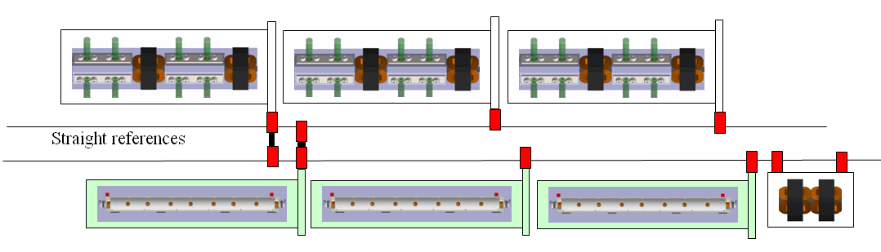
Two-beam Concept
2m

Slide 6
CLIC Main Parameters

Slide 7
Key Design Issues
Main linac gradient
Accelerating structure
Drive beam scheme
Drive beam generation
PETS (power extraction and transfer structures)
Two beam acceleration
Drive beam deceleration
Luminosity
Main beam emittance generation, preservation and focusing
Alignment and stabilisation
Operation and Machine Protection System (robustness)
Detector (experimental conditions)

Slide 8
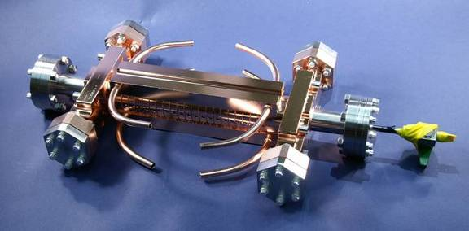
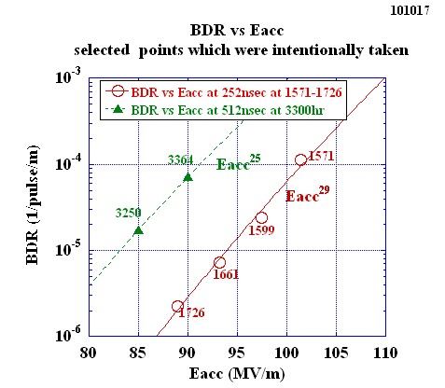
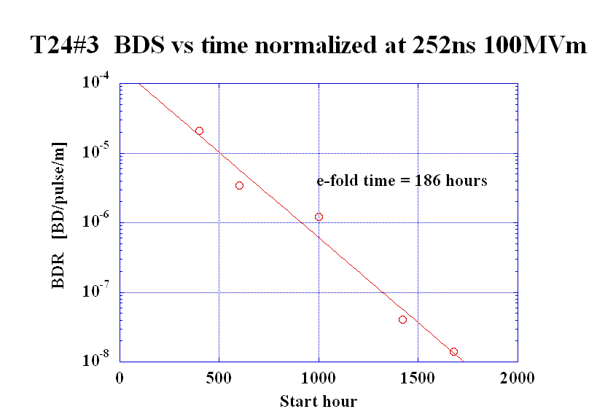
Accelerating Structure
Require <1% probability of even a single break down in any structure
  p ≤ 3x10⁻⁷m⁻¹pulse⁻¹
Design based on empirical constraints

Slide 9
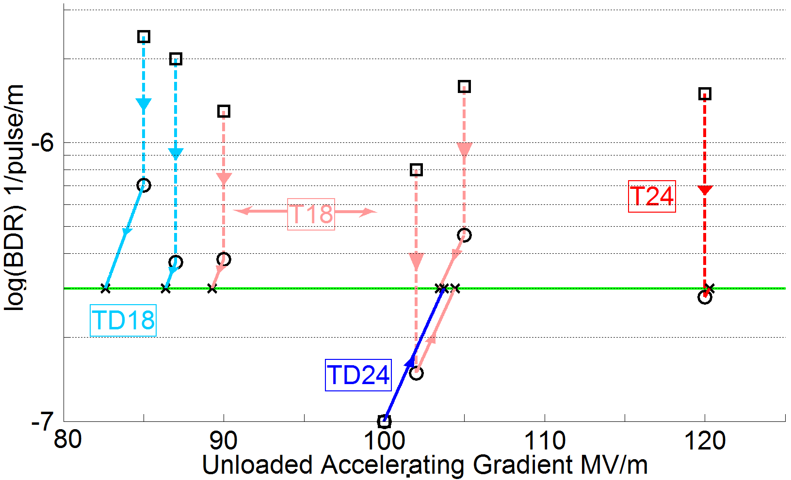
Achieved Gradient
Tests at KEK and SLAC
Measurements scaled according to
 | Simple early design to get started | More efficient fully optimised structure
No damping waveguides | T18 | T24
Damping waveguides | TD18 | TD24 = CLIC goal
Unloaded 103MV/m
Expected with beam loading 86-103 MV/m

Slide 10
CLIC Power Source Concept
Delay Loop × 2
gap creation, pulse compression & frequency multiplication
Drive Beam Accelerator
efficient acceleration in fully loaded linac
RF Transverse Deflectors
Combiner Ring × 3
pulse compression &
frequency multiplication
Combiner Ring × 4
pulse compression &
frequency multiplication
CLIC RF POWER SOURCE LAYOUT
Drive Beam Decelerator Section (2 × 24 in total)
Power Extraction
Drive beam time structure - initial
Drive beam time structure - final
240 ns
240 ns
5.8 μs
140 μs train length - 24 × 24 sub-pulses
4.2 A - 2.4 GeV – 60 cm between bunches
24 pulses – 101 A – 2.5 cm between bunches

Slide 11
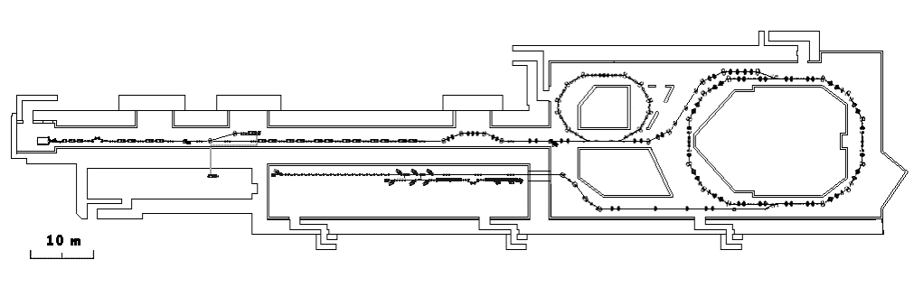
CLIC Test Facility (CTF3)
Delay Loop
Combiner ring
150 MeV e-linac
3.5 A – 1200 ns
Thermionic source
Experimental area
28 A - 140 ns
Recycled infrastructure
made it affordable
causes lots of headache

Slide 12
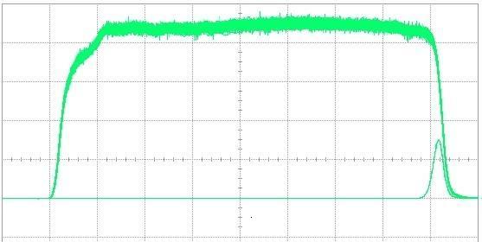
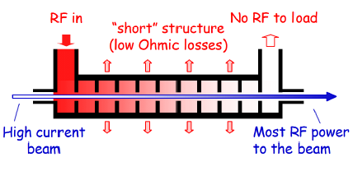
Drive Beam Linac
95.3% RF to beam efficiency
No instabilities
Phase switch works OK
Pulse current measurement
10 m
Power
Parameter | CLIC goal | CTF3 measured at end of linac
Transverse emittance | 100μm | 50-60μm
Pulse current | 7.5e-4 | 5.4e-4

Slide 13
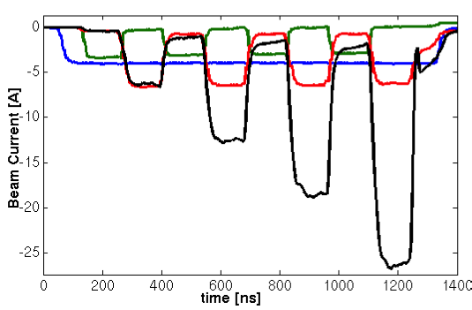
Drive Beam Combination
29 A reached, routinely 25A
Current measurement in CTF3
  Significant increase of transverse emittance
  Current jitter increases to O(0.1%-1%)
Focus has been on current
will now further improve beam quality
CTF3 specific issues need to be addressed and limits identified
RF pulse compression
Beam energy in combiner ring is
5% of that in CLIC
Geometric emittance 20 times larger
…
…
Delay loop
After delay loop
End of linac
In combiner ring

Slide 14
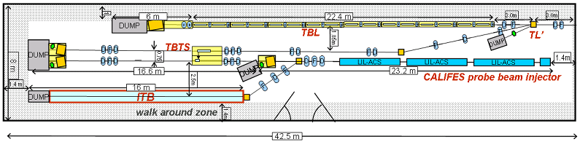
Drive Beam Deceleration and Module: CLEX
TBTS (two-beam test stand)
power transfer to main beam
module design
TBL (test beam line)
drive beam stability during deceleration
Main beam injector

Slide 15
PETS
Designed with more margin than accelerating structures
P_{out}≈130MW
Pulse used for measurement
and nominal pulse (blue)
0.25m
Measurements at SLAC:
No breakdown last O(8 10⁶ pulses)
-> P consistent with p≤10⁻⁷/m/pulse

Slide 16
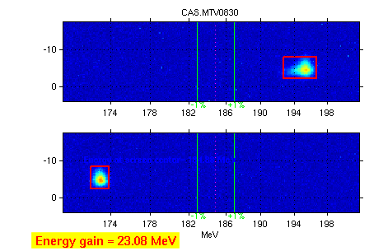
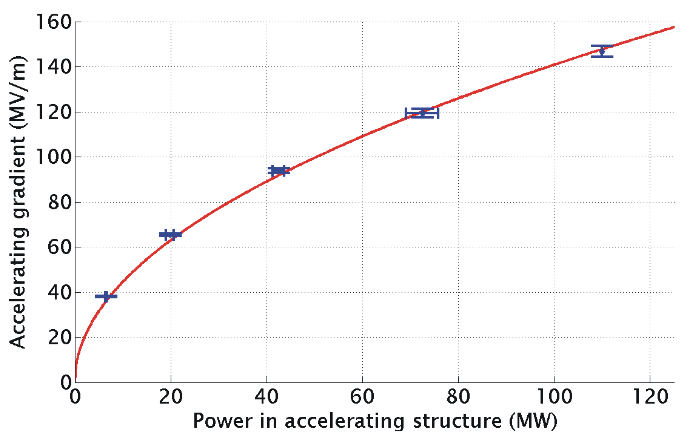
TBTS: Two Beam Acceleration
Measured accelerating gradient
Maximum gradient 145 MV/m
Consistency between
produced power
drive beam current
test beam acceleration

Slide 17
Decelerator Design
≈ 900m (900 quadrupoles)
100A, 2.4-0.24GeV beam
aperture ≈ 10σ
large energy spread
significant wakefields
Simulation of 3σ-envelope along decelerator w. imperfections
Simulation of final energy along train
Simulations show that design is OK

Slide 18
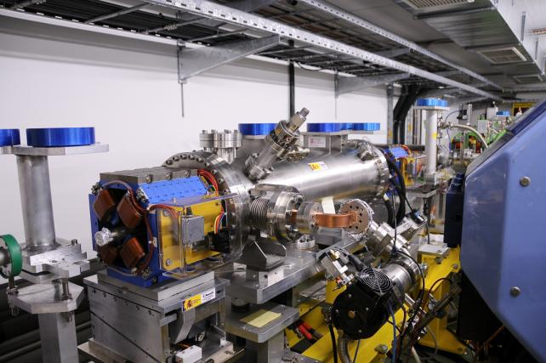
TBL: Drive Beam Deceleration
9 out of 16 PETS installed
Rest will come this year
~26% deceleration
Final goal is 50% deceleration
Measurend in TBL:
Up to 21A current
optics understood
no losses in TBL
Good agreement
power production
beam current
beam deceleration

Slide 19
Main Beam Emittances
Beam power
Luminosity
spectrum
Beam Quality
(+bunch length)

Slide 20
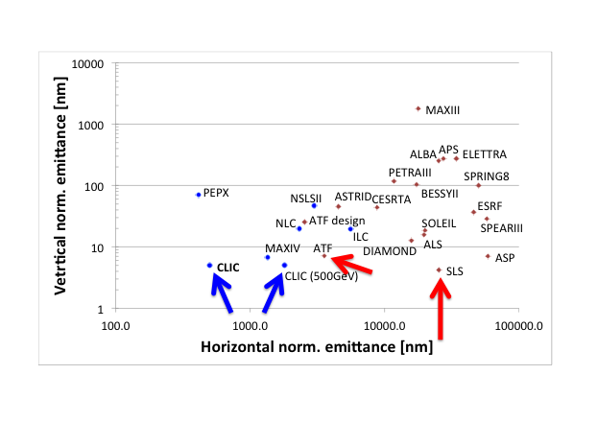
Emittance Generation
Many design issues addressed
lattice design
dynamic aperture
tolerances
intra-beam scattering
space charge
wigglers
RF system
vacuum
electron cloud
kickers
CLIC @3 TeV would achieve 1/3 of luminosity with ATF performance
(3800nm/15nm@4e9)
Damping ring design is consistent with target performance

Slide 21
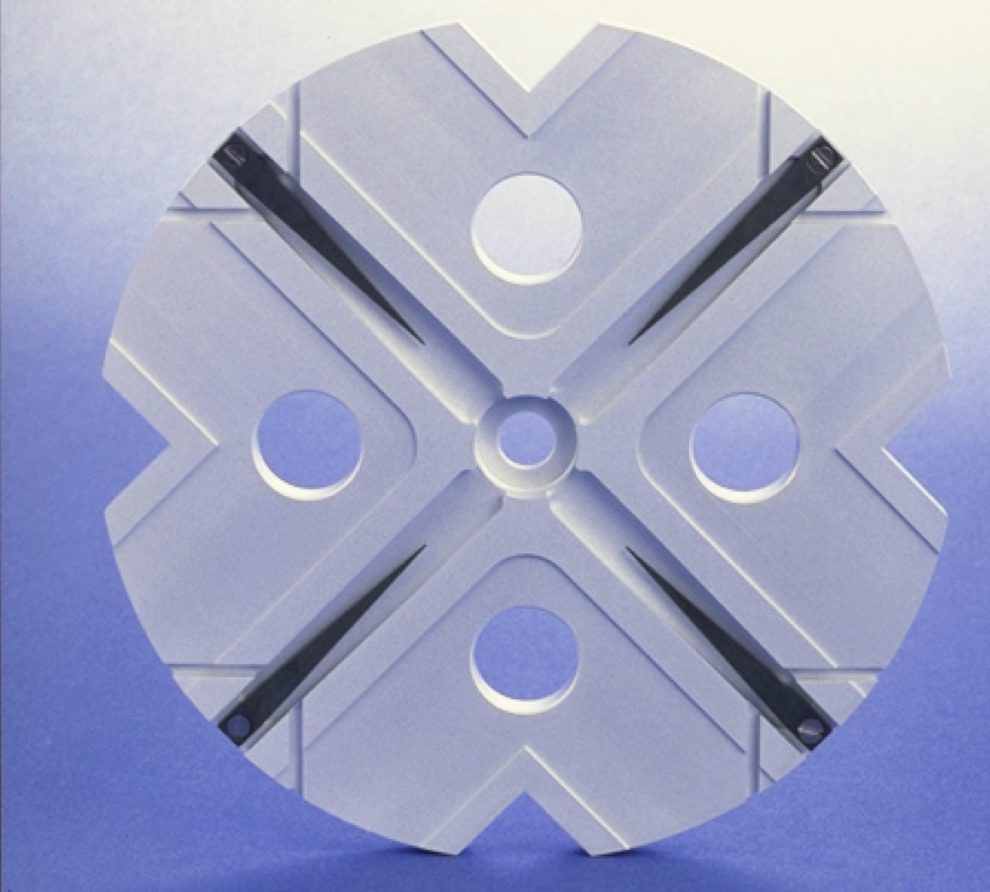
Main Linac
Wakefields limit efficiency
(beam break-up)
Damping
(long-range wakefields)
Strong lattice
-> tight tolerances
Short bunches (short-range wakefield)
Trade-off for aperture (short-range wakefields)

Slide 22
Main Linac Tolerances
Stabilise quadrupole
O(1nm) @ 1Hz
Pre-align BPMs+quads
accuracy O(10μm)
3) Use wakefield monitors accuracy O(3.5μm)
2) Beam-based alignment

Slide 23

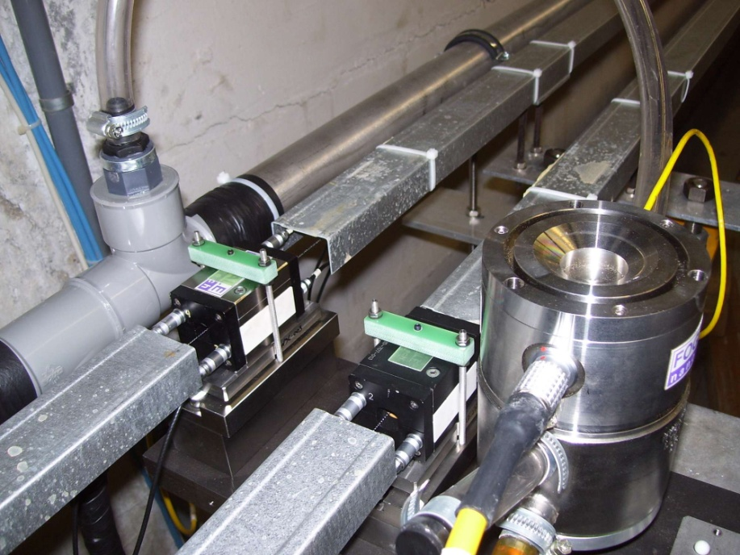
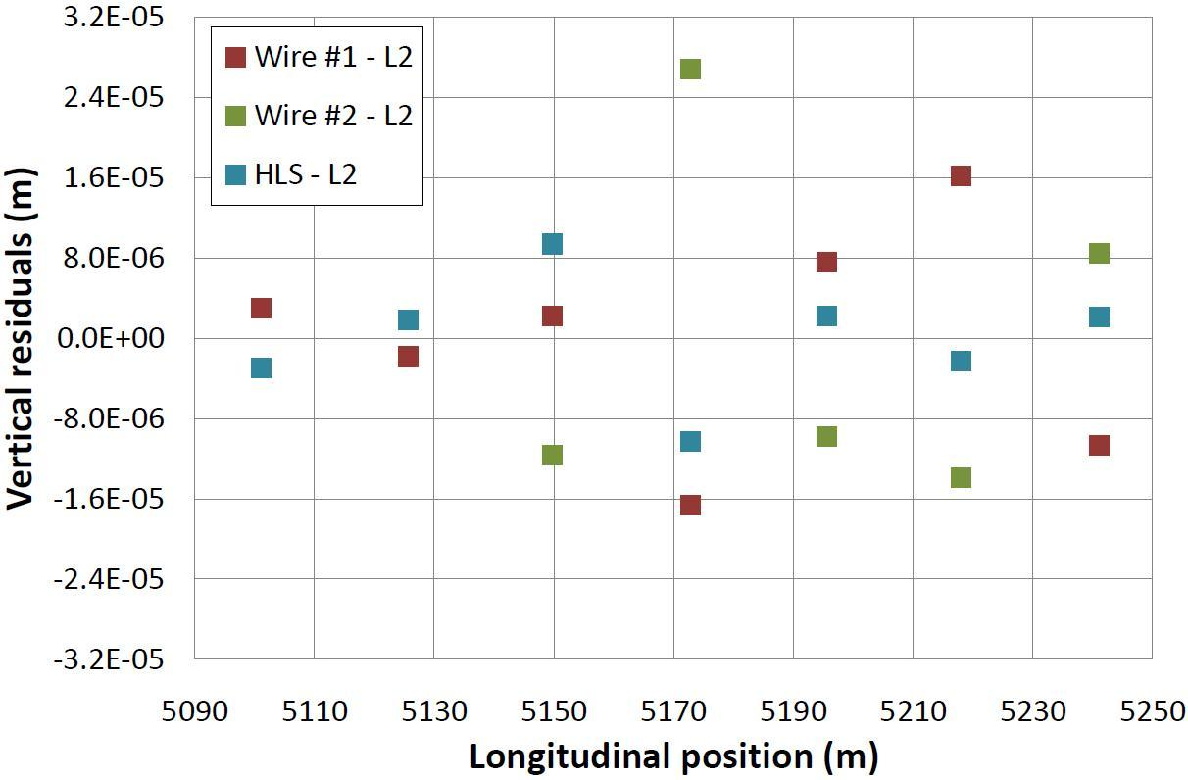
Pre-alignment System
Required accuracy of reference point is 10μm
Test of prototype shows
  vertical RMS error of 11μm
  i.e. accuracy is approx. 13.5μm
Improvement path identified

Slide 24
BDS Design and Alignment
Probability to achieve more than L/L₀ [%]
Main design issues
chromaticity
non-linear effects
synchrotron radiation
tuning
stability
Goal
Static imperfections:
Goal is L ≥ 110% L₀
with probability of 90%
Convergence is slow
faster method is being developed
Simulated full tuning performance
Need more complete imperfection modelling
independent sides
field errors
dynamic imperfections during tuning
realistic signals
Design is OK
Imperfection mitigation comes close to target
Test programme at ATF2 at KEK

Slide 25
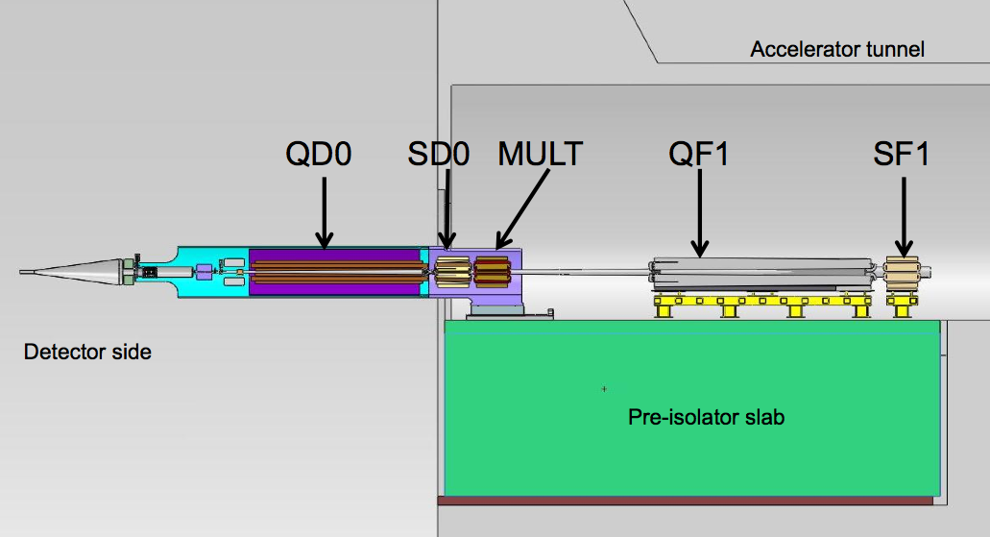
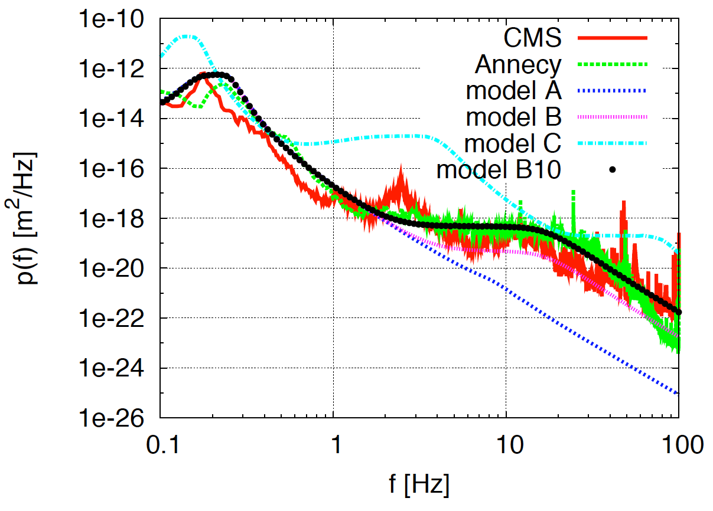
Ground Motion and Its Mitigation
Natural ground motion can impact the luminosity
typical quadrupole jitter tolerance O(1nm) in main linac and O(0.1nm) in final doublet
-> develop stabilisation for beam guiding magnets

Slide 26
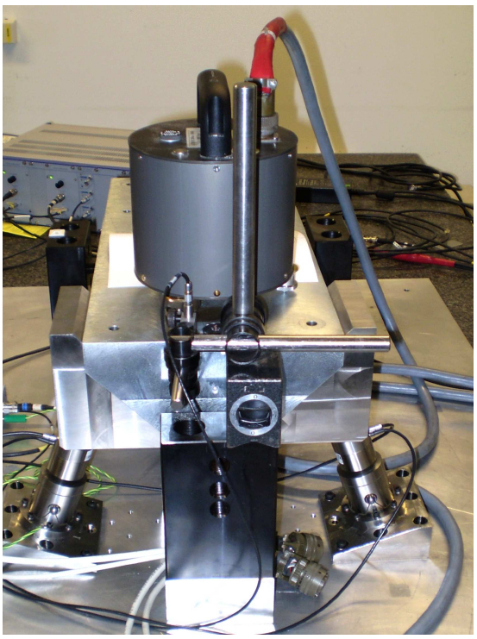
Active Stabilisation Results
Luminosity achieved/lost [%]
 | B10
No stab. | 53%/68%
Current stab. | 108%/13%
Future stab. | 118%/3%
Code
Machine model
Beam-based feedback
Close to/better than target

Slide 27
Machine Protection/Operation
Machine protection concept
inherently robust against fast failures
detect slow failures (next pulse permit)
Most important example BDS collimation
energy collimators supposed to take a pulse
betatron collimators not
Concept for start-up developed
based on CTF3/LHC experience

Slide 28
Energy Flexibility
Need to operate at
Lower than nominal energy
Concept developed
based on reduced main and drive beam current but longer pulses
can cover factor 3 in energy

Slide 29
CLIC Implementation – in Stages?
CLIC two-beam scheme compatible with energy staging to provide the optimal machine for a large energy range
Lower energy machine can run most of the time during the construction of the next stage.
Physics results will determine the energies of the stages
Linac 1
I.P.
Linac 2
0.5 TeV Stage
Injector
Complex
4 km
4 km
~14 km
Linac 1
I.P.
Linac 2
1-2 TeV Stage
Injector
Complex
7.0-14 km
7.0-14 km
~20-34 km
Linac 1
3 TeV Stage
I.P.
Linac 2
Injector
Complex
20.8 km
3 km
3 km
20.8 km
48.2 km

Slide 30
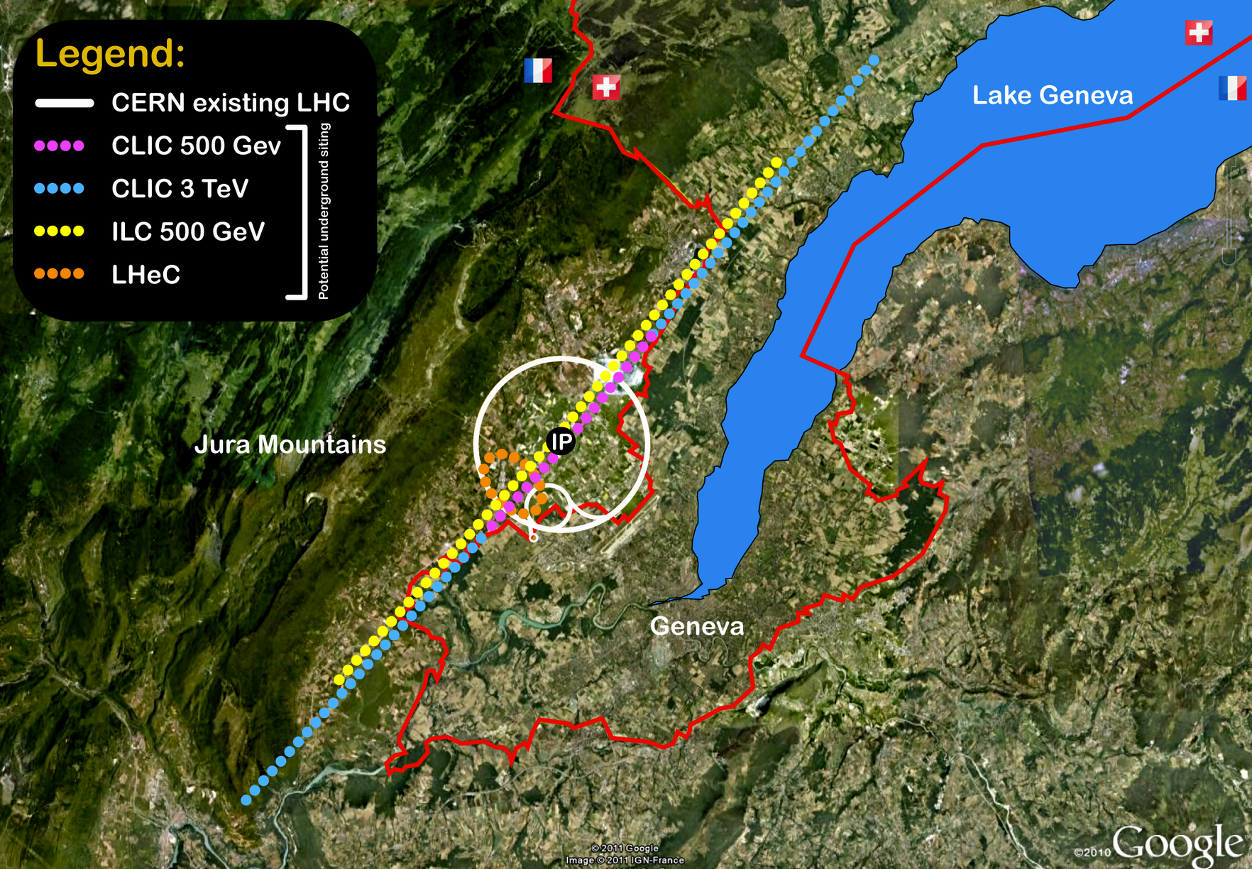
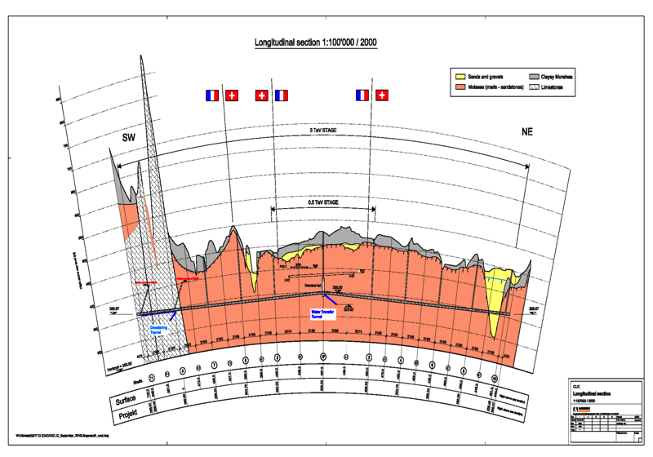
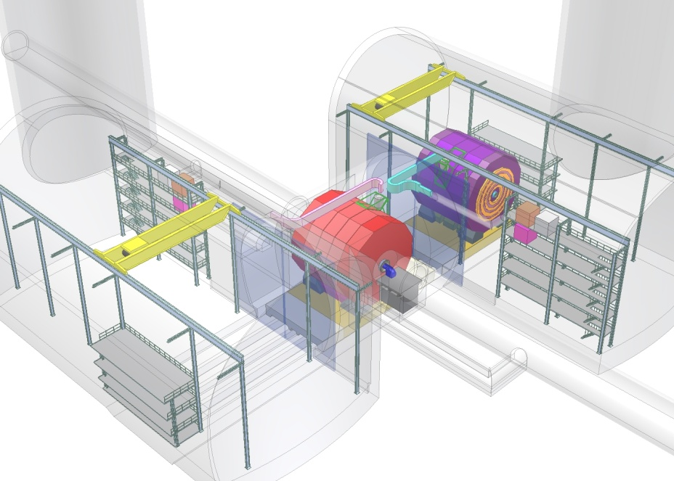
Tunnel implementations (laser straight)
Central MDI & Interaction Region

Slide 31
Conclusion
Main linac gradient
Ongoing test close to or on target
Uncertainty from beam loading
Drive beam scheme
Generation tested, used to accelerate test beam, deceleration as expected
Improvements on operation, reliability, losses, more deceleration (more PETS) to come
We are ready for the next phase
Luminosity
Damping ring like an ambitious light source, no show stopper
Alignment system principle demonstrated
Stabilisation system developed, benchmarked, better system in pipeline
Simulations seem on or close to the target
Operation
Machine Protection
Start-up sequence defined
Most critical failure studied
First reliability studies
Low energy operation developed

Slide 32
Thanks
Thanks to the CLIC collaboration in general
Thanks in particular to:
N. Shipman, I Syratchev, A. Grudiev, W. Wuensch, G. Riddone
M. Csatari
T. Persson, G. Sterbini, P. Skowronski, F. Tecker, R. Corsini,
S. Doebert, A. Dubrovski, W. Farabolini, R. Ruber
H. Meinaud Durand, K. Artoos, J. Snuverink, J. Pfingstner,
R. Tomas, Y. Papaphilippou, A. Latina, B. Dalena, B. Jeanneret
J.-P. Delahaye, S. Stapnes

Slide 33
Reserve

Slide 34
Implementation issues

Slide 35
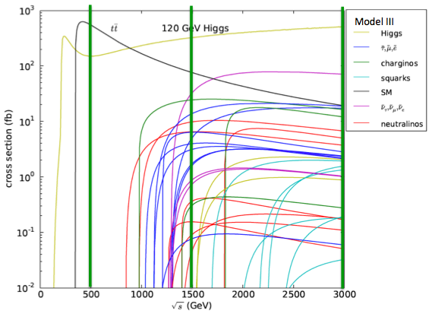
CLIC physics potential
CLIC physics potential is complementary to LHC
Beyond LHC discovery reach:
e+e- collisions give access to additional physics processes
  weakly interacting states (e.g. slepton, chargino, neutralino searches)
  more clean conditions than in LHC
Defined initial state + more precise measurements
^{σ(fb)}
Examples highlighted in the CDR
Higgs physics (SM and non-SM)
Top
SUSY
Higgs strong interactions
New Z’ sector
Contact interactions
Extra dimensions
….
^{√s (GeV)}

Slide 36
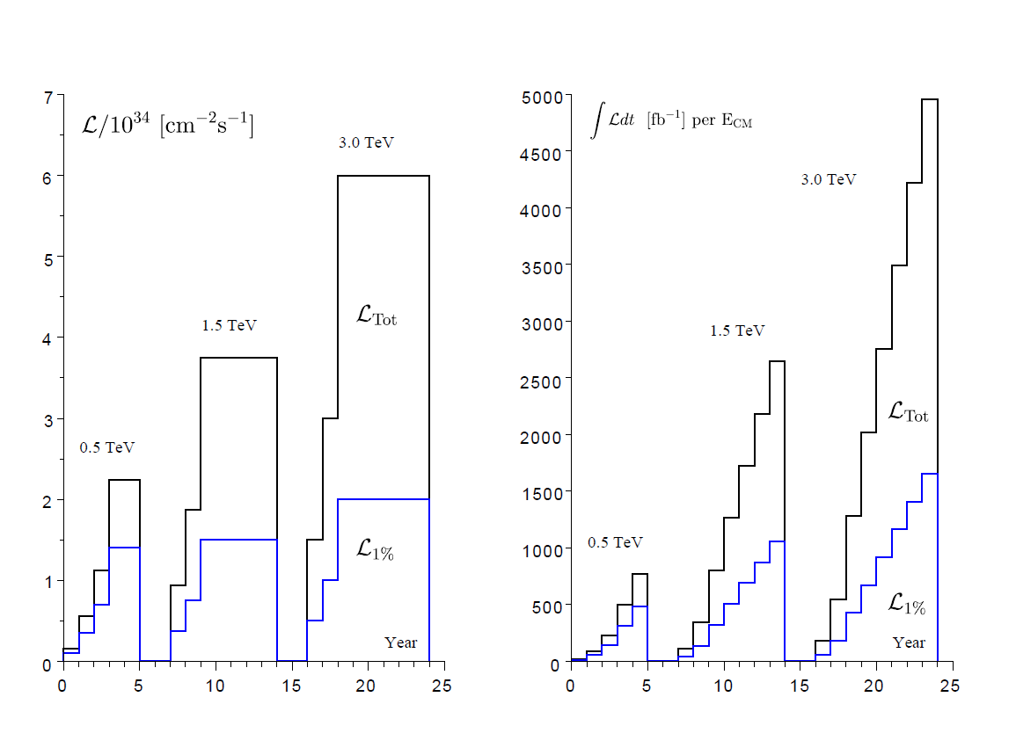
A possible energy/luminosity scenario
With a model (see figure for one example) for energies and luminosities, and assumptions about running scenarios (see below), one can extract power and energy estimates as function of time (next slide).
For each value of CM energy:
177 days/year of beam time
188 days/year of scheduled and fault stops
First year
  59 days of injector and one-by-one sector commissioning
  59 days of main linac commissioning, one linac at a time
  59 days of luminosity operation
  Quoted power : average over the three periods
  All along : 50% of downtime
Second year
  88 days with one linac at a time and 30 % of downtime
  88 days without downtime
  Quoted power : average over the two periods
Third year
  Still only one e+ target at 0.5 TeV, like for years 1 & 2
  Nominal at 1.5 and 3 TeV
Power during stops (scheduled, fault, downtime) :
  (40 MW, 45 MW, 60 MW) at (0.5, 1.5, 3) TeV, respectively

Slide 37
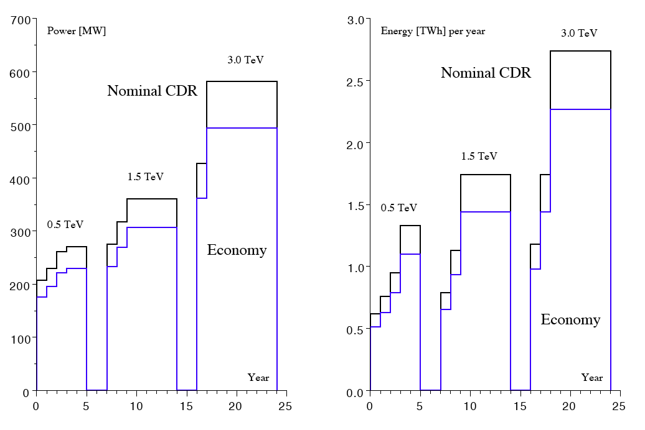
Power/energy
Other models can be envisaged (this is one out of many), and one should also keep in mind that reducing the instantaneous luminosity at the highest energies reduced both power and yearly energy, and finer energy scans might well be needed within one stage
The possible « economy » (see blue curves):
Sobriety
  Reduced current density in normal-conducting magnets
  Reduction of heat loads to HVAC
  Re-optimization of accelerating gradient with different objective function
Efficiency
  Grid-to-RF power conversion
  Permanent or super-ferric superconducting magnets
Energy management
  Low-power configurations in case of beam interruption
  Modulation of scheduled operation to match electricity demand: Seasonal and Daily
  Power quality specifications
Waste heat recovery
  Possibilities of heat rejection at higher temperature
  Waste heat valorization by concomitant needs, e.g. residential heating, absorption cooling

Slide 38
Costing review 21-22.2 2012
Extract from summary slide:
The Panel was impressed by the quality of the presentations and degree of detail to which the value estimate has been studied
No major omissions were found
The Panel endorses the methodology used to make the value estimates
There is a lack of coherence between the two stages (500, 1500 GeV) that must be resolved when the numbers are presented
  Luminosity factor 2 higher than achieveable with nominal bunch charge
  Justification for such high luminosity should be re-examined (since it has a significant cost impact)
The Panel recommends more work on prototyping & collaboration with industry in order to refine value estimates
  More confidence in scaling laws
  Bring precision below the 30 % level
  Inconsistency in costing the 500 GeV stage since component costs are estimated using learning curves corresponding to quantities of 1.5 TeV stage
  Scope for further optimization, e.g. length of TBM girders
Rough comparison with ILC cost data shows no major discrepancy, except in ventilation costs
Clearly state what the claimed uncertainty means (1 sigma, 2 sigma, 90 % ?)

Slide 39
Review of CLIC costing review
- The PANEL -
  C. Adolphsen, SLAC
  W. Bialowons, DESY
  H. Braun, PSI
  G. Dugan, Cornell University
  L. Evans, Imperial College (chair)
  P. Garbincius, Fermilab
  K. Peach, JAI (ex officio)
  T. Shidara, KEK
  M. Vretenar, CERN
  M. Yoshioka, KEK

Slide 40
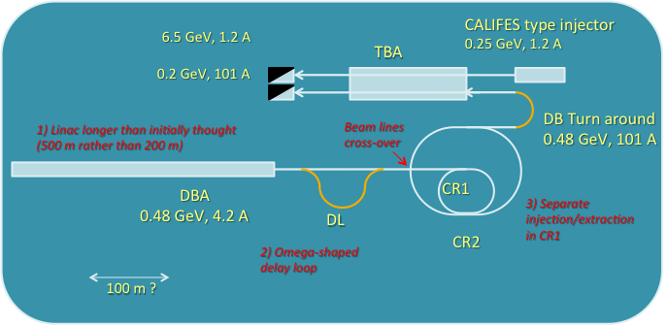
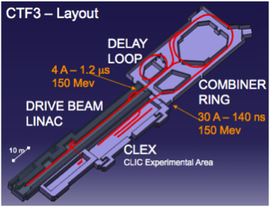
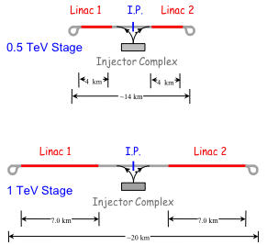
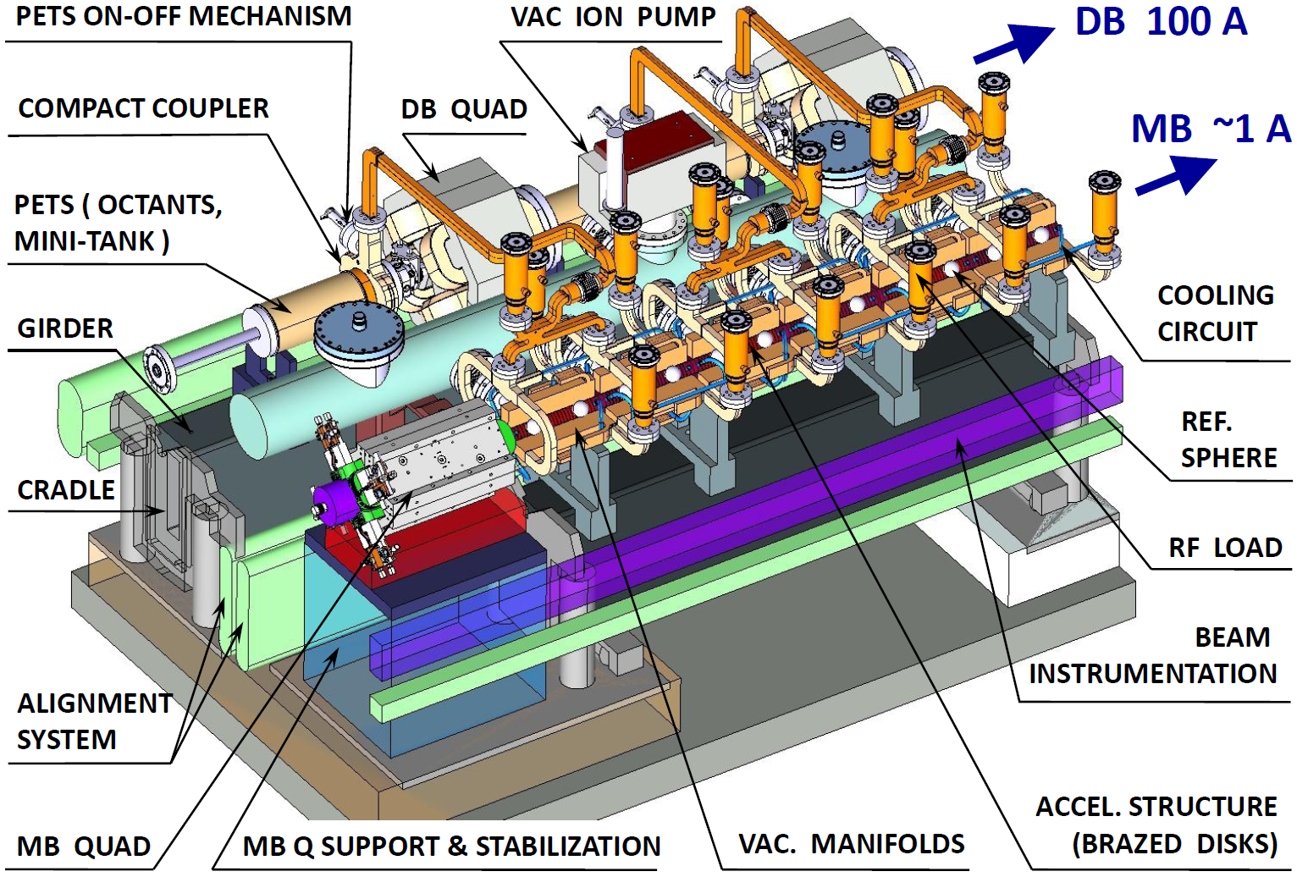

CLIC project time-line
From 2016 – Project Implementation phase, including an initial project to lay the
grounds for full construction:
CLIC 0 – a significant part of the drive beam facility: prototypes of hardware components at real frequency, final validation of drive beam quality/main beam emittance preservation, facility for reception tests – and part of the final project)
Finalization of the CLIC technical design, taking into account the results of technical studies done in the previous phase, and final energy staging scenario based on the LHC Physics results, which should be fully available by the time
Further industrialization and pre-series production of large series components with validation facilities
Final CLIC CDR and
feasibility established, also input for the Eur. Strategy Update
2004 - 2012
2012 - 2016
2016 – 2022
~ 2020 onwards
2011-2016 – Goal: Develop a project implementation plan for a Linear Collider:
Addressing the key physics goals as emerging from the LHC data
With a well-defined scope (i.e. technical implementation and operation model,
energy and luminosity), cost and schedule
With a solid technical basis for the key elements of the machine and detector
Including the necessary preparation for siting the machine
Within a project governance structure as defined with international partners
CLIC project construction – in stages, making use of CLIC 0

Slide 41
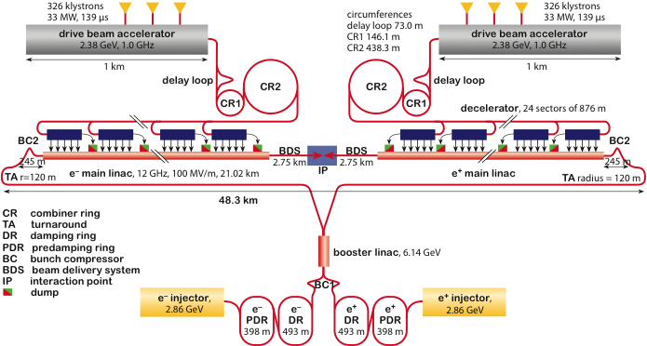
The objectives and plans for 2012-16
In order to achieve the overall goal for 2016 the follow four primary objectives for 2011—16 can defined:
    These are to be addressed by activities (studies, working groups, task forces) or work-packages (technical developments, prototyping and tests of single components or larger systems at various places)

Slide 42
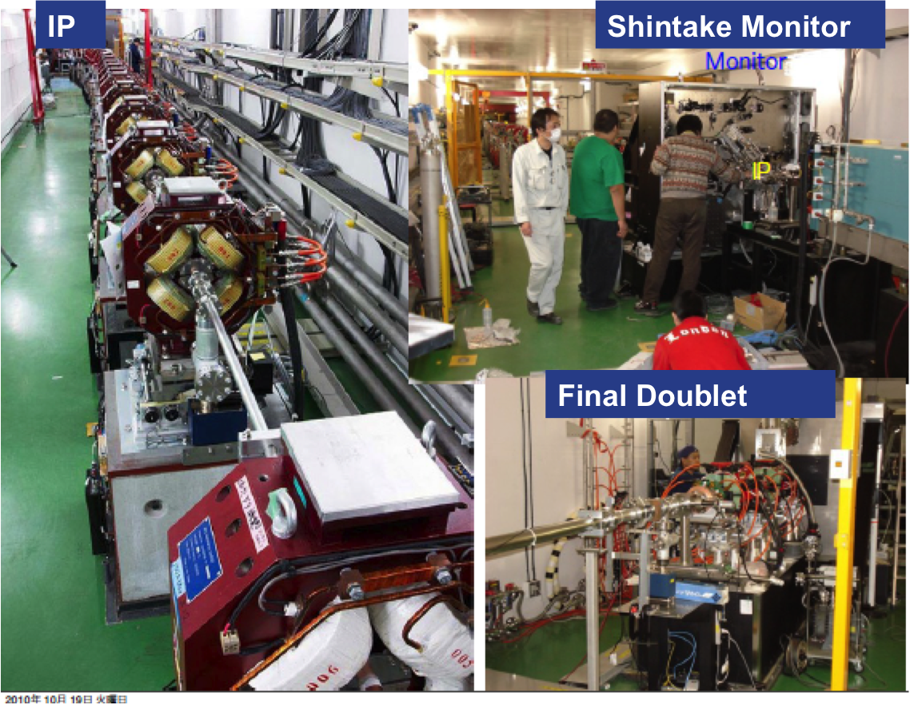
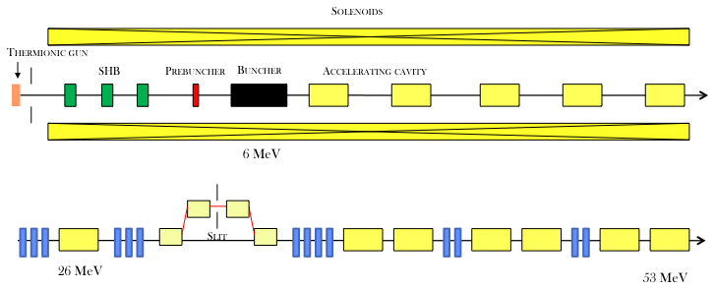
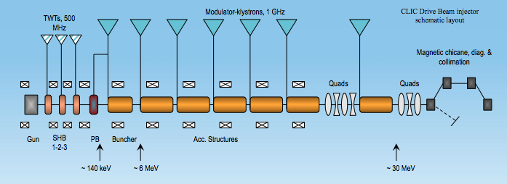
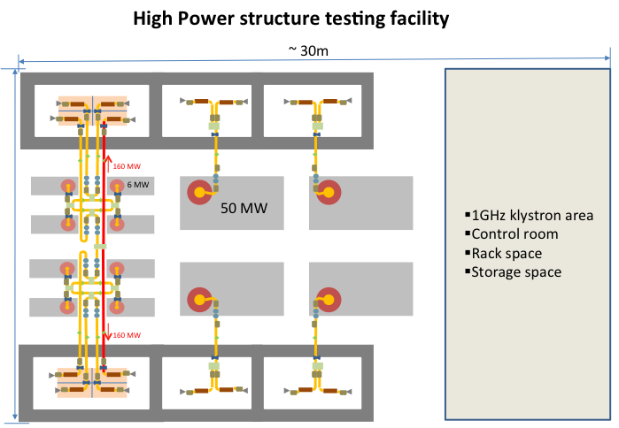
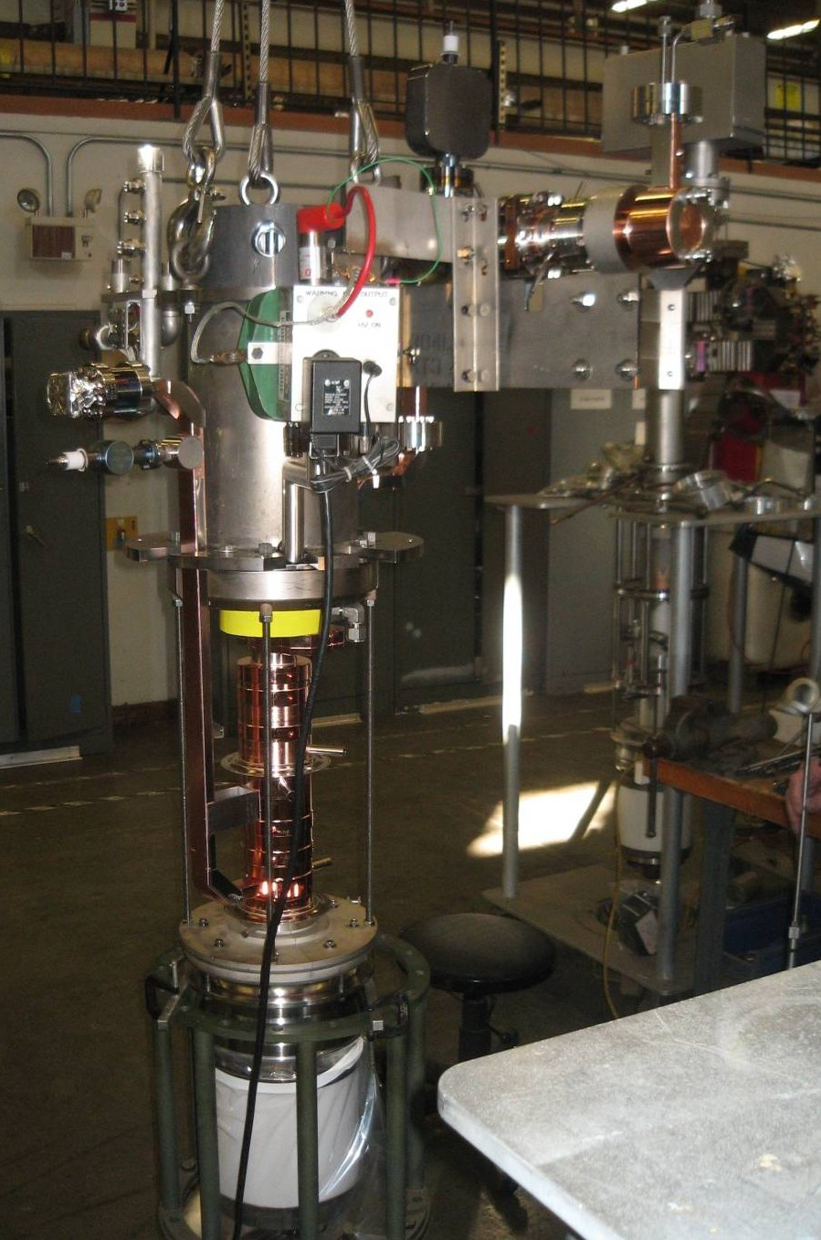
The objectives and plans for 2012-16
Notes:
Add some info about space at CERN

Slide 43
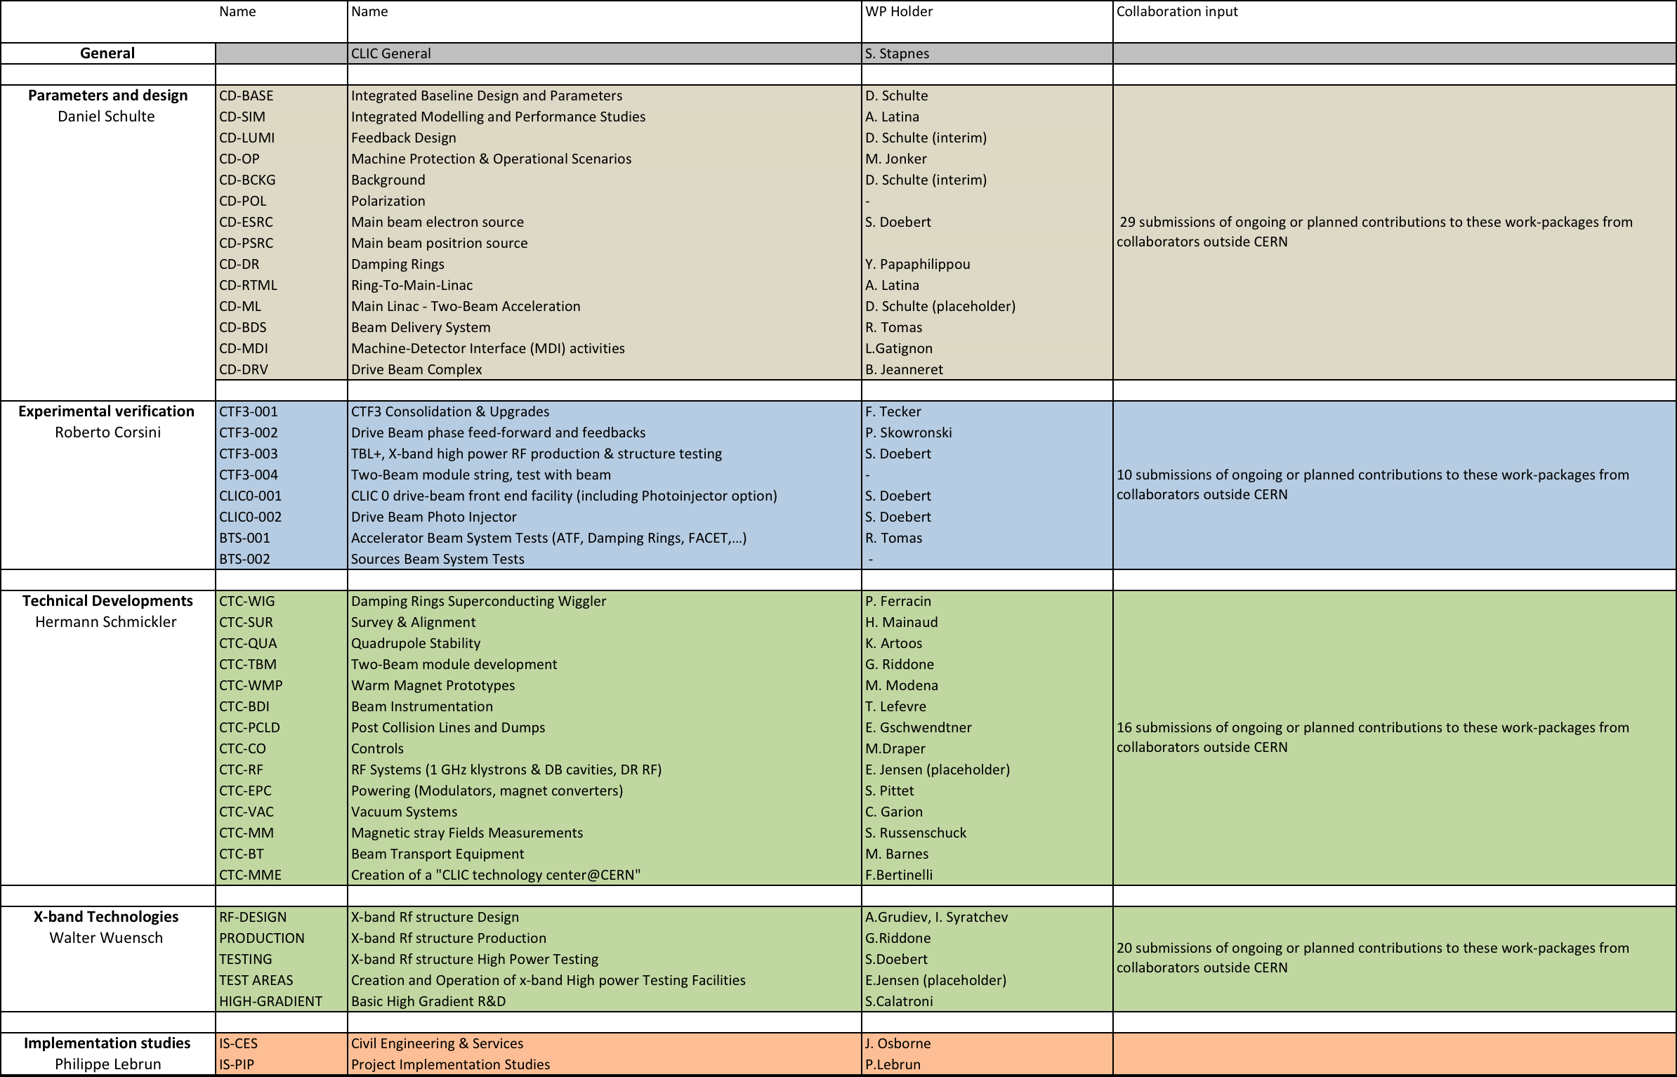
Work-packages and responsibilities
The programme combines the resources of collaborators inside the current collaboration, plus several new ones – and also involves around 20 CERN groups:
Have ~75 submitted descriptions of ongoing or planned efforts linked to these work-packages 2012-16 from groups outside CERN (result of CLIC working meeting 3-4.11: https://indico.cern.ch/conferenceOtherViews.py?view=standard&confId=156004 (still open for more interests)
Description of contributions, link-persons, planned personnel and material resources at home and at CERN for the period

Slide 44
System test and initial step for CLIC
Objectives beyond 2016:
Final components at some scale
Full currents
Needed for initial phase of project (receptions and conditioning of final modules before installation)

Slide 45
Tentative beam parameters
Drive beam (TBA entrance)
Energy 480 MeV
Emittance, norm. rms ≤ 150 um
Energy spread, rms ~ 1 %
Bunch length, rms 1 mm (3.6 ps)
Bunch charge 8.4 nC
Pulse Current 101 A (4.2 A in DBA)
Pulse length 244 ns (~ 6 us in DBA, option for full pulse length – 140 us)
Rep. Rate 50 Hz
Probe beam (end of TBA)
Energy 6.5 – 6.75 GeV (250 to 500 MeV injector exit, 6.25 GeV acceleration)
Emittance, norm. rms 1 – 20 um (both horizontal and vertical)
Energy spread, rms 0.1 – 1 %
Bunch length, rms ~ 0.5 mm (1.8 ps – may changed by adding a bunch compressor)
Bunch charge 0.2 - 1 nC
Pulse Current 0.4 – 2 A
Pulse length up to 156 ns (possibility of single bunch)
Rep. Rate up to 50 Hz

Slide 46
Potential Staged Parameters

Slide 47
Concept First Stage
Concept! Not to scale

Slide 48
Parameter and Structure Choice
Potential structures designs
Beam physics constraints
RF limitations
Parameter set
Physics requirements
Structure chosen to work for beam physics
Will tell the story as if we had a structure given
Cost model
Design choice

Slide 49
Main Linac Alignment and Emittance Growth
Target is achieved:
90% likely hood of less than 5nm vertical emittance growth

Slide 50
Drive Beam Requirements
Emittance ε_{x,y} ≤ 150μm
Transverse jitter ≤ 0.3σ
Current stability 0.75 •10⁻³
Phase stability 0.2° @ 12GHz
Bunch length stability 1%
RF power stability 0.2%
RF phase stability 0.05°
Phase stability 2.5° @ 12GHz
0.2° @ 1GHz

Slide 51
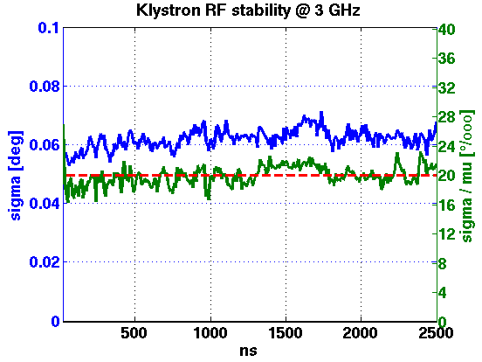
RF Stability
Cannot yet measure beam phase jitter accurately enough
monitor being built (Frascati)
Have specifications for RF
compare to CTF3
Good CTF3 klystron
pulse-to-pulse
10ns time slices
with respect to local phase reference
 | Tolerance | Measured
RF Power | 0.2% | 0.21%
RF Phase | 0.05° | 0.07° (0.035°)

Slide 52
PETS On-Off Mechanism
On-off mechanism is essential for operation
Switch off bad structures/PETS
Successfully tested in CTF3
Power to acc. structure
0N
Forward power in PETS
0FF

Slide 53
The CLIC Damping Rings CDR Parameters
Parameters | 1GHz | 2GHz
Energy [GeV] | 2.86
Circumference [m] | 427.5
Energy loss/turn [MeV] | 4.0
RF voltage [MV] | 5.1 | 4.5
Stationary phase [°] | 51 | 62
Natural chromaticity x / y | -115/-85
Momentum compaction factor | 1.3e-4
Damping time x / s [ms] | 2.0/1.0
Number of dipoles/wigglers | 100/52
Cell /dipole length [m] | 2.51 / 0.58
Dipole/Wiggler field [T] | 1.0/2.5
Bend gradient [1/m2] | -1.1
Phase advance x / z | 0.408/0.05
Bunch population, [e9] | 4.1
IBS growth factor x/z/s | 1.5/1.4/1.2
Hor./ Ver Norm. Emittance [nm.rad] | 456/4.8 | 472/4.8
Bunch length [mm] | 1.8 | 1.6
Longitudinal emittance [keVm] | 6.0 | 5.3
Space charge tune shift | -0.10 | -0.11
The latest DR lattice parameters (CDR version)
  2 RF options at 1 and 2 GHz with the 1 GHz option as the baseline
Main problems of the previous lattice
  Large space charge tune shift (~-0.2) ➔ warning by ACE
    Larger longitudinal emittance needed
  Large RF stable phase (70º) → warning by Alexej
    Larger RF voltage needed (goes to the opposite direction for longitudinal emittance)
  Stay always within the requirements for the transverse emittances

