Slide 1
MC11/12 Validation and Production: Higgs to Displaced, Heavy Fermions
Daniel Blackburn
University of Washington

Slide 2
Validation Plots
Validation plots on our twiki:
https://twiki.cern.ch/twiki/bin/viewauth/AtlasProtected/HiddenValleyDisplacedDecaysPythia8
In the following slides, I show a sample of the validation plots with mass points
m(H) = 120 GeV, m(π_{v}) = 20 GeV.
MC11 Production uses PDF CTEQ6L1
MC12 Production uses PDF MSTW2008
2

Slide 3
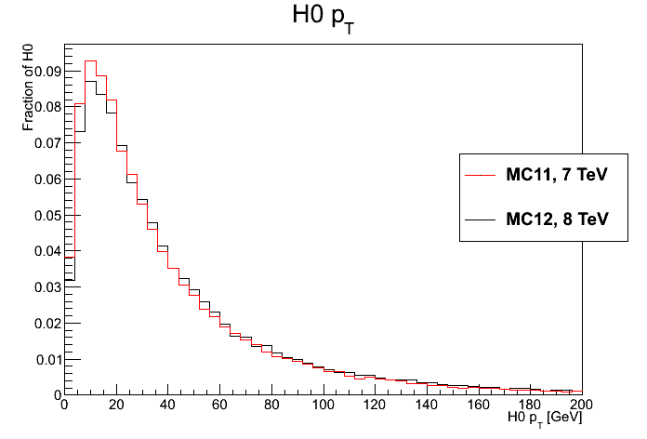
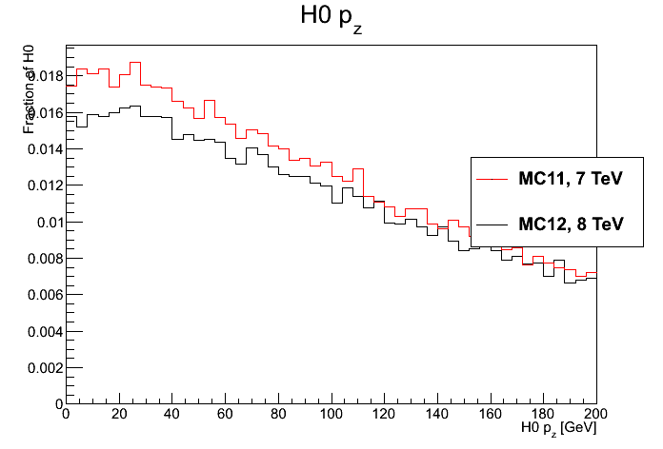
Higgs Momentum
3

Slide 4
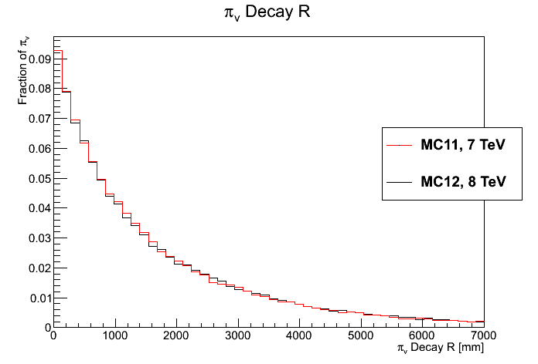
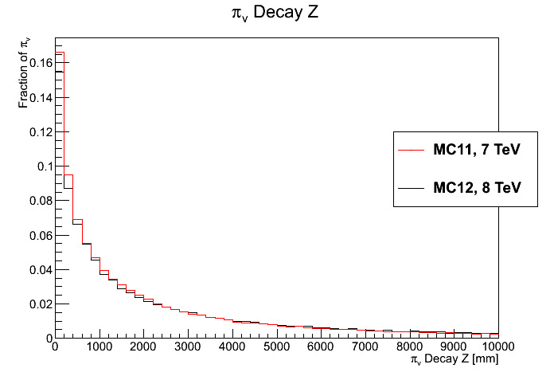
π_{v} Decay Position
4

Slide 5
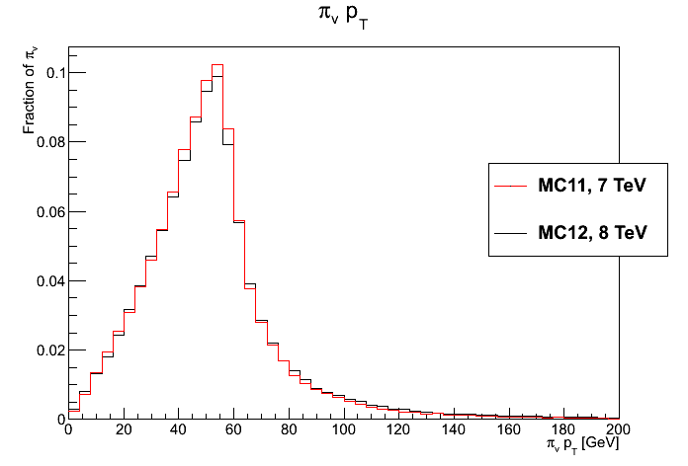
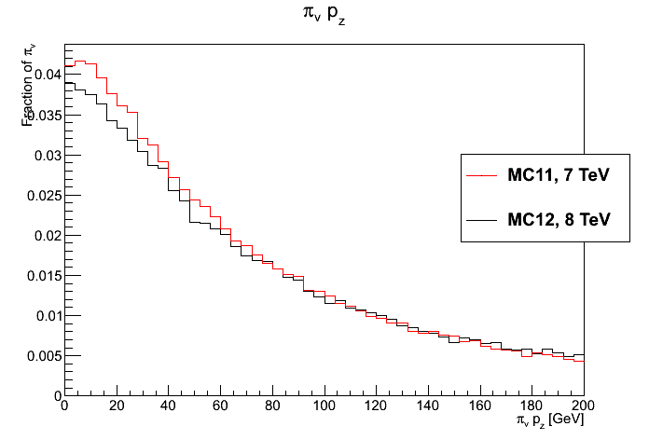
π_{v} Momentum
5

Slide 6
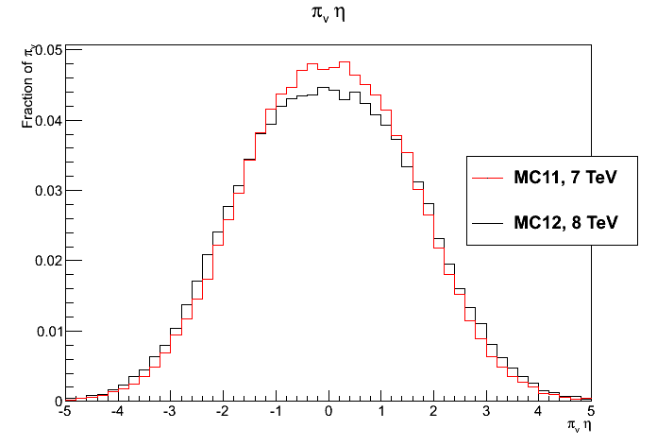
π_{v} Eta
6

Slide 7
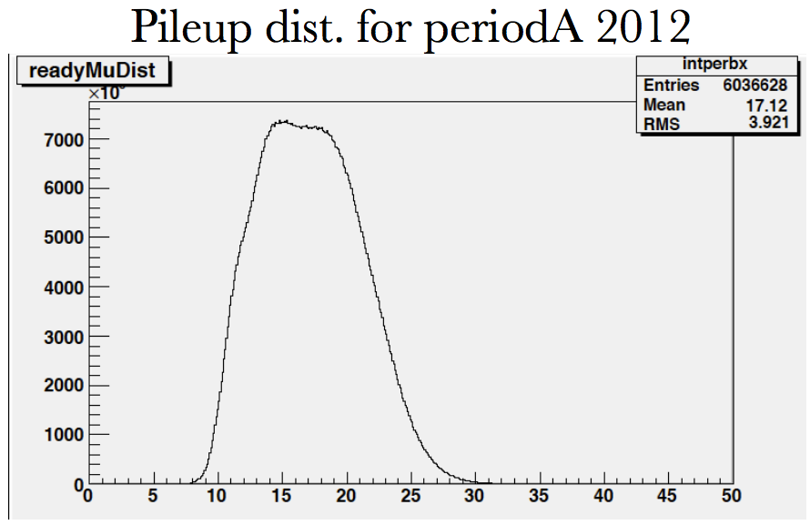
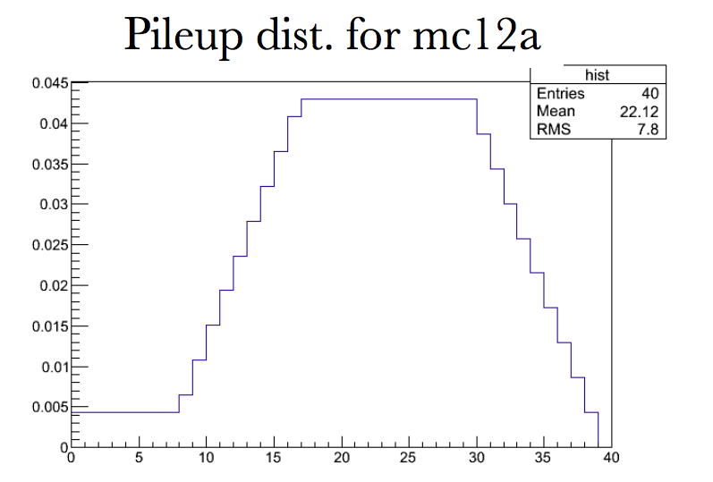
Plans
Request ~250,000 events for MC12.
We would like enough MC signal events that our results are limited by systematic errors.
We also note that pileup reweighting reduces the statistical significance of signal events.
7

Slide 8
MSVx Analysis Package
A SVN package with our analysis code has been created:
svn+ssh://svn.cern.ch/reps/atlasgrp/Physics/Exotic/Analysis/LongLived/HVHeavyFermionPairs/MSVxAnalysis/
If there is analysis code which could be used by multiple analyses, we should try to identify it and make a shared package.
8

Slide 9
Current MSVx Package Contents (1)
TruthAnalysis – Runs over fully reconstructed MC signal events. Determines trigger and vertex reconstruction efficiencies for analysis.
EvgenSample,EvgenSkimmer – Generates large samples of events at the MC level and skims the file to a more manageable size.
9

Slide 10
Current MSVx Package Contents (2)
LifetimeLimits – From EvgenSkimmer output, calculates the expected number of events to pass analysis cuts as a function of π_{v} lifetime.
LifetimeLimitsII – Transforms the expected number of events to an exclusion limit.
10

Slide 11
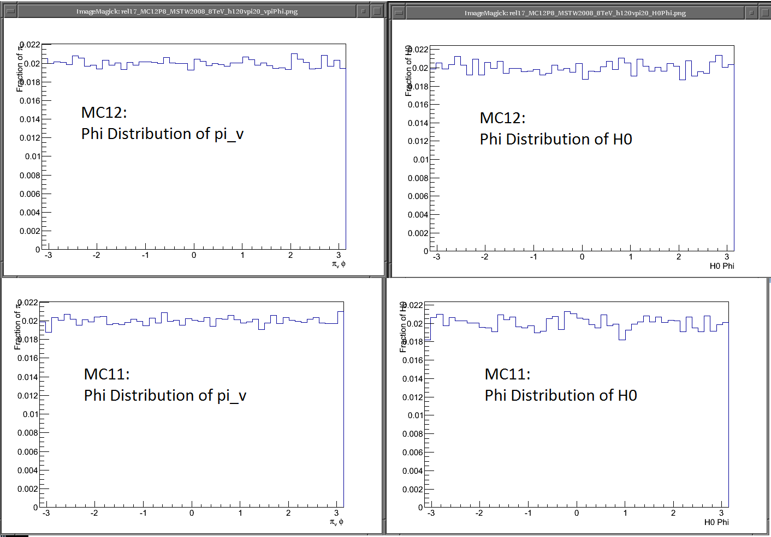
Phi distribution of MC Signal generated in Pythia 8

Slide 12
Conclusions
Event generation appears to behave correctly.
Once approval has been granted, MC11/12 official production will begin.
12

Slide 13
Backup Slides

Slide 14
